Slide 1
SECTION 2: HW3 Setup
Justin Bare and Deric Pang
slides borrowed and adapted from Alex Mariakis and CSE 390a

Slide 2
OUTLINE
Version Control – Git
Eclipse and Java versions
SSH
Ant
Eclipse Debugging

Slide 3
LINKS TO DETAILED SETUP AND USAGE INSTRUCTIONS
All References
http://courses.cs.washington.edu/courses/cse331/16wi/#ref
Basic Setup
http://courses.cs.washington.edu/courses/cse331/16wi/tools/basicSetup.html
Working from home: Java, Eclipse, SSH
http://courses.cs.washington.edu/courses/cse331/16wi/tools/WorkingAtHome.html
Editing, Compiling, Running, and Testing Programs
http://courses.cs.washington.edu/courses/cse331/16wi/tools/editing-compiling.html
Eclipse Reference
http://courses.cs.washington.edu/courses/cse331/16wi/tools/eclipse_reference.html
Version Control - Git
http://courses.cs.washington.edu/courses/cse331/16wi/tools/versioncontrol.html
Assignment Submission
http://courses.cs.washington.edu/courses/cse331/16wi/tools/turnin.html

Slide 4
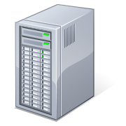
331 VERSION CONTROL
Instructors
create/push
Git Repository
pull
Working copy for grading
commit/push
clone/pull
add
Working copy
Students

Slide 5
GIT BEST PRACTICES
Add/commit/push your code EARLY and OFTEN!!!
You really, really, really don’t want to deal with merge conflicts
Keep your repository up-to-date all the time
Use the combined ‘Commit and Push’ tool in Eclipse
Do not rename folders and files that we gave you – this will mess up our grading process and you could get a bad score
Use the repo only for the homework
Adding other stuff (like notes from lecture) may mess up our grading process

Slide 6
WHAT IS ECLIPSE?
Integrated development environment (IDE)
Allows for software development from start to finish
Type code with syntax highlighting, warnings, etc.
Run code straight through or with breakpoints (debug)
Mainly used for Java
Supports C, C++, JavaScript, PHP, Python, Ruby, etc.
Alternatives
NetBeans, Visual Studio, IntelliJIDEA

Slide 7
ECLIPSE SHORTCUTS
Shortcut | Purpose
Ctrl + D | Delete an entire line
Alt + Shift + R | Refactor (rename)
Ctrl + Shift + O | Clean up imports
Ctrl + / | Toggle comment
Ctrl + Shift + F | Make my code look nice ☺
Notes:
Demo these shortcuts and their uses briefly

Slide 8
ECLIPSE and Java
Get Java 8
Please use Eclipse 4.5 (Mars), “Eclipse for Java Developers”

Slide 9
DEMO
Eclipse
Git cloning

Slide 10
DEVELOPMENT PROCESS
We distribute starter code by adding it to your GitLab repo. You retrieve it with git clone the first time then git pull for later assignments
You will write code using Eclipse
You update your files on the repo by adding them to the repo, committing your changes, and eventually pushing accumulated changes to GitLab
You “turn in” an assignment when you’re finished by tagging your repo and pushing the tag to GitLab
You will validate your homework submission by SSHing onto attu, cloning your repo, and running ant validate

Slide 11
HW 3
Many small exercises to get you used to version control and tools and a Java refresher
More information on homework instructions

Slide 12
DEMO
Editing HW3
Git pull in Eclipse
Add/commit/push in Eclipse

Slide 13
Turning in HW3
Add/commit/push your final code
Create a hw3-final tag on the last commit and push the tag to the repo (this can and should be done in Eclipse)
You can push a new hw3-final tag that overwrites the old one if you realize that you still need to make changes
But keep track of how many late days you have left!
After the final commit and tag pushed, remember to log on to attu and run ant validate

Slide 14
WHAT IS AN SSH CLIENT?
Uses the secure shell protocol (SSH) to connect to a remote computer
Enables you to work on a lab machine from home
Similar to remote desktop
Windows users: PuTTY and WinSCP
PuTTY: ssh connection
WinSCP: transfer or edit files
Mac/Linux users: Terminal application
Go to Applications/Utilities/Terminal
Type in “ssh cseNetID@attu.cs.washington.edu”

Slide 15
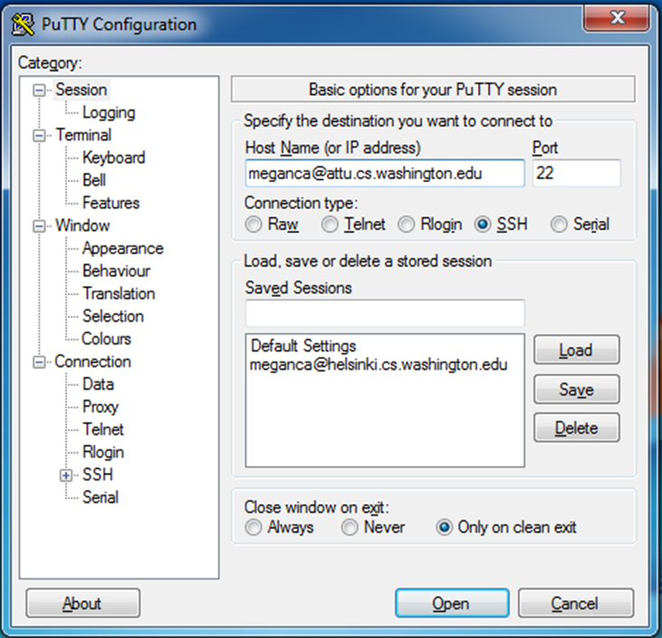
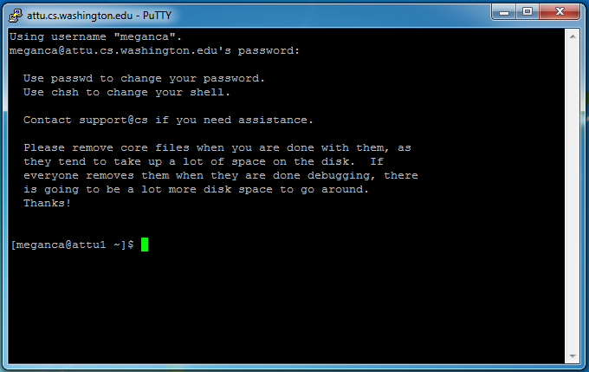
PUTTY

Slide 16
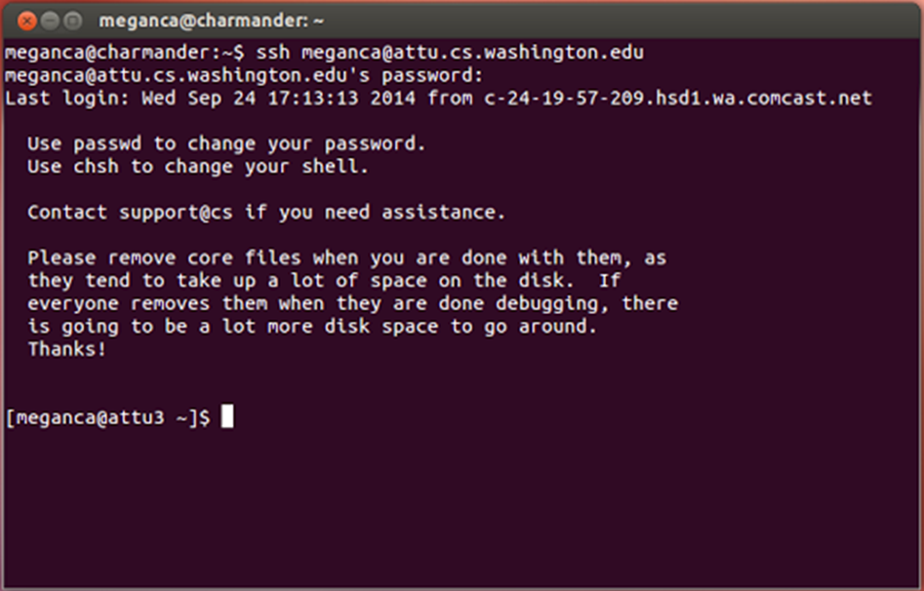
TERMINAL (LINUX, MAC)

Slide 17
Ant Validate
What will this do?
You start with a freshly cloned copy of your repo and do “git checkout hw3-final” to switch to the files you intend for us to grade, then run ant validate
Makes sure you have all the required files
Make sure your homework builds without errors
Passes specification and implementation tests in the repository
Note: this does not include the additional tests we will use when grading
This is just a sanity check that your current tests pass

Slide 18
Ant Validate
How do you run ant validate?
Has to be done on attu from the command line since that is the environment your grading will be done on
Do not use the Eclipse ant validate build tool!
Be sure to use a fresh copy of your repo, and discard that copy when you’re done
If you need to fix things, do it in your primary working copy (eclipse)

Slide 19
Ant Validate
How do you run ant validate?
Steps
Log into attu via SSH
In attu, checkout a brand new local copy (clone) of your repository through the command-line
Note: Now, you have two local copies of your repository, one on your computer through Eclipse and one in attu
Go to the hw folder which you want to validate through the ‘cd’ command, then switch to the hw3 tag
For example: cd ~/cse331/src/hw3 git checkout hw3-final
Run ant validate

Slide 20
Ant Validate
How do you know it works?
If successful, will output Build Successful at the bottom
If unsuccessful, will output Build Failed at the bottom with information on why
If ant validate failed, discard the validate copy of the repo on attu, fix and commit changes through eclipse, go back to attu, clone a fresh copy of the repo, and try ant validate again

Slide 21
DEMO
Tagging your final submission
SSH into attu
Running ant validate on attu

Slide 22
ECLIPSE DEBUGGING (if time)
System.out.println() works for debugging…
It’s quick
It’s dirty
Everyone knows how to do it
…but there are drawbacks
What if I’m printing something that’s null?
What if I want to look at something that can’t easily be printed (e.g., what does my binary search tree look like now)?
Eclipse’s debugger is powerful…if you know how to use it

Slide 23
ECLIPSE DEBUGGING

Slide 24
ECLIPSE DEBUGGING
Double click in the grey area to the left of your code to set a breakpoint. A breakpoint is a line that the Java VM will stop at during normal execution of your program, and wait for action from you.

Slide 25
ECLIPSE DEBUGGING
Click the Bug icon to run in Debug mode. Otherwise your program won’t stop at your breakpoints.

Slide 26
ECLIPSE DEBUGGING
Controlling your program while debugging is done with these buttons

Slide 27
ECLIPSE DEBUGGING
Play, pause, stop work just like you’d expect

Slide 28
ECLIPSE DEBUGGING
Step Into
Steps into the method at the current execution point – if possible. If not possible then just proceeds to the next execution point.
If there’s multiple methods at the current execution point step into the first one to be executed.

Slide 29
ECLIPSE DEBUGGING
Step Over
Steps over any method calls at the current execution point.
Theoretically program proceeds just to the next line.
BUT, if you have any breakpoints set that would be hit in the method(s) you stepped over, execution will stop at those points instead.

Slide 30
ECLIPSE DEBUGGING
Step Out
Allows method to finish and brings you up to the point where that method was called.
Useful if you accidentally step into Java internals (more on how to avoid this next).
Just like with step over though you may hit a breakpoint in the remainder of the method, and then you’ll stop at that point.

Slide 31
ECLIPSE DEBUGGING
Enable/disable step filters
There’s a lot of code you don’t want to enter when debugging, internals of Java, internals of JUnit, etc.
You can skip these by configuring step filters.
Checked items are skipped.

Slide 32
ECLIPSE DEBUGGING
Stack Trace
Shows what methods have been called to get you to current point where program is stopped.
You can click on different method names to navigate to that spot in the code without losing your current spot.

Slide 33
ECLIPSE DEBUGGING
Variables Window
Shows all variables, including method parameters, local variables, and class variables, that are in scope at the current execution spot. Updates when you change positions in the stackframe. You can expand objects to see child member values. There’s a simple value printed, but clicking on an item will fill the box below the list with a pretty format.
Some values are in the form of ObjectName (id=x), this can be used to tell if two variables are reffering to the same object.

Slide 34
ECLIPSE DEBUGGING
Variables that have changed since the last break point are highlighted in yellow.
You can change variables right from this window by double clicking the row entry in the Value tab.

Slide 35
ECLIPSE DEBUGGING
Variables that have changed since the last break point are highlighted in yellow.
You can change variables right from this window by double clicking the row entry in the Value tab.

Slide 36
ECLIPSE DEBUGGING
There’s a powerful right-click menu.
See all references to a given variable
See all instances of the variable’s class
Add watch statements for that variables value (more later)

Slide 37
ECLIPSE DEBUGGING
Show Logical Structure
Expands out list items so it’s as if each list item were a field (and continues down for any children list items)

Slide 38
ECLIPSE DEBUGGING
Breakpoints Window
Shows all existing breakpoints in the code, along with their conditions and a variety of options.
Double clicking a breakpoint will take you to its spot in the code.

Slide 39
ECLIPSE DEBUGGING
Enabled/Disabled Breakpoints
Breakpoints can be temporarily disabled by clicking the checkbox next to the breakpoint. This means it won’t stop program execution until re-enabled.
This is useful if you want to hold off testing one thing, but don’t want to completely forget about that breakpoint.

Slide 40
ECLIPSE DEBUGGING
Hit count
Breakpoints can be set to occur less-frequently by supplying a hit count of n.
When this is specified, only each n-th time that breakpoint is hit will code execution stop.

Slide 41
ECLIPSE DEBUGGING
Conditional Breakpoints
Breakpoints can have conditions. This means the breakpoint will only be triggered when a condition you supply is true. This is very useful for when your code only breaks on some inputs!
Watch out though, it can make your code debug very slowly, especially if there’s an error in your breakpoint.

Slide 42
ECLIPSE DEBUGGING
Disable All Breakpoints
You can disable all breakpoints temporarily. This is useful if you’ve identified a bug in the middle of a run but want to let the rest of the run finish normally.
Don’t forget to re-enable breakpoints when you want to use them again.

Slide 43
ECLIPSE DEBUGGING
Break on Java Exception
Eclipse can break whenever a specific exception is thrown. This can be useful to trace an exception that is being “translated” by library code.

Slide 44
ECLIPSE DEBUGGING
Expressions Window
Used to show the results of custom expressions you provide, and can change any time.
Not shown by default but highly recommended.

Slide 45
ECLIPSE DEBUGGING
Expressions Window
Used to show the results of custom expressions you provide, and can change any time.
Resolves variables, allows method calls, even arbitrary statements “2+2”
Beware method calls that mutate program state – e.g. stk1.clear() or in.nextLine() – these take effect immediately

Slide 46
ECLIPSE DEBUGGING
Expressions Window
These persist across projects, so clear out old ones as necessary.

Slide 47
ECLIPSE DEBUGGING
The debugger is awesome, but not perfect
Not well-suited for time-dependent code
Recursion can get messy
Technically, we talked about a “breakpoint debugger”
Allows you to stop execution and examine variables
Useful for stepping through and visualizing code
There are other approaches to debugging that don’t involve a debugger

