Slide 1
CSE332: Data Abstractions Lecture 2: Math Review; Algorithm Analysis
Dan Grossman
Spring 2012

Slide 2
Announcements
Project 1 posted
Section materials on Eclipse will be very useful if you have never used it
(Could also start in a different environment if necessary)
Section materials on generics will be very useful for Phase B
Homework 1 posted
Feedback on typos is welcome
Won’t announce every minor fix to posted materials
Section tomorrow

Slide 3
Today
Finish discussing queues
Review math essential to algorithm analysis
Proof by induction
Powers of 2
Exponents and logarithms
Begin analyzing algorithms
Using asymptotic analysis (continue next time)

Slide 4
Mathematical induction
Suppose P(n) is some predicate (mentioning integer n)
Example: n ≥ n/2 + 1
To prove P(n) for all integers n ≥ c, it suffices to prove
P(c) – called the “basis” or “base case”
If P(k) then P(k+1) – called the “induction step” or “inductive case”
Why we will care:
To show an algorithm is correct or has a certain running time no matter how big a data structure or input value is
(Our “n” will be the data structure or input size.)

Slide 5
Example
P(n) = “the sum of the first n powers of 2 (starting at 0) is 2^{n}-1”
Theorem: P(n) holds for all n ≥ 1
Proof: By induction on n
Base case: n=1. Sum of first 1 power of 2 is 2⁰ , which equals 1.
And for n=1, 2^{n}-1 equals 1.
Inductive case:
Assume the sum of the first k powers of 2 is 2^{k}-1
Show the sum of the first (k+1) powers of 2 is 2^{k+1}-1
Using assumption, sum of the first (k+1) powers of 2 is
(2^{k}-1) + 2^{(k+1)-1} = (2^{k}-1) + 2^{k} = 2^{k+1}-1

Slide 6
Powers of 2
A bit is 0 or 1
A sequence of n bits can represent 2^{n} distinct things
For example, the numbers 0 through 2^{n}-1
2¹⁰ is 1024 (“about a thousand”, kilo in CSE speak)
2²⁰ is “about a million”, mega in CSE speak
2³⁰ is “about a billion”, giga in CSE speak
Java: an int is 32 bits and signed, so “max int” is “about 2 billion”
a long is 64 bits and signed, so “max long” is 2⁶³-1

Slide 7
Therefore…
Could give a unique id to…
Every person in the U.S. with 29 bits
Every person in the world with 33 bits
Every person to have ever lived with 38 bits (estimate)
Every atom in the universe with 250-300 bits
So if a password is 128 bits long and randomly generated,
do you think you could guess it?

Slide 8
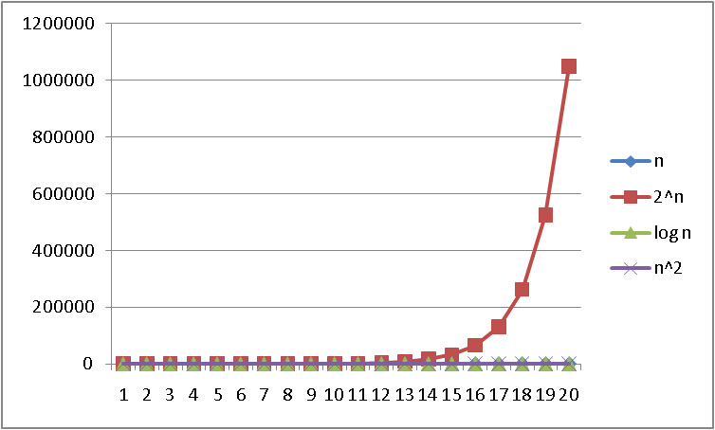
Logarithms and Exponents
Since so much is binary in CS log almost always means log₂
Definition: log₂ x = y if x = 2^{y}
So, log₂ 1,000,000 = “a little under 20”
Just as exponents grow very quickly, logarithms grow very slowly
See Excel file
for plot data –
play with it!

Slide 9
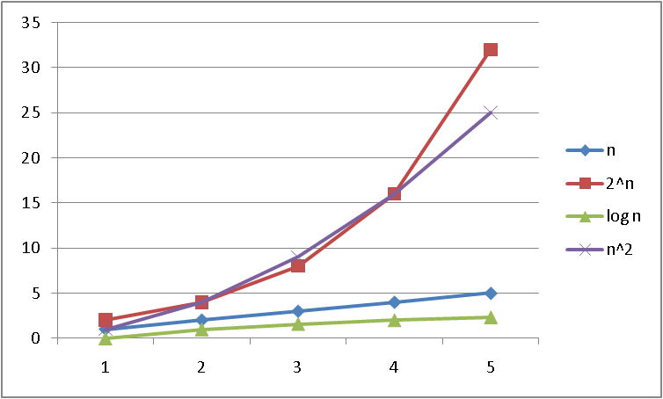
Logarithms and Exponents
Since so much is binary log in CS almost always means log₂
Definition: log₂ x = y if x = 2^{y}
So, log₂ 1,000,000 = “a little under 20”
Just as exponents grow very quickly, logarithms grow very slowly
See Excel file
for plot data –
play with it!

Slide 10
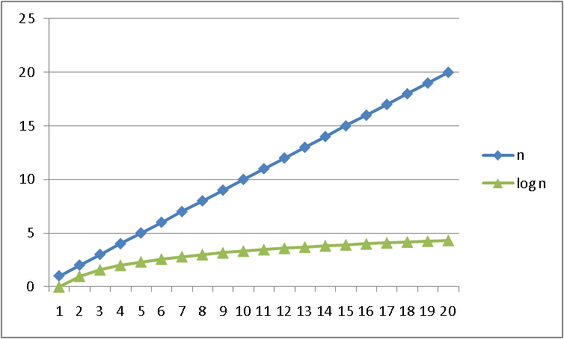
Logarithms and Exponents
Since so much is binary log in CS almost always means log₂
Definition: log₂ x = y if x = 2^{y}
So, log₂ 1,000,000 = “a little under 20”
Just as exponents grow very quickly, logarithms grow very slowly
See Excel file
for plot data –
play with it!

Slide 11
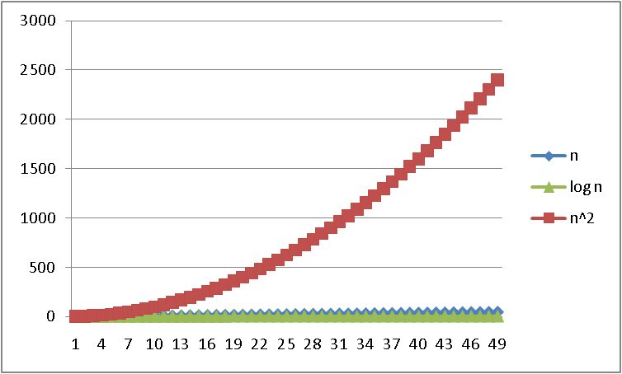
Logarithms and Exponents
Since so much is binary log in CS almost always means log₂
Definition: log₂ x = y if x = 2^{y}
So, log₂ 1,000,000 = “a little under 20”
Just as exponents grow very quickly, logarithms grow very slowly
See Excel file
for plot data –
play with it!

Slide 12
Properties of logarithms
log(A*B) = log A + log B
So log(N^{k})= k log N
log(A/B) = log A – log B
log(log x) is written log log x
Grows as slowly as 2² grows fast
(log x)(log x) is written log²x
It is greater than log x for all x > 2
y

Slide 13
Log base doesn’t matter much!
“Any base B log is equivalent to base 2 log within a constant factor”
And we are about to stop worrying about constant factors!
In particular, log₂ x = 3.22 log₁₀ x
In general,
log_{B} x = (log_{A} x) / (log_{A} B)

Slide 14
Algorithm Analysis
As the “size” of an algorithm’s input grows
(integer, length of array, size of queue, etc.):
How much longer does the algorithm take (time)
How much more memory does the algorithm need (space)
Because the curves we saw are so different, often care about only “which curve we are like”
Separate issue: Algorithm correctness – does it produce the right answer for all inputs
Usually more important, naturally

Slide 15
Example
What does this pseudocode return?
x := 0;
for i=1 to N do
for j=1 to i do
x := x + 3;
return x;
Correctness: For any N ≥ 0, it returns…

Slide 16
Example
What does this pseudocode return?
x := 0;
for i=1 to N do
for j=1 to i do
x := x + 3;
return x;
Correctness: For any N ≥ 0, it returns 3N(N+1)/2
Proof: By induction on n
P(n) = after outer for-loop executes n times, x holds 3n(n+1)/2
Base: n=0, returns 0
Inductive: From P(k), x holds 3k(k+1)/2 after k iterations. Next iteration adds 3(k+1), for total of 3k(k+1)/2 + 3(k+1) = (3k(k+1) + 6(k+1))/2 = (k+1)(3k+6)/2 = 3(k+1)(k+2)/2

Slide 17
Example
How long does this pseudocode run?
x := 0;
for i=1 to N do
for j=1 to i do
x := x + 3;
return x;
Running time: For any N ≥ 0,
Assignments, additions, returns take “1 unit time”
Loops take the sum of the time for their iterations
So: 2 + 2*(number of times inner loop runs)
And how many times is that…

Slide 18
Example
How long does this pseudocode run?
x := 0;
for i=1 to N do
for j=1 to i do
x := x + 3;
return x;
The total number of loop iterations is N*(N+1)/2
This is a very common loop structure, worth memorizing
Proof is by induction on N, known for centuries
This is proportional to N² , and we say O(N²), “big-Oh of”
For large enough N, the N and constant terms are irrelevant, as are the first assignment and return
See plot… N*(N+1)/2 vs. just N²/2

Slide 19
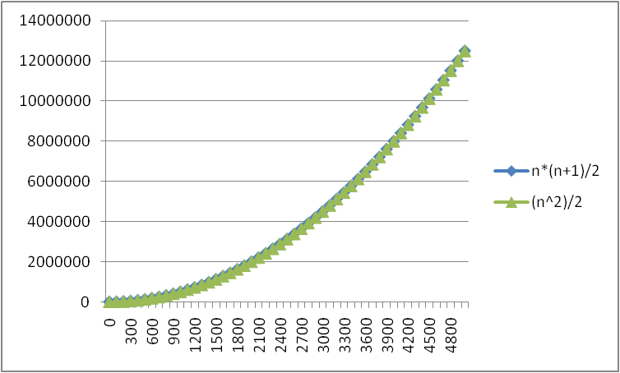
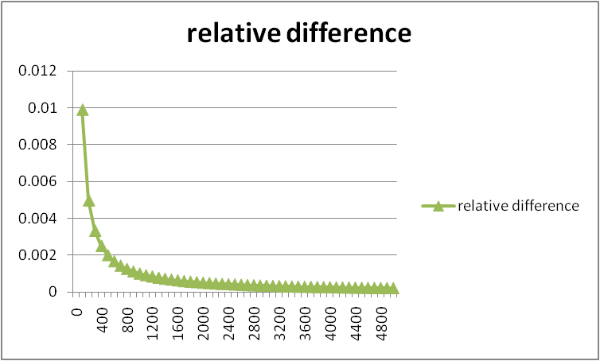
Lower-order terms don’t matter
N*(N+1)/2 vs. just N²/2

Slide 20
Geometric interpretation
∑ i = N*N/2+N/2
for i=1 to N do
for j=1 to i do
// small work
N
i=1
Area of square: N*N
Area of lower triangle of square: N*N/2
Extra area from squares crossing the diagonal: N*1/2
As N grows, fraction of “extra area” compared to lower triangle goes to zero (becomes insignificant)

Slide 21
Recurrence Equations
For running time, what the loops did was irrelevant, it was how many times they executed.
Running time as a function of input size n (here loop bound):
T(n) = n + T(n-1)
(and T(0) = 2ish, but usually implicit that T(0) is some constant)
Any algorithm with running time described by this formula is O(n²)
“Big-Oh” notation also ignores the constant factor on the high-order term, so 3N² and 17N² and (1/1000) N² are all O(N²)
As N grows large enough, no smaller term matters
Next time: Many more examples + formal definitions

Slide 22
Big-O: Common Names
O(1) constant (same as O(k) for constant k)
O(log n) logarithmic
O(n) linear
O(n log n) “n log n”
O(n²) quadratic
O(n³) cubic
O(n^{k}) polynomial (where is k is any constant)
O(k^{n}) exponential (where k is any constant > 1)
Pet peeve: “exponential” does not mean “grows really fast”, it means “grows at rate proportional to k^{n} for some k>1”
A savings account accrues interest exponentially (k=1.01?)
If you don’t know k, you probably don’t know it’s exponential

