Slide 1
CSE332: Data Abstractions Lecture 26: Course Victory Lap
Dan Grossman
Spring 2012

Slide 2
Today
Rest-of-course logistics: exam, etc.
Review of main course themes
Some thoughts on “data structures and threads” together
Some time for questions and discussion
Course evaluations
Thoughtful and constructive feedback deeply appreciated
(Including what you liked)

Slide 3
Final Exam
As also indicated on the web page:
Next Tuesday, 2:30-4:20
Intention is to test a subset of the topics in sorting, graphs, parallelism, concurrency, amortization
In other words, “stuff not covered by the midterm”
But as always the course topics build on earlier ones, especially algorithm analysis
May need to read and write Java, among other things

Slide 4
Grading Schedule
Needs grading:
Homework 8 [Stanley]
Project 3 [Tyler]
Final exam [Dan]
Will let you know when grading is done
Encourage you to pick up your homework, exam
But Dan will be out of town June 9-20
Exams at department front desk during this time?

Slide 5
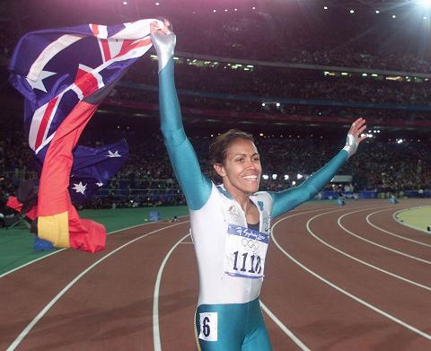
Victory Lap
A victory lap is an extra trip
around the track
By the exhausted victors
(that’s us) ☺
Review course goals
Slides from Lecture 1
What makes CSE332 special

Slide 6
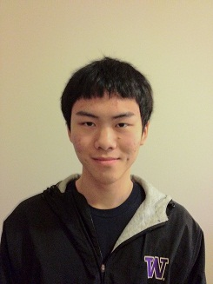
Thank you!
Big thank-you to your TAs
Section covers essential software topics and complements lecture: indispensable in my opinion
Lots of grading in CSE332: “free response” and “open design” better for students, harder for TAs

Slide 7
Thank you!
And huge thank you to all of you
Great attitude
Extraordinarily good class attendance and questions
Occasionally laughed at stuff ☺

Slide 8
Now five slides, completely unedited, from Lecture 1
Hopefully they make more sense now
Hopefully we succeeded

Slide 9
Data Structures + Threads
About 70% of the course is a “classic data-structures course”
Timeless, essential stuff
Core data structures and algorithms that underlie most software
How to analyze algorithms
Plus a serious first treatment of programming with multiple threads
For parallelism: Use multiple processors to finish sooner
For concurrency: Correct access to shared resources
Will make many connections to the classic material

Slide 10
What is 332 is about
Deeply understand the basic structures used in all software
Understand the data structures and their trade-offs
Rigorously analyze the algorithms that use them (math!)
Learn how to pick “the right thing for the job”
Experience the purposes and headaches of multithreading
Practice design, analysis, and implementation
The elegant interplay of “theory” and “engineering” at the core of computer science

Slide 11
Goals
Be able to make good design choices as a developer, project manager, etc.
Reason in terms of the general abstractions that come up in all non-trivial software (and many non-software) systems
Be able to justify and communicate your design decisions
Dan’s take:
3 years from now this course will seem like it was a waste of your time because you can’t imagine not “just knowing” every main concept in it
Key abstractions computer scientists and engineers use almost every day
A big piece of what separates us from others

Slide 12
Data structures
(Often highly non-obvious) ways to organize information to enable efficient computation over that information
Key goal over the next week is introducing asymptotic analysis to precisely and generally describe efficient use of time and space
A data structure supports certain operations, each with a:
Meaning: what does the operation do/return
Performance: how efficient is the operation
Examples:
List with operations insert and delete
Stack with operations push and pop

Slide 13
Trade-offs
A data structure strives to provide many useful, efficient operations
But there are unavoidable trade-offs:
Time vs. space
One operation more efficient if another less efficient
Generality vs. simplicity vs. performance
That is why there are many data structures and educated CSEers internalize their main trade-offs and techniques
And recognize logarithmic < linear < quadratic < exponential

Slide 14
Now thoughts on teaching parallelism and concurrency in this class
Something I have vigorously advocated personally
And it seems to be working

Slide 15
Background
“Old” data structures course taught more data structures and algorithms
Splay trees, leftist heaps, skew heaps, disjoint-set, network flow, …
Threads are way more important than they used to be
“Data structures” is not what most faculty would think of for the “best place to fit it”…

Slide 16
The fit
Hopefully it did not seem to odd to you, because:
Work, span, Amdahl’s Law are about asymptotics
Fork-join is great for divide-and-conquer
Sequential cutoffs are like quicksort/insertion-sort cutoffs
ADTs need critical sections
Queues motivate passive waiting
… (several more examples)
Other main thesis: emphasize parallelism vs. concurrency distinction
Not always widely appreciated
Often mixed in practice

Slide 17
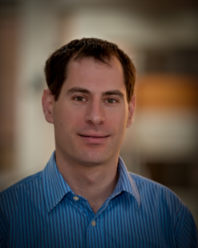
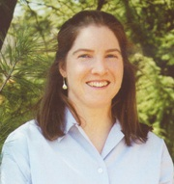
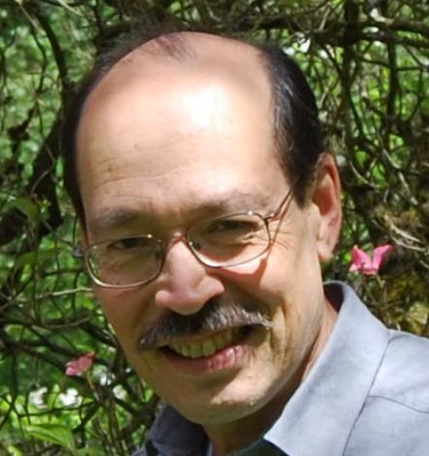
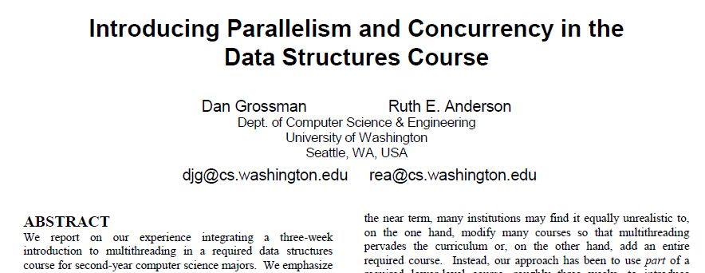
Seems to work
CSE332 instructors at UW
Parts of materials picked up by 8 other schools so far
So please keep reporting typos, especially in reading notes
A paper at SIGCSE2012 (main CS Education Conference)

Slide 18
Last slide
What do you think was good about 332?
What could be improved?
And:
Don’t be a stranger: let me know how the rest of your time in CSE (and beyond!) goes… I really do like to know

