Slide 1
CSE341: Programming Languages Lecture 1 Course Mechanics ML Variable Bindings
Dan Grossman
Fall 2011

Slide 2
Welcome!
We have 10 weeks to learn the fundamental concepts of programming languages
With hard work, patience, and an open mind, this course makes you a much better programmer
Even in languages we won’t use
Learn the core ideas around which every language is built, despite countless surface-level differences and variations
Poor course summary: “Uses SML, Racket, and Ruby”
Today’s class:
Course mechanics
[A rain-check on motivation]
Dive into ML: Homework 1 due end of next week

Slide 3
Concise to-do list
In the next 24-48 hours:
Read course web page: http://www.cs.washington.edu/education/courses/cse341/11au/
Read all course policies
Adjust class email-list settings as necessary
Complete Homework 0 (survey worth 0 points)
Get set up using emacs and SML
Installation/configuration/use instructions on web page
Essential; no reason to delay

Slide 4
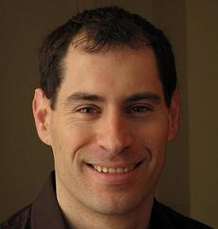
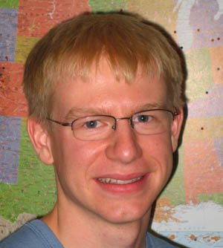
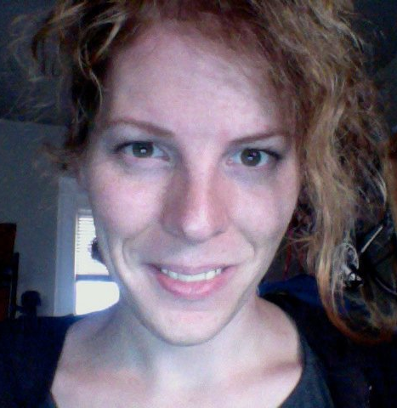
Who
Course Staff:
Dan Grossman Ben Wood Lydia Duncan Chloe Houvener TBD
Dan: Faculty, 341 my favorite course / area of expertise
Ben: Ph.D. student, also a PL expert
Lydia: Took 341 Spring 2011, helped with new project over summer
Chloe: Took 341 Fall 2010, favorite class so far
A nice large staff: get to know us!

Slide 5
Staying in touch
Course email list: cse341a_au11@u.washington.edu
Students and staff already subscribed
You must get announcements sent there
Fairly low traffic
Course staff: cse341-staff@cs.washington.edu plus individual emails
Message Board
For appropriate discussions; TAs will monitor
Optional, won’t use for important announcements
Anonymous feedback link on webpage
For good and bad: If you don’t tell me, I don’t know

Slide 6
Lecture: Dan
Slides, code, and essay summaries posted
Often revised after class
Summary might not be posted until after class
Take notes: materials may not describe everything
Slides in particular are visual aids for me to use
Ask questions, focus on key ideas
Engage actively
Arrive punctually (beginning matters most!) and well-rested
Just like you will for the midterm!
Write down ideas and code as we go
If attending and paying attention is a poor use of your time, one of us is doing something wrong

Slide 7
Section: Ben
Required: will usually cover new material
Sometimes more language or environment details
Sometimes main ideas needed for homework
Will meet this week: using SML

Slide 8
Office hours
Regular hours and locations on course web [soon]
Changes as necessary announced on email list
Use them
Please visit me
Ideally not just for homework questions (but that’s good too)

Slide 9
Textbooks, or lack thereof
Will mostly use the “textbooks” as useful references
Look up details you want/need to know
Can provide good second explanations, but (because!) they often take a fairly different approach
Some topics aren’t in the texts
Don’t be surprised when I essentially ignore the texts
List on web page what sections are most relevant
Some but not all of you will do fine without using the texts

Slide 10
Homework
Seven total
To be done individually
Doing the homework involves:
Understanding the concepts being addressed
Writing code demonstrating understanding of the concepts
Testing your code to ensure you understand and have correct programs
“Playing around” with variations, incorrect answers, etc.
We grade only (2), but focusing on (2) makes the homework harder
Challenge problems: Low points/difficulty ratio

Slide 11
Note my writing style
Homeworks tend to be worded very precisely and concisely
I’m a computer scientist and I write like one (a good thing!)
Technical issues deserve precise technical writing
Conciseness values your time as a reader
You should try to be precise too
Skimming or not understanding why a word or phrase was chosen can make the homework harder
By all means ask if a problem is confusing
Being confused is normal and understandable
And I may have made a mistake
Once you’re unconfused, you might agree the problem wording didn’t cause the confusion

Slide 12
Academic Integrity
Read the course policy carefully
Clearly explains how you can and cannot get/provide help on homework and projects
Always explain any unconventional action
I have promoted and enforced academic integrity since I was a freshman
Great trust with little sympathy for violations
Honest work is the most important feature of a university

Slide 13
Exams
Midterm: Monday October 31 (spooky ☺), in class
Final: Tuesday December 13, 2:30-4:20
Same concepts, but different format from homework
More conceptual (but write code too)
Will post old exams
Closed book/notes, but you bring one sheet with whatever you want on it

Slide 14
Questions?
Anything I forgot about course mechanics before we discuss, you know, programming languages?

Slide 15
What this course is about
Many essential concepts relevant in any programming language
And how these pieces fit together
Use the languages ML, Racket, and Ruby because:
They let many of the concepts “shine”
Using multiple languages shows how the same concept can “look different” or actually be slightly different
In many ways simpler than Java
A big focus on functional programming
Not using mutation (assignment statements) (!)
Using first-class functions (can’t explain that yet)

Slide 16
Let’s start over
For at least the next two weeks, please “let go of Java”
Learn ML as a “totally new way of programming”
Later we’ll contrast with what you know
Saying “oh that is kind of like that thing in Java” will confuse you, slow you down, and make you learn less
In a few weeks, we’ll have the background to
Intelligently motivate the course
Understand how functional programming is often simple, powerful, and good style – even when “stuck” in Java or C
Understand why functional programming is increasingly important in the “real world” even if ML and Racket aren’t widely popular languages

Slide 17
My claim
Learning to think about software in this “PL” way will make you a better programmer even if/when you go back to old ways
It will also give you the mental tools and experience you need for a lifetime of confidently picking up new languages and ideas
[Somewhat in the style of The Karate Kid movies (1984, 2010)]

Slide 18
A strange environment
The next 4-5 weeks will use
The ML language
The emacs editor
A read-eval-print-loop (REPL) for evaluating programs
You need to get things installed, configured, and usable
Either in the department labs or your own machine
We’ve written instructions (read carefully; ask questions)
Only then can you focus on the content of Homework 1
Working in strange environments is a CS life skill

Slide 19
ML from the beginning
A program is a sequence of bindings
Type-check each binding in order using the static environment produced by the previous bindings
Evaluate each binding in order using the dynamic environment produced by the previous bindings
Dynamic environment holds values, the results of evaluating expressions
Today the only kind of binding is a variable binding

Slide 20
A very simple ML program
(* My first ML program *)
val x = 34;
val y = 17;
val z = (x + y) + (y + 2);
val q = z + 1;
val abs_of_z = if z < 0 then 0 – z else z;
val abs_of_z_simpler = abs z

Slide 21
A variable binding
val z = (x + y) + (y + 2); (* comment *)
More generally:
val x = e;
Syntax:
Keyword val and punctuation = and ;
Variable x
Expression e
many forms of these, most containing subexpressions

Slide 22
Expressions
We have seen many kinds of expressions:
34 true false x e1+e2 e1<e2
if e1 then e2 else e3
Can get arbitrarily large since any subexpression can contain subsubexpressions, etc.
Every kind of expression has
Syntax
Type-checking rules
Produces a type or fails (with a bad error message ☹)
Types so far: int bool unit
Evaluation rules (used only on things that type-check)
Produces a value (or exception or infinite-loop)

Slide 23
Variables
Syntax:
sequence of letters, digits, _, not starting with digit
Type-checking:
Look up type in current static environment
If not there fail
Evaluation:
Look up value in current dynamic environment

Slide 24
Addition
Syntax:
e1 + e2 where e1 and e2 are expressions
Type-checking:
If e1 and e2 have type int,
then e1 + e2 has type int
Evaluation:
If e1 evaluates to v1 and e2 evaluates to v2,
then e1 + e2 evaluates to sum of v1 and v2

Slide 25
Values
All values are expressions
Not all expressions are values
A value “evaluates to itself” in “zero steps”
Examples:
34, 17, 42 have type int
true, false have type bool
() has type unit

Slide 26
A slightly tougher one
What are the syntax, typing rules, and evaluation rules for conditional expressions?

Slide 27
use
use “foo.sml” is an unusual expression
It enters bindings from the file foo.sml
Result is () bound to variable it
Ignorable

Slide 28
The foundation we need
We have many more types, expression forms, and binding forms to learn before we can write “anything interesting”
Syntax, typing rules, evaluation rules will guide us the whole way!
For homework 1: functions, pairs, conditionals, lists, options, and local bindings
Earlier problems require less
Will not add (or need):
Mutation (a.k.a. assignment): use new bindings instead
Statements: everything is an expression
Loops: use recursion instead

Slide 29
Pragmatics
Lecture has emphasized building up from simple pieces
But in practice you make mistakes and get inscrutable messages
Example gotcha: x = 7 instead of val x = 7
Work on developing resilience to mistakes
Slow down
Don’t panic
Read what you wrote very carefully

