Slide 1
CSE 341 : Programming Languages Lecture 1 Hello World! Welcome to ML
Zach Tatlock
Spring 2014

Slide 2
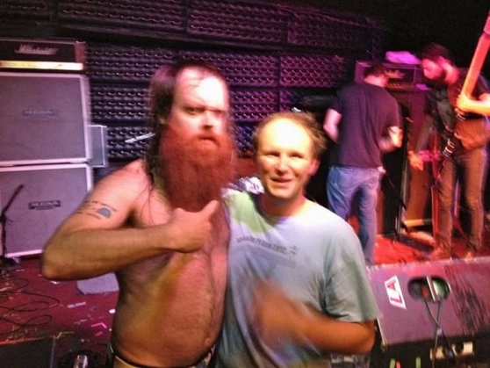
Hello! My name is…
Zach Tatlock
ztatlock@cs
CSE 546
New faculty ➔ You’ll learn PL. I’ll master teaching.

Slide 3
I really like studying programming languages.
Super stoked to explore PL with all of you.
Why?

Slide 4
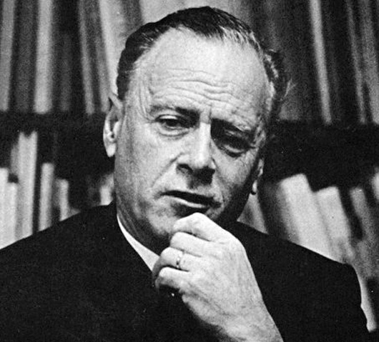
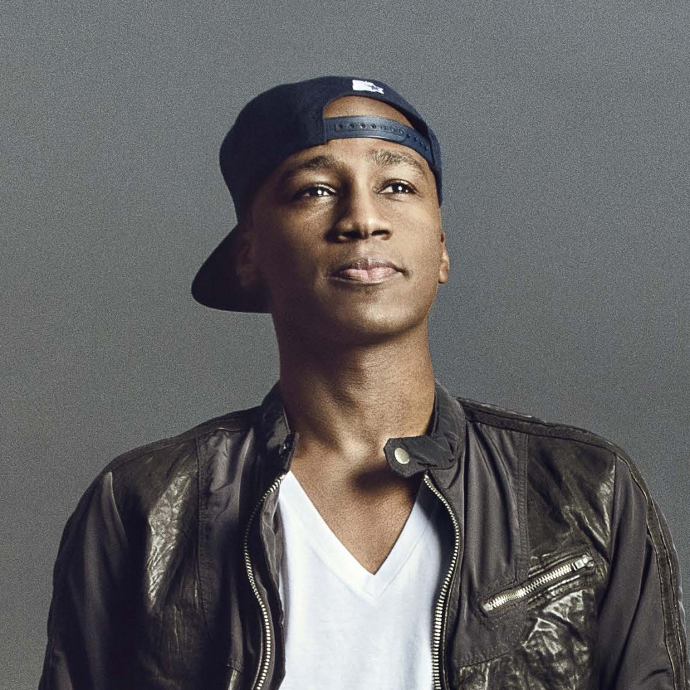
We shape our tools and thereafter
our tools shape us.
Marshall McLuhan
I discover that I think in words. The more words I know, the more things I can think about...
Reading was illegal because if you limit someone's vocab, you limit their thoughts. They can't even think of freedom because they don't have the language to.
M. K. Asante

Slide 5
I really like studying programming languages.
Super stoked to explore PL with all of you.
Why?
PL helps us break free to think thoughts, ask questions, and solve problems that would otherwise be inaccessible.

Slide 6
Welcome!

Slide 7
Welcome!
We have 10 short weeks to learn the fundamental concepts of PL.
Curiosity and persistence will get you everywhere.
We’ll become better programmers:
Even in languages we won’t use
Learn the core ideas around which every language is built, despite countless surface-level differences and variations
Today’s class:
Administrivia
Dive into ML: HW 1 due Wed next week

Slide 8
Concise to-do list
In the next 24-48 hours:
Read course web page:
Read all course policies (posted soon)
Adjust class email-list / Piazza settings as necessary
Set up Emacs and ML
Installation/configuration/use instructions on web page
Essential; non-intellectual
No reason to delay!
http://www.cs.washington.edu/education/courses/cse341/14sp/

Slide 9
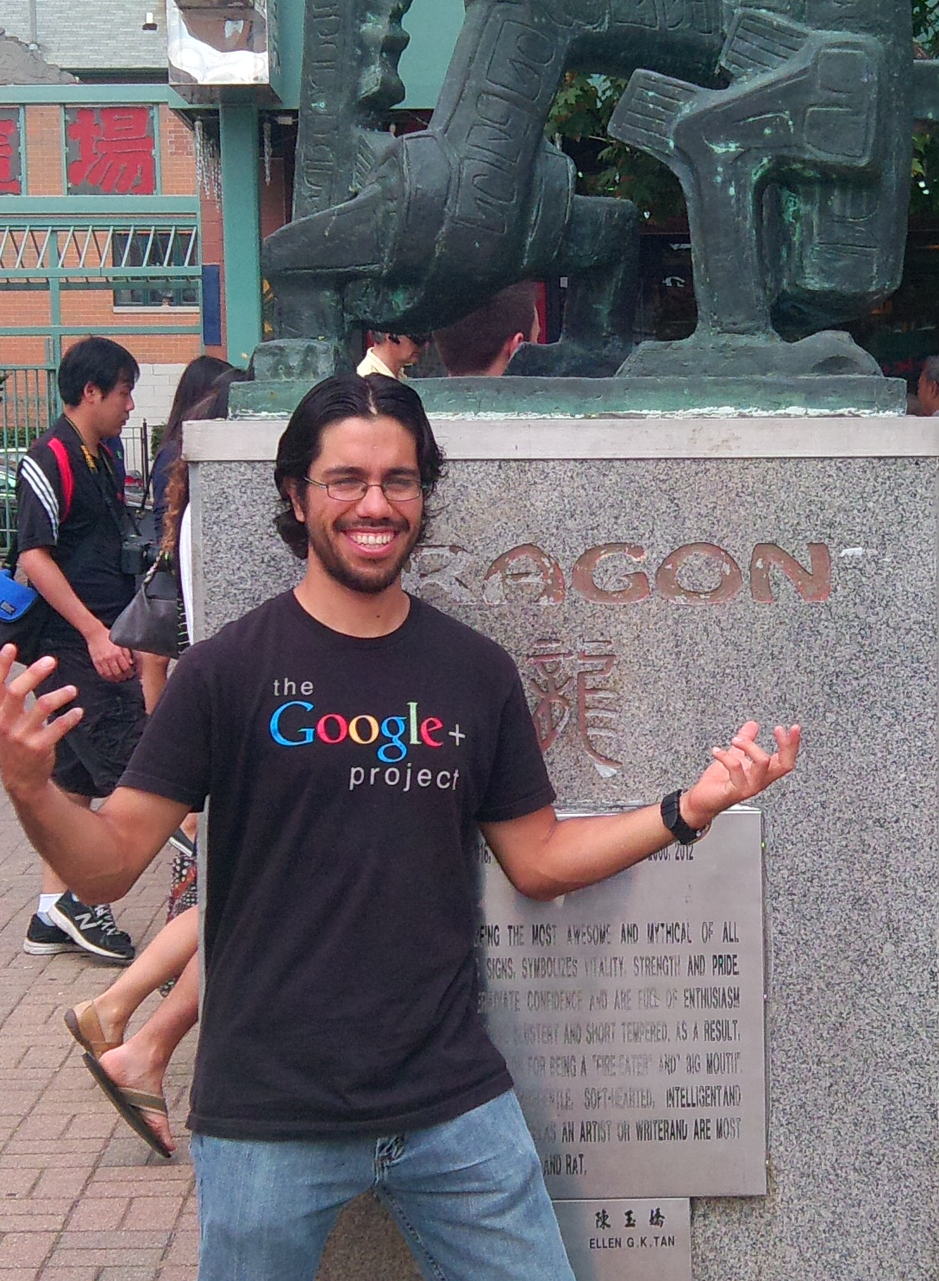
Our Incredible Guides
super ultra helpful, extraordinarily smart, stellar smiles
Armando Diaz Tolentino
Riley Klingler
Max Sherman

Slide 10
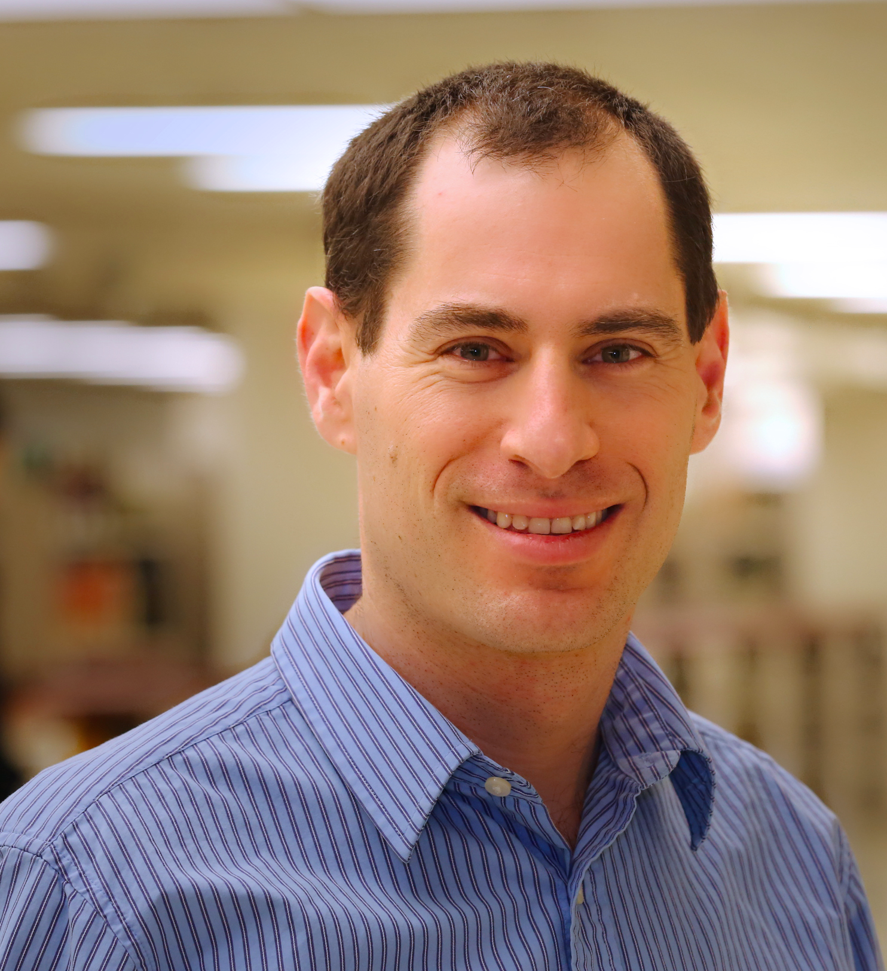
Our Guide in Spirit
(spiritual guide?)
Dan Grossman
Creator of this flavor of 341.

Slide 11
Staying in touch
Course email list: cse341a_sp14@u.washington.edu
Students and staff already subscribed
You must get announcements sent there
Fairly low traffic
Piazza! Piazza! Piazza!
https://piazza.com/washington/spring2014/cse341/home
For all discussions
We’ll be there!
You can ask anonymous (to classmates) questions!
Cookies with the Professor (that’s me!)
5 minute chat, 2% of grade

Slide 12
Lecture:
Slides, code, and reading notes / videos posted
May be revised after class
Take notes: materials may not describe everything
The more ways we engage, the better we learn
Ask questions, focus on key ideas
Engage actively
We’ll start pretty much on time (beginning matters most!)
Write down ideas and code as we go
We’ll make lectures interactive, fun, and valuable

Slide 13
Section
Required: will usually cover new material
Sometimes more language or environment details
Sometimes main ideas needed for homework
Will meet this week: using Emacs and ML
Material often also covered in reading notes / videos

Slide 14
Reading Notes and Videos
Posted for each “course unit:” reading notes and videos that go over most (all?) of the material (and some extra stuff?)
So why come to class?
Videos can make class-time much more valuable (and fun)
Answer your questions without rushing
Can point to occasional optional topics/videos
Can try different things in class, not just recite material
Interact with peers and yours truly!
(probably) see me trip over stuff

Slide 15
Textbooks, or lack thereof
Will treat the “textbooks” as optional, possibly useful references
Look up details you want/need to know, but often in free online resources too
Can provide second explanations, but (because!) they often take a fairly different approach
If the “341 view” confuses you, lecture, reading notes, and video might all confuse you
Some topics aren’t in the texts
Don’t be surprised when we essentially ignore the texts
List on web page what sections are most relevant
Most but maybe not all of you will do fine without the texts

Slide 16
Office hours
Regular hours and locations on course web
Changes as necessary announced on Piazza
Use them
Please visit me
Ideally not just for homework questions (but that’s good too)

Slide 17
Homework
Seven total
To be done individually
Doing the homework involves:
Understanding the concepts being addressed
Writing code demonstrating understanding of the concepts
Testing your code to ensure you understand and have correct programs
“Playing around” with variations, incorrect answers, etc.
Only (2) is graded, but focusing on (2) makes homework harder
Challenge problems: Low points/difficulty ratio

Slide 18
HEADS UP: Homeworks are terse!
Homeworks tend to be worded very precisely and concisely
Technical issues deserve precise technical writing
Conciseness values your time as a reader
You should try to be precise too
Skimming or not understanding why a word or phrase was chosen can make the homework harder
By all means ask if a problem is confusing
Being confused is normal and understandable
I make a mistakes too

Slide 20
Academic Integrity
Read the course policy carefully (posted this afternoon)
Clearly explains how you can and cannot get/provide help on homework and projects
Always explain any unconventional action
Academic integrity is the foundation of the university system
Great trust with little sympathy for violations
Honest work is the most important feature of a university
When in doubt, ask!

Slide 21
Exams
Midterm: … week 5-ish
Final: Late in finals week (probably June 12/13)
I know, bummer city
Yeah, you have to be here
Unfortunately, probably not much I can do about it
Same concepts, but different format from homework
More conceptual (but write code too)
Will post old exams
Closed book/notes, but you bring one sheet with whatever you want on it

Slide 22
Coursera Doppelgänger
Dan taught this course to thousands of people around the world
You are not allowed to participate in that class!
Please do not search for related homework problems!
This should have little impact on you
Two courses are separate
341 is a great (the greatest?) class
We are committed to this offering being the best ever
Big win for us:
We can use videos and other materials
More time to interact in class and build things

Slide 23
Questions?
Anything I forgot about course mechanics before we discuss, you know, programming languages?

Slide 24
What this course is about
Many essential concepts relevant in any programming language
And how these pieces fit together
Use ML, Racket, and Ruby:
They let various important concepts “shine”
Using multiple languages shows how the same concept just can “look different” or actually be slightly different
In many ways simpler than Java
Big focus on functional programming
Not using mutation (assignment statements) (!)
Using first-class functions (can’t explain that yet)
But many other topics too

Slide 25
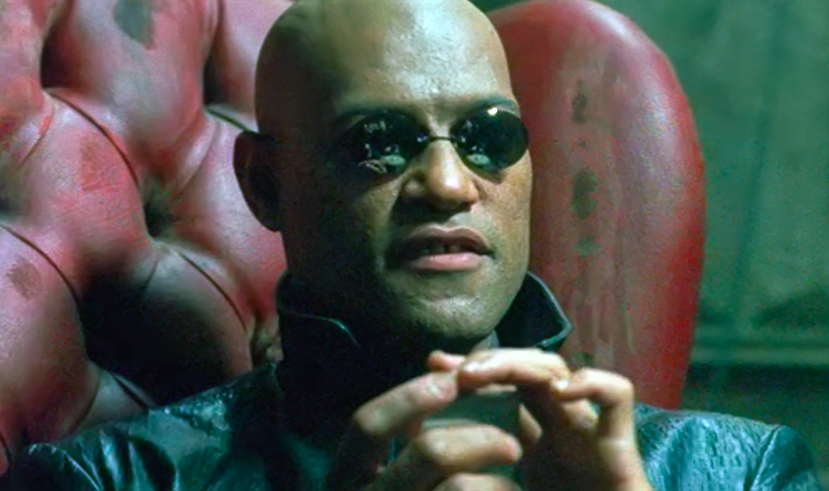
Why learn this?
To free our minds from the shackles of imperative programming.

Slide 26
A strange environment
Next 4-5 weeks will use
ML language
Emacs editor
Read-eval-print-loop (REPL) for evaluating programs
Get things installed and configured ASAP!
Either in the department labs or your own machine
We’ve written thorough instructions (questions welcome)
Only then can you focus on the content of Homework 1
Working in strange environments is a CSE life skill

Slide 27
Mindset
“Let go” of all programming languages you already know
For now, treat ML as a “totally new thing”
Time later to compare/contrast to what you know
For now, “oh that seems kind of like this thing in [Java]” will confuse you, slow you down, and you will learn less
Start from a blank file…

Slide 28
A very simple ML program
[The same program we just wrote in Emacs; here for review]
(* My first ML program *)
val x = 34;
val y = 17;
val z = (x + y) + (y + 2);
val q = z + 1;
val abs_of_z = if z < 0 then 0 – z else z;
val abs_of_z_simpler = abs z

Slide 29
A variable binding
val z = (x + y) + (y + 2); (* comment *)
More generally:
val x = e;
Syntax:
Keyword val and punctuation = and ;
Variable x
Expression e
Many forms of these, most containing subexpressions

Slide 30
The semantics
Syntax is just how you write something
Semantics is what that something means
Type-checking (before program runs)
Evaluation (as program runs)
For variable bindings:
Type-check expression and extend static environment
Evaluate expression and extend dynamic environment
So what is the precise syntax, type-checking rules, and evaluation rules for various expressions? Good question!

Slide 31
ML, carefully, so far
A program is a sequence of bindings
Type-check each binding in order using the static environment produced by the previous bindings
Evaluate each binding in order using the dynamic environment produced by the previous bindings
Dynamic environment holds values, the results of evaluating expressions
So far, the only kind of binding is a variable binding
More soon

Slide 32
Expressions
We have seen many kinds of expressions:
34 true false x e1+e2 e1<e2
if e1 then e2 else e3
Can get arbitrarily large since any subexpression can contain subsubexpressions, etc.
Every kind of expression has
Syntax
Type-checking rules
Produces a type or fails (with a bad error message ☹)
Types so far: int bool unit
Evaluation rules (used only on things that type-check)
Produces a value (or exception or infinite-loop)

Slide 33
Variables
Syntax:
sequence of letters, digits, _, not starting with digit
Type-checking:
Look up type in current static environment
If not there fail
Evaluation:
Look up value in current dynamic environment

Slide 34
Addition
Syntax:
e1 + e2 where e1 and e2 are expressions
Type-checking:
If e1 and e2 have type int,
then e1 + e2 has type int
Evaluation:
If e1 evaluates to v1 and e2 evaluates to v2,
then e1 + e2 evaluates to sum of v1 and v2

Slide 35
Values
All values are expressions
Not all expressions are values
A value “evaluates to itself” in “zero steps”
Examples:
34, 17, 42 have type int
true, false have type bool
() has type unit

Slide 36
Slightly tougher ones
What are the syntax, typing rules, and evaluation rules for conditional expressions?
What are the syntax, typing rules, and evaluation rules for
less-than expressions?

Slide 37
The foundation we need
We have many more types, expression forms, and binding forms to learn before we can write “anything interesting”
Syntax, typing rules, evaluation rules will guide us the whole way!
HW 1: functions, pairs, conditionals, lists, options, local bindings
Earlier problems require less
Will not add (or need):
Mutation (a.k.a. assignment): use new bindings instead
Statements: everything is an expression
Loops: use recursion instead

