Slide 1
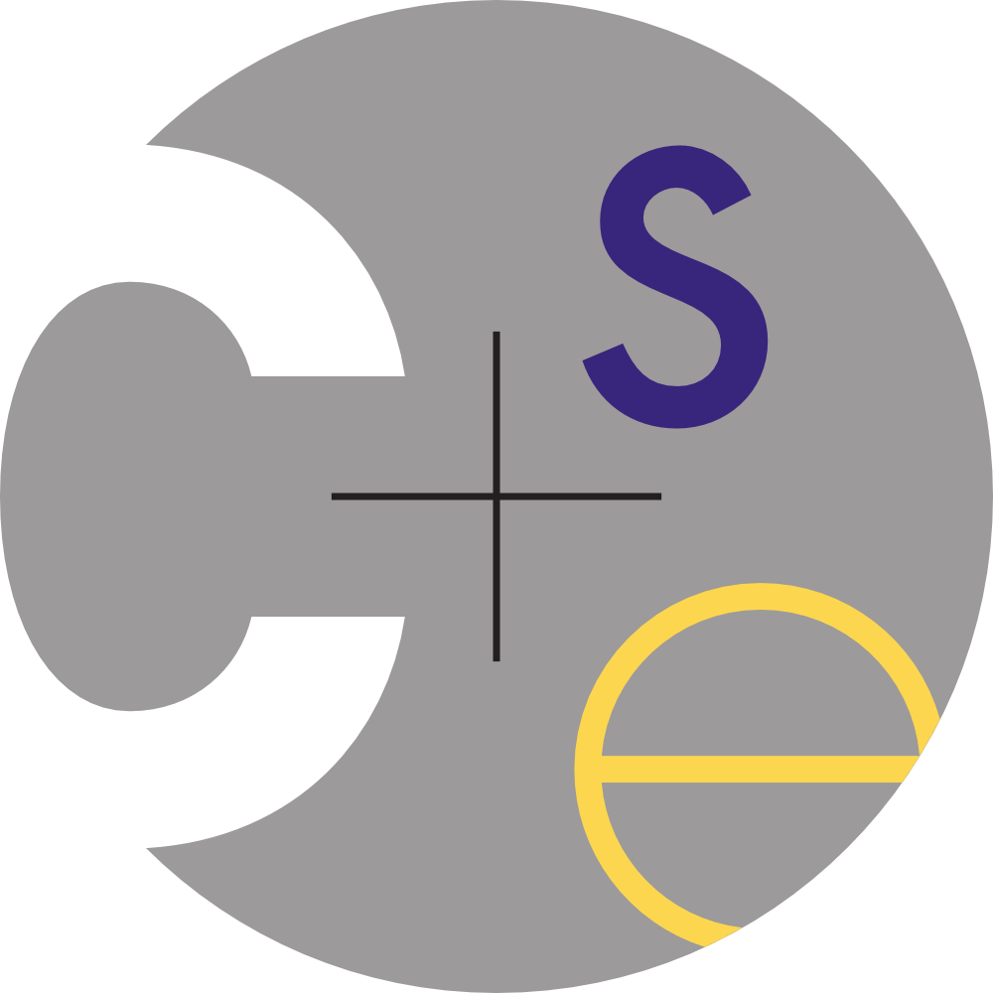
CSE 341 : Programming Languages Section 4 Haskel #2
Autumn 2015

Slide 2
Reminders
Homework 3
due last night
up to two late days
questions after section / in office hours
Office hours remaining:
Justin Adsuara (justbads at cs)
OH: Thurs 3:30-4:20, CSE 002
Alan Borning (borning at cs)
OH: Fri 4:30-5:20, or by appointment, or whenever
the door is open. CSE 478

Slide 3
Reminders
Anonymous functions:
plus x y = x + y can be defined in an expression as:
(\x -> \y -> x + y)
Currying:
plus 7 is like the partial evaluation:
plus y = 7 + y or:
(\y -> 7 + y)
User Types (simple):
data NAME PARAM(s) = VALUE1 | VALUE2 | …
constructs (i.e. deriving (Show, Read))

Slide 4
Reminders
Higher order functions:
one or more arguments are functions [map, filter, …]
Function composition: [ . ]
f . g (of x, x can be omitted) is like:
compose f g x = f (g x) [Need the x here, though]
Pointfree programming: [omitting the argument]
incr = plus 1 Is sugar for: incr a = plus 1 a

Slide 5
Exercises [Haskell mini #2]

Slide 6
Exercises [Haskell mini #2]
data List a = Empty | Cell a (List a) deriving (Show,Read)

Slide 7
Exercises [Haskell mini #2]
data List a = Empty | Cell a (List a) deriving (Show,Read)
append :: List a -> List a -> List a
append Empty ys = ys append (Cell x xs) ys = Cell x (append xs ys)

Slide 8
Exercises [Haskell mini #2]
data List a = Empty | Cell a (List a) deriving (Show,Read)
append :: List a -> List a -> List a
append Empty ys = ys append (Cell x xs) ys = Cell x (append xs ys)
mymap :: (t -> a) -> List t -> List a mymap f Empty = Empty mymap f (Cell x xs) = Cell (f x) (mymap f xs)
Questions?

Slide 9
Exercises [Section]
data List a = Empty | Cell a (List a) deriving (Show,Read)
append :: List a -> List a -> List a
append Empty ys = ys append (Cell x xs) ys = Cell x (append xs ys)
mymap :: (t -> a) -> List t -> List a mymap f Empty = Empty mymap f (Cell x xs) = Cell (f x) (mymap f xs)
numlist = Cell 1 (Cell 2 ( Cell 3))
What is the result of;
mymap (\x -> 1 + x) numlist

Slide 10
Exercises [Section]
data List a = Empty | Cell a (List a) deriving (Show,Read)
append :: List a -> List a -> List a
append Empty ys = ys append (Cell x xs) ys = Cell x (append xs ys)
mymap :: (t -> a) -> List t -> List a mymap f Empty = Empty mymap f (Cell x xs) = Cell (f x) (mymap f xs)
numlist = Cell 1 (Cell 2 ( Cell 3))
What is the result of;
mymap (\x -> 1 + x) numlist
ERROR!
Why?

Slide 11
Exercises [Section]
data List a = Empty | Cell a (List a) deriving (Show,Read)
append :: List a -> List a -> List a
append Empty ys = ys append (Cell x xs) ys = Cell x (append xs ys)
mymap :: (t -> a) -> List t -> List a mymap f Empty = Empty mymap f (Cell x xs) = Cell (f x) (mymap f xs)
numlist = Cell 1 (Cell 2 ( Cell 3))
What is the result of;
mymap (\x -> 1 + x) numlist
ERROR!
Why? Cell 3 is missing its second argument of type ‘List’

Slide 12
Exercises [Section]
data List a = Empty | Cell a (List a) deriving (Show,Read)
append :: List a -> List a -> List a
append Empty ys = ys append (Cell x xs) ys = Cell x (append xs ys)
mymap :: (t -> a) -> List t -> List a mymap f Empty = Empty mymap f (Cell x xs) = Cell (f x) (mymap f xs)
numlist = Cell 1 (Cell 2 (Cell 3 ????))
What is the result of:
mymap (\x -> 1 + x) numlist

Slide 13
Exercises [Section]
data List a = Empty | Cell a (List a) deriving (Show,Read)
append :: List a -> List a -> List a
append Empty ys = ys append (Cell x xs) ys = Cell x (append xs ys)
mymap :: (t -> a) -> List t -> List a mymap f Empty = Empty mymap f (Cell x xs) = Cell (f x) (mymap f xs)
numlist = Cell 1 (Cell 2 ( Cell 3 Empty))
What is the result of:
mymap (\x -> 1 + x) numlist
Cell 2 (Cell 3 ( Cell 4 Empty))
Questions?

Slide 14
Homework[Interpreter] questions?

