Slide 1
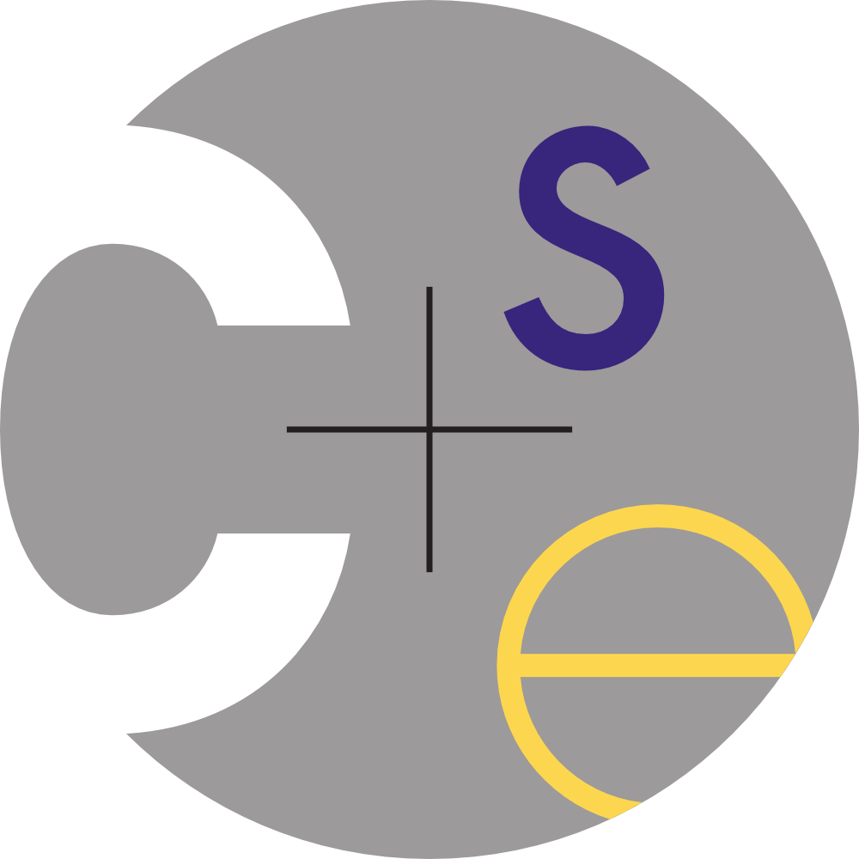
CSE 341 : Programming Languages Section 5 Haskell: Round 3
Autumn 2015

Slide 2
Octopus Interpreter... Due Tomorrow!
It’s really okay to use late days on this one!
Any pressing questions?
Office hours remaining:
Justin Adsuara (justbads at cs)
Section AC: Thurs 2:30pm-3:20pm SAV 130
Office Hours: Thurs 3:30-4:20, CSE 002

Slide 3
Reminder: Monads
class Monad m where (>>=) :: m a -> (a -> m b) -> m b (>>) :: m a -> m b -> m b return :: a -> m a fail :: String -> m a
Remember these!
Monads do all sorts of things in Haskell.
We’ve seen some IO, but there’s also
[random, graphics, HTTP ..]

Slide 4
Some dos and don’ts
Let’s convert!
printsqrt2 = do
putStr "the square root of 2 is "
putStrLn (show (sqrt 2))
calcsqrt = do
x <- readLn
putStrLn "finding the square root of x"
putStrLn (show (sqrt x))

Slide 5
Some dos and don’ts
Let’s convert!
printsqrt2 = do
putStr "the square root of 2 is "
putStrLn (show (sqrt 2))
printsqrt2 =
putStr "the square root of 2 is " >>
putStrLn (show (sqrt 2))

Slide 6
Some dos and don’ts
Let’s convert!
calcsqrt = do
x <- readLn
putStrLn "finding the square root of x"
putStrLn (show (sqrt x))
calcsqrt =
readLn >>= \x -> putStrLn
"finding the square root of x" >>
putStrLn (show (sqrt x))
Questions?

Slide 7
Let’s Keep Things in Scope!
What does this print?
x = 10
xs = map (x+) [1..]
printout (x:xs) = putStrLn $ show x
dostuff (x:xs) = do
putStrLn $ show x
printout xs
dostuff xs

Slide 8
Let’s Keep Things in Scope!
What does this print?
x = 10
xs = map (x+) [1..]
printout (x:xs) = putStrLn $ show x
dostuff (x:xs) = do
putStrLn $ show x
printout xs
dostuff xs
11
12

Slide 9
Seriously, Let’s Keep Things in Scope!
How about if Haskell were dynamically scoped?
x = 10
xs = map (x+) [1..]
printout (x:xs) = putStrLn $ show x
dostuff (x:xs) = do
putStrLn $ show x
printout xs
dostuff xs

Slide 10
Seriously, Let’s Keep Things in Scope!
How about if Haskell were dynamically scoped?
x = 10
xs = map (x+) [1..]
printout (x:xs) = putStrLn $ show x
dostuff (x:xs) = do
putStrLn $ show x
printout xs
dostuff xs
11
13

Slide 11
Seriously, Let’s Keep Things in Scope!
How about if Haskell were dynamically scoped?
x = 10
xs = map (x+) [1..]
printout (x:xs) = putStrLn $ show x
dostuff (x:xs) = do
putStrLn $ show x
printout xs
dostuff xs
11
13

Slide 12
Seriously, Let’s Keep Things in Scope!
How about if Haskell were dynamically scoped?
x = 10
xs = map (x+) [1..]
printout (x:xs) = putStrLn $ show x
dostuff (x:xs) = do
putStrLn $ show x
printout xs
dostuff xs
Or maybe it would hang...

Slide 13
Seriously, Let’s Keep Things in Scope!
How about if Haskell were dynamically scoped?
x = 10
xs = map (x+) [1..]
printout (x:xs) = putStrLn $ show x
dostuff (x:xs) = do
putStrLn $ show x
printout xs
dostuff xs
Or,
um...

Slide 14
Seriously, Let’s Keep Things in Scope!
How about if Haskell were dynamically scoped?
x = 10
xs = map (x+) [1..]
printout (x:xs) = putStrLn $ show x
dostuff (x:xs) = do
putStrLn $ show x
printout xs
dostuff xs
Yeah, this doesn’t really work with lazy evaluation.

Slide 15
Speaking of Lazy Evaluation...
Define a list containing all integers.
1. As a non-recursive data structure
2. As a recursive data structure

Slide 16
Speaking of Lazy Evaluation...
Define a list containing all integers.
1. As a non-recursive data structure
nonzeroints = 0:foldr1 (++)
[[x,(-x)] | x <- [1..]]
2. As a recursive data structure

Slide 17
Speaking of Lazy Evaluation...
Define a list containing all integers.
1. As a non-recursive data structure
nonzeroints = 0:foldr1 (++)
[[x,(-x)] | x <- [1..]]
2. As a recursive data structure
nonzeroints = 0 : map
(\x -> if (x > 0)
then (-x)
else (1 - x)) nonzeroints

Slide 18
Any Haskell/Octopus questions?
Tomorrow we start Prolog!

