Slide 1
CSE 341 Section 4
Ethan Shea
Autumn 2017
With thanks to Nick Mooney, Spencer Pearson & Alexander Lent

Slide 2
Today’s Agenda
Mutual Recursion
Module System Example
Namespace Organization
Preserving Invariants
Practice with Currying and High Order Functions

Slide 3
Mutual Recursion
What if we need function f to call g, and function g to call f?
This is a common idiom
fun earlier x =
...
later x
...
fun later x =
...
earlier x
...
Unfortunately this does not work ☹

Slide 4
Mutual Recursion Workaround
We can use higher order functions to get this working
It works, but there has got to be a better way!
fun earlier f x =
...
f x
...
fun later x =
...
earlier later x
...
Notes:
We know “earlier” will want to recurse on another function, but at the time of definition, we don’t know what function this will be
We can “solve” this by allowing it to take a function at runtime
But remember when I told you that “and” meant something else and to ignore it…?
(We can’t easily do this with both taking a function, because we have to do what’s known as “tying the knot”.)

Slide 5
Mutual Recursion with and
SML has a keyword for that
Works with mutually recursive datatype bindings too
fun earlier x =
...
later x
...
and later x =
...
earlier x
...

Slide 6
Module System
Good for organizing code, and managing namespaces (useful, relevant)
Good for maintaining invariants (interesting)
Good for data hiding (useful)

Slide 7
Interesting Examples of Invariants
Ordering of operations
e.g. insert, then query
Data kept in good state
e.g. fractions in lowest terms
Policies followed
e.g. don't allow shipping request without purchase order
Notes:
We’ll see more on this in class.

Slide 8
Currying and High Order Functions
Some examples:
List.map
List.filter
List.foldl

Slide 9
Currying
fun plus x y = x + y
fun plus x =
fn y => x + y
plus : int -> (int -> int)
plus : int -> int -> int
plus 5

Slide 10
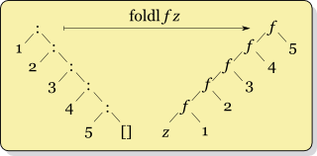
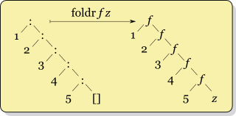
Foldr vs Foldl
List.foldl (fn (x, acc) => x+acc) 0 xs
List.foldr (fn (x, acc) => x+acc) 0 xs
0 [1, 2, 3, 4, 5]
[1, 2, 3, 4, 5] 0

