Slide 1
CSE373: Data Structures & Algorithms Lecture 10: Disjoint Sets and the Union-Find ADT
Linda Shapiro
Winter 2015

Slide 2
Announcements
HW03 due Monday Tuesday

Slide 3
Where we are
Last lecture:
Priority queues and binary heaps
Today:
Disjoint sets
The union-find ADT for disjoint sets

Slide 4
http://thesportsquotient.com/media/posts/7096/russell-wilson_3.jpg

Slide 5
Disjoint sets
A set is a collection of elements (no-repeats)
In computer science, two sets are said to be disjoint if they have no element in common.
S₁ ∩ S₂ = ∅
For example, {1, 2, 3} and {4, 5, 6} are disjoint sets.
For example, {x, y, z} and {t, u, x} are not disjoint.

Slide 6
Partitions
A partition P of a set S is a set of sets {S1,S2,…,Sn} such that every element of S is in exactly one Si
Formally:
S₁ ∪ S₂ ∪ . . . ∪ S_{k} = S
i ≠ j implies S_{i} ∩ S_{j} = ∅ (sets are disjoint with each other)
Example:
Let S be {a,b,c,d,e}
One partition: {a}, {d,e}, {b,c}
Another partition: {a,b,c}, ∅, {d}, {e}
A third: {a,b,c,d,e}
Not a partition: {a,b,d}, {c,d,e} …. element d appears twice
Not a partition of S: {a,b}, {e,c} …. missing element d

Slide 7
Binary relations
S x S is the set of all pairs of elements of S (Cartesian product)
Example: If S = {a,b,c}
then S x S = {(a,a),(a,b),(a,c),(b,a),(b,b),(b,c), (c,a),(c,b),(c,c)}
A binary relation R on a set S is any subset of S x S
i.e. a collection of ordered pairs of elements of S.
Write R(x,y) to mean (x,y) is “in the relation”
(Unary, ternary, quaternary, … relations defined similarly)
Examples for S = people-in-this-room
Sitting-next-to-each-other relation
First-sitting-right-of-second relation
Went-to-same-high-school relation
First-is-younger-than-second relation

Slide 8
Properties of binary relations
A relation R over set S is reflexive means R(a,a) for all a in S
e.g. The relation “<=“ on the set of integers {1, 2, 3} is
{<1, 1>, <1, 2>, <1, 3>, <2, 2>, <2, 3>, <3, 3>}
It is reflexive because <1, 1>, <2, 2>, <3, 3> are in this relation.
A relation R on a set S is symmetric if and only if for any a and b in S, whenever <a, b> is in R , <b, a> is in R .
e.g. The relation “=“ on the set of integers {1, 2, 3} is
{<1, 1> , <2, 2> <3, 3> } and it is symmetric.
The relation "being acquainted with" on a set of people is symmetric.
A binary relation R over set S is transitive means:
If R(a,b) and R(b,c) then R(a,c) for all a,b,c in S
e.g. The relation “<=“ on the set of integers {1, 2, 3} is transitive, because for <1, 2> and <2, 3> in “<=“, <1, 3> is also in “<=“ (and similarly for the others)

Slide 9
Equivalence relations
A binary relation R is an equivalence relation if R is
reflexive, symmetric, and transitive
Examples
Same gender
Connected roads in the world
"Is equal to" on the set of real numbers
"Has the same birthday as" on the set of all people
…

Slide 10
Punch-line
Equivalence relations give rise to partitions.
Every partition induces an equivalence relation
Every equivalence relation induces a partition
Suppose P={S1,S2,…,Sn} is a partition
Define R(x,y) to mean x and y are in the same Si
R is an equivalence relation
Suppose R is an equivalence relation over S
Consider a set of sets S1,S2,…,Sn where
(1) x and y are in the same Si if and only if R(x,y)
(2) Every x is in some Si
This set of sets is a partition

Slide 11
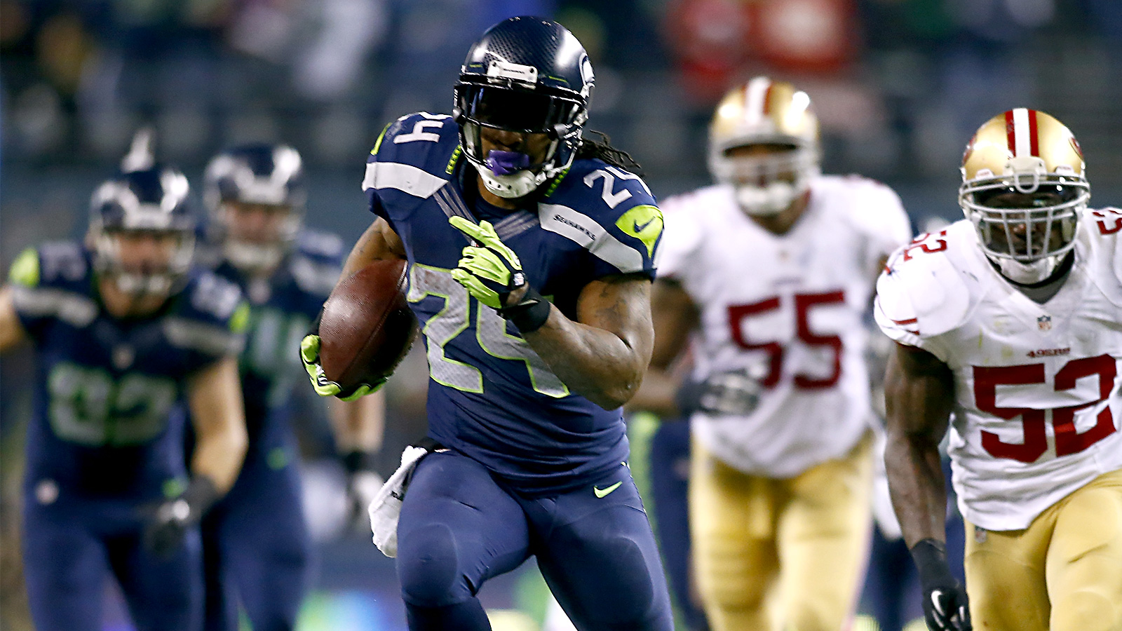
http://www.foxsports.com/content/dam/fsdigital/fscom/nfl/images/2014/01/19/011914-NFL-seahawks-marshawn-lynch-runs-for-touchdown-ahn-PI.jpg

Slide 12
Example
Let S be {a,b,c,d,e}
One partition: {a,b,c}, {d}, {e}
The corresponding equivalence relation:
(a,a), (b,b), (c,c), (a,b), (b,a), (a,c), (c,a), (b,c), (c,b), (d,d), (e,e)

Slide 13
The Union-Find ADT
The union-find ADT (or "Disjoint Sets" or "Dynamic Equivalence Relation") keeps track of a set of elements partitioned into a number of disjoint subsets.
Many uses (which is why an ADT taught in CSE 373):
Road/network/graph connectivity (will see this again)
“connected components” e.g., in social network
Partition an image by connected-pixels-of-similar-color
Type inference in programming languages
Not as common as dictionaries, queues, and stacks, but valuable because implementations are very fast, so when applicable can provide big improvements

Slide 14
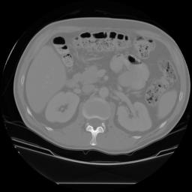
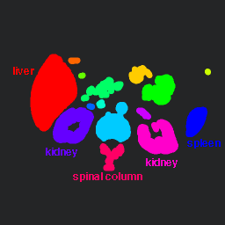
Labeling shown as Pseudo-Color
connected
components
of 1’s from
thresholded
image
connected
components
of cluster
labels

Slide 15
Union-Find Operations
Given an unchanging set S, create an initial partition of a set
Typically each item in its own subset: {a}, {b}, {c}, …
Give each subset a “name” by choosing a representative element
Operation find takes an element of S and returns the representative element of the subset it is in
Operation union takes two subsets and (permanently) makes one larger subset
A different partition with one fewer set
Affects result of subsequent find operations
Choice of representative element up to implementation

Slide 16
Example
Let S = {1,2,3,4,5,6,7,8,9}
Let initial partition be (will highlight representative elements red)
{1}, {2}, {3}, {4}, {5}, {6}, {7}, {8}, {9}
union(2,5):
{1}, {2, 5}, {3}, {4}, {6}, {7}, {8}, {9}
find(4) = 4, find(2) = 2, find(5) = 2
union(4,6), union(2,7)
{1}, {2, 5, 7}, {3}, {4, 6}, {8}, {9}
find(4) = 6, find(2) = 2, find(5) = 2
union(2,6)
{1}, {2, 4, 5, 6, 7}, {3}, {8}, {9}

Slide 17
No other operations
All that can “happen” is sets get unioned
No “un-union” or “create new set” or …
As always: trade-offs
– Implementations will exploit this small ADT
Surprisingly useful ADT
But not as common as dictionaries or priority queues

Slide 18
http://www.psemanagement.com/news/article/seahawks_get_big_day_from_jermaine_kearse

Slide 19
Example application: maze-building
Build a random maze by erasing edges
Possible to get from anywhere to anywhere
Including “start” to “finish”
No loops possible without backtracking
After a “bad turn” have to “undo”

Slide 20
Maze building
Pick start edge and end edge
Start
End

Slide 21
Repeatedly pick random edges to delete
One approach: just keep deleting random edges until you can get from start to finish
Start
End

Slide 22
Problems with this approach
How can you tell when there is a path from start to finish?
We do not really have an algorithm yet
We could have cycles, which a “good” maze avoids
Want one solution and no cycles
Start
End

Slide 23
Revised approach
Consider edges in random order (i.e. pick an edge)
Only delete an edge if it introduces no cycles (how? TBD)
When done, we will have a way to get from any place to any other place (including from start to end points)
Start
End

Slide 24
Cells and edges
Let’s number each cell
36 total for 6 x 6
An (internal) edge (x,y) is the line between cells x and y
60 total for 6x6: (1,2), (2,3), …, (1,7), (2,8), …
Start
1
2
3
4
5
6
7
8
9
10
11
12
13
14
15
16
17
18
19
20
21
22
23
24
25
26
27
28
29
30
31
32
33
34
35
36
End

Slide 25
The trick
Partition the cells into disjoint sets
Two cells in same set if they are “connected”
Initially every cell is in its own subset
If removing an edge would connect two different subsets:
then remove the edge and union the subsets
else leave the edge because removing it makes a cycle
Start
1
2
3
4
5
6
Start
1
2
3
4
5
6
7
8
9
10
11
12
7
8
9
10
11
12
13
14
15
16
17
18
13
14
15
16
17
18
19
20
21
22
23
24
19
20
21
22
23
24
25
26
27
28
29
30
25
26
27
28
29
30
31
32
33
34
35
36
End
31
32
33
34
35
36
End

Slide 26
The algorithm
P = disjoint sets of connected cells
initially each cell in its own 1-element set
E = set of edges not yet processed, initially all (internal) edges
M = set of edges kept in maze (initially empty)
while P has more than one set {
Pick a random edge (x,y) to remove from E
u = find(x)
v = find(y)
if u==v
add (x,y) to M // same subset, do not remove edge, do not create cycle
else
union(u,v) // connect subsets, do not put edge in M
}
Add remaining members of E to M, then output M as the maze

Slide 27
Example at some step
P
{1,2,7,8,9,13,19}
{3}
{4}
{5}
{6}
{10}
{11,17}
{12}
{14,20,26,27}
{15,16,21}
{18}
{25}
{28}
{31}
{22,23,24,29,30,32
33,34,35,36}
Pick edge (8,14)
Start
1
2
3
4
5
6
7
8
9
10
11
12
13
14
15
16
17
18
19
20
21
22
23
24
25
26
27
28
29
30
31
32
33
34
35
36
End

Slide 28
Example
P
{1,2,7,8,9,13,19}
{3}
{4}
{5}
{6}
{10}
{11,17}
{12}
{14,20,26,27}
{15,16,21}
{18}
{25}
{28}
{31}
{22,23,24,29,30,32,33,34,35,36}
P
{1,2,7,8,9,13,19,14,20,26,27}
{3}
{4}
{5}
{6}
{10}
{11,17}
{12}
{15,16,21}
{18}
{25}
{28}
{31}
{22,23,24,29,30,32,33,34,35,36}
Find(8) = 7
Find(14) = 20
Union(7,20)

Slide 29
Example: Add edge to M step
P
{1,2,7,8,9,13,19,14,20,26,27}
{3}
{4}
{5}
{6}
{10}
{11,17}
{12}
{15,16,21}
{18}
{25}
{28}
{31}
{22,23,24,29,30,32
33,34,35,36}
Pick edge (19,20)
Find (19) = 7
Find (20) = 7
Add (19,20) to M
Start
1
2
3
4
5
6
7
8
9
10
11
12
13
14
15
16
17
18
19
20
21
22
23
24
25
26
27
28
29
30
31
32
33
34
35
36
End

Slide 30
At the end
Stop when P has one set (i.e. all cells connected)
Suppose green edges are already in M and black edges were not yet picked
Add all black edges to M
P
{1,2,3,4,5,6,7,… 36}
Start
1
2
3
4
5
6
7
8
9
10
11
12
13
14
15
16
17
18
19
20
21
22
23
24
25
26
27
28
29
30
31
32
33
34
35
36
End
Done! ☺

Slide 31
A data structure for the union-find ADT
Start with an initial partition of n subsets
Often 1-element sets, e.g., {1}, {2}, {3}, …, {n}
May have any number of find operations
May have up to n-1 union operations in any order
After n-1 union operations, every find returns same 1 set

Slide 32
Teaser: the up-tree data structure
Tree structure with:
No limit on branching factor
References from children to parent
Start with forest of 1-node trees
Possible forest after several unions:
Will use roots for
set names
1
2
3
4
5
6
7
1
3
7
2
5
4
6

Slide 33
http://x.pac-12.com/sites/default/files/styles/homepage_featured/public/JPWWXAUEMJLFWRP.20131223055806_0.jpg?itok=yHRXZ_jc

