Slide 1
CSE373: Data Structures & Algorithms Lecture 16: Introduction to Graphs
Linda Shapiro
Winter 2015

Slide 2
Announcements
HW03 all graded, posted, regarded on some due to the AVL no-credit problem. Email Evan if any more problems.
HW04 all graded and entered.
HW05 posted, announced, due Monday March 2
There will be one more assignment with problems
to work, one of which will involve a small program.

Slide 3
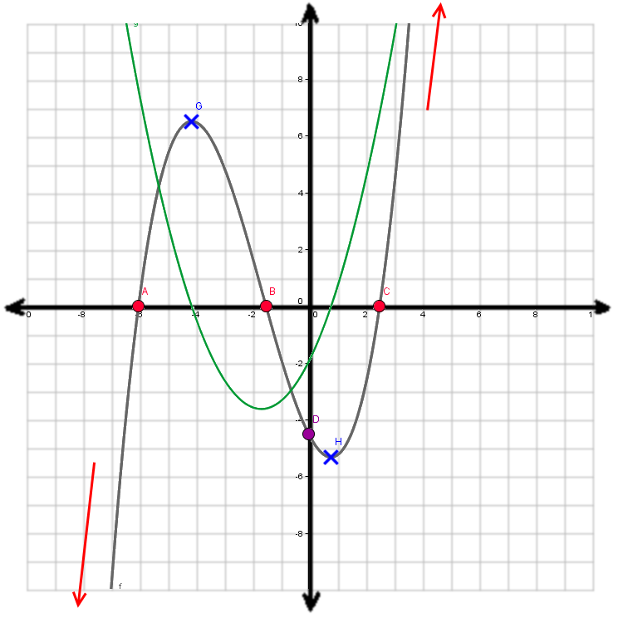
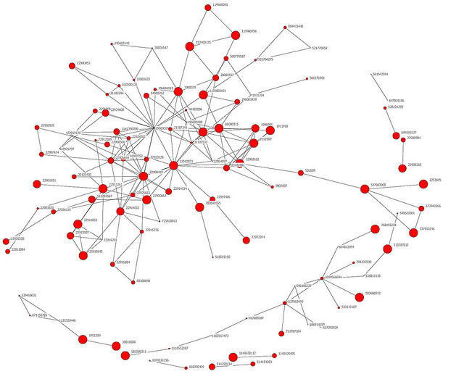
What is a Graph?
Which kind of graph are we going to study?

Slide 4
Graphs: the mathematical definition
A graph is a formalism for representing relationships among items
Very general definition because very general concept
A graph is a pair
G = (V,E)
A set of vertices, also known as nodes
V = {v₁,v₂,…,v_{n}}
A set of edges
E = {e₁,e₂,…,e_{m}}
Each edge e_{i} is a pair of vertices
(v_{j},v_{k})
An edge “connects” the vertices
Graphs can be directed or undirected
Han
Luke
Leia
V = {Han,Leia,Luke}
E = {(Luke,Leia),
(Han,Leia),
(Leia,Han)}

Slide 5
Undirected Graphs
In undirected graphs, edges have no specific direction
Edges are always “two-way”
D
A
C
B
Thus, (u,v) ∈ E implies (v,u) ∈ E (What do we call this property?)
Only one of these edges needs to be in the set
The other is implicit, so normalize how you check for it
Degree of a vertex: number of edges containing that vertex
Put another way: the number of adjacent vertices

Slide 6
Directed Graphs
In directed graphs (sometimes called digraphs), edges have a direction
D
A
C
A
or
C
2 edges here
B
B
Thus, (u,v) ∈ E does not imply (v,u) ∈ E.
Let (u,v) ∈ E mean u → v
Call u the source and v the destination
In-degree of a vertex: number of in-bound edges, i.e., edges where the vertex is the destination
Out-degree of a vertex: number of out-bound edges i.e., edges where the vertex is the source

Slide 7
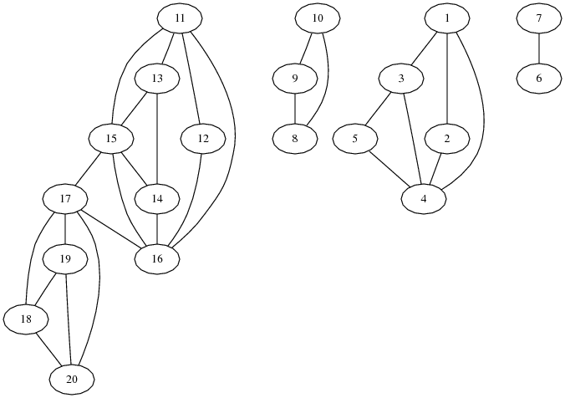
Self-Edges, Connectedness
A self-edge a.k.a. a loop is an edge of the form (u,u)
Depending on the use/algorithm, a graph may have:
No self edges
Some self edges
All self edges (often therefore implicit, but we will be explicit)
A node can have a degree / in-degree / out-degree of zero
A graph does not have to be connected
Even if every node has non-zero degree

Slide 8
More notation
D
V = {A, B, C, D}
E = {(C, B),
(A, B),
(B, A)
(C, D)}
A
C
B
For a graph G = (V,E):
|V| is the number of vertices
|E| is the number of edges
Minimum?
Maximum for undirected?
Maximum for directed?
If (u,v) ∈ E
Then v is a neighbor of u, i.e., v is adjacent to u
Order matters for directed edges
u is not adjacent to v unless (v,u) ∈ E
0
|V||V+1|/2 ∈ O(|V|²)
|V|² ∈ O(|V|²)
(assuming self-edges allowed, else subtract |V|)
v u

Slide 9
Examples
Which would use directed edges? Which would have self-edges? Which would be connected? Which could have 0-degree nodes?
Web pages with links
Facebook friends
Methods in a program that call each other
Road maps (e.g., Google maps)
Airline routes
Family trees
Course pre-requisites

Slide 10
Weighted Graphs
In a weighed graph, each edge has a weight a.k.a. cost
Typically numeric (most examples use ints)
Orthogonal to whether graph is directed
Some graphs allow negative weights; many do not
Clinton
20
Mukilteo
Kingston
30
Edmonds
Bainbridge
35
Seattle
60
Bremerton

Slide 11
Examples
What, if anything, might weights represent for each of these?
Do negative weights make sense?
Web pages with links
Facebook friends
Methods in a program that call each other
Road maps (e.g., Google maps)
Airline routes
Family trees
Course pre-requisites

Slide 12
Paths and Cycles
A path is a list of vertices [v₀,v₁,…,v_{n}] such that (v_{i},v_{i+1})∈ E for all 0 ≤ i < n. Say “a path from v₀ to v_{n}”
A cycle is a path that begins and ends at the same node (v₀==v_{n})
Chicago
Seattle
Salt Lake City
San Francisco
Dallas
Example: [Seattle, Salt Lake City, Chicago, Dallas, San Francisco, Seattle]

Slide 13
Path Length and Cost
Path length: Number of edges in a path
Path cost: Sum of weights of edges in a path
Example where P= [Seattle, Salt Lake City, Chicago, Dallas, San Francisco, Seattle]
3.5
Chicago
Seattle
2
2
length(P) =
cost(P) =
2
Salt Lake City
5
2.5
11.5
2.5
2.5
3
San Francisco
Dallas

Slide 14
Simple Paths and Cycles
A simple path repeats no vertices, except the first might be the last [Seattle, Salt Lake City, San Francisco, Dallas] [Seattle, Salt Lake City, San Francisco, Dallas, Seattle]
Recall, a cycle is a path that ends where it begins [Seattle, Salt Lake City, San Francisco, Dallas, Seattle] [Seattle, Salt Lake City, Seattle, Dallas, Seattle]
A simple cycle is both a cycle and a simple path [Seattle, Salt Lake City, San Francisco, Dallas, Seattle]

Slide 15
Paths and Cycles in Directed Graphs
Example:
Is there a path from A to D?
Does the graph contain any cycles?
D
A
C
B
No
No

Slide 16
Undirected-Graph Connectivity
An undirected graph is connected if for all pairs of vertices u,v, there exists a path from u to v
An undirected graph is complete, a.k.a. fully connected if for all pairs of vertices u,v, there exists an edge from u to v
Connected graph
Disconnected graph
plus self edges

Slide 17
Directed-Graph Connectivity
A directed graph is strongly connected if there is a path from every vertex to every other vertex
A directed graph is weakly connected if there is a path from every vertex to every other vertex ignoring direction of edges
A complete a.k.a. fully connected directed graph has an edge from every vertex to every other vertex
plus self edges

Slide 18
Trees as Graphs
When talking about graphs,
we say a tree is a graph that is:
Undirected
Acyclic
Connected
So all trees are graphs, but not all graphs are trees

Slide 19
Rooted Trees
We are more accustomed to rooted trees where:
We identify a unique root
We think of edges as directed: parent to children
Given a tree, picking a root gives a unique rooted tree
The tree is just drawn differently
D
E
B
A
redrawn
A
B
C
C
D
E
F
F
G
H
G
H

Slide 20
Rooted Trees
We are more accustomed to rooted trees where:
We identify a unique root
We think of edges as directed: parent to children
Given a tree, picking a root gives a unique rooted tree
The tree is just drawn differently
D
E
F
B
redrawn
G
H
C
A
A
C
B
F
D
E
G
H

Slide 21
Directed Acyclic Graphs (DAGs)
A DAG is a directed graph with no (directed) cycles
Every rooted directed tree is a DAG
But not every DAG is a rooted directed tree
Every DAG is a directed graph
But not every directed graph is a DAG

Slide 22
Examples
Which of our directed-graph examples do you expect to be a DAG?
Web pages with links
Methods in a program that call each other
Airline routes
Family trees
Course pre-requisites

Slide 23
Density / Sparsity
Let E be the set of edges and V the set of vertices.
Then 0 ≤ |E| ≤ |V|²
And |E| is O(|V|²)
Because |E| is often much smaller than its maximum size, we do not always approximate |E| as O(|V|²)
This is a correct bound, it just is often not tight
If it is tight, i.e., |E| is Θ(|V|²) we say the graph is dense
More sloppily, dense means “lots of edges”
If |E| is O(|V|) we say the graph is sparse
More sloppily, sparse means “most possible edges missing”

Slide 24
What is the Data Structure?
So graphs are really useful for lots of data and questions
For example, “what’s the lowest-cost path from x to y”
But we need a data structure that represents graphs
The “best one” can depend on:
Properties of the graph (e.g., dense versus sparse)
The common queries (e.g., “is (u,v) an edge?” versus “what are the neighbors of node u?”)
So we’ll discuss the two standard graph representations
Adjacency Matrix and Adjacency List
Different trade-offs, particularly time versus space

Slide 25
Adjacency Matrix
Assign each node a number from 0 to |V|-1
A |V| x |V| matrix (i.e., 2-D array) of Booleans (or 1 vs. 0)
If M is the matrix, then M[u][v] being true means there is an edge from u to v
0
1
2
3
D(3)
0
F
T
F
F
A(0)
C(2)
1
T
F
F
F
B(1)
2
F
T
F
T
3
F
F
F
F

Slide 26
Adjacency Matrix Properties
0
1
2
3
0
F
T
F
F
Running time to:
Get a vertex’s out-edges:
Get a vertex’s in-edges:
Decide if some edge exists:
Insert an edge:
Delete an edge:
Space requirements:
|V|² bits
Best for sparse or dense graphs?
Best for dense graphs
O(|V|)
1
T
F
F
F
O(|V|)
O(1)
2
F
T
F
T
O(1)
3
F
F
F
F
O(1)

Slide 27
Adjacency Matrix Properties
How will the adjacency matrix vary for an undirected graph?
Undirected will be symmetric around the diagonal
How can we adapt the representation for weighted graphs?
Instead of a Boolean, store a number in each cell
Need some value to represent ‘not an edge’
In some situations, 0 or -1 works

Slide 28
Adjacency List
Assign each node a number from 0 to |V|-1
An array of length |V| in which each entry stores a list of all adjacent vertices (e.g., linked list)
D(3)
0
1
/
A(0)
C(2)
1
0
/
B(1)
2
3
1
/
3
/

Slide 29
Adjacency List Properties
0
1
/
1
0
/
Running time to:
Get all of a vertex’s out-edges:
O(d) where d is out-degree of vertex
Get all of a vertex’s in-edges:
O(|E|) (but could keep a second adjacency list for this!)
Decide if some edge exists:
O(d) where d is out-degree of source
Insert an edge:
O(1) (unless you need to check if it’s there)
Delete an edge:
O(d) where d is out-degree of source
Space requirements:
O(|V|+|E|)
2
3
1
/
3
/
Good for sparse graphs

Slide 30
Next…
Okay, we can represent graphs
Next lecture we’ll implement some useful and non-trivial algorithms
Topological sort: Given a DAG, order all the vertices so that every vertex comes before all of its neighbors
Shortest paths: Find the shortest or lowest-cost path from x to y
Related: Determine if there even is such a path

