Slide 1
CSE373: Data Structures & Algorithms Lecture 23: Applications
Linda Shapiro
Winter 2015

Slide 2
Announcements
Friday we’ll go over the review list and HW06
Help Sessions will be reviewing the course this week
Final is Tuesday at 2:30
PLEASE FILL OUT THE ONLINE EVALUATIONS

Slide 3
Other Data Structures and Algorithms
Quadtrees: used in spatial applications like geography and image processing
Octrees: used in vision and graphics
Image pyramids: used in image processing and computer vision
Backtracking search: used in AI and vision
Graph matching: used in AI and vision

Slide 4
Quadtrees
Finkel and Bentley, 1974
Lots of work by Hanan Samet, including a book
Raster structure: divides space, not objects
Form of block coding: compact storage of a large 2-dimensional array
Vector versions exist too

Slide 5
Quadtrees, the idea
NW
NE
SW
SE
NW
NE
SW
SE
1, 4, 16, 64, 256 nodes

Slide 6
Quadtrees, the idea
NW
NE
Choropleth raster map
SW
SE
NW
NE
SW
SE

Slide 7
Quadtrees
Represents a grid with 2^{k} times 2^{k} pixels
Depth is k +1
Internal nodes always have 4 children
Internal nodes represent a non-homogeneous region
Leaves represent a homogeneous region and store the common value (or name)

Slide 8
Quadtree complexity theorem
A subdivision with boundary length r pixels in a grid of 2^{k} times 2^{k} gives a quadtree with O(k ⋅ r) nodes.
Idea: two adjacent, different pixels “cost” at most 2 paths in the quadtree.

Slide 9
Overlay with quadtrees
Water
Acid rain with
PH below 4.5

Slide 10
Result of overlay

Slide 11
Various queries
Point location: trivial
Windowing: descend into subtree(s) that intersect query window
Traversal boundary polygon: up and down in the quadtree

Slide 12
Octrees
Like quadtrees, but for 3D applications.
Breaks 3D space into octants
Useful in graphics for representing 3D objects at different resolutions

Slide 15
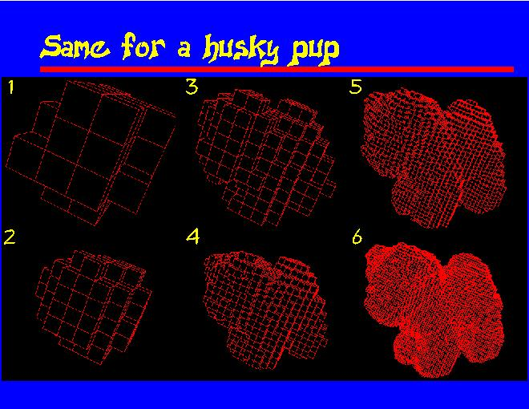

Slide 18
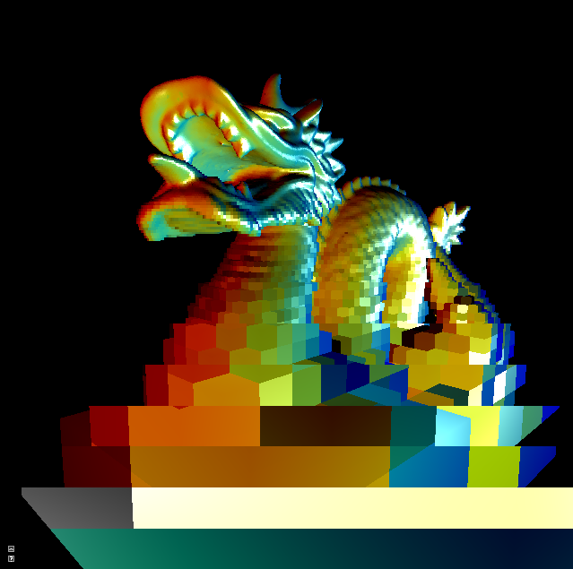
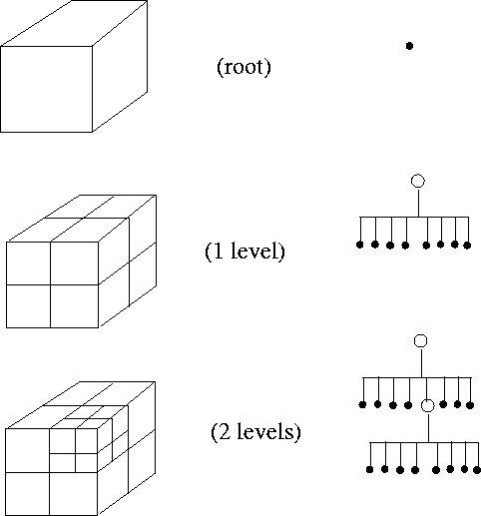

Slide 19
Image Pyramids
And so on.
3rd level is derived from the
2nd level according to the same
funtion
2nd level is derived from the
original image according to
some function
Bottom level is the original image.

Slide 20
Mean Pyramid
And so on.
At 3rd level, each pixel is the mean
of 4 pixels in the 2nd level.
At 2nd level, each pixel is the mean
of 4 pixels in the original image.
mean
Bottom level is the original image.

Slide 21
Gaussian Pyramid At each level, image is smoothed and reduced in size.
And so on.
At 2nd level, each pixel is the result
of applying a Gaussian mask to
the first level and then subsampling
to reduce the size.
Apply Gaussian filter
Bottom level is the original image.
1 2 1
2 4 2
1 2 1
Gaussian mask

Slide 22
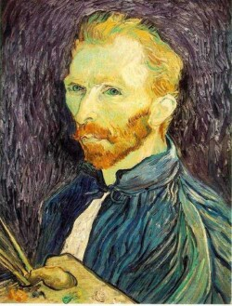
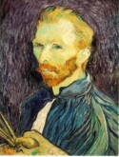
Example: Subsampling with Gaussian pre-filtering
G 1/8
G 1/4
Gaussian 1/2

Slide 23
Backtracking Search in AI/Vision
Start at the root of a search tree at a “state”
Generate children of that state
For each child
If the child is the goal, done
If the child does not satisfy the constraints of the problem, ignore it and keep going in this loop
Else call the search recursively for this child
Return
This is called backtracking, because if it goes through all children of
a node and finds no solution, it returns to the parent and continues
with the children of that parent.

Slide 24
Graph Matching
Input: 2 digraphs G1 = (V1,E1), G2 = (V2,E2)
Questions to ask:
Are G1 and G2 isomorphic?
Is G1 isomorphic to a subgraph of G2?
How similar is G1 to G2?
How similar is G1 to the most similar
subgraph of G2?

Slide 25
Isomorphism for Digraphs
G1 is isomorphic to G2 if there is a 1-1, onto
mapping h: V1 → V2 such that ( vi,vj ) ∈ E1 iff ( h(vi), h(vj) ) ∈ E2.
G1 G2
1
2
a
b
3
c
4
5
d
e
Find an isomorphism h: {1,2,3,4,5} → {a,b,c,d,e}.
Check that the condition holds for every edge.
Answer: h(1)=b, h(2)=e, h(3)=c, h(4)=a, h(5)=d

Slide 26
Isomorphism for Digraphs
G1 is isomorphic to G2 if there is a 1-1, onto
mapping h: V1 → V2 such that ( vi,vj ) ∈ E1 iff ( h(vi), h(vj) ) ∈ E2
G1 G2
1
2
a
b
3
c
4
5
d
e
Answer: h(1)=b, h(2)=e, h(3)=c, h(4)=a, h(5)=d
(1,2) ∈ E1 and (h(1),h(2))=(b,e) ∈ E2.
(2,1) ∈ E1 and (e,b) ∈ E2.
(2,5) ∈ E1 and (e,d) ∈ E2.
(3,1) ∈ E1 and (c,b) ∈ E2.
(3,2) ∈ E1 and (c,e) ∈ E2.
...

Slide 27
Subgraph Isomorphism for Digraphs
G1 is isomorphic to a subgraph of G2 if there
is a 1-1 mapping h: V1 → V2 such that ( vi,vj ) ∈ E1 ⇒ ( h(vi), h(vj) ) ∈ E2.
G1 G2
1
2
a
b
3
c
d
Isomorphism and subgraph isomorphism
are defined similarly for undirected graphs.
In this case, when (vi,vj) ∈ E1, either
(vi,vj) or (vj,vi) can be listed in E2, since
they are equivalent and both mean {vi,vj}.

Slide 28
Subgraph Isomorphism for Graphs
G1 is isomorphic to a subgraph of G2 if there
is a 1-1 mapping h: V1 → V2 such that {vi,vj } ∈ E1 ⇒ { h(vi), h(vj) } ∈ E2.
G1 G2
1
2
a
b
3
c
d
Because there are no directed edges, there are more possible mappings.
2 3
c b d
c d b (shown on graph)
b c d
b d c
d b c
d c b

Slide 29
Graph Matching Algorithms:
Subgraph Isomorphism for Digraph
Given model graph M = (VM,EM)
data graph D = (VD,ED)
Find 1-1 mapping h:VM → VD
satisfying (vi,vj) ∈ EM ⇒ ((h(vi),h(vj)) ∈ ED.

Slide 30
Method: Recursive Backtracking Tree Search
(Order is depth first, leftmost child first.)
M
D
1
2
a
b
c
3
e
d
(1,2) ∈ M, but (a,b) ∈ D
root
1,a
1,b
1,c
1,d
1,e
. . .
. . .
. . .
2,b
2,c
. . .
2,a
2,c
X
X
3,c
3,d
3,e
3,a
3,d
X
X
X
X
YES!

Slide 31
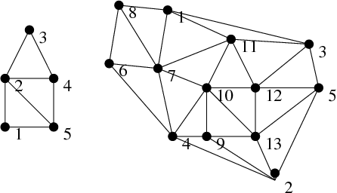
Application to Computer Vision
Find the house model in the image graph.

Slide 32
More Examples

Slide 33
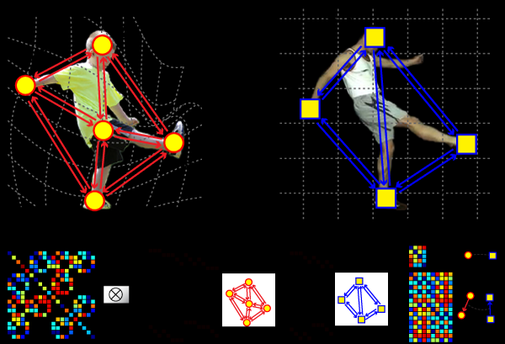

Slide 34
RIO: Relational Indexing for Object Recognition
RIO worked with industrial parts that could have
- planar surfaces
- cylindrical surfaces
- threads

Slide 35
Object Representation in RIO
3D objects are represented by a 3D mesh and set of
2D view classes.
Each view class is represented by an attributed graph
whose nodes are features and whose attributed
edges are relationships.
Graph matching is done through an indexing method,
not covered here.

Slide 36
RIO Features
ellipses coaxials coaxials-multi
parallel lines junctions triples
close and far L V Y Z U

Slide 37
RIO Relationships
share one arc
share one line
share two lines
coaxial
close at extremal points
bounding box encloses / enclosed by

Slide 38
Graph Representation
1 coaxials-
multi
encloses
This is just a piece of
the whole graph.
encloses
2 ellipse
encloses
3 parallel
lines
coaxial

Slide 39
Sample Alignments 3D to 2D Perspective Projection

Slide 40
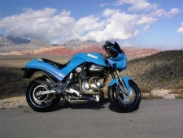
Fergus Object Recognition by Parts:
Enable Computers to Recognize Different Categories of Objects in Images.

Slide 41
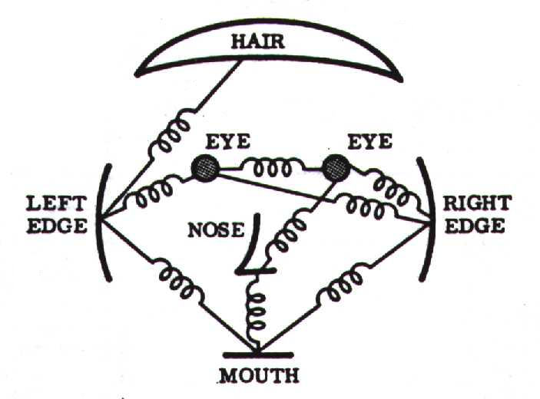
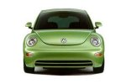
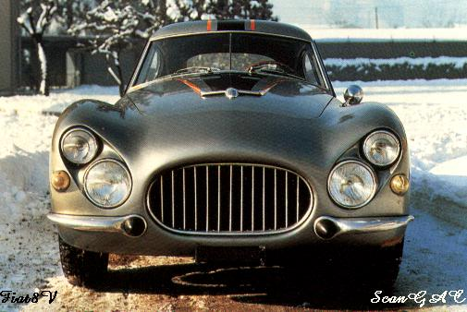
Model: Constellation Of Parts
Fischler & Elschlager, 1973

Slide 42
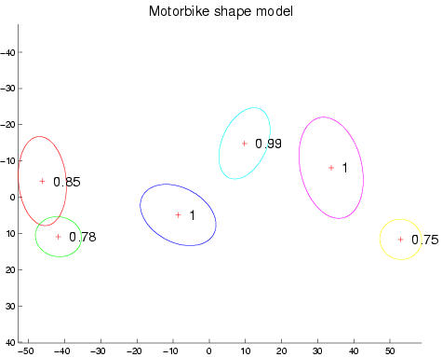
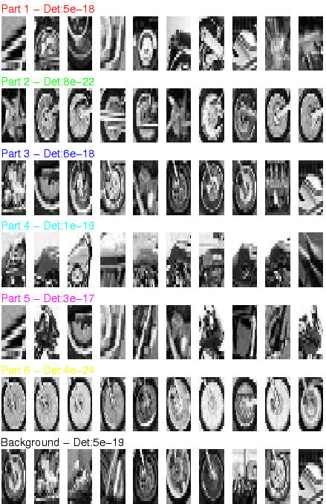
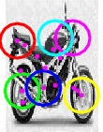
Motorbikes

