Slide 1
CSE373: Data Structures and Algorithms Lecture 3: Math Review; Algorithm Analysis
Linda Shapiro
Winter 2015

Slide 2
Today
Registration should be done.
Homework 1 due 11:59 pm next Wednesday, January 14
ArrayQueueTest has been replaced in the zip file.
to algorithm analysis
Proof Review math essential by induction (review example)
Exponents and logarithms
Floor and ceiling functions
Begin algorithm analysis

Slide 3
Mathematical induction
Suppose P(n) is some statement (mentioning integer n)
Example: n ≥ n/2 + 1
We can use induction to prove P(n) for all integers n ≥ n₀.
We need to
Prove the “base case” i.e. P(n₀). For us n₀ is usually 1.
Assume the statement holds for P(k).
Prove the “inductive case” i.e. if P(k) is true, then P(k+1) is true.
Why we care:
To show an algorithm is correct or has a certain running time
no matter how big a data structure or input value is
(Our “n” will be the data structure or input size.)

Slide 4
Review Example
P(n) = “the sum of the first n powers of 2 (starting at 2⁰) is 2^{n}-1”
2⁰ + 2¹ + 2² + … + 2^{n-1} = 2^{n} - 1.
in other words: 1 + 2 + 4 + … + 2^{n-1} = 2^{n} - 1.

Slide 5
Review Example
P(n) = “the sum of the first n powers of 2 (starting at 2⁰) is 2^{n}-1”
We will show that P(n) holds for all n ≥ 1
Proof: By induction on n
Base case: n=1. Sum of first 1 power of 2 is 2⁰ , which equals 1.
And for n=1, 2^{n}-1 equals 1.

Slide 6
Review Example
P(n) = “the sum of the first n powers of 2 (starting at 2⁰) is 2^{n}-1”
Inductive case:
Assume P(k) is true i.e. the sum of the first k powers of 2 is 2^{k}-1
Show P(k+1) is true i.e. the sum of the first (k+1) powers of 2 is 2^{k+1}-1
Using our assumption, we know the first k powers of 2 is
2⁰ + 2¹ + 2² + … + 2^{k-1} = 2^{k} - 1
Add the next power of 2 to both sides…
2⁰ + 2¹ + 2² + … + 2^{k-1} + 2^{k} = 2^{k} - 1 + 2^{k}
We have what we want on the left; massage the right a bit:
2⁰ + 2¹ + 2² + … + 2^{k-1} + 2^{k} = 2(2^{k}) – 1
= 2^{k+1} – 1
Success!

Slide 7
Mathematical Preliminaries
The following N slides contain basic mathematics needed for analyzing algorithms.
You should actually know this stuff.
Hang in there!

Slide 8
Logarithms and Exponents
Definition: x = 2^{y} if log₂ x = y
8 = 2³, so log₂ 8 = 3
65536= 2¹⁶, so log₂ 65536 = 16
The exponent of a number says how many times to use the number in a multiplication. e.g. 2³ = 2 × 2 × 2 = 8
(2 is used 3 times in a multiplication to get 8)
A logarithm says how many of one number to multiply to get another number. It asks "what exponent produced this?”
e.g. log₂8 = 3 (2 makes 8 when used 3 times in a multiplication)

Slide 9
Logarithms and Exponents
Definition: x = 2^{y} if log₂ x = y
8 = 2³, so log₂ 8 = 3
65536= 2¹⁶, so log₂ 65536 = 16
Since so much is binary in CS, log almost always means log₂
log₂ n tells you how many bits needed to represent n combinations.
So, log₂ 1,000,000 = “a little under 20”
Logarithms and exponents are inverse functions. Just as exponents grow very quickly, logarithms grow very slowly.

Slide 10
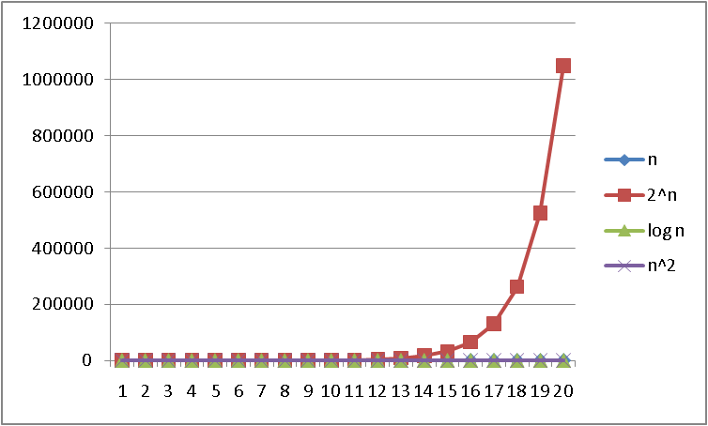
Logarithms and Exponents
n

Slide 11
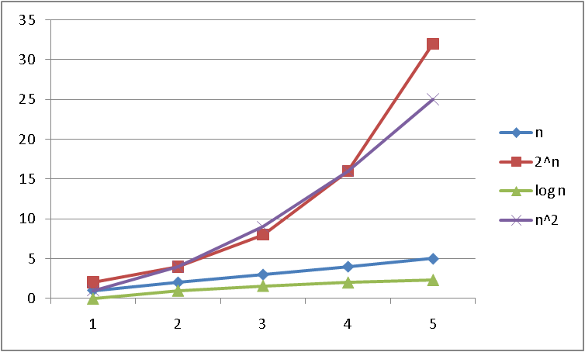
Logarithms and Exponents
n

Slide 12
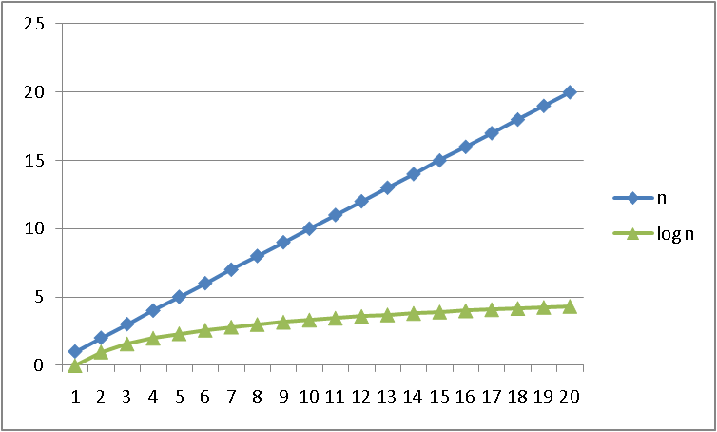
Logarithms and Exponents
n

Slide 13
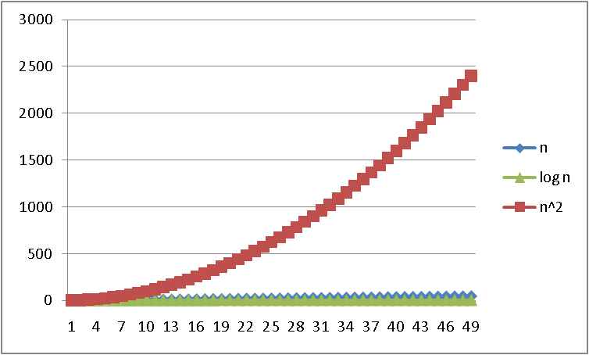
Logarithms and Exponents
n

Slide 14
Properties of logarithms
log(A*B) = log A + log B
log(N^{k})= k log N
log(A/B) = log A – log B
log(log x) is written log log x
Grows as slowly as 2² grows quickly
(log x)(log x) is written log²x
It is greater than log x for all x > 2
It is not the same as log log x
y

Slide 15
Log base doesn’t matter much!
“Any base B log is equivalent to base 2 log within a constant factor”
And we are about to stop worrying about constant factors!
In particular, log₂ x = 3.22 log₁₀ x
In general we can convert log bases via a constant multiplier
To convert from base B to base A:
log_{B} x = (log_{A} x) / (log_{A} B)
I use this because my calculator doesn’t have log₂.

Slide 16
Floor and ceiling
Floor function: the largest integer < X
Ceiling function: the smallest integer > X

Slide 17
Facts about floor and ceiling

Slide 18
Algorithm Analysis
As the “size” of an algorithm’s input grows (integer, length of array, size of queue, etc.), we want to know
How much longer does the algorithm take to run? (time)
How much more memory does the algorithm need? (space)
Because the curves we saw are so different, often care about only “which curve we are like”
Separate issue: Algorithm correctness – does it produce the right answer for all inputs
Usually more important, naturally

Slide 19
Algorithm Analysis: A first example
Consider the following program segment:
x:= 0;
for i = 1 to n do
for j = 1 to i do
x := x + 1;
What is the value of x at the end?
1 to 1 1
1 to 2 3
1 to 3 6
1 to 4 10
…
n 1 to n ?
i j x
Number of times x gets incremented is
= 1 + 2 + 3 + … + (n-1) + n
= n*(n+1)/2

Slide 20
Analyzing the loop
Consider the following program segment:
x:= 0;
for i = 1 to n do
for j = 1 to i do
x := x + 1;
The total number of loop iterations is n*(n+1)/2
This is a very common loop structure, worth memorizing
This is proportional to n² , and we say O(n²), “big-Oh of”
n*(n+1)/2 = (n²+ n)/2 = 1/2n² + 1/2n
For large enough n, the lower order and constant terms are irrelevant, as are the assignment statements
See plot… (n²+ n)/2 vs. just n²/2

Slide 21
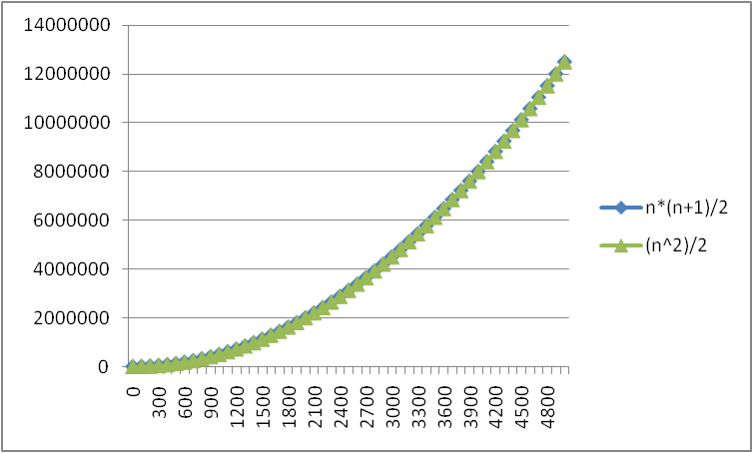
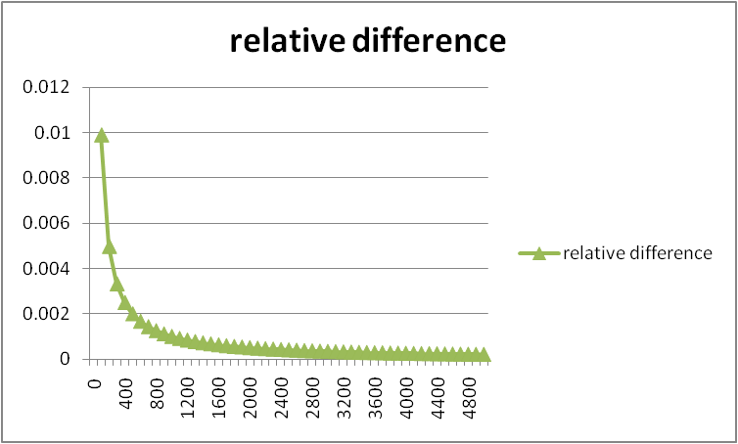
Lower-order terms don’t matter
n*(n+ 1)/2 vs. just n²/2
We just say O(n²)

Slide 22
Big-O: Common Names
O(1) constant (same as O(k) for constant k)
O(log n) logarithmic
O(n) linear
O(n log n) “n log n”
O(n²) quadratic
O(n³) cubic
O(n^{k}) polynomial (where is k is any constant)
O(k^{n}) exponential (where k is any constant > 1)
O(n!) factorial
Note: “exponential” does not mean “grows really fast”, it means “grows at rate proportional to k^{n} for some k>1”

Slide 23
Big-O running times
For a processor capable of one million instructions per second

Slide 24
Analyzing code
Basic operations take “some amount of” constant time
Arithmetic (fixed-width)
Assignment
Access one Java field or array index
Etc.
(This is an approximation of reality: a very useful “lie”.)
Consecutive statements Sum of times
Conditionals Time of test plus slower branch
Loops Sum of iterations
Calls Time of call’s body
Recursion Solve recurrence equation (next lecture)

Slide 25
Analyzing code
Add up time for all parts of the algorithm
e.g. number of iterations = (n²+ n)/2
Eliminate low-order terms i.e. eliminate n: (n²)/2
Eliminate coefficients i.e. eliminate 1/2: (n²) : Result is O(n²)
Examples:
4n + 5
0.5n log n + 2n + 7
n³ + 2^{n} + 3n
365
= O(n)
= O(n log n)
= O(2^{n})
= O(1)

Slide 26
Try a Java sorting program
private static void bubbleSort(int[] intArray) {
int n = intArray.length;
int temp = 0;
for(int i=0; i < n; i++){
for(int j=1; j < (n-i); j++){
if(intArray[j-1] > intArray[j]){
//swap the elements!
temp = intArray[j-1];
intArray[j-1] = intArray[j];
intArray[j] = temp;
}}}}

