Slide 1
PixelPetz
Robots
Food
Mirror
Messages
Force Fields
Friends
Fun
Marbles
Dragons
Profiles
Lasers
Games
Machetes
Rabbits
Cacti
Competition
Turtles

Slide 2
Team Breakdown
PM: Kari
Design, Documentation, Development on Demand
View Team: Daniel, Bill
Frontend Development, Graphics, Design
Model Team: Tracy, Teresa
Backend Development, Database Management, Design
Controller Team: Ryan
Controller Development, Code Integration, Design

Slide 3
Features
Pets
Five Types: Robot, Cactus, Rabbit, Turtle, Dragon
Each user can own up to three pets at a time
Feeding
Meat, Oil, Plants, and Water available
Increases the size of a users pet
Items
Laser Gun, Force Field, Machete, Marble, and Mirror
Competition
Rock, Paper, Scissors, Machete
User Interactions
Messaging
User Profiles

Slide 4
Languages
Java
JSP
CSS
Javascript
HTML
JDBC

Slide 5
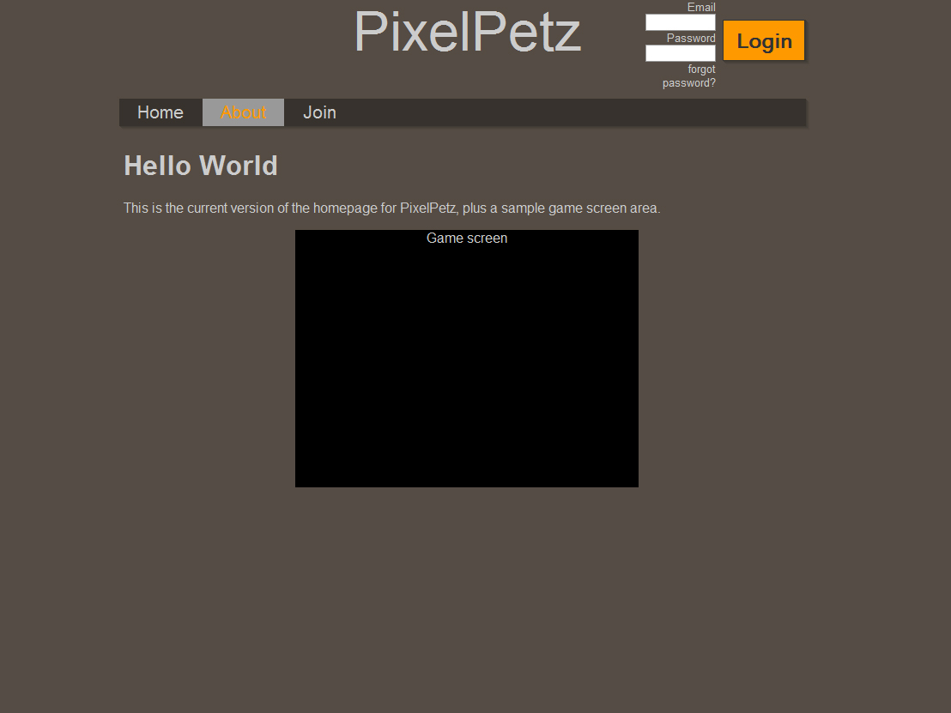

Slide 6
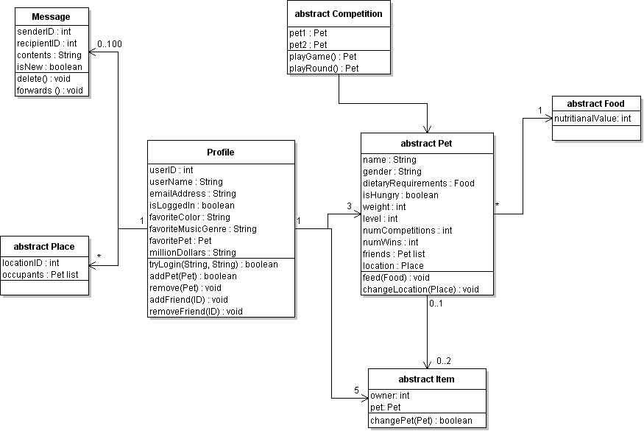
Model

Slide 7
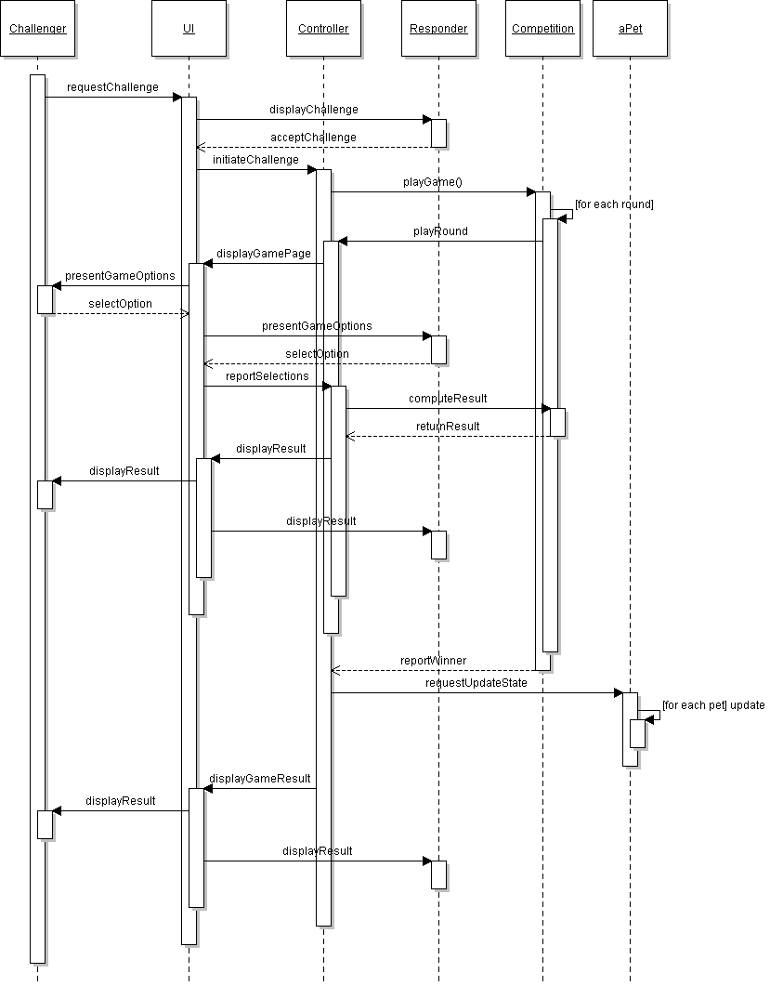
Competition

Slide 8
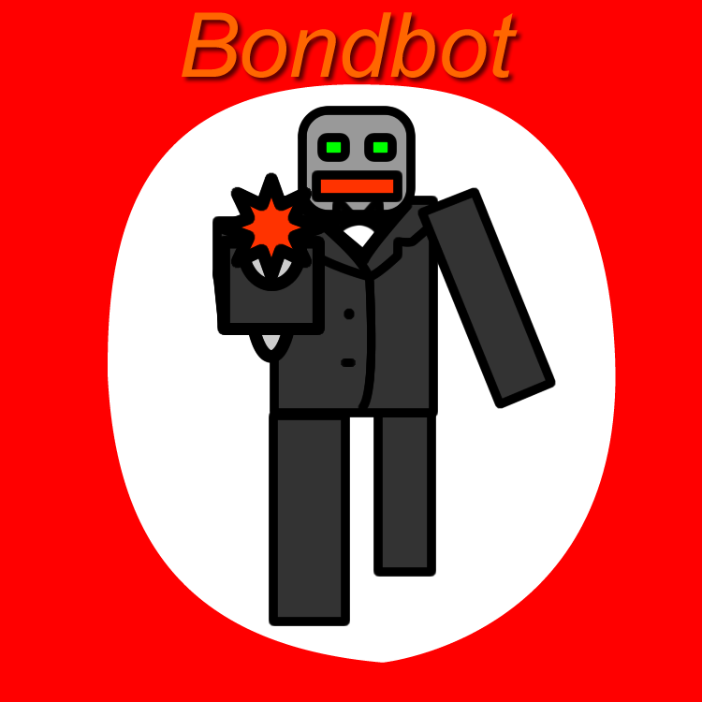
Rock
Paper
Scissors
Laser Gun!

