Slide 1
CSE 421
Divide and Conquer
Yin Tat Lee

Slide 2
Median

Slide 3

Selecting k-th smallest
    Problem: Given numbers $x_{1},…,x_{n}$ and an integer $1≤k≤n$ output the $k$-th smallest number
    $$Sel(\left\{x_{1},…,x_{n}\right\},k)$$
    Can we do $O\left(n\right)$ for all possible values of k?

Slide 4
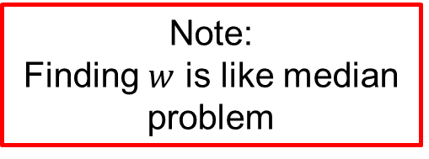
An Idea
Note:
Finding $w$ is like median problem
    Choose a number $w$ from $x_{1},…,x_{n}$
    Define
    $S_{<}\left(w\right)=\left\{x_{i}:x_{i}<w\right\}$
    $S_{=}\left(w\right)=\left\{x_{i}:x_{i}=w\right\}$
    $S_{>}\left(w\right)=\left\{x_{i}:x_{i}>w\right\}$
    Solve the problem recursively as follows:
    If $k≤{|S}_{<}(w)|$, output $Sel(S_{<}\left(w\right),k)$
    Else if $k≤\left|S_{<}\left(w\right)\right|+\left|S_{=}\left(w\right)\right|$, output w
    Else output $Sel(S_{>}\left(w\right),k−|S_{<}\left(w\right)|−|S_{=}\left(w\right)|)$
    Ideally want $\left|S_{<}\left(w\right)\right|,{|S}_{>}(w)|≤n/2$. In this case ALG runs in $O\left(n\right)+O\left(\frac{n}{2}\right)+O\left(\frac{n}{4}\right)+…+O\left(1\right)=O\left(n\right).$
Can be computed in
linear time

Slide 5

How to choose w?
    Almost correct approach:
    Partition numbers into sets of size 3.
    Sort each set (takes O(n))
    $w=Sel(midpoints,n/6$)
$$≤$$
$$≤$$
$$≤$$
$$≤$$
$$≤$$
$$≤$$
$$≤$$
$$≤$$
$$≤$$
$$≤$$
$$≤$$
$$≤$$
$$≤$$
$$≤$$
$$w$$
$$≤$$
$$≤$$
$$≤$$
$$≤$$
$$≤$$
$$≤$$
$$≤$$
$$≤$$
$$≤$$
$$≤$$
$$≤$$
$$≤$$
$$≤$$
$$≤$$

Slide 6
How to lower bound $\left|S_{<}\left(w\right)\right|,|S_{>}\left(w\right)|$?
Assume all numbers are distinct for simplicity.
$$>w$$
    $\left|S_{<}\left(w\right)\right|≥2\left(\frac{n}{6}\right)=\frac{n}{3}$
    $\left|S_{>}\left(w\right)\right|≥2\left(\frac{n}{6}\right)=\frac{n}{3}.$
    So, what is the running time?
$$<$$
$$<$$
$$<$$
$$<$$
$$<$$
$$<$$
$$<$$
$$<$$
$$<$$
$$<$$
$$<$$
w
$$<$$
$$<$$
$$<$$
$$<$$
$$<$$
$$<$$
$$<$$
$$<$$
$$<$$
$$<$$
$$<$$
$$<$$
$$<$$
$$<$$
$$<$$
$$<$$
$$<$$
$$<$$
$$<$$
$$<$$
$$<$$
$$<w$$
$$\frac{n}{3}≤{|S}_{<}\left(w\right)|,\left|S_{>}\left(w\right)\right|≤\frac{2n}{3}$$

Slide 7
Asymptotic Running Time?
Assume all numbers are distinct for simplicity.
    If $k≤{|S}_{<}(w)|$, output $Sel(S_{<}\left(w\right),k)$
    Else if $k≤\left|S_{<}\left(w\right)\right|+\left|S_{=}\left(w\right)\right|$, output w
    Else output $Sel(S_{>}\left(w\right),k−|S_{<}\left(w\right)|−|S_{=}\left(w\right)|)$
    Where $\frac{n}{3}≤\left|S_{<}\left(w\right)\right|,\left|S_{>}\left(w\right)\right|≤\frac{2n}{3}$
    $$T\left(n\right)=T\left(\frac{n}{3}\right)+T\left(\frac{2n}{3}\right)+O\left(n\right)⇒T\left(n\right)=O(n log n)$$
$$<$$
$$<$$
$$<$$
$$<$$
$$<$$
$$<$$
$$<$$
$$<$$
$$<$$
$$<$$
$$<$$
$$w$$
$$<$$
$$<$$
$$<$$
$$<$$
$$<$$
$$<$$
$$<$$
$$<$$
$$<$$
$$<$$
$$<$$
$$<$$
$$<$$
$$<$$
$$<$$
$$<$$
$$<$$
$$<$$
$$<$$
$$<$$
$$<$$
$O(n log⁡n)$ again?
So, what is the point?

Slide 8
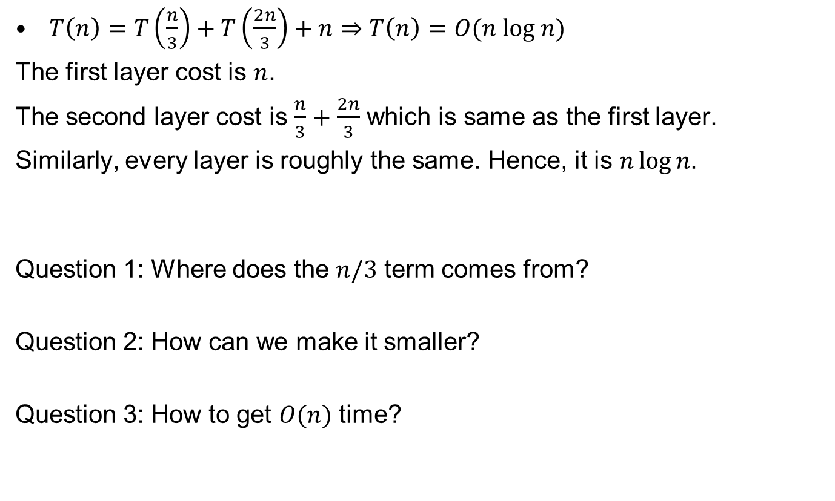
Recurrences
$T\left(n\right)=T\left(\frac{n}{3}\right)+T\left(\frac{2n}{3}\right)+n⇒T\left(n\right)=O(n log n)$
The first layer cost is $n$.
The second layer cost is $\frac{n}{3}+\frac{2n}{3}$ which is same as the first layer.
Similarly, every layer is roughly the same. Hence, it is $n\log{n}$.
Question 1: Where does the $n/3$ term comes from?
Question 2: How can we make it smaller?
Question 3: How to get $O(n)$ time?

Slide 9
An Improved Idea
$$>w$$
    Partition into n/5 sets. Sort each set and set $w=Sel(midpoints,n/10$)
    $\left|S_{<}\left(w\right)\right|≥3\left(\frac{n}{10}\right)=\frac{3n}{10}$
    $\left|S_{>}\left(w\right)\right|≥3\left(\frac{n}{10}\right)=\frac{3n}{10}$
    $$T\left(n\right)=T\left(\frac{n}{5}\right)+T\left(\frac{7n}{10}\right)+O\left(n\right)⇒T\left(n\right)=O(n)$$
$$<$$
$$<$$
$$<$$
$$<$$
$$<$$
$$<$$
$$<$$
$$<$$
$$<$$
$$<$$
$$<$$
$$<$$
$$<$$
$$<$$
$$<$$
$$<$$
$$<$$
$$<$$
$$<$$
$$<$$
$$<$$
$$<$$
$$<$$
$$<$$
$$<$$
$$<$$
$$<$$
$$<$$
$$<$$
$$<$$
$$<$$
$$<$$
$$<$$
$$<$$
$$<$$
$$<$$
$$<$$
$$<$$
$$<$$
$$<$$
$$<$$
$$<$$
$$<$$
$$<$$
$$<$$
$$<$$
$$<$$
$$<$$
$$<$$
$$<$$
$$<$$
$$<$$
$$<$$
$$<$$
$$<w$$
$$\frac{3n}{10}≤{|S}_{<}\left(w\right)|,\left|S_{>}\left(w\right)\right|≤\frac{7n}{10}$$

Slide 10
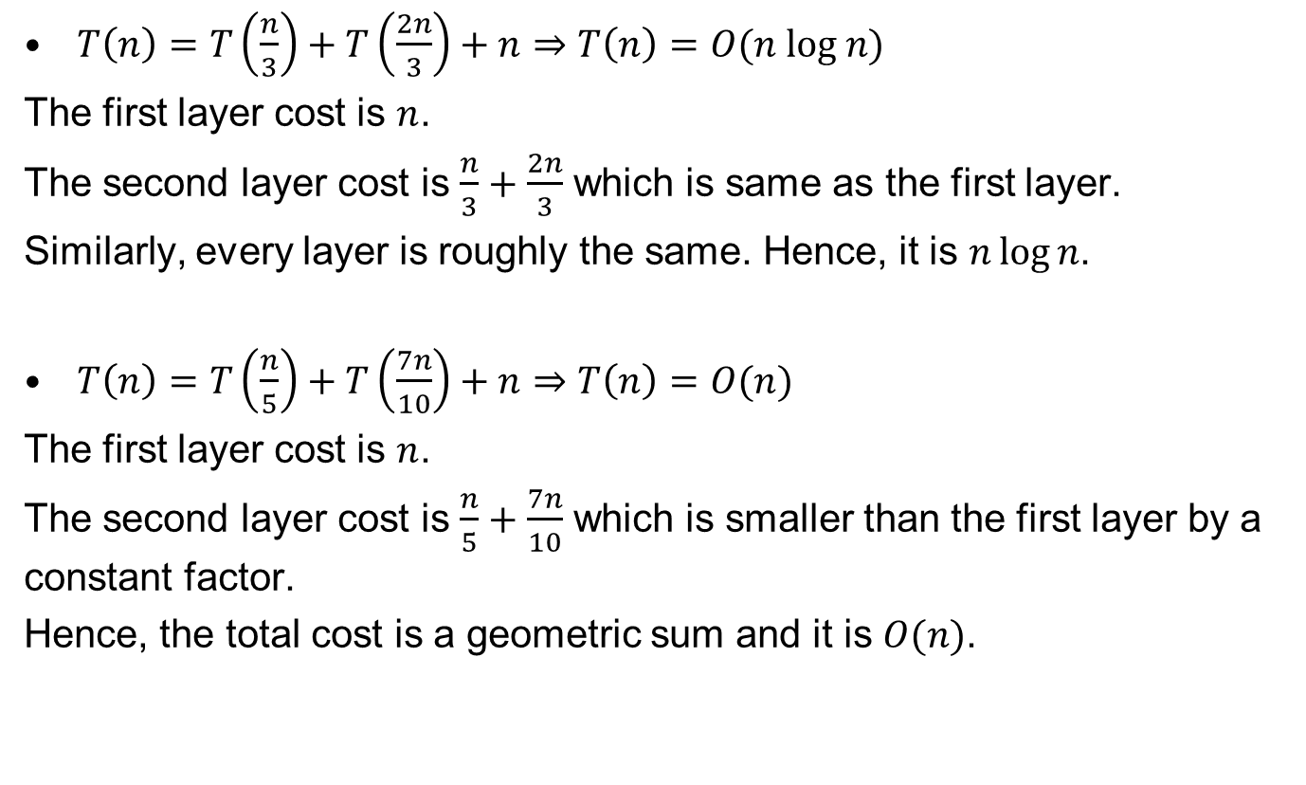
Recurrences
$T\left(n\right)=T\left(\frac{n}{3}\right)+T\left(\frac{2n}{3}\right)+n⇒T\left(n\right)=O(n log n)$
The first layer cost is $n$.
The second layer cost is $\frac{n}{3}+\frac{2n}{3}$ which is same as the first layer.
Similarly, every layer is roughly the same. Hence, it is $n\log{n}$.
$T\left(n\right)=T\left(\frac{n}{5}\right)+T\left(\frac{7n}{10}\right)+n⇒T\left(n\right)=O(n)$
The first layer cost is $n$.
The second layer cost is $\frac{n}{5}+\frac{7n}{10}$ which is smaller than the first layer by a constant factor.
Hence, the total cost is a geometric sum and it is $O(n)$.

Slide 11
Integer Multiplication

Slide 12



Integer Arithmetic
1
1
1
1
1
1
0
1
Add: Given two $n$-bit integers
$a$ and $b$, compute $a+b$.
Multiply: Given two $n$-bit
integers $a$ and $b$, compute $a×b$.
The “grade school” method:
1
1
0
1
0
1
0
1
Add
+
0
1
1
1
1
1
0
1
1
0
1
0
1
0
0
1
0
$O(n)$ bit operations.
1
1
0
1
0
1
0
1
*
0
1
1
1
1
1
0
1
1
1
0
1
0
1
0
1
Multiply
0
0
0
0
0
0
0
0
1
1
0
1
0
1
0
1
1
1
0
1
0
1
0
1
1
1
0
1
0
1
0
1
$O(n^{2})$ bit operations.
1
1
0
1
0
1
0
1
1
1
0
1
0
1
0
1
0
0
0
0
0
0
0
0
0
1
1
0
1
0
0
0
0
0
0
0
0
0
0
1
12

Slide 13

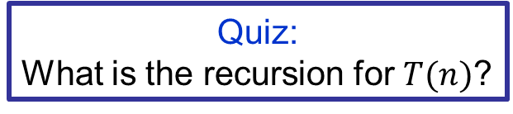
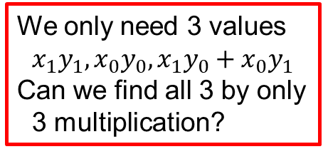
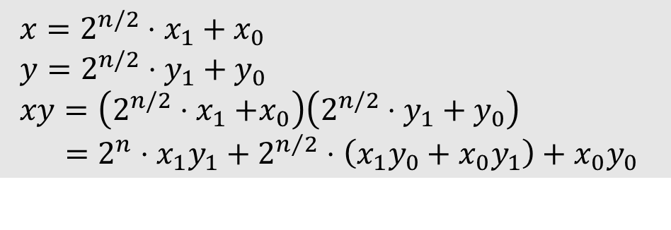
Divide and Conquer
Quiz:
What is the recursion for $T(n)$?
Let $x,y$ be two $n$-bit integers
Write $x=2^{n/2}x_{1}+x_{0}$ and $y=2^{n/2}y_{1}+y_{0}$
where $x_{0},x_{1},y_{0},y_{1}$ are all $n/2$-bit integers.
Therefore,
$$T\left(n\right)=4T\left(\frac{n}{2}\right)+Θ(n)$$
So,
$$T\left(n\right)=Θ\left(n^{2}\right).$$
$x=2^{n/2}⋅x_{1}+x_{0}$
$y=2^{n/2}⋅y_{1}+y_{0}$
$xy=\left(2^{n/2}{⋅x}_{1}+x_{0}\right)\left(2^{n/2}⋅y_{1}+y_{0}\right)$
$=2^{n}⋅x_{1}y_{1}+2^{n/2}⋅\left(x_{1}y_{0}+x_{0}y_{1}\right)+x_{0}y_{0}$
We only need 3 values
$$x_{1}y_{1},x_{0}y_{0},x_{1}y_{0}+x_{0}y_{1}$$
Can we find all 3 by only
3 multiplication?

Slide 14


Key Trick: 4 multiplies at the price of 3
$x=2^{n/2}⋅x_{1}+x_{0}$
$y=2^{n/2}⋅y_{1}+y_{0}$
$xy=\left(2^{n/2}{⋅x}_{1}+x_{0}\right)\left(2^{n/2}⋅y_{1}+y_{0}\right)$
$=2^{n}⋅x_{1}y_{1}+2^{n/2}⋅\left(x_{1}y_{0}+x_{0}y_{1}\right)+x_{0}y_{0}$
$α=x_{1}+x_{0}$
$β=y_{1}+y_{0}$
$αβ=\left(x_{1}+x_{0}\right)\left(y_{1}+y_{0}\right)$
$=x_{1}y_{1}+\left(x_{1}y_{0}+x_{0}y_{1}\right)+x_{0}y_{0}$
$\left(x_{1}y_{0}+x_{0}y_{1}\right)=αβ−x_{1}y_{1}−x_{0}y_{0}$

Slide 15
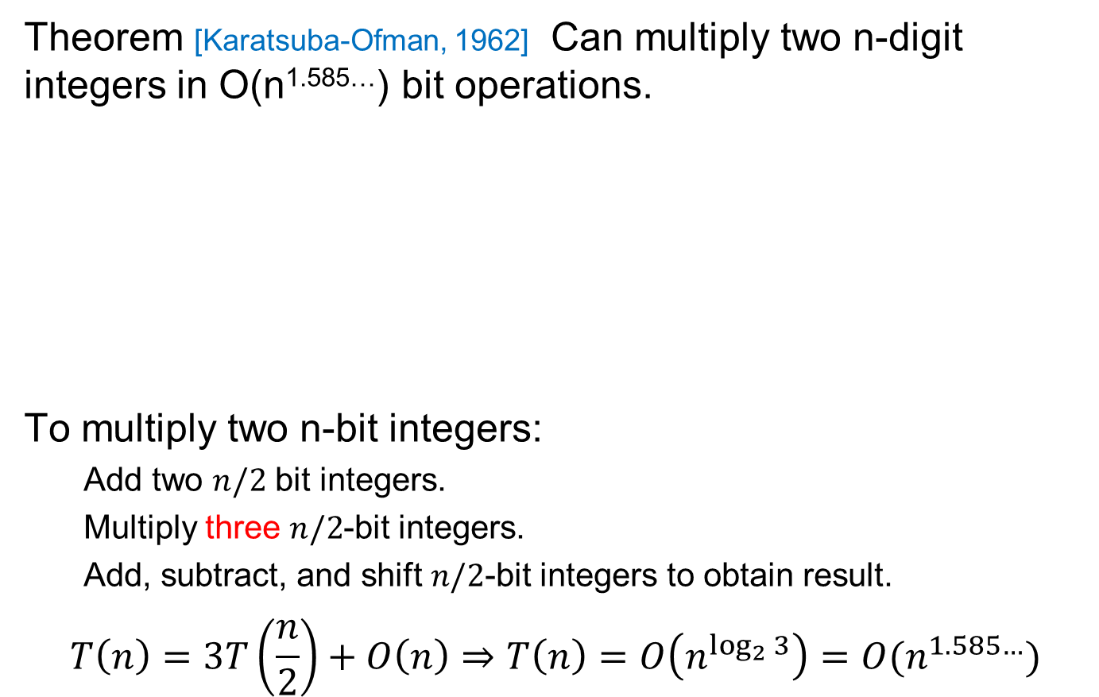

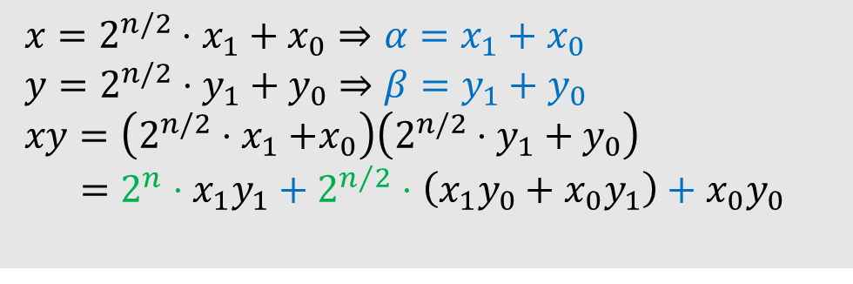
Key Trick: 4 multiplies at the price of 3
Theorem [Karatsuba-Ofman, 1962] Can multiply two n-digit integers in O(n^{1.585…}) bit operations.
To multiply two n-bit integers:
  Add two $n/2$ bit integers.
  Multiply three $n/2$-bit integers.
  Add, subtract, and shift $n/2$-bit integers to obtain result.
$$T\left(n\right)=3T\left(\frac{n}{2}\right)+O\left(n\right)⇒T\left(n\right)=O\left(n^{\log_{2}{3}}\right)=O(n^{1.585…})$$
$x=2^{n/2}⋅x_{1}+x_{0}⇒α=x_{1}+x_{0}$
$y=2^{n/2}⋅y_{1}+y_{0}⇒β=y_{1}+y_{0}$
$xy=\left(2^{n/2}{⋅x}_{1}+x_{0}\right)\left(2^{n/2}⋅y_{1}+y_{0}\right)$
$=2^{n}⋅x_{1}y_{1}+2^{n/2}⋅\left(x_{1}y_{0}+x_{0}y_{1}\right)+x_{0}y_{0}$
A
$$αβ−A−B$$
B

Slide 16
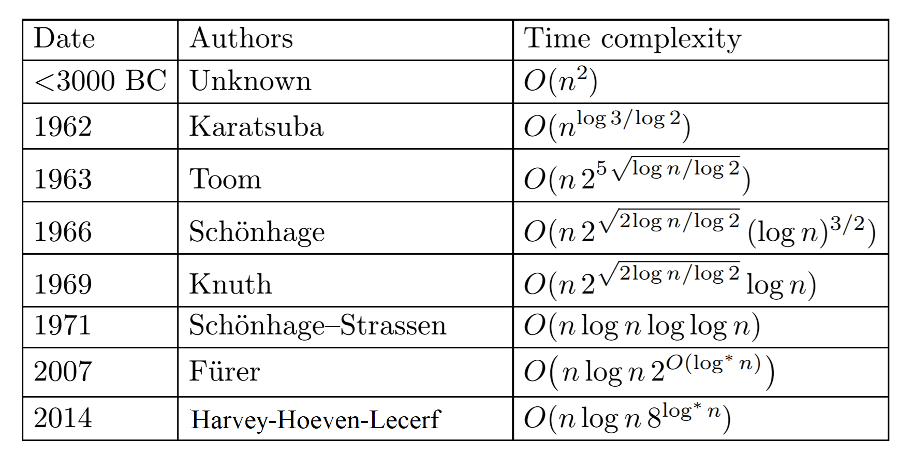

Integer Multiplication (Summary)
Exercise: generalize Karatsuba to do 5 size
$n/3$ subproblems
  This gives $Θ\left(n^{1.46…}\right)$ time algorithm
2019 Harvey-Hoeven $O(n\log{n})$

Slide 17
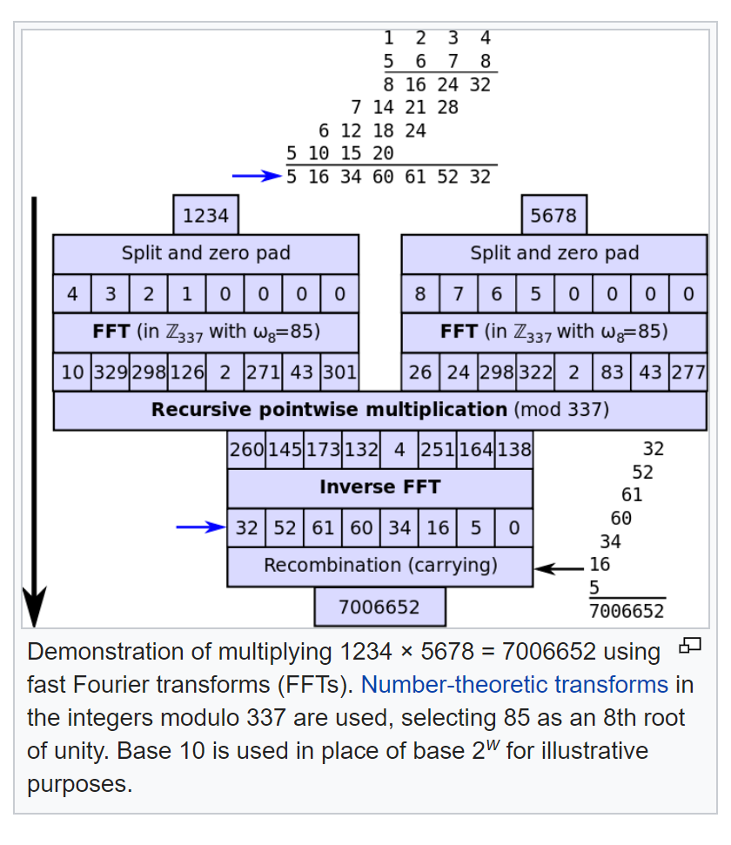
Integer Multiplication (Summary)

Slide 18
Matrix Matrix Multiplication

Slide 19
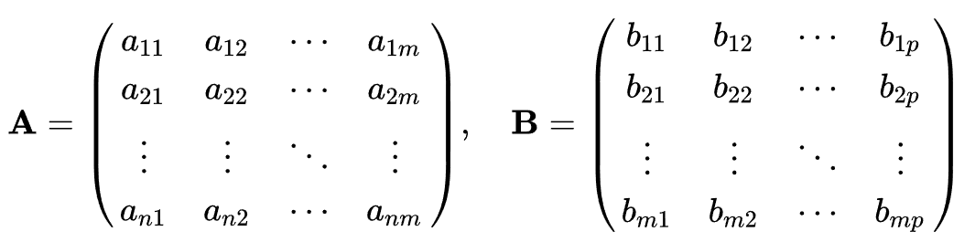
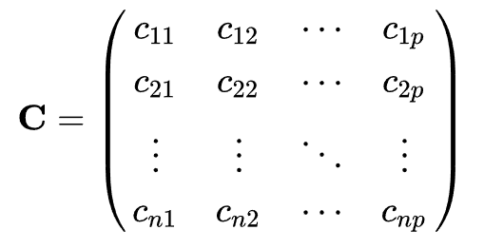
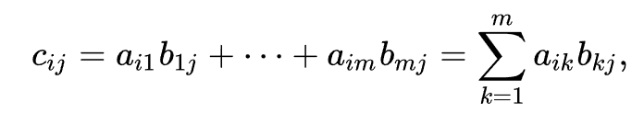
Multiplying Matrices
Let $A$ be an $n×m$ matrix, $B$ be an $m×p$ matrix.
Then, $C=AB$ is an $n×p$ matrix
such that
Question: Why matrix multiplication is defined in such way?

Slide 20
Multiplying Matrices

Slide 21
Multiplying Matrices

Slide 22
Multiplying Matrices
A₁₁
A₁₂
B₁₁
B₁₂
A₂₁
A₂₂
B₂₁
B₂₂
A₁₁B₁₁+A₁₂B₂₁
A₁₁B₁₂+A₁₂B₂₂
A₂₁B₁₁+A₂₂B₂₁
A₂₁B₁₂+A₂₂B₂₂

Slide 23

Simple Divide and Conquer
Quiz:
What is the recursion for $T(n)$?
$T(n)=8T(n/2)+4{\left(\frac{n}{2}\right)}^{2}=8T(n/2)+n2$
  So, $T\left(n\right)=Θ\left(n^{\log_{2}8}\right)=Θ(n^{3})$
A₁₁
A₁₂
B₁₁
B₁₂
A₂₁
A₂₂
B₂₁
B₂₂
A₁₁B₁₁+A₁₂B₂₁
A₁₁B₁₂+A₁₂B₂₂
=
A₂₁B₁₁+A₂₂B₂₁
A₂₁B₁₂+A₂₂B₂₂

Slide 24
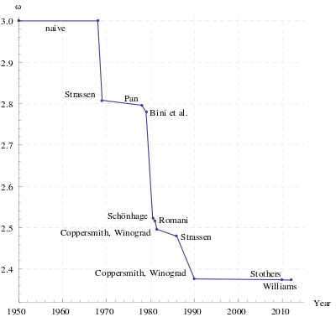

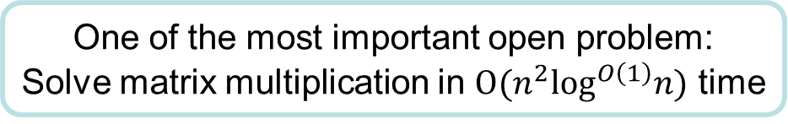
Strassen’s Divide and Conquer Algorithm
Strassen’s algorithm
  Multiply $2×2$ matrices using $7$ instead of $8$ multiplications (and $18$ additions)
  $$T\left(n\right)=7T\left(\frac{n}{2}\right)+18n^{2}$$
  Hence, we have $T\left(n\right)=O\left(n^{\log_{2}{7}}\right).$
Useful when $n\sim 500$.
One of the most important open problem:
Solve matrix multiplication in $O(n^{2}\log^{O\left(1\right)}n)$ time

Slide 25
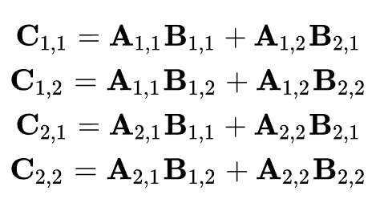
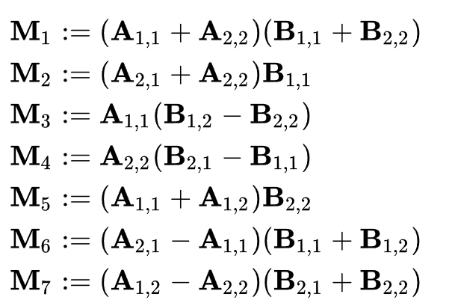
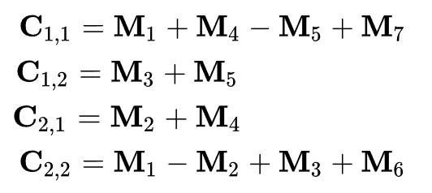
Strassen’s Divide and Conquer Algorithm
Naive
Strassen

Slide 26
Matrix Vector Multiplication

Slide 27
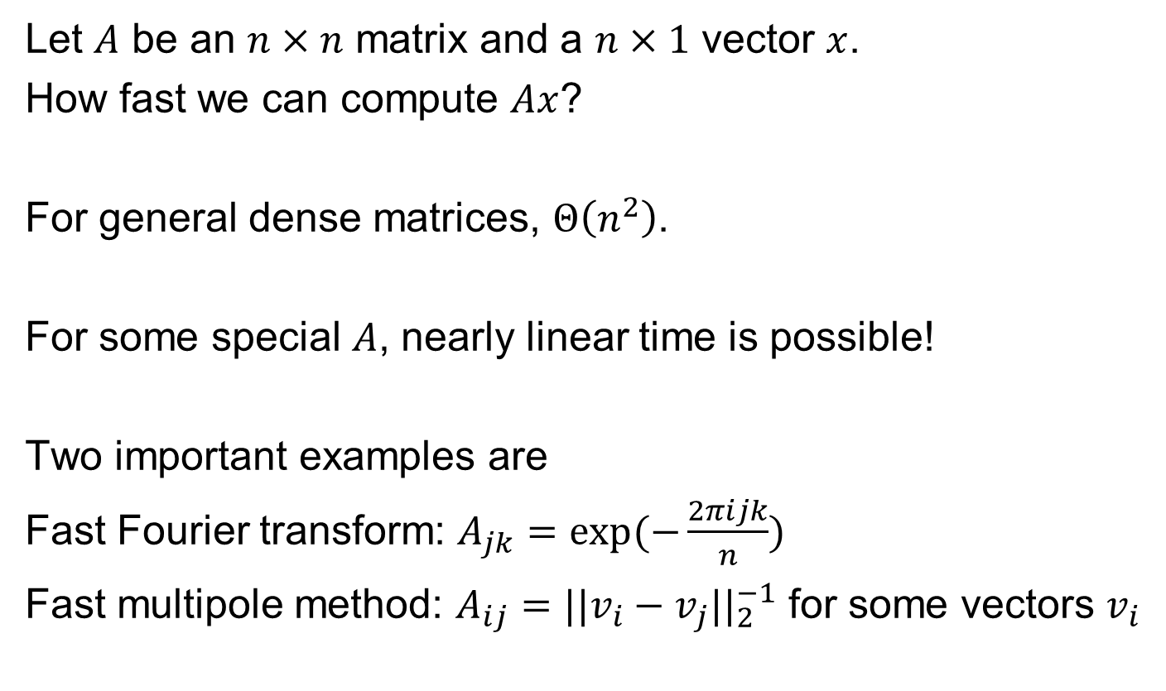
Matrix Vector Multiplication
Let $A$ be an $n×n$ matrix and a $n×1$ vector $x$.
How fast we can compute $Ax$?
For general dense matrices, $Θ\left(n^{2}\right)$.
For some special $A$, nearly linear time is possible!
Two important examples are
Fast Fourier transform: $A_{jk}=exp⁡(−\frac{2πijk}{n})$
Fast multipole method: $A_{ij}=||v_{i}−v_{j}||_{2}^{−1}$ for some vectors $v_{i}$
Textbook explains it in a totally different way.

Slide 28
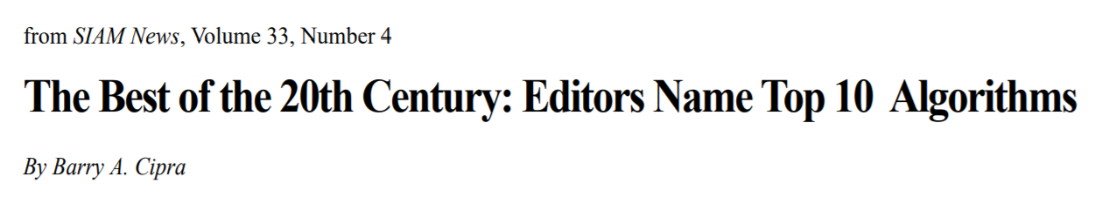
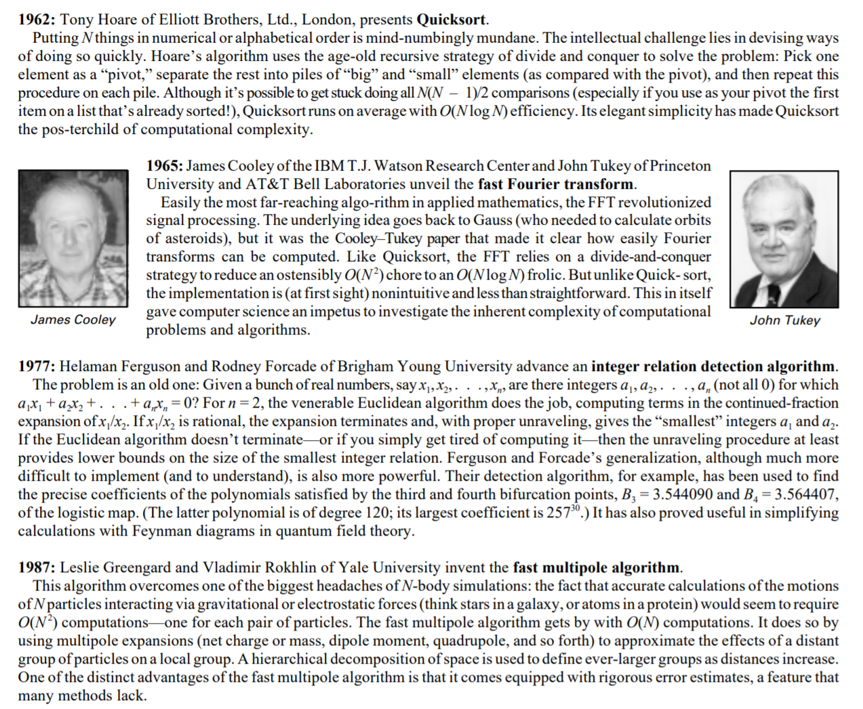
Divide and Conquer

Slide 29
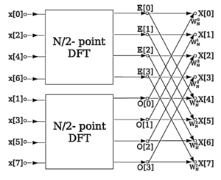

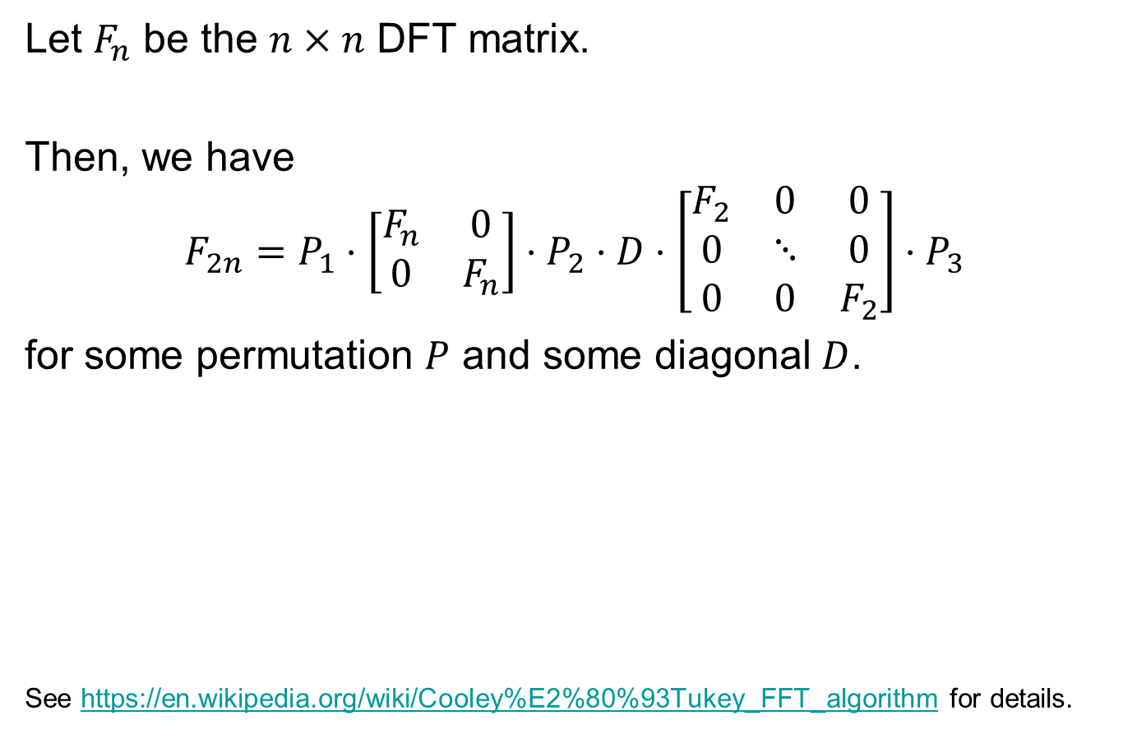
Matrix Vector Multiplication (FFT)
$$T\left(n\right)=2T\left(n/2\right)+O(n)$$
Let $F_{n}$ be the $n×n$ DFT matrix.
Then, we have
$$F_{2n}=P_{1}⋅\left[\begin{matrix}F_{n} & 0 \\ 0 & F_{n}\end{matrix}\right]⋅P_{2}⋅D⋅\left[\begin{matrix}F_{2} & 0 & 0 \\ 0 & ⋱ & 0 \\ 0 & 0 & F_{2}\end{matrix}\right]⋅P_{3}$$
for some permutation $P$ and some diagonal $D$.
See https://en.wikipedia.org/wiki/Cooley%E2%80%93Tukey_FFT_algorithm for details.

Slide 30

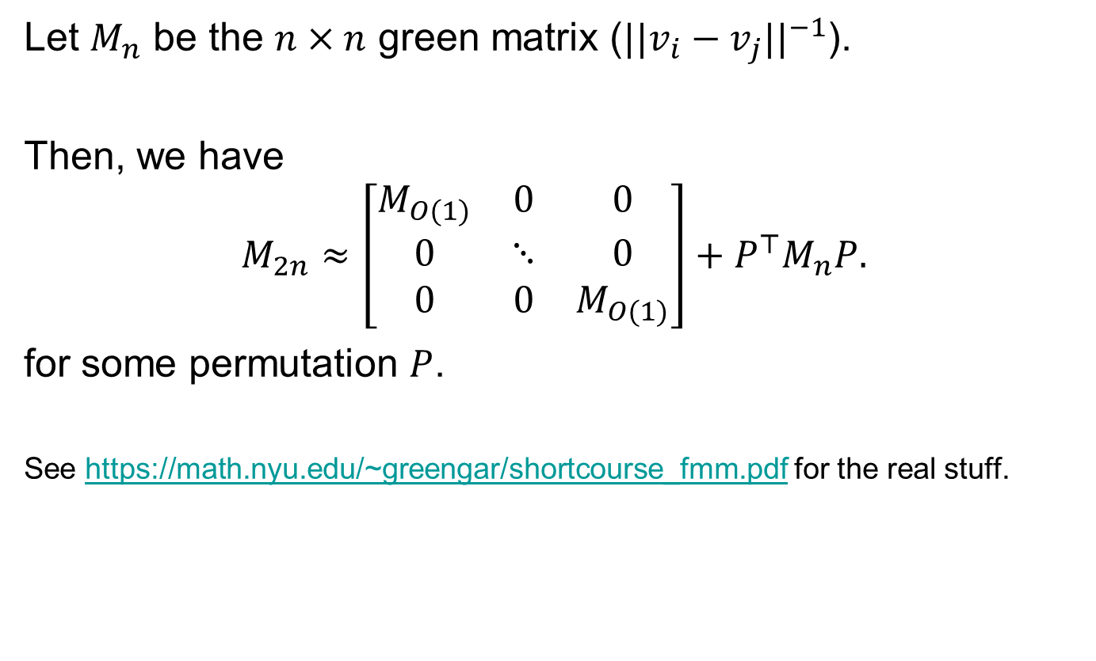
Matrix Vector Multiplication (FMM)
Let $M_{n}$ be the $n×n$ green matrix ($||v_{i}−v_{j}||^{−1}$).
Then, we have
$$M_{2n}≈\left[\begin{matrix}M_{O(1)} & 0 & 0 \\ 0 & ⋱ & 0 \\ 0 & 0 & M_{O(1)}\end{matrix}\right]+P^{⊤}M_{n}P.$$
for some permutation $P$.
See https://math.nyu.edu/~greengar/shortcourse_fmm.pdf for the real stuff.
$$T\left(n\right)=T\left(n/2\right)+O\left(n\right)$$

