Slide 1
CSE 421: Introduction to Algorithms
Terminology: Complexity
Yin-Tat Lee

Slide 2

Administrativia Stuffs
HW1 is out.
Please submit to Gradescope
Guidelines:
You can collaborate, but you must write solutions on your own
You CANNOT search the solution online
See Ed for more guidelines.
Tips:
Rewrite your proof.
Make sure you use assumptions of the problem
Make sure it is easy to understand

Slide 3
More
Algorithm:
😃😃😃😃😃😃😃😃😃
😃😃😃😃😃😃😃😃😃
😃😃😃😃😃😃😃😃😃
😃😃😃😃😃😃😃😃😃
Runtime:
😃😃😃😃😃😃😃😃😃
Correctness:
😃😃😃😃😃😃😃😃😃
😃😃😃😃😃😃😃😃😃
😃😃😃😃😃😃😃😃😃
Exceptions (not limited to):
If possible, reduce the question into a solved problem,
For example, for stable matching, explain
  What “man” and “woman” are corresponding to
  What their preference are.
  How convert the stable matching to what we asked in the question.
If the algorithm is similar to one in the class,
Simply explain the difference.
Make sure your description is not ambiguous.

Slide 4
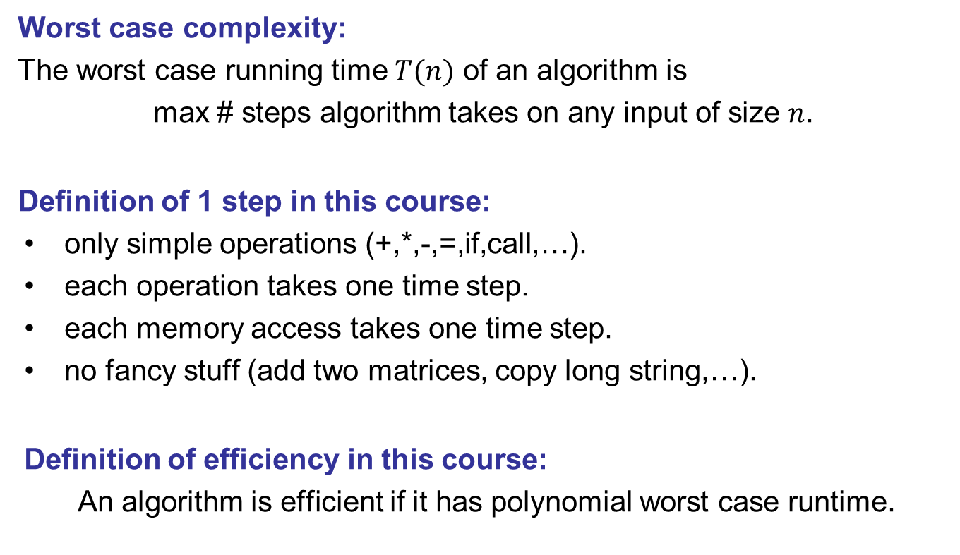
Definition for Efficiency in This Course
Worst case complexity:
The worst case running time $T(n)$ of an algorithm is
max # steps algorithm takes on any input of size $n$.
Definition of 1 step in this course:
only simple operations (+,*,-,=,if,call,…).
each operation takes one time step.
each memory access takes one time step.
no fancy stuff (add two matrices, copy long string,…).
Definition of efficiency in this course:
An algorithm is efficient if it has polynomial worst case runtime.

Slide 5


Time Complexity on Worst Case Inputs
T(N)
$$2N log2N$$
Time
$$N \log_{2}N$$
Problem size N

Slide 6
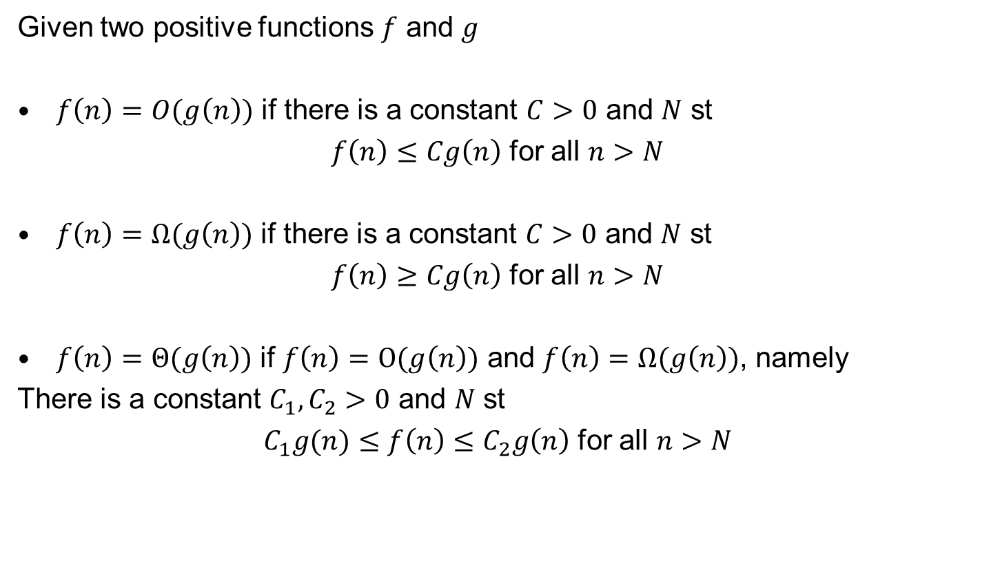
O-Notation
Given two positive functions $f$ and $g$
$f\left(n\right)=O(g\left(n\right))$ if there is a constant $C>0$ and $N$ st
$f\left(n\right)≤Cg\left(n\right)$ for all $n>N$
$f\left(n\right)=Ω(g\left(n\right))$ if there is a constant $C>0$ and $N$ st
$f\left(n\right)≥Cg\left(n\right)$ for all $n>N$
$f\left(n\right)=Θ(g\left(n\right))$ if $f\left(n\right)=O(g\left(n\right))$ and $f\left(n\right)=Ω(g\left(n\right))$, namely
There is a constant $C_{1},C_{2}>0$ and $N$ st
$C_{1}g(n)≤f\left(n\right)≤C_{2}g\left(n\right)$ for all $n>N$

Slide 7
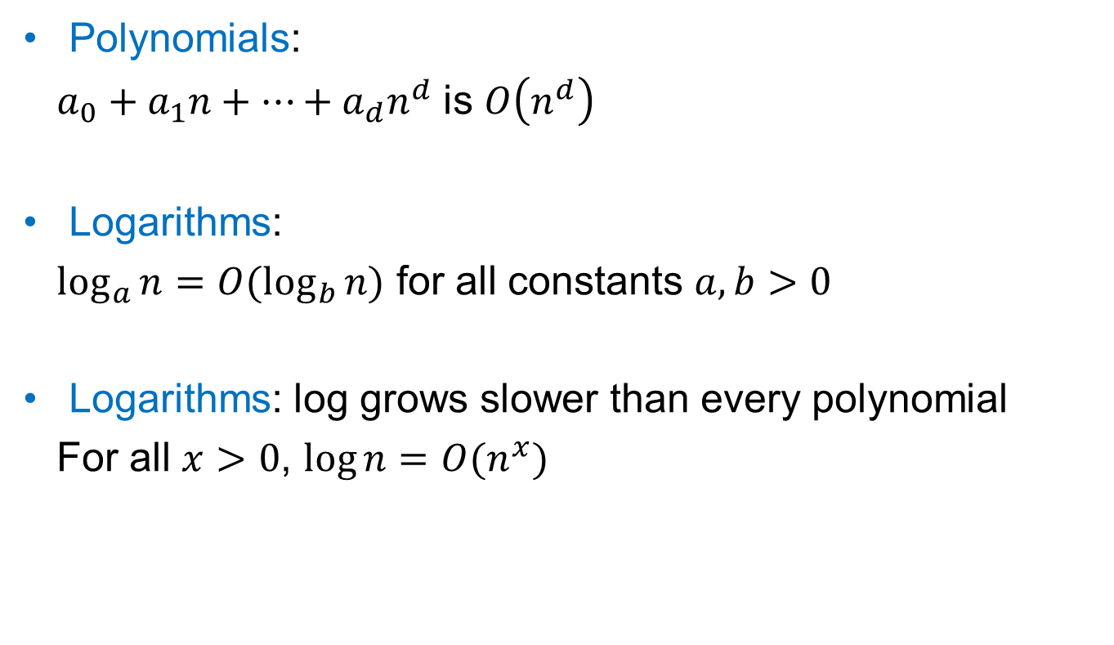
Common Asymptotic Bounds
Polynomials:
$a_{0}+a_{1}n+…+a_{d}n^{d}$ is $O\left(n^{d}\right)$
Logarithms:
$\log_{a}{n}=O(\log_{b}{n)}$ for all constants $a,b>0$
Logarithms: log grows slower than every polynomial
For all $x>0$, $\log{n=O(n^{x})}$

Slide 8
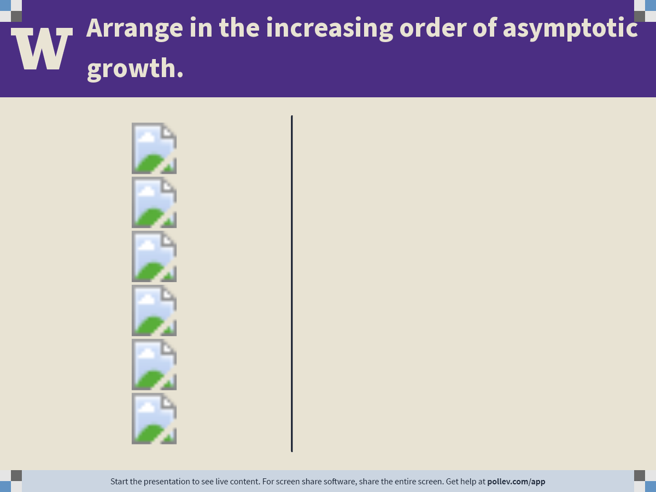
Notes:
Poll Title: Do not modify the notes in this section to avoid tampering with the Poll Everywhere activity.
More info at polleverywhere.com/support
Arrange in the increasing order of asymptotic growth.
https://www.polleverywhere.com/ranking_polls/h6BkuWOlJoC80y4Mcd1vC

Slide 9
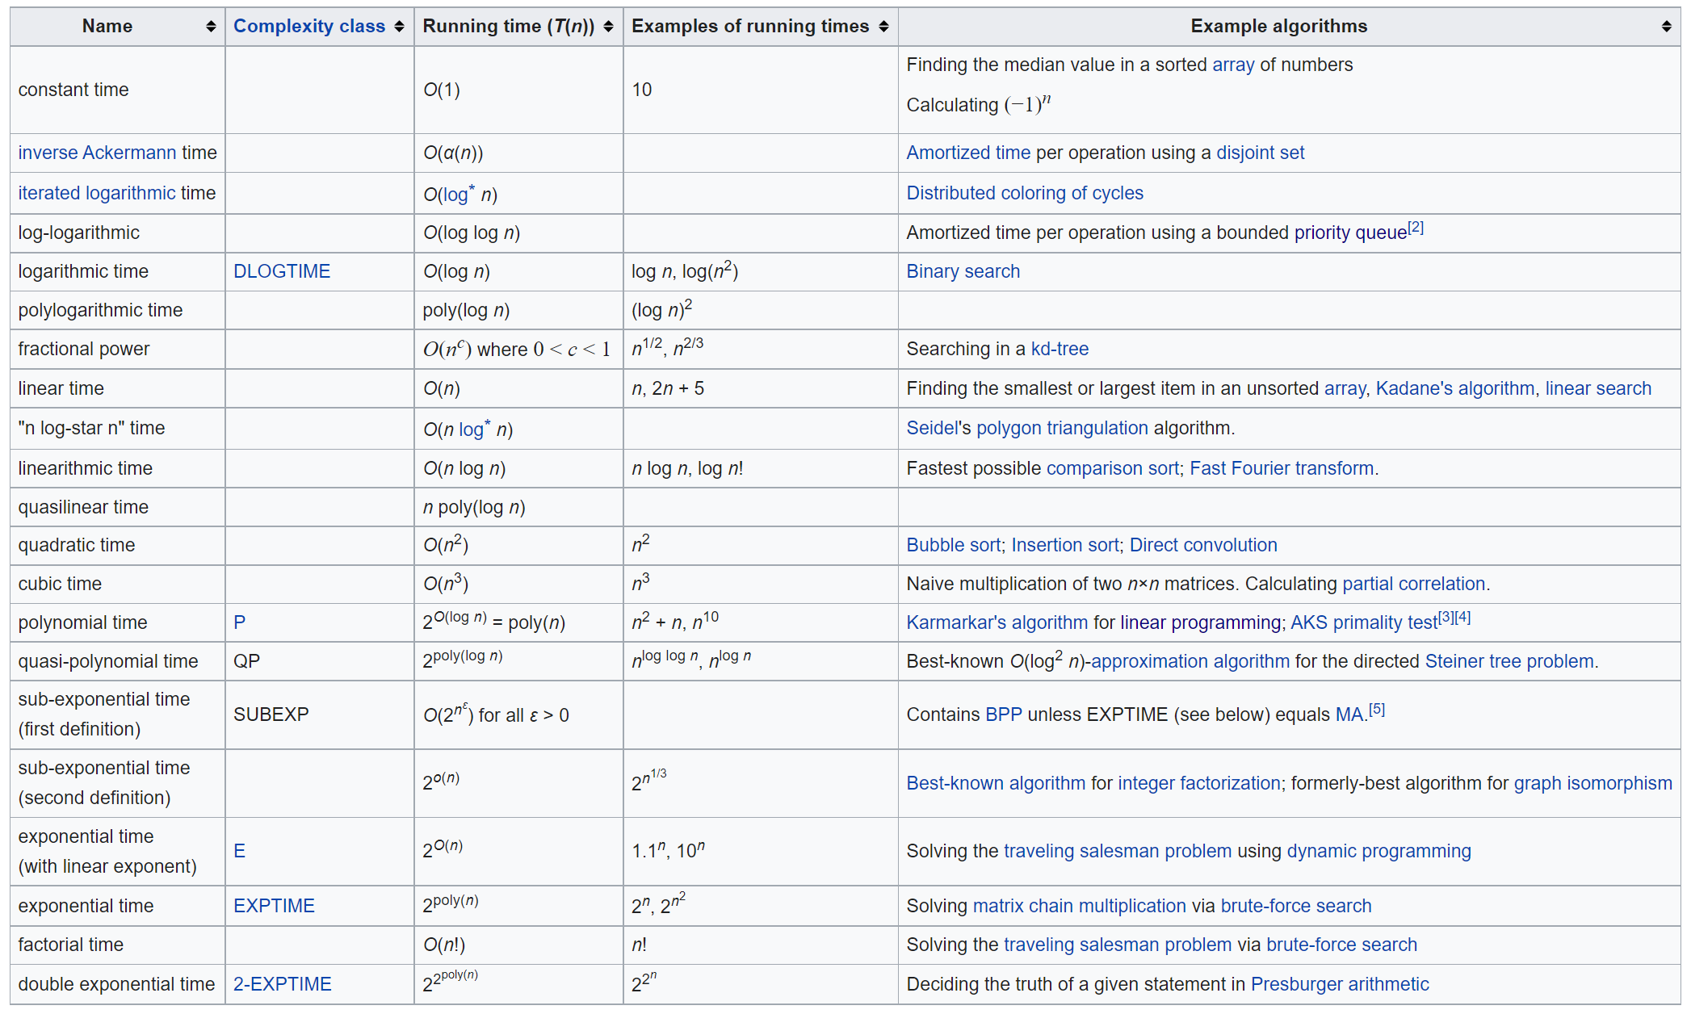

Running Time
An algorithm runs in polynomial time if $T\left(n\right)=n^{O(1)}$.
Equivalently, $T\left(n\right)=O(n^{d})$ for some constant d.
Data
Structures
CSE332
Sublinear Algorithms
This
course

Slide 10
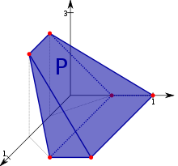
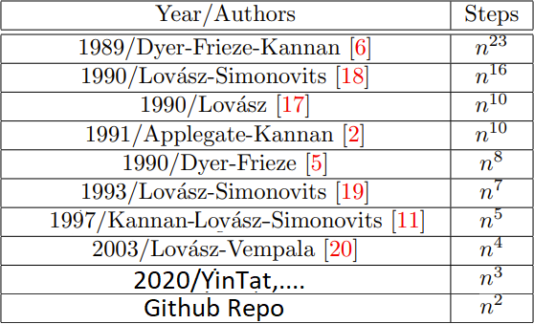
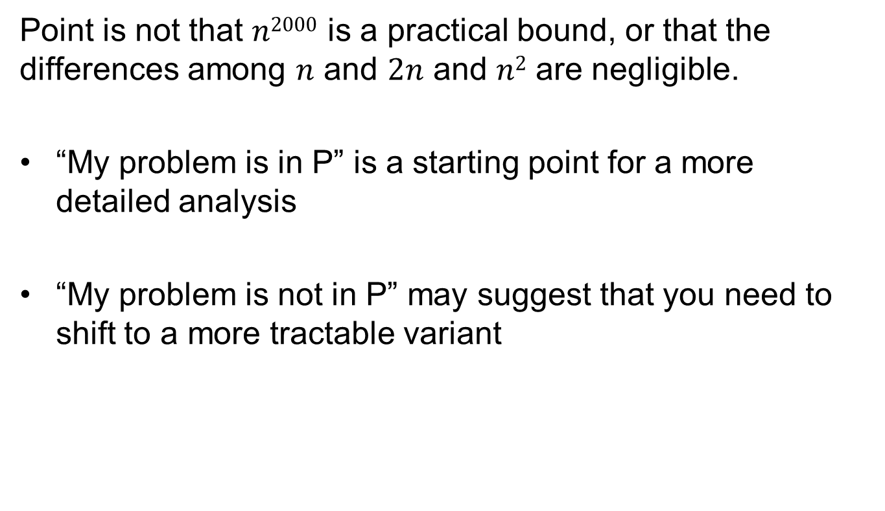
Why “Polynomial”?
Point is not that $n2000$ is a practical bound, or that the differences among $n$ and $2n$ and $n2$ are negligible.
“My problem is in P” is a starting point for a more detailed analysis
“My problem is not in P” may suggest that you need to shift to a more tractable variant

Slide 11
Other Complexities
Average Case Complexity:
avg # steps algorithm takes
Communication Complexity:
max # communication algorithm send between servers
Space Complexity:
max # space algorithm needs
Parallel Complexity:
max length of the longest series of operations that have to be performed sequentially due to data dependencies

Slide 12
CSE 351 Quiz
What is the cost of following operations? (in terms of cycle for CPU with 1 core)
Compute a*b+c where a,b,c are float (throughput)
~1/16 cycles
Cost of unpredictable if (latency)
~20 cycles
Cost of reading 1 byte from a random location in memory (latency)
~300 cycles
Cost of reading 1 byte from a random location in a M.2 SSD (latency)
~100k cycles
Cost of reading 1 byte from a random location in a 7200RPM harddisk (latency)
~10M cycles
Cost of Elon posting a Twitter from Mars (latency)
~10T cycles
Life is simple in 421.
Everything is O(1)

Slide 13
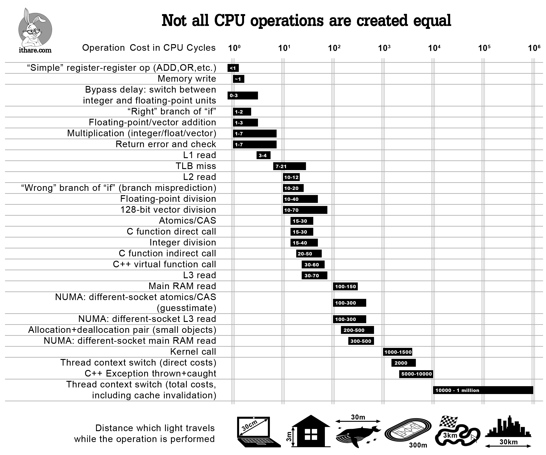
Warning
In real world, not all operations take same amount of time.

Slide 14
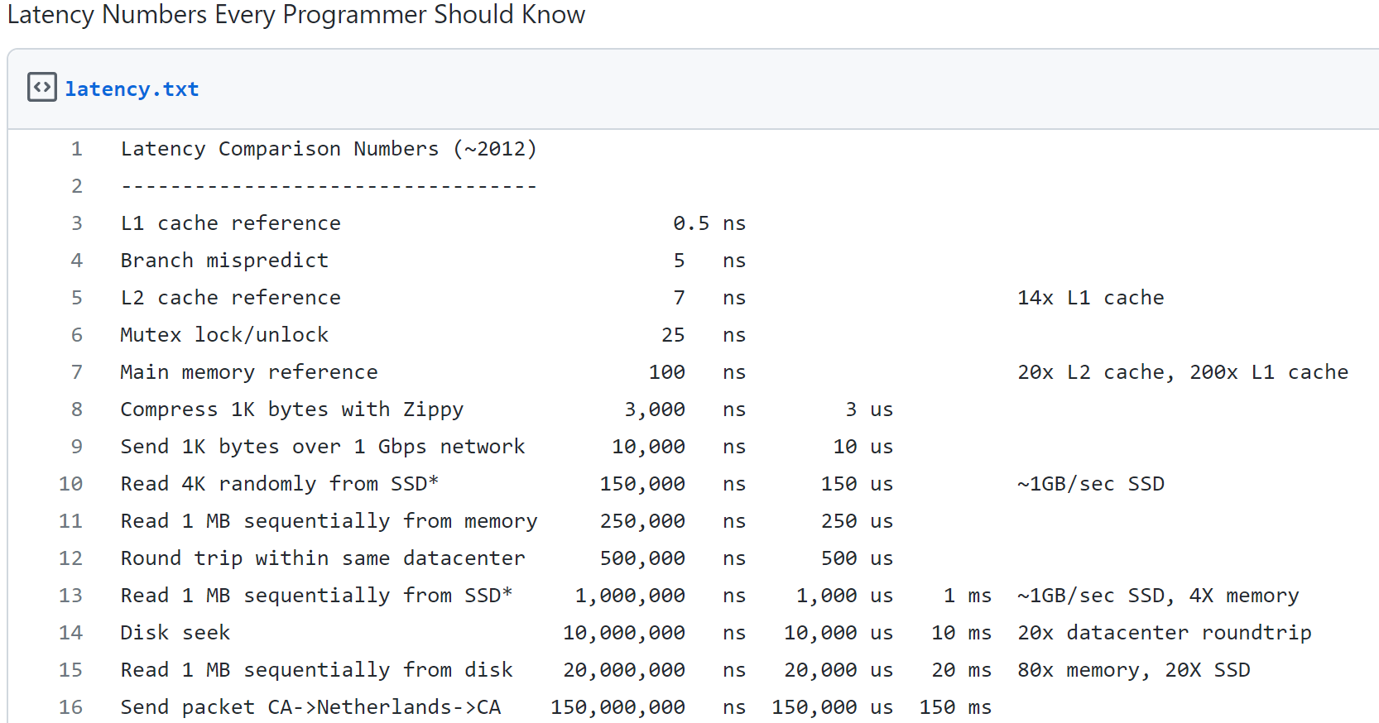
Warning
In real world, not all memory accesses take same amount of time.
Example:
Improving Google CPU usage by 0.5% via a better hash table
https://www.youtube.com/watch?v=ncHmEUmJZf4

Slide 15
CSE 421: Introduction to Algorithms
Terminology: Graph
Yin-Tat Lee

Slide 16
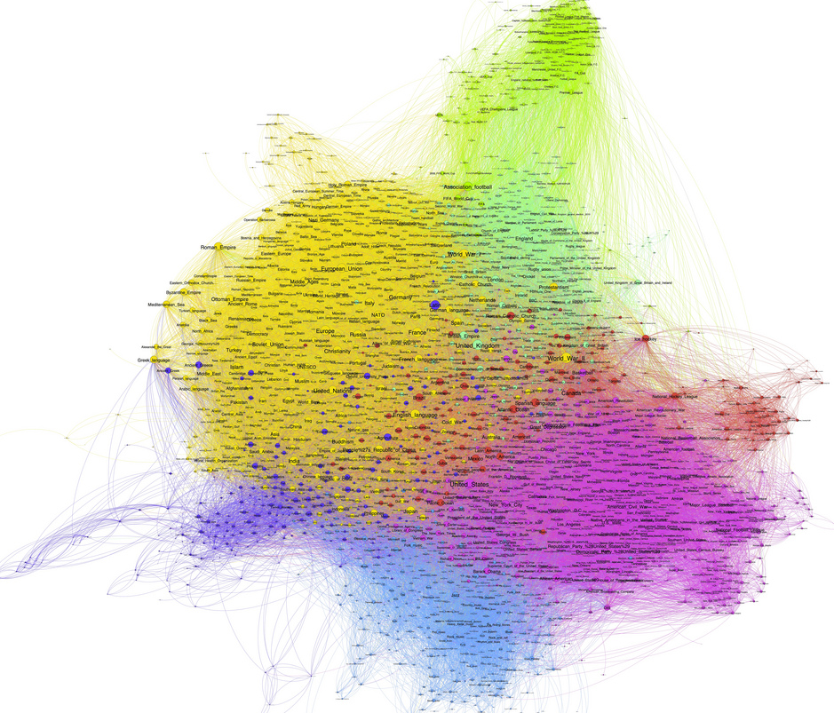
Graphs
Examples:
Transportation networks
Communication networks
Internet
Social networks
Dependency networks

Slide 17
Undirected Graphs G=(V,E)
A
2
10
3
Disconnected graph
11
12
4
8
Multi edges
13
B
9
Isolated vertices
6
Self loop
7

Slide 18
Graphs don’t Live in Flat Land
Geometrical drawing is mentally convenient, but mathematically irrelevant:
4 drawings of a single graph:
A
7
4
3
A
A
4
7
7
4
7
4
3
A
3
3

Slide 19
Directed Graphs
1
2
10
3
self loop
11
12
4
8
13
5
9
Multi edge
6
7

Slide 20
Terminology
Degree of a vertex: # edges that touch that vertex
deg(6)=3
Connected: Graph is connected if there is a path between every two vertices
Connected component: Maximal set of connected vertices
3
5
4
1
6
2
7
10

Slide 21
Terminology (cont’d)
Path: A sequence of distinct vertices
s.t. each vertex is connected
to the next vertex with an edge
Cycle: Path of length > 2 that has
the same start and end
Tree: A connected graph with no cycles
3
5
6
4
1
2
10
1
2
5
4
3
6

Slide 22

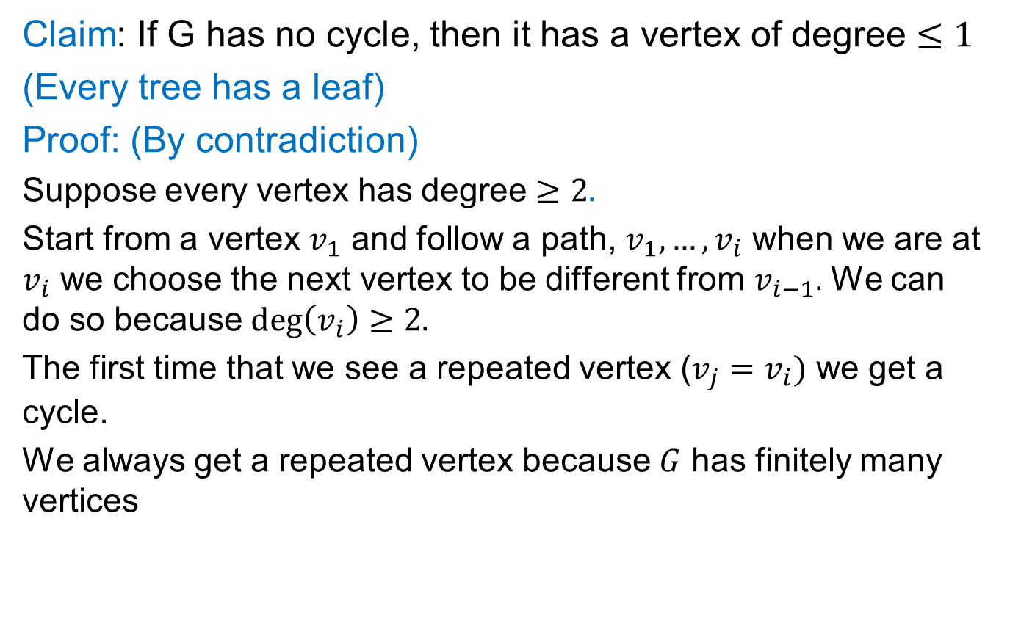




Exercise: Degree 1 vertices
Claim: If G has no cycle, then it has a vertex of degree $≤1$
(Every tree has a leaf)
Proof: (By contradiction)
Suppose every vertex has degree $≥2.$
Start from a vertex $v_{1}$ and follow a path, $v_{1},…,v_{i}$ when we are at $v_{i}$ we choose the next vertex to be different from $v_{i−1}.$ We can do so because $\deg\left(v_{i}\right)≥2.$
The first time that we see a repeated vertex ($v_{j}=v_{i})$ we get a cycle.
We always get a repeated vertex because $G$ has finitely many vertices
$$v_{1}$$
$$v_{2}$$
$$v_{3}$$
$$v_{4}$$
$$v_{5}$$

Slide 23
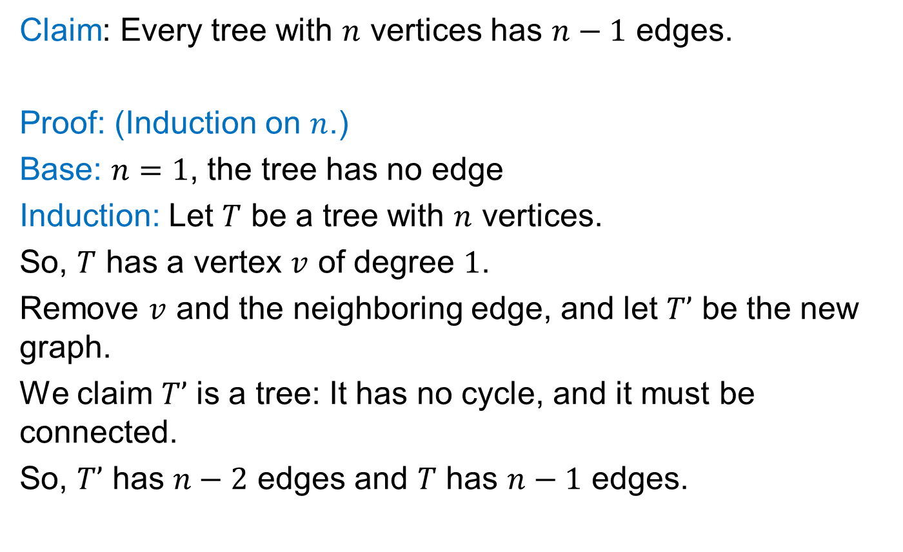
Exercise: Trees and Induction
Claim: Every tree with $n$ vertices has $n−1$ edges.
Proof: (Induction on $n$.)
Base: $n=1$, the tree has no edge
Induction: Let $T$ be a tree with $n$ vertices.
So, $T$ has a vertex $v$ of degree $1$.
Remove $v$ and the neighboring edge, and let $T’$ be the new graph.
We claim $T’$ is a tree: It has no cycle, and it must be connected.
So, $T’$ has $n−2$ edges and $T$ has $n−1$ edges.

Slide 24
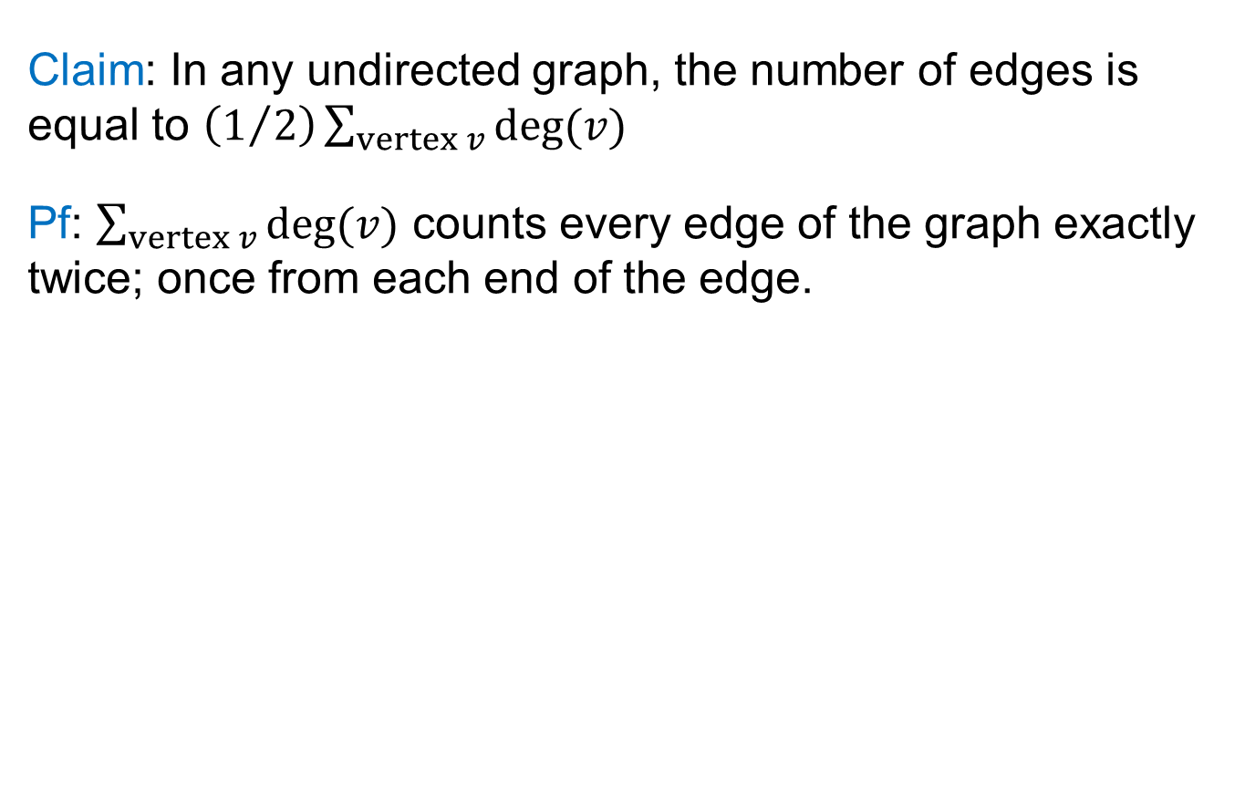
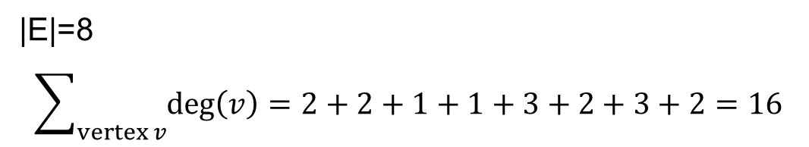
Exercise: Degree Sum
Claim: In any undirected graph, the number of edges is equal to $\left(1/2\right)\sum_{vertex v}{deg⁡(v)}$
Pf: $\sum_{vertex v}{deg⁡(v)}$ counts every edge of the graph exactly twice; once from each end of the edge.
3
5
4
1
6
2
|E|=8
$$\sum_{vertex v}{\deg\left(v\right)=2+2+1+1+3+2+3+2=16}$$
7
10

Slide 25
Exercise: Odd Degree Vertices
Claim: In any undirected graph, the number of odd degree vertices is even
Pf: In previous claim we showed sum of all vertex degrees is even. So there must be even number of odd degree vertices, because sum of odd number of odd numbers is odd.
3
5
4
1
6
2
4 odd degree vertices
3, 4, 5, 6
7
10

Slide 26
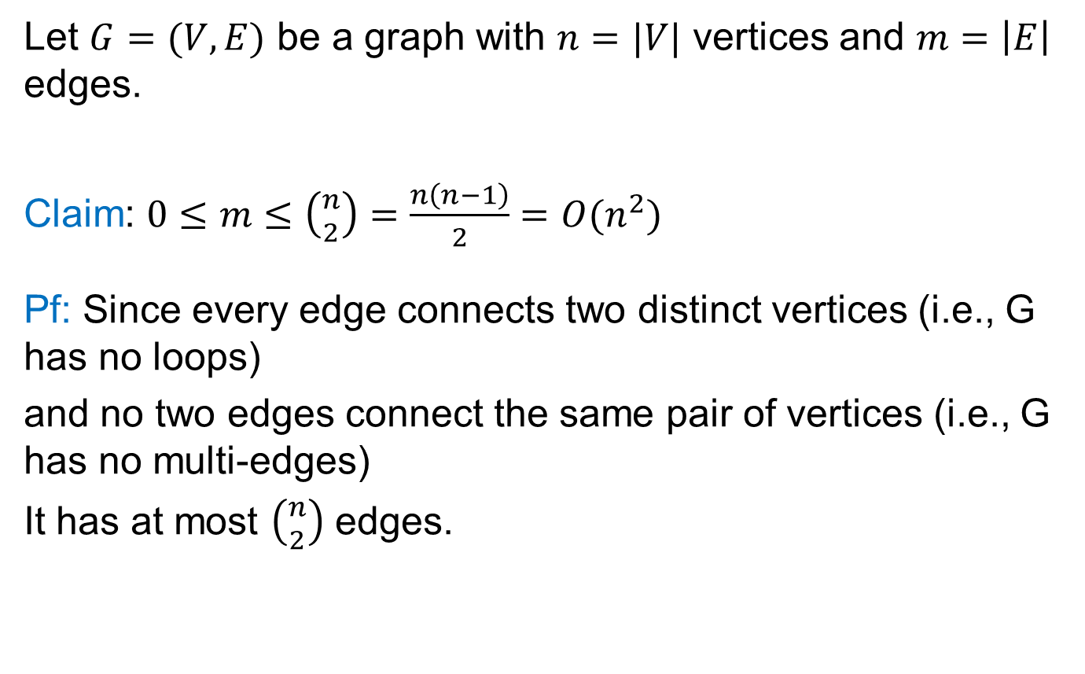
Exercise: #edges
Let $G=(V,E)$ be a graph with $n=|V|$ vertices and $m=\left|E\right|$ edges.
Claim: $0≤m≤\left({n \atop 2}\right)=\frac{n\left(n−1\right)}{2}=O(n^{2})$
Pf: Since every edge connects two distinct vertices (i.e., G has no loops)
and no two edges connect the same pair of vertices (i.e., G has no multi-edges)
It has at most $\left({n \atop 2}\right)$ edges.

Slide 27
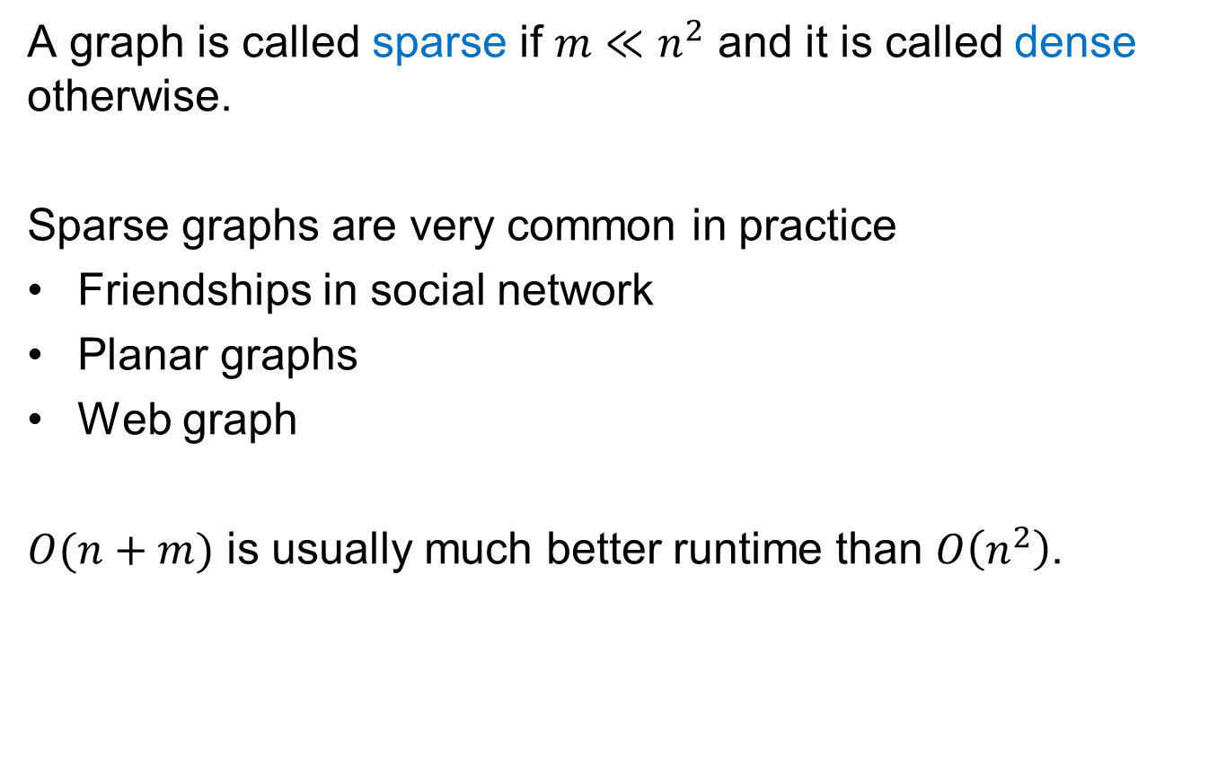
Sparse Graphs
A graph is called sparse if $m≪n^{2}$ and it is called dense otherwise.
Sparse graphs are very common in practice
Friendships in social network
Planar graphs
Web graph
$O(n+m)$ is usually much better runtime than $O\left(n^{2}\right)$.

Slide 28
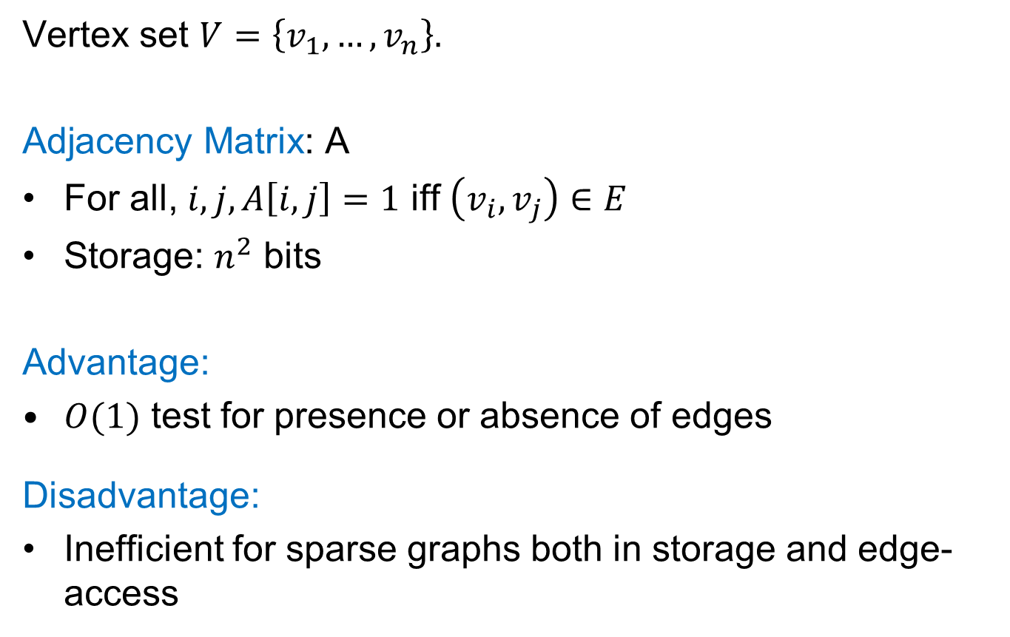
Storing Graphs
Vertex set $V=\left\{v_{1},…,v_{n}\right\}.$
Adjacency Matrix: A
For all, $i,j, A\left[i,j\right]=1$ iff $\left(v_{i},v_{j}\right)∈E$
Storage: $n^{2}$ bits
Advantage:
$O(1)$ test for presence or absence of edges
Disadvantage:
Inefficient for sparse graphs both in storage and edge-access
1
2
4
3
$$\begin{matrix} & 1 & 2 & 3 & 4 \\ 1 & 0 & 0 & 0 & 1 \\ 2 & 0 & 0 & 1 & 1 \\ 3 & 0 & 1 & 0 & 1 \\ 4 & 1 & 1 & 1 & 0\end{matrix}$$

Slide 29
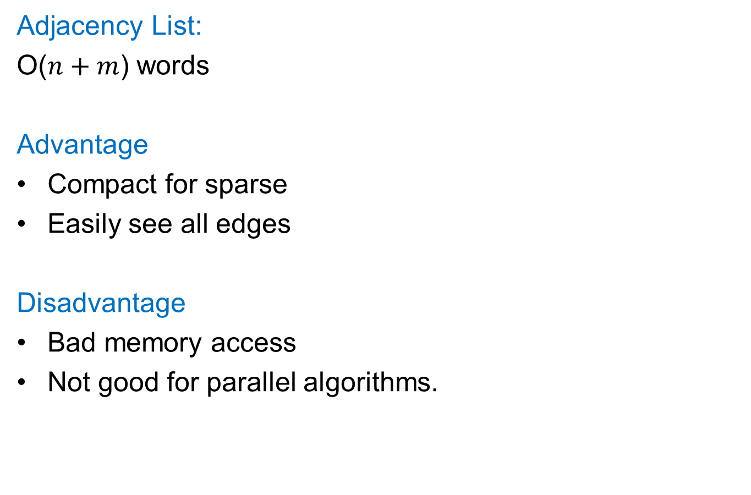
Storing Graphs
1
2
4
Adjacency List:
O($n+m$) words
Advantage
Compact for sparse
Easily see all edges
Disadvantage
Bad memory access
Not good for parallel algorithms.
3
1
4
2
3
4
3
2
4
4
1
2
3

Slide 30
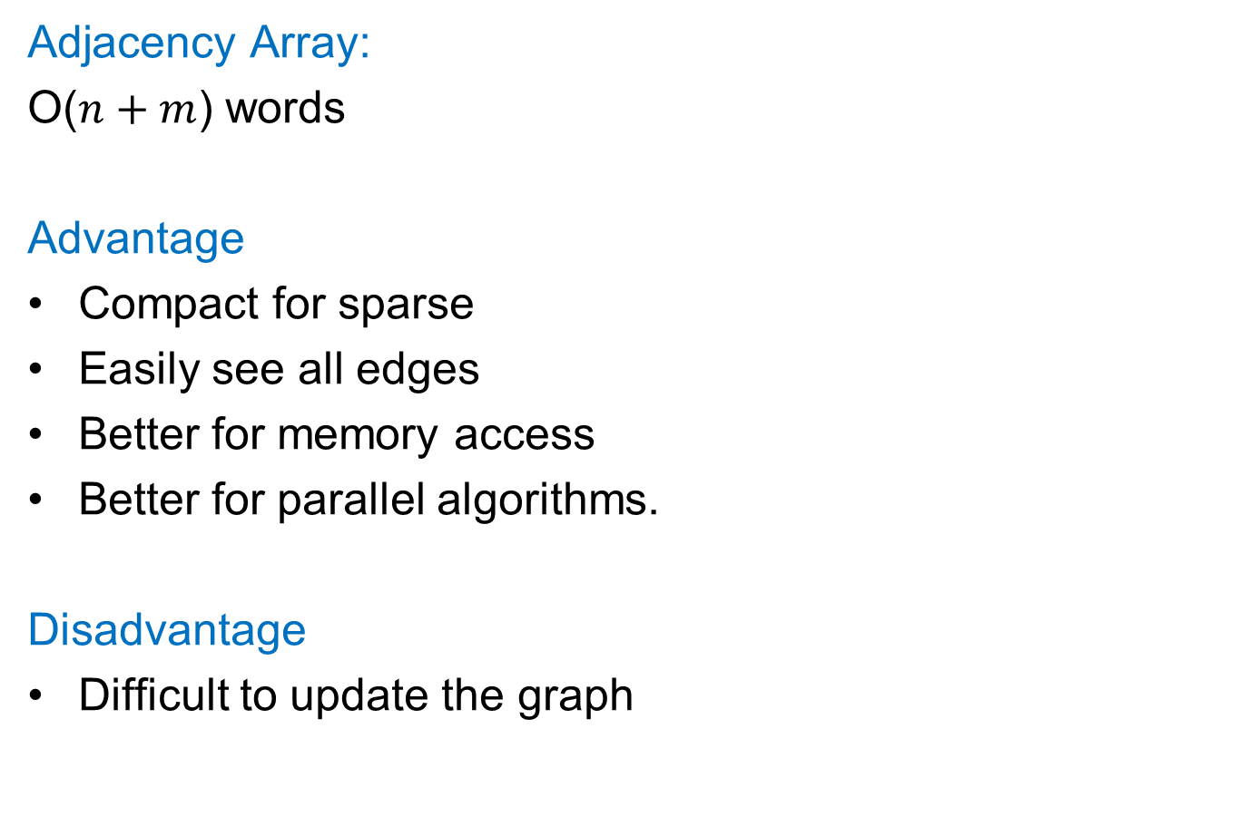
Storing Graphs
1
2
4
Adjacency Array:
O($n+m$) words
Advantage
Compact for sparse
Easily see all edges
Better for memory access
Better for parallel algorithms.
Disadvantage
Difficult to update the graph
3
1
4
2
3 4
3
2 4
4
1 2 3

Slide 31
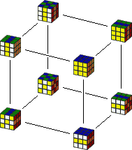
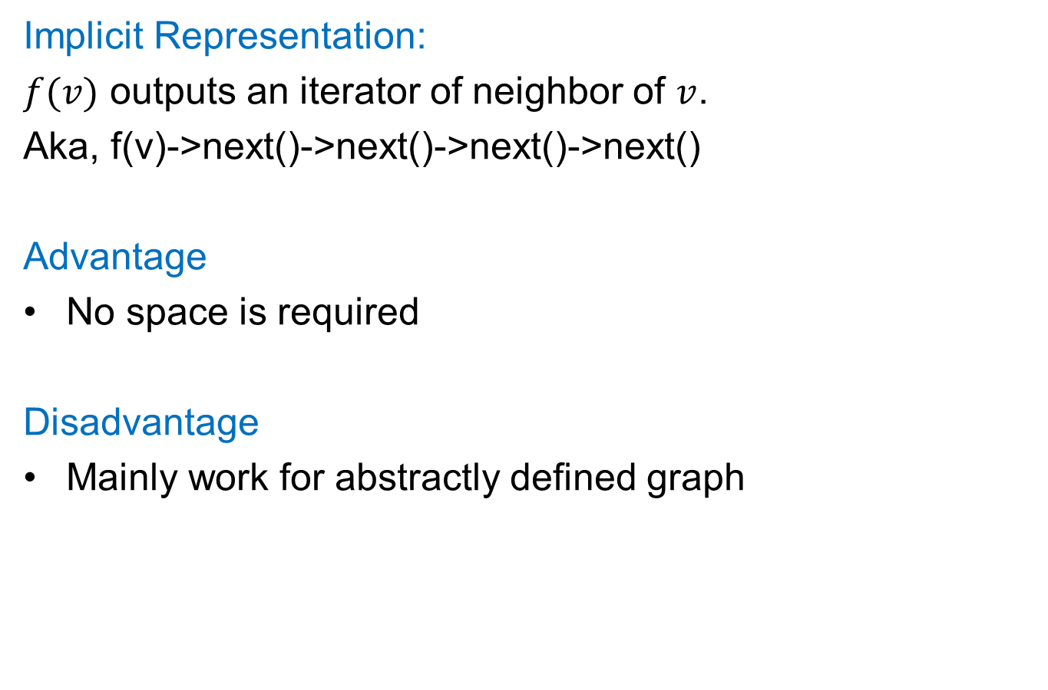
Storing Graphs
Implicit Representation:
$f(v)$ outputs an iterator of neighbor of $v$.
Aka, f(v)->next()->next()->next()->next()
Advantage
No space is required
Disadvantage
Mainly work for abstractly defined graph
2,125,922,464,947,725,402,112,000 states.

Slide 32
Storing Graphs
In practice, pick the representation according to the algorithm (depends how we want to access the graph).
In this course, we focus on asymptotic runtime.
We can simply do this:
For each vertex, use a hash table to store its neighbors
This gives O(1) time for many operations
Insert, Delete, Find, Next, …

