Slide 1
CSE 421
Applications of Max Flow
Yin Tat Lee

Slide 2
Applications of Max Flow: Bipartite Matching

Slide 3
Maximum Matching Problem
Given an undirected graph $G=(V, E)$.
A set $M⊆E$ is a matching if each vertex appears in at most 1 edge in $M$.
Goal: find a matching with largest cardinality.

Slide 4
Bipartite Matching Problem
Given an undirected bipartite graph $G=(X∪Y,E)$
A set $M⊆E$ is a matching if each vertex appears in at most 1 edge in $M$.
Goal: find a matching with largest cardinality.
1
1'
2
2'
3
3'
$$X$$
$$Y$$
4
4'
5
5'

Slide 5
Bipartite Matching using Max Flow
Create digraph $H$ as follows:
Orient all edges from $X$ to $Y$ and assign infinite (or unit) capacity.
Add source $s$, and unit capacity edges from $s$ to each node in $X$.
Add sink $t$, and unit capacity edges from each node in $Y$ to $t$.
$$H$$
1
$$∞$$
1'
$$1$$
2
2'
$$1$$
s
3
3'
t
4
4'
5
5'
$$X$$
$$Y$$

Slide 6
Bipartite Matching: Proof of Correctness
Thm. Max cardinality matching in $G=$ value of max flow in $H$.
Pf. (matching val ≤ maxflow val)
Given max matching $M$ of cardinality $k$.
Consider flow $f$ that sends $1$ unit along each of $k$ edges of $M$.
$f$ is a flow and has cardinality $k$.
1
1'
1
$$∞$$
1'
$$H$$
$$G$$
2
2'
1
2
2'
1
3
3'
s
3
3'
t
4
4'
4
4'
5
5'
5
5'

Slide 7
Bipartite Matching: Proof of Correctness
Thm. Max cardinality matching in $G$ $=$ value of max flow in $H$.
Pf. (of matching val $≥$ flow val) Let f be a max flow in $H$ of value $k$.
Integrality theorem ⇒ $k$ is integral and we can assume $f$ is 0-1.
Consider $M=$ set of edges from $X$ to $Y$ with $f\left(e\right)=1$.
each node in $X$ and $Y$ participates in at most one edge in $M$
$|M| = k$ because the flow from $s∪X$ to $Y∪t$ equals to the flow value $k$.
G
1
$$∞$$
1'
H
1
1'
1
2
2'
1
2
2'
s
3
3'
t
3
3'
4
4'
4
4'
5
5'
5
5'

Slide 8
Applications of Max Flow: Perfect Bipartite Matching

Slide 9
Perfect Bipartite Matching
Def. A matching $M⊂E$ is perfect if each node appears in exactly one edge in M.
Q. When does a bipartite graph have a perfect matching?
Structure of bipartite graphs with perfect matchings:
Clearly we must have $|X|=|Y|$.
What other conditions are necessary?
What conditions are sufficient?

Slide 10
Perfect Bipartite Matching: N(S)
$$N(S)$$
Def. Let $S$ be a subset of nodes,
and let $N(S)$ be the set of nodes
adjacent to nodes in $S$.
Observation. If a bipartite graph $G$ has a
perfect matching, then $\left|N\left(S\right)\right|≥|S|$ for all subsets $S⊂X$.
Pf. Each $v∈S$ has to be matched to a unique node in $N(S)$.
$$S$$
$$N(S)$$
$$S$$

Slide 11
Marriage Theorem
Thm: [Frobenius 1917, Hall 1935] Let $G = (X∪Y, E)$ be a bipartite graph with $|X| = |Y|$.
Then, $G$ has a perfect matching iff $\left|N\left(S\right)\right|≥\left|S\right|$ for all subsets $S⊆X$.
Pf. ⇒
This was the previous observation.
If $\left|N\left(S\right)\right|<|S|$ for some $S$, then there is no perfect matching.

Slide 12
Marriage Theorem
Pf. $∃S⊆X$ s.t., $|N\left(S\right)|<|S|$ $⇐$ G does not a perfect matching
Formulate as a max-flow and let $(A,B)$ be the min s-t cut
G has no perfect matching => $v\left(f^{∗}\right)<|X|$. So, $cap\left(A,B\right)<|X|$
Define $X_{A}=X∩A,X_{B}=X∩B,Y_{A}=Y∩A$
Then, $cap\left(A,B\right)≥\left|X_{B}\right|+|Y_{A}|$
Since min-cut does not use $∞$ edges, $N\left(X_{A}\right)⊆Y_{A}$
$$\left|N\left(X_{A}\right)\right|≤\left|Y_{A}\right|≤cap\left(A,B\right)−\left|X_{B}\right|=cap\left(A,B\right)−\left|X\right|+\left|X_{A}\right|<|X_{A}|$$
$$X_{B}$$
$$Y_{B}$$
$$∞$$
s
t
$$X_{A}$$
$$Y_{A}$$

Slide 13
Applications of Max Flow: Edge Disjoint Paths

Slide 14
Edge Disjoint Paths Problem
Given a digraph $G=(V, E)$ and two nodes $s$ and $t$, find the max number of edge-disjoint $s−t$ paths.
Def. Two paths are edge-disjoint if they have no edge in common.
Ex: communication networks.
2
5
s
3
6
t
4
7

Slide 15
Max Flow Formulation
Assign a unit capacitary to every edge. Find Max flow from $s$ to $t$.
Thm. Max number edge-disjoint s-t paths equals max flow value.
Proof. # of disjoint path $≤$ maxflow value
Suppose there are $k$ edge-disjoint paths $P_{1},…,P_{k}$.
Set $f(e)=1$ if $e$ participates in some path $P_{i}$ ; else set $f\left(e\right)=0$.
Since paths are edge-disjoint, $f$ is a flow of value $k$. ▪
1
1
1
1
1
1
s
1
1
t
1
1
1
1
1
1

Slide 16
Max Flow Formulation
Thm. Max number edge-disjoint s-t paths equals max flow value.
Pf. # of disjoint path $≥$ maxflow val Suppose max flow value is $k$
Integrality theorem ⇒ there exists 0-1 flow $f$ of value $k$.
Consider edge $(s, u)$ with $f(s, u)=1$.
by conservation, there exists an edge $(u, v)$ with $f(u, v)=1$
continue until reach $t$, always choosing a new edge
This produces $k$ (not necessarily simple) edge-disjoint paths. ▪
1
1
1
1
1
1
s
1
1
t
1
1
1
1
1
1
We can return to u so we can have cycles. But we can eliminate cycles if desired

Slide 17
Applications of Max Flow: Project Selection

Slide 18
Project Selection
Given a DAG $G=(V,E)$ representing precedence constraints on tasks (a task points to its predecessors).
Task $v∈V$ has a profit value $p(v)$ (can be positive or negative).
Goal: Find a set $A⊂V$ of tasks that
satisfies the precedence constraints,
maximizes $Profit\left(A\right)=\sum_{v∈A}{p(v)}.$
-1
2
4
3
8
-5
-6
-3
10
4
11
12
-13
14
Each task points to its predecessors

Slide 19
Extended Graph
s
-1
2
4
3
8
-5
-6
-3
10
4
11
12
-13
14
t

Slide 20
Extended Graph $G′$
For each $v$
If $p\left(v\right)>0$, add $\left(s,v\right)$ edge with capacity $p\left(v\right)$.
If $p\left(v\right)<0$, add $(v,t)$ edge with capacity $−p(v)$.
s
10
-1
2
4
3
8
-5
-6
-3
10
4
11
12
5
-13
14
t

Slide 21
Extended Graph $G′$
Goal: Set capacities on edges of $G$ so that for minimum $s$-$t$ cut $(S,\overline{S})$ in $G′$, the set $A=S−\{s\}$
satisfies precedence constraints
has maximum possible profit in $G$
To satisfy constraints, don’t want any original edges of $G$ cross the minimum cut
Otherwise, a task in $A=S−\{s\}$ had a predecessor not in $A$.
How?
Set capacity of each of the edges of $G$ to $+∞$.

Slide 22
Extended Graph $G′$
s
Cut $C≔\sum_{v:p\left(v\right)>0}{p\left(v\right)}$
C = 11+8+14+4+
10+12+3+4+2
-1
2
4
3
8
-5
-6
-3
10
4
11
12
-13
14
t

Slide 23
Extended Graph $G′$
Cut
=13+3+2+3+4
=13+3
+C-4-8-10-11-12-14
s
This edge doesn’t cross $A$
-1
2
4
3
8
-5
-6
-3
10
4
11
12
-13
14
t

Slide 24
Project Selection
Claim: For any $s$-$t$ cut $(S,\overline{S})$ in $G′$ with finite capacity,
the set $A=S−\{s\}$ satisfies
precedence constraints and
has capacity $cap\left(S,\overline{S}\right)=C−\sum_{v∈A}{p\left(v\right)}=C−Profit\left(A\right)$
Corollary: A minimum $s$-$t$ cut $(S,\overline{S})$ in $G′$ yields an optimal solution $A=S−\{s\}$ to the project selection problem
Algorithm:
Compute maximum flow $f$ in $G′$
Find the set $S$ of vertices reachable from $s$ in $G_{f}^{′}$
Return $S−\{s\}$

Slide 25
Proof of Claim
$A=S−\{s\}$ satisfies precedence constraints
No edge of $G$ crosses forward out of $A$ since those edges have capacity $+∞$
Capacity = $C−Profit\left(A\right)$
Only forward edges cut are of the form
$(v,t)$ for $v∈A$ or $(s,v)$ for $v∉A$
The $(v,t)$ edges for $v∈A$ contribute
$\sum_{v∈A:p\left(v\right)<0}{−p(v)}=−\sum_{v∈A:p\left(v\right)<0}{p(v)}$
The $(s,v)$ edges for $v∉A$ contribute
$\sum_{v∉A:p\left(v\right)>0}{p(v)}=C−\sum_{v∈A:p\left(v\right)>0}{p(v)}$
Therefore, the total capacity is
$C−\sum_{v:p\left(v\right)>0}{p\left(v\right)}=C−Profit\left(A\right)$

Slide 26
Applications of Max Flow: Image Segmentation

Slide 27
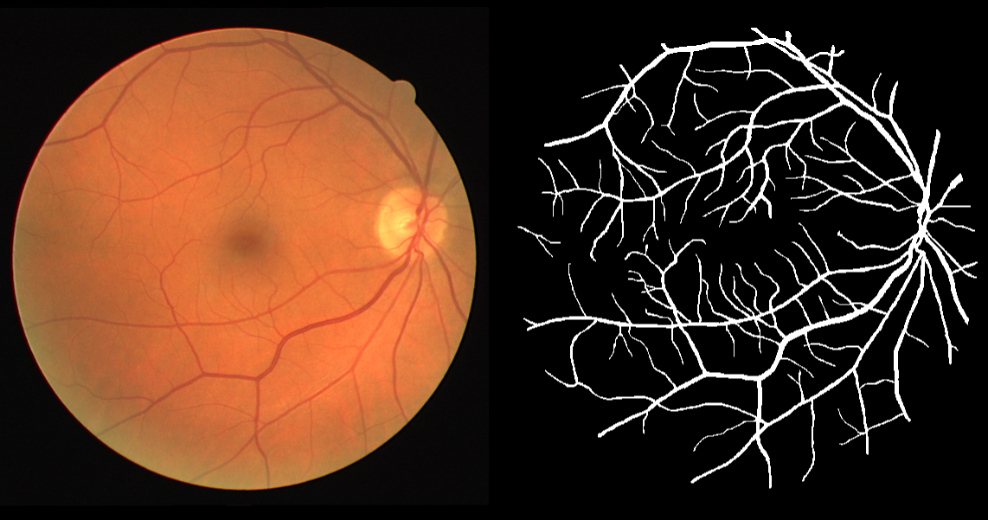
Image Segmentation
Given an image we want to separate
foreground from background
Important problem in image processing.
Divide image into coherent regions.

Slide 28
Foreground / background segmentation
Label each pixel as foreground/background.
$V$ = set of pixels, $E$ = pairs of neighboring pixels.
$a_{i}$ is the original image.
$a_{i}≫0$ means we prefer to label $i$ in foreground.
$p_{i,j}≥0$ is separation penalty for labeling one of $i$ and j as foreground, and the other as background.
Goals:
Find partition $(S, \overline{S})$ that minimizes:
$$−\sum_{i∈S}{a_{i}}+\sum_{\begin{aligned}\left(i,j\right)∈E \\ i∈S,j∈\overline{S}\end{aligned}}{p_{i,j}}$$
where $S$ is the foreground.

Slide 29
Min cut Formulation
$G′ = (V′, E′).$
Add $s$ to correspond to foreground;
Add $t$ to correspond to background;
Use two anti-parallel edges instead of undirected edge.
$$p_{i,j}$$
$$p_{i,j}$$
$$p_{i,j}$$
$$p_{i,j}$$
$a_{j}$ if $a_{j}>0$
s
i
j
t
$−a_{j}$ if $a_{j}<0$
$$G′$$

Slide 30
Min cut Formulation (cont’d)
Consider min cut $(S, \overline{S})$ in G’. ($S$ = foreground.)
$$cap\left(S, \overline{S}\right)=\sum_{i∈S}{−a_{i}}1_{a_{i}<0}+\sum_{i∈\overline{S}}{a_{i}}1_{a_{i}>0}+\sum_{\begin{aligned}\left(i,j\right)∈E \\ i∈S,j∈\overline{S}\end{aligned}}{p_{i,j}}$$
$=−\sum_{i∈S}{a_{i}}+\sum_{i∈S}{a_{i}}1_{a_{i}>0}+\sum_{i∈\overline{S}}{a_{i}}1_{a_{i}>0}+\sum_{⋯}{p_{i,j}}$
$=−\sum_{i∈S}{a_{i}}+\sum_{i}{a_{i}}+\sum_{⋯}{p_{i,j}}$
$=−\sum_{i∈S}{a_{i}}+\sum_{⋯}{p_{i,j}}+constant$
Precisely, what we want to minimize.
$$p_{i,j}$$
$a_{j}$ if $a_{j}>0$
s
i
j
t
$$S$$
$−a_{j}$ if $a_{j}<0$
$$G′$$

Slide 31
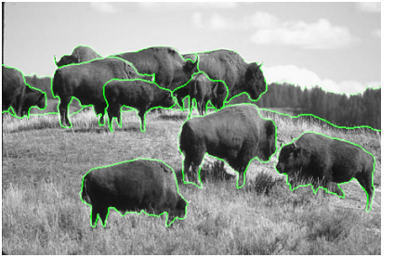
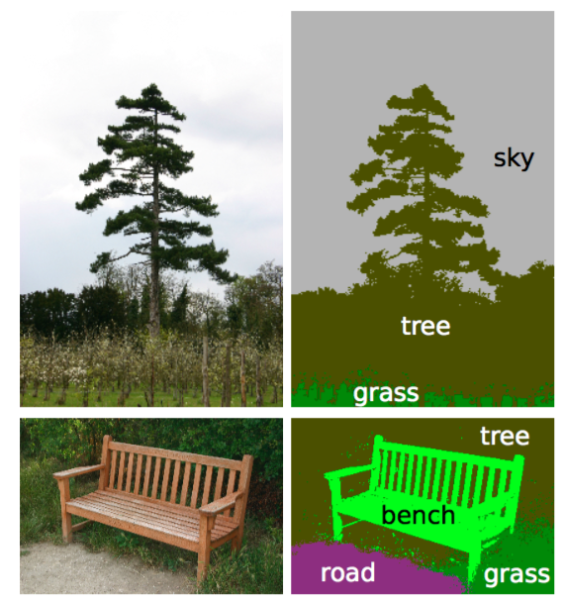
Remark
The main difficulty is to come up with a good model.
May want to have human interaction.
Segmentation may be real-valued instead of {0,1}.
There are many more than 1 objects.
May need labeling.
Augmenting path is not great for GPU.

Slide 32
Edmonds-Karp Algorithm

Slide 33
Edmonds-Karp Algorithm
Use a shortest augmenting path (via Breadth First Search in residual graph)
Time: $O(m^{2}n)$.
G
G_{f}
G_{f’}
s
s
s
5/9
x
x
x
3/10
0/5
u
u
u
3/3
v
v
v
2/5
t
t
t

Slide 34
Distance to $s$ is non-decreasing.
Let $f$ be a flow, $G_{f}$ the residual graph, and $P$ a shortest augmenting path. Then no vertex is closer to $s$ after augmentation along $P$.
Proof: Augmentation along $P$ only
deletes forward edges
no new (hence no shorter) path created
adds back edges that go to previous vertices along $P$
BFS is unchanged, since $v$ visited before $(u,v)$ examined
s
v
a back edge
u

Slide 35
Distance for bottleneck edges
Let $d_{f}(s,v)$ be the distance from $s$ to $v$ on $G_{f}$.
Shortest s-t path P in G_{f}
>c_{P}
>c_{P}
c_{P}
c_{P}
s
u
v
x
w
t
bottleneck edge
After augmenting along $P$
$d_{f}\left(s,v\right)=d_{f}\left(s,u\right)+1$ since this is a shortest path
>0
>0
s
u
v
x
w
t
For $(u,v)$ to be bottleneck again for some flow $f′$
s
u
v
x
w
t
$$d_{f^{′}}\left(s,u\right)=d_{f^{′}}\left(s,v\right)+1≥d_{f}\left(s,v\right)+1=d_{f}\left(s,u\right)+2$$

Slide 36
Theorem
Edmonds-Karp performs $O(mn)$ flow augmentations
Proof:
Each step, some edge disappear from $G_{f}$.
(Note however that some edge may reappear.)
Any edge $(u,v)$ disappears from $G_{f}$ at most $n/2$ times.
(because the distance increased by $2$ every disappearance.)
There are at most $mn/2$ disappearances.
Total time is $O(m^{2}n)$.

