Slide 1
CSE 421: Introduction to Algorithms
Application of BFS
Yin Tat Lee

Slide 2

Bipartite Graphs
Definition: An undirected graph $G=(V,E)$ is bipartite
if you can partition the vertex set into 2 parts (say, blue/red or left/right) so that
all edges join vertices in different parts
i.e., no edge has both ends in the same part.
Application:
Scheduling: machine=red, jobs=blue
Stable Matching: men=blue, woman=red
a bipartite graph

Slide 3

Testing Bipartiteness
  Problem: Given a graph $G$, is it bipartite?
  Many graph problems become:
  Easier/Tractable if the underlying graph is bipartite (matching)
  Before attempting to design an algorithm, we need to understand structure of bipartite graphs.
v₂
v₃
v₂
v₁
v₄
v₆
v₅
v₄
v₃
v₅
v₆
v₇
v₁
v₇
a bipartite graph G
another drawing of G

Slide 4

An Obstruction to Bipartiteness
  Lemma: If $G$ is bipartite, then it does not contain an odd length cycle.
Proof: We cannot $2$-color an odd cycle, let alone $G$.
?
bipartite
(2-colorable)
not bipartite
(not 2-colorable)

Slide 5

A Characterization of Bipartite Graphs
Lemma: Let $G$ be a connected graph, and let $L0, …, L_{k}$ be the layers produced by BFS($s$). Exactly one of the following holds.
  (i) No edge of $G$ joins two nodes of the same layer, and $G$ is bipartite.
  (ii) An edge of $G$ joins two nodes of the same layer, and $G$contains an odd-length cycle (and hence is not bipartite).
L₁
L₂
L₃
L₁
L₂
L₃
Case (i)
Case (ii)

Slide 6
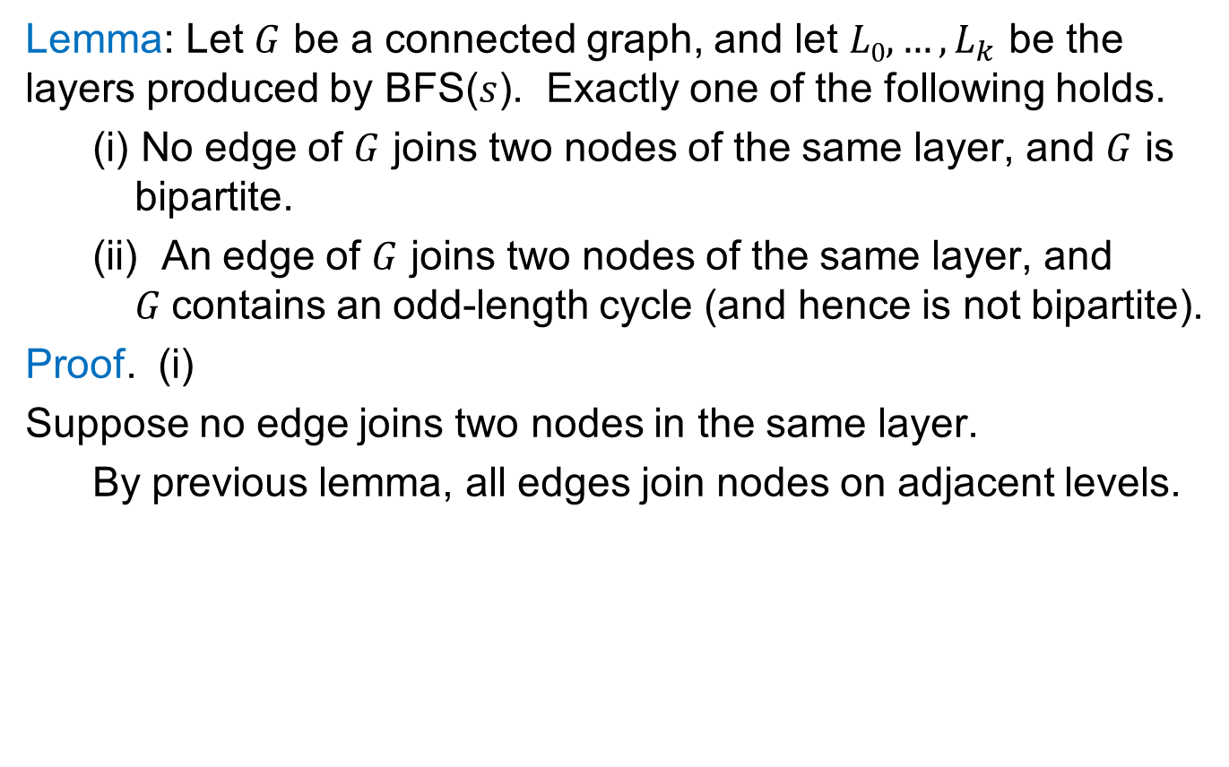
A Characterization of Bipartite Graphs
Lemma: Let $G$ be a connected graph, and let $L0, …, L_{k}$ be the layers produced by BFS($s$). Exactly one of the following holds.
  (i) No edge of $G$ joins two nodes of the same layer, and $G$ is bipartite.
  (ii) An edge of $G$ joins two nodes of the same layer, and $G$contains an odd-length cycle (and hence is not bipartite).
Proof. (i)
Suppose no edge joins two nodes in the same layer.
  By previous lemma, all edges join nodes on adjacent levels.
Bipartition:
blue = nodes on odd levels,
red = nodes on even levels.
L₁
L₂
L₃
Case (i)

Slide 7
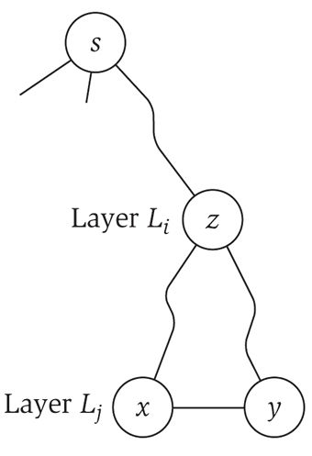
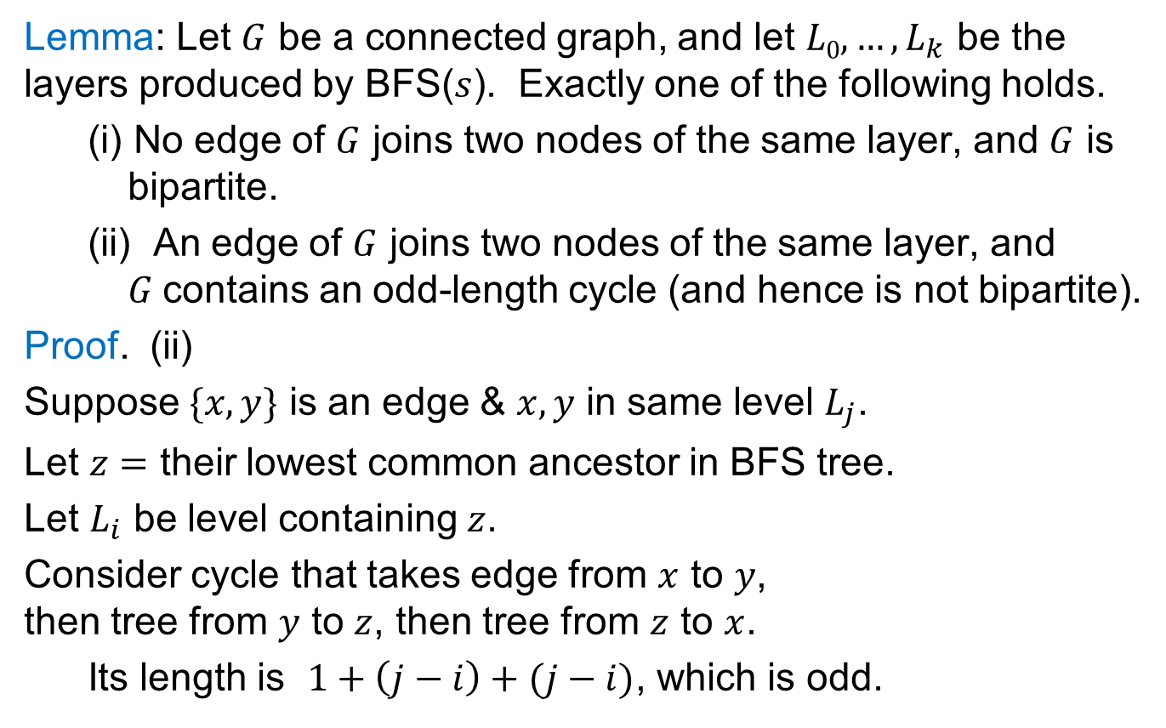
A Characterization of Bipartite Graphs
Lemma: Let $G$ be a connected graph, and let $L0, …, L_{k}$ be the layers produced by BFS($s$). Exactly one of the following holds.
  (i) No edge of $G$ joins two nodes of the same layer, and $G$ is bipartite.
  (ii) An edge of $G$ joins two nodes of the same layer, and $G$contains an odd-length cycle (and hence is not bipartite).
Proof. (ii)
Suppose $\{x, y\}$ is an edge & $x,y$ in same level $L_{j}$.
Let $z=$ their lowest common ancestor in BFS tree.
Let $L_{i}$ be level containing $z$.
Consider cycle that takes edge from $x$ to $y$,
then tree from $y$ to $z$, then tree from $z$ to $x$.
  Its length is $1+\left(j−i\right)+(j−i)$, which is odd.
z = lca(x, y)

Slide 8

Obstruction to Bipartiteness
  Corollary: A graph $G$ is bipartite if and only if it contains no odd length cycles.
  Furthermore, one can test bipartiteness using BFS.
bipartite
(2-colorable)
not bipartite
(not 2-colorable)

Slide 9
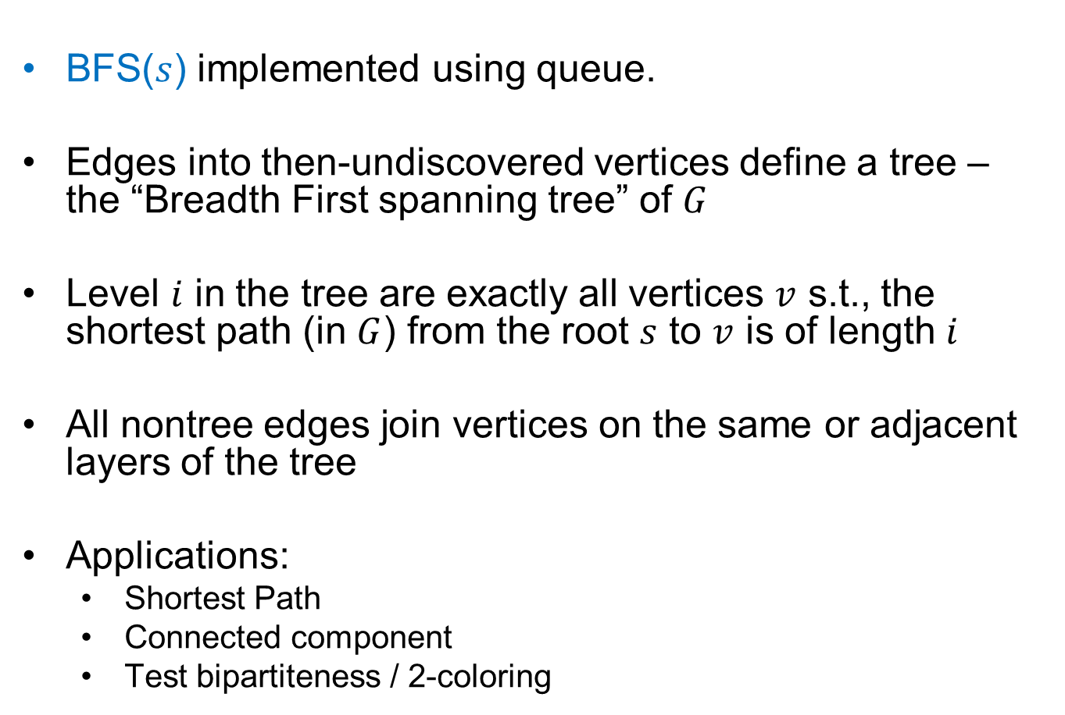
Summary
BFS($s$) implemented using queue.
Edges into then-undiscovered vertices define a tree – the “Breadth First spanning tree” of $G$
Level $i$ in the tree are exactly all vertices $v$ s.t., the shortest path (in $G$) from the root $s$ to $v$ is of length $i$
All nontree edges join vertices on the same or adjacent layers of the tree
Applications:
  Shortest Path
  Connected component
  Test bipartiteness / 2-coloring

Slide 10
CSE 421
Depth First Search
Yin Tat Lee

Slide 11
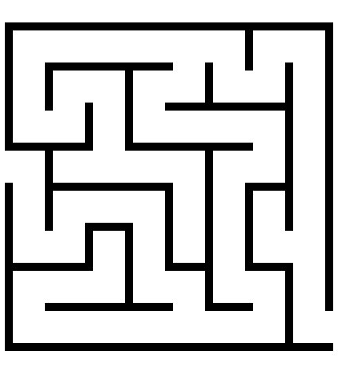

Depth First Search
Follow the first path you find
as far as you can go; back up
to last unexplored edge when
you reach a dead end,
then go as far you can
Naturally implemented using recursive calls or a stack

Slide 12
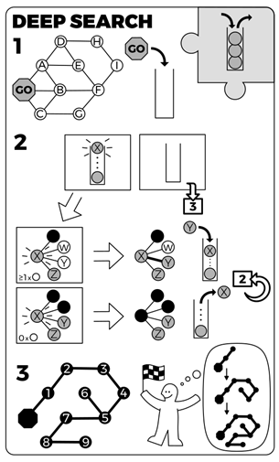
DFS(s) – Recursive version
Initialization: mark all vertices undiscovered
DFS($v$)
  Mark $v$ discovered
  for each edge $\{v,x\}$
  if ($x$ is undiscovered)
  Mark $x$ discovered
  $x→parent=u$
  DFS($x$)
  Mark $v$ fully-discovered

Slide 13
Non-Tree Edges in DFS
BFS tree ≠ DFS tree, but, as with BFS, DFS has found a tree in the graph s.t. non-tree edges are "simple" in some way.
All non-tree edges join a vertex and one of its descendants/ancestors in the DFS tree

Slide 14
DFS(A)
Color code:
  undiscovered
  discovered
  fully-explored
A,1
Suppose edge lists
at each vertex
are sorted alphabetically
Call Stack
(Edge list):
A (B,J)
B
J
C
G
H
K
L
D
F
I
M
st[] = {1}
E

Slide 15
DFS(A)
Color code:
  undiscovered
  discovered
  fully-explored
A,1
Call Stack:
(Edge list)
A (B,J)
B (A,C,J)
B,2
J
C
G
H
K
L
D
F
I
M
st[] = {1,2}
E

Slide 16
DFS(A)
Color code:
  undiscovered
  discovered
  fully-explored
A,1
Call Stack:
(Edge list)
A (B,J)
B (A,C,J)
C (B,D,G,H)
B,2
J
C,3
G
H
K
L
D
F
I
M
st[] = {1,2,3}
E

Slide 17
DFS(A)
Color code:
  undiscovered
  discovered
  fully-explored
A,1
Call Stack:
(Edge list)
A (B,J)
B (A,C,J)
C (B,D,G,H)
D (C,E,F)
B,2
J
C,3
G
H
K
L
D,4
F
I
M
st[] = {1,2,3,4}
E

Slide 18
DFS(A)
Color code:
  undiscovered
  discovered
  fully-explored
A,1
Call Stack:
(Edge list)
A (B,J)
B (A,C,J)
C (B,D,G,H)
D (C,E,F)
E (D,F)
B,2
J
C,3
G
H
K
L
D,4
F
I
M
st[] = {1,2,3,4,5}
E,5

Slide 19
DFS(A)
Color code:
  undiscovered
  discovered
  fully-explored
A,1
Call Stack:
(Edge list)
A (B,J)
B (A,C,J)
C (B,D,G,H)
D (C,E,F)
E (D,F)
F (D,E,G)
B,2
J
C,3
G
H
K
L
D,4
F,6
I
M
st[] = {1,2,3,4,5,6}
E,5

Slide 20
DFS(A)
Color code:
  undiscovered
  discovered
  fully-explored
A,1
Call Stack:
(Edge list)
A (B,J)
B (A,C,J)
C (B,D,G,H)
D (C,E,F)
E (D,F)
F (D,E,G)
G (C,F)
B,2
J
C,3
G,7
H
K
L
D,4
F,6
I
M
st[] = {1,2,3,4,5,6,7}
E,5

Slide 21
DFS(A)
Color code:
  undiscovered
  discovered
  fully-explored
A,1
Call Stack:
(Edge list)
A (B,J)
B (A,C,J)
C (B,D,G,H)
D (C,E,F)
E (D,F)
F (D,E,G)
G (C,F)
B,2
J
C,3
G,7
H
K
L
D,4
F,6
I
M
st[] = {1,2,3,4,5,6,7}
E,5

Slide 22
DFS(A)
Color code:
  undiscovered
  discovered
  fully-explored
A,1
Call Stack:
(Edge list)
A (B,J)
B (A,C,J)
C (B,D,G,H)
D (C,E,F)
E (D,F)
F (D,E,G)
B,2
J
C,3
G,7
H
K
L
D,4
F,6
I
M
st[] = {1,2,3,4,5,6}
E,5

Slide 23
DFS(A)
Color code:
  undiscovered
  discovered
  fully-explored
A,1
Call Stack:
(Edge list)
A (B,J)
B (A,C,J)
C (B,D,G,H)
D (C,E,F)
E (D,F)
B,2
J
C,3
G,7
H
K
L
D,4
F,6
I
M
st[] = {1,2,3,4,5}
E,5

Slide 24
DFS(A)
Color code:
  undiscovered
  discovered
  fully-explored
A,1
Call Stack:
(Edge list)
A (B,J)
B (A,C,J)
C (B,D,G,H)
D (C,E,F)
B,2
J
C,3
G,7
H
K
L
D,4
F,6
I
M
st[] = {1,2,3,4}
E,5

Slide 25
DFS(A)
Color code:
  undiscovered
  discovered
  fully-explored
A,1
Call Stack:
(Edge list)
A (B,J)
B (A,C,J)
C (B,D,G,H)
B,2
J
C,3
G,7
H
K
L
D,4
F,6
I
M
st[] = {1,2,3}
E,5

Slide 26
DFS(A)
Color code:
  undiscovered
  discovered
  fully-explored
A,1
Call Stack:
(Edge list)
A (B,J)
B (A,C,J)
C (B,D,G,H)
H (C,I,J)
B,2
J
C,3
G,7
H,8
K
L
D,4
F,6
I
M
st[] = {1,2,3,8}
E,5

Slide 27
DFS(A)
Color code:
  undiscovered
  discovered
  fully-explored
A,1
Call Stack:
(Edge list)
A (B,J)
B (A,C,J)
C (B,D,G,H)
H (C,I,J)
I (H)
B,2
J
C,3
G,7
H,8
K
L
D,4
F,6
I,9
M
st[] = {1,2,3,8,9}
E,5

Slide 28
DFS(A)
Color code:
  undiscovered
  discovered
  fully-explored
A,1
Call Stack:
(Edge list)
A (B,J)
B (A,C,J)
C (B,D,G,H)
H (C,I,J)
B,2
J
C,3
G,7
H,8
K
L
D,4
F,6
I,9
M
st[] = {1,2,3,8}
E,5

Slide 29
DFS(A)
Color code:
  undiscovered
  discovered
  fully-explored
A,1
Call Stack:
(Edge list)
A (B,J)
B (A,C,J)
C (B,D,G,H)
H (C,I,J)
J (A,B,H,K,L)
B,2
J,10
C,3
G,7
H,8
K
L
D,4
F,6
I,9
M
st[] = {1,2,3,8, 10}
E,5

Slide 30
DFS(A)
Color code:
  undiscovered
  discovered
  fully-explored
A,1
Call Stack:
(Edge list)
A (B,J)
B (A,C,J)
C (B,D,G,H)
H (C,I,J)
J (A,B,H,K,L)
K (J,L)
B,2
J,10
C,3
G,7
H,8
K,11
L
D,4
F,6
I,9
M
st[] = {1,2,3,8,10,11}
E,5

Slide 31
DFS(A)
Color code:
  undiscovered
  discovered
  fully-explored
A,1
Call Stack:
(Edge list)
A (B,J)
B (A,C,J)
C (B,D,G,H)
H (C,I,J)
J (A,B,H,K,L)
K (J,L)
L (J,K,M)
B,2
J,10
C,3
G,7
H,8
K,11
L,12
D,4
F,6
I,9
M
st[] = {1,2,3,8,10,11,12}
E,5

Slide 32
DFS(A)
Color code:
  undiscovered
  discovered
  fully-explored
A,1
Call Stack:
(Edge list)
A (B,J)
B (A,C,J)
C (B,D,G,H)
H (C,I,J)
J (A,B,H,K,L)
K (J,L)
L (J,K,M)
M (L)
B,2
J,10
C,3
G,7
H,8
K,11
L,12
D,4
F,6
I,9
M,13
st[] = {1,2,3,8,10,11,12,13}
E,5

Slide 33
DFS(A)
Color code:
  undiscovered
  discovered
  fully-explored
A,1
Call Stack:
(Edge list)
A (B,J)
B (A,C,J)
C (B,D,G,H)
H (C,I,J)
J (A,B,H,K,L)
K (J,L)
L (J,K,M)
B,2
J,10
C,3
G,7
H,8
K,11
L,12
D,4
F,6
I,9
M,13
st[] = {1,2,3,8,10,11,12}
E,5

Slide 34
DFS(A)
Color code:
  undiscovered
  discovered
  fully-explored
A,1
Call Stack:
(Edge list)
A (B,J)
B (A,C,J)
C (B,D,G,H)
H (C,I,J)
J (A,B,H,K,L)
K (J,L)
B,2
J,10
C,3
G,7
H,8
K,11
L,12
D,4
F,6
I,9
M,13
st[] = {1,2,3,8,10,11}
E,5

Slide 35
DFS(A)
Color code:
  undiscovered
  discovered
  fully-explored
A,1
Call Stack:
(Edge list)
A (B,J)
B (A,C,J)
C (B,D,G,H)
H (C,I,J)
J (A,B,H,K,L)
B,2
J,10
C,3
G,7
H,8
K,11
L,12
D,4
F,6
I,9
M,13
st[] = {1,2,3,8, 10}
E,5

Slide 36
DFS(A)
Color code:
  undiscovered
  discovered
  fully-explored
A,1
Call Stack:
(Edge list)
A (B,J)
B (A,C,J)
C (B,D,G,H)
H (C,I,J)
J (A,B,H,K,L)
B,2
J,10
C,3
G,7
H,8
K,11
L,12
D,4
F,6
I,9
M,13
st[] = {1,2,3,8, 10}
E,5

Slide 37
DFS(A)
Color code:
  undiscovered
  discovered
  fully-explored
A,1
Call Stack:
(Edge list)
A (B,J)
B (A,C,J)
C (B,D,G,H)
H (C,I,J)
B,2
J,10
C,3
G,7
H,8
K,11
L,12
D,4
F,6
I,9
M,13
st[] = {1,2,3,8}
E,5

Slide 38
DFS(A)
Color code:
  undiscovered
  discovered
  fully-explored
A,1
Call Stack:
(Edge list)
A (B,J)
B (A,C,J)
C (B,D,G,H)
B,2
J,10
C,3
G,7
H,8
K,11
L,12
D,4
F,6
I,9
M,13
st[] = {1,2,3}
E,5

Slide 39
DFS(A)
Color code:
  undiscovered
  discovered
  fully-explored
A,1
Call Stack:
(Edge list)
A (B,J)
B (A,C,J)
B,2
J,10
C,3
G,7
H,8
K,11
L,12
D,4
F,6
I,9
M,13
st[] = {1,2}
E,5

Slide 40
DFS(A)
Color code:
  undiscovered
  discovered
  fully-explored
A,1
Call Stack:
(Edge list)
A (B,J)
B (A,C,J)
B,2
J,10
C,3
G,7
H,8
K,11
L,12
D,4
F,6
I,9
M,13
st[] = {1,2}
E,5

Slide 41
DFS(A)
Color code:
  undiscovered
  discovered
  fully-explored
A,1
Call Stack:
(Edge list)
A (B,J)
B,2
J,10
C,3
G,7
H,8
K,11
L,12
D,4
F,6
I,9
M,13
st[] = {1}
E,5

Slide 42
DFS(A)
Color code:
  undiscovered
  discovered
  fully-explored
A,1
Call Stack:
(Edge list)
A (B,J)
B,2
J,10
C,3
G,7
H,8
K,11
L,12
D,4
F,6
I,9
M,13
st[] = {1}
E,5

Slide 43
DFS(A)
Color code:
  undiscovered
  discovered
  fully-explored
A,1
Call Stack:
(Edge list)
TA-DA!!
B,2
J,10
C,3
G,7
H,8
K,11
L,12
D,4
F,6
I,9
M,13
st[] = {}
E,5

Slide 44
DFS(A)
Edge code:
  Tree edge
  Back edge
A,1
B,2
J,10
C,3
G,7
H,8
K,11
L,12
D,4
F,6
I,9
M,13
E,5

Slide 45
DFS(A)
A,1
Edge code:
  Tree edge
  Back edge
  No Cross Edges!
B,2
C,3
H,8
D,4
J,10
E,5
I,9
K,11
F,6
L,12
G,7
M,13
Notes:
By the way, suppose I’ve run dfs and each node has a dfs#
Suppose I then hand you an edge and tell you the dfs#’s of the two endpoints, how do you know which of the endpoints is the ancestor?

Slide 46
Properties of (undirected) DFS
Like BFS($s$):
DFS($s$) visits $x$ iff there is a path in G from $s$ to $x$
  So, we can use DFS to find connected components
  Edges into then-undiscovered vertices define a tree – the "depth first spanning tree" of G
Unlike the BFS tree:
The DF spanning tree isn't minimum depth
Its levels don't reflect min distance from the root
Non-tree edges never join vertices on the same or adjacent levels

Slide 47
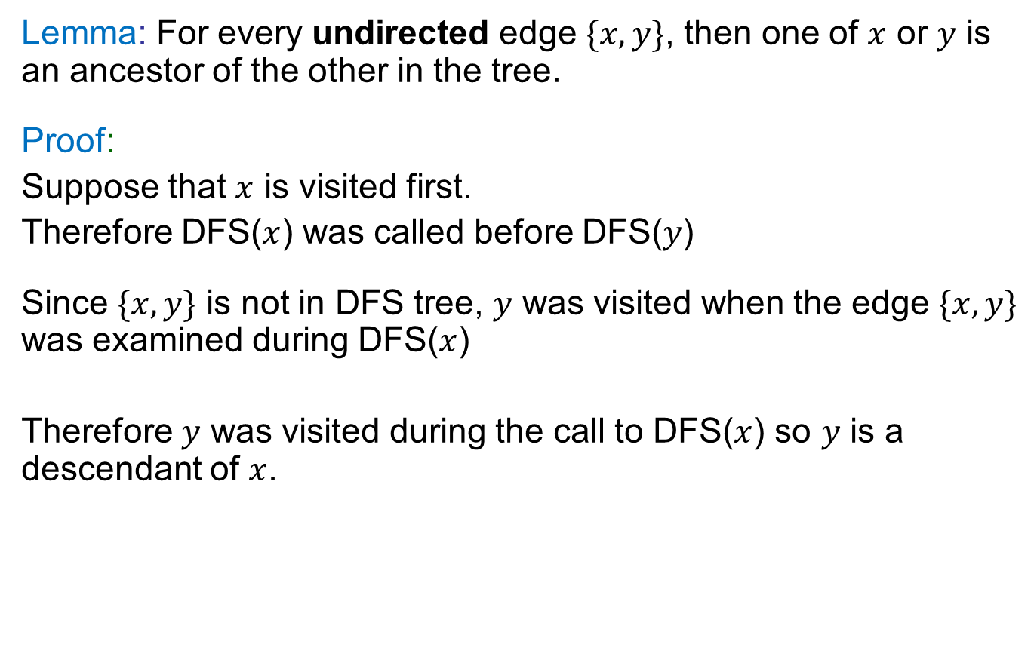
Non-Tree Edges in DFS
Lemma: For every undirected edge $\{x,y\}$, then one of $x$ or $y$ is an ancestor of the other in the tree.
Proof:
Suppose that $x$ is visited first.
Therefore DFS($x$) was called before DFS($y$)
Since $\{x,y\}$ is not in DFS tree, $y$ was visited when the edge $\{x,y\}$ was examined during DFS($x$)
Therefore $y$ was visited during the call to DFS($x$) so $y$ is a descendant of $x$.

Slide 48
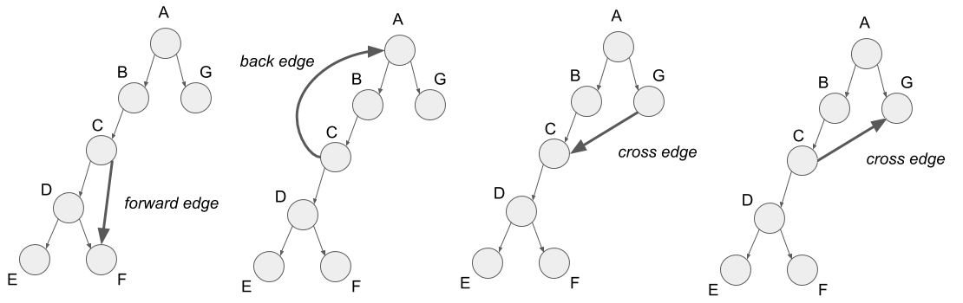

Non-Tree Edges (Directed Graph)
Lemma: For every directed edge $(x,y)$, then either
$y$ is visited first or
$y$ is a descendant of $x$

Slide 49
CSE 421
Applications of DFS
Topological sort
Yin Tat Lee

Slide 50
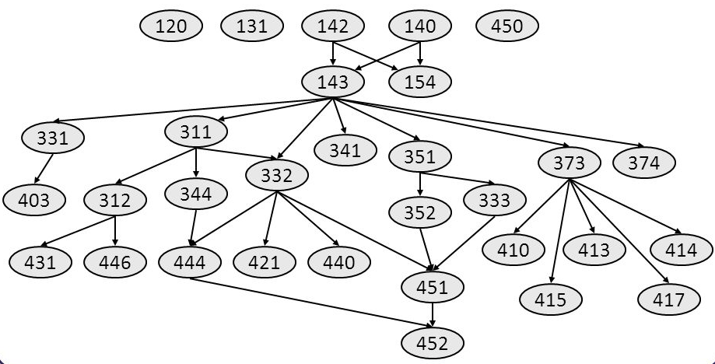
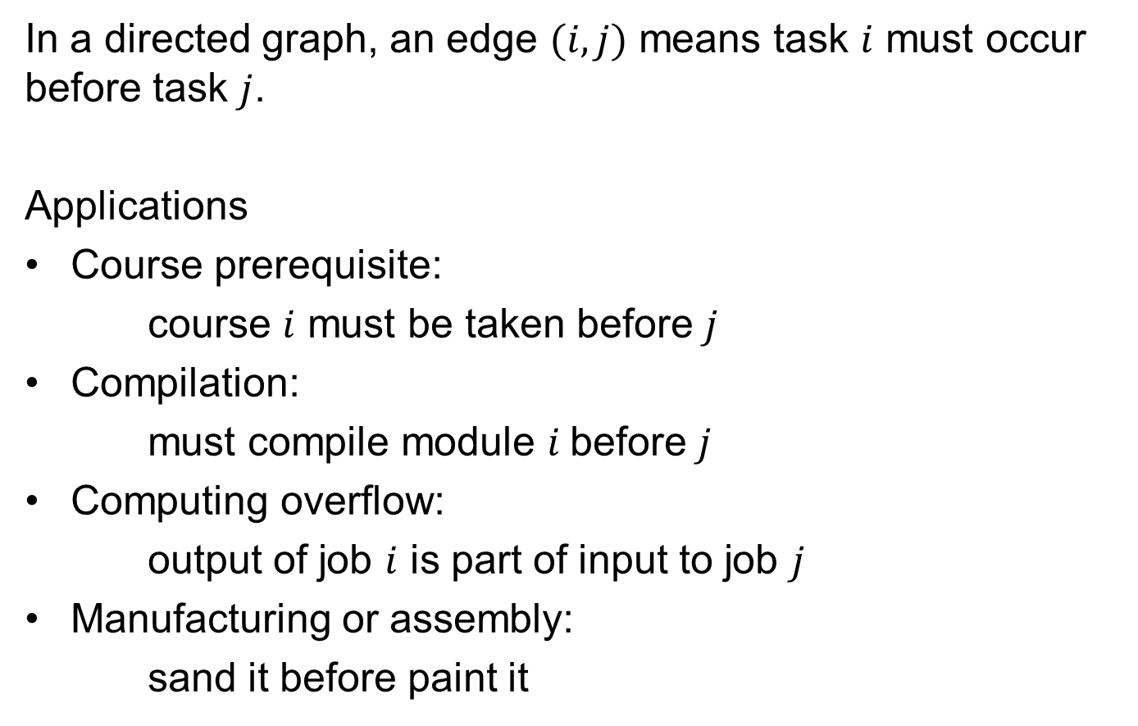
Precedence Constraints
In a directed graph, an edge $(i,j)$ means task $i$ must occur before task $j$.
Applications
Course prerequisite:
course $i$ must be taken before $j$
Compilation:
must compile module $i$before $j$
Computing overflow:
output of job $i$ is part of input to job $j$
Manufacturing or assembly:
sand it before paint it

Slide 51

Directed Acyclic Graphs (DAG)
Def: A directed acyclic graph (DAG) is a graph that
contains no directed cycles.
Def: A topological order of a directed graph $G=(V, E)$ is an ordering of its nodes as $v_{1}, v_{2}, …, v_{n}$ so that for every edge $(v_{i},v_{j})$ we have $i<j$.
₂
₃
₆
₅
₄
₁
₂
₃
₄
₅
₆
₇
₇
₁
a topological ordering of that DAG–
all edges left-to-right
a DAG

Slide 52
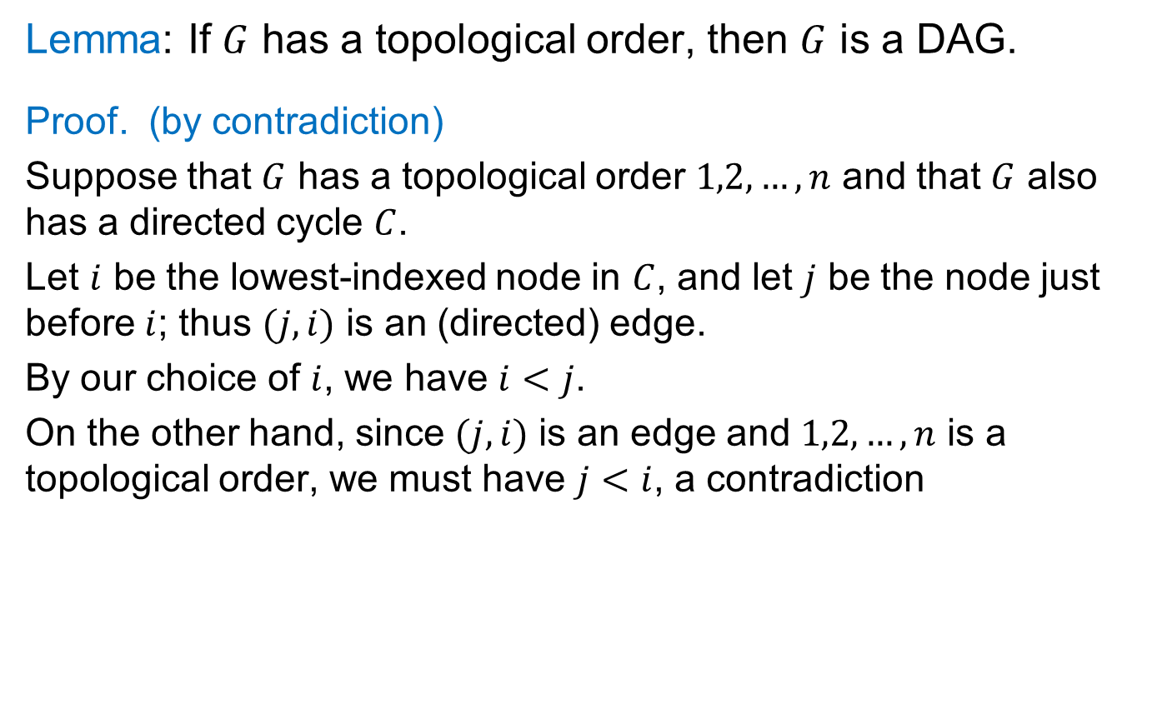


DAGs: A Sufficient Condition
Lemma: If $G$ has a topological order, then $G$ is a DAG.
Proof. (by contradiction)
Suppose that $G$ has a topological order $1,2,…,n$ and that $G$ also has a directed cycle $C$.
Let $i$ be the lowest-indexed node in $C$, and let $j$ be the node just before $i$; thus $(j, i)$ is an (directed) edge.
By our choice of $i$, we have $i<j$.
On the other hand, since $(j,i)$ is an edge and $1,2,…,n$ is a topological order, we must have $j<i$, a contradiction
the directed cycle $C$
₁
_{i}
_{j}
_{n}
the supposed topological order: $1,2,…,n$

Slide 53


DAGs: A Sufficient Condition
$G$ has a topological order
$G$ is a DAG
?

Slide 54
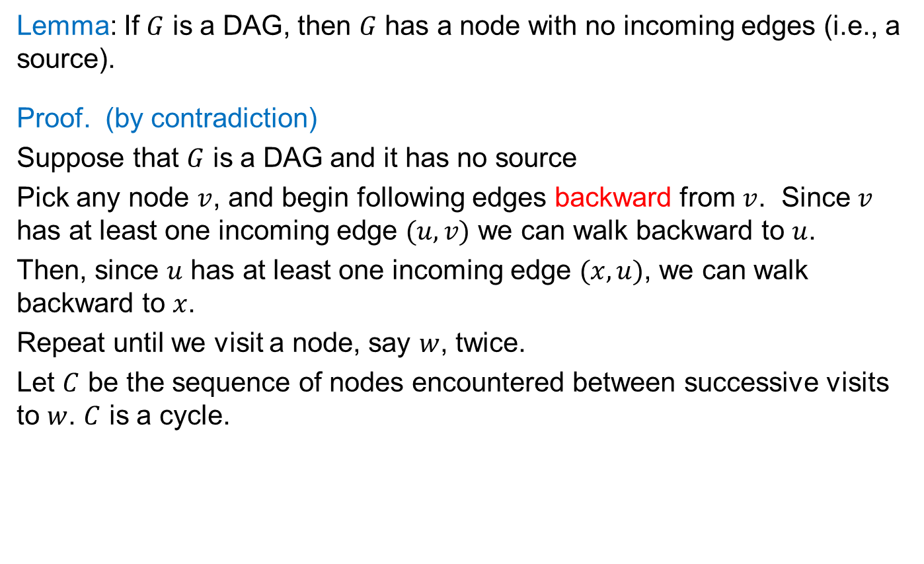
Every DAG has a source node
Lemma: If $G$ is a DAG, then $G$ has a node with no incoming edges (i.e., a source).
Proof. (by contradiction)
Suppose that $G$ is a DAG and it has no source
Pick any node $v$, and begin following edges backward from $v$. Since $v$ has at least one incoming edge $(u, v)$ we can walk backward to $u$.
Then, since $u$ has at least one incoming edge $(x, u)$, we can walk backward to $x$.
Repeat until we visit a node, say $w$, twice.
Let $C$ be the sequence of nodes encountered between successive visits to $w$. $C$ is a cycle.
The proof is similar to “tree has $n−1$ edges”.
w
x
u
v
w
x
u
v
C

Slide 55
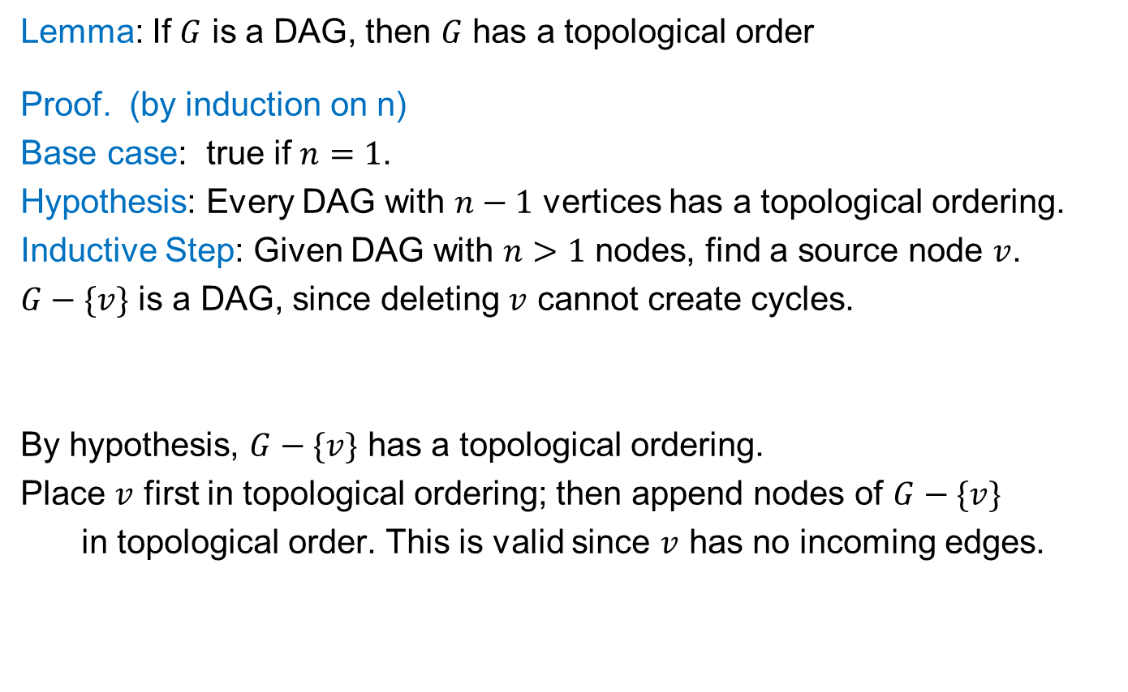
DAG => Topological Order
Lemma: If $G$ is a DAG, then $G$ has a topological order
Proof. (by induction on n)
Base case: true if $n=1$.
Hypothesis: Every DAG with $n−1$ vertices has a topological ordering.
Inductive Step: Given DAG with $n>1$ nodes, find a source node $v$.
$G−\{v\}$ is a DAG, since deleting $v$ cannot create cycles.
By hypothesis, $G−\{v\}$ has a topological ordering.
Place $v$ first in topological ordering; then append nodes of $G−\{v\}$
  in topological order. This is valid since $v$ has no incoming edges.
Reminder: Always remove
vertices/edges to use IH

Slide 56
A Characterization of DAGs
G has a topological order
G is a DAG

Slide 57
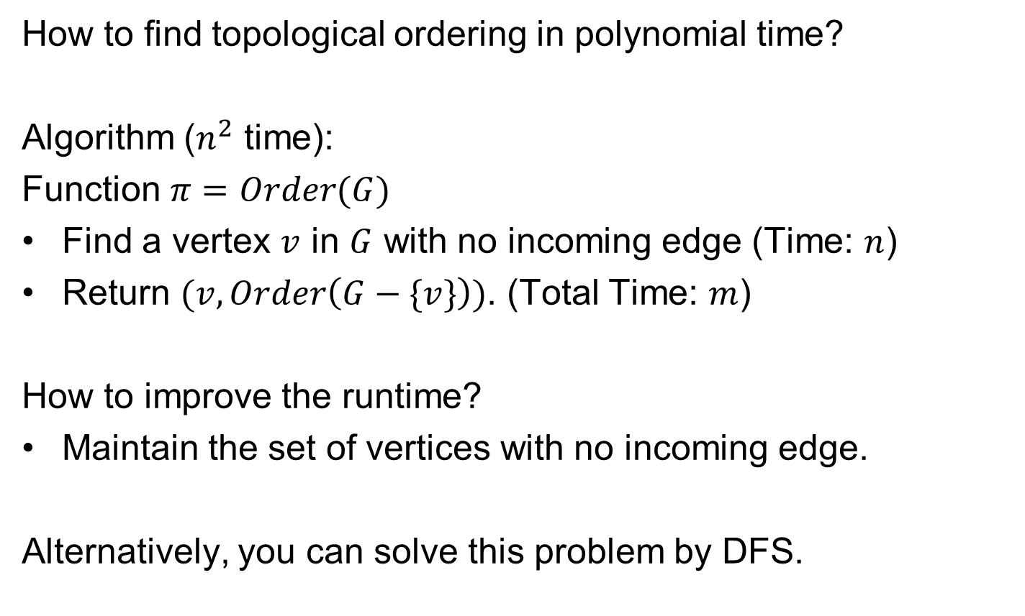
Quiz
How to find topological ordering in polynomial time?
Algorithm ($n^{2}$ time):
Function $π=Order(G)$
Find a vertex $v$ in $G$ with no incoming edge (Time: $n$)
Return $(v,Order\left(G−\{v\}\right))$. (Total Time: $m$)
How to improve the runtime?
Maintain the set of vertices with no incoming edge.
Alternatively, you can solve this problem by DFS.

Slide 58
Example
₂
₃
₆
₅
₄
₇
₁

Slide 59
Example
₂
₃
₆
₅
₄
₁
₂
₃
₄
₅
₆
₇
₇
₁
Topological order: 1, 2, 3, 4, 5, 6, 7

Slide 60
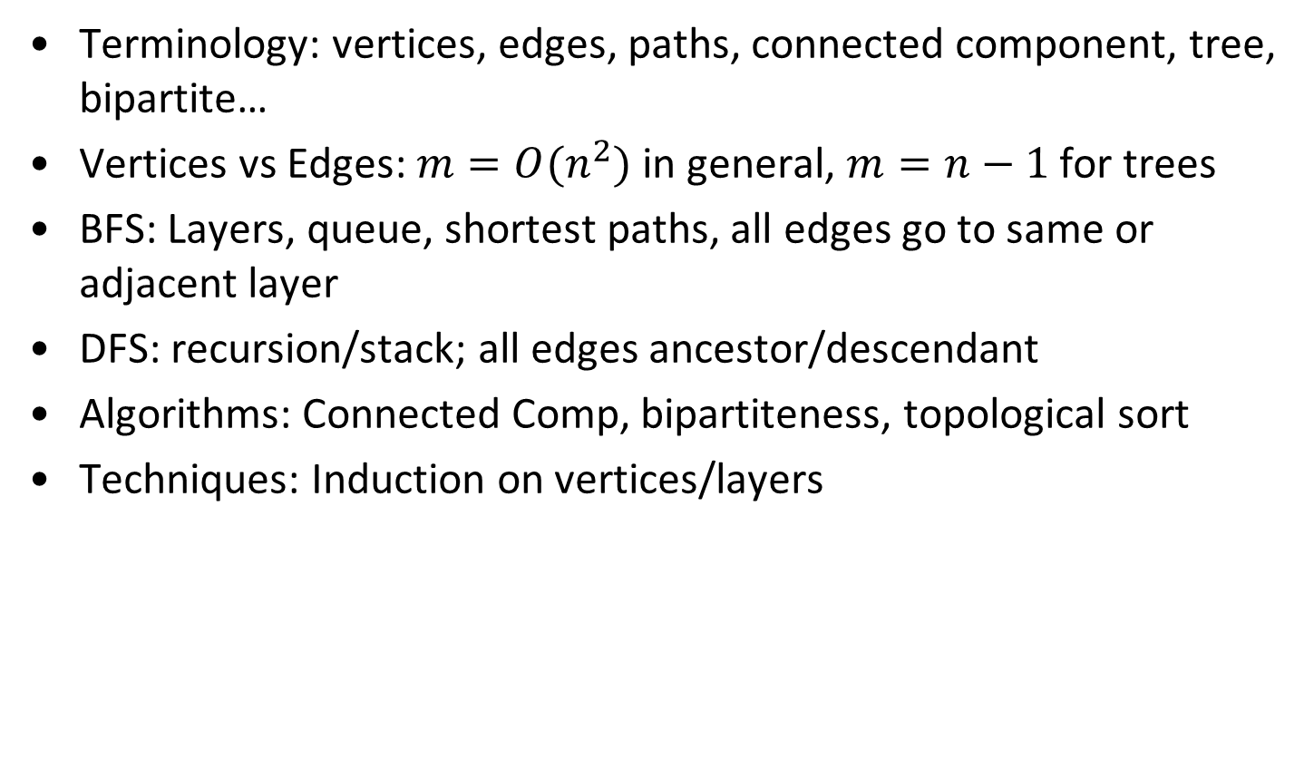
Summary for last few classes
Terminology: vertices, edges, paths, connected component, tree, bipartite…
Vertices vs Edges: $m=O(n^{2})$ in general, $m=n−1$ for trees
BFS: Layers, queue, shortest paths, all edges go to same or adjacent layer
DFS: recursion/stack; all edges ancestor/descendant
Algorithms: Connected Comp, bipartiteness, topological sort
Techniques: Induction on vertices/layers

