Slide 1
CSE 421 Introduction to Algorithms
Richard Anderson
Lecture 10, Winter 2024
Divide and Conquer

Slide 2
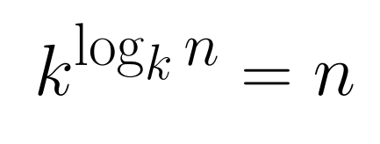
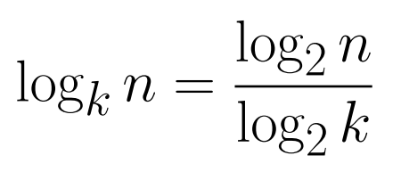
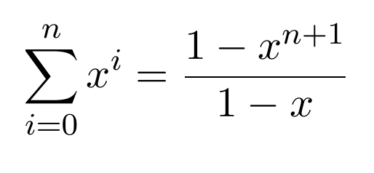
Announcements
Divide and Conquer and Recurrences
Recurrence Techniques
Fast Matrix Multiplication
Counting Inversions (5.3)
Closest Pair (5.4)
Multiplication (5.5)
Quicksort and Median Finding
Dynamic Programming
Midterm, Friday, February 9

Slide 3
Recurrence Analysis
Solution methods
Unrolling recurrence
Guess and verify
Plugging in to a “Master Theorem”
T(n) = a T(n/b) + O(n^{d})
T(n) = O(n^{d}) if d > log_{b} a
T(n) = O(n^{d} log n) if d = log_{b} a
T(n) = O($n^{logba})$ if d < log_{b} a
T(n) ≤ T(3n/4) + T(n/5) + 20 n

Slide 4
Recursive Matrix Multiplication
Multiply 2 x 2 Matrices:
| r s | | a b| |e g|
| t u | | c d| | f h|
r = ae + bf
s = ag + bh
t = ce + df
u = cg + dh
A N x N matrix can be viewed as a 2 x 2 matrix with entries that are (N/2) x (N/2) matrices.
The recursive matrix multiplication algorithm recursively multiplies the (N/2) x (N/2) matrices and combines them using the equations for multiplying 2 x 2 matrices
=

Slide 5
Recursive Matrix Multiplication
How many recursive calls are made at each level?
8, for the multiplication of n/2 X n/2 submatrices
How much work in combining the results?
O(n²), for matrix addition and copying matrices
What is the recurrence?
T(n) = 8 T(n/2) + n²; T(2) = 1;

Slide 6
T(n) = 8 T(n/2) + n²
n
n/2
n/2
n/2
n/2
n/2
n/2
n/2
n/2

Slide 7
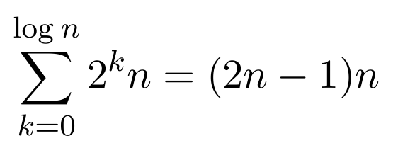
T(n) = 4T(n/2) + n
Total Work
n
n/2
n/2
n/2
n/2
n/4
n/4
n/4
n/4
n/4
n/4
n/4
n/4
n/4
n/4
n/4
n/4
n/4
n/4
n/4
n/4

Slide 8
T(n) = 2T(n/2) + n²

Slide 9
T(n) = 2T(n/2) + n^{1/2}

Slide 10
Recurrences
Three basic behaviors
Dominated by initial case
Dominated by base case
All cases equal – we care about the depth

Slide 11
What you really need to know about recurrences
Work per level changes geometrically with the level
Geometrically increasing (x > 1)
The bottom level wins
Geometrically decreasing (x < 1)
The top level wins
Balanced (x = 1)
Equal contribution

Slide 12
Classify the following recurrences (Increasing, Decreasing, Balanced)
T(n) = n + 5T(n/8)
T(n) = n + 9T(n/8)
T(n) = n² + 4T(n/2)
T(n) = n³ + 7T(n/2)
T(n) = n^{1/2} + 3T(n/4)

Slide 13
Strassen’s Algorithm
Where:
p₁ = (b – d)(f + h)
p₂= (a + d)(e + h)
p₃= (a – c)(e + g)
p₄= (a + b)h
p₅= a(g – h)
p₆= d(f – e)
p₇= (c + d)e
Multiply 2 x 2 Matrices:
| r s | | a b| |e g|
| t u| | c d| | f h|
=
r = p₁ + p₂ – p₄ + p₆
s = p₄ + p₅
t = p₆ + p₇
u = p₂ - p₃ + p₅ - p₇
From AHU 1974

Slide 14
Recurrence for Strassen’s Algorithm
T(n) = 7 T(n/2) + cn²
What is the runtime?
log₂ 7 = 2.8073549221

Slide 15
Strassen’s Algorithm
Treat n x n matrices as 2 x 2 matrices of n/2 x n/2 submatrices
Use Strassen’s trick to multiply 2 x 2 matrices with 7 multiplies
Base case standard multiplication for single entries
Recurrence: T(n) = 7 T(n/2) + cn²
Solution is O(7^{log n})= O(n^{log 7}) which is about O(n^{2.807})
Practical for n ~ 64
Standard trick – switch to normal algorithm for small values of n

Slide 16
Divide and Conquer Algorithms
Split into sub problems
Recursively solve the problem
Combine solutions
Make progress in the split and combine stages
Quicksort – progress made at the split step
Mergesort – progress made at the combine step
D&C Algorithms
Strassen’s Algorithm – Matrix Multiplication
Inversions
Median
Closest Pair
Integer Multiplication
FFT

Slide 17
Inversion Problem
Let a₁, . . . a_{n} be a permutation of 1 . . n
(a_{i}, a_{j}) is an inversion if i < j and a_{i} > a_{j}
Problem: given a permutation, count the number of inversions
This can be done easily in O(n²) time
Can we do better?
4, 6, 1, 7, 3, 2, 5

Slide 18
Application
Counting inversions can be use to measure how close ranked preferences are
People rank 20 movies, based on their rankings you cluster people who like that same type of movie

Slide 19
Counting Inversions
11 | 12 | 4 | 1 | 7 | 2 | 3 | 15 | 9 | 5 | 16 | 8 | 6 | 13 | 10 | 14
Count inversions on lower half
Count inversions on upper half
Count the inversions between the halves

Slide 20
Count the Inversions
5
2
3
1
11 | 12 | 4 | 1
7 | 2 | 3 | 15
9 | 5 | 16 | 8
6 | 13 | 10 | 14
8
6
15
10
11 | 12 | 4 | 1 | 7 | 2 | 3 | 15
9 | 5 | 16 | 8 | 6 | 13 | 10 | 14
19
44
11 | 12 | 4 | 1 | 7 | 2 | 3 | 15 | 9 | 5 | 16 | 8 | 6 | 13 | 10 | 14

Slide 21
Problem – how do we count inversions between sub problems in O(n) time?
Solution – Count inversions while merging
1 | 2 | 3 | 4 | 7 | 11 | 12 | 15
5 | 6 | 8 | 9 | 10 | 13 | 14 | 16
Standard merge algorithm – add to inversion count when an element is moved from the upper array to the solution

Slide 22
Use the merge algorithm to count inversions
1 | 4 | 11 | 12
2 | 3 | 7 | 15
5 | 8 | 9 | 16
6 | 10 | 13 | 14
Indicate the number of inversions for each
element detected when merging

Slide 23
Inversions
Counting inversions between two sorted lists
O(1) per element to count inversions
Algorithm summary
Satisfies the “Standard recurrence”
T(n) = 2 T(n/2) + cn
x | x | x | x | x | x | x | x
y | y | y | y | y | y | y | y
z | z | z | z | z | z | z | z | z | z | z | z | z | z | z | z

Slide 24
Closest Pair Problem (2D)
Given a set of points find the pair of points p, q that minimizes dist(p, q)

Slide 25
Divide and conquer
If we solve the problem on two subsets, does it help? (Separate by median x coordinate)
δ₁
δ₂

Slide 26
Packing Lemma
Suppose that the minimum distance between points is at least δ, what is the maximum number of points that can be packed in a ball of radius δ?

Slide 27
Combining Solutions
Suppose the minimum separation from the sub problems is δ
In looking for cross set closest pairs, we only need to consider points with δ of the boundary
How many cross border interactions do we need to test?

Slide 28
A packing lemma bounds the number of distances to check
δ

Slide 29
Details
Preprocessing: sort points by y
Merge step
Select points in boundary zone
For each point in the boundary
Find highest point on the other side that is at most δ above
Find lowest point on the other side that is at most δ below
Compare with the points in this interval (there are at most 6)

Slide 30
Identify the pairs of points that are compared in the merge step following the recursive calls

Slide 31
Algorithm run time
After preprocessing:
T(n) = cn + 2 T(n/2)

Slide 32
Integer Arithmetic
9715480283945084383094856701043643845790217965702956767
+ 1242431098234099057329075097179898430928779579277597977
Runtime for standard algorithm to add two n digit numbers:
2095067093034680994318596846868779409766717133476767930
X 5920175091777634709677679342929097012308956679993010921
Runtime for standard algorithm to multiply two n digit numbers:

Slide 33
Recursive Multiplication Algorithm (First attempt)
x = x₁ 2^{n/2} + x₀
y = y₁ 2^{n/2} + y₀
xy = (x₁ 2^{n/2} + x₀) (y₁ 2^{n/2} + y₀)
= x₁y₁ 2^{n} + (x₁y₀ + x₀y₁)2^{n/2} + x₀y₀
Recurrence:
Run time:

Slide 34
Simple algebra
x = x₁ 2^{n/2} + x₀
y = y₁ 2^{n/2} + y₀
xy = x₁y₁ 2^{n} + (x₁y₀ + x₀y₁) 2^{n/2} + x₀y₀
p = (x₁ + x₀)(y₁ + y₀) = x₁y₁ + x₁y₀ + x₀y₁ + x₀y₀

Slide 35
Karatsuba’s Algorithm
Multiply n-digit integers x and y
Let x = x₁ 2^{n/2} + x₀ and y = y₁ 2^{n/2} + y₀
Recursively compute
a = x₁y₁
b = x₀y₀
p = (x₁ + x₀)(y₁ + y₀)
Return a2^{n} + (p – a – b)2^{n/2} + b
Recurrence: T(n) = 3T(n/2) + cn
log₂ 3 = 1.58496250073…

