Slide 1
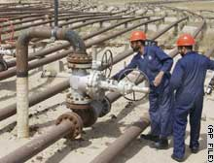
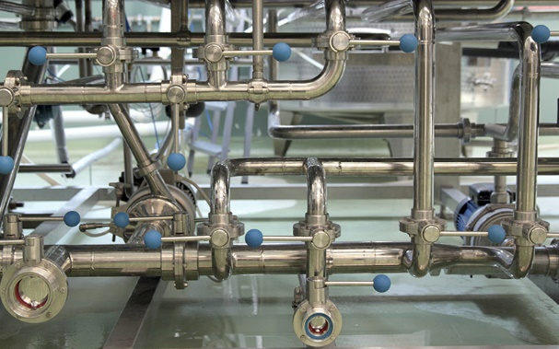
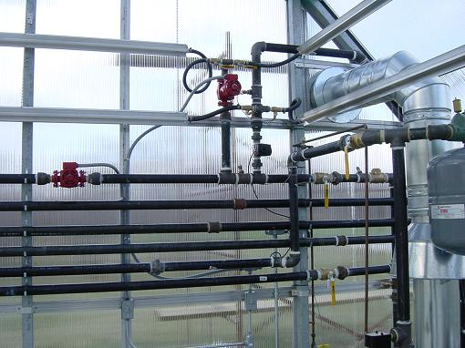
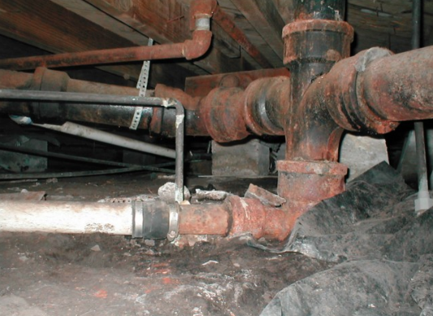
CSE 421 Introduction to Algorithms
Lecture 19
Winter 2024
Network Flow, Part 3

Slide 2
Midterm

Slide 3
Outline
Network flow definitions
Flow examples
Augmenting Paths
Residual Graph
Ford Fulkerson Algorithm
Cuts
Maxflow-MinCut Theorem
Worst Case Runtime for FF
Improving Runtime bounds
Capacity Scaling
Fully Polynomial Time Algorithms
Applications of Network Flow

Slide 4
Ford-Fulkerson Algorithm (1956)
while not done
Construct residual graph G_{R}
Find an s-t path P in G_{R} with capacity b > 0
Add b units of flow along path P in G

Slide 5
Ford Fulkerson Runtime
Cost per phase X number of phases
Phases
Capacity leaving source: C
Add at least one unit per phase
Cost per phase
Build residual graph: O(m)
Find s-t path in residual: O(m)

Slide 6
Performance
The worst case performance of the Ford-Fulkerson algorithm O(Cm)
u
C
C
s
1
t
C
C
v

Slide 7
Polynomial Time Algorithms
Input of size n, runtime T(n) = O(n^{k})
Input size measures
Bits of input
Number of data items
Maximum item magnitude C
O(Cn^{k}): Exponential
O(n^{k} log C): Polynomial
O(n^{k}): Fully polynomial

Slide 8
Better methods of finding augmenting paths
Find the maximum capacity augmenting path
O(m²log(C)) time algorithm for network flow
Find the shortest augmenting path
O(m²n) time algorithm for network flow
Find a blocking flow in the residual graph
O(mnlog n) time algorithm for network flow

Slide 9
Capacity Scaling Algorithm
Choose Δ = 2^{k} such that all edges in G_{R} have capacity less than 2Δ
while Δ ≥ 1
while there is a path P in G_{R} with capacity Δ
Add Δ units of flow along path P in G
Update G_{R}
Δ = Δ / 2
Edmonds-Karp: Easier analysis than Max Capacity First

Slide 10
Analysis
If capacities are integers, then graph is disconnected when Δ = ½
If largest edge capacity is C, then there are at most log C outer phases
At the start of each outer phase, the flow is within 2mΔ of the maximum
So there are at most 2m inner phases for each Δ

Slide 11
Shortest Augmenting Path
Find augmenting paths by BFS
for k = 1 to n
while there is a path P in G_{R} of length k and capacity b > 0
Add b units of flow along path P in G
Update G_{R}
Need to show:
The length of the shortest augmenting path is non-decreasing
Each while loop finds at most m paths

Slide 12
Analysis
Augmenting along shortest path from s to t does not decrease distance from s to t

Slide 13
Analysis
The distance from s to t must increase in G_{R} after m augmentations by shortest paths

Slide 14
Improving the shortest augmenting path algorithm
Find a blocking flow in one phase to increase the length of augmenting paths
Dinitz (Ефим Абрамович Диниц) Algorithm
O(n²m)
Dynamic Trees to decrease cost per augmentation
O(nm log n)

Slide 15
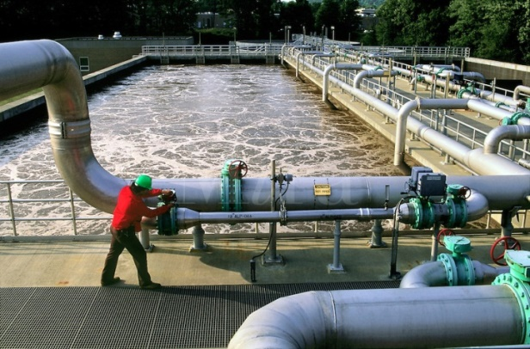
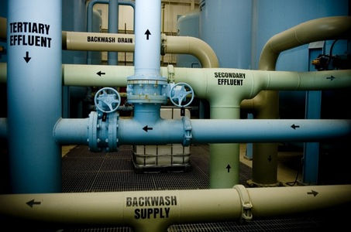
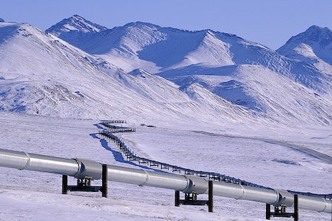
Applications of Network Flow

Slide 16
Problem Reduction
Reduce Problem A to Problem B
Convert an instance of Problem A to an instance of Problem B
Use a solution of Problem B to get a solution to Problem A
Practical
Use a program for Problem B to solve Problem A
Theoretical
Show that Problem B is at least as hard as Problem A

Slide 17
Problem Reduction Examples
Reduce the problem of finding the Maximum of a set of integers to finding the Minimum of a set of integers
Find the maximum of: 8, -3, 2, 12, 1, -6
Construct an equivalent minimization problem

Slide 18
Undirected Network Flow
Undirected graph with edge capacities
Flow may go either direction along the edges (subject to the capacity constraints)
u
10
20
s
5
t
20
10
v
Construct an equivalent flow problem

Slide 19
Bipartite Matching
A graph G=(V,E) is bipartite if the vertices can be partitioned into disjoints sets X,Y
A matching M is a subset of the edges that does not share any vertices
Find a matching as large as possible

Slide 20
Application
A collection of teachers
A collection of courses
And a graph showing which teachers can teach which courses
RA
311
PB
331
ME
332
DG
401
AK
421

Slide 21
Converting Matching to Network Flow
s
t

Slide 22
Finding edge disjoint paths
t
s
Construct a maximum cardinality set of
edge disjoint paths

Slide 23
Multi-source network flow
Multi-source network flow
Sources s₁, s₂, . . ., s_{k}
Sinks t₁, t₂, . . . , t_{j}
Solve with Single source network flow

Slide 24
Resource Allocation: Assignment of reviewers
A set of papers P₁, . . ., P_{n}
A set of reviewers R₁, . . ., R_{m}
Paper P_{i} requires A_{i} reviewers
Reviewer R_{j} can review B_{j} papers
For each reviewer R_{j}, there is a list of paper L_{j1}, . . ., L_{jk} that R_{j} is qualified to review

Slide 25
Resource Allocation: Illegal Campaign Donations
Candidates C_{i}, . . ., C_{n}
Donate b_{i} to C_{i}
With a little help from your friends
Friends F₁, . . ., F_{m}
F_{i} can give a_{ij} to candidate C_{j}
You can give at most M_{i} to F_{i}

