Slide 1
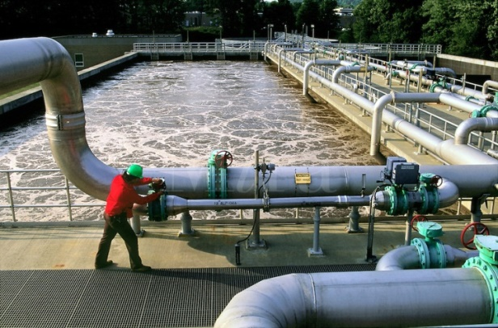
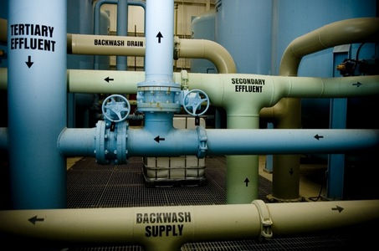
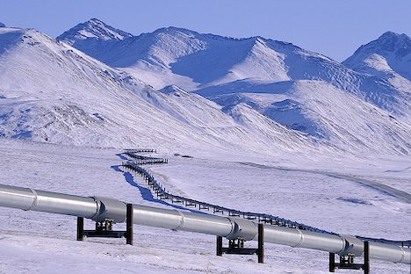
CSE 421 Introduction to Algorithms
Winter 2024
Lecture 21
Mincut Applications: Task Selection

Slide 2
Today’s topics
Task Selection
Network Flow Extensions
Reading: 7.5, 7.6, 7.10-7.12
Starting Wednesday – NP Completeness
Reading: 8.1-8.10

Slide 3
Application of Min-cut
Task Selection Problem
Reduction to Min Cut problem
S, T is a cut if S, T is a partition of the vertices with
s in S and t in T
The capacity of an S, T cut is the sum of the capacities of
all edges going from S to T

Slide 4
Task Selection
Precedence graph G=(V,E)
Each v in V has a profit p(v)
A set F is feasible if when w in F, and (v,w) in E, then v in F.
Find a feasible set to maximize the profit
6
-4
-2
-2
5
-1
-10
4

Slide 5
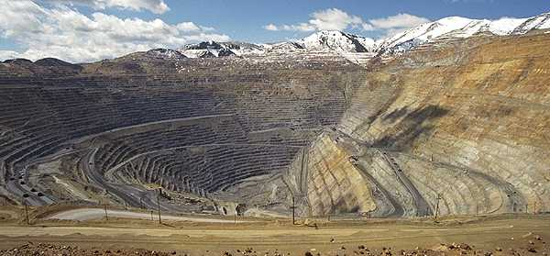
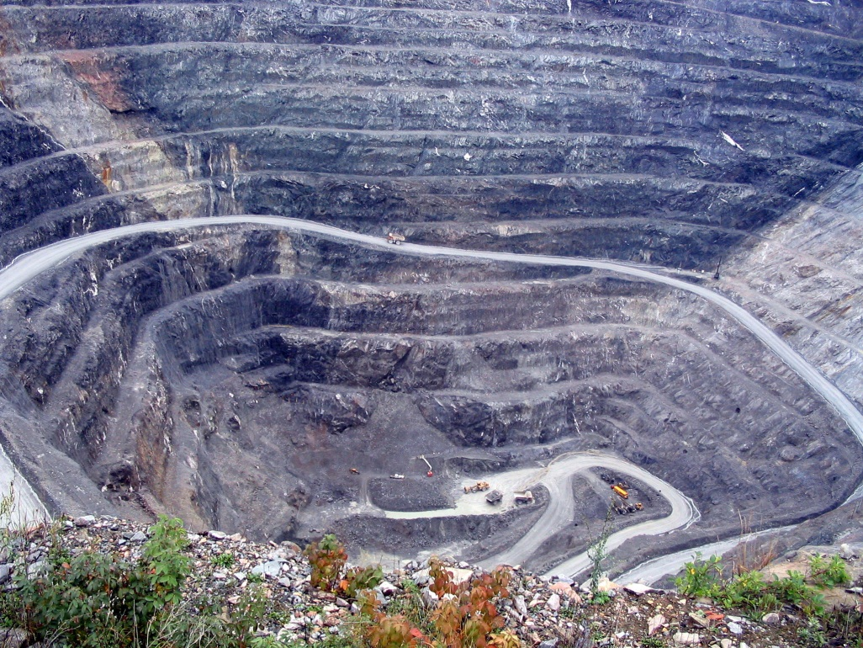
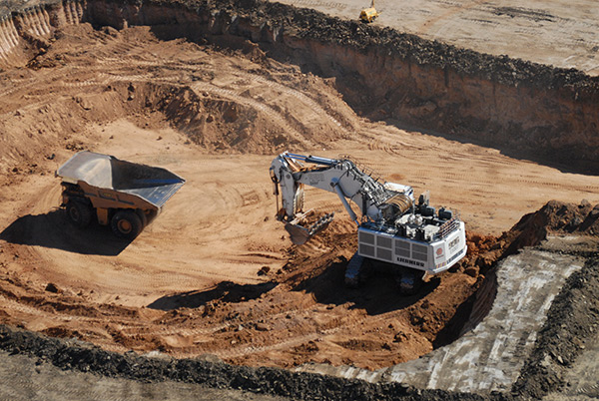
Open Pit Mining

Slide 6
Open Pit Mining
Each unit of earth has a profit (possibly negative)
Getting to the ore below the surface requires removing the dirt above
Test drilling gives reasonable estimates of costs
Plan an optimal mining operation

Slide 7
Mine Graph
-4
-3
-2
-1
-1
-3
3
-1
4
-7
-10
-2
8
3
-10

Slide 8
Determine an optimal mine
-5
-3
-4
-4
2
-4
3
-1
-7
-10
-1
-3
-3
3
4
4
-3
-10
-10
-10
4
7
-2
-10
3
-10
-10
-10
-10
6
8
6
-3
-10
-10
-10
-10
-10
-10
1
4
4
-10
-10
-10
-10
-10
-10
-10
-10
-10
-10
-10
-10

Slide 9
Min cut algorithm for profit maximization
Construct a flow graph where the minimum cut identifies a feasible set that maximizes profit

Slide 10
Precedence graph construction
Precedence graph G=(V,E)
Each edge in E has infinite capacity
Add vertices s, t
Each vertex in V is attached to s and t with finite capacity edges

Slide 11
Find a finite value cut with at least two vertices on each side of the cut
s
Infinite
Finite
t

Slide 12
The sink side of a finite cut is a feasible set
No edges permitted from S to T
If a vertex is in T, all of its ancestors are in T

Slide 13
Setting the costs
s
If p(v) > 0,
cap(v,t) = p(v)
cap(s,v) = 0
If p(v) < 0
cap(s,v) = -p(v)
cap(v,t) = 0
If p(v) = 0
cap(s,v) = 0
cap(v,t) = 0
3
3
1
1
-3
-3
-1
0
2
3
2
1
3
t

Slide 14
Minimum cut gives optimal solution Why?
s
2
2
-2
1
2
-2
1
1
2
1
t

Slide 15
Computing the Profit
Cost(W) = Σ_{{w in W; p(w) < 0}}-p(w)
Benefit(W) = Σ_{{w in W; p(w) > 0}} p(w)
Profit(W) = Benefit(W) – Cost(W)
Maximum cost and benefit
C = Cost(V)
B = Benefit(V)

Slide 16
Express Cap(S,T) in terms of B, C, Cost(T), Benefit(T), and Profit(T)
Cap(S,T) = Cost(T) + Ben(S) = Cost(T) + Ben(S) + Ben(T) – Ben(T)
= B + Cost(T) – Ben(T) = B – Profit(T)

Slide 17
Beyond Network Flow
Related Optimization Problems
Matching
Minimum Cost Flow
Multicommodity Flow
Linear Programming

Slide 18
Matching
Undirected Graph G=(V,E), find a maximum cardinality matching

Slide 19
Matching Algorithms
Bipartite Problem
Set up as network flow
Find augmenting paths
Algorithm can be adapted to just working on the graph with “Alternating Paths”

Slide 20
Alternating Paths
Path of adjacent edges e₁ e₂ e₃ . . e_{2k} e_{2k+1}
First and last vertices unmatched
Every other edge in matching
Swap matched an unmatched edges increases size of matching by one
Find alternating paths by a BFS from unmatched vertex

Slide 21
Complication with non-bipartite graphs
Odd length cycles make searching for augmenting paths tricky
Blossom Collapsing

Slide 22
Mincost Flow
Edges have capacities and costs
The cost of the flow on an edge is the product of the edges flow and cost
The overall cost of the flow is the sum of the cost of the flows on the edges
Find the maximum flow of minimum cost

Slide 23
Assignment Problem
Bipartite graph with edge costs
Find a maximum matching of minimum cost

Slide 24
Alternating cycles
Even length cycle alternating between matched and unmatched edges
Augmenting cycle: Alternating cycle with matched edges have greater cost than unmatched edges
5
2
1
3
4
6

Slide 25
Mincost matching
Find maximum cardinality matching
While there exists an augmenting cycle C
Swap matched edges along C

Slide 26
Multicommodity Flow
Two types of flows, f₁ and f₂
Sources and sinks, s₁, s₂, t₁, t₂
f₁ routed from s₁ to t₁, f₂ from s₂ to t₂
0 ≤ f₁(e) + f₂(e) ≤ cap(e)
f₁ and f₂ conserved at vertices

Slide 27
Linear Programming
Maximize a linear function subject to linear constraints

