Slide 1
CSE 421 Section 7
What Tool?
How to Determine Which Algo Paradigm to Try

Slide 2
Administrivia
Notes:
Administrivia ~2 mins

Slide 3
Announcements & Reminders
HW6
  Was due Wednesday, 2/14
HW7
  Due Friday, 2/23
Grade Questions
  If you think something was graded incorrectly, submit a regrade request!
  If you have more concerns, schedule a 1-on-1 to discuss privately

Slide 4
What Tool?
Notes:
~10 min microteach? Maybe shorter maybe longer?

Slide 5
In the real world…
When you come across a problem you’d like to solve (perhaps on an interview or on the final exam), you generally won’t be told what kind of algorithm to write. You COULD just randomly start trying stuff, but that’s going to be pretty inefficient, and you may waste a lot of time pursuing algorithmic paradigms that just won’t work for the given problem.
Ideally, you want to be able to figure out what kind of algorithm to write in only a few tries. So how do you figure out what technique to use?

Slide 6
The Strategy
Read the Problem Carefully
Generate Example Inputs/Outputs
Ask Some Questions
Still Stuck?

Slide 7
Step 1: Read the Problem Carefully
Are there any technical terms in the problem? Any words that look like normal words but really are technical terms?
What is the input type?
What is the output type?
If these questions look familiar, they should!
If you can’t answer these, there’s no way to figure out what technique to use—you don’t even know what problem you’re solving!

Slide 8
Step 2: Generate Example Inputs/Outputs
Spend a few minutes producing some examples. This will help make sure that you have a clear understanding of the problem. Like usual, it’s helpful to think about a few different “typical” cases here, don’t worry too much about edge cases yet.
Plus, you might stumble upon which technique to use here; for example, if you try to visualize an example input, and you start drawing a graph.

Slide 9
Step 3: Ask Some Questions
At this point, you should ask “is this really a graph modeling problem?” Some signs to look for:
The problem mentions a graph or something graph-sounding (like “routes” or “maps”).
There are “direct connections” between elements that could be edges.
When you try to visualize an input example you end up drawing a graph.

Slide 10
Step 3: Ask Some Questions
If it doesn’t feel like graph modeling, the next step to ask is probably “could I solve this problem recursively?” Try asking all of these:
Is there a natural way to split things “in half” (or thirds, or...)?
Could I make the problem a little bit smaller?
What’s “one step” toward the solution?
These might start leading you to either a divide and conquer (with the first bullet) or dynamic programming solution. In all cases, be sure you can see “how the recursion is helping”.

Slide 11
Step 3: Ask Some Questions
Finally:
Did an idea immediately jump to mind?
Did you start a sentence with something like “Well, couldn’t I just...”?
Then maybe it’s time for a greedy algorithm. But really, it’s time for you to generate like 3 more examples and try them against your proposed algorithm. It’s not fun to write a bunch of code only to realize it doesn’t work! And greedy algorithms very often fail. Do some more checks before you jump into code writing.

Slide 12
Step 4: Still Stuck?
So, none of the earlier steps worked…
Take a deep breath, it’s going to be ok.

Slide 13
Step 4.1: Get a Baseline Algorithm
Figure out what “brute force” or any other baseline would be, and jot it down quickly on paper. And when you’re scared, look to your baseline like that hang-in-there-cat motivational poster. Worst-case, you’re going to use that one. And if you figured out that one, you could probably find another one.
Hang in there.

Slide 14
Step 4.2: Write a Few More Examples
And solve them. How are you, as a person, solving them? You’re doing some process. See if you can reflect on it and realize what it looks like. That might inspire you toward an algorithm.

Slide 15
Step 4.3: Ask Yourself Some More Questions
Does this remind you of any of the problems you’ve seen before? If so, a similar approach might work.
Can you solve a simpler version of the problem? If there are two variables, make one of them a constant (a small constant, like 1) and ask “now what would I do?” Maybe you can generalize from there.
Can you sort the input? Assume a graph is connected or topologically sorted? What if it’s a tree? What if the array contains only positive elements? Any of these might give you inspiration for the general case.

Slide 16
2. Try it Yourself
Notes:
~5 mins

Slide 17
Problem 2 – Try it Yourself!
For each of these problems, get far enough through these steps that you’re able to guess what technique you might want to use. Then write down a sentence or two about what in the problem lead you toward that technique.
Work through the parts of this problem with the people around you, and then we’ll go over it together!
Notes:
Give ~2-3 minutes to think

Slide 18

Problem 2 – Try it Yourself!
There are a total of $n$ courses you have to take, labeled from 1 to $n$. You are given a list prerequisites where $prerequisites[i] = (a_{i}, b_{i})$ indicates that you must take course $b_{i}$ first if you want to take $a_{i}$. Return true if you can finish all courses. Otherwise return false.

Slide 19
Problem 2 – Try it Yourself!
There are a total of $n$ courses you have to take, labeled from 1 to $n$. You are given a list prerequisites where $prerequisites[i] = (a_{i}, b_{i})$ indicates that you must take course $b_{i}$ first if you want to take $a_{i}$. Return true if you can finish all courses. Otherwise return false.
Graph. The list prerequisites contains pairs of courses that can be represented as edges and the course numbers can represent vertices in a graph.

Slide 20
Problem 2 – Try it Yourself!
You are given a list of integers coins representing coins of different denominations and an integer amount representing a total amount of money. Return the fewest number of coins you need to make up that amount. If that amount of money cannot be made up by any combination of coins, return -1.

Slide 21
Problem 2 – Try it Yourself!
You are given a list of integers coins representing coins of different denominations and an integer amount representing a total amount of money. Return the fewest number of coins you need to make up that amount. If that amount of money cannot be made up by any combination of coins, return -1.
Dynamic Programming. Different combination of coins must be tested to find the minimum number to use. By using a coin, the total amount of money is reduced which becomes the next sub-problem.

Slide 22
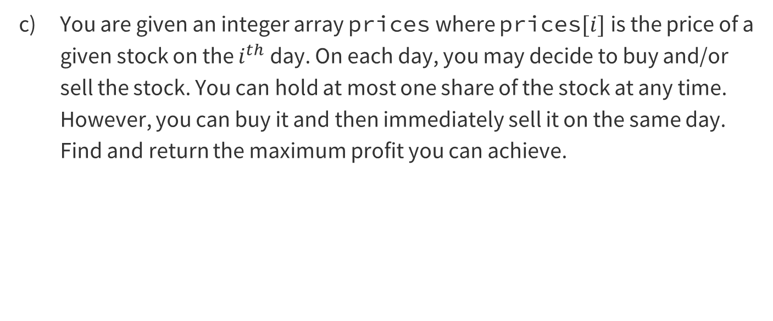
Problem 2 – Try it Yourself!
You are given an integer array prices where prices$[i]$ is the price of a given stock on the $i^{th}$ day. On each day, you may decide to buy and/or sell the stock. You can hold at most one share of the stock at any time. However, you can buy it and then immediately sell it on the same day. Find and return the maximum profit you can achieve.

Slide 23
Problem 2 – Try it Yourself!
You are given an integer array prices where prices$[i]$ is the price of a given stock on the $i^{th}$ day. On each day, you may decide to buy and/or sell the stock. You can hold at most one share of the stock at any time. However, you can buy it and then immediately sell it on the same day. Find and return the maximum profit you can achieve.
Greedy/Dynamic Programming. The goal is to maximize the output, so dynamic programming can be used to memoize the smaller sub-problems for buying/selling on certain days. An indicator to try a greedy algorithm is that you can only hold one share at any time, so there might be a way to decide which share to hold and when to sell it

Slide 24

Problem 2 – Try it Yourself!
You are given an array of $k$ linked-lists, where each linked-list is sorted in ascending order. Merge all the linked-lists into one sorted linked-list and return it.

Slide 25
Problem 2 – Try it Yourself!
You are given an array of $k$ linked-lists, where each linked-list is sorted in ascending order. Merge all the linked-lists into one sorted linked-list and return it.
Divide and Conquer. We can split this into smaller sub-problems and we know that each linked list is sorted which is an indicator for divide and conquer algorithms.

Slide 26
Problem 2 – Try it Yourself!
Given an array of distinct integers nums and a target integer target, return the number of possible combinations that add up to target.

Slide 27
Problem 2 – Try it Yourself!
Given an array of distinct integers nums and a target integer target, return the number of possible combinations that add up to target.
Dynamic Programming. One key phrase is ”number of possible combinations”, so there must be a way to find the number of combinations for a sub-problem (a smaller target integer) which can be memoized using dynamic programming.

Slide 28
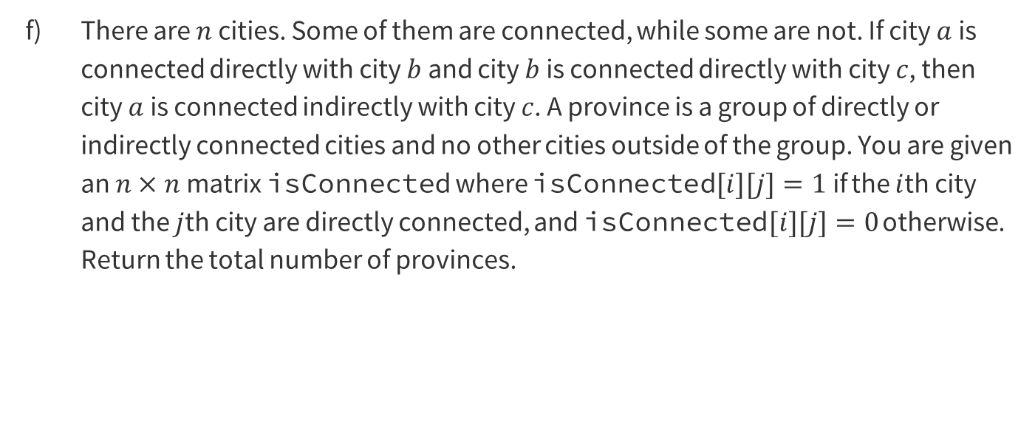
Problem 2 – Try it Yourself!
There are $n$ cities. Some of them are connected, while some are not. If city $a$ is connected directly with city $b$ and city $b$ is connected directly with city $c$, then city $a$ is connected indirectly with city $c$. A province is a group of directly or indirectly connected cities and no other cities outside of the group. You are given an $n×n$matrix isConnected where isConnected$[i][j]=1$if the $i$th city and the $j$th city are directly connected, and isConnected$[i][j]=0$ otherwise. Return the total number of provinces.

Slide 29
Problem 2 – Try it Yourself!
There are $n$ cities. Some of them are connected, while some are not. If city $a$ is connected directly with city $b$ and city $b$ is connected directly with city $c$, then city $a$ is connected indirectly with city $c$. A province is a group of directly or indirectly connected cities and no other cities outside of the group. You are given an $n×n$matrix isConnected where isConnected$[i][j]=1$if the $i$th city and the $j$th city are directly connected, and isConnected$[i][j]=0$ otherwise. Return the total number of provinces.
Graph. Some key words here are ”n cities” and “connected directly/indirectly” which represents a graph where cities are the vertices and whether they are connected or not as the edges.

Slide 30
Problem 2 – Try it Yourself!
You are given an integer array nums. You are initially positioned at the array’s first index, and each element in the array represents your maximum jump length at that position. Return true if you can reach the last index or false otherwise.

Slide 31
Problem 2 – Try it Yourself!
You are given an integer array nums. You are initially positioned at the array’s first index, and each element in the array represents your maximum jump length at that position. Return true if you can reach the last index or false otherwise.
Greedy/Dynamic Programming. A greedy algorithm can be used to always keep track of the furthest location you can jump to given which locations you’ve already been and similarly, with dynamic programming, it can be done by memoizing the furthest location for each location.

Slide 32

Problem 2 – Try it Yourself!
Write an efficient algorithm that searches for a value target in an $m×n$ integer matrix. This matrix has the following properties:
  Integers in each row are sorted in ascending order from left to right.
  Integers in each column are sorted in ascending order from top to bottom.

Slide 33
Problem 2 – Try it Yourself!
Write an efficient algorithm that searches for a value target in an $m×n$ integer matrix. This matrix has the following properties:
  Integers in each row are sorted in ascending order from left to right.
  Integers in each column are sorted in ascending order from top to bottom.
Divide and Conquer. Some keywords here are “search” and “ascending order”, so we know each column and row are sorted which can be split into smaller matrices that are sorted as well to find a value.

Slide 34

Problem 2 – Try it Yourself!
You are given an integer array height of length $n$. There are $n$ vertical lines drawn such that the two endpoints of the $i$th line are $(i,0)$ and ($i,$height$[i]$). Find two lines that together with the $x$-axis form a container, such that the container contains the most water. Return the maximum amount of water a container can store.

Slide 35
Problem 2 – Try it Yourself!
You are given an integer array height of length $n$. There are $n$ vertical lines drawn such that the two endpoints of the $i$th line are $(i,0)$ and ($i,$height$[i]$). Find two lines that together with the $x$-axis form a container, such that the container contains the most water. Return the maximum amount of water a container can store.
Greedy. The goal is to maximize the height and width, so walls that are further away and taller should be prioritized.

Slide 36
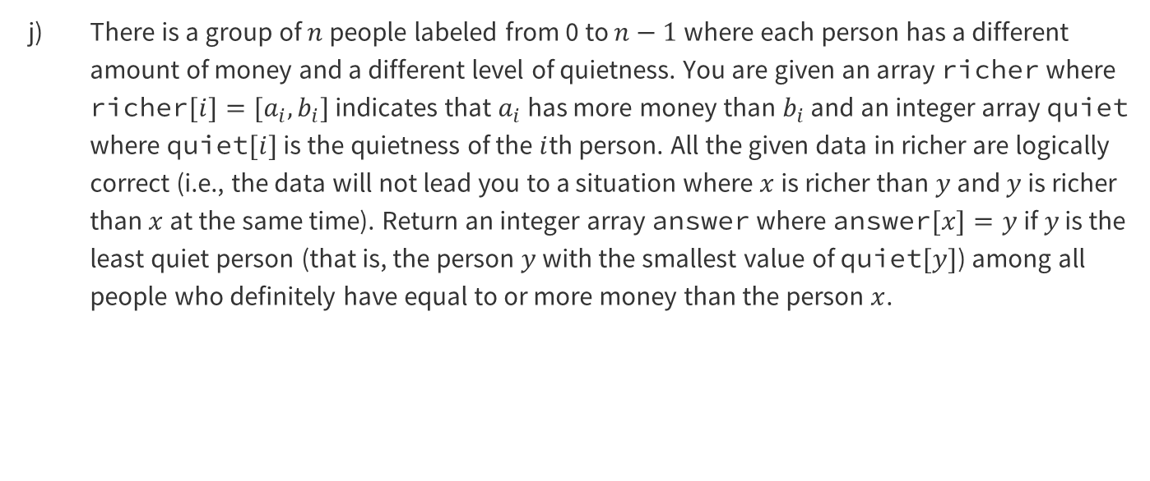
Problem 2 – Try it Yourself!
There is a group of $n$ people labeled from 0 to $n−1$ where each person has a different amount of money and a different level of quietness. You are given an array richer where richer$[i]=[a_{i}, b_{i}]$ indicates that $a_{i}$ has more money than $b_{i}$ and an integer array quiet where quiet$[i]$ is the quietness of the $i$th person. All the given data in richer are logically correct (i.e., the data will not lead you to a situation where $x$ is richer than $y$ and $y$ is richer than $x$ at the same time). Return an integer array answer where answer$[x]=y$ if $y$ is the least quiet person (that is, the person $y$ with the smallest value of quiet$[y]$) among all people who definitely have equal to or more money than the person $x$.

Slide 37
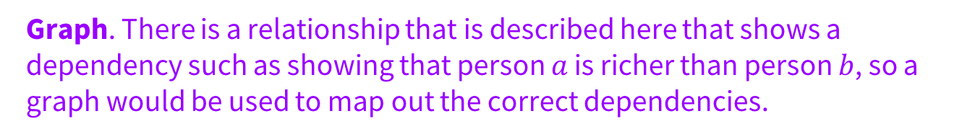
Problem 2 – Try it Yourself!
There is a group of $n$ people labeled from 0 to $n−1$ where each person has a different amount of money and a different level of quietness. You are given an array richer where richer$[i]=[a_{i}, b_{i}]$ indicates that $a_{i}$ has more money than $b_{i}$ and an integer array quiet where quiet$[i]$ is the quietness of the $i$th person. All the given data in richer are logically correct (i.e., the data will not lead you to a situation where $x$ is richer than $y$ and $y$ is richer than $x$ at the same time). Return an integer array answer where answer$[x]=y$ if $y$ is the least quiet person (that is, the person $y$ with the smallest value of quiet$[y]$) among all people who definitely have equal to or more money than the person $x$.
Graph. There is a relationship that is described here that shows a dependency such as showing that person $a$ is richer than person $b$, so a graph would be used to map out the correct dependencies.

Slide 38

Problem 2 – Try it Yourself!
Given an integer array nums, return an integer array counts where counts$[i]$ is the number of smaller elements to the right of nums$[i]$.

Slide 39
Problem 2 – Try it Yourself!
Given an integer array nums, return an integer array counts where counts$[i]$ is the number of smaller elements to the right of nums$[i]$.
Divide and Conquer. Since we want to find the number of smaller elements to the right of an element in an unsorted array, there must be some sorting that occurs, so a modified divide and conquer sorting algorithm can be used.

Slide 40
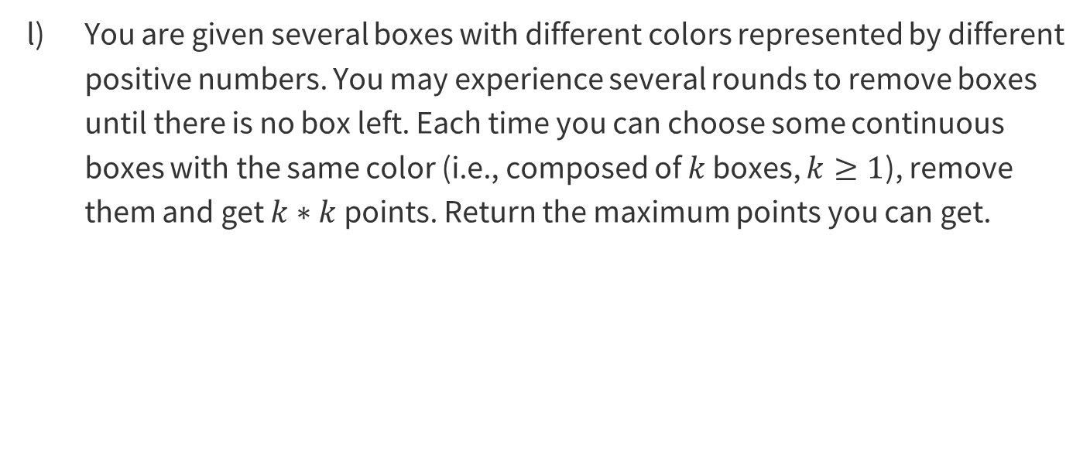
Problem 2 – Try it Yourself!
You are given several boxes with different colors represented by different positive numbers. You may experience several rounds to remove boxes until there is no box left. Each time you can choose some continuous boxes with the same color (i.e., composed of $k$ boxes, $k≥1$), remove them and get $k∗k$ points. Return the maximum points you can get.

Slide 41
Problem 2 – Try it Yourself!
You are given several boxes with different colors represented by different positive numbers. You may experience several rounds to remove boxes until there is no box left. Each time you can choose some continuous boxes with the same color (i.e., composed of $k$ boxes, $k≥1$), remove them and get $k∗k$ points. Return the maximum points you can get.
Dynamic Programming. The indicator here is that we want to try out different permutations of removing boxes to maximize the output. After removing boxes, the problem becomes smaller, so dynamic programming should be used to memoize the solutions to smaller sub-problems.

Slide 42
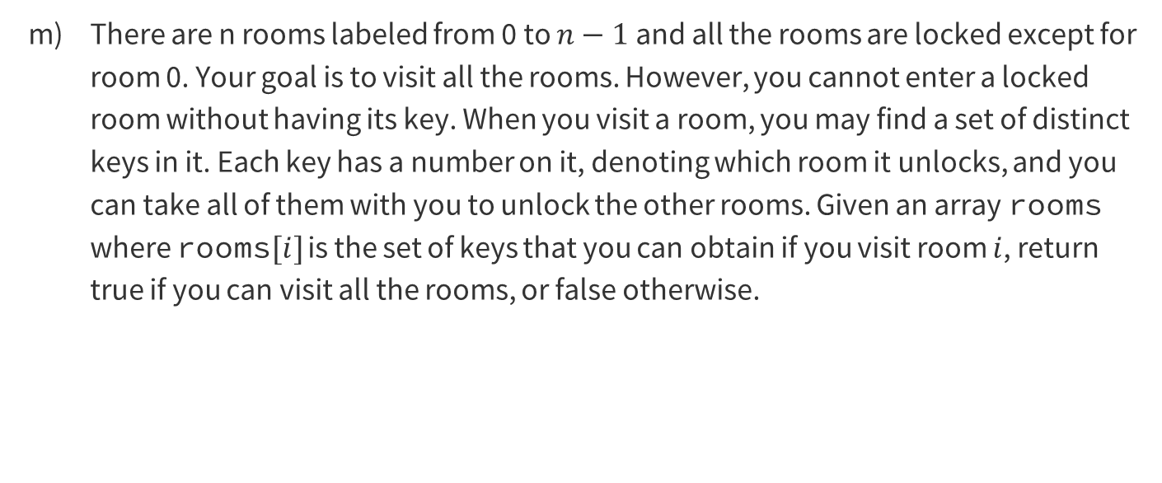
Problem 2 – Try it Yourself!
There are n rooms labeled from 0 to $n−1$ and all the rooms are locked except for room 0. Your goal is to visit all the rooms. However, you cannot enter a locked room without having its key. When you visit a room, you may find a set of distinct keys in it. Each key has a number on it, denoting which room it unlocks, and you can take all of them with you to unlock the other rooms. Given an array rooms where rooms$[i]$ is the set of keys that you can obtain if you visit room $i$, return true if you can visit all the rooms, or false otherwise.

Slide 43
Problem 2 – Try it Yourself!
There are n rooms labeled from 0 to $n−1$ and all the rooms are locked except for room 0. Your goal is to visit all the rooms. However, you cannot enter a locked room without having its key. When you visit a room, you may find a set of distinct keys in it. Each key has a number on it, denoting which room it unlocks, and you can take all of them with you to unlock the other rooms. Given an array rooms where rooms$[i]$ is the set of keys that you can obtain if you visit room $i$, return true if you can visit all the rooms, or false otherwise.
Graph. There is a dependency on being able to visit a room since you must have found a key in the previous room to unlock it and the goal is to visit all rooms. Because of this, the problem can be represented as a graph with the goal as traversing through all nodes of the graph.

Slide 44

Problem 2 – Try it Yourself!
Given an integer $n$, return the least number of perfect square numbers that sum to $n$. A perfect square is an integer that is the square of an integer, in other words, it is the product of some integer with itself. For example, 1, 4, and 9 are perfect squares while 3 and 11 are not.

Slide 45
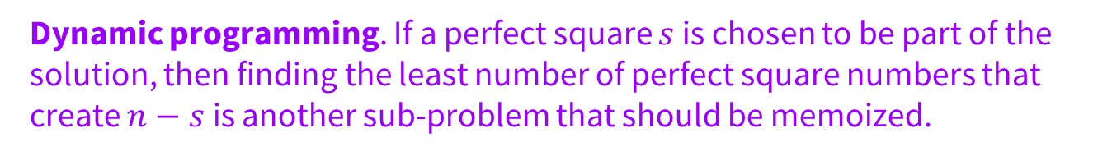
Problem 2 – Try it Yourself!
Given an integer $n$, return the least number of perfect square numbers that sum to $n$. A perfect square is an integer that is the square of an integer, in other words, it is the product of some integer with itself. For example, 1, 4, and 9 are perfect squares while 3 and 11 are not.
Dynamic programming. If a perfect square $s$ is chosen to be part of the solution, then finding the least number of perfect square numbers that create $n−s$ is another sub-problem that should be memoized.

Slide 46
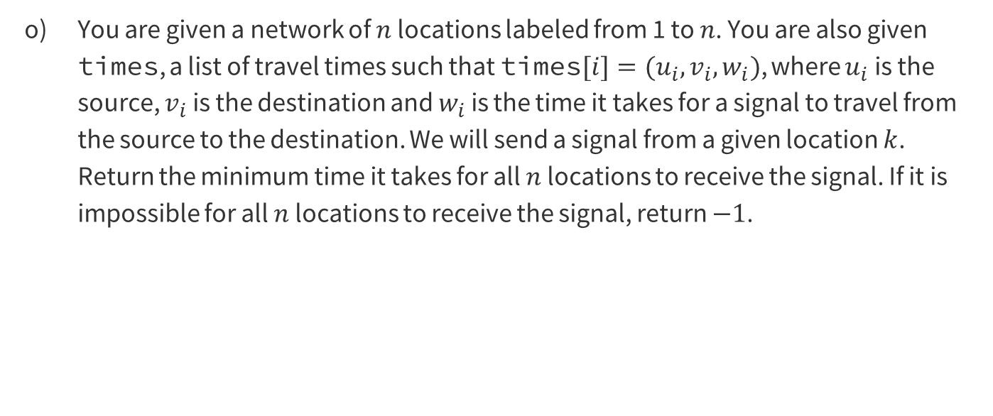
Problem 2 – Try it Yourself!
You are given a network of $n$ locations labeled from 1 to $n$. You are also given times, a list of travel times such that times$[i]=(u_{i},v_{i},w_{i})$, where $u_{i}$ is the source, $v_{i}$ is the destination and $w_{i}$ is the time it takes for a signal to travel from the source to the destination. We will send a signal from a given location $k$. Return the minimum time it takes for all $n$ locations to receive the signal. If it is impossible for all $n$ locations to receive the signal, return $−1$.

Slide 47
Problem 2 – Try it Yourself!
You are given a network of $n$ locations labeled from 1 to $n$. You are also given times, a list of travel times such that times$[i]=(u_{i},v_{i},w_{i})$, where $u_{i}$ is the source, $v_{i}$ is the destination and $w_{i}$ is the time it takes for a signal to travel from the source to the destination. We will send a signal from a given location $k$. Return the minimum time it takes for all $n$ locations to receive the signal. If it is impossible for all $n$ locations to receive the signal, return $−1$.
Graph. The key takeaway here is that the list times is a list of weighted edges since for every element, it provides the source, destination and the weight. Another element in this question is that it wants to find the minimum time it takes for all n locations to receive a signal which alludes to some sort of graph traversal.

Slide 48
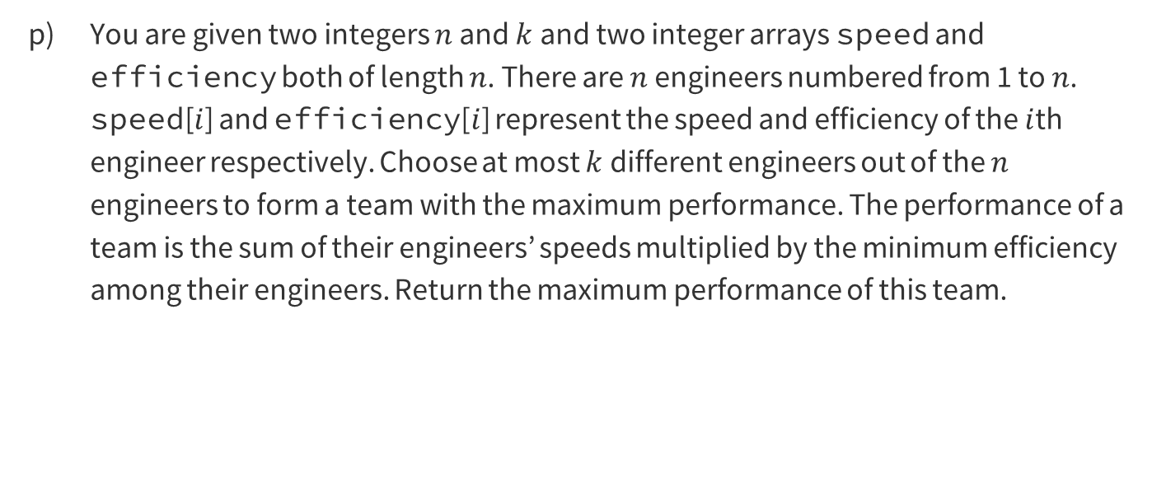
Problem 2 – Try it Yourself!
You are given two integers $n$ and $k$ and two integer arrays speed and efficiency both of length $n$. There are $n$ engineers numbered from 1 to $n$. speed[$i$] and efficiency[$i$] represent the speed and efficiency of the $i$th engineer respectively. Choose at most $k$ different engineers out of the $n$ engineers to form a team with the maximum performance. The performance of a team is the sum of their engineers’ speeds multiplied by the minimum efficiency among their engineers. Return the maximum performance of this team.

Slide 49
Problem 2 – Try it Yourself!
You are given two integers $n$ and $k$ and two integer arrays speed and efficiency both of length $n$. There are $n$ engineers numbered from 1 to $n$. speed[$i$] and efficiency[$i$] represent the speed and efficiency of the $i$th engineer respectively. Choose at most $k$ different engineers out of the $n$ engineers to form a team with the maximum performance. The performance of a team is the sum of their engineers’ speeds multiplied by the minimum efficiency among their engineers. Return the maximum performance of this team.
Greedy: Less trivial greedy idea: for each candidate, we treat him/her as the one who has the minimum efficiency in a team. Then, we select the rest of the team members based on this condition.

Slide 50

Problem 2 – Try it Yourself!
There are $n$ piles of stones arranged in a row. The $i$th pile has stones[$i$] stones. A move consists of merging exactly $k$ consecutive piles into one pile, and the cost of this move is equal to the total number of stones in these $k$ piles. Return the minimum cost to merge all piles of stones into one pile.

Slide 51
Problem 2 – Try it Yourself!
There are $n$ piles of stones arranged in a row. The $i$th pile has stones[$i$] stones. A move consists of merging exactly $k$ consecutive piles into one pile, and the cost of this move is equal to the total number of stones in these $k$ piles. Return the minimum cost to merge all piles of stones into one pile.
Dynamic programming. Since different merging orders could lead to the same subproblem, using a memo structure could reduce the amount of calculation needed.

Slide 52
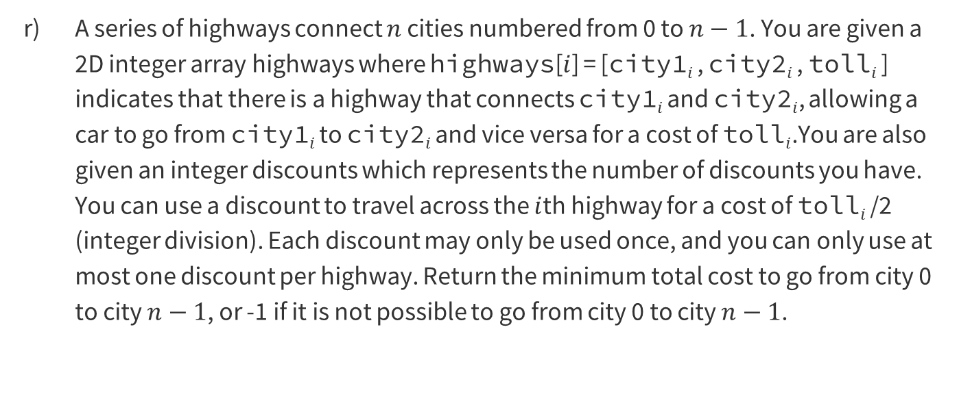
Problem 2 – Try it Yourself!
A series of highways connect $n$ cities numbered from 0 to $n−1$. You are given a 2D integer array highways where highways[$i$] = [city1$i$ , city2$i$ , toll$i$ ] indicates that there is a highway that connects city1$i$ and city2$i$, allowing a car to go from city1$i$ to city2$i$ and vice versa for a cost of toll$i$.You are also given an integer discounts which represents the number of discounts you have. You can use a discount to travel across the $i$th highway for a cost of toll$i$ /2 (integer division). Each discount may only be used once, and you can only use at most one discount per highway. Return the minimum total cost to go from city 0 to city $n−1$, or -1 if it is not possible to go from city 0 to city $n−1$.

Slide 53
Problem 2 – Try it Yourself!
A series of highways connect $n$ cities numbered from 0 to $n−1$. You are given a 2D integer array highways where highways[$i$] = [city1$i$ , city2$i$ , toll$i$ ] indicates that there is a highway that connects city1$i$ and city2$i$, allowing a car to go from city1$i$ to city2$i$ and vice versa for a cost of toll$i$.You are also given an integer discounts which represents the number of discounts you have. You can use a discount to travel across the $i$th highway for a cost of toll$i$ /2 (integer division). Each discount may only be used once, and you can only use at most one discount per highway. Return the minimum total cost to go from city 0 to city $n−1$, or -1 if it is not possible to go from city 0 to city $n−1$.
Graph: Cities are the nodes and highways are undirected edges.

Slide 54
Problem 2 – Try it Yourself!
A subsequence of a string is a new string that is formed from the original string by deleting some (can be none) of the characters without disturbing the relative positions of the remaining characters. (i.e., ”ace” is a subsequence of ”abcde” while ”aec” is not). Given two strings source and target, return the minimum number of subsequences of source such that their concatenation equals target. If the task is impossible, return -1.

Slide 55
Problem 2 – Try it Yourself!
A subsequence of a string is a new string that is formed from the original string by deleting some (can be none) of the characters without disturbing the relative positions of the remaining characters. (i.e., ”ace” is a subsequence of ”abcde” while ”aec” is not). Given two strings source and target, return the minimum number of subsequences of source such that their concatenation equals target. If the task is impossible, return -1.
Greedy: we greedily concatenate source and check if we have target as a subsequence of the concatenated string or not.

Slide 56
That’s All, Folks!
Thanks for coming to section this week!
Any questions?

