Slide 1
CSE 421 Section 10
P, NP, Reductions

Slide 2
Administrivia
Notes:
Administrivia ~2 mins

Slide 3
Announcements & Reminders
Last Homework!
Due Friday!
Final Exam on Monday, March 11, 2:30-4:20 PM!
Sample exams on course website!

Slide 4
NP-Completeness
Notes:
~5 min intro

Slide 5

Precedence graph construction
A problem X is NP-complete if
1. X is in NP
2. For every Y in NP, Y $<_{p}$ X
X is a “hardest” problem in NP
If X is NP-Complete, Z is in NP and X $<_{p}$ Z. Then Z is NP-Complete

Slide 6
Important NPC
The Circuit Satisfiability Problem
3 SAT
Independent Set
Vertex Cover
Integer Programming
Hamiltonian Circuit
Graph Coloring
Subset sum

Slide 7
Reductions
Notes:
~5 mins

Slide 8
Efficient Recruiting Problem
Suppose you’re helping to organize a summer sports camp, and the following problem comes up. The camp is supposed to have at least one counselor who’s skilled at each of the n sports covered by the camp (baseball, volleyball, and so on). They have received job applications from m potential counselors. For each of the n sports, there is some subset of the m applicants qualified in that sport. The question is: For a given number k < m, is it possible to hire at most k of the counselors and have at least one counselor qualified in each of the n sports?

Slide 9
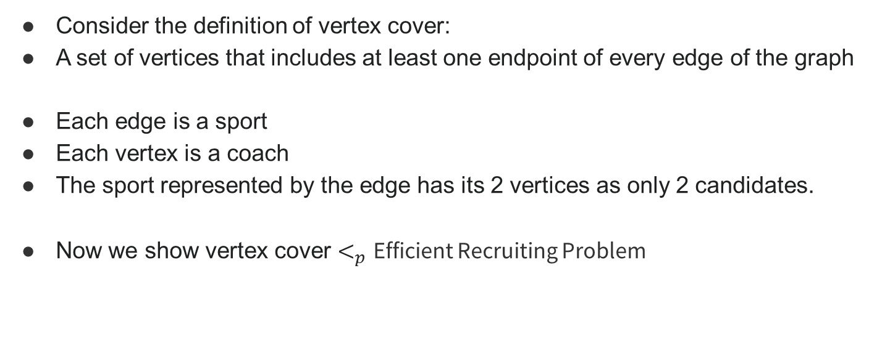
Vertex Cover!
Consider the definition of vertex cover:
A set of vertices that includes at least one endpoint of every edge of the graph
Each edge is a sport
Each vertex is a coach
The sport represented by the edge has its 2 vertices as only 2 candidates.
Now we show vertex cover $<_{p}$ Efficient Recruiting Problem

Slide 10
Strong Independent Set
The following is a version of the Independent Set Problem. You are given a graph G=(V,E) and an integer k. For this problem, we will call a set I in V strongly independent if, for any two nodes v, u in l, the edge (v, u) does not belong to E, and there is also no path of two edges from u to v, that is, there is no node w such that both (u, w) in E and (w, v) in E. The Strongly Independent Set Problem is to decide whether G has a strongly independent set of size at least k.
Prove that the Strongly Independent Set Problem is NP-complete.

Slide 11
Independent Set!
One very simple intuition is adding a vertex between each edges (u,v) to (u,w),(w,v), so distance 1 becomes distance 2 now.
But how can we avoid choosing the added in our solution?

Slide 12
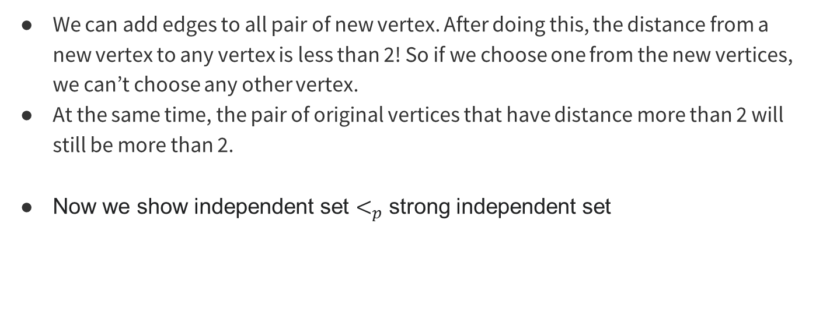
We can add edges to all pair of new vertex. After doing this, the distance from a new vertex to any vertex is less than 2! So if we choose one from the new vertices, we can’t choose any other vertex.
At the same time, the pair of original vertices that have distance more than 2 will still be more than 2.
Now we show independent set $<_{p}$ strong independent set

Slide 13
That’s All, Folks!
Thanks for coming to section this week!
Any questions?

