Slide 1
Early Stage Prototyping
February 14, 2013

Slide 2
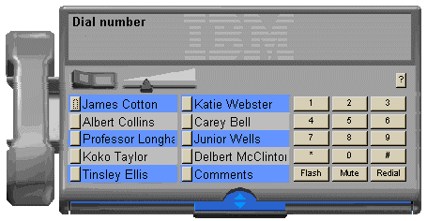
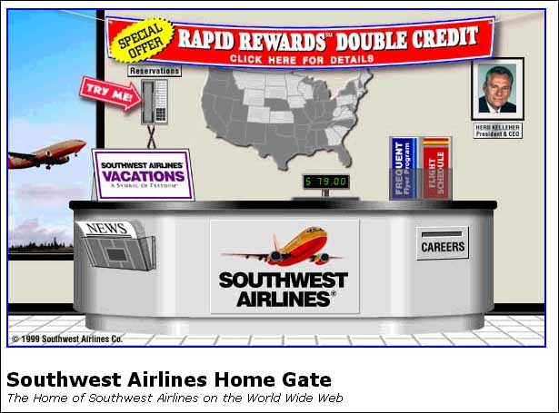
Hall of Fame or Shame?
Direct translations
software telephony solution where users dial a number by clicking on a simulated keypad
airline web site that simulates a ticket counter

Slide 3
Hall of Shame!
Direct translations
software telephony solution where users dial a number by clicking on a simulated keypad
airline web site that simulates a ticket counter
Misused Metaphors!

Slide 4
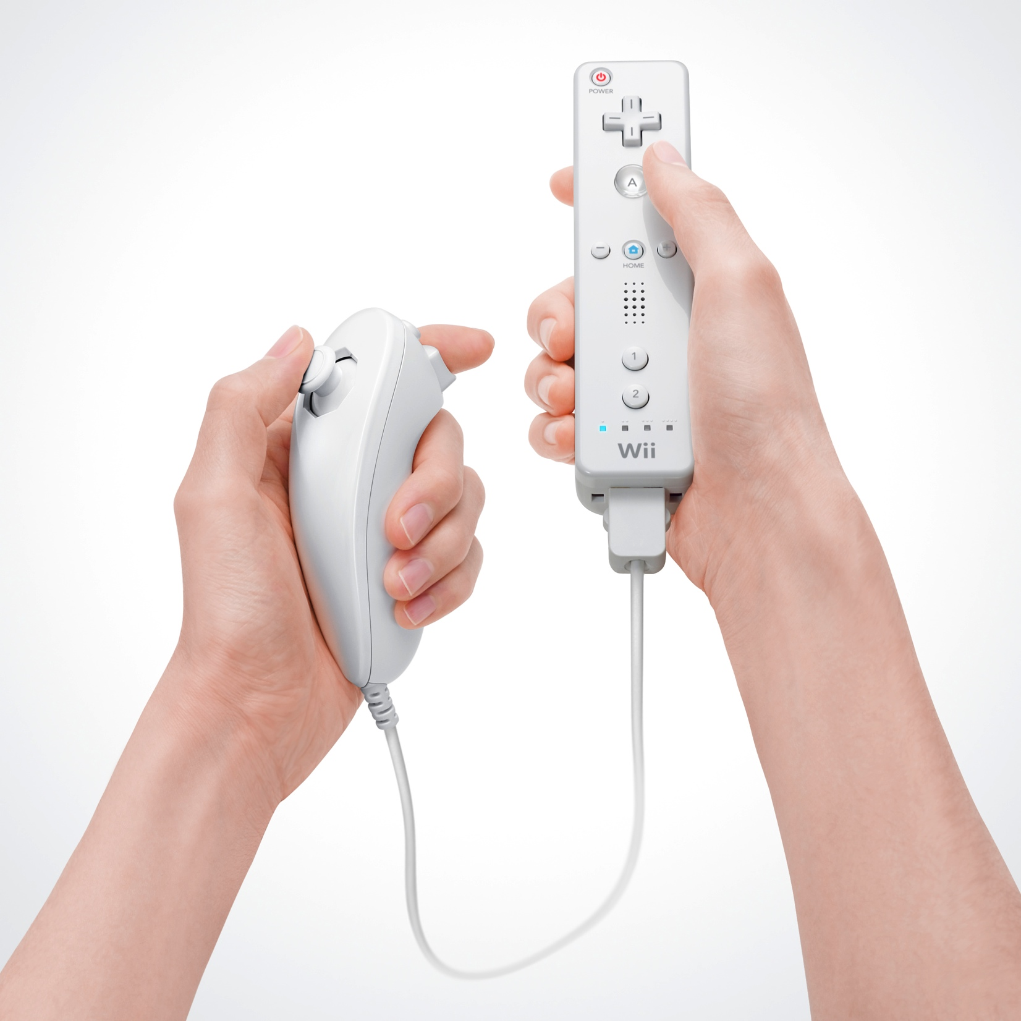
Hall of Fame or Shame?
Wiimote
By Nintendo

Slide 5
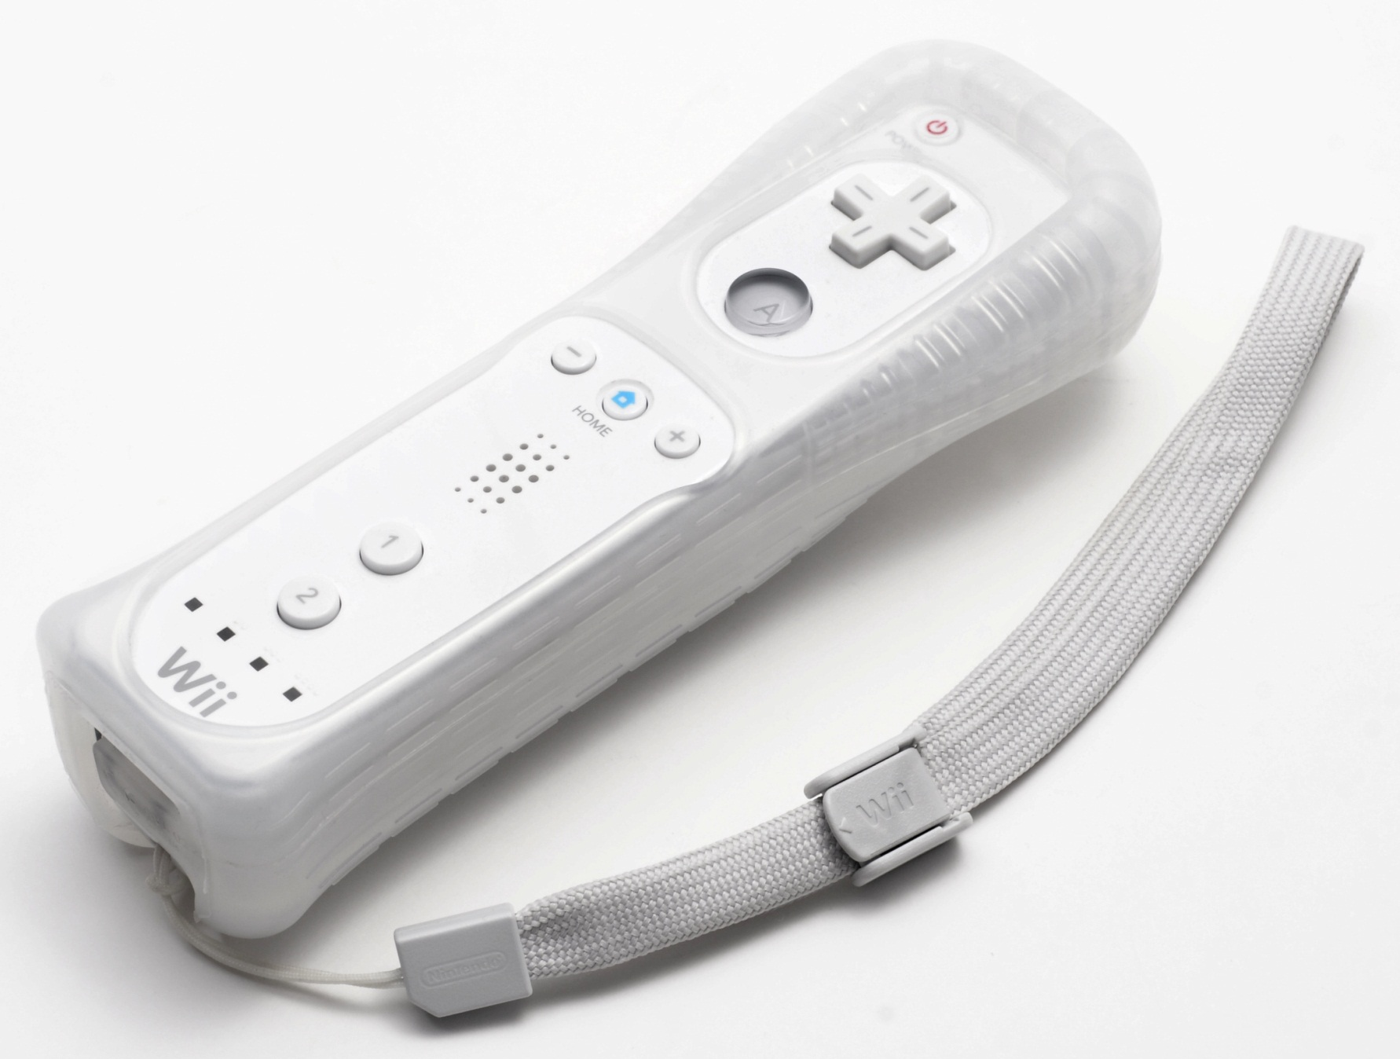
Hall of Shame!
The main thing that differentiated the product (movement in gaming) resulted in it being thrown at windows
Slippery plastic hard to hold onto. Later designs added rubber case & strap
Lack of a joystick was initial problem resulting in a second controller

Slide 6
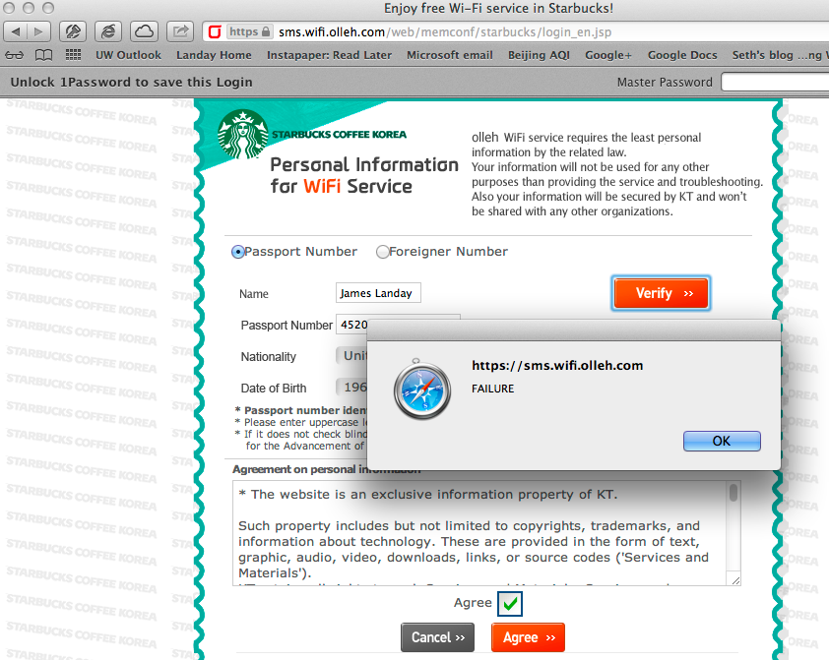
Hall of Shame!
Starbucks/Olleh WiFi
Broken form – mouse didn’t work
Require my personal information (passport #)
Fail on verify!
Bad experience!

Slide 7
Early Stage Prototyping
February 14, 2013

Slide 8
Outline
Conceptual Models & Interface Metaphors Review
Types of Prototypes
Low-fi prototyping
Wizard of Oz technique

Slide 9
Conceptual Models Review
Conceptual models ?
mental representation of how the object works & how interface controls effect it
Design model should equal customer’s model ?
mismatches lead to errors
use customer’s likely conceptual model to design
Design guides ?
make things visible
map interface controls to customer’s model
provide feedback
Design Model
Customer Model
System Image

Slide 10
Design Process: Exploration
Expand Design Space
Brainstorming
Sketching
Storyboarding
Prototyping
Discovery
Design Exploration
Design Refinement
Production

Slide 11
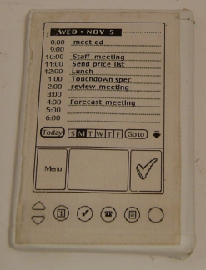
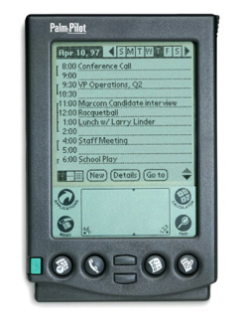
What is a Prototype?
“A prototype is an early sample or model built to test a concept or process or to act as a thing to be replicated or learned from.” – Wikipedia
a working representation of a final artifact
http://www.computerhistory.org/collections/accession/102716262
Notes:
Jeff Hawkins carried around a block of wood like this in his pocket & pulled it out when meeting people and used a pen to act like he was adding things to his device
This led to the prototype in the middle and
The final product: The PalmPilot (right)

Slide 12
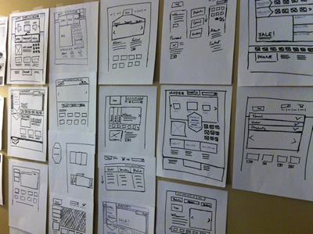
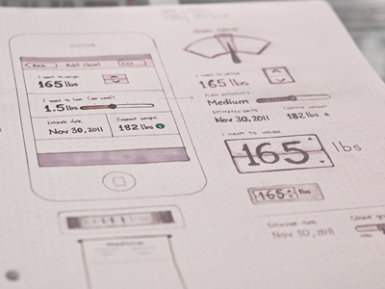
Types of Prototypes
Prototypes are concrete representations of a design
Prototype dimensions
representation: form of the prototype
off-line (paper) or on-line (software)
precision: level of detail (e.g., informal or polished)
interactivity: watch-only vs. fully interactive
fixed prototype (video clips)
fixed-path prototype (each step triggered by specified actions)
at extreme could be 1 path or possibly more open (e.g., Denim)
open prototype (real, but limited error handling or performance)
evolution: expected life cycle of prototype
e.g., throw away or iterative
PJ McCormick
Karem Suer
Notes:
PJ McCormick (left)
Kerem Suer (right)

Slide 13
Types of Prototypes
Prototypes are concrete representations of a design
Prototype dimensions
representation: form of the prototype
off-line (paper) or on-line (software)
precision: level of detail (e.g., informal or polished)
interactivity: watch-only vs. fully interactive
fixed prototype (video clips)
fixed-path prototype (each step triggered by specified actions)
at extreme could be 1 path or possibly more open (e.g., Denim)
open prototype (real, but limited error handling or performance)
evolution: expected life cycle of prototype
e.g., throw away or iterative

Slide 14
Fidelity in Prototyping
Fidelity refers to the level of detail
High fidelity?
prototypes look like the final product
Low fidelity?
artists renditions with many details missing

Slide 15
Hi-fi Prototypes Warp
Perceptions of the tester/reviewer
representation communicates “finished”
comments focus on color, fonts, & alignment
Time
encourage precision
specifying details takes more time
Creativity
lose track of the big picture

Slide 16
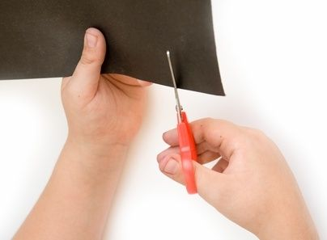
Why Use Low-fi Prototypes?
Traditional methods take too long
sketches → prototype → evaluate → iterate
Can instead simulate the prototype
sketches → evaluate → iterate
sketches act as prototypes
designer “plays computer”; others observe & record
Kindergarten implementation skills
allows non-programmers to participate

Slide 17
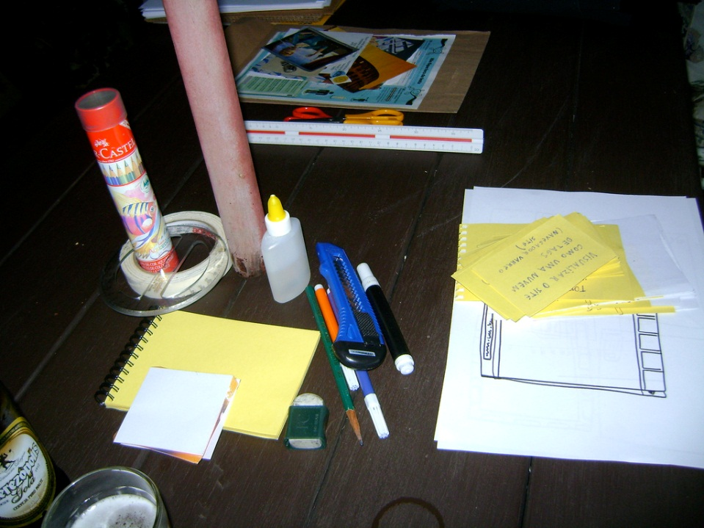
The Basic Materials
Large, heavy, white paper (A3 or 11x17)
5x8 in./A5/A6 index cards
Tape, stick glue, correction tape
Pens & markers (many colors & sizes)
Post-its
Overhead transparencies
Scissors
X-acto knives, etc.
http://www.flickr.com/photos/latitude14/3651034642/sizes/l/in/photostream/

Slide 18
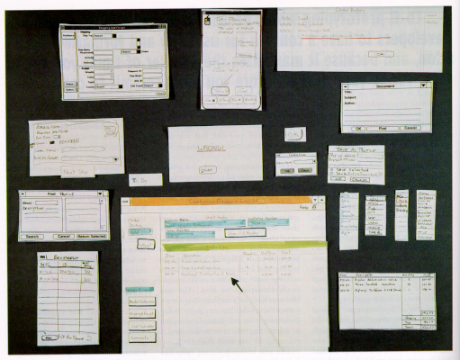
from “Prototyping for Tiny Fingers” by Rettig

Slide 19
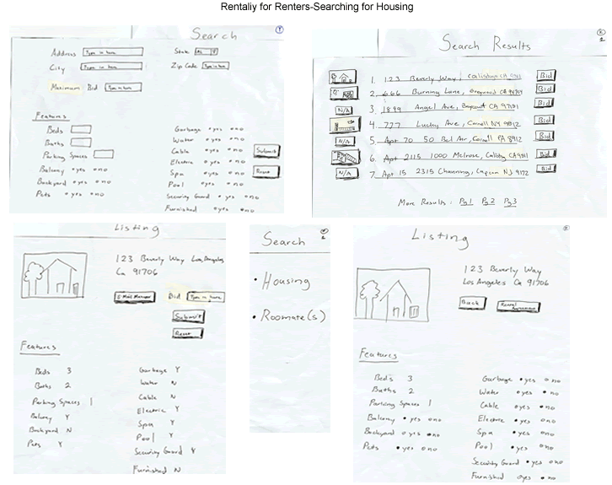

Slide 20
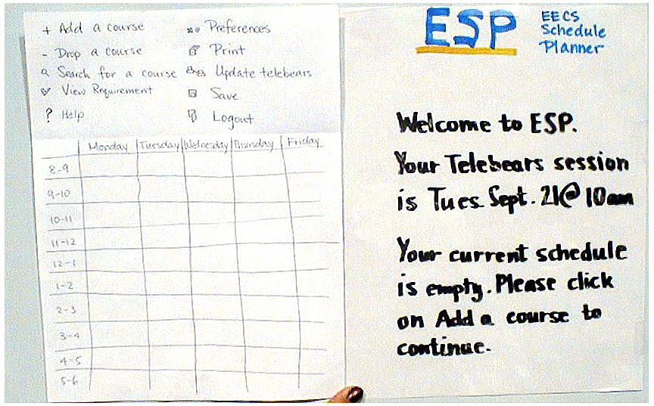
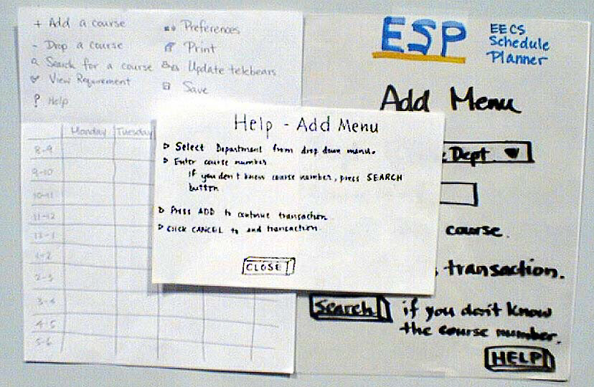
ESP

Slide 21
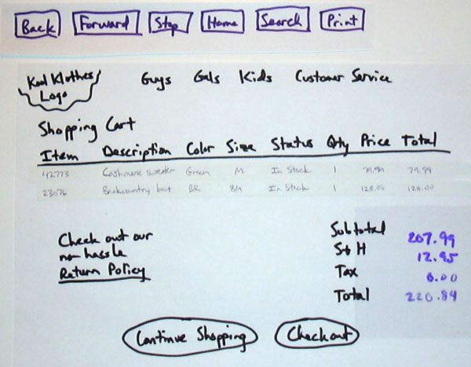

Slide 22
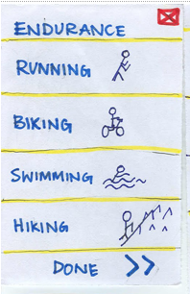
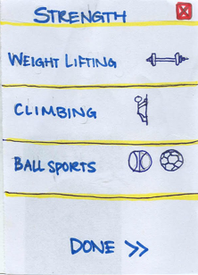
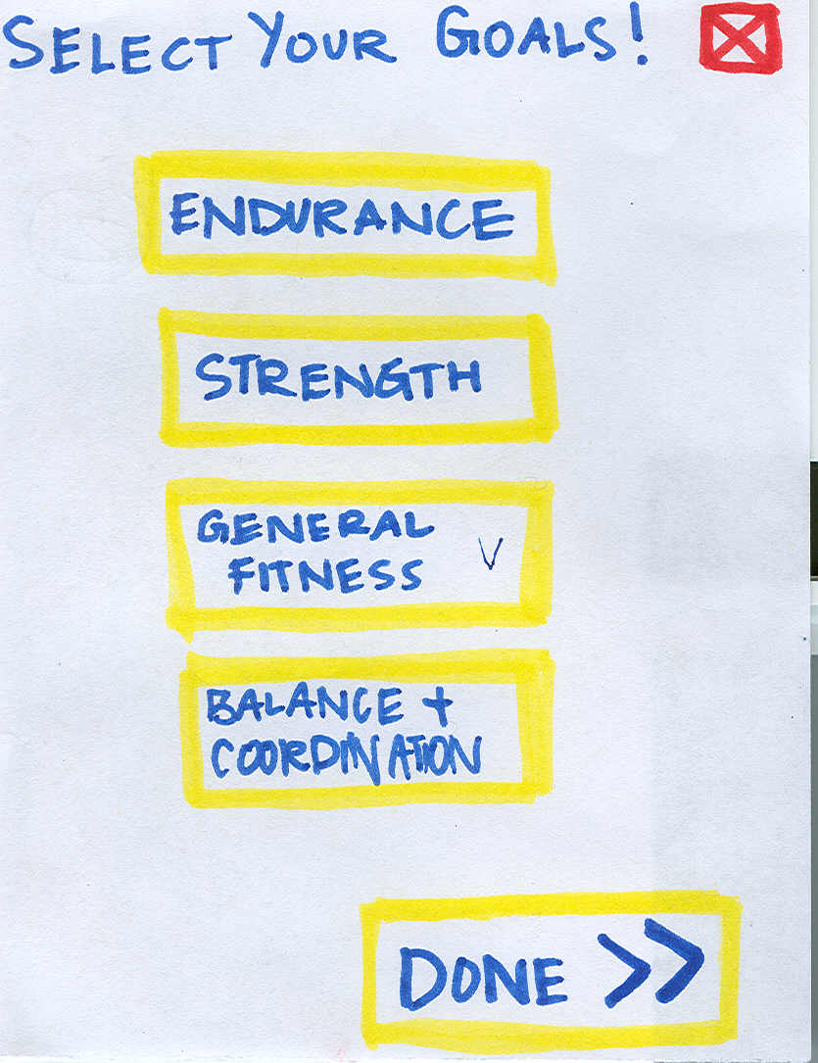
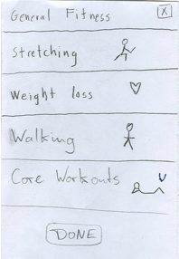
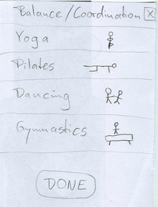
➔
ZAPT

Slide 23
Constructing the Model
Set a deadline
Don’t think too long - build it!
Draw a window frame on large paper
Put different screen regions on cards
anything that moves, changes, appears/disappears
Ready response for any user action
e.g., have those pull-down menus already made
Use photocopier to make many versions

Slide 24
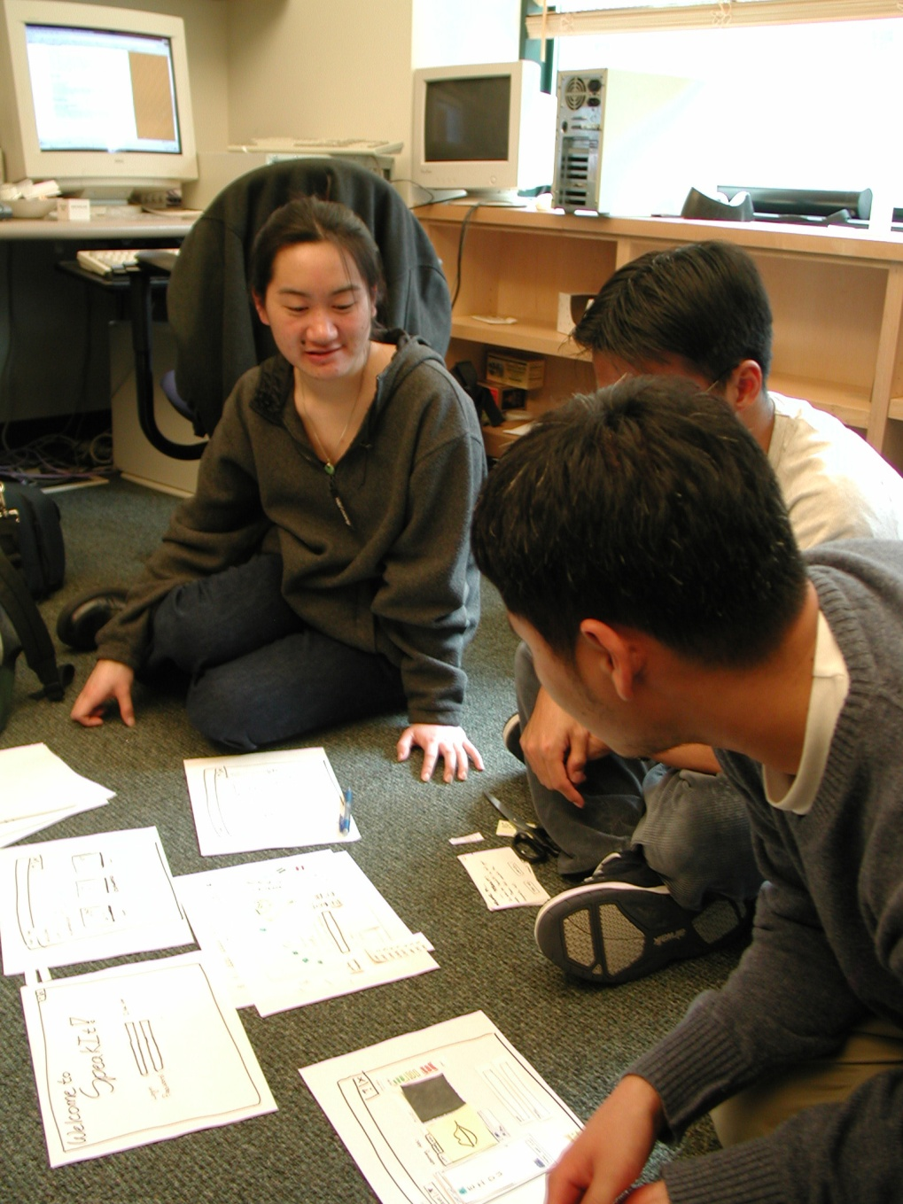
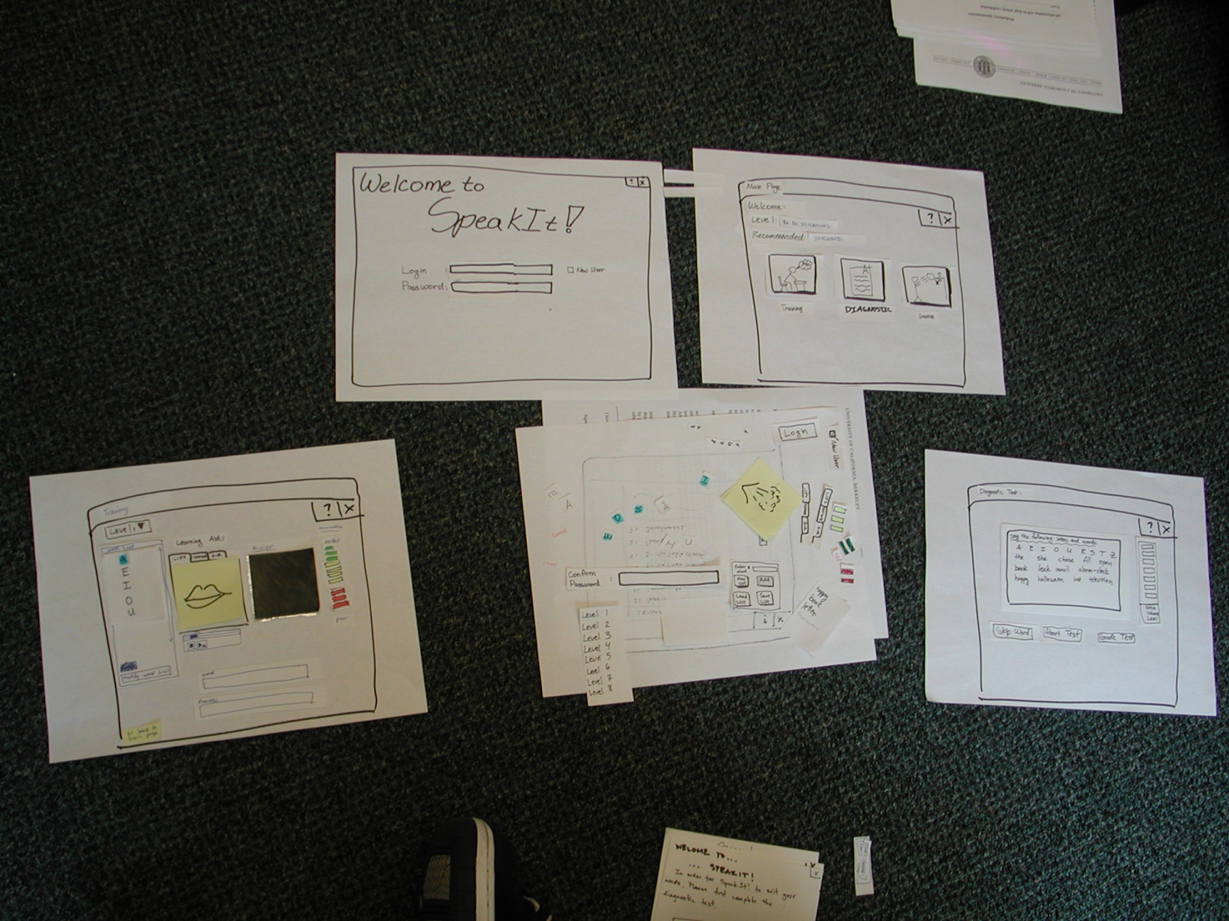
Constructing the Model

Slide 25
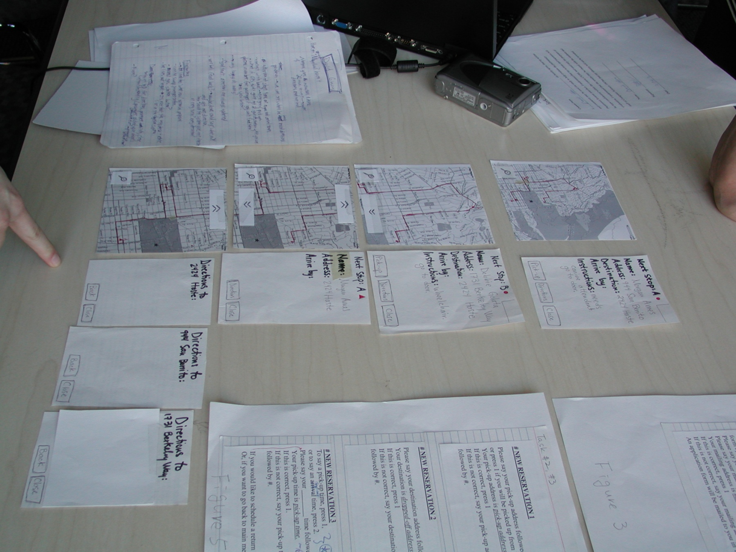
Constructing the Model

Slide 26
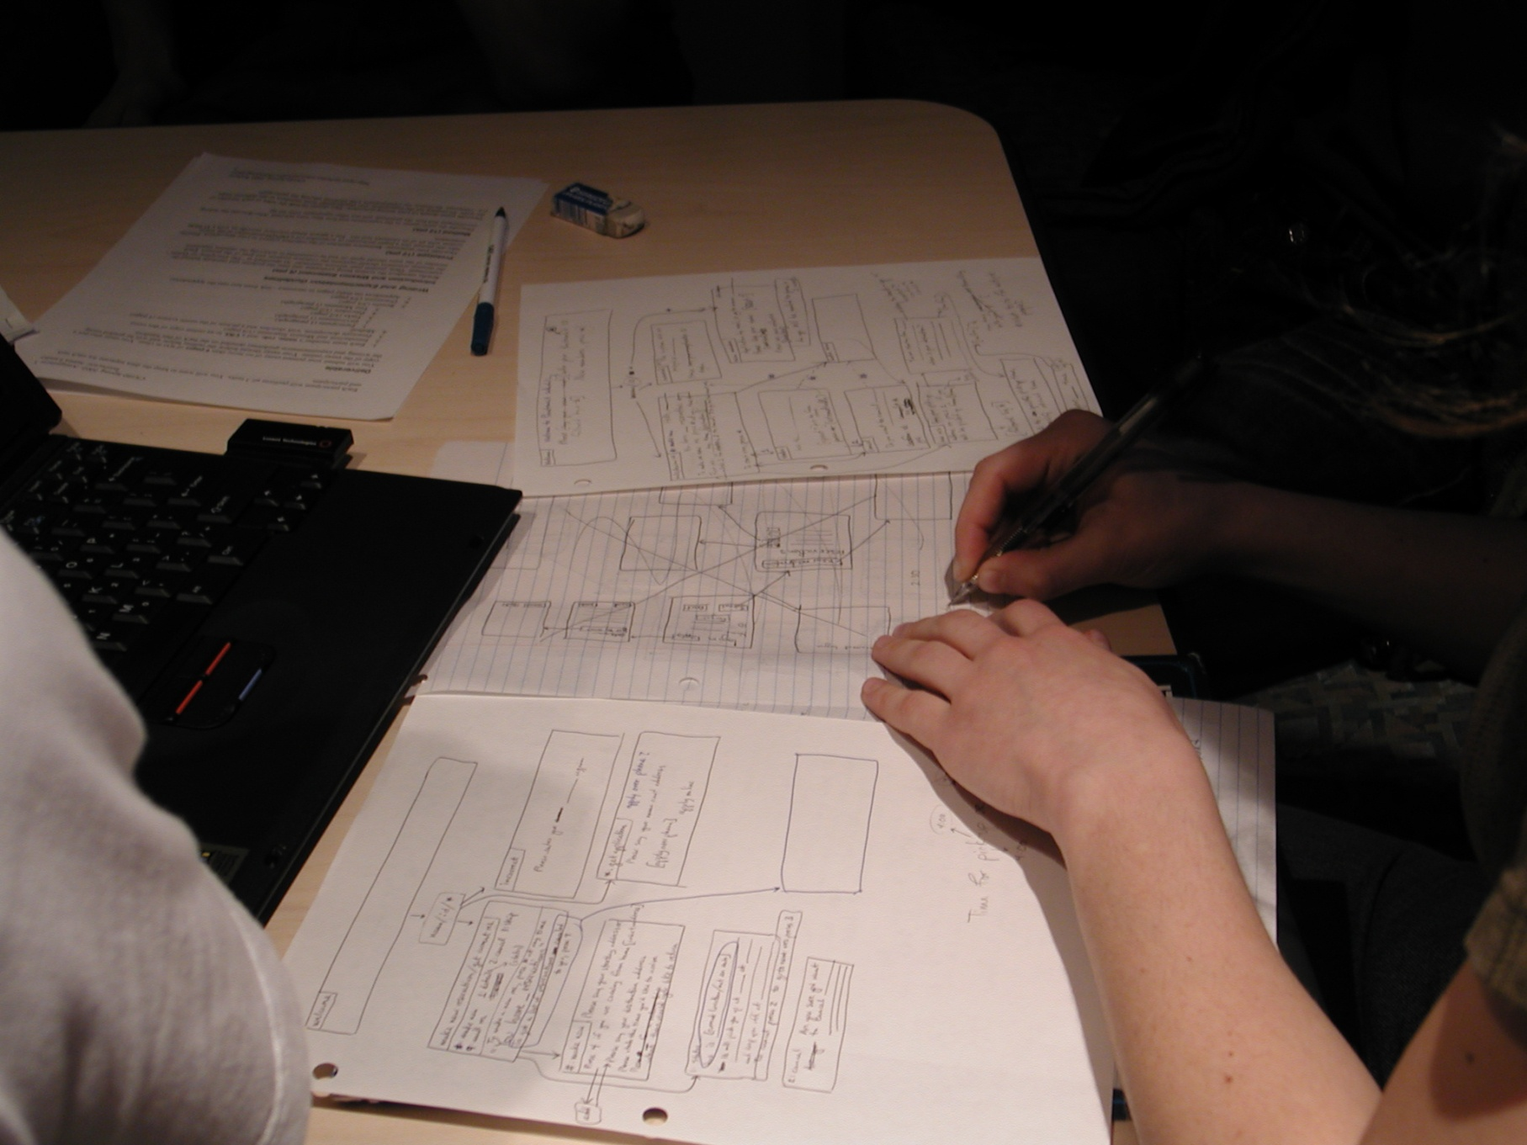
Constructing the Model

Slide 27
Constructing the Model

Slide 28
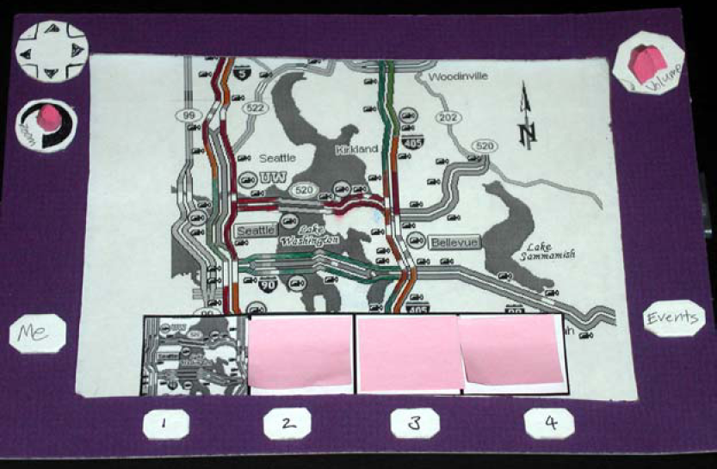
Constructing the Model

Slide 29
Preparing for a Test
Select your “customers”
understand background of intended users
use a questionnaire to get the people you need
don’t use friends or family
I think existing “customers” are OK (Rettig disagrees)
Prepare scenarios that are
typical of the product during actual use
make prototype support these (small, yet broad)
Practice to avoid “bugs”

Slide 30
Conducting a Test
Four roles
greeter – puts users at ease & gets data
facilitator – only team member who speaks
gives instructions & encourages thoughts, opinions
computer – knows application logic & controls it
always simulates the response, w/o explanation
observers – take notes & recommendations
Typical session is 1 hour
preparation, the test, debriefing
Read the Gommol paper (1 page) for details on conducting a test

Slide 31
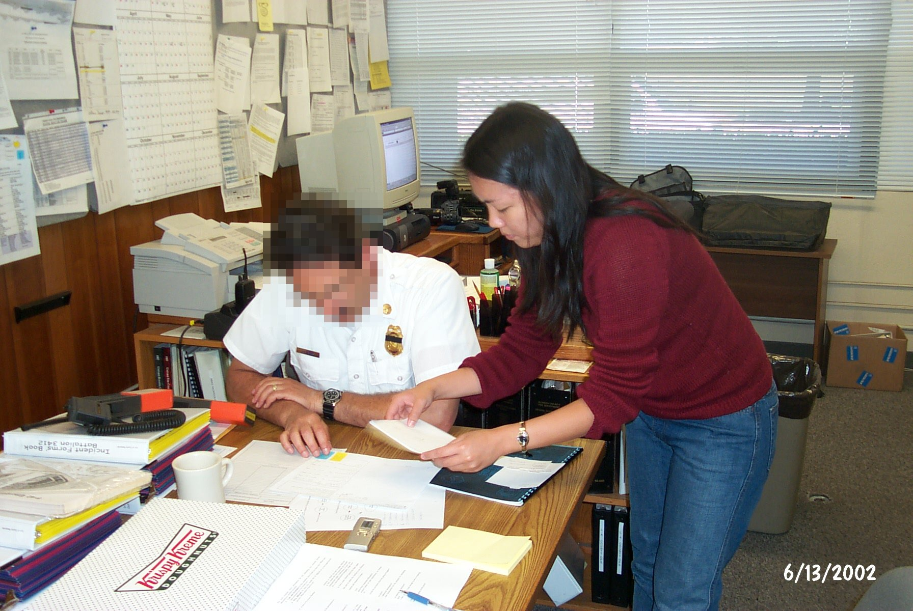
Conducting a Test

Slide 32
Evaluating Results
Sort & prioritize observations
what was important?
lots of problems in the same area?
Create a written report on findings
gives agenda for meeting on design changes
Make changes & iterate

Slide 33
Advantages of Low-fi Prototyping
Takes only a few hours
no expensive equipment needed
Can test multiple alternatives
fast iterations
number of iterations is tied to final quality
Almost all interaction can be faked

Slide 34
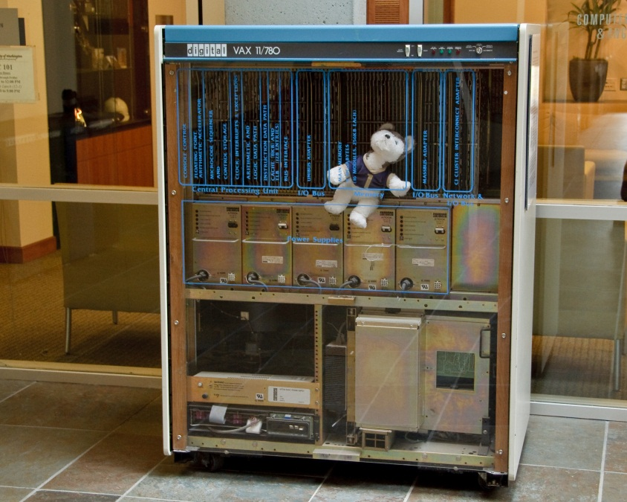
Wizard of Oz Technique
Faking the interaction. Comes from?
the film “The Wizard of OZ”
“the man behind the curtain”
Long tradition in computer industry
e.g., prototype of a PC w/ a DEC VAX behind the curtain

Slide 35
Wizard of Oz Technique
Faking the interaction. Comes from?
the film “The Wizard of OZ”
“the man behind the curtain”
Long tradition in computer industry
e.g., prototype of a PC w/ a DEC VAX behind the curtain
Much more important for hard to implement features
speech & handwriting recognition

Slide 36
Problems with Low-fi Prototypes
“Computer” inherently buggy
Slow compared to real app
timings not accurate
Hard to implement some functionality
pulldowns, feedback, drag, viz …
Won’t look like final product
sometimes hard to recognize widgets
End-users can’t use by themselves
not in context of user’s work environment

Slide 37
Summary
Prototypes are a concrete representation of a design or final product
Low-fi testing allows us to quickly iterate
get feedback from users & change right away

Slide 38
Further Reading Prototyping
Books
Paper Prototyping: The Fast and Easy Way to Design and Refine User Interfaces, by Carolyn Snyder, Morgan Kaufmann, 2003
Articles
“Prototyping for Tiny Fingers” by Marc Rettig, in Communications of the ACM, 1994
“Using Paper Prototypes to Manage Risk” by Carolyn Snyder, http://world.std.com/~uieweb/paper.htm
“The Perils of Prototyping” by Alan Cooper,
http://www.chi-sa.org.za/Documents/articles/perils.htm
Web Sites
dub Group web site, for DENIM & SUEDE downloads, http://dub.washington.edu
InfoDesign Toolkit, http://www.infodesign.com.au

Slide 39
Next Time
Heuristic Evaluation
Reading
Lewis & Rieman 4.3-4.4
Nielsen HE chapter (read 5 links under "Heuristic Evaluation")

