Slide 1
CSE 451: Operating Systems Spring 2012 Module 24 Distributed Systems
Ed Lazowska
lazowska@cs.washington.edu
Allen Center 570
Notes:
1

Slide 2
What is a “distributed system”?
Nearly all systems today are distributed in some way
they use email
they access files over a network
they access printers over a network
they’re backed up over a network
they share other physical or logical resources
they cooperate with other people on other machines
they access the web
they receive video, audio, etc.

Slide 3
Loosely-coupled systems
Earliest systems used simple explicit network programs
FTP (rcp): file transfer program
telnet (rlogin/rsh): remote login program
mail (SMTP)
Each system was a completely autonomous independent system, connected to others on the network

Slide 4
Even today, most distributed systems are loosely-coupled (although not that loosely!):
each CPU runs an independent autonomous OS
computers don’t really trust each other
some resources are shared, but most are not
the system may look differently from different hosts

Slide 5
Closely-coupled systems
A distributed system becomes more “closely-coupled” as it
appears more uniform in nature
runs a “single” operating system
has a single security domain
shares all logical resources (e.g., files)
shares all physical resources (CPUs, memory, disks, printers, etc.)
In the limit, a distributed system looks to the user as if it were a centralized timesharing system, except that it’s constructed out of a distributed collection of hardware and software components

Slide 6
Tightly-coupled systems
A “tightly-coupled” system usually refers to a multiprocessor
runs a single copy of the OS with a single workload queue
has a single address space
usually has a single bus or backplane to which all processors and memories are connected
has very low communication latency
processors communicate through shared memory

Slide 7
Some issues in distributed systems
Transparency (how visible is the distribution)
Security
Reliability
Performance
Scalability
Programming models
Communication models

Slide 8
Example: Grapevine distributed mail service
Xerox PARC, 1980
cf. Microsoft Outlook/Exchange today!!!!!
Goals
cannot rely on integrity of client
once the system accepts mail, it will be delivered
no single Grapevine computer failure will make the system unavailable to any client either for sending or for receiving mail
Components
GrapevineUser package on each client workstation
Registration Servers
Message Servers
Implementation: Remote Procedure Call

Slide 9
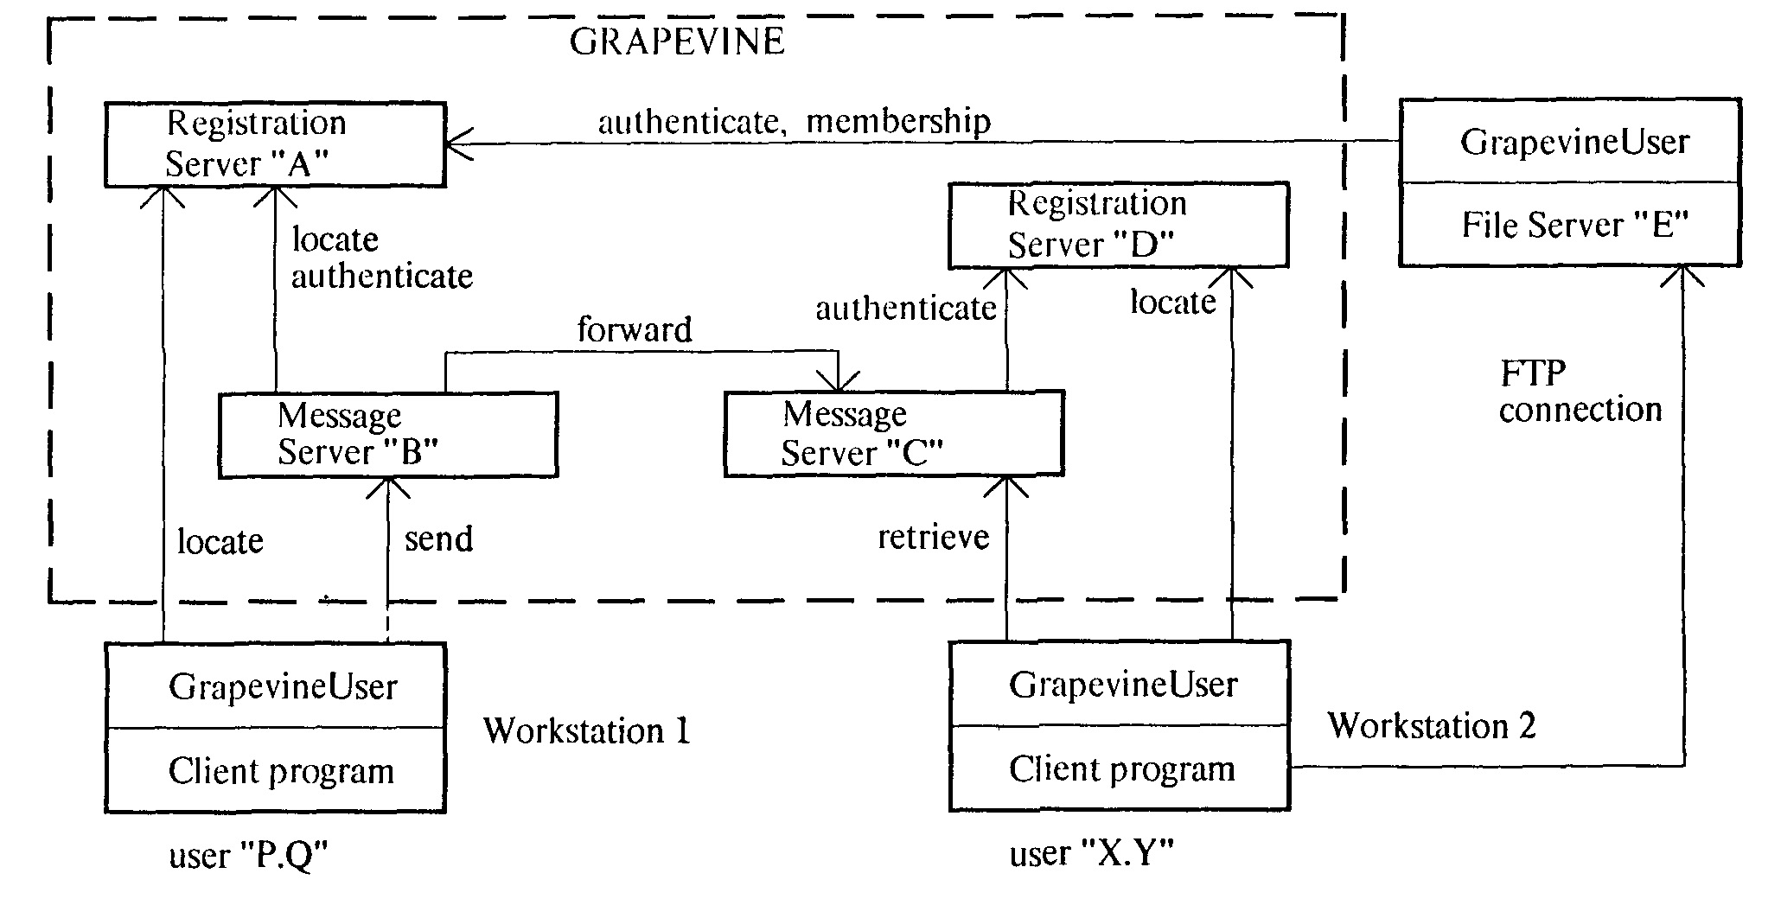
Grapevine: Functional diagram

Slide 10
Grapevine: Sending a message
User prepares message using mail client
Mail client contacts GrapevineUser package on same workstation to actually send message
GrapevineUser package
Contacts any Registration Server to get a list of Message Servers
Contacts any Message Server to transmit message
presents source and destination userids, and source password, for authentication
Message Server uses any Registration Server to authenticate
sends message body to Message Server
Message Server places it in stable storage and acknowledges receipt

Slide 11
Grapevine: Functional diagram
3
4
2
1

Slide 12
Registries
Actually, I lied: There’s an additional step.
For scalability, users are partitioned into registries – “user ‘P.Q’” is user P in registry Q.
Registries are replicated.
There is one registry that is replicated on every registration server: the registry of registries.
So, when I said:
Message Server uses any Registration Server to authenticate
what actually happens is the Message Server contacts any Registration Server to obtain a list of those Registration Servers holding the registry of the user, then contacts one of those registration servers to authenticate the user

Slide 13
Grapevine: Transport and buffering
For each recipient of the message, Message Server contacts any Registration Server to obtain list of Message Servers holding mail for that recipient
Same lie as before
Sends a copy of the message to one of those Message Servers for that recipient

Slide 14
Grapevine: Functional diagram
5*
6*
3
4
2
1

Slide 15
Grapevine: Retrieving mail
User uses mail client to contact GrapevineUser package on same workstation to retrieve mail
GrapevineUser package
Contacts any Registration Server to get a list of each Message Server holding mail for the user (“inbox site”)
Same lie as before
Contacts each of these Message Servers to retrieve mail
presents user credentials
Message Server uses any Registration Server to authenticate
acknowledges receipt of messages so that the server can delete them from its storage

Slide 16
Grapevine: Functional diagram
5*
6*
4*
3
2
4
3*
2
1
1

Slide 17
Grapevine: Scalability
Can add more Registration Servers
Can add more Message Servers
Only thing that didn’t scale was handling of distribution lists
the accepting Message Server was responsible for expanding the list (recursively if necessary) and delivering to an appropriate Message Server for each recipient
some distribution lists contained essentially the entire user community
Jeff Dean (Google) told us they don’t even think about more than two decimal orders of magnitude
fundamental design decisions will need to change
advances in technology will make it possible

Slide 18
Example: Google search infrastructure
It’s likely that Google has several million machines
But let’s be conservative – 1,000,000 machines
A rack holds 176 CPUs (88 1U dual-processor boards), so that’s about 6,000 racks
A rack requires about 50 square feet (given datacenter cooling capabilities), so that’s about 300,000 square feet of machine room space (more than 6 football fields of real estate – although of course Google divides its machines among dozens of datacenters all over the world)
A rack requires about 10kw to power, and about the same to cool, so that’s about 120,000 kw of power, or nearly 100,000,000 kwh per month ($10 million at $0.10/kwh)
Equivalent to about 20% of Seattle City Light’s generating capacity

Slide 19
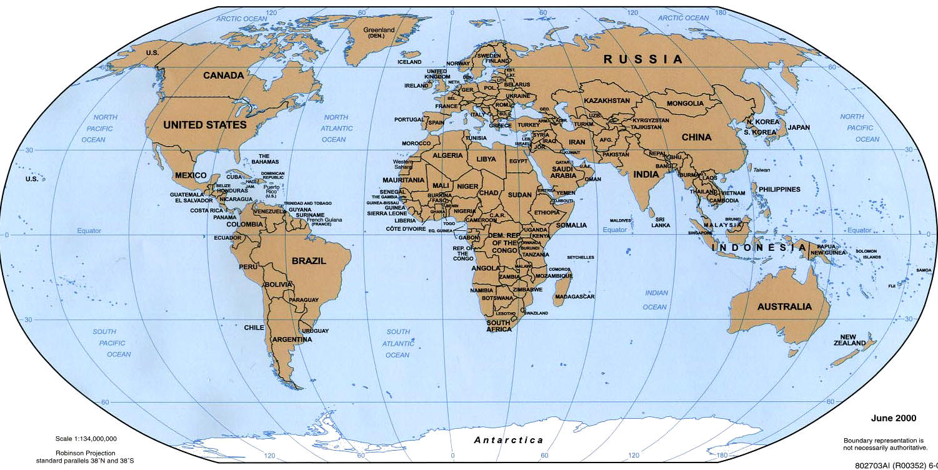
There are multiple clusters (of thousands of computers each) all over the world
Many hundreds of machines are involved in a single Google search request (remember, the web is 400+TB)
DNS routes your search request to a nearby cluster

Slide 20
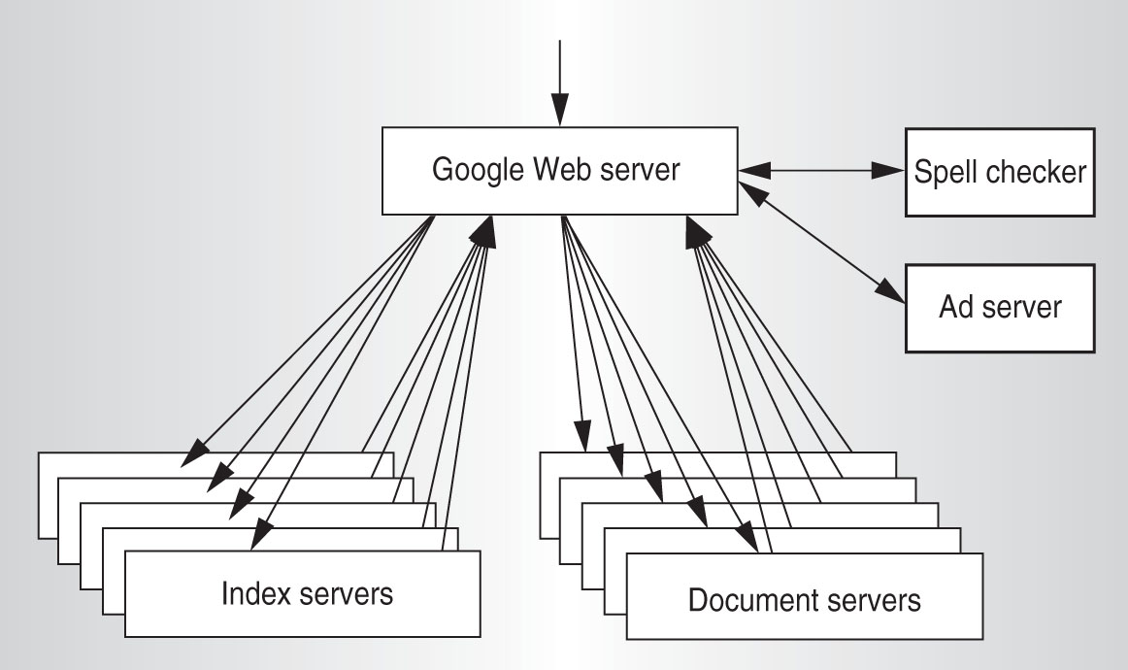
A cluster consists of Google Web Servers, Index Servers, Doc Servers, and various other servers (ads, spell checking, etc.)
These are cheap standalone computers, rack-mounted, connected by commodity networking gear

Slide 21
Within the cluster, load-balancing routes your search to a lightly-loaded Google Web Server (GWS), which will coordinate the search and response

Slide 22
The index is partitioned into “shards.” Each shard indexes a subset of the docs (web pages). Each shard is replicated, and can be searched by multiple computers – “index servers”
The GWS routes your search to one index server associated with each shard, through another load-balancer
When the dust has settled, the result is an ID for every doc satisfying your search, rank-ordered by relevance

Slide 23
The docs, too, are partitioned into “shards” – the partitioning is a hash on the doc ID. Each shard contains the full text of a subset of the docs. Each shard can be searched by multiple computers – “doc servers”
The GWS sends appropriate doc IDs to one doc server associated with each relevant shard
When the dust has settled, the result is a URL, a title, and a summary for every relevant doc

Slide 24
Meanwhile, the ad server has done its thing, the spell checker has done its thing, etc.
The GWS builds an HTTP response to your search and ships it off
Many hundreds of computers have enabled you to search 400+TB of web in ~100 ms.

Slide 25
Google: The Big Picture
Enormous volumes of data
Extreme parallelism
The cheapest imaginable components
Failures occur all the time
You couldn’t afford to prevent this in hardware
Software makes it
Fault-Tolerant
Highly Available
Recoverable
Consistent
Scalable
Predictable
Secure

Slide 26
How on earth would you enable mere mortals write hairy applications such as this?
Recognize that many Google applications have the same structure
Apply a “map” operation to each logical record in order to compute a set of intermediate key/value pairs
Apply a “reduce” operation to all the values that share the same key in order to combine the derived data appropriately
Build a runtime library that handles all the details, accepting a couple of customization functions from the user – a Map function and a Reduce function
That’s what MapReduce is
Supported by the Google File System and the Chubby lock manager
Augmented by the BigTable not-quite-a-database system

Slide 27
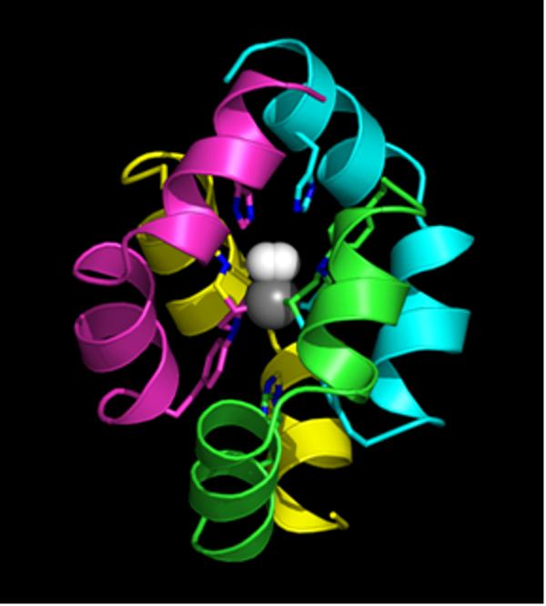
An extremely loosely coupled system: BOINC
David Baker

Slide 28
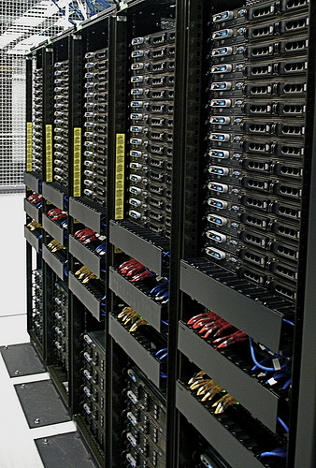

Slide 30
Berkeley Open Infrastructure for Network Computing

Slide 31
Totally off the subject of OS: Human Computation
David Baker and Zoran Popovic

Slide 32
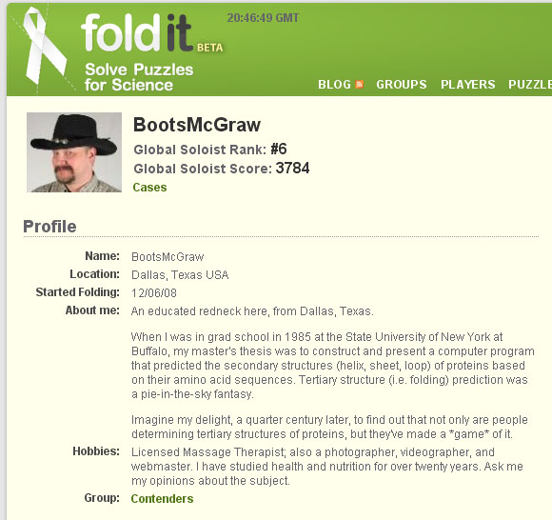

Slide 33
Humans and computers have different computational strengths
Can we exploit these differences?
To differentiate computers from humans?
E.g., to make it harder for spambots to acquire new email accounts from which to send spam
To create human/machine computational systems that combine the best of each?
Luis von Ahn

Slide 34
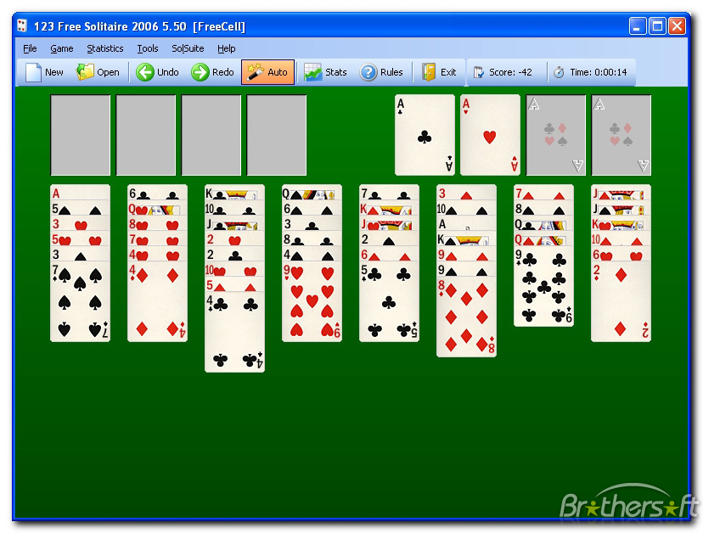
Hours per year, world-wide, spent playing computer solitaire: 9 billion
Hours spent building the Panama Canal: 20 million (less than a day of solitaire)

Slide 35
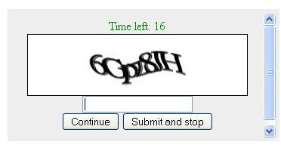
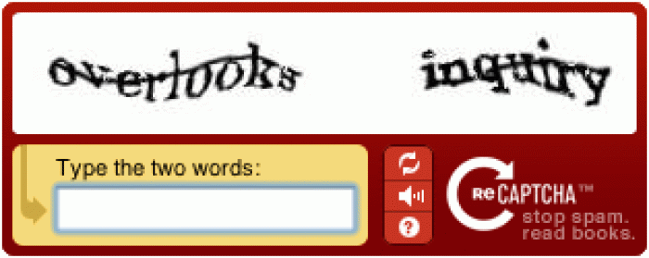

Slide 36
Where do the words come from?
Entire photo archive (years 1851-1980) was completed in 2009
Notes:
36

Slide 37
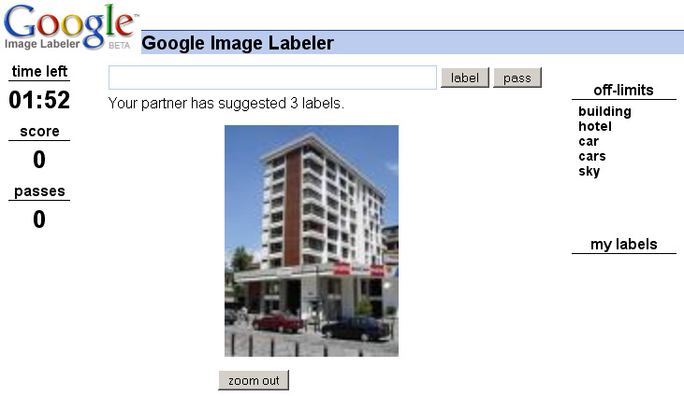

Slide 38
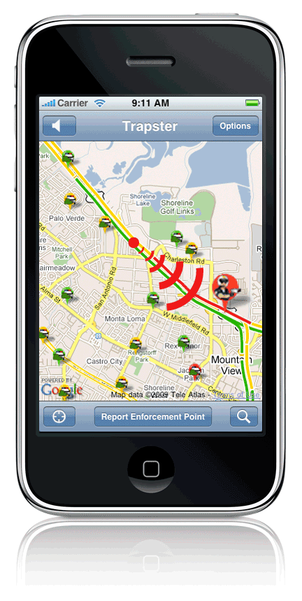
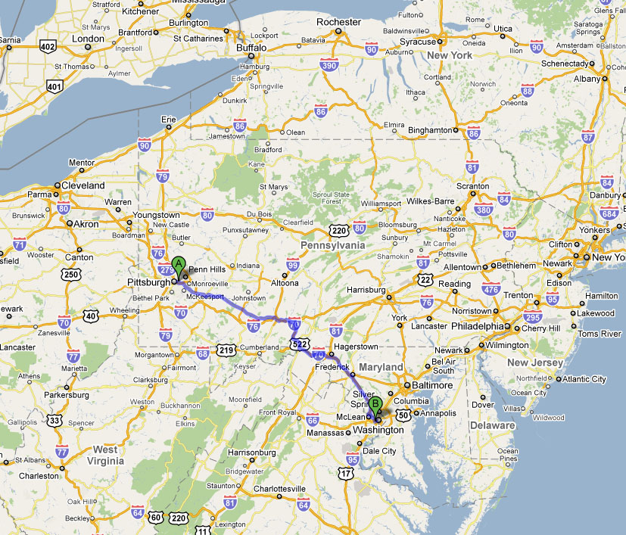
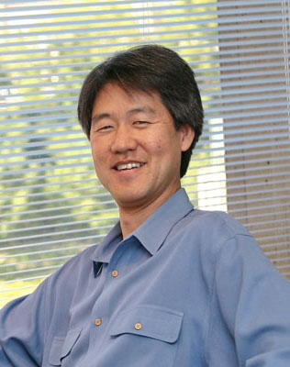
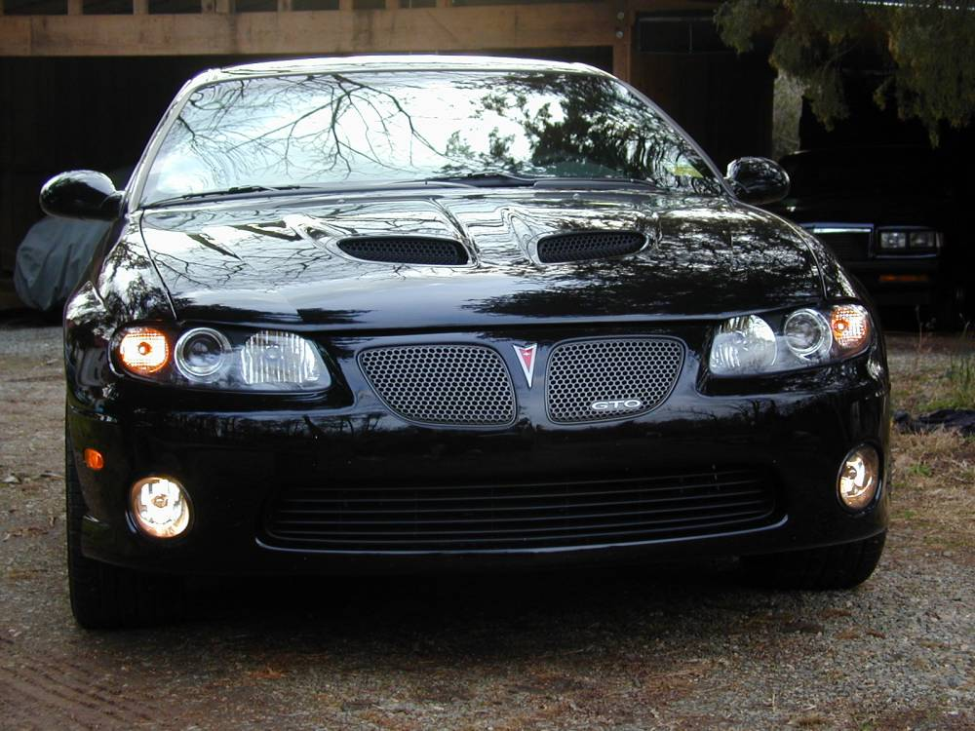

Slide 39
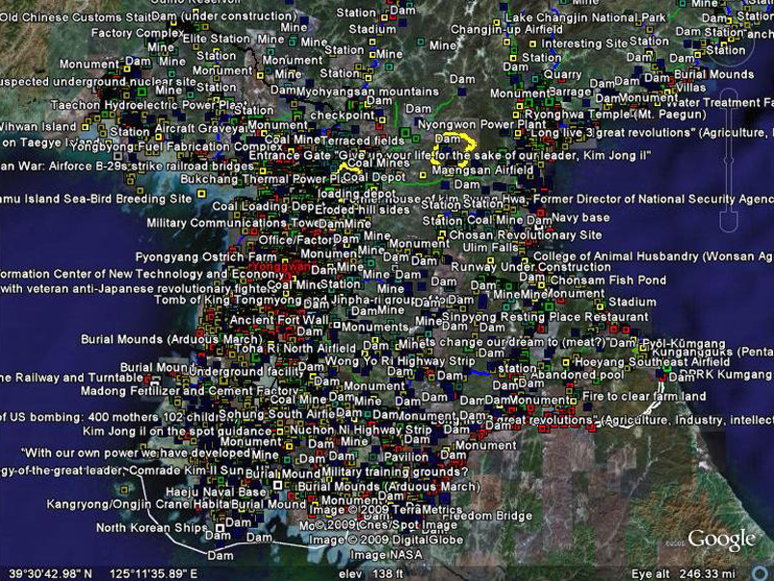

Slide 40
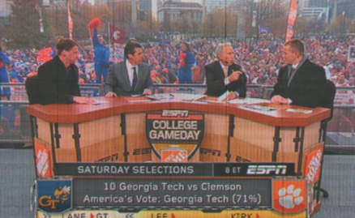
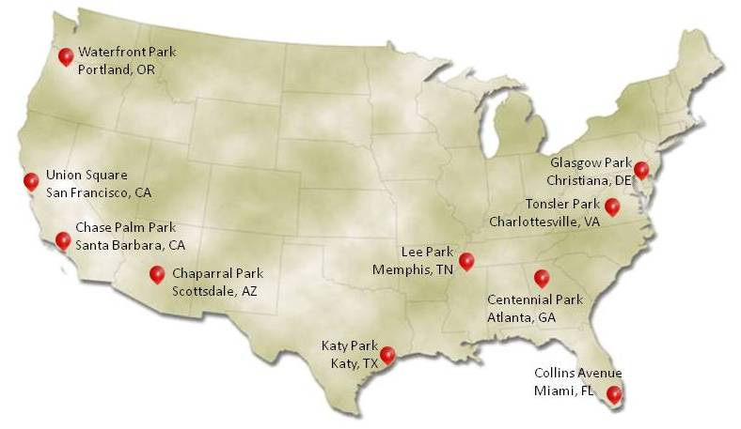
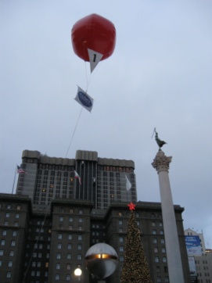
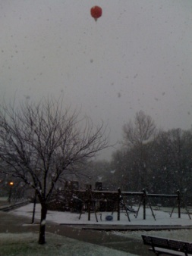
40th Anniversary of the Internet
29 Oct – Announced
5 Dec – Balloons Up
$40k Prize
4367 registrants
39 countries
922 submissions
correct locations
[Peter Lee, DARPA]

