Slide 1
Recognition III
Ali Farhadi
CSE 455

Slide 2
We have talked about
Nearest Neighbor
Naïve Bayes
Logistic Regression
Boosting

Slide 3
Support Vector Machines

Slide 4
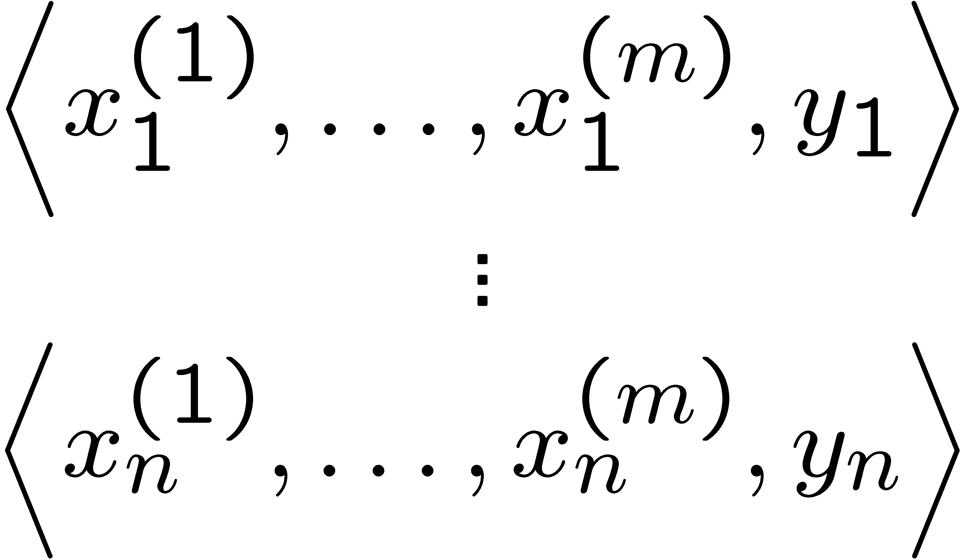
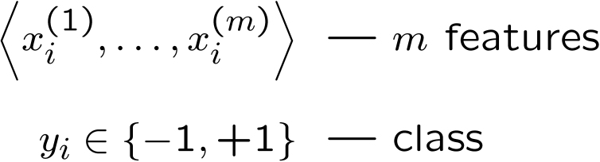
Linear classifiers – Which line is better?
w. = ∑_{j} w^{(j)} x^{(j)}
Data
Example i
Notes:
(1) perceptron, (2) minize weights, (3) max margin

Slide 5
Pick the one with the largest margin!
Margin: measures height of w.x+b plane at each point, increases with distance
w.x + b >> 0
w.x + b > 0
w.x + b = 0
w.x + b < 0
w.x + b << 0
γ
γ
γ
Max Margin: two equivalent forms
γ
(1)
(2)
w.x = ∑_{j} w^{(j)} x^{(j)}

Slide 6
How many possible solutions?
w.x + b = 0
Any other ways of writing the same dividing line?
w.x + b = 0
2w.x + 2b = 0
1000w.x + 1000b = 0
….
Any constant scaling has the same intersection with z=0 plane, so same dividing line!
Do we really want to max _{γ,w,b}?

Slide 7
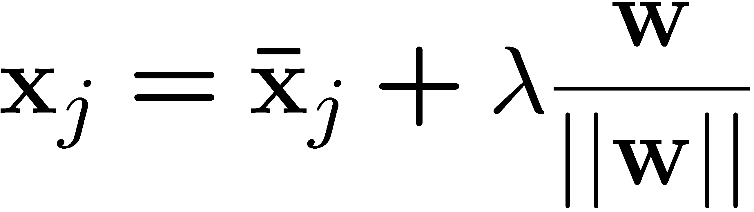
Review: Normal to a plane
w.x + b = 0
Key Terms
-- projection of x_{j} onto w
-- unit vector normal to w

Slide 8
Idea: constrained margin
Generally:
w.x + b = +1
w.x + b = 0
w.x + b = -1
Assume: x⁺ on positive line, x⁻ on negative
γ
x⁺
x⁻
Final result: can maximize constrained margin by minimizing ||w||₂!!!

Slide 9
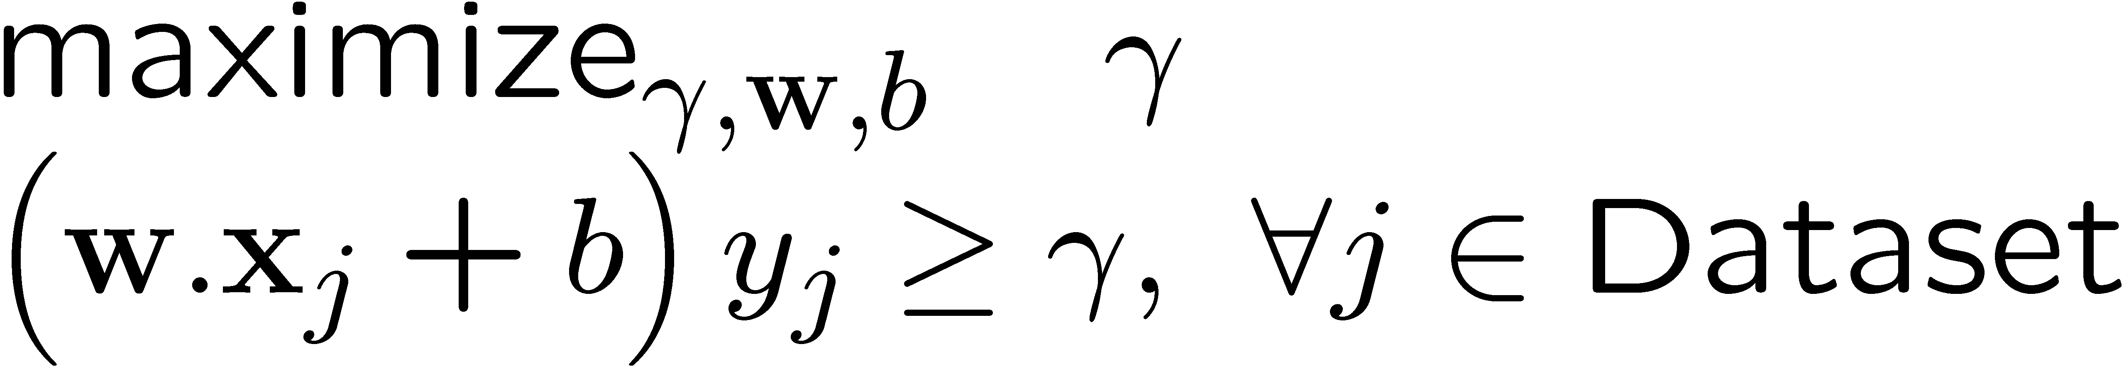
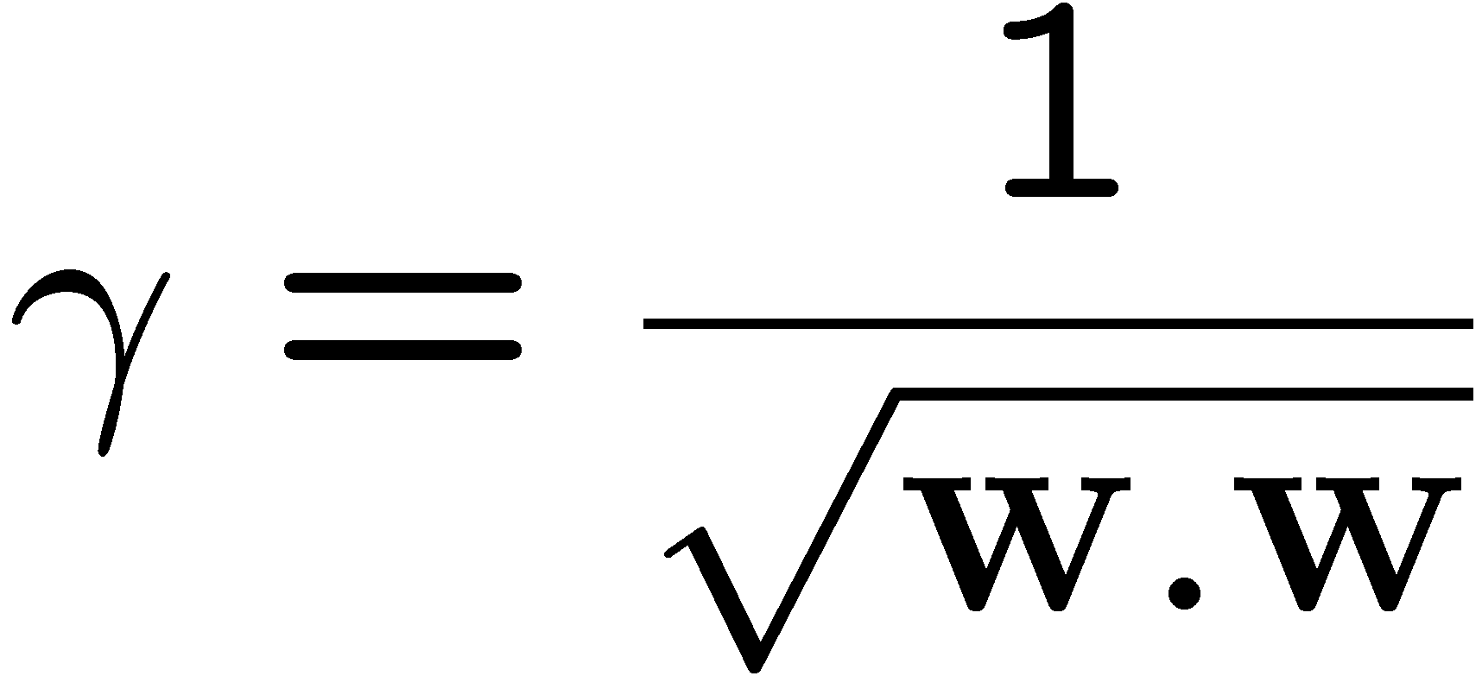
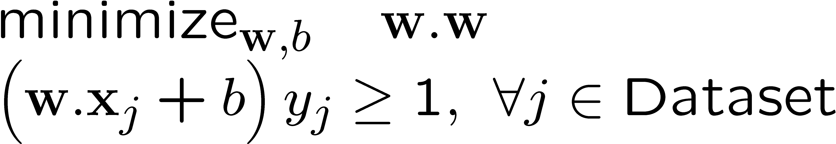
Max margin using canonical hyperplanes
w.x + b = +1
w.x + b = 0
w.x + b = -1
γ
x⁺
x⁻
The assumption of canonical hyperplanes (at +1 and -1) changes the objective and the constraints!

Slide 10
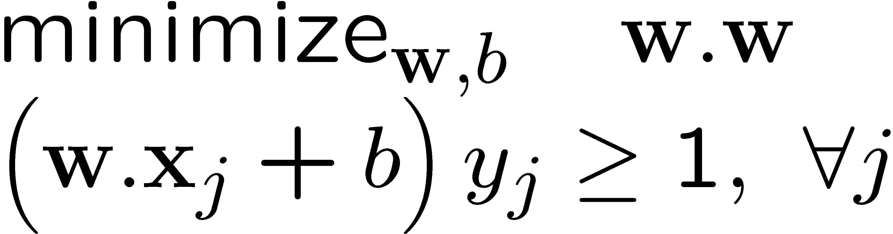
Support vector machines (SVMs)
w.x + b = +1
w.x + b = 0
w.x + b = -1
Solve efficiently by quadratic programming (QP)
  Well-studied solution algorithms
  Not simple gradient ascent, but close
Hyperplane defined by support vectors
  Could use them as a lower-dimension basis to write down line, although we haven’t seen how yet
  More on this later
margin 2γ
Non-support Vectors:
everything else
moving them will not change w
Support Vectors:
data points on the canonical lines

Slide 11
What if the data is not linearly separable?
Add More Features!!!
What about overfitting?

Slide 12
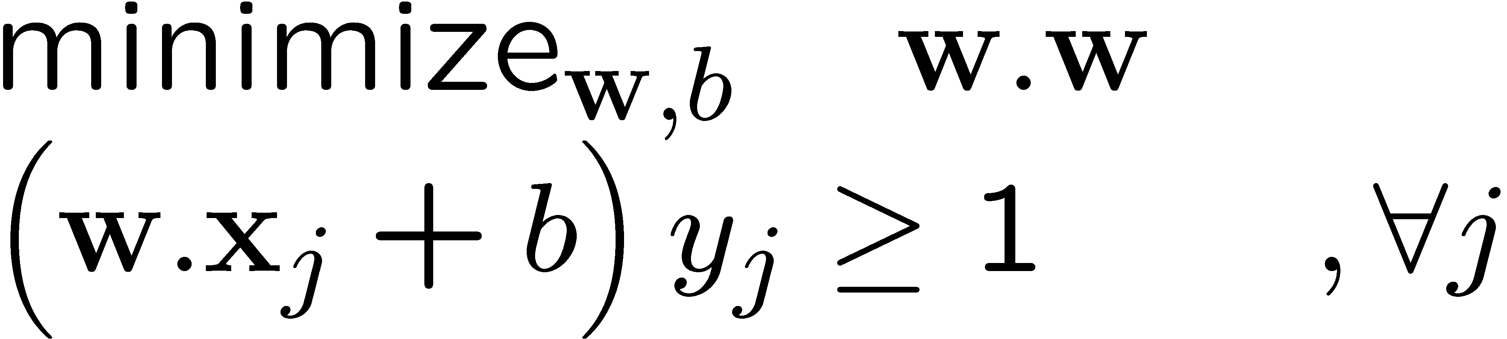
What if the data is still not linearly separable?
+ C #(mistakes)
First Idea: Jointly minimize w.w and number of training mistakes
  How to tradeoff two criteria?
  Pick C on development / cross validation
Tradeoff #(mistakes) and w.w
  0/1 loss
  Not QP anymore
  Also doesn’t distinguish near misses and really bad mistakes
  NP hard to find optimal solution!!!

Slide 13
Slack variables – Hinge loss
+ C Σ_{j} ξ_{j}
w.x + b = +1
w.x + b = 0
w.x + b = -1
- ξ_{j}
ξ_{j}≥0
ξ
ξ
Slack Penalty C > 0:
C=∞ → have to separate the data!
C=0 → ignore data entirely!
Select on dev. set, etc.
ξ
ξ
For each data point:
If margin ≥ 1, don’t care
If margin < 1, pay linear penalty

Slide 14
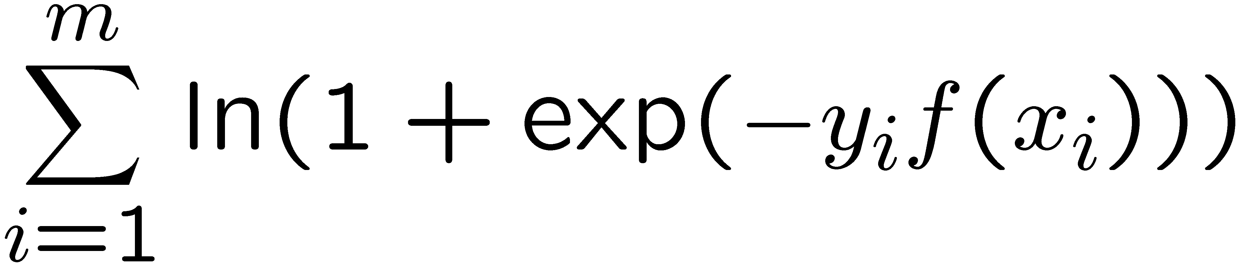
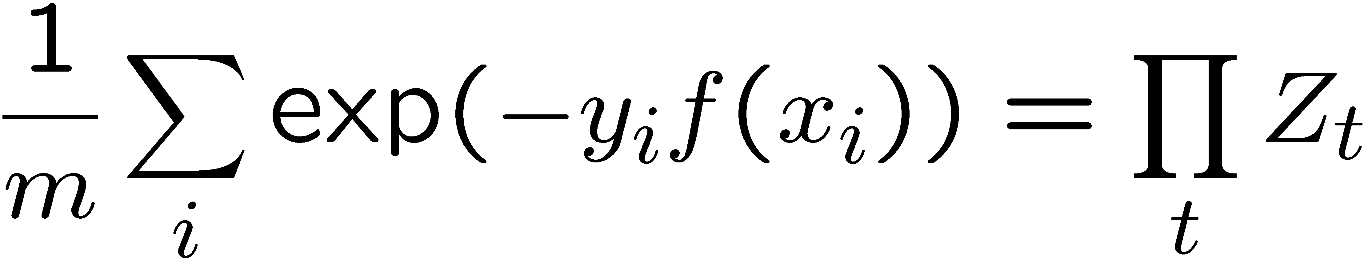
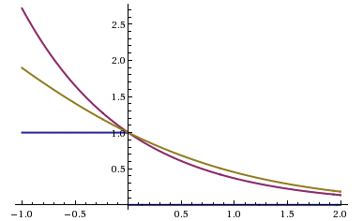
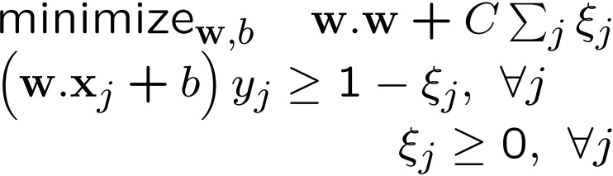
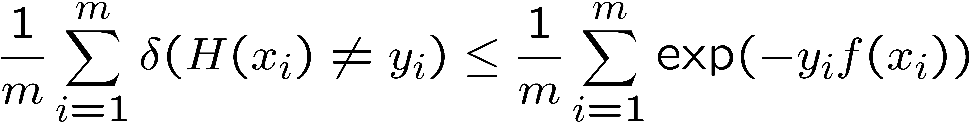
Side Note: Different Losses
Logistic regression:
Boosting :
SVM:
Hinge loss:
0-1 Loss:
All our new losses approximate 0/1 loss!
Notes:
Hinge loss can lead to sparse solutions!!!!

Slide 15
What about multiple classes?

Slide 16
One against All
w₊
Learn 3 classifiers:
+ vs {0,-}, weights w₊
- vs {0,+}, weights w₋
0 vs {+,-}, weights w₀
Output for x:
y = argmax_{i} w_{i}.x
w₋
w₀
Any other way?
Any problems?
Notes:
Could we learn lines above? Yes, but would require slack vairables?

Slide 17
Learn 1 classifier: Multiclass SVM
w₊
Simultaneously learn 3 sets of weights:
How do we guarantee the correct labels?
Need new constraints!
w₋
w₀
For j possible classes:
Notes:
Could we learn lines above? Currently, no slack variables…

Slide 18
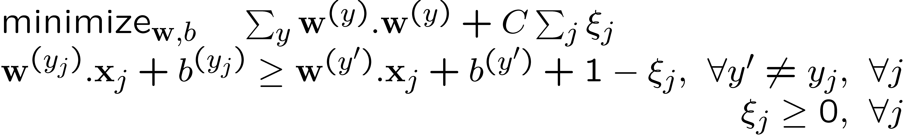
Learn 1 classifier: Multiclass SVM
Also, can introduce slack variables, as before:

Slide 19
What if the data is not linearly separable?
Add More Features!!!

Slide 20


Slide 21
Comparison
assuming x in {0 1}
Learning Objective
Training
Inference
Naïve Bayes
Logistic Regression
Gradient ascent
Linear SVM
Quadratic programming or subgradient opt.
Kernelized SVM
complicated to write
Quadratic programming
Nearest Neighbor
most similar features → same label
Record data

Slide 22

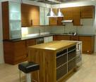
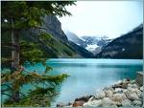


Image Categorization
Training
Training Labels
Training Images
Image Features
Classifier Training
Trained Classifier
Testing
Image Features
Trained Classifier
Prediction
Outdoor
Test Image

Slide 23
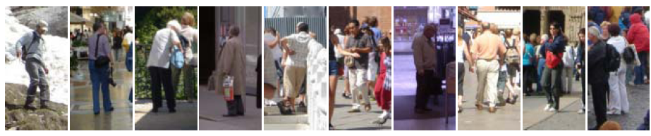
Example: Dalal-Triggs pedestrian detector
Extract fixed-sized (64x128 pixel) window at each position and scale
Compute HOG (histogram of gradient) features within each window
Score the window with a linear SVM classifier
Perform non-maxima suppression to remove overlapping detections with lower scores
Navneet Dalal and Bill Triggs, Histograms of Oriented Gradients for Human Detection, CVPR05

Slide 24

Slides by Pete Barnum
Navneet Dalal and Bill Triggs, Histograms of Oriented Gradients for Human Detection, CVPR05

Slide 25
Tested with
  RGB
  LAB
  Grayscale
Slightly better performance vs. grayscale

Slide 26
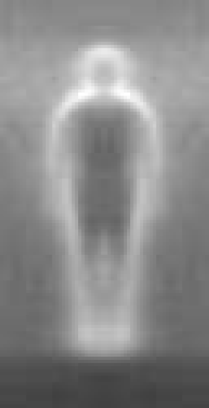

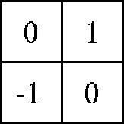

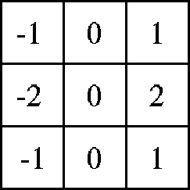

Outperforms
centered
diagonal
uncentered
cubic-corrected
Sobel
Slides by Pete Barnum
Navneet Dalal and Bill Triggs, Histograms of Oriented Gradients for Human Detection, CVPR05

Slide 27

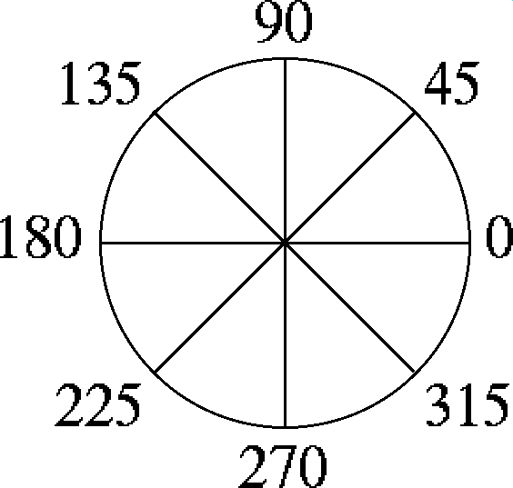
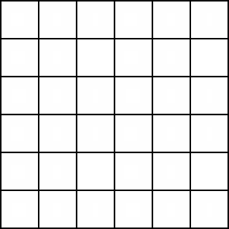
Histogram of gradient orientations
  Votes weighted by magnitude
  Bilinear interpolation between cells
Orientation: 9 bins (for unsigned angles)
Histograms in 8x8 pixel cells
Slides by Pete Barnum
Navneet Dalal and Bill Triggs, Histograms of Oriented Gradients for Human Detection, CVPR05

Slide 28
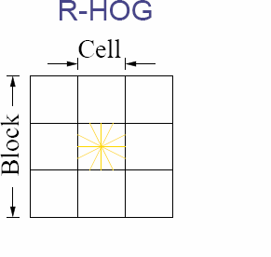
Normalize with respect to surrounding cells
Slides by Pete Barnum
Navneet Dalal and Bill Triggs, Histograms of Oriented Gradients for Human Detection, CVPR05

Slide 29
# orientations
# features = 15 x 7 x 9 x 4 = 3780
X=
# cells
# normalizations by neighboring cells
Slides by Pete Barnum
Navneet Dalal and Bill Triggs, Histograms of Oriented Gradients for Human Detection, CVPR05

Slide 30
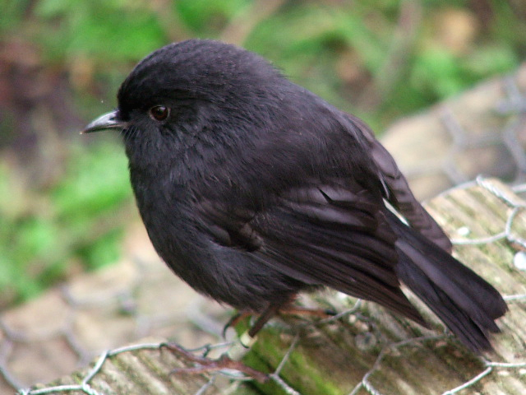
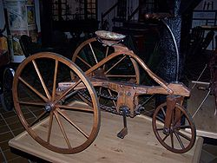
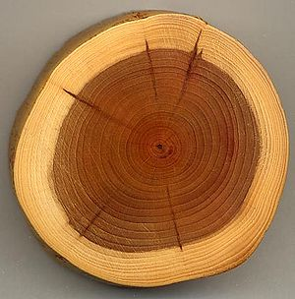
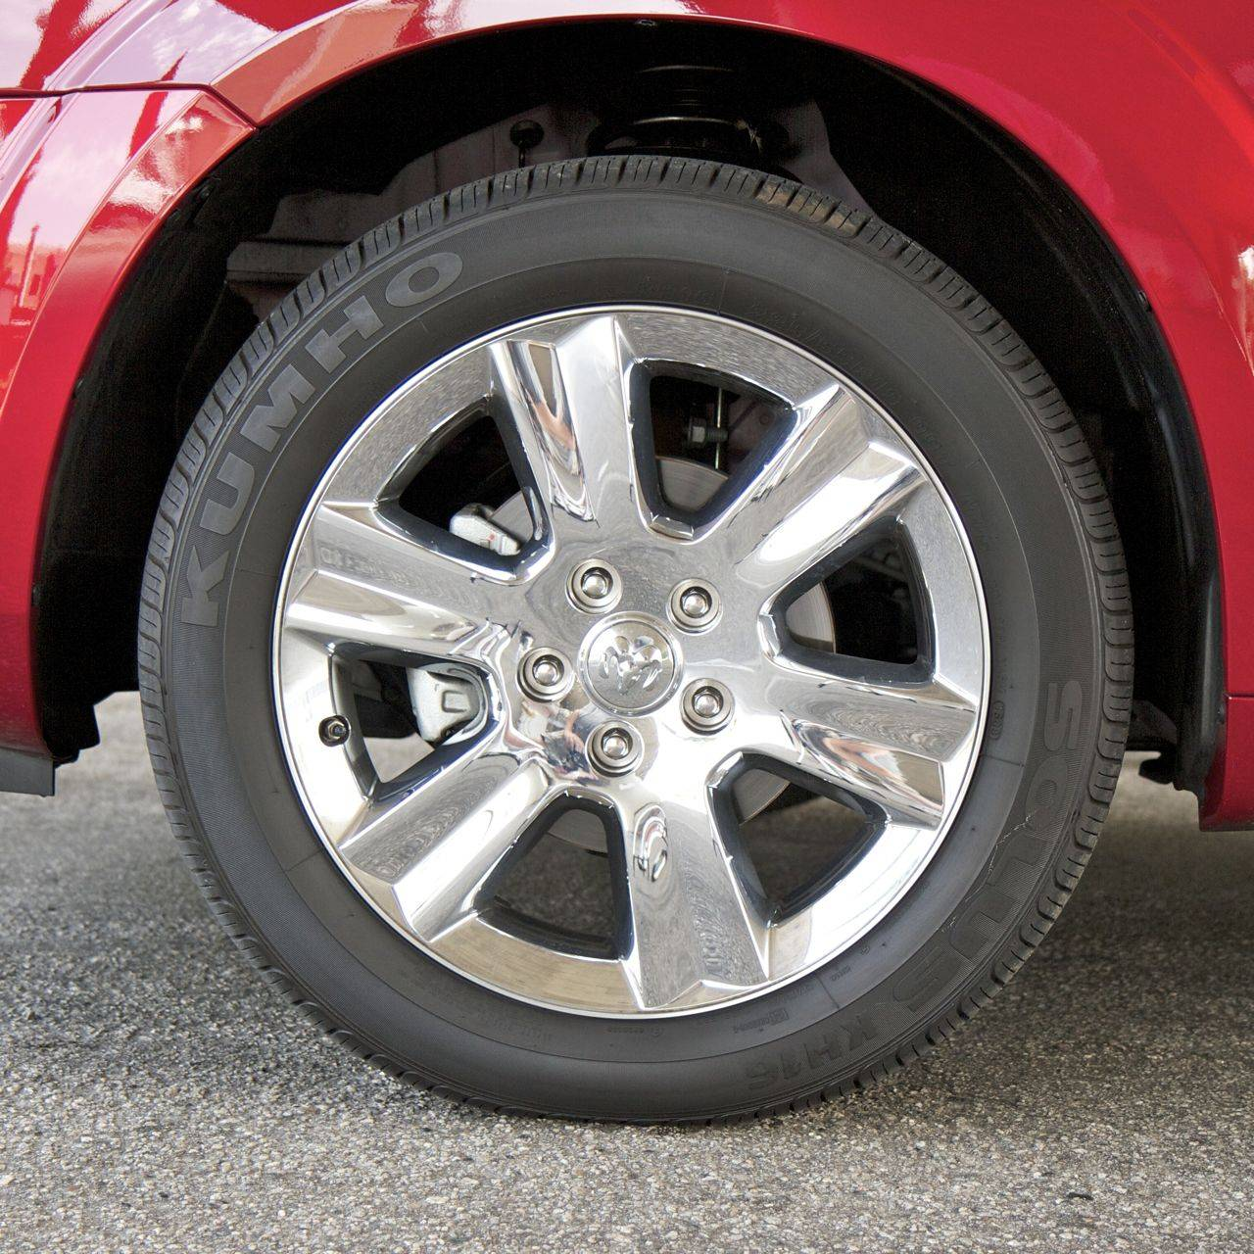
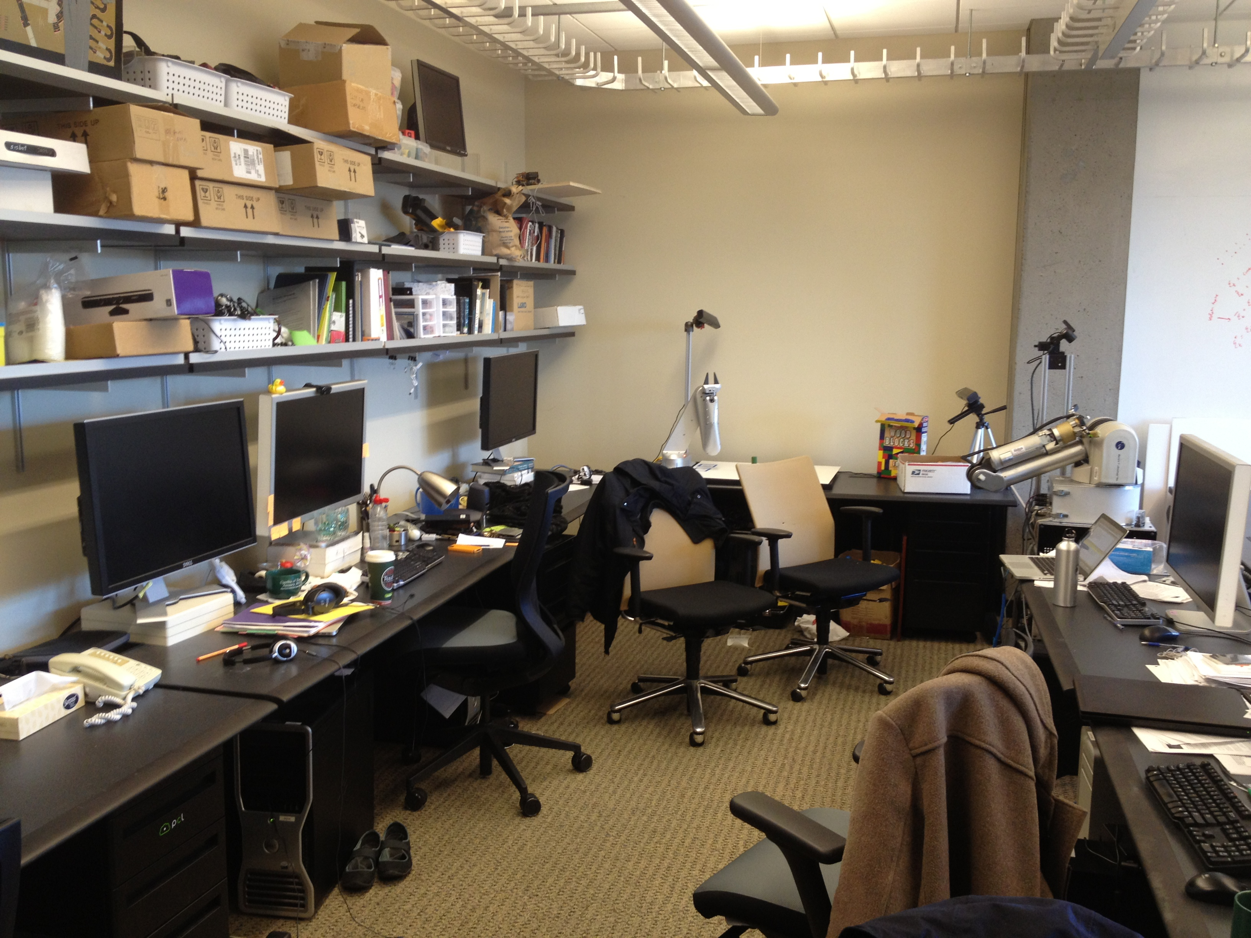
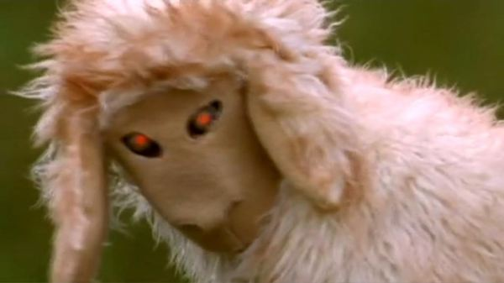
Training set

Slide 31
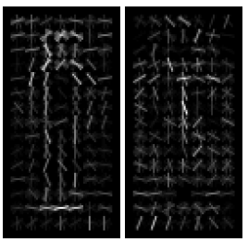
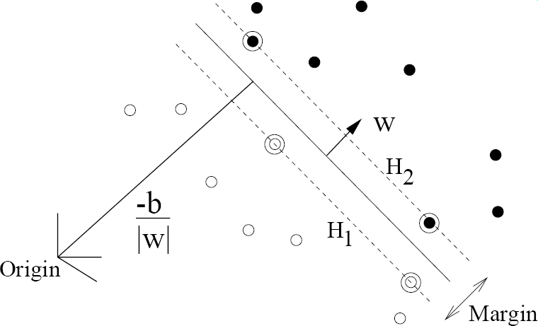
pos w
neg w
Slides by Pete Barnum
Navneet Dalal and Bill Triggs, Histograms of Oriented Gradients for Human Detection, CVPR05

Slide 32
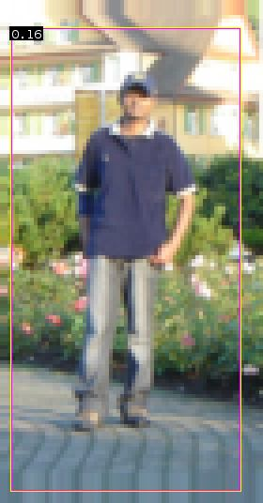


pedestrian
Slides by Pete Barnum
Navneet Dalal and Bill Triggs, Histograms of Oriented Gradients for Human Detection, CVPR05

Slide 33
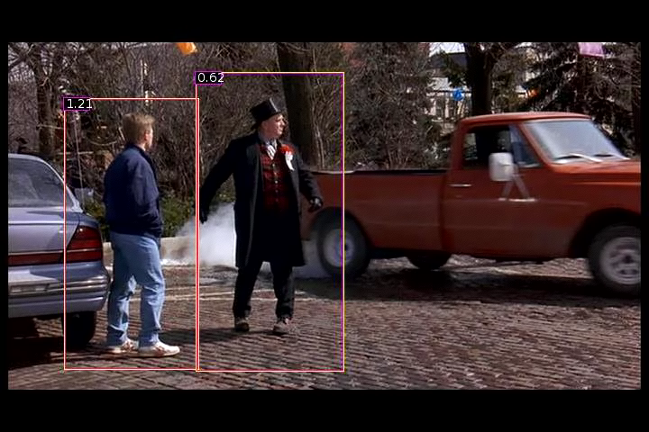
Detection examples

Slide 34


Slide 35

Each window is separately classified

Slide 37
THE END

Slide 38
Statistical Template
Object model = sum of scores of features at fixed positions
?
+3
+2
-2
-1
-2.5
= -0.5
> 7.5
Non-object
?
+4
+1
+0.5
+3
+0.5
= 10.5
> 7.5
Object

Slide 39
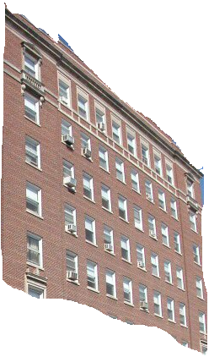
Boosted Decision Trees
High in
Image?
Gray?
Yes
No
Yes
No
Smooth?
Green?
High in
Image?
Many Long
Lines?
…
Yes
No
Yes
No
Yes
No
Yes
No
Blue?
Very High
Vanishing
Point?
Yes
No
Yes
No
Ground Vertical Sky
P(label | good segment, data)
[Collins et al. 2002]

Slide 40
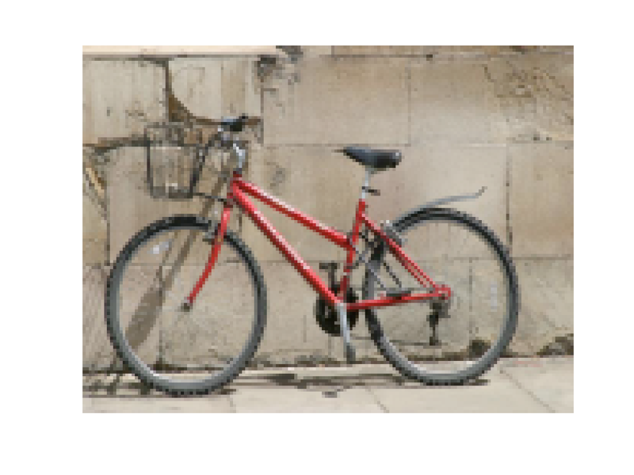
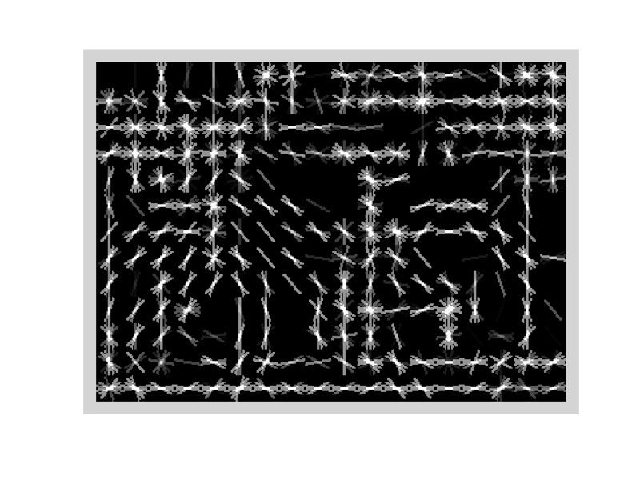
Specifying an object model
Statistical Template in Bounding Box
  Object is some (x,y,w,h) in image
  Features defined wrt bounding box coordinates
Image
Template Visualization
Images from Felzenszwalb

Slide 41
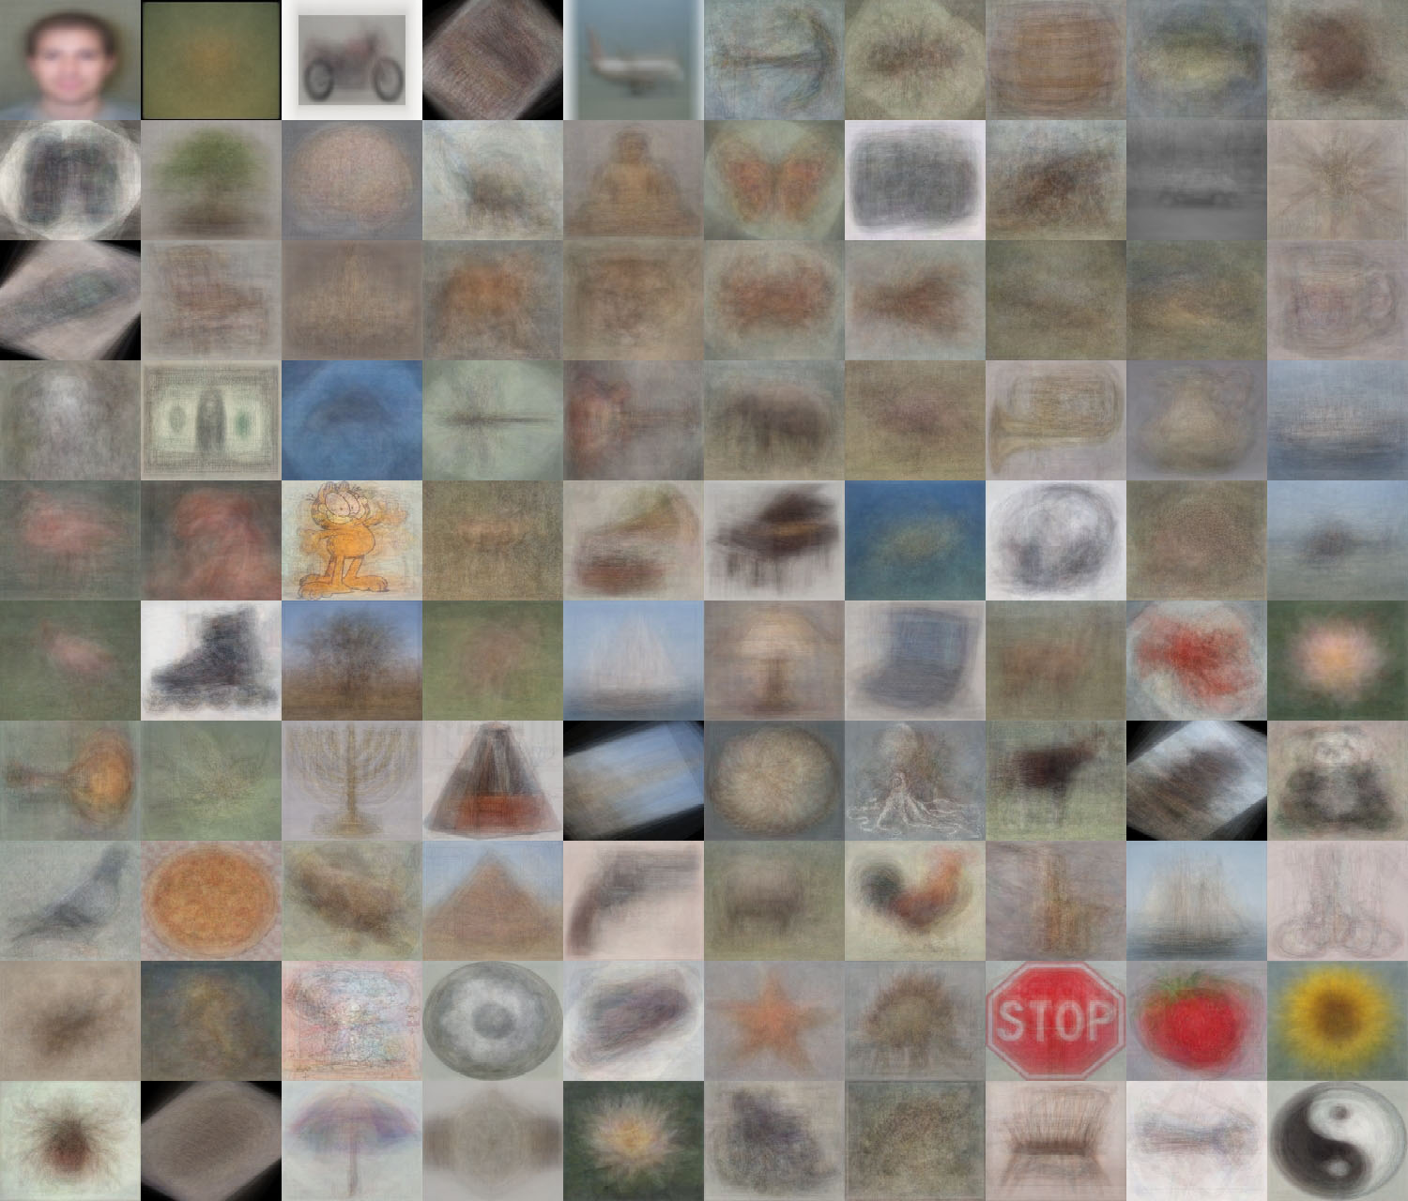
When do statistical templates make sense?
Caltech 101 Average Object Images

Slide 42
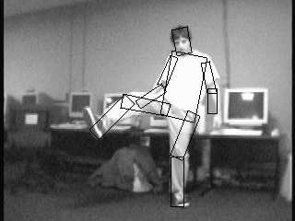

Specifying an object model
2. Articulated parts model
  Object is configuration of parts
  Each part is detectable
Images from Felzenszwalb

Slide 43
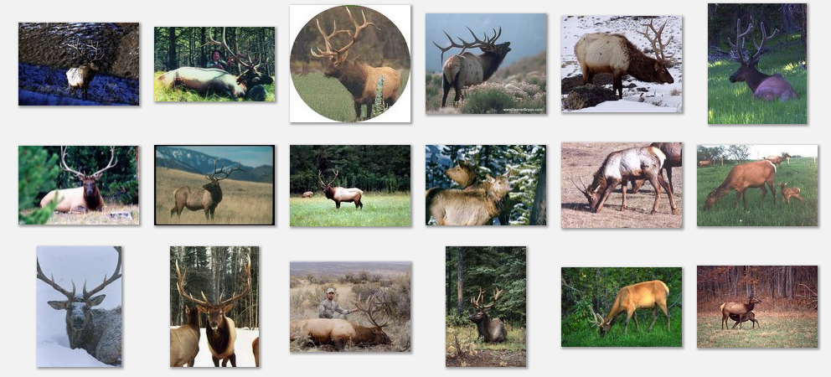
Deformable objects
Images from Caltech-256
Slide Credit: Duan Tran

Slide 44
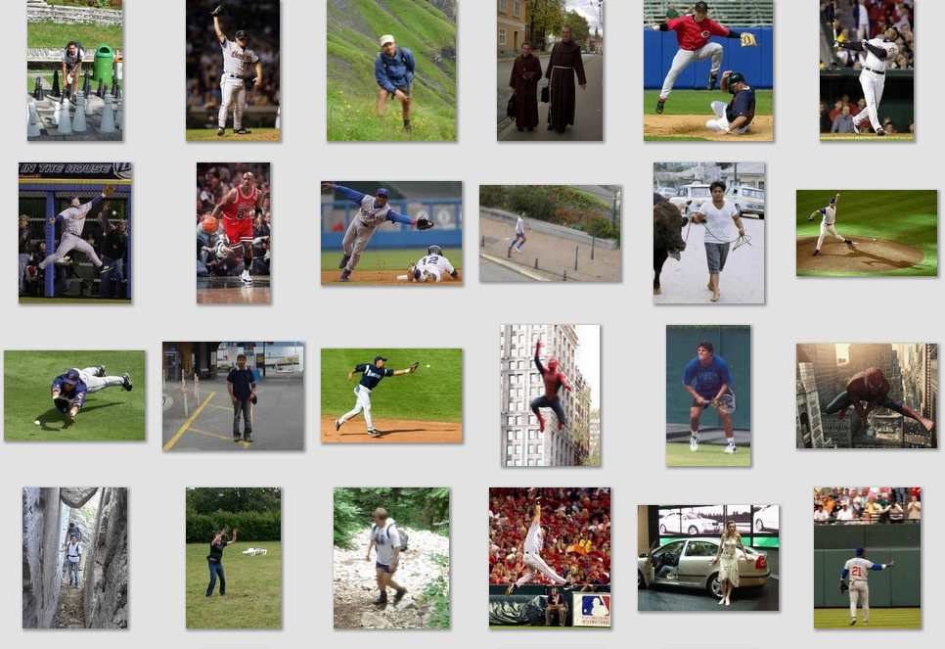
Deformable objects
Images from D. Ramanan’s dataset
Slide Credit: Duan Tran

Slide 45
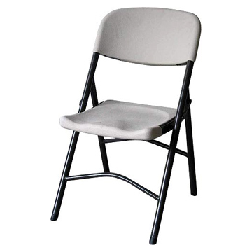
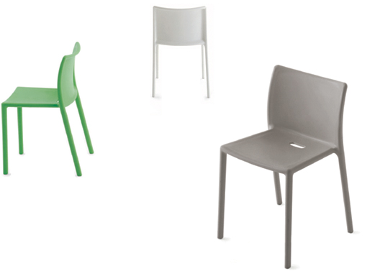
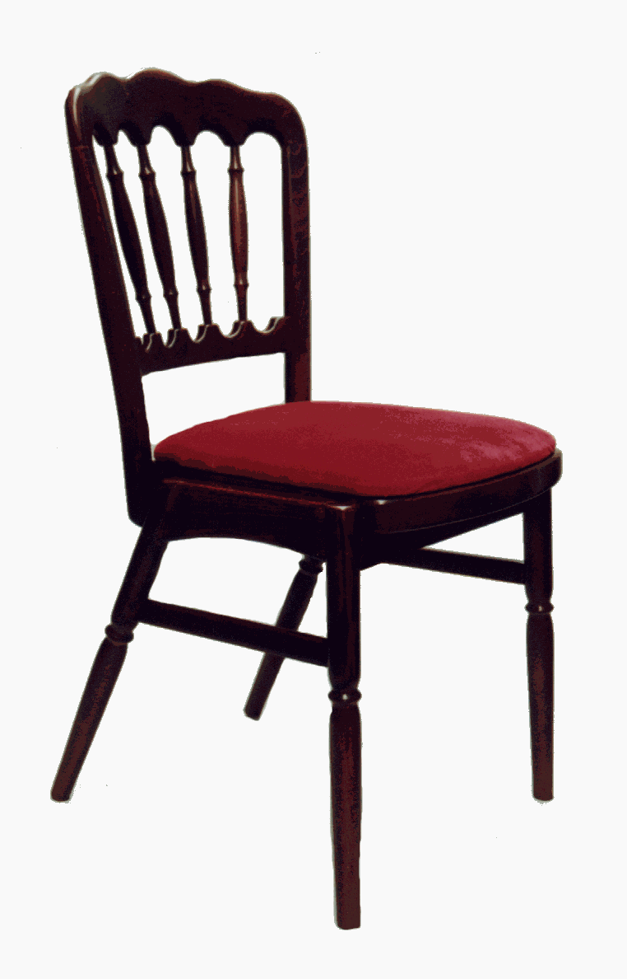
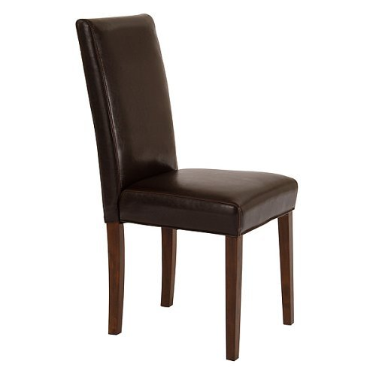
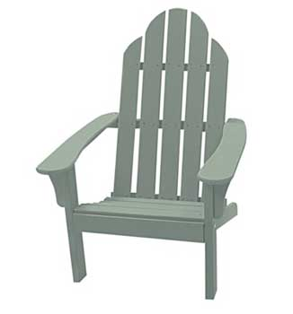
Compositional objects

Slide 46
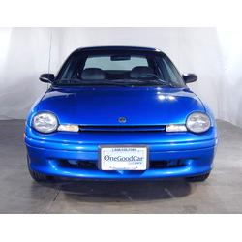
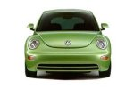
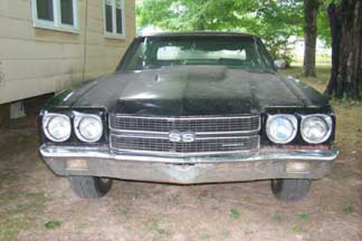
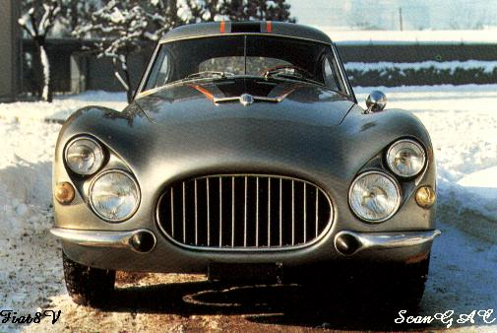
Parts-based Models
Define object by collection of parts modeled by
  Appearance
  Spatial configuration
Slide credit: Rob Fergus

Slide 47
How to model spatial relations?
One extreme: fixed template

Slide 48
How to model spatial relations?
Another extreme: bag of words
=

Slide 49
How to model spatial relations?
Explicit Models
Too expensive
Part
Part
Part
Part
Part

Slide 50
How to model spatial relations?
Star-shaped model
Part
Part
Part
Root
Part
Part

Slide 51
How to model spatial relations?
Star-shaped model
=
X
X
≈
Part
Part
Part
X
Root
Part
Part

Slide 52
How to model spatial relations?
Tree-shaped model

Slide 53
How to model spatial relations?
Many others...
O(N⁶)
O(N²)
O(N³)
O(N²)
Fergus et al. ’03
Fei-Fei et al. ‘03
Leibe et al. ’04, ‘08
Crandall et al. ‘05
Fergus et al. ’05
Crandall et al. ‘05
Felzenszwalb & Huttenlocher ‘05
Csurka ’04
Vasconcelos ‘00
Bouchard & Triggs ‘05
Carneiro & Lowe ‘06
from [Carneiro & Lowe, ECCV’06]

Slide 54
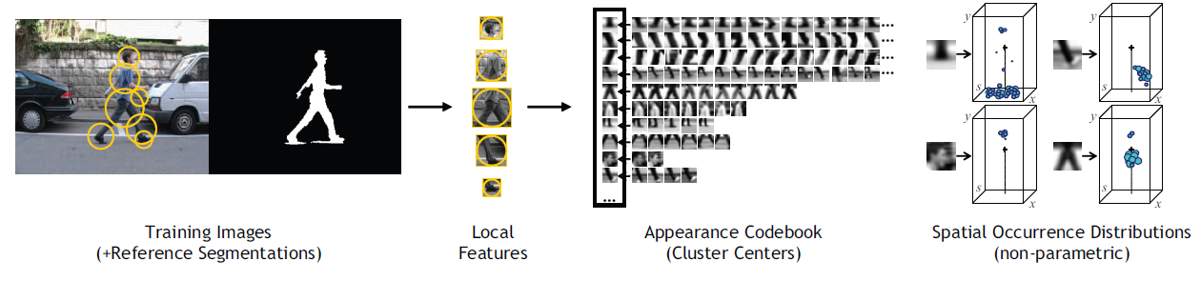
ISM: Implicit Shape Model
Training overview
Start with bounding boxes and (ideally) segmentations of objects
Extract local features (e.g., patches or SIFT) at interest points on objects
Cluster features to create codebook
Record relative bounding box and segmentation for each codeword

Slide 55

ISM: Implicit Shape Model
Testing overview
Extract interest points in test image
Softly match to codebook entries
Each matched codeword votes for object bounding box
Compute modes of votes using mean-shift
Check which codewords voted for modes
Refine

Slide 56

Example: Results on Cows
Original image

Slide 57

Example: Results on Cows
Original image
Interest points

Slide 58

Example: Results on Cows
Original image
Interest points
Matched patches

Slide 59

Example: Results on Cows
Original image
Interest points
Prob. Votes
Matched patches

Slide 60

Example: Results on Cows
1st hypothesis

Slide 61

Example: Results on Cows
2nd hypothesis

Slide 62

Example: Results on Cows
3rd hypothesis

Slide 63
ISM: Detection Results
Qualitative Performance
  Robust to clutter, occlusion, noise, low contrast

Slide 64


Specifying an object model
3. Hybrid template/parts model
Detections
Template Visualization
Felzenszwalb et al. 2008

Slide 65
Tree-shaped model

Slide 66



Pictorial Structures Model
Part = oriented rectangle
Spatial model = relative size/orientation
Felzenszwalb and Huttenlocher 2005
Notes:
What is the root of the tree?

Slide 67

Pictorial Structures Model
Appearance likelihood
Geometry likelihood

Slide 68
Modeling the Appearance
Any appearance model could be used
  HOG Templates, etc.
  Here: rectangles fit to background subtracted binary map
Can train appearance models independently (easy, not as good) or jointly (more complicated but better)
Appearance likelihood
Geometry likelihood

Slide 69



Part representation
Background subtraction

Slide 70



Pictorial structures model
Optimization is tricky but can be efficient
For each l₁, find best l₂:
Remove v₂, and repeat with smaller tree, until only a single part
For k parts, n locations per part, this has complexity of O(kn²), but can be solved in ~O(nk) using generalized distance transform

Slide 71

Results for person matching

Slide 72

Results for person matching

Slide 73

Enhanced pictorial structures
BMVC 2009

Slide 74
Deformable Latent Parts Model
Useful parts discovered during training
Detections
Template Visualization
Felzenszwalb et al. 2008

Slide 75


Score = F₀.Φ(p₀,H) + Σ F_{i}.Φ(p_{i},H) - Σ d_{i}.Φ_{d}(x,y)

Slide 76


Slide 77


Slide 78


Slide 83



State-of-the-art Detector:
Deformable Parts Model (DPM)
Lifetime
Achievement
Strong low-level features based on HOG
Efficient matching algorithms for deformable part-based models (pictorial structures)
Discriminative learning with latent variables (latent SVM)
Felzenszwalb et al., 2008, 2010, 2011, 2012
Notes:
For the local window detector implementation, we used the publicly available implementation of the DPM detector. This is the best performing sliding window implementation and has consistently performed well in the VOC challenge receiving the lifetime achievement award.

Slide 84

What is Object Detection?

