Slide 1
Image Sampling
CSE 455
Ali Farhadi
Many slides from Steve Seitz and Larry Zitnick

Slide 2
Image Sampling
F( ) =
F( ) =

Slide 3
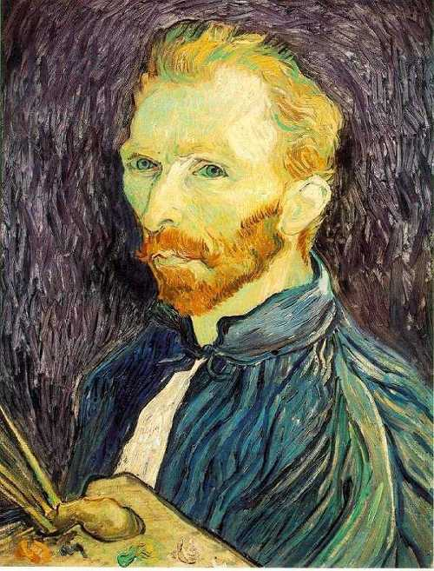
Image Scaling
This image is too big to
fit on the screen. How
can we reduce it?
How to generate a half-
sized version?

Slide 4
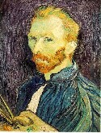
Image sub-sampling
1/8
1/4
Throw away every other row and column to create a 1/2 size image
- called image sub-sampling

Slide 5
Image sub-sampling
1/2
1/4 (2x zoom)
1/8 (4x zoom)
Why does this look so crufty?

Slide 6
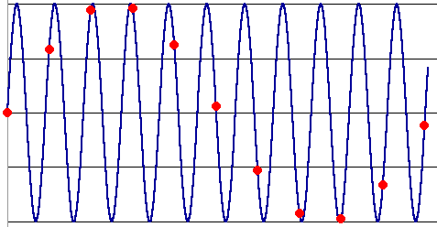
Down-sampling
Aliasing can arise when you sample a continuous signal or image
occurs when your sampling rate is not high enough to capture the amount of detail in your image
Can give you the wrong signal/image—an alias
formally, the image contains structure at different scales
called “frequencies” in the Fourier domain
the sampling rate must be high enough to capture the highest frequency in the image

Slide 7
Sampling and the Nyquist rate
Aliasing can arise when you sample a continuous signal or image
occurs when your sampling rate is not high enough to capture the amount of detail in your image
Can give you the wrong signal/image—an alias
formally, the image contains structure at different scales
called “frequencies” in the Fourier domain
the sampling rate must be high enough to capture the highest frequency in the image
To avoid aliasing:
sampling rate ≥ 2 * max frequency in the image
said another way: ≥ two samples per cycle
This minimum sampling rate is called the Nyquist rate

Slide 8
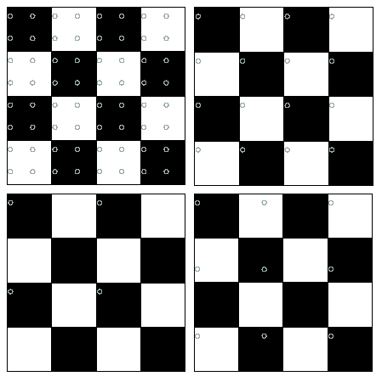
2D example
Good sampling
Bad sampling

Slide 9
Subsampling with Gaussian pre-filtering
G 1/8
G 1/4
Gaussian 1/2
Solution: filter the image, then subsample
Filter size should double for each ½ size reduction. Why?

Slide 10
Subsampling with Gaussian pre-filtering
Gaussian 1/2
G 1/4
G 1/8
Solution: filter the image, then subsample
Filter size should double for each ½ size reduction. Why?
How can we speed this up?

Slide 11
Compare with...
1/2
1/4 (2x zoom)
1/8 (4x zoom)

Slide 12
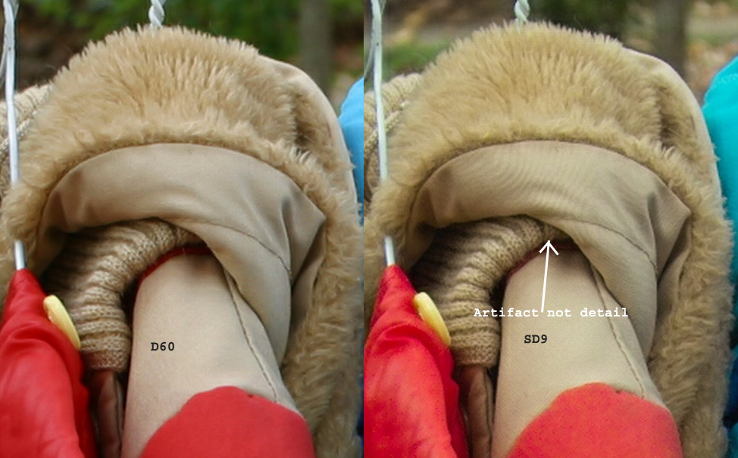
Moire patterns in real-world images. Here are comparison images by Dave Etchells of Imaging Resource using the Canon D60 (with an antialias filter) and the Sigma SD-9 (which has no antialias filter). The bands below the fur in the image at right are the kinds of artifacts that appear in images when no antialias filter is used. Sigma chose to eliminate the filter to get more sharpness, but the resulting apparent detail may or may not reflect features in the image.

Slide 13
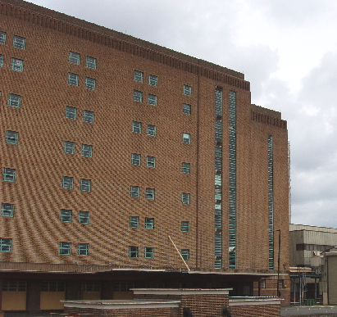
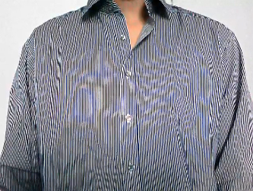
More examples
Check out Moire patterns on the web.

Slide 14
Up-sampling
How do we compute the values of pixels at fractional positions?

Slide 15
Up-sampling
How do we compute the values of pixels at fractional positions?
f (x,y)
f (x+1,y)
Bilinear sampling:
f (x+0.8,y+0.3)
f (x + a, y + b) =
(1 - a)(1 - b) f (x, y) +
a(1 - b) f (x + 1, y) +
(1 - a)b f (x,y + 1) +
ab f (x + 1, y + 1)
f (x,y+1)
f (x+1,y+1)
Bicubic sampling fits a higher order function using a larger area of support.

Slide 16
Up-sampling
Nearest neighbor
Bilinear
Bicubic

