Slide 1
Computer Vision
CSE 455
Object Recognition
Linda Shapiro
Professor of Computer Science & Engineering
Professor of Electrical Engineering
With slides from Ross Girshick

Slide 2
Outline
Object detection
  the task, evaluation, datasets
Convolutional Neural Networks (CNNs)
  overview and history
Region-based Convolutional Networks (R-CNNs)
You Only Look Once (YOLO)

Slide 3
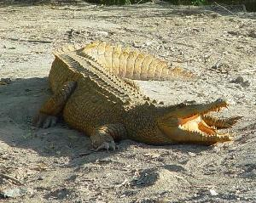
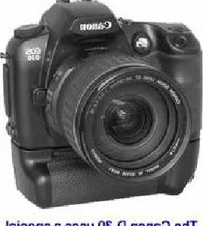
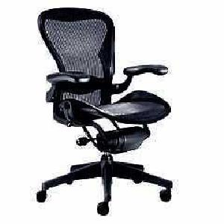
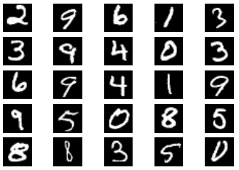
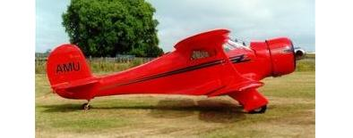
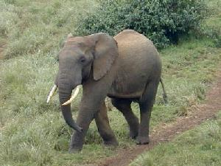
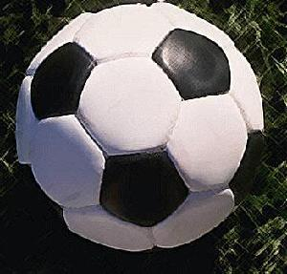

Image classification
$K$ classes
Task: assign correct class label to the whole image
Digit classification (MNIST)
Object recognition (Caltech-101)

Slide 4
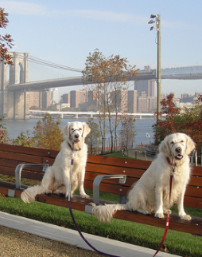
Classification vs. Detection
Dog
Dog
Dog

Slide 5
Problem formulation
{ airplane, bird, motorbike, person, sofa }
person
motorbike
Input
Desired output

Slide 6
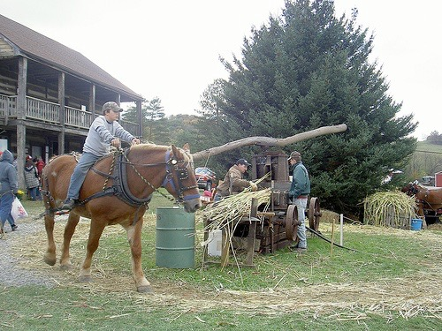
Evaluating a detector
Test image (previously unseen)

Slide 7
First detection ...
0.9
‘person’ detector predictions

Slide 8
Second detection ...
0.9
0.6
‘person’ detector predictions

Slide 9
Third detection ...
0.2
0.9
0.6
‘person’ detector predictions

Slide 10
Compare to ground truth
0.2
0.9
0.6
‘person’ detector predictions
ground truth ‘person’ boxes

Slide 11
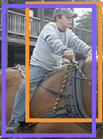


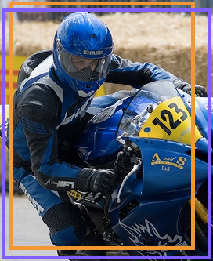


Sort by confidence
0.9
0.8
0.6
0.5
0.2
0.1
...
...
...
...
...
✓
X
✓
✓
X
X
true
positive
(high overlap)
false
positive
(no overlap,
low overlap, or
duplicate)
Notes:
Let’s define the problem a bit more so we’re all on the same page.

Slide 12

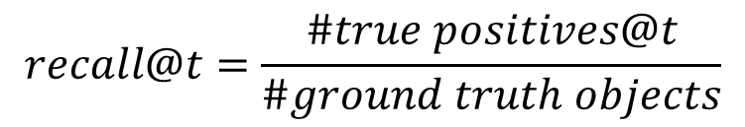
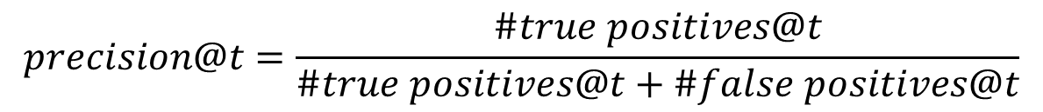
Evaluation metric
0.9
0.8
0.6
0.5
0.2
0.1
...
...
...
...
...
✓
X
✓
✓
X
X
$$t$$
$$precision@t=\frac{\#true positives@t}{\#true positives@t+\#false positives@t}$$
✓
✓ +
X
$$recall@t=\frac{\#true positives@t}{\#ground truth objects}$$
Notes:
Let’s define the problem a bit more so we’re all on the same page.

Slide 13
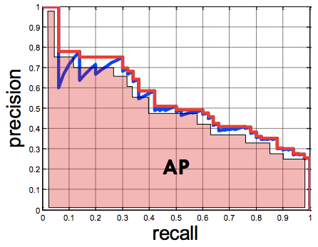
Evaluation metric
0.9
0.8
0.6
0.5
0.2
0.1
...
...
...
...
...
✓
X
✓
✓
X
X
Average Precision (AP)
0% is worst
100% is best
mean AP over classes
(mAP)
Notes:
Let’s define the problem a bit more so we’re all on the same page.

Slide 14
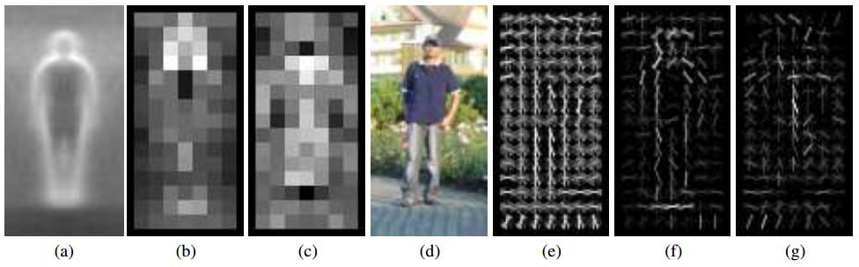
Pedestrians
Histograms of Oriented Gradients for Human Detection, Dalal and Triggs, CVPR 2005
AP ~77%
More sophisticated methods: AP ~90%
(a) average gradient image over training examples
(b) each “pixel” shows max positive SVM weight in the block centered on that pixel
(c) same as (b) for negative SVM weights
(d) test image
(e) its R-HOG descriptor
(f) R-HOG descriptor weighted by positive SVM weights
(g) R-HOG descriptor weighted by negative SVM weights

Slide 15
Overview of HOG Method
1. Compute gradients in the region to be described
2. Put them in bins according to orientation
3. Group the cells into large blocks
4. Normalize each block
5. Train classifiers to decide if these are parts of a human

Slide 16
Details
Gradients
[-1 0 1] and [-1 0 1]^{T} were good enough filters.
Cell Histograms
Each pixel within the cell casts a weighted vote for an
orientation-based histogram channel based on the values
found in the gradient computation. (9 channels worked)
Blocks
Group the cells together into larger blocks, either R-HOG
blocks (rectangular) or C-HOG blocks (circular).

Slide 17
More Details
Block Normalization
If you think of the block as a vector v, then the
normalized block is v/norm(v)
They tried 4 different kinds of normalization.
L1-norm
sqrt of L1-norm
L2 norm
L2-norm followed by clipping

Slide 18
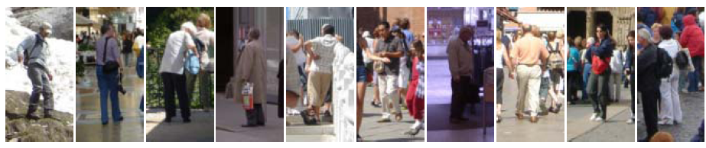
Example: Dalal-Triggs pedestrian detector
Extract fixed-sized (64x128 pixel) window at each position and scale
Compute HOG (histogram of gradient) features within each window
Score the window with a linear SVM classifier
Perform non-maxima suppression to remove overlapping detections with lower scores
Navneet Dalal and Bill Triggs, Histograms of Oriented Gradients for Human Detection, CVPR05

Slide 19
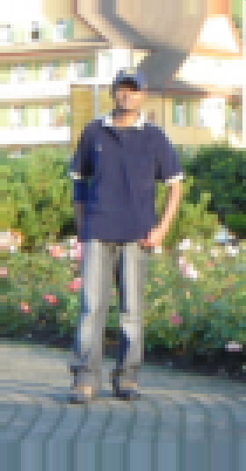
Slides by Pete Barnum
Navneet Dalal and Bill Triggs, Histograms of Oriented Gradients for Human Detection, CVPR05

Slide 20
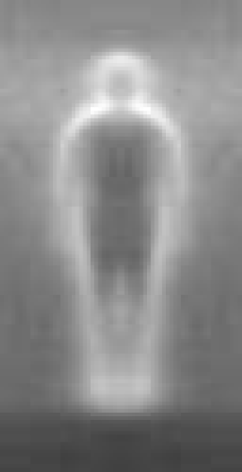

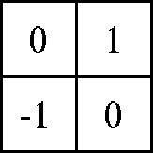

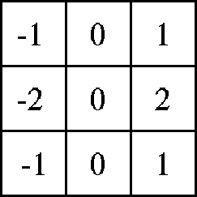

Outperforms
centered
diagonal
uncentered
cubic-corrected
Sobel
Slides by Pete Barnum
Navneet Dalal and Bill Triggs, Histograms of Oriented Gradients for Human Detection, CVPR05

Slide 21

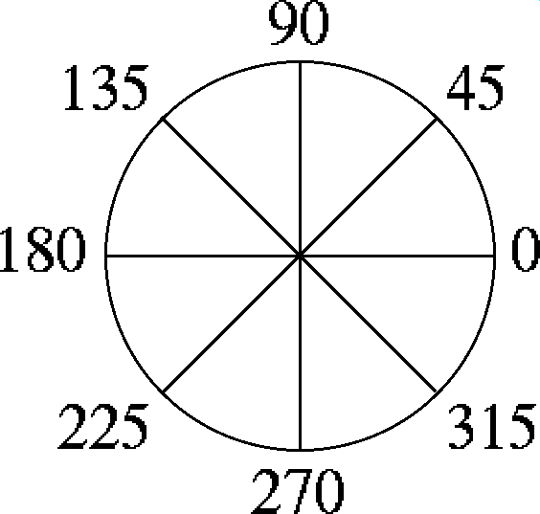
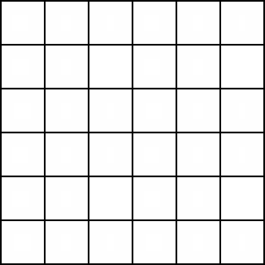
Histogram of gradient orientations
  Votes weighted by magnitude
  Bilinear interpolation between cells
Orientation: 9 bins (for unsigned angles)
Histograms in 8x8 pixel cells
Slides by Pete Barnum
Navneet Dalal and Bill Triggs, Histograms of Oriented Gradients for Human Detection, CVPR05

Slide 22
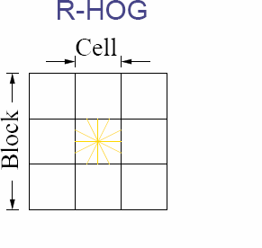
Normalize with respect to surrounding cells
Slides by Pete Barnum
Navneet Dalal and Bill Triggs, Histograms of Oriented Gradients for Human Detection, CVPR05

Slide 23
# orientations
# features = 15 x 7 x 9 x 4 = 3780
X=
# cells
# normalizations by neighboring cells
Slides by Pete Barnum
Navneet Dalal and Bill Triggs, Histograms of Oriented Gradients for Human Detection, CVPR05

Slide 24
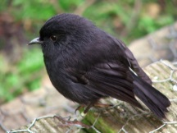
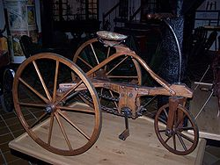
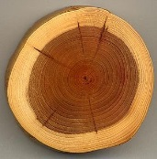
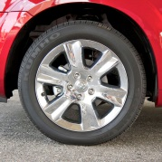
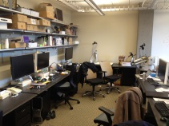
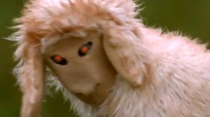
Training set

Slide 25
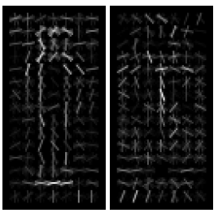
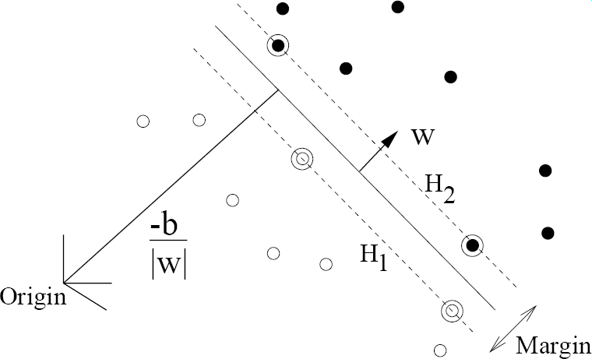
pos w
neg w
Slides by Pete Barnum
Navneet Dalal and Bill Triggs, Histograms of Oriented Gradients for Human Detection, CVPR05

Slide 26
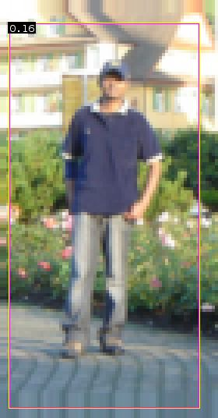


pedestrian
Slides by Pete Barnum
Navneet Dalal and Bill Triggs, Histograms of Oriented Gradients for Human Detection, CVPR05

Slide 27
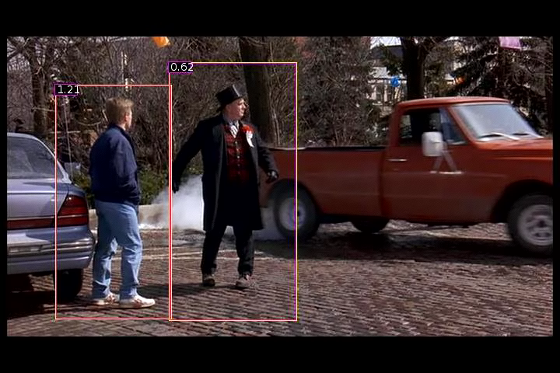
Detection examples

Slide 28


Slide 29

Each window is separately classified

Slide 31
Deformable Parts Model
Takes the idea a little further
Instead of one rigid HOG model, we have multiple HOG models in a spatial arrangement
One root part to find first and multiple other parts in a tree structure.

Slide 32
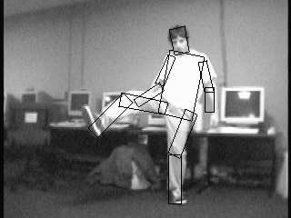

The Idea
Articulated parts model
  Object is configuration of parts
  Each part is detectable
Images from Felzenszwalb

Slide 33
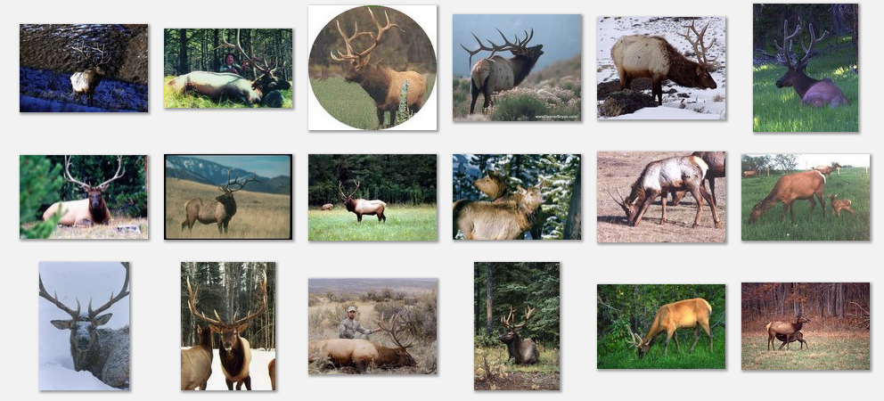
Deformable objects
Images from Caltech-256
Slide Credit: Duan Tran

Slide 34
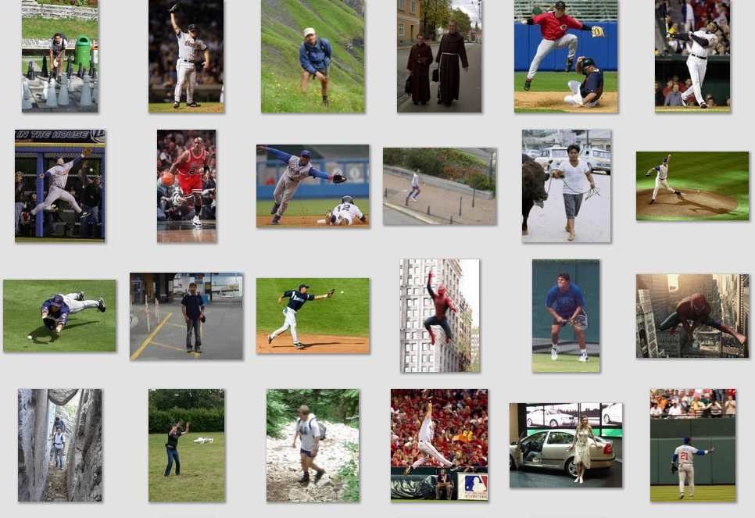
Deformable objects
Images from D. Ramanan’s dataset
Slide Credit: Duan Tran

Slide 35
How to model spatial relations?
Tree-shaped model

Slide 36
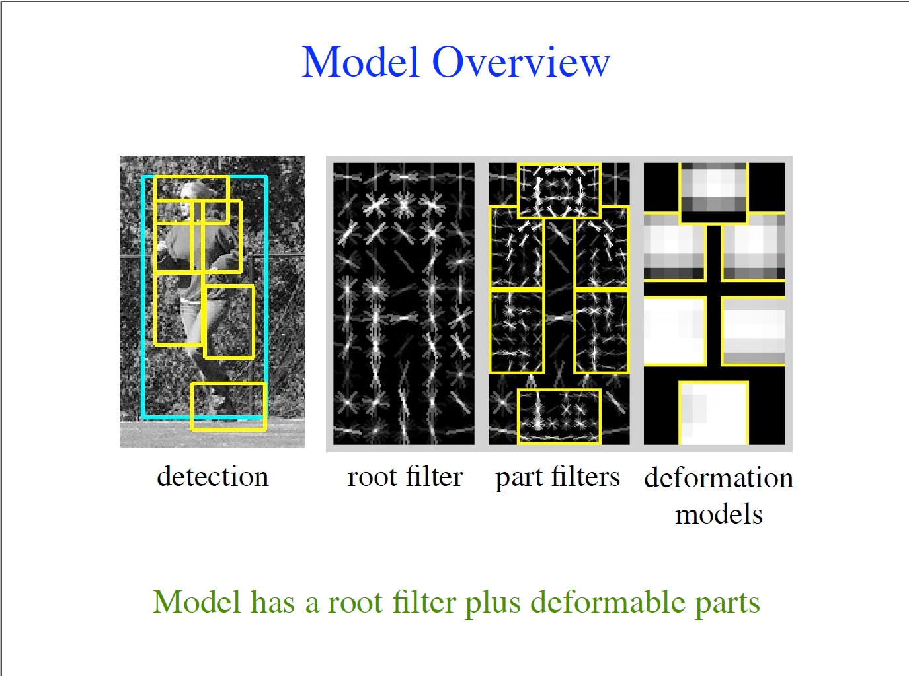

Slide 37

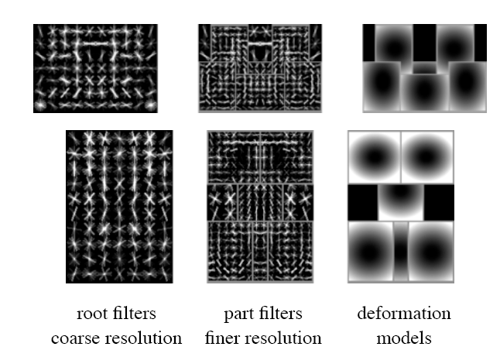
Hybrid template/parts model
Detections
Template Visualization
Felzenszwalb et al. 2008

Slide 38
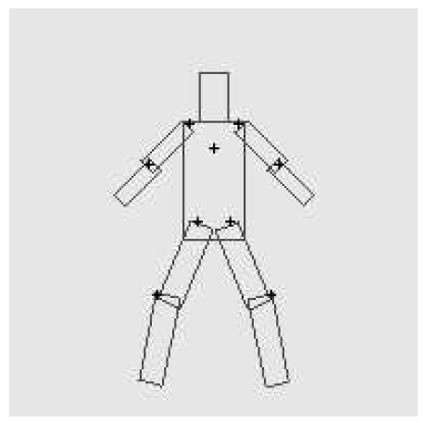
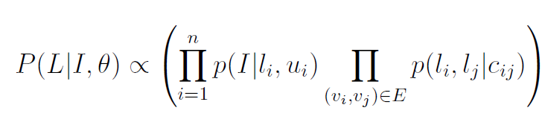
Pictorial Structures Model
Appearance likelihood
Geometry likelihood

Slide 39
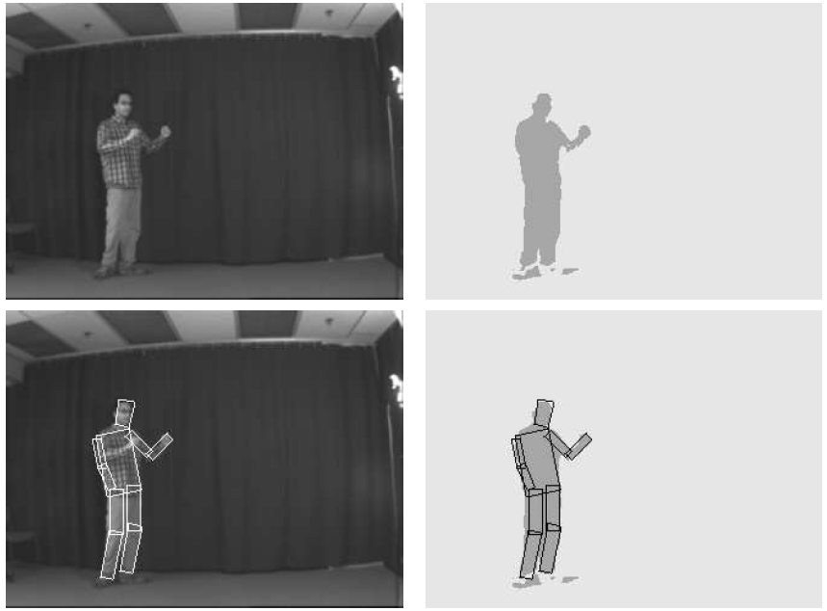
Results for person matching

Slide 40
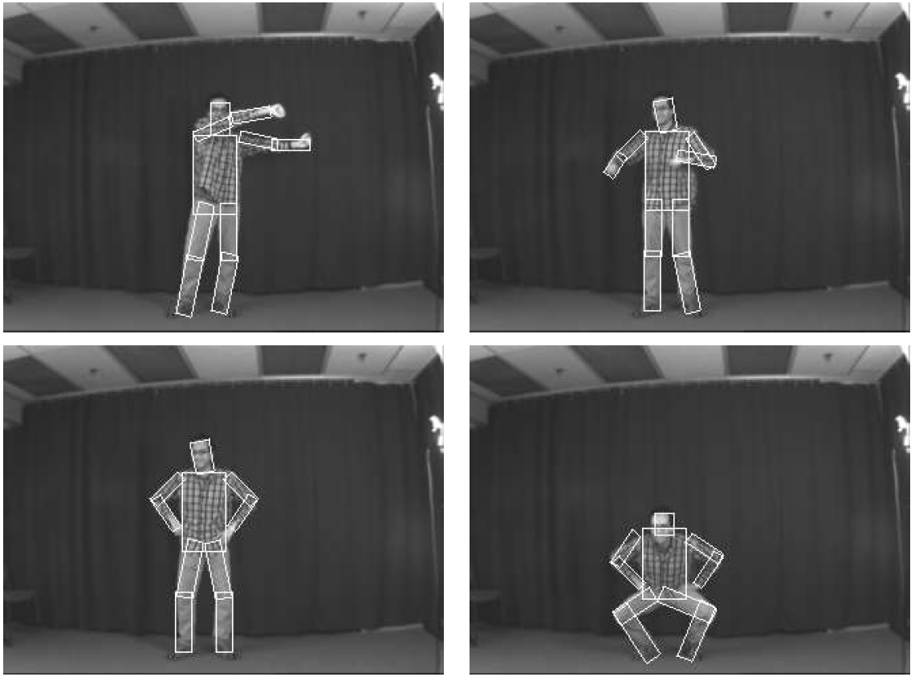
Results for person matching

Slide 41
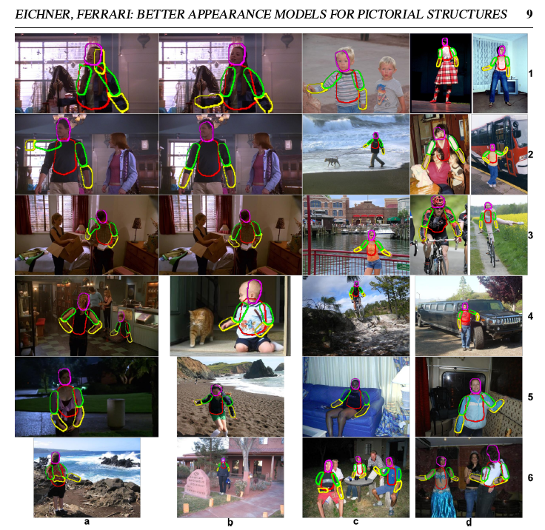
BMVC 2009

Slide 42
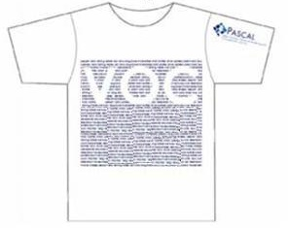
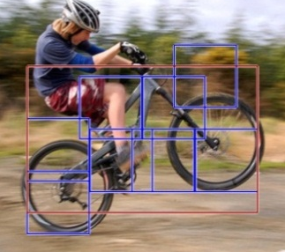
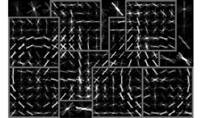
2012 State-of-the-art Detector:
Deformable Parts Model (DPM)
Lifetime
Achievement
Strong low-level features based on HOG
Efficient matching algorithms for deformable part-based models (pictorial structures)
Discriminative learning with latent variables (latent SVM)
Felzenszwalb et al., 2008, 2010, 2011, 2012
Notes:
For the local window detector implementation, we used the publicly available implementation of the DPM detector. This is the best performing sliding window implementation and has consistently performed well in the VOC challenge receiving the lifetime achievement award.

Slide 43
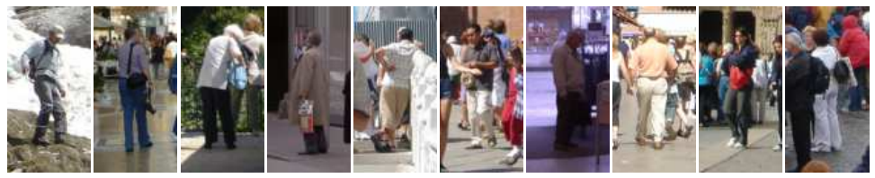
Why did gradient-based models work?
Average gradient image

Slide 44
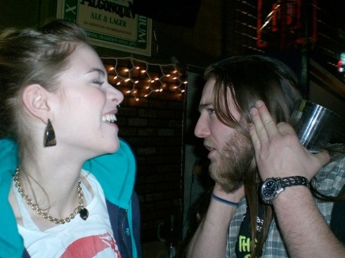
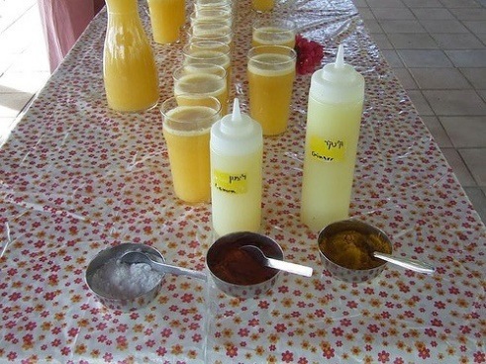






Generic categories
Can we detect people, chairs, horses, cars, dogs, buses, bottles, sheep …?
PASCAL Visual Object Categories (VOC) dataset

Slide 45
Generic categories
Why doesn’t this work (as well)?
Can we detect people, chairs, horses, cars, dogs, buses, bottles, sheep …?
PASCAL Visual Object Categories (VOC) dataset

Slide 46
Quiz time
(Back to Girshick)

Slide 47

Warm up
This is an average image of which object class?

Slide 48
Warm up
pedestrian

Slide 49

A little harder
?

Slide 50
A little harder
?
Hint: airplane, bicycle, bus, car, cat, chair, cow, dog, dining table

Slide 51
A little harder
bicycle (PASCAL)

Slide 52

A little harder, yet
?

Slide 53
A little harder, yet
?
Hint: white blob on a green background

Slide 54
A little harder, yet
sheep (PASCAL)

Slide 55

Impossible?
?

Slide 56
Impossible?
dog (PASCAL)

Slide 57
Impossible?
dog (PASCAL)
Why does the mean look like this?
There’s no alignment between the examples!
How do we combat this?

Slide 58
PASCAL VOC detection history
41%
41%
37%
DPM++,
MKL,
Selective
Search
Selective
Search,
DPM++,
MKL
28%
DPM++
23%
DPM,
MKL
17%
DPM,
HOG+
BOW
DPM

Slide 59
Part-based models & multiple features (MKL)
41%
41%
37%
rapid performance improvements
DPM++,
MKL,
Selective
Search
Selective
Search,
DPM++,
MKL
28%
DPM++
23%
DPM,
MKL
17%
DPM,
HOG+
BOW
DPM

Slide 60
Kitchen-sink approaches
increasing complexity & plateau
41%
41%
37%
DPM++,
MKL,
Selective
Search
Selective
Search,
DPM++,
MKL
28%
DPM++
23%
DPM,
MKL
17%
DPM,
HOG+
BOW
DPM

Slide 61
Region-based Convolutional Networks (R-CNNs)
62%
53%
R-CNN v2
R-CNN v1
41%
41%
37%
DPM++,
MKL,
Selective
Search
Selective
Search,
DPM++,
MKL
28%
DPM++
23%
DPM,
MKL
17%
DPM,
HOG+
BOW
DPM
[R-CNN. Girshick et al. CVPR 2014]

Slide 62
Region-based Convolutional Networks (R-CNNs)
~1 year
~5 years
[R-CNN. Girshick et al. CVPR 2014]

Slide 63
Convolutional Neural Networks
Overview

Slide 64





Standard Neural Networks
“Fully connected”
$$x={\left(x_{1},…,x_{784}\right)}^{T}$$
$$z_{j}={g(w}_{j }^{T}x)$$
$$g\left(t\right)=\frac{1}{1+e^{−t}}$$

Slide 65
From NNs to Convolutional NNs
Local connectivity
Shared (“tied”) weights
Multiple feature maps
Pooling

Slide 66
Convolutional NNs
Local connectivity
compare
Each green unit is only connected to (3)
neighboring blue units

Slide 67







Convolutional NNs
Shared (“tied”) weights
$$w_{1}$$
$$w_{2}$$
$$w_{3}$$
All green units share the same parameters $w$
Each green unit computes the same function,
but with a different input window
$$w_{1}$$
$$w_{2}$$
$$w_{3}$$

Slide 68

Convolutional NNs
Convolution with 1-D filter: $[w_{3},w_{2},w_{1}]$
$$w_{1}$$
$$w_{2}$$
$$w_{3}$$
All green units share the same parameters $w$
Each green unit computes the same function,
but with a different input window

Slide 69



Convolutional NNs
Convolution with 1-D filter: $[w_{3},w_{2},w_{1}]$
$$w_{1}$$
$$w_{2}$$
All green units share the same parameters $w$
Each green unit computes the same function,
but with a different input window
$$w_{3}$$

Slide 70



Convolutional NNs
Convolution with 1-D filter: $[w_{3},w_{2},w_{1}]$
All green units share the same parameters $w$
Each green unit computes the same function,
but with a different input window
$$w_{1}$$
$$w_{2}$$
$$w_{3}$$

Slide 71



Convolutional NNs
Convolution with 1-D filter: $[w_{3},w_{2},w_{1}]$
All green units share the same parameters $w$
Each green unit computes the same function,
but with a different input window
$$w_{1}$$
$$w_{2}$$
$$w_{3}$$

Slide 72



Convolutional NNs
Convolution with 1-D filter: $[w_{3},w_{2},w_{1}]$
All green units share the same parameters $w$
Each green unit computes the same function,
but with a different input window
$$w_{1}$$
$$w_{2}$$
$$w_{3}$$

Slide 73



Convolutional NNs
Multiple feature maps
$${w′}_{1}$$
$${w′}_{2}$$
All orange units compute the same function
but with a different input windows
Orange and green units compute
different functions
$${w′}_{3}$$
$$w_{1}$$
Feature map 2
(array of orange
units)
$$w_{2}$$
$$w_{3}$$
Feature map 1
(array of green
units)

Slide 74
Convolutional NNs
Pooling (max, average)
1
4
Pooling area (how much to pool): 2 units
Pooling stride (how far to move): 2 units
Subsamples feature maps
4
0
3
3

Slide 75



2D input
Pooling
Convolution
Image

Slide 76

Historical perspective – 1980
Hubel and Wiesel
1962
Included basic ingredients of ConvNets, but no supervised learning algorithm

Slide 77

Supervised learning – 1986
Gradient descent training with error backpropagation
Early demonstration that error backpropagation can be used
for supervised training of neural nets (including ConvNets)

Slide 78

1989
Backpropagation applied to handwritten zip code recognition, Lecun et al., 1989

Slide 79

Practical ConvNets
Gradient-Based Learning Applied to Document Recognition,
Lecun et al., 1998

Slide 80
Core idea of “deep learning”
Input: the “raw” signal (image, waveform, …)
Features: hierarchy of features is learned from the raw input

Slide 81



What’s new since the 1980s?
More layers
  LeNet-3 and LeNet-5 had 3 and 5 learnable layers
  Current models have 8 – 20+
“ReLU” non-linearities (Rectified Linear Unit)
  $g\left(x\right)=\max\left(0, x\right)$
  Gradient doesn’t vanish
“Dropout” regularization (randomly selects neurons to remove during training epochs, reduces overfitting)
Fast GPU implementations
More data
$$g(x)$$
$$x$$

Slide 82
Demo
http://cs.stanford.edu/people/karpathy/convnetjs/demo/mnist.html
ConvNetJS by Andrej Karpathy (Ph.D. student at Stanford)
Software libraries
Caffe (C++, python, matlab)
Torch7 (C++, lua)
Theano (python)

Slide 83

What else? Object Proposals
Sliding window based object detection
Object proposals
  Fast execution
  High recall with low # of candidate boxes
Iterate over window size, aspect ratio, and location

Slide 84

The number of contours wholly enclosed by a bounding box is indicative of
the likelihood of the box containing an object.

Slide 85

Ross’s Own System: Region CNNs

Slide 86

Competitive Results

Slide 87
Top Regions for Six Object Classes

Slide 88
What came Next?
Faster R-CNN (Girshick, 2016)
YOLO (Redmon, Girshick, Divvala, Farhadi, 2016)
You Only Look Once (People’s Choice Award)
YOLO9000: Better, Faster, Stronger (Redmon, Farhadi, CVPR 2017) Runner up for Best Paper
YOLOv3: more improvements

Slide 89


Slide 90


Slide 91


Slide 92


Slide 93


Slide 94


Slide 95


Slide 96


Slide 97


Slide 98
More YOLO (second paper)
At 67 FPS, YOLOv2 gets76.8 mAP on VOC 2007.
At 40 FPS, YOLOv2 gets 78.6mAP, outperforming state-of-the-art methods like Faster R-CNN with ResNet and SSD while still running significantly faster
A new methodology that jointly trains for detection and classification produced YOLO9000.
YOLO9000 can detect more than 9000 object categories in real time.
And YOLOv3 has come out.

Slide 99
Finale
Object recognition has moved rapidly in the last 12 years to becoming very appearance based.
The HOG descriptor lead to fast recognition of specific views of generic objects, starting with pedestrians and using SVMs.
Deformable parts models extended that to allow more objects with articulated limbs, but still specific views.
CNNs have become the method of choice; they learn from huge amounts of data and can learn multiple views of each object class.
YOLO is one of the best.

