Slide 1
Computer Vision CSE 455 Filters Linda Shapiro Professor of Computer Science & Engineering Professor of Electrical Engineering

Slide 2
Let’s do something interesting already!!

Slide 3
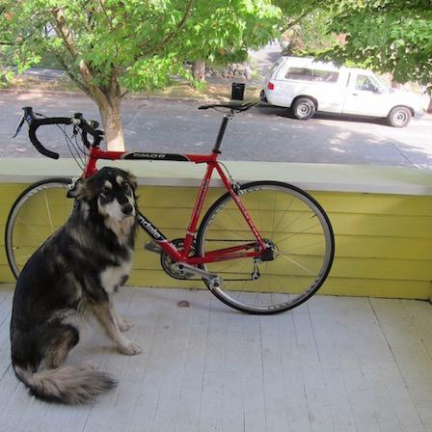
Want to make image smaller

Slide 4
448x448 -> 64x64

Slide 5
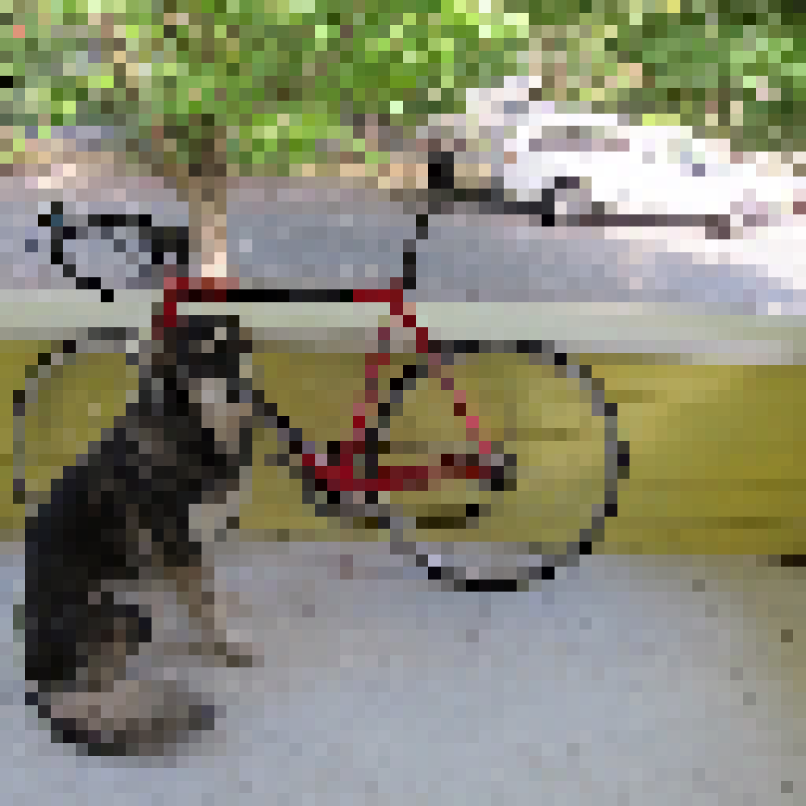
448x448 -> 64x64

Slide 6
448x448 -> 64x64

Slide 7
448x448 -> 64x64

Slide 8
448x448 -> 64x64

Slide 9
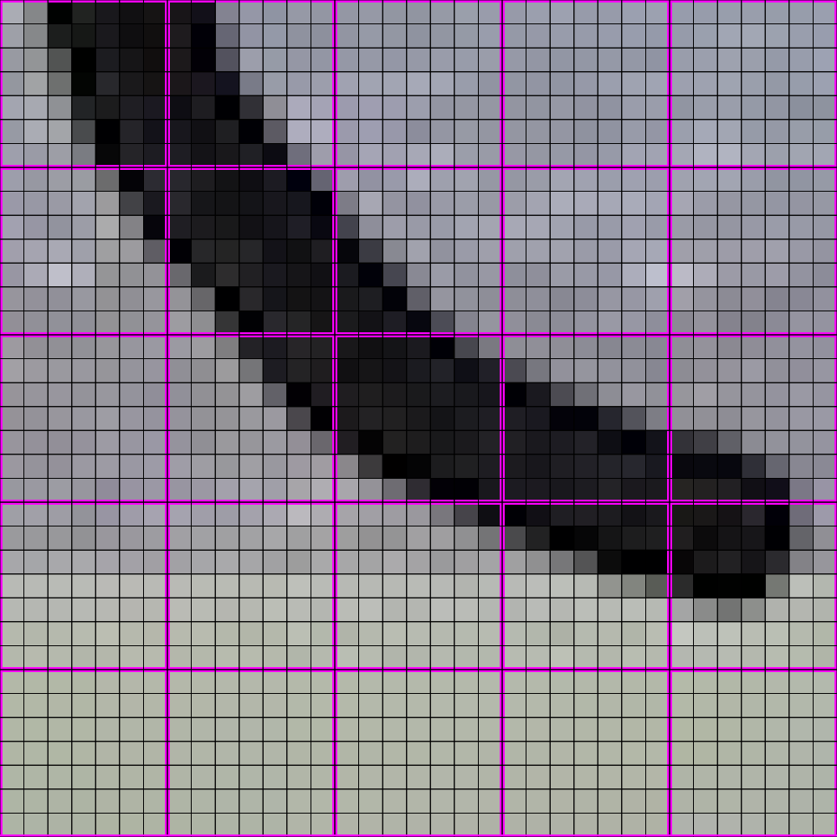
448x448 -> 64x64

Slide 10
448x448 -> 64x64

Slide 11
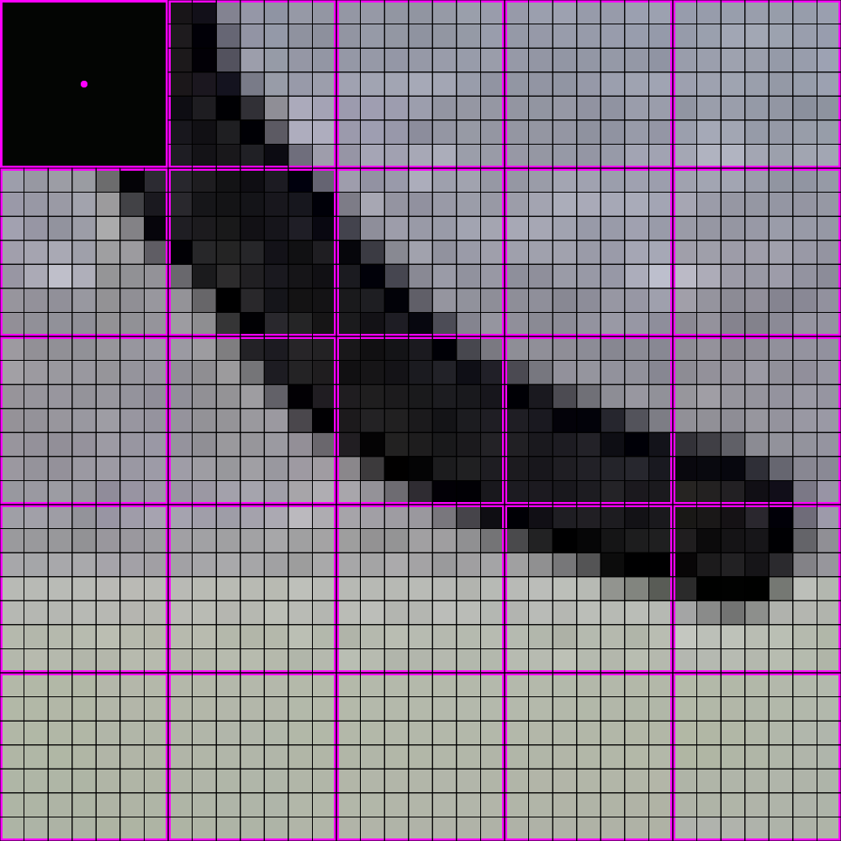
448x448 -> 64x64

Slide 12
448x448 -> 64x64

Slide 13
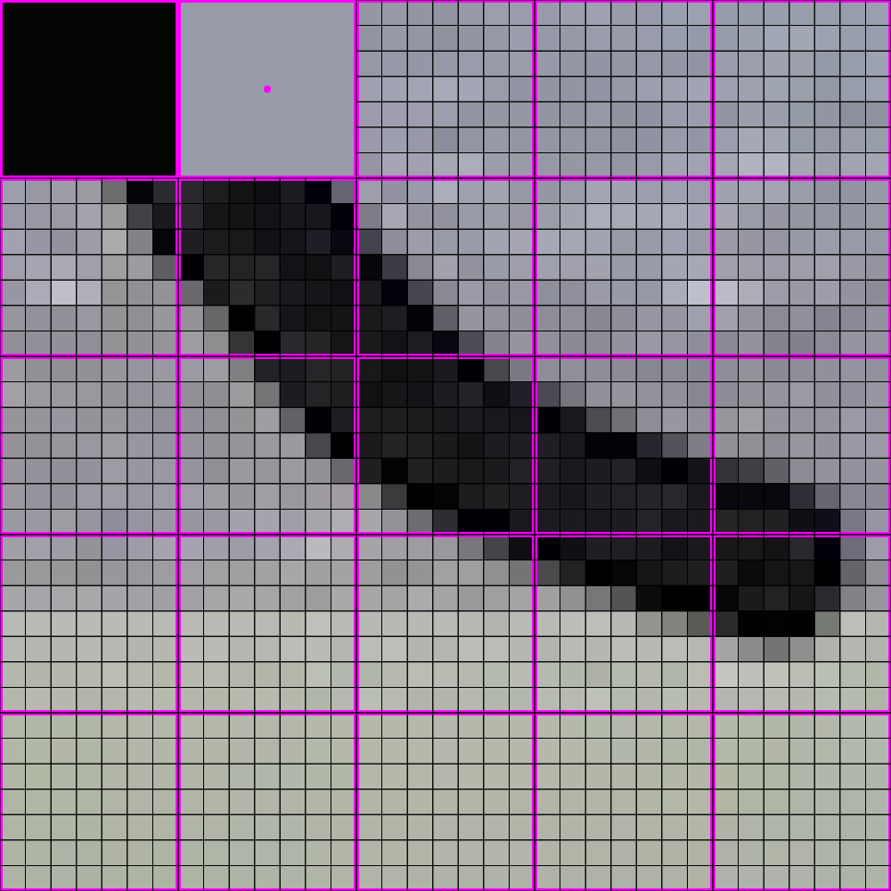
448x448 -> 64x64

Slide 14
448x448 -> 64x64

Slide 15
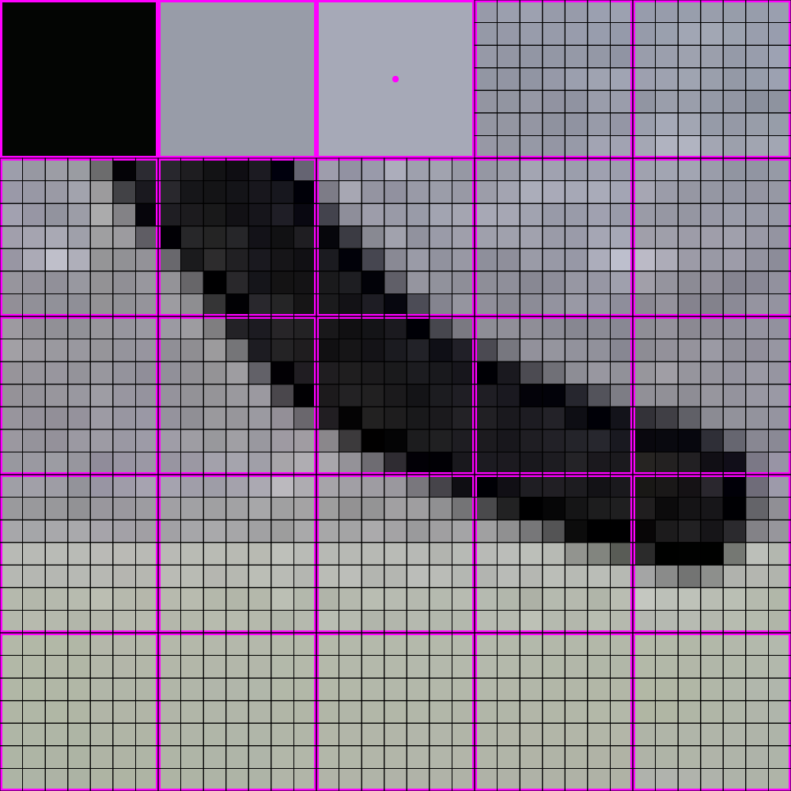
448x448 -> 64x64

Slide 16
448x448 -> 64x64

Slide 17
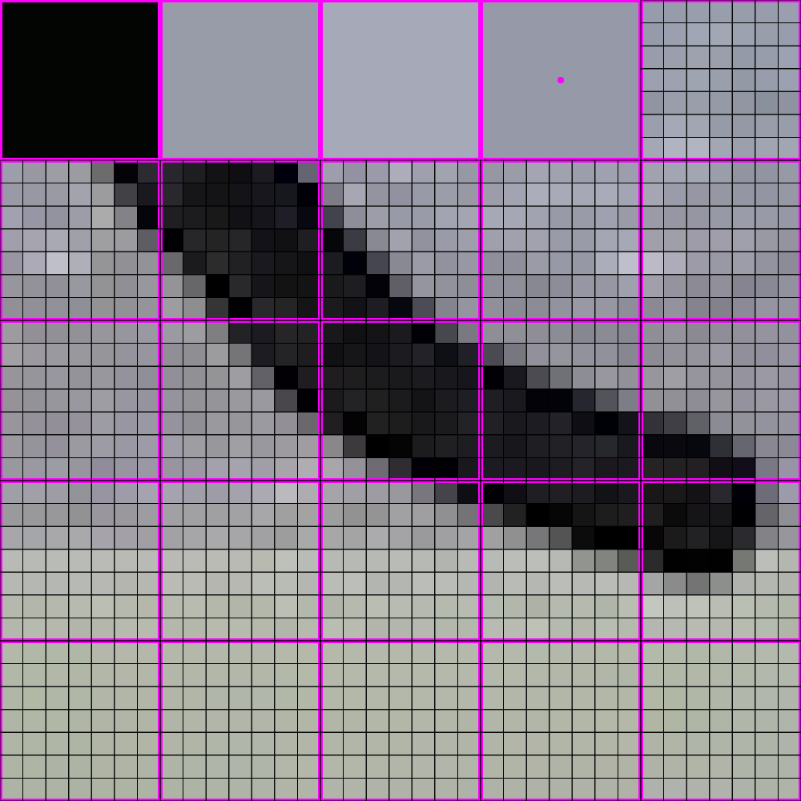
448x448 -> 64x64

Slide 18
448x448 -> 64x64

Slide 19
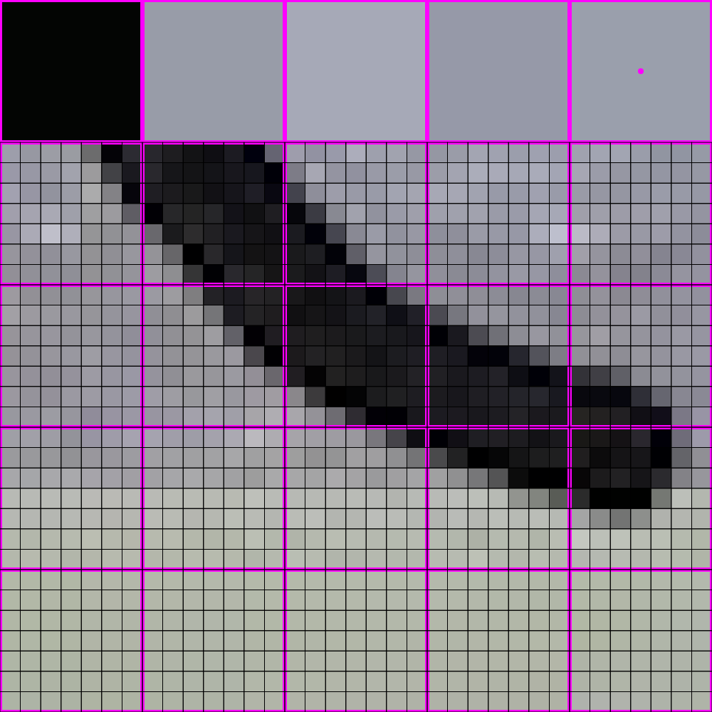
448x448 -> 64x64

Slide 20
448x448 -> 64x64

Slide 21
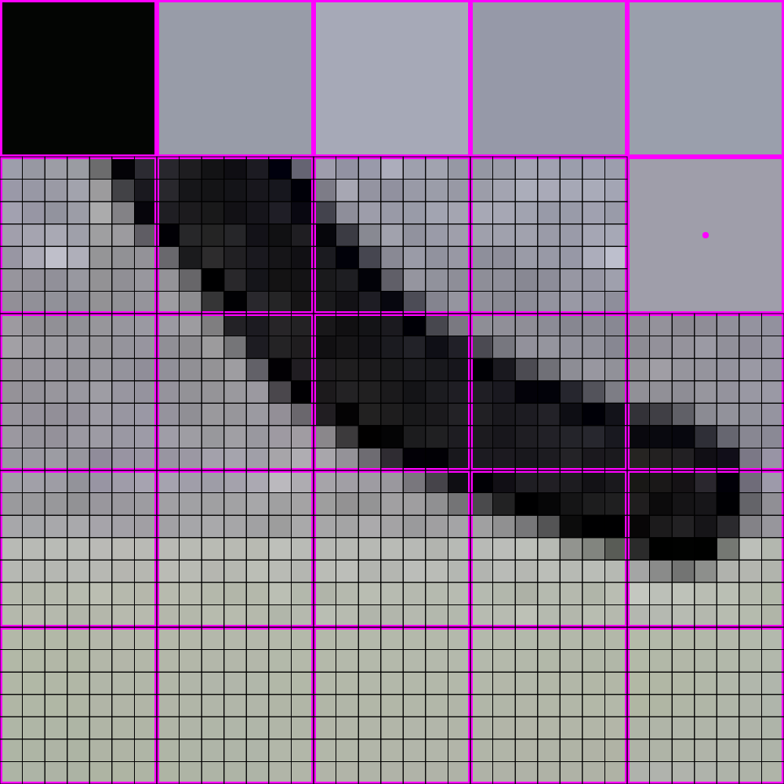
448x448 -> 64x64

Slide 22
448x448 -> 64x64

Slide 23
448x448 -> 64x64

Slide 24
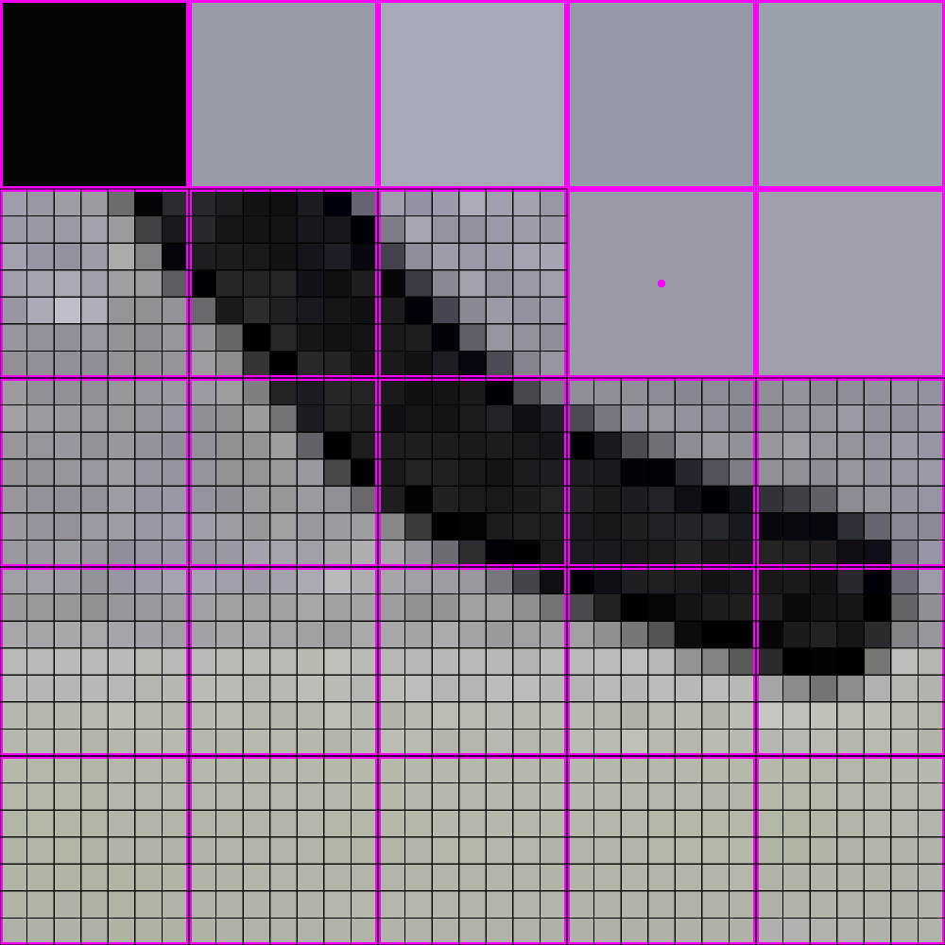
448x448 -> 64x64

Slide 25
448x448 -> 64x64

Slide 26
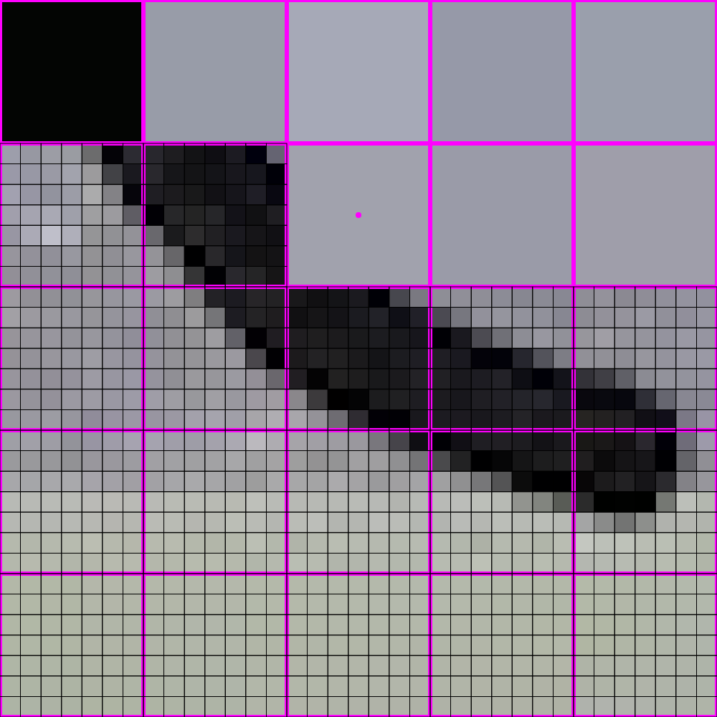
448x448 -> 64x64

Slide 27
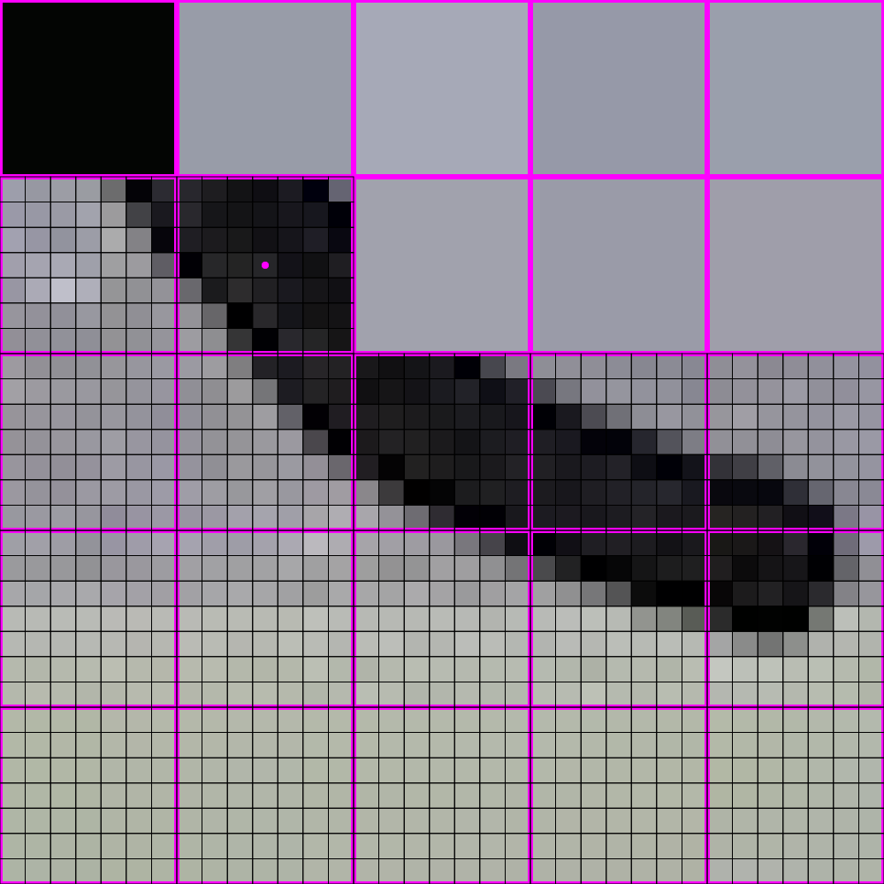
448x448 -> 64x64

Slide 28
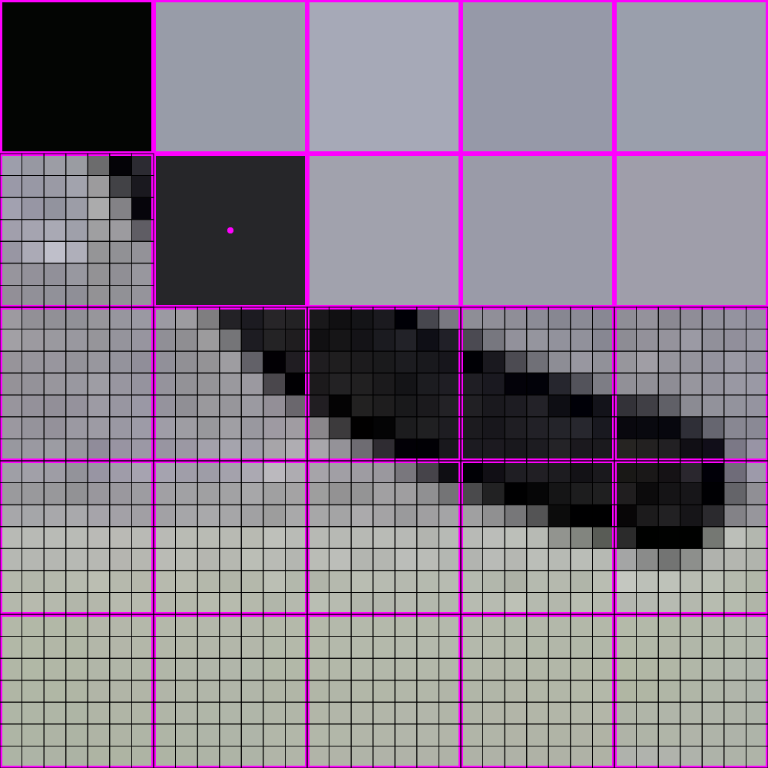
448x448 -> 64x64

Slide 29
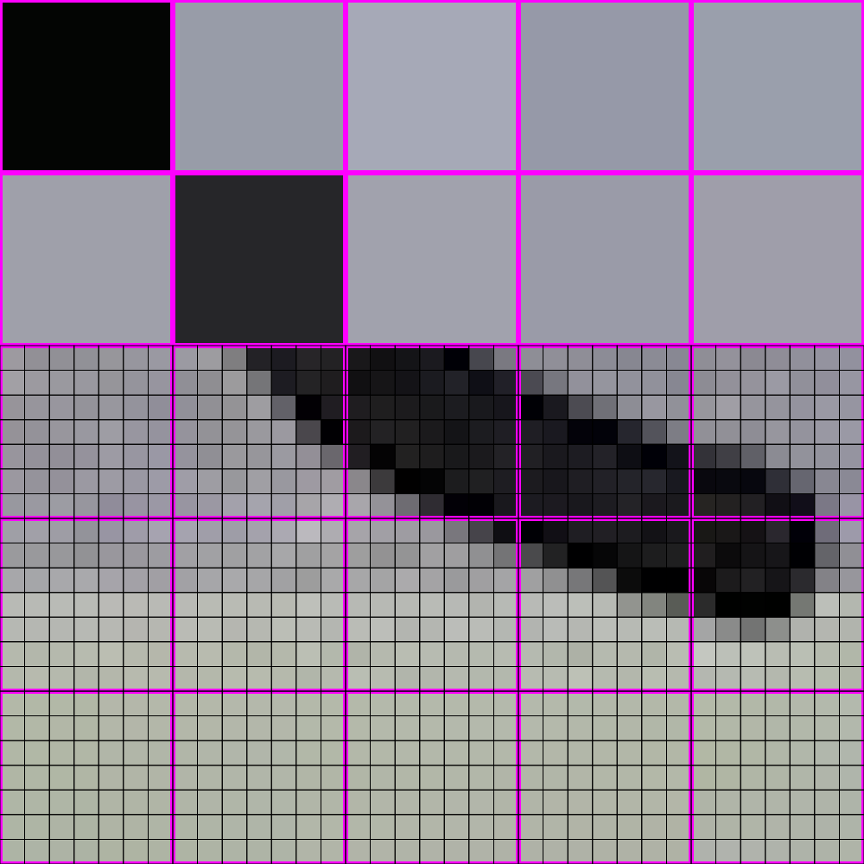
448x448 -> 64x64

Slide 30
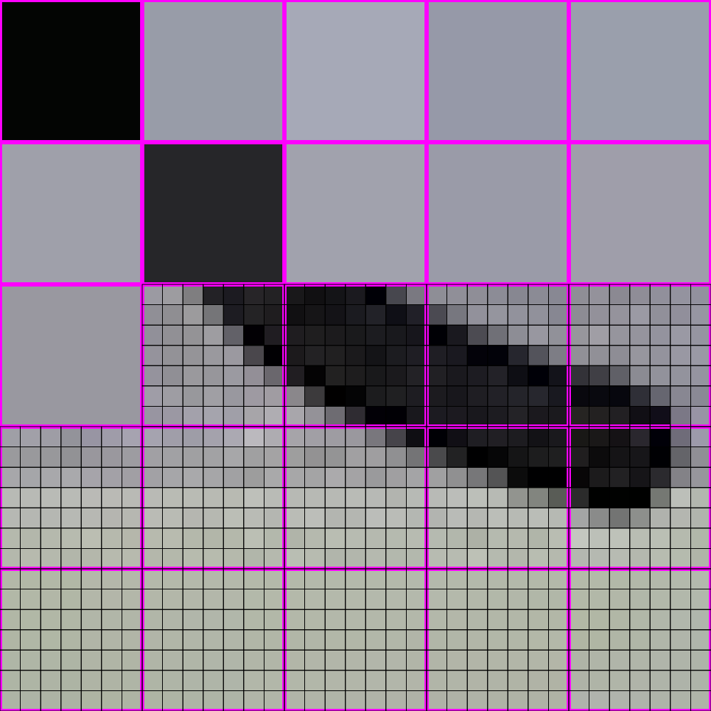
448x448 -> 64x64

Slide 31
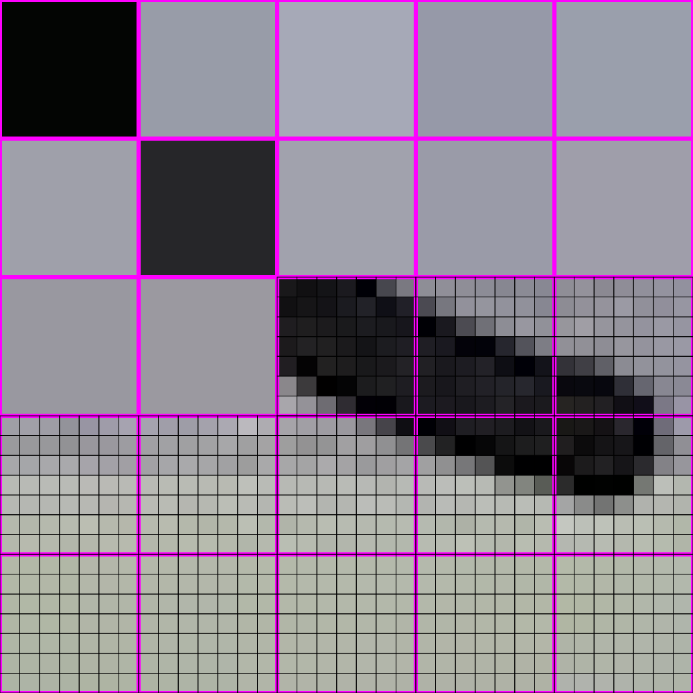
448x448 -> 64x64

Slide 32
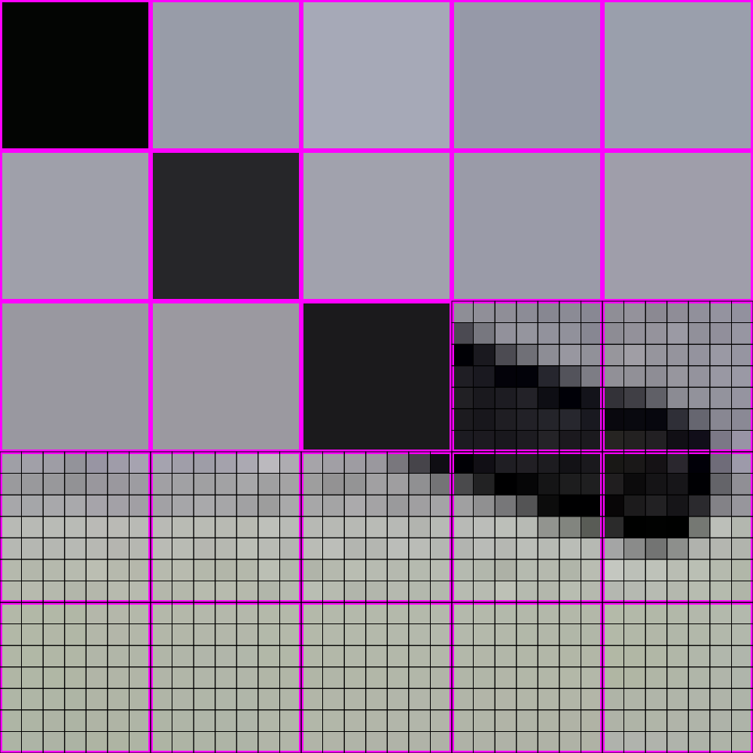
448x448 -> 64x64

Slide 33
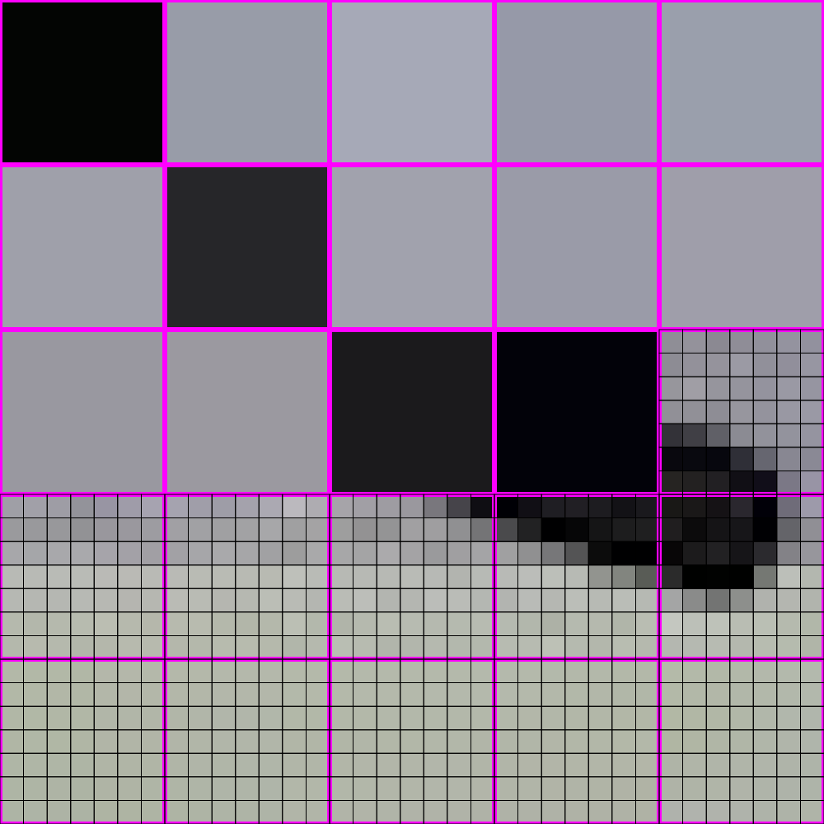
448x448 -> 64x64

Slide 34
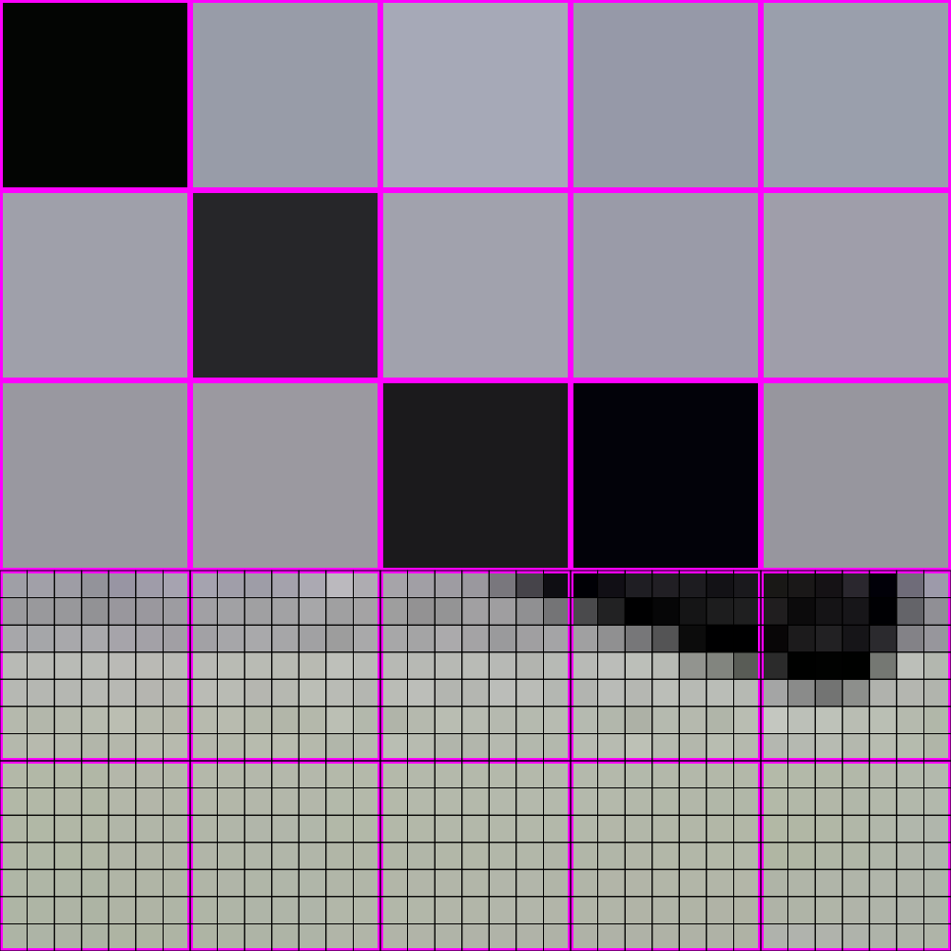
448x448 -> 64x64

Slide 35
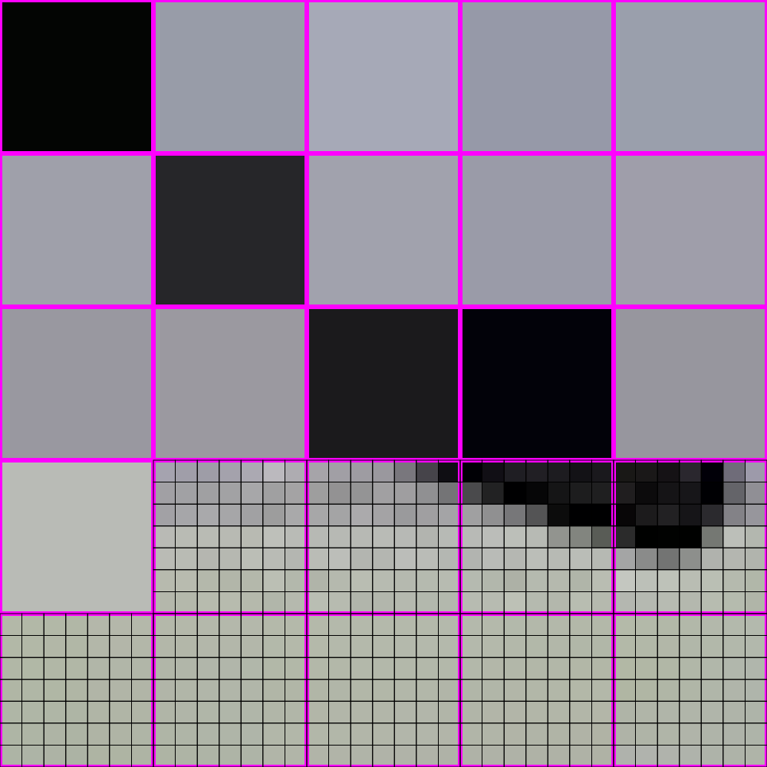
448x448 -> 64x64

Slide 36
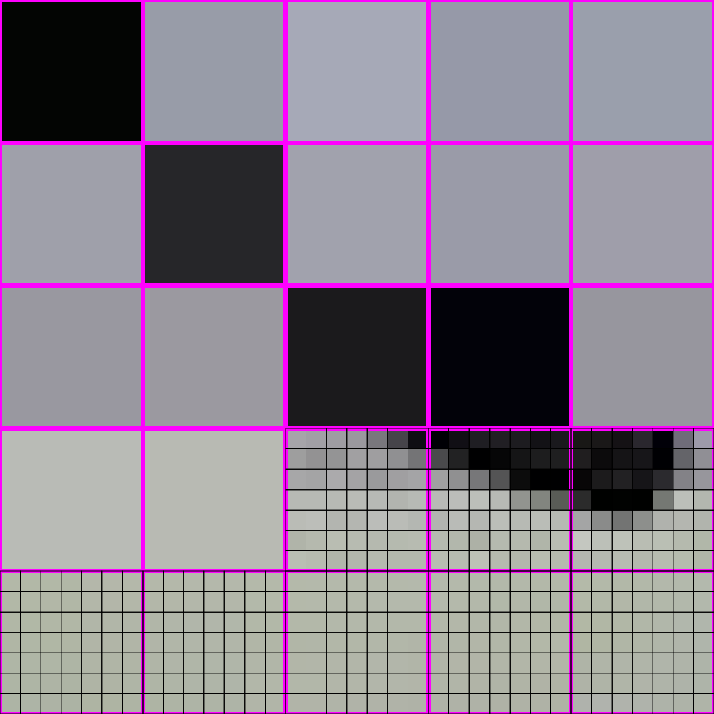
448x448 -> 64x64

Slide 37
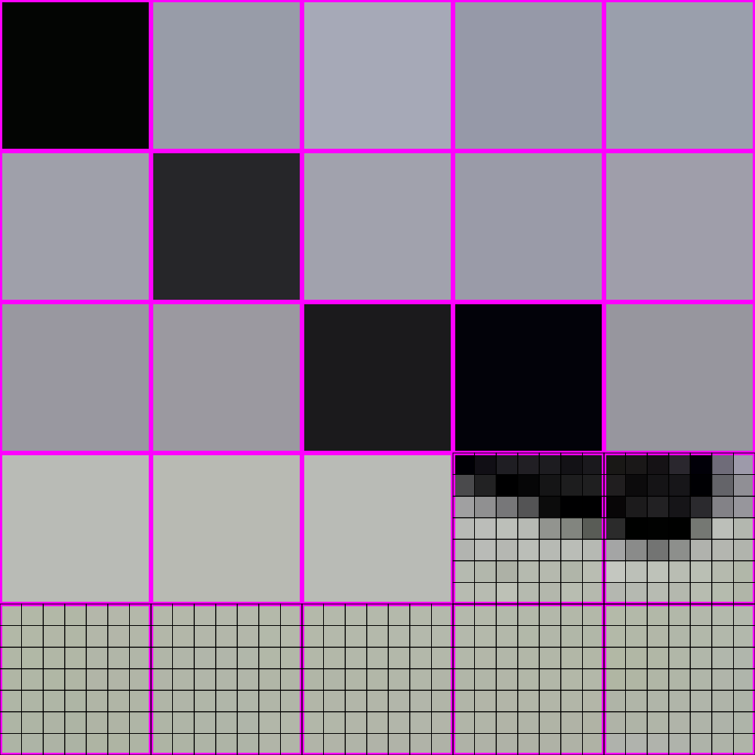
448x448 -> 64x64

Slide 38
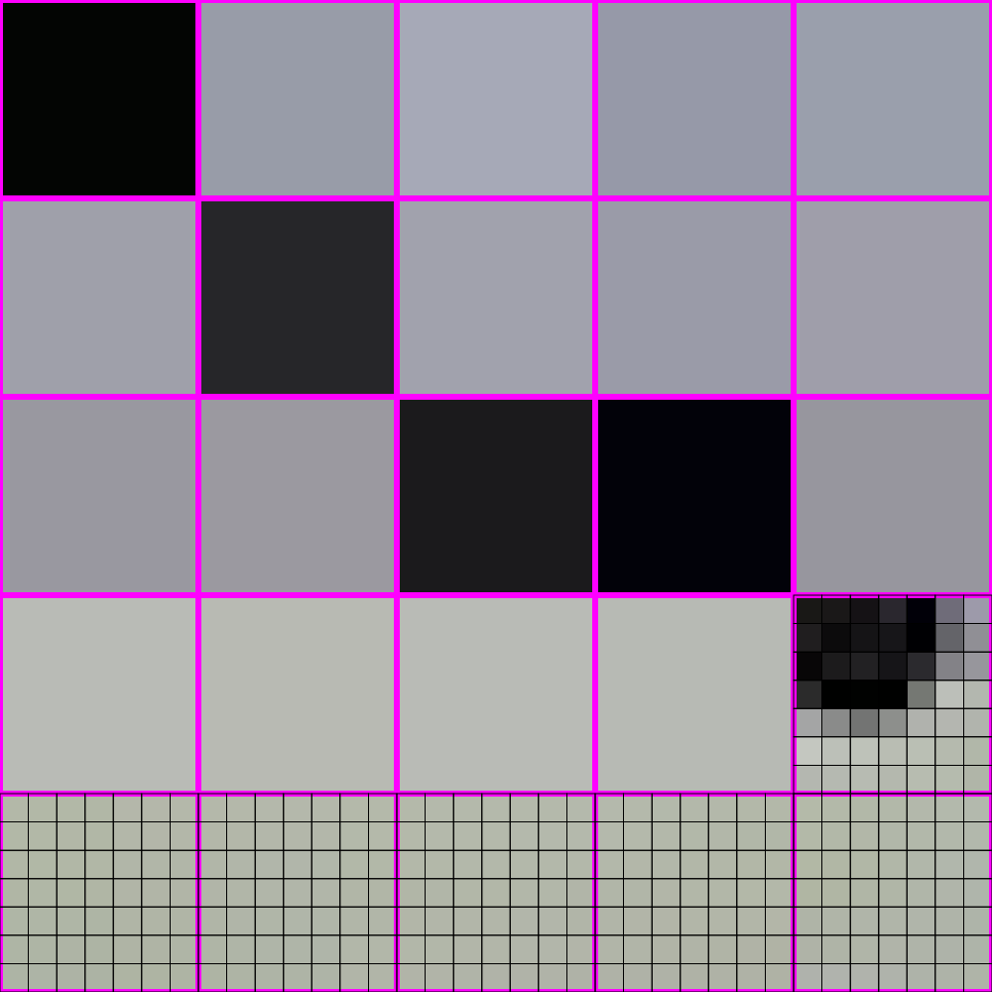
448x448 -> 64x64

Slide 39
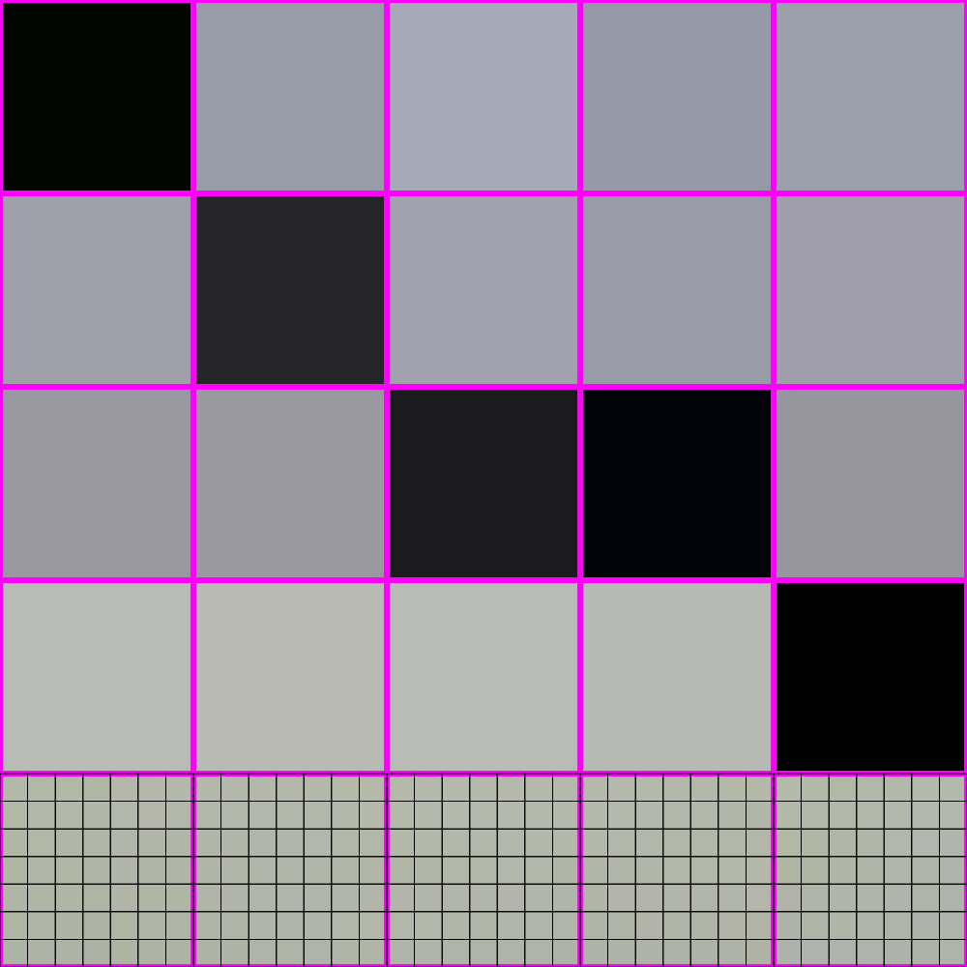
448x448 -> 64x64

Slide 40
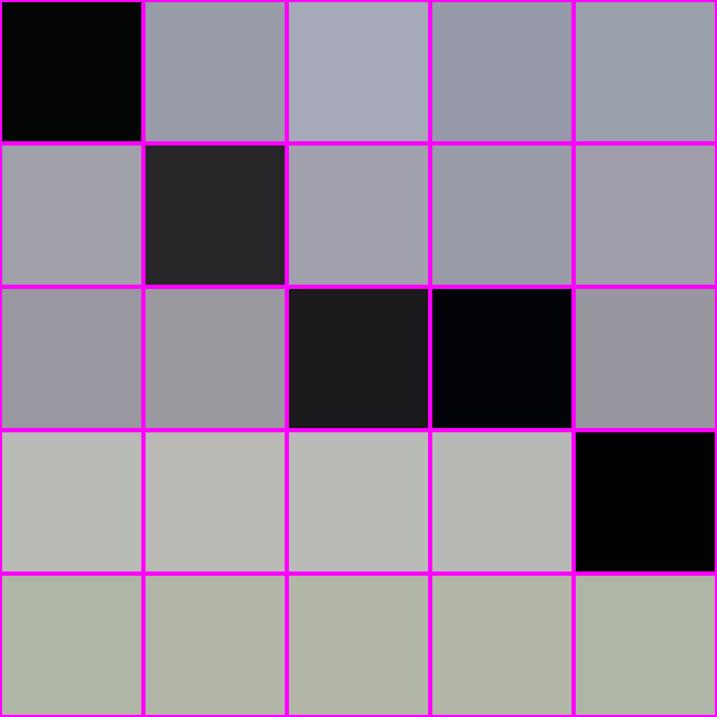
448x448 -> 64x64

Slide 41
448x448 -> 64x64

Slide 42
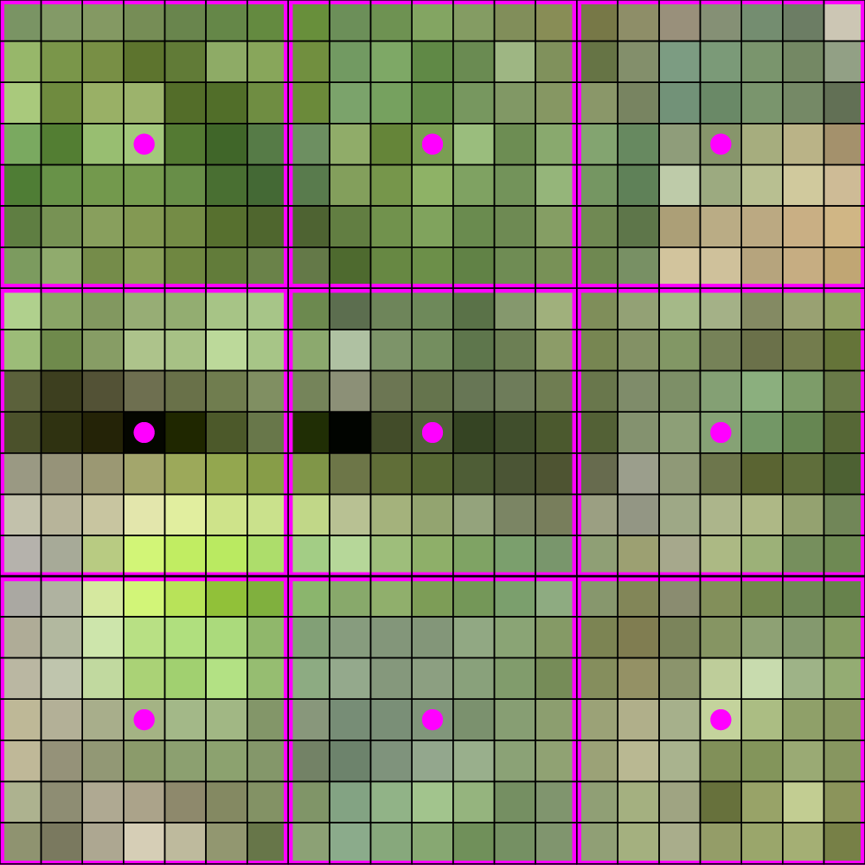
448x448 -> 64x64

Slide 43
448x448 -> 64x64

Slide 44
IS THIS ALL THERE IS??

Slide 45
THERE IS A BETTER WAY!

Slide 46
LOOK AT HOW MUCH BETTER

Slide 47
How do?

Slide 48
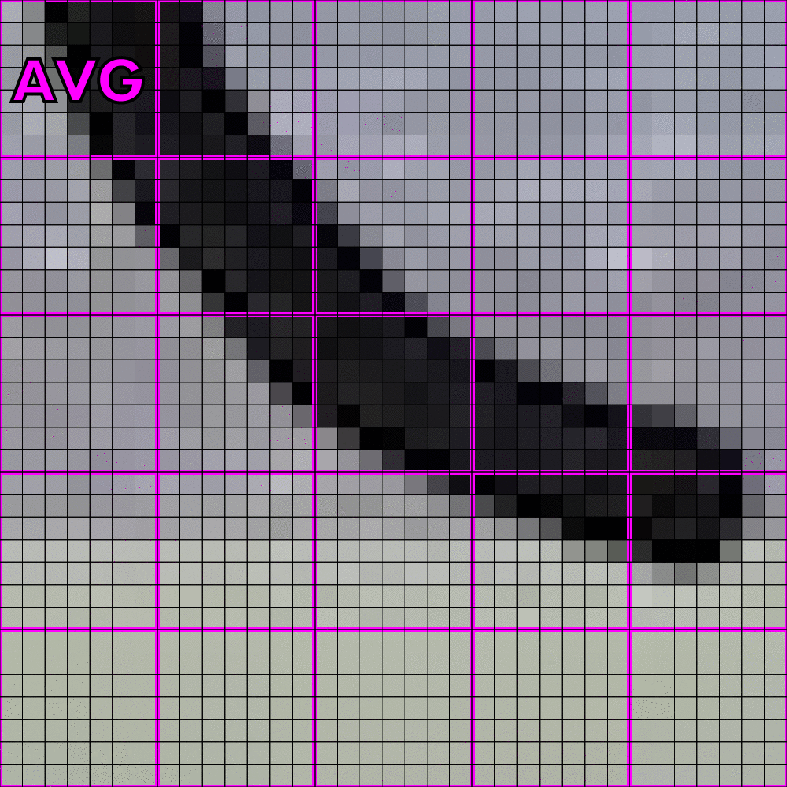
How do? Averaging!

Slide 49
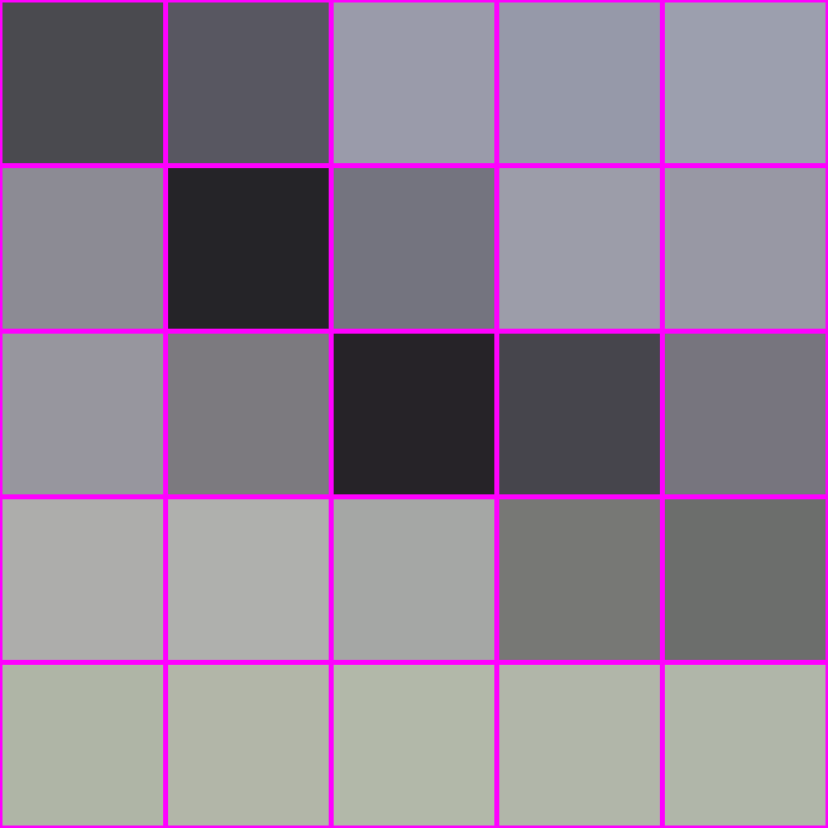
How do? Averaging!
“interpolation”
averaging
X

Slide 50
What is averaging?

Slide 51
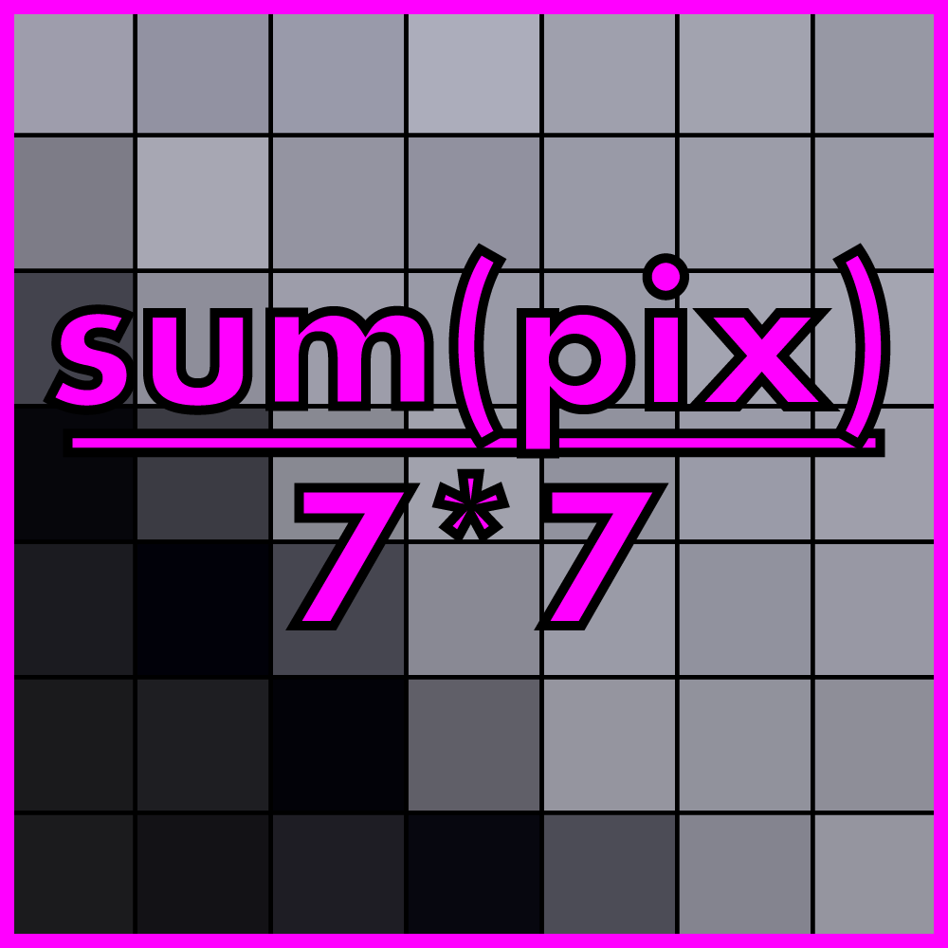
What is averaging? A weighted sum

Slide 52
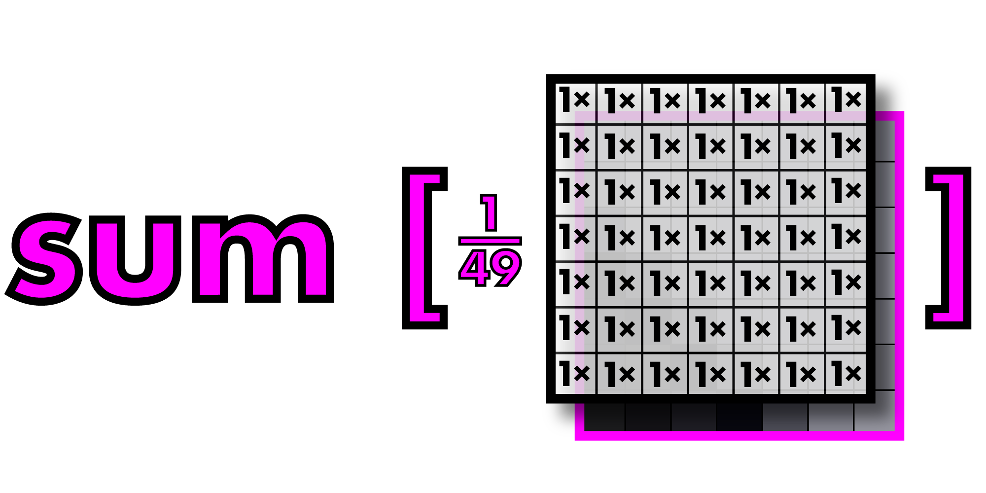
What is averaging? A weighted sum

Slide 53
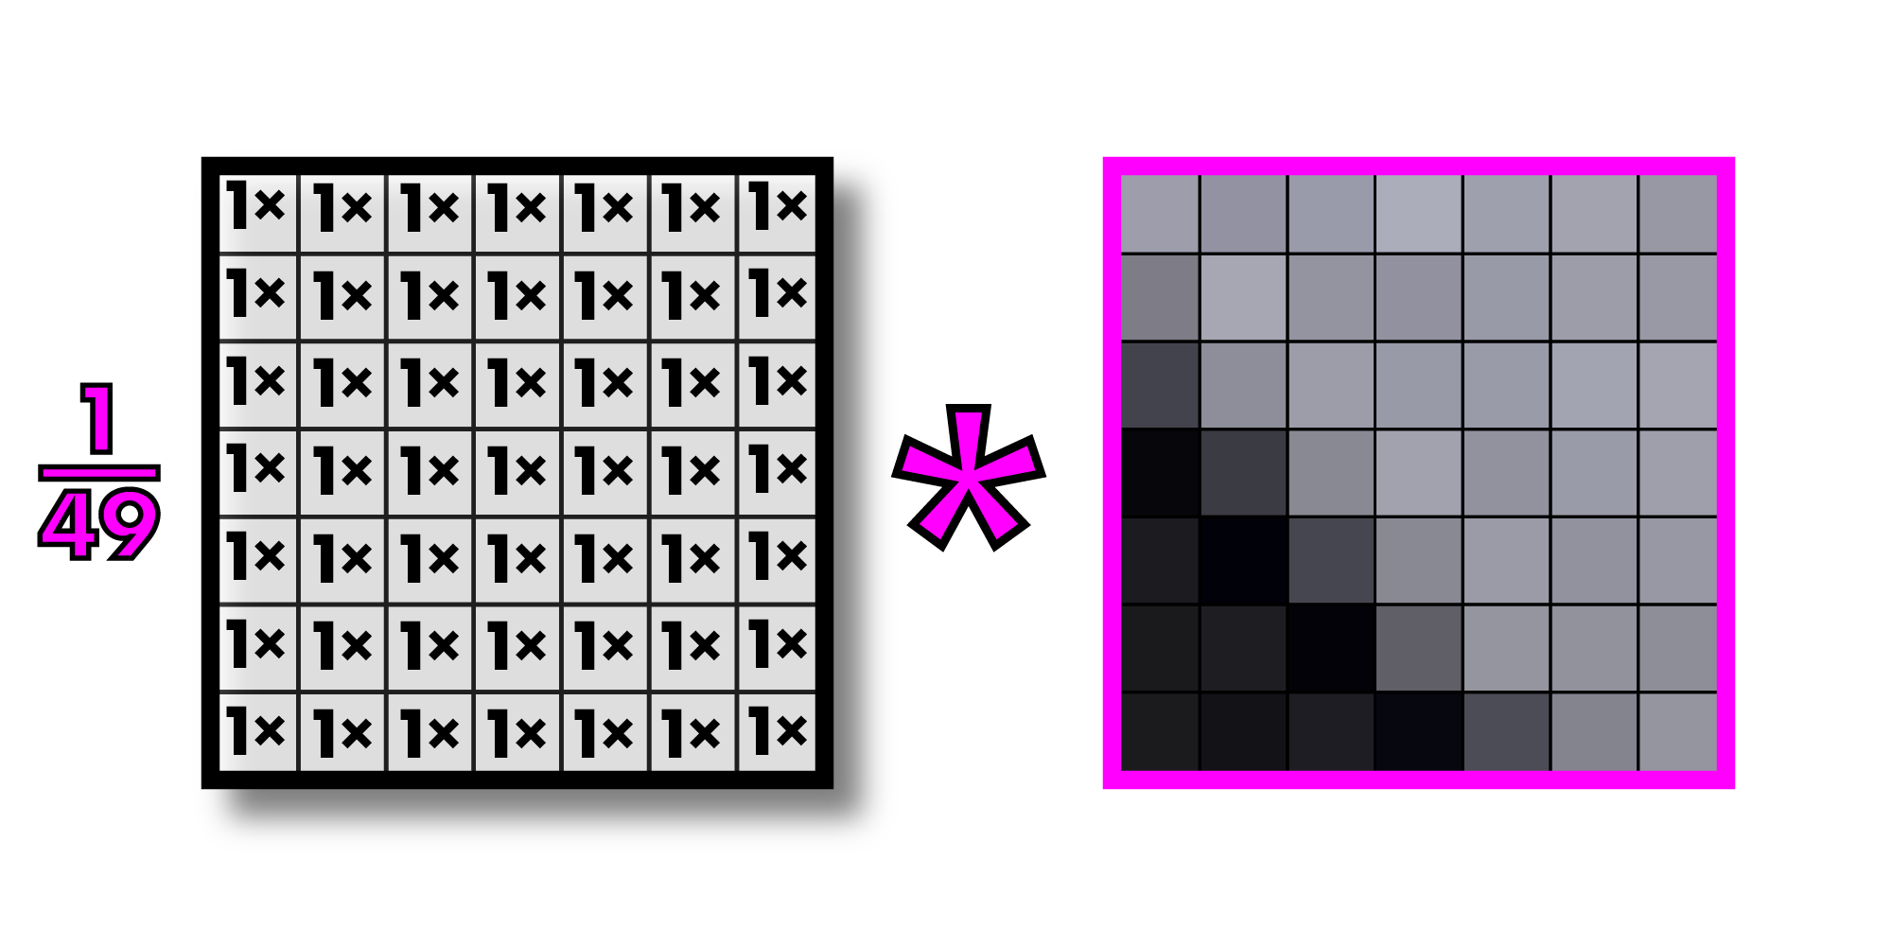
Call this operation “convolution”
Filter or kernel
Note: multiplying an image section by a filter is actually called “correlation” and convolution
Involves inverting the filter first, but since our filters are generally symmetric, we call
Everything convolution. This is what all computer vision people do.

Slide 54
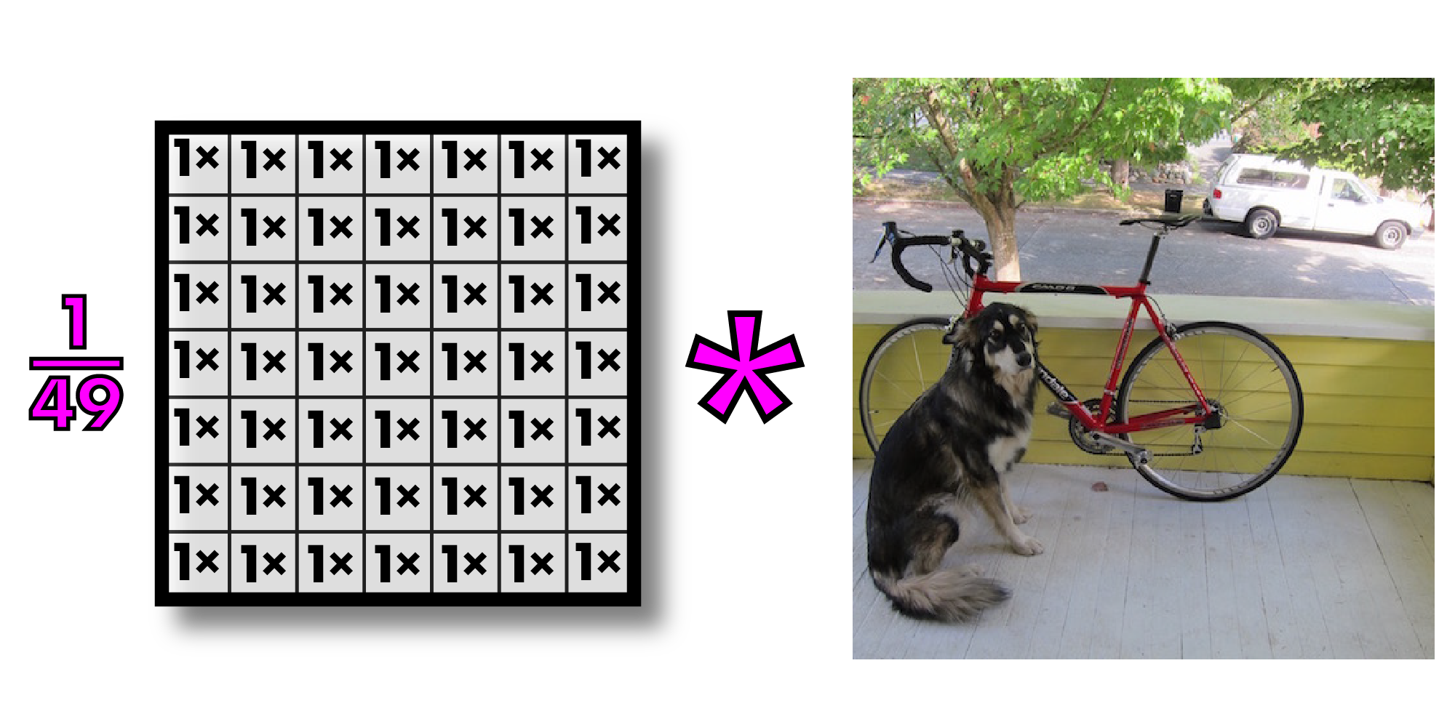
Convolutions on larger images

Slide 55
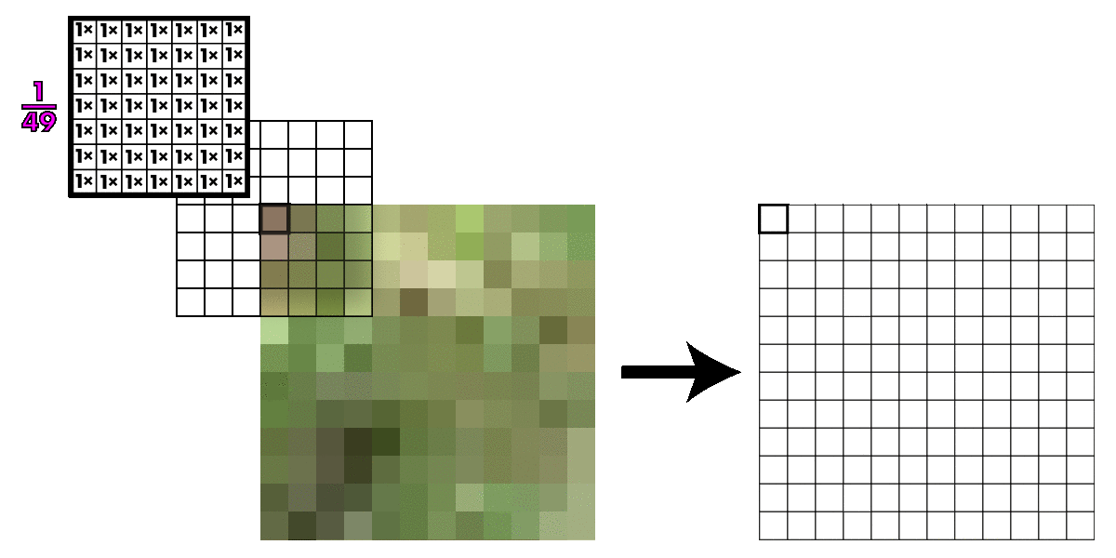
Kernel slides across image

Slide 56
Convolutions on larger images

Slide 57
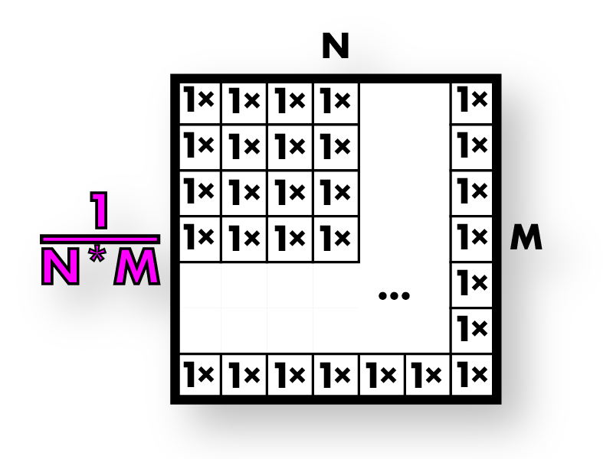
This is called box filter
Box filters

Slide 58
Box filters smooth image
Box filters

Slide 59
Box filters smooth image
Box filters

Slide 60
Now we resize our smoothed image

Slide 61
So much better!

Slide 62
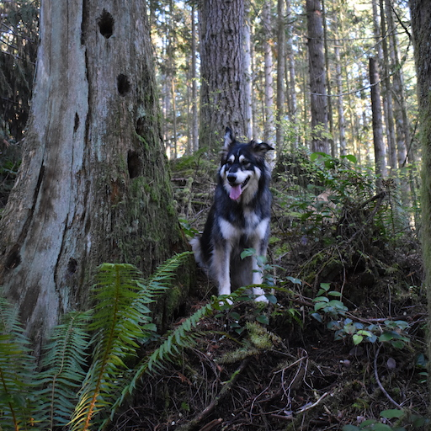
Box filters have artifacts

Slide 63
Box filters have artifacts

Slide 64
Box filters: vertical + horizontal streaking

Slide 65
Box filters: vertical + horizontal streaking

Slide 66
Box filters: vertical + horizontal streaking

Slide 67
Box filters: vertical + horizontal streaking

Slide 68
We want a smoothly weighted kernel

Slide 69
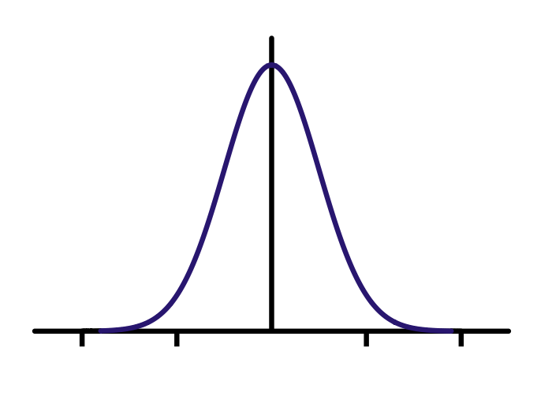
Gaussians

Slide 70
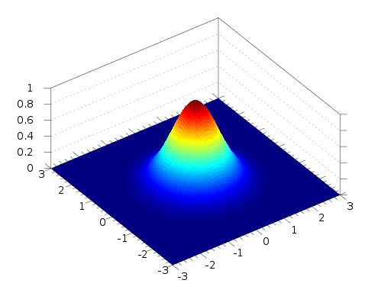
2d Gaussian

Slide 71
Better smoothing with Gaussians
=
*

Slide 72
Better smoothing with Gaussians

Slide 73
Better smoothing with Gaussians
Box Filtered Gaussian Filtered

Slide 74
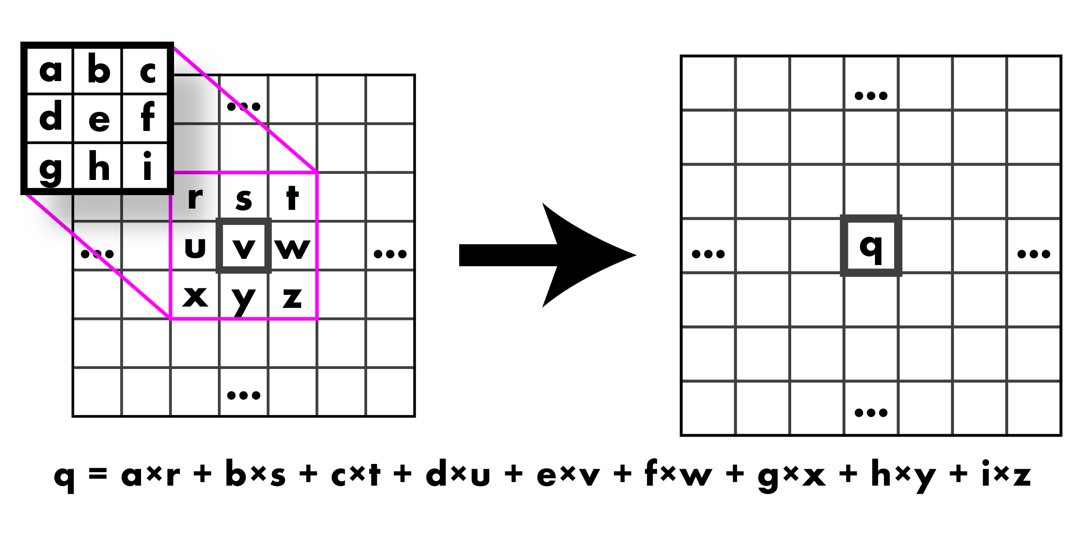
Wow, so what was that convolution thing??

Slide 75
Wow, so what was that convolution thing??

Slide 76
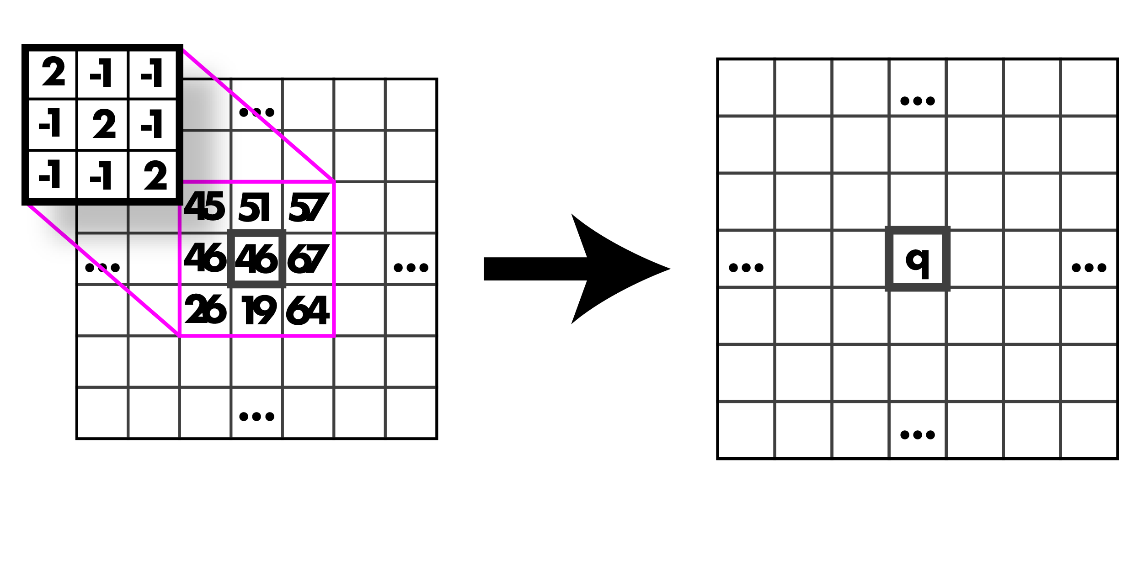
Calculate it, go!

Slide 77
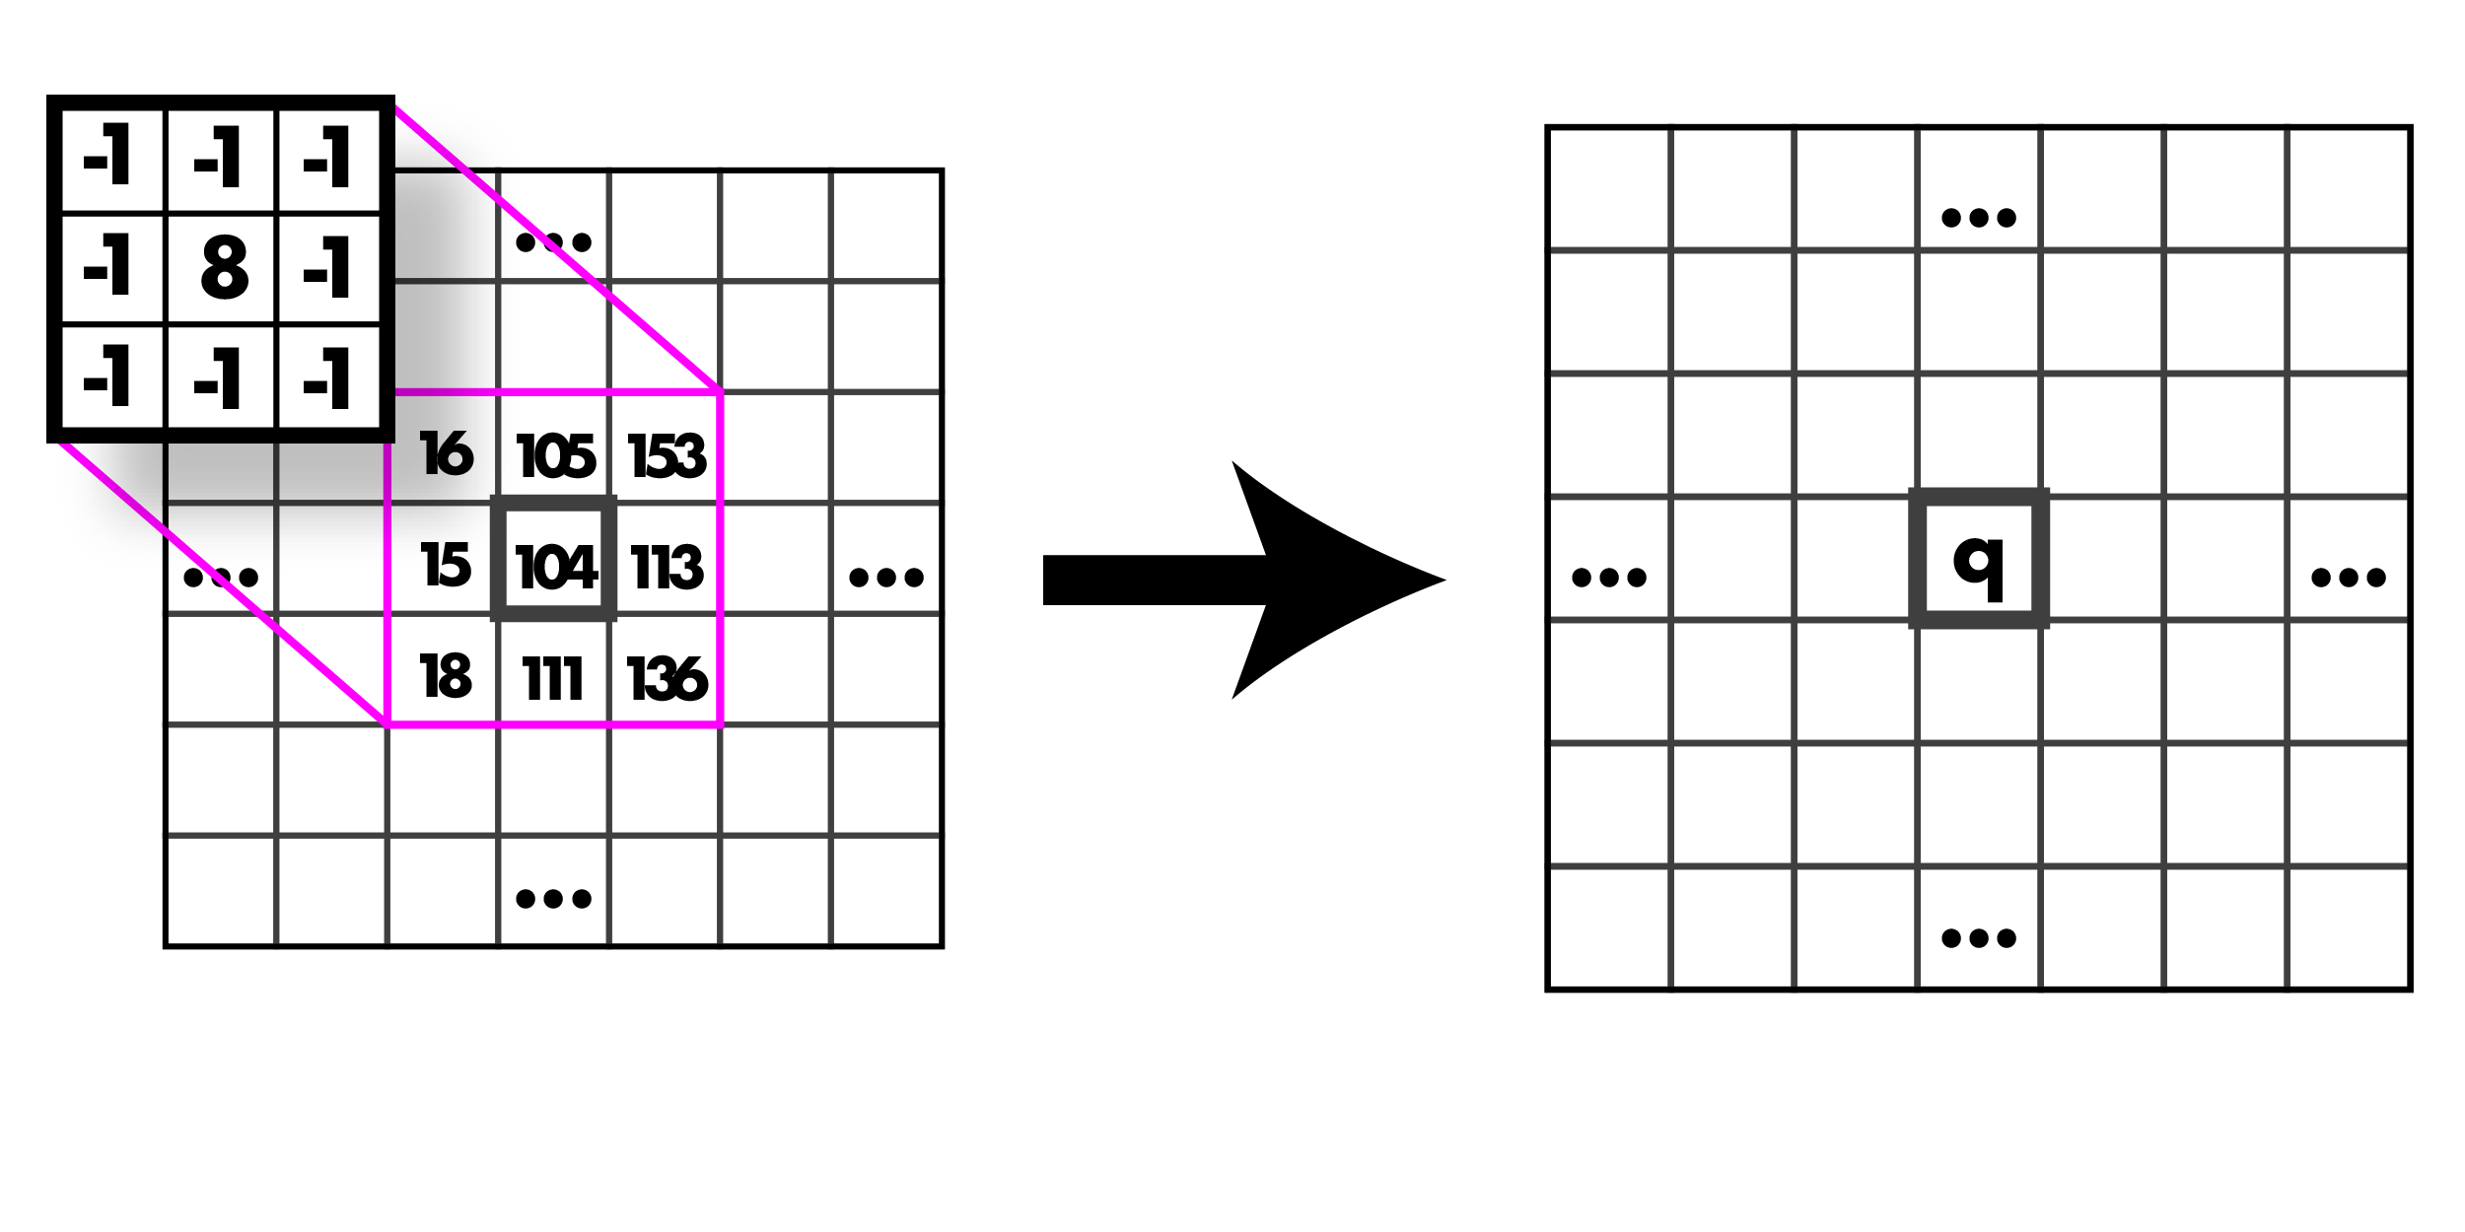
Calculate it, go!

Slide 78
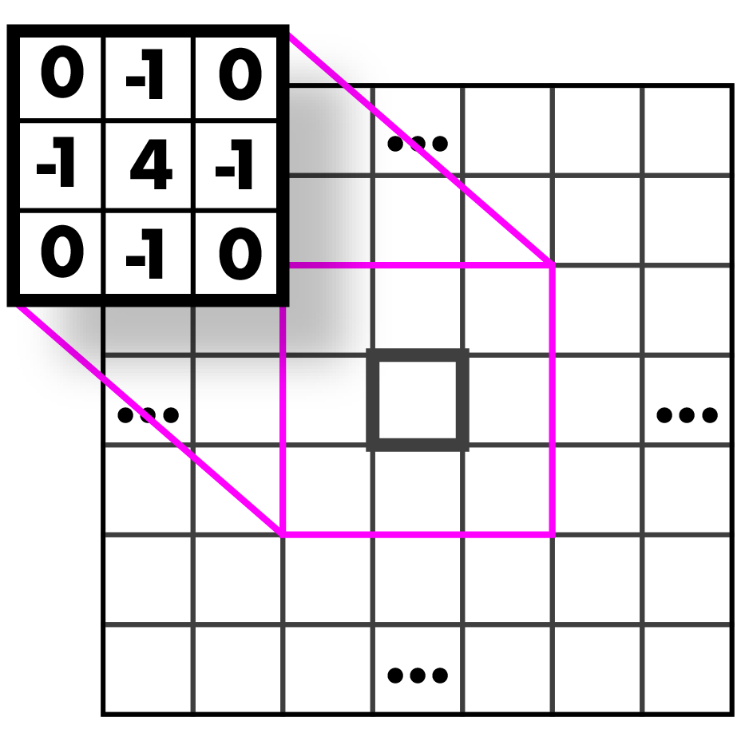
Guess that kernel!

Slide 79
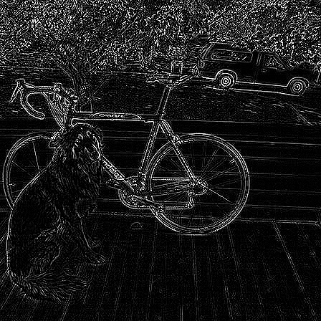
Highpass Kernel: finds edges (applied to the graytone image!)

Slide 80
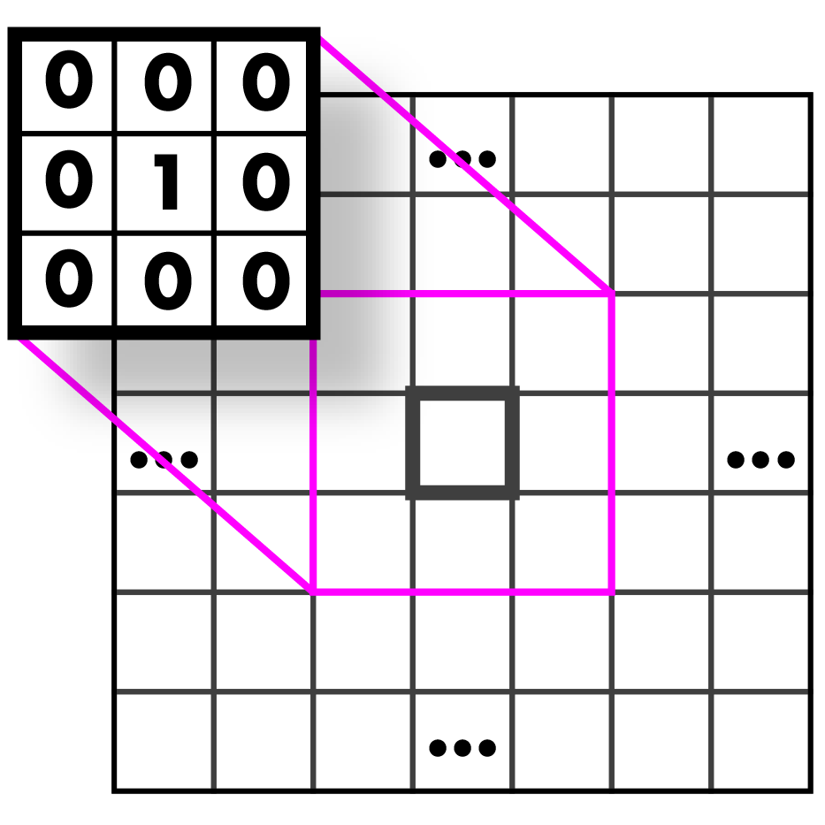
Guess that kernel!

Slide 81
Identity Kernel: Does nothing!

Slide 82
Guess that kernel!

Slide 83
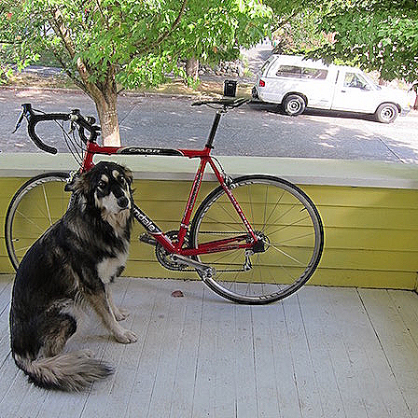
Sharpen Kernel: sharpens! (applied to all three bands)
Note: sharpen = highpass + identity!

Slide 84
Guess that kernel!

Slide 85
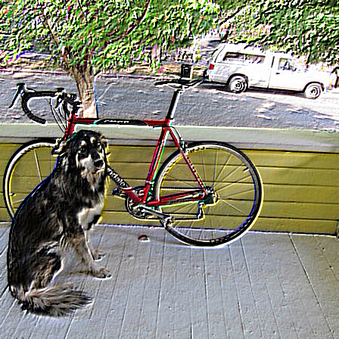
Emboss Kernel: stylin’ (applied to all three bands)

Slide 86
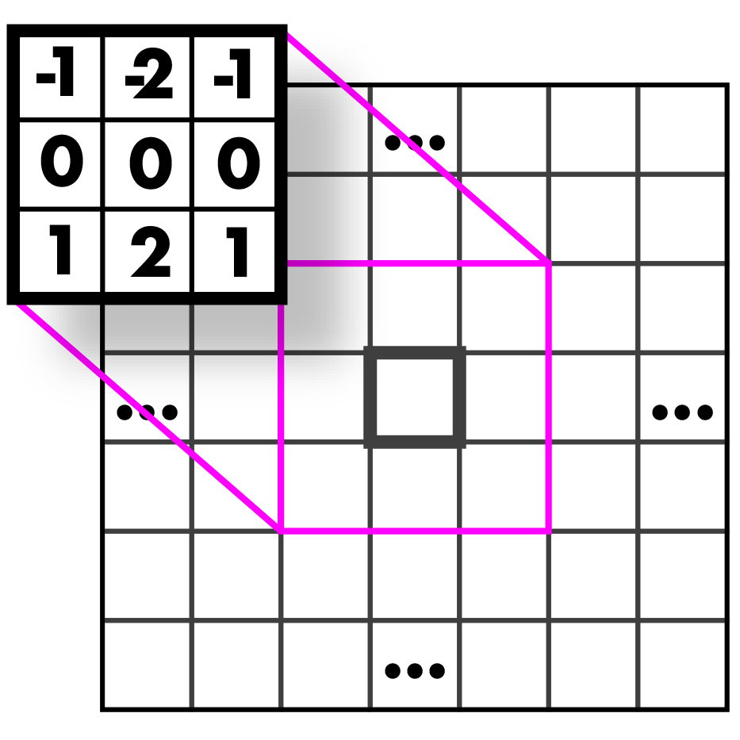
Guess those kernels!

Slide 87
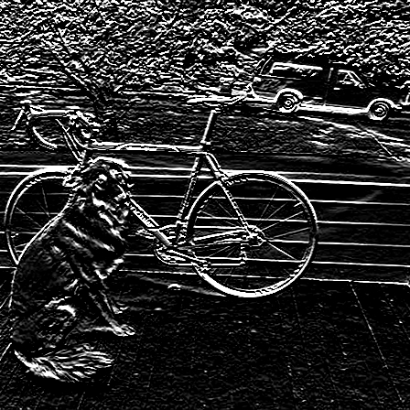
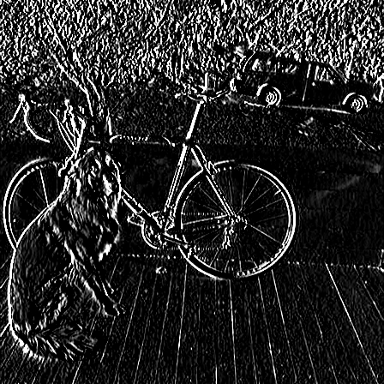
Sobel Kernels: edges (applied to a graytone image and thresholded)

Slide 88
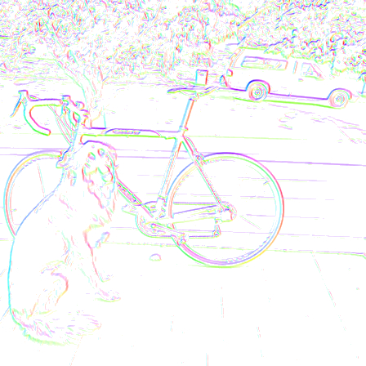
Sobel Kernels: edges and gradient!

Slide 89
Sobel Kernels: edges and gradient!
This visualization is showing the magnitude and direction of the gradient. We will talk further about this when we discuss edges.

Slide 90
And so much more!!

Slide 91
Assignment 1
Image resizing
and a bit of filtering..

Slide 92
First things first!
First, you need to run git pull from inside your homeworks folder to get the latest changes from GitHub.
Remember that you might need some of your code from the previous hw (e.g. set_pixel) for this hw as well. Have your code from hw0 in your src folder.
Then run:
make clean
make

Slide 93
Assignment 1
Image Resizing:
Interpolation
Nearest-Neighbor (NN)
Bilinear
Image Filtering:
Starting out with a box filter. We'll create the box filter in this homework and will use it together with convolution function in the next homework.

Slide 94
To Do #1
1.1 Nearest Neighbor Interpolation
Fill in:
float nn_interpolate(image im, float x, float y, int c)
This function performs nearest-neighbor interpolation on image "im”, given a floating column value "x", row value "y" and integer channel "c". It interpolates and returns the interpolated value.

Slide 95
To Do #2
1.2 Nearest Neighbor Resizing
Fill in:
image nn_resize(image im, int w, int h)
This function uses nearest-neighbor interpolation on image "im" to construct a new image of size "w x h”
Create a new image that is "w x h" and the same number of channels as "im”
Loop over the pixels and map back to the old coordinates.
Use nearest-neighbor interpolate to fill in the image.

Slide 96
To Do #2
1.2 Nearest Neighbor Resizing
Fill in:
image nn_resize(image im, int w, int h)
You can try your function in tryhw1.py:
from uwimg import *
im = load_image("data/dogsmall.jpg")
a = nn_resize(im, im.w*4, im.h*4)
save_image(a, "dog4x-nn")

Slide 97
To Do #3
1.3 Bilinear Interpolation
Fill in:
float bilinear_interpolate(image im, float x, float y, int c)
This function performs bilinear interpolation on image "im”, given a floating column value "x", row value "y" and integer channel "c". It interpolates and returns the interpolated value.

Slide 98
To Do #4
1.4 Bilinear Resizing
Fill in:
image bilinear_resize(image im, int w, int h)
This function uses bilinear interpolation on image "im" to construct a new image of size "w x h”
Create a new image that is "w x h" and the same number of channels as "im”
Loop over the pixels and map back to the old coordinates.
Use bilinear interpolate to fill in the image.

Slide 99
To Do #5
2.1 Create your box filter
Fill in:
void l1_normalize(image im)
This function divides each value in an image “im” by the sum of all the values in the image.

Slide 100
To Do #6
2.1 Create your box filter
Fill in:
image make_box_filter(int w)
We will only use square box filters, so just make your filter w x w.
Change the make_image arguments
image of width = height = w
number of channels = 1
all entries equal to 1.
- Then use l1_normalize to normalize your filter.

Slide 101
Assignment 1
Test your code:
Use command ./main test hw1 to make sure your functions pass the tests.
Use python tryhw1.py to check out output images.
Turn it in:
Turn in your resize_image.c (including l1_normalize and make_box_filter) on canvas under Homework 1.
Save l1_normalize and make_box_filter for your next assignment. You will need them.

