Slide 1
Course Introduction
CSE481M: Home Networking Capstone
March 28th, 2011

Slide 2
Smart homes
Capability to automate and control multiple, disparate systems within the home [ABI Research]
http://www.youtube.com/watch?v=TwcDOVrsCLI
http://www.youtube.com/watch?v=qsDRV1UjySI&feature=related

Slide 3
Why don’t you have it?

Slide 4
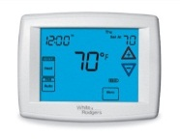
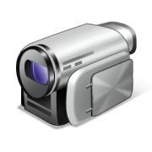
The basic ingredients are easily available

Slide 5
One fundamental problem: Diversity
People differ
Applications desired
Cost sensitivity
Access control preferences
Technical expertise
….
Makes it difficult to (easily) compose devices
Need time and expertise or money

Slide 6
This course
1. Engineering applications and systems for the connected home
Especially those that need multiple devices
Run across a range of homes
2. Reading and discussing papers on the subject

Slide 7
Things we hope to learn
What applications are interesting?
How to best build and deploy them?
What kind of system support can simplify app development?
Acquire a deeper understanding of issues that underlie connected homes

Slide 8
Sample applications
http://www.cs.washington.edu/education/courses/cse481m/11sp/projectIdeas.shtml
(You don’t have to pick from this list.)

Slide 9
Course resources
Hardware
Home automation gear (dimmers, d/w sensors, etc.)
Cameras
Windows Phones
Google TVs
Software:
HomeOS kit
Come talk to us if you need something else

Slide 10
HomeOS kit
An experimental system to build apps for the home
Drivers to control hardware
Applications provide richer functionality using drivers
Project0: a warm-up exercise for everyone
Detailed instructions are online
And the password is ….

Slide 11
Windows Phone programming
Need to sign up as developer
Part of Project Hawaii
Instruction on how to get started are here
Give two-weeks of lead time

Slide 12
Field trip!
What: Microsoft Home
When: Apr 11th, 4-5 PM (tour time)
Where: Location and driving directions are online
Transit options: ST 542, ST 545
Get down at Overlake TC (SR 520 and 40th)
15-min walk from there

