Slide 1
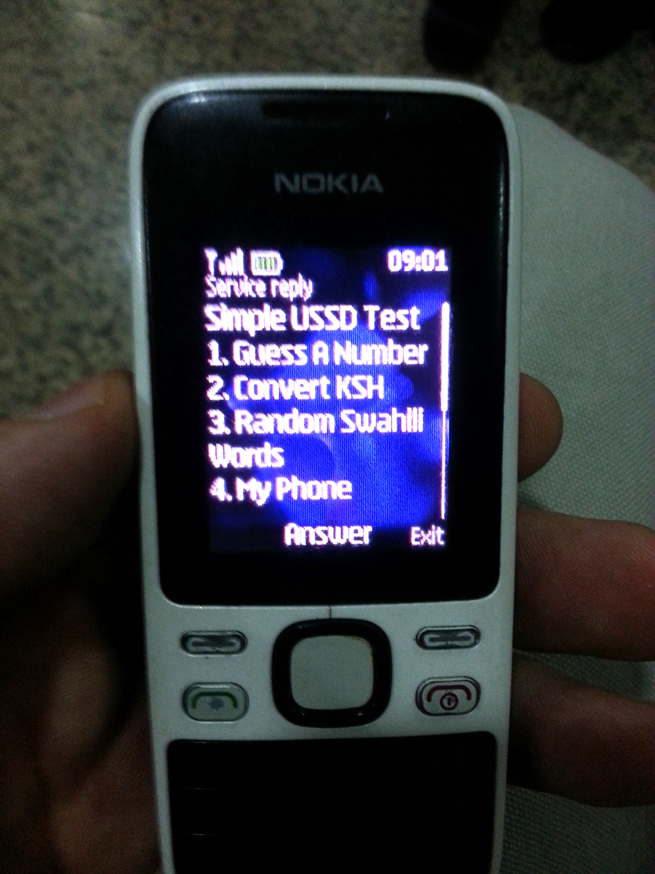
Universal Mobile Apps
IVR, USSD, SMS, and the STK
490d - Digital Financial Services
Feb 3, 2016
Trevor Perrier

Slide 2
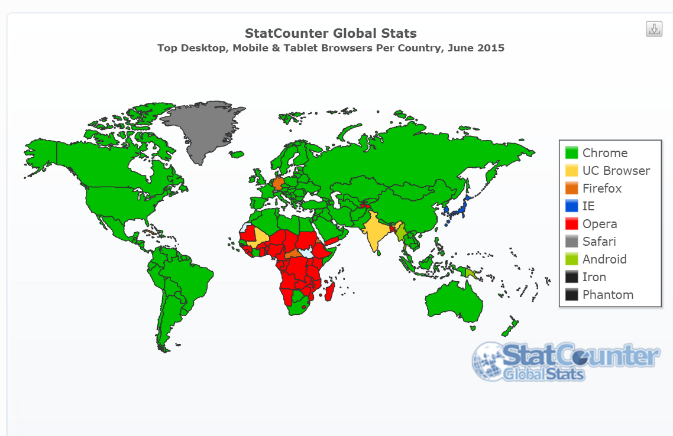

Slide 3
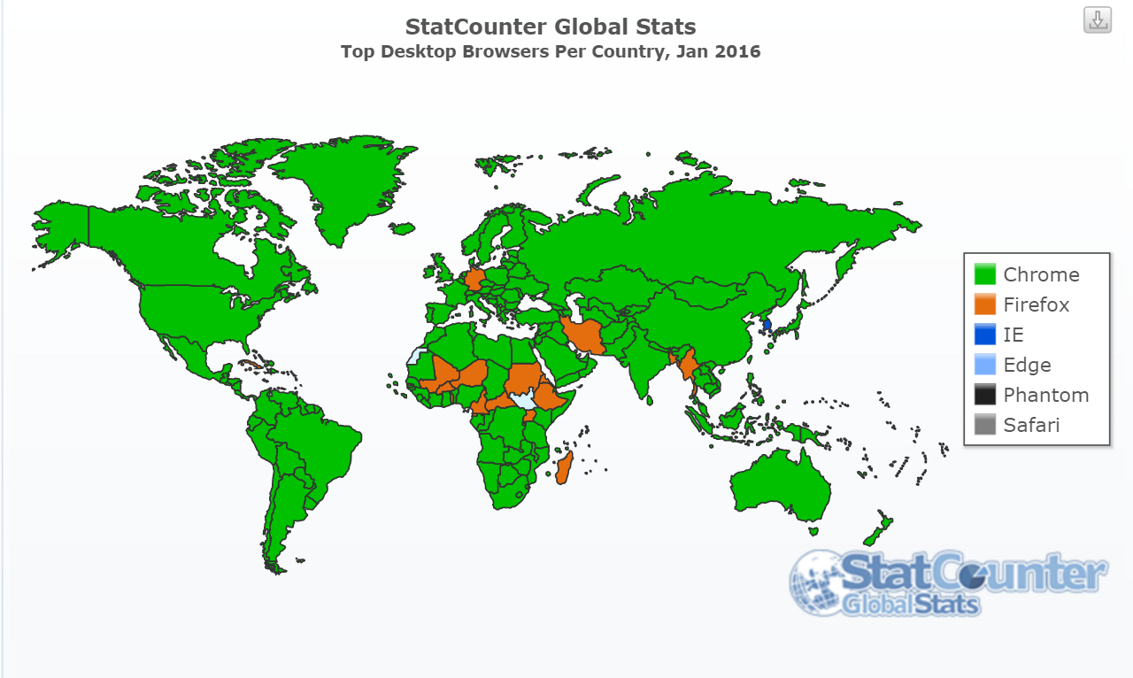

Slide 4
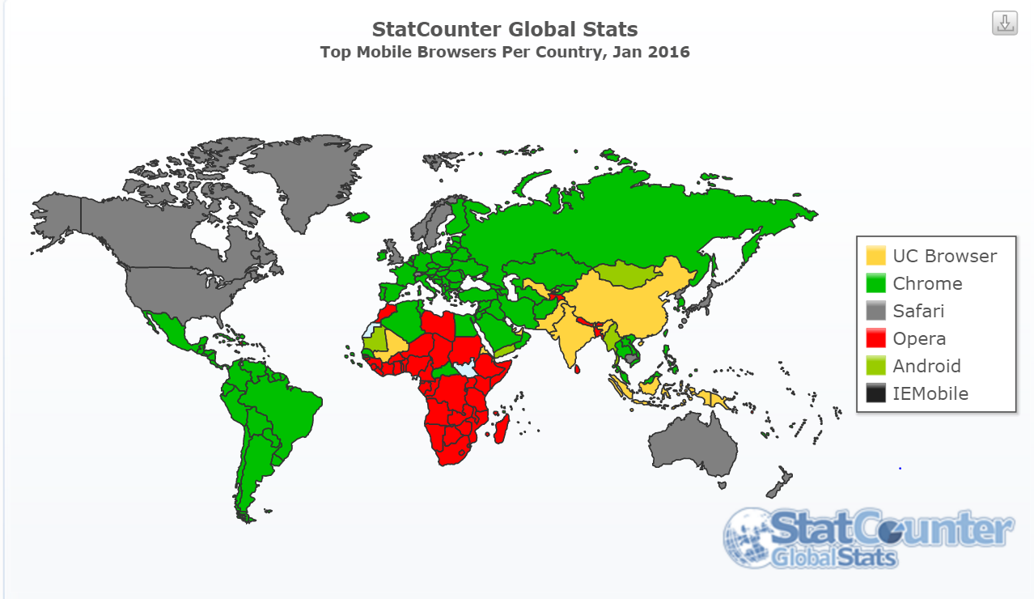

Slide 5
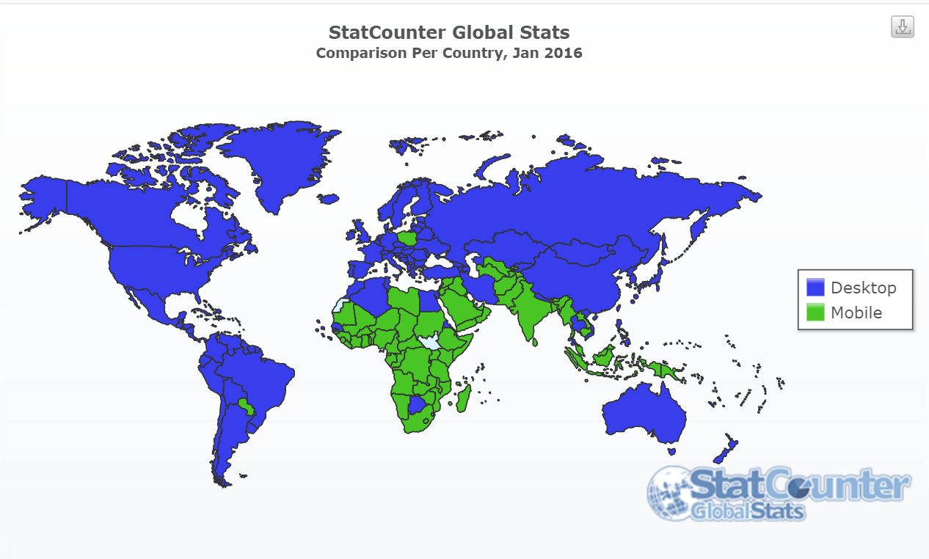

Slide 6
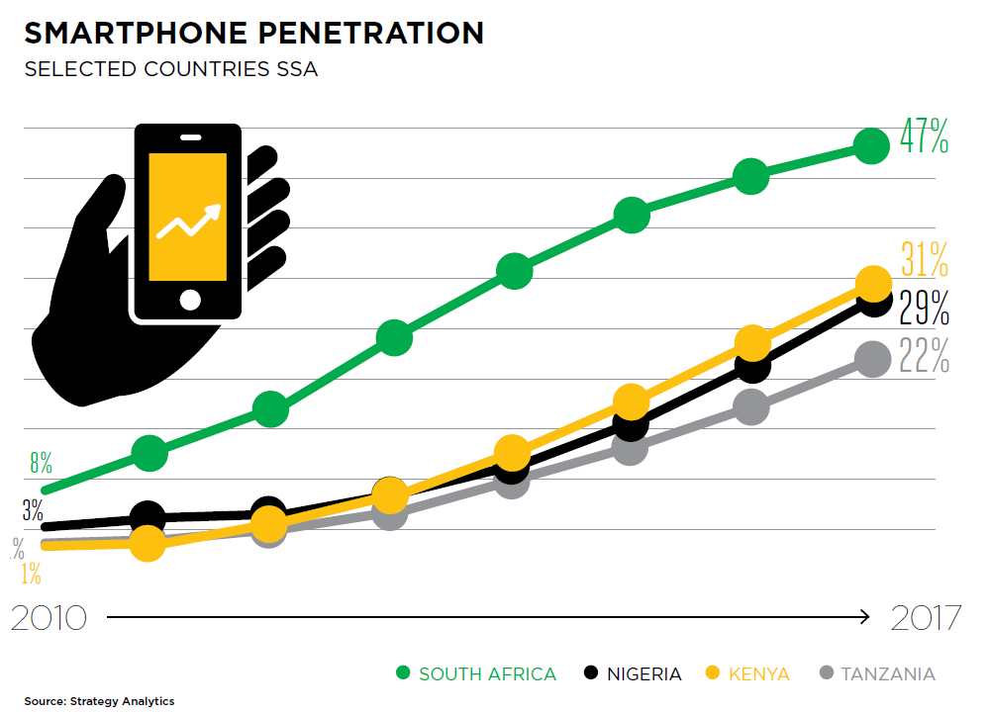
Quick Aside - Smartphone Penetration in Africa

Slide 7
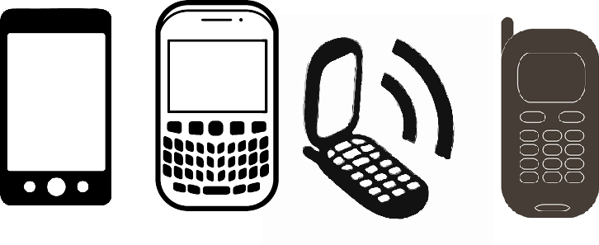
Universal Applications Work on ANY Phone
What does this leave out?

Slide 8
 | Voice | Text

Slide 9
 | Voice | Text
Stateless
Stateful

Slide 10
 | Voice | Text
 | Robo Call | SMS Short Message Service
 | IVR Interactive Voice Response | USSD Unstructured Supplementary Service Data
Stateless
Stateful

Slide 11
 | Voice | Text
 | Robo Call | SMS Short Message Service
 | IVR Interactive Voice Response | USSD Unstructured Supplementary Service Data
Stateless
Stateful

Slide 12
Africa’s Talking USSD gateway

Slide 13
USSD vs STK by Example
USSD example gateway running on Africa’s Talking
mPesa on a Windows phone

Slide 14
USSD vs STK by Example

Slide 15
Signaling System 7

Slide 16
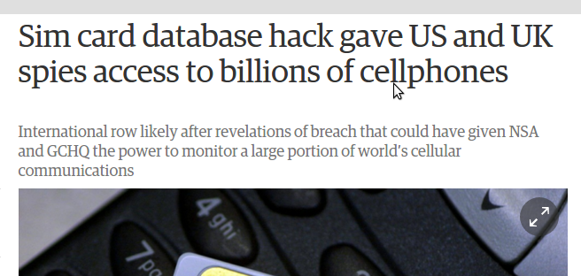
How safe is GSM - USSD/SMS

Slide 17
STK - SIM Application Toolkit
Basic UI - display text, menus, play tones, read input.
Launch URLs
Send SMSes, initiate calls, use data
Interact with the rest of the SIM card
Run arbitrary AT commands on the phone

Slide 18
Discussion
Regulatory issues around USSD and STK
Usability issues between SMS, USSD, STK
Is Facebook Money or SquareCash mobile money?

