Slide 1
CSE503: Software Engineering Software architecture
David Notkin
Spring 2011

Slide 2
Software architecture
Software architecture: design-based
Formal reasoning about properties
Static vs. dynamic architectures
Software architecture: property-based
Autonomic systems
Relationship to model-based design

Slide 3
Two categories: very soft distinction
Software architecture: design-oriented
Based in software design, in defining taxonomies based on experience, etc.
Software architecture: property-oriented
Based on a desire to design software systems with a particular property – such as autonomic systems, fault-tolerance, privacy, etc.

Slide 4
Design-based software architecture
Two primary goals
Capturing, cataloguing and exploiting experience in software designs
Allowing reasoning about classes of designs
Composition of components and connectors
Components are the core computational entities
Connectors are the core ways in which components communicate and interact
Under constraints – only some combinations are permitted, which is intended to allow demonstration of the presence or absence of key properties

Slide 5
Describing architectures
There are, roughly, two approaches to describing software architectures
The first – and the most heavily explored – is to define an ADL – architecture description language
The second is to extend a programming language with architectural constructs

Slide 6
Partial Comparison
ADL
Extend PL
Can focus on architectural issues
Can allow architecture-related analysis
Separates architectural activities from lower-level activities
Separates architecture from software, allowing drift
Requires additional learning and experience by developers, testers, etc.
Provides transition to adopt architecture for existing systems
Connects architecture with program, reducing drift
Incremental cost to train developers, testers, etc.
Fuzzier distinction between architecture and program
May constrain possible analyses

Slide 7
First generation ADLs
ACME (CMU/USC)
Rapide (Stanford)
Wright (CMU)
Unicon (CMU)
Aesop (CMU)
MetaH (Honeywell)
C2 SADL (UCI)
SADL (SRI)
Lileanna
UML
Modechart
From 1999 MCC report
Much of the following material is adapted from that report

Slide 8
Second generation ADLs
Changes from MCC list with respect to Wikipedia’s list (1/9/2010)
Added
LePUS3 and Class-Z (University of Essex)
ABACUS (UTS)
AADL (SAE) - Architecture Analysis & Design Language
Removed:
UML
Modechart

Slide 9
ADL +/-’s
Positives
Negatives
Formal representation of architecture
Higher level system description than previously possible
Permit analysis of architectures – completeness, consistency, ambiguity, and performance
Can support automatic generation of software systems
No universal agreement on what ADLs should represent, particularly as regards the behavior of the architecture
Tend to be very vertically optimized toward a particular kind of analysis

Slide 10
Architecture definition
Components
Connectors
Configurations (topologies)
Constraints (restrictions)

Slide 11
MCC 1999 Report: ACME
Developed jointly by Monroe, Garlan (CMU), Wile (ISI/USC)
A general purpose ADL originally designed to be a lowest common denominator interchange language
Simple, consistent with interchange objective, allowing only syntactic linguistic analysis

Slide 12
MCC report 1999 simple ACME example (client-server)
System simple_cs = { Component client = {Port send-req} Component server = {Port receive-req} Connector rpc = {Roles {caller, callee}} Attachments : {client.send-req to rpc.caller; server.receive-req to rpc.callee} }
client
server
send-req
caller
callee
receive-req
Very much in the flavor of module interconnection languages

Slide 13
1999 MCC: Rapide
By Luckham at Stanford
A general purpose ADL designed with an emphasis on simulation yielding partially ordered sets of events
Fairly sophisticated, including data types and operations
Analysis tools focus on posets
matching simulation results against patterns of allowed/prohibited behaviors
some support for timing analysis
focus on causality

Slide 14
Rapide
Components
Interface objects
Architecture that implements an interface
Module that implements an interface
Connections
Connects “sending interfaces” to “receiving interfaces”
Components communicate through connections by calling actions or functions in its own interface
Events generated by components trigger event pattern connections between their interfaces – basic, pipe, agent

Slide 15
Rapide constraints
Pattern
Bound execution in terms of event patterns
Appear in an interface and/or architecture definition
[label] filter_part constraint_body
Filter creates context
Constraint body constrains computation in context
Sequential
Bound execution in terms of boolean expressions
Normally appear in module level behavior
Applied to parameters, types, objects and statements

Slide 16
Rapide example
type Producer (Max : Positive) is interface
action out Send (N: Integer);
action in Reply(N : Integer);
behavior
Start => send(0);
(?X in Integer) Reply(?X) where ?X<Max => Send(?X+1);
end Producer;
type Consumer is interface
action in Receive(N: Integer);
action out Ack(N : Integer);
behavior
(?X in Integer) Receive(?X) => Ack(?X);
end Consumer
architecture ProdCon() return SomeType is
Prod : Producer(100); Cons : Consumer;
connect
(?n in Integer) Prod.Send(?n) => Cons.Receive(?n);
Cons.Ack(?n) => Prod.Reply(?n);
end architecture ProdCon;

Slide 17
Wright: Garlan and Allen (CMU)
ADL designed with an emphasis on analysis of communication protocols
Wright uses a variation of CSP to specify the behaviors of components, connectors, and systems
CSP: Hoare’s Communicating Sequential Processes
Syntactically similar to ACME
Wright analysis focuses on analyzing the CSP behavior specifications

Slide 18
Wright Example
System simple_cs
Component client =
port send-request = [behavioral spec]
spec = [behavioral spec]
Component server =
port receive-request= [behavioral spec]
spec = [behavioral spec]
Connector rpc =
role caller = (request!x -> result?x ->caller) ^ STOP
role callee = (invoke?x -> return!x -> callee) [] STOP
glue = (caller.request?x -> callee.invoke!x
-> callee.return?x -> callee.result!x -> glue) [] STOP
Instances
s : server; c : client; r : rpc
Attachments :
client.send-request as rpc.caller
server.receive-request as rpc.callee
end simple_cs.

Slide 19
MCC “other” ADLs
Unicon (Shaw et al. @ CMU)
An emphasis on generation of connectors
Treatment of connectors as first class objects, which also supports generation n Unicon as a language focuses primarily on the basic
MetaH (Honeywell)
Domain specific ADL aimed at guidance, navigation, and control applications with ControlH
Sophisticated tool support available
C2 SADL (Taylor/Medvidovic @ UCI)
Emphasis on dynamism
SADL (Moriconi/Riemenschneider @ SRI)
Emphasis on refinement mappings

Slide 20
MCC: UML as an ADL
Major positives: lowers entry barrier, enables use of mainstream modeling approaches and tools
Major negatives
Encourages an object connection architecture rather than interface connection architecture
Weakly integrated models with inadequate semantics for automated analysis
Connectors are not first class objects
Visual notation with ambiguity

Slide 21
CSP (Wikipedia 1/11/10) [for Wright]
Communicating Sequential Processes (CSP) is a formal language for describing patterns of interaction in concurrent systems. It is a member of the family of mathematical theories of concurrency known as process algebras, or process calculi. …
CSP was first described in a 1978 paper by C. A. R. Hoare… CSP has been practically applied in industry as a tool for specifying and verifying the concurrent aspects of a variety of different systems, such as the T9000 Transputer, as well as a secure ecommerce system. …

Slide 22
CSP vending machine example
Three event types
Inserting a coin into the machine
Inserting a pre-paid card into the machine
Extracting a chocolate from the machine
Examples
(coin→STOP)
Person = (coin→STOP)  (card→STOP)
SVM = (coin→(choc→SVM))
…

Slide 23
Wright: CSP-based
A process is an entity that engages in communication events
Events may be primitive or they can have associated data: e?x and e!x represent input and output of data, respectively
The simplest process STOP engages in no events
The “success” event is √
A process that engages in event e and then becomes P is denoted e → P

Slide 24
Wright: CSP-based
A process that can behave like P or Q, where the choice is made by the environment, is P  Q
A process that can behave like P or Q, where the choice is made non-deterministically by the process itself, is P ∏ Q
P1 ║ P2 is a process whose behavior is permitted by both P1 and P2 and for events that both processes accept
A successfully terminating process is §, which is the same as √ → STOP

Slide 25
Wright example
A shared memory connector, with different forms of initialization
Any of the roles can either get or set the value repeatedly, terminating at any time. The overall communication is complete only when all participants are done with the data
This version includes no initialization
Style SharedData Connector SharedData1 Role User1 = set → User1 ∏ get → User1 ∏ § Role User2 = set → User2 ∏ get → User2 ∏ § Glue = User1.set → Glue  User2.set → Glue  User1.get → Glue  User2.get → Glue  §
End Style

Slide 26
With initialization
This definition indicates that there is a distinguished role, Initializer, that must supply the initial value.
The Initializer agrees to set the value before getting it
The glue ensures that this will occur before the other participant (User) gets or a sets a variable
connector Shared Data2 =
role Initializer =
let A = set→ A ∏ get → A ∏ § in set → A
role User = set → User ∏ get → User ∏ §
glue = let Continue = Initializer.set → Continue  User.set → Continue  Initializer.get → Continue  User.get → Continue  § in Initializer.set → Continue  §

Slide 27
With lazy initialization
Does not require that the other participant wait for initialization to proceed
connector Shared Data3 =
role Initializer =
let A = set → A ∏ get → A ∏ § in set → A
role User = set → User ∏ get → User ∏ §
glue = let Continue = Initializer.set → Continue  User.set → Continue  Initializer.get → Continue  User.get → Continue  § in Initializer.set → Continue  User.set → Continue  §

Slide 28
Looks good but…
connector Bogus =
role User1 = set → User1 ∏ get → User1 ∏ §
role User2 = set → User2 ∏ get → User2 ∏ §
glue = let Continue = User1.set → Continue
 User2.set → Continue
 User1.get → Continue
 User2.get → Continue  § in User1.set → Continue  User2.set → Continue  §

Slide 29
Analysis
An analysis of a well-formed system should be able to show that it is deadlock-free
For architectural connectors, the means avoiding the situation in which two components can wait in the middle of an interaction, each port expecting the other to take some action that will never happen
A connector process is free from deadlock if whenever it cannot make progress, then the last event to have taken place must have been √
In other words, the roles and glue work in such a way that if the overall connector process stops, it will be in a situation that is a success state for all the parties

Slide 30
Wright tools
Allow you to assert deadlock-freedom and to have it automatically checked
It converts Wright descriptions into FDR, a commercial model-checker that offers the choice of verification using CSP Traces Refinement, Failures Refinement, and Failures-Divergences Refinement models
Asserts might be, for the shared data example:
? DFA [FD=User1
? DFA [FD=User2
? DFA [FD=SharedData1
DFA means DeadlockFree Process
FD means Failures-Divergences Refinement model
Returns true if proven, false with counterexample otherwise

Slide 31
Counterexample example
√ DFA [FD=User1
√ DFA [FD=User2
X DFA [FD=Bogus
The connector glue requires that User1 or User2 initialize the variable, but does not specify which one
If either begins with a set, then that event will occur first and all is OK
But if User1 and User2 both attempt to perform an initial get – which is entirely legal – then the connector will deadlock
The tool identifies a counterexample
The Glue process is ready to accept – √,User1.set,User2.set while both the User1 and User2 processes will only accept get

Slide 32
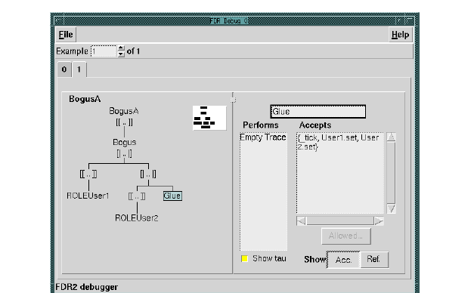

Slide 33
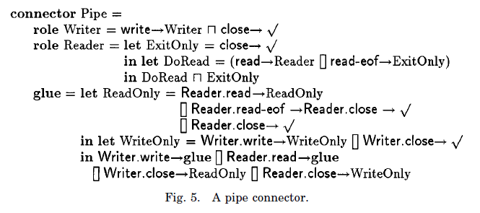
Wright: pipe connector

Slide 34
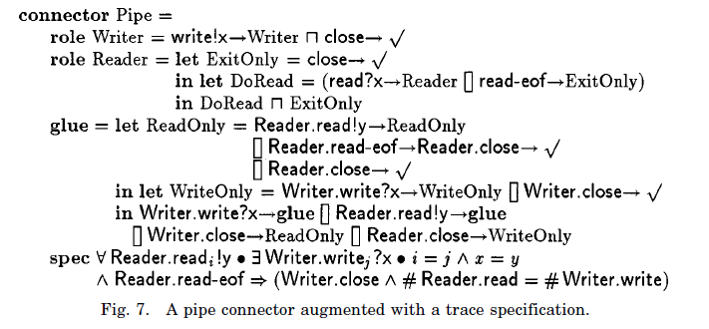
With trace specification
For every trace in which Reader.read-eof occurs, there must also be an occurrence of the event Writer.close, and the number of times that Reader.read has occurred equals the number of occurrences of Writer.write. That is, before eof is signaled, all data have been read, and the pipe is closed.

Slide 35
ArchJava: PL++ rather than ADL
ArchJava: Jonathan Aldrich, UW⇒CMU (much more since the material here)
Combine architectural description with programming language
Ensure implementation code obeys architectural constraints.
Doesn’t preclude common programming idioms
Allow easier traceability between architecture and implementation
ArchJava uses a type system to guarantee communication integrity between an architecture and its implementation

Slide 36
Communication integrity
Each component in the implementation may only communicate directly with the components to which it is connected in the architecture [Luckham & Vera]
If “out of band” communication can take place, most properties are hard to guarantee
Related to some degree to The Law of Demeter [Lieberherr et al.]
A can call B, but A cannot use B to allow A to call C – this would allow A to have knowledge of B’s internal structure – a form of representation exposure
B can be modified (if needed) to handle this for A, or A can obtain a direct reference to C
Wikipedia [1/10/2010]: “In particular, an object should avoid invoking methods of a member object returned by another method. For many modern object oriented languages that use a dot as field identifier, the law can be stated simply as ‘use only one dot’. That is, the code ‘a.b.Method()’ breaks the law where ‘a.Method()’ does not.”

Slide 37
Component example
public component class Parser {
public port in {
provides void setInfo(Token symbol, SymTabEntry e);
requires Token nextToken() throws ScanException;
}
public port out {
provides SymTabEntry getInfo(Token t);
requires void compile(AST ast);
}
public void parse() {
Token tok = in.nextToken();
AST ast = parseFile(tok);
out.compile(ast);
}
AST parseFile(Token lookahead) { ... }
void setInfo(Token t, SymTabEntry e) {...}
SymTabEntry getInfo(Token t) { ... }
...
}
A component can only communicate with other components at its level in the architecture through explicitly declared ports—regular method calls between components are not allowed
A port represents a logical communication channel between a component and one or more components that it is connected to

Slide 38
Component example
public component class Compiler {
private final Scanner scanner = ...;
private final Parser parser = ...;
private final CodeGen codegen = ...;
connect scanner.out, parser.in;
connect parser.out, codegen.in;
public static void main(String args[]) {
new Compiler().compile(args);
}
public void compile(String args[]) {
// for each file in args do:
...parser.parse();...
}
}
compiler
scanner
parser
codegen

Slide 39
Communication integrity
Ensures that the implementation does not communicate in ways that could violate reasoning about control flow in the architecture
A component instance A may not call the methods of another component instance B unless
B is A’s subcomponent, or
A and B are sibling subcomponents of a common component instance that declares a connection or connection pattern between them

Slide 40
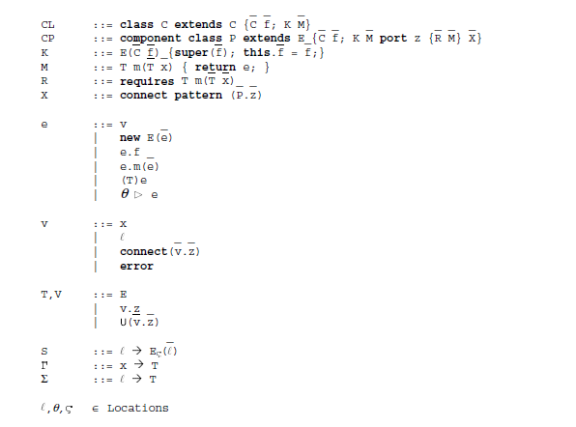
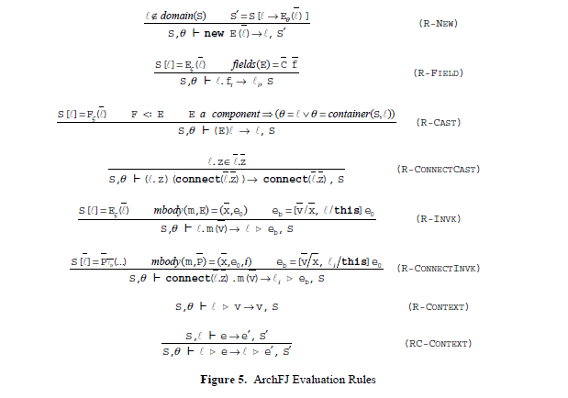
How does ArchJava work?

Slide 41
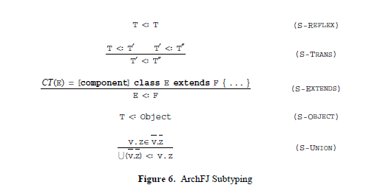
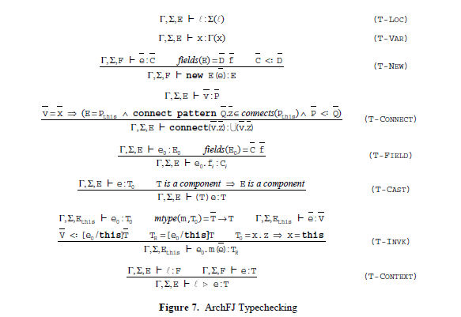
More…

Slide 42
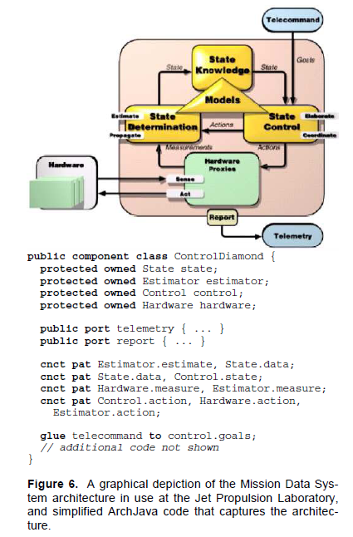
Data sharing
ArchJava extensions to describe architectural constraints on data sharing (using alias control analysis)
Can describe data that is confined within a component, passed linearly from one component to another, or shared temporarily or persistently between components.
Careful use of sophisticated language/type constructs like uniqueness, lending, mutability, etc.

Slide 43
Quick recap
Architectural description via specially designed languages (ADLs) and via programming language extensions
Reasoning about architectural properties
ADLs (like Wright) allow the definition of properties to check within the scope of the language and analysis tools
PL++ (like ArchJava) define the properties to always be checked
Other tradeoffs with respect to adoption, to implementation issues, etc.

Slide 44
Static vs. dynamic architectures
ACME, WRIGHT, etc. define static architectures – essentially, all processes need to be known statically (and thus not created during execution of the implementation)
The need for dynamic architectures – creation and management of processes at run-time – has been a hot topic for at least a decade (in the software architecture research area, that is)
Lots of work on this, but I’ll focus on
Peyman Oreizy, Nenad Medvidovic, Richard N. Taylor. "Architecture-Based Runtime Software Evolution". International Conference on Software Engineering (April 1998)

Slide 45
ICSE N-10 award paper
This paper received the ICSE 2008 Most Influential Paper Award, which recognizes the paper with the most influence on theory or practice during the 10 years since its publication
The following (partial set of) slides are stolen from the retrospective talk at ICSE 2008 by Peyman, Neno and Dick (http://www.ics.uci.edu/~peymano/dynamic-arch/)

Slide 47
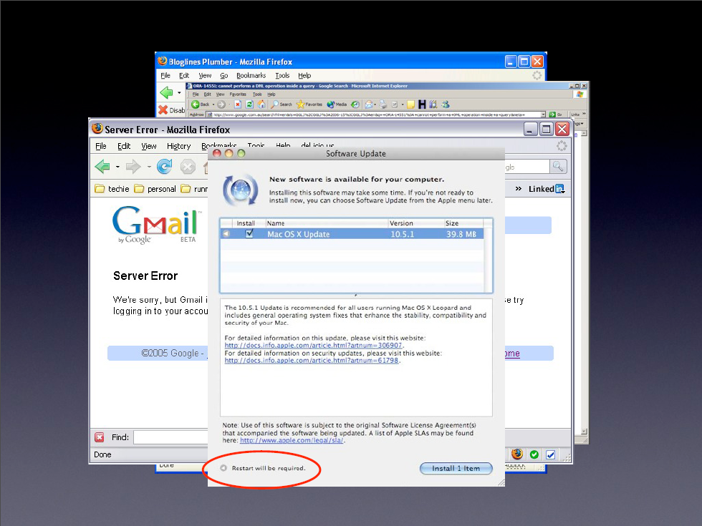

Slide 56
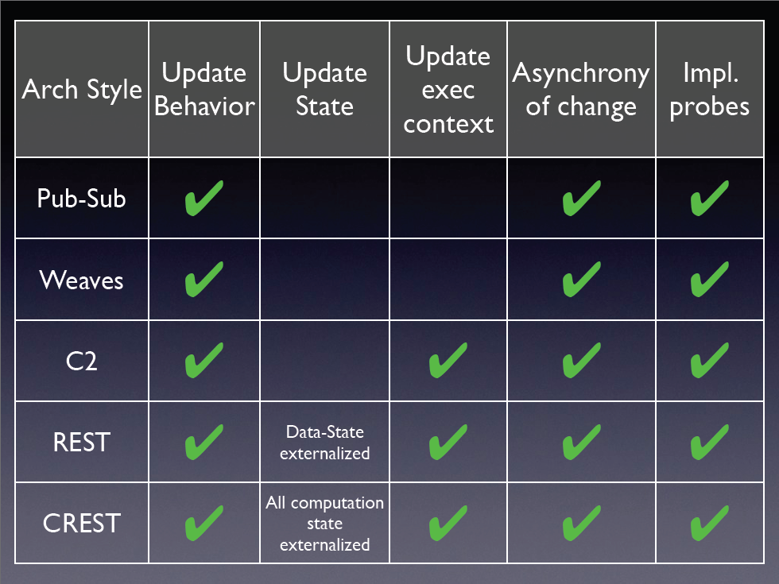

Slide 57
Checklists: an aside
Last night my wife and I attended the Town Hall talk by Dr. Atul Gawande on his new book, The Checklist Manifesto
Excerpts from Malcolm Gladwell’s review [amazon.com]
“[H]e is really interested in a problem that afflicts virtually every aspect of the modern world–and that is how professionals deal with the increasing complexity of their responsibilities.
“… a distinction between errors of ignorance (mistakes we make because we don’t know enough), and errors of ineptitude (mistakes we made because we don’t make proper use of what we know). Failure in the modern world…is really about the second of these errors …”

Slide 58
More from Gladwell
“[H]e walks us through a series of examples from medicine showing how the routine tasks of surgeons have now become so incredibly complicated that mistakes of one kind or another are virtually inevitable: it’s just too easy for an otherwise competent doctor to miss a step, or forget to ask a key question or, in the stress and pressure of the moment, to fail to plan properly for every eventuality.
“Gawande then visits with pilots and the people who build skyscrapers and comes back with a solution. Experts need checklists–literally–written guides that walk them through the key steps in any complex procedure. [H]e shows how his research team has taken this idea, developed a safe surgery checklist, and applied it around the world, with staggering success.”

Slide 59
So, role of checklists in software engineering?

Slide 60
Software architecture: property-oriented
Based on a desire to design software systems with a particular property – such as autonomic systems, fault-tolerance, privacy, etc.
But weren’t properties checked by ADLs, etc.?
Absolutely.
The difference in property-oriented (remember, I made that term up) is that the properties are described and the systems are produced – at least to the first order
In contrast to producing an architecture and ensuring it has properties
Perhaps this is at least as much an issue of generation as property-orientation

Slide 61
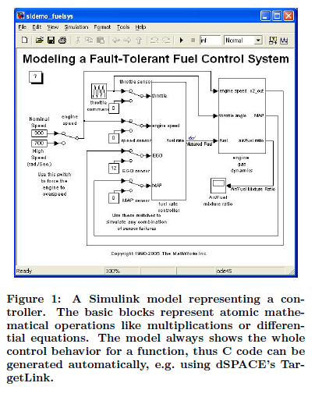
Model-based design
[Wikipedia 1/11/10]: “… is a mathematical and visual method of addressing problems associated with designing complex control systems. … Model-based design is a methodology applied in designing embedded software.”
“The automotive industry has embraced model-based approaches mainly for the following reasons: (i) These graphical functional models visualize both the underlying mathematics (i.e. the differential equations) and the software that later on implements the functions on a specific processor. … (ii) The models can be simulated … very early in the development process. … (iii) The models can be used as a basis for automatic code generation. This not only saves the efforts for the manual coding of the algorithms but also prevents transcription errors from the models to the code.”
Also related to domain specific modeling
Niggemann, O. and Stroop, J. Models for model's sake: why explicit system models are also an end to themselves. 30th international Conference on Software Engineering (May 2008).

Slide 62
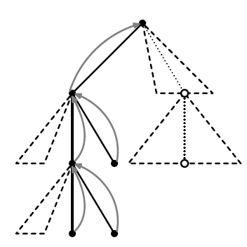
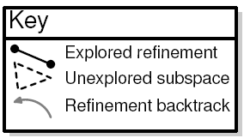
Principle of Alternatives [via E. Jackson]
A high-level specification defines a design space
The design space is complex, so some refinements are dead-ends and require backtracking through the design space
Model-based design (or model integrated computing), provides tool support to simultaneously explore multiple alternatives
http://research.microsoft.com/en-us/um/people/ejackson/publications/asm07_pres.pptx

Slide 63
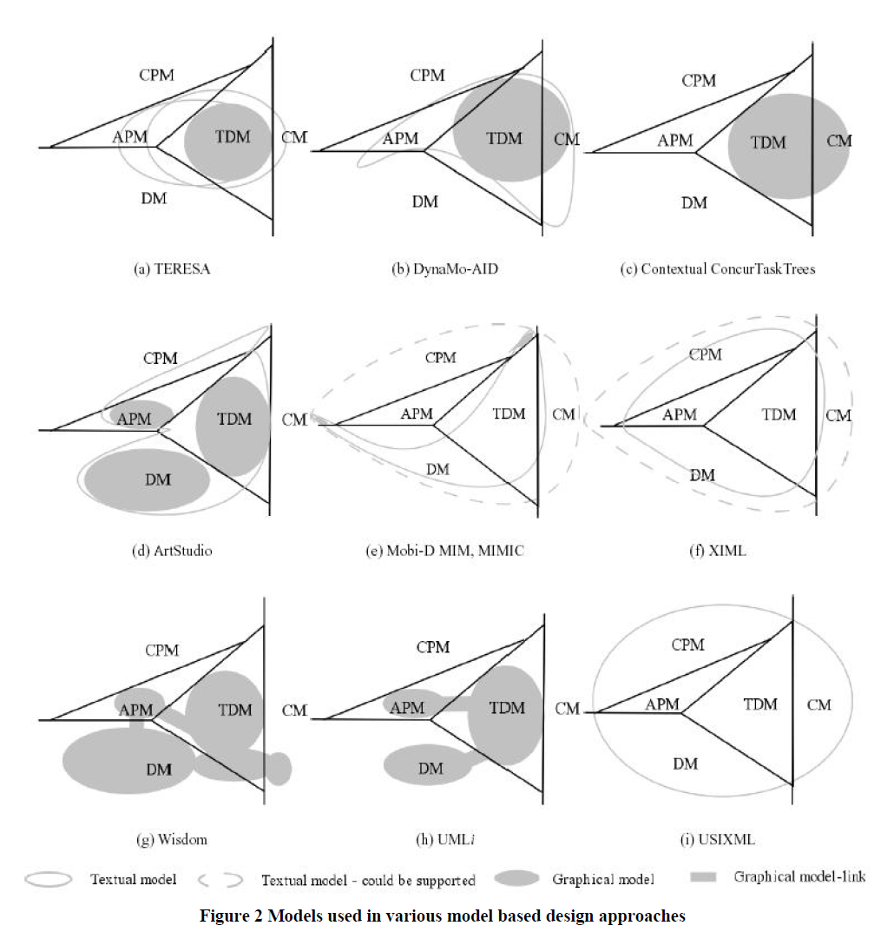
How to describe the design space?
UML, UML variants (e.g., Executable UML), etc.
MatLab/Simulink
Design-time approximations of embedded system models
Abstract state machines (E. Jackson et al.)
Security policies as complex data + invariants
Model transformations for semantic anchoring and code generation.
Many more!
Van den Bergh, J. and Coninx, K. 2004. Model-based design of context-sensitive interactive applications: a discussion of notations. In Proc.3rd Annual Conference on Task Models and Diagrams (2004).

Slide 64
E. Jackson: FORMULA (sketch!)

Slide 65
E. Jackson con’t

Slide 66
E. Jackson con’t

Slide 67
E. Jackson con’t

Slide 68
Autonomic computing
IBM’s term for self-managing and self-adaptive software systems
Systems get more complex, increasing the difficulty and cost of building larger systems in new domains, etc.
Autonomic computing systems are intended to adapt to unpredictable changes in the environment to remove the need for explicit adaption from the users and developers

Slide 69
Related to architecture how?
Dependent on some of the kinds of mechanisms used in model based design
Dependent on dynamic architectures
Disciplined creation and adaptation of architectures that exhibit the self-manageability characteristic

Slide 70
IBM’s vision
Kephart and Chess focused on the increasing “nightmare of pervasive computing” in which the complexity of the interactions leads us to a situation where the designers are deeply hampered
The essence of autonomic computing is to have the systems manage themselves, to deliver better system behavior while offloading tedious and error-prone system administrative activities from people
The autonomic nervous system is a regulatory branch of the central nervous system that helps people adapt to changes in their environment. It adjusts or modifies some functions in response to stress. American Heart Association

Slide 71
IBM: four dimensions
Self-Configuration: Automatic configuration of components
Self-Healing: Automatic discovery and correction of faults
Self-Optimization: Automatic monitoring and control of resources to ensure the optimal functioning with respect to the defined requirements
Self-Protection: Proactive identification and protection from arbitrary attacks

Slide 72
IBM Autonomic Systems: 8 defining characteristics
An autonomic computing system needs to "know itself" - its components must also possess a system identity. Since a "system" can exist at many levels, an autonomic system will need detailed knowledge of its components, current status, ultimate capacity, and all connections to other systems to govern itself. …
An autonomic computing system must configure and reconfigure itself under varying (and in the future, even unpredictable) conditions. System configuration or "setup" must occur automatically, as well as dynamic adjustments to that configuration to best handle changing environments.
An autonomic computing system never settles for the status quo - it always looks for ways to optimize its workings. It will monitor its constituent parts and fine-tune workflow to achieve predetermined system goals.

Slide 73
An autonomic computing system must perform something akin to healing - it must be able to recover from routine and extraordinary events that might cause some of its parts to malfunction. It must be able to discover problems or potential problems, then find an alternate way of using resources or reconfiguring the system to keep functioning smoothly.
A virtual world is no less dangerous than the physical one, so an autonomic computing system must be an expert in self-protection. It must detect, identify and protect itself against various types of attacks to maintain overall system security and integrity.
An autonomic computing system must know its environment and the context surrounding its activity, and act accordingly. It will find and generate rules for how best to interact with neighboring systems. It will tap available resources, even negotiate the use by other systems of its underutilized elements, changing both itself and its environment in the process -- in a word, adapting.

Slide 74
An autonomic computing system cannot exist in a hermetic environment. While independent in its ability to manage itself, it must function in a heterogeneous world and implement open standards -- in other words, an autonomic computing system cannot, by definition, be a proprietary solution.
An autonomic computing system will anticipate the optimized resources needed while keeping its complexity hidden. It must marshal I/T resources to shrink the gap between the business or personal goals of the user, and the I/T implementation necessary to achieve those goals -- without involving the user in that implementation.

Slide 75
Great thoughts, but…
How to achieve these characteristics?
One key mechanism is closed control loops – from control theory
That is, the system needs to be able to monitor itself and to adapt itself – without diverging into unexpected and unacceptable behaviors
This requires explicit representations of many aspects of the system, so they can be accessed and modified at run-time
At some level connected to mechanisms such as run-time code-generation, reflection, the meta-object protocol, open implementations, etc.

Slide 76
Key mechanism
Closed control loops – control theory
That is, the system needs to be able to monitor itself and to adapt itself – without diverging into unexpected and unacceptable behaviors
This requires explicit representations of many aspects of the system, so they can be accessed and modified at run-time
At some level connected to mechanisms such as run-time code-generation, reflection, the meta-object protocol, open implementations, etc.

Slide 77
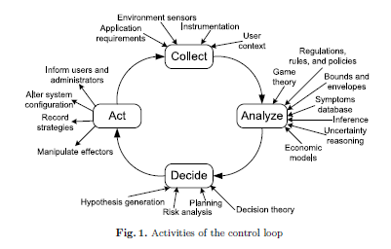
Cheng et al. 2009: Roadmap

Slide 78
Alternative mechanisms
Biologically-inspired… stay tuned

Slide 79
Suggestions for third topic…
…after architecture and tools?

Slide 80
Questions?

