Slide 1
CSE503: Software Engineering Introduction
Shoes must be worn
Dogs must be carried
[Michael Jackson]
David Notkin
Spring 2011

Slide 2
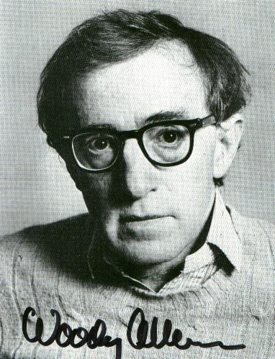
My favorite software pundit
Lady #1: “The food in this place is terrible.”
Lady #2: “Yes, and in such small portions.”
This captures much of the confusion about software: it’s broadly believed to be of low quality, but there is a voracious appetite for it
Software engineering R&D must consider both dimensions

Slide 3
When I say “software engineering”
…what do you think of?
Shout it out! I’ll write them on the board…
(Can somebody write these down and mail them to me?)

Slide 4
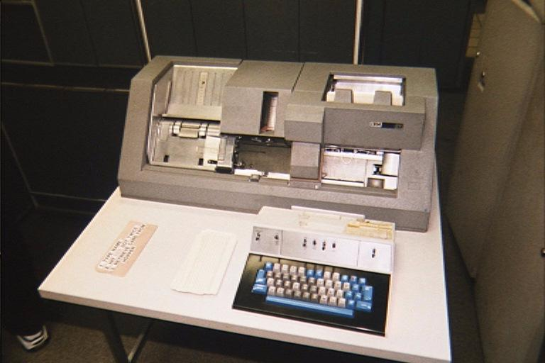
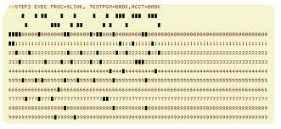
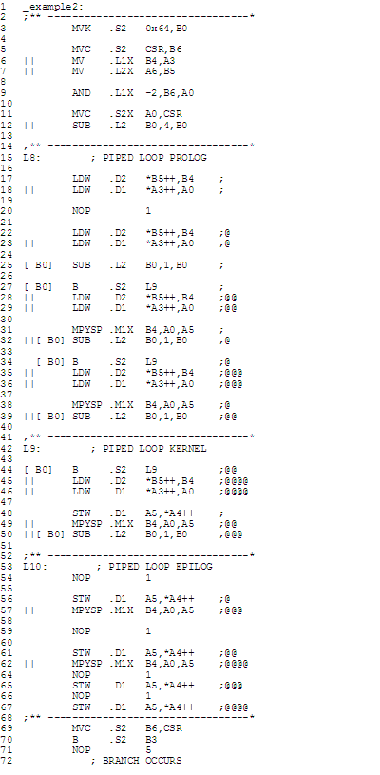
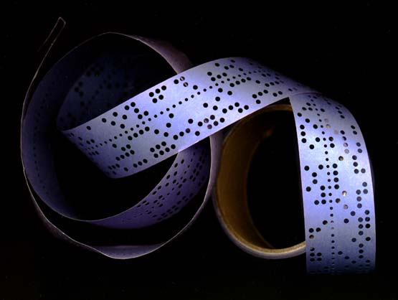
In the beginning
csc.colstate.edu/bosworth/Talks/ WhyStudyAssemblyLanguage.doc

Slide 5
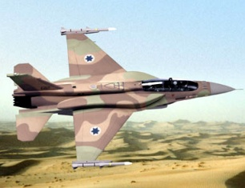
A Story: How much does software weigh?

Slide 6
Back to the beginning
Computers were a more precious resource than were people – “it’s the money, honey”
Working in ways that optimized the use of the computer, even at the cost of significant human effort, was sensible Aside: What was the most precious computing resource – cycles, memory, bandwidth, …?

Slide 7
Towards the present
1968 and 1969 NATO conferences on software engineering
Friedrich Bauer chaired it in 1968, with about 50 attendees including Turing Award winners Alan Perlis, Edsger Dijkstra and Peter Naur
There were increasing difficulties and costs in developing software – the “human” vs. “computer” tradeoff had to be reconsidered
Perlis epigrams (http://www.cs.yale.edu/quotes.html)
“Syntactic sugar causes cancer of the semicolon.”

Slide 8
Quotations from the 1968 “Highlights”
The discussions cover all aspects of software including
relation of software to the hardware of computers
design of software
production, or implementation of software
distribution of software
service on software.
[T]he report also contains sections on …
the problems of achieving sufficient reliability in the data systems which are becoming increasingly integrated into the central activities of modern society
the difficulties of meeting schedules and specifications on large software projects
the education of software (or data systems) engineers
the highly controversial question of whether software should be priced separately from hardware

Slide 9
Quotations on growth rate of software
Helms: In Europe alone there are about 10,000 installed computers — this number is increasing at a rate of anywhere from 25 per cent to 50 per cent per year. The quality of software provided for these computers will soon affect more than a quarter of a million analysts and programmers.
David: …OS/360 cost IBM over $50 million dollars a year during its preparation, and at least 5000 man-years’ investment. TSS/360 is said to be in the 1000 man-year category. It has been said, too, that development costs for software equal the development costs for hardware in establishing a new machine line.
d’Agapeyeff: In 1958 a European general purpose computer manufacturer often had less than 50 software programmers, now they probably number 1,000-2,000 people; what will be needed in 1978?
[This] growth rate was viewed with more alarm than pride

Slide 10
The “usual” questions…
…that drive software engineering research
Why does software cost so much?
Why does software [ testing | maintenance | … ] cost so much?
Why are there so many errors in software?
Why do so many software projects fail?
Why can’t software be more like hardware or cars or buildings or bridges or …?
Why can’t software engineering be more like real engineering?
Where’s Moore’s Law for software?
…
Why does software suck?

Slide 11
Standish Report 1995 http://www.spinroot.com/spin/Doc/course/Standish_Survey.htm
U.S. spends more than $250 billion annually on IT application development
The average cost of a development project ranges from $434K (for small) to $2.3M (for large) projects
31.1% of projects will be canceled before completion
52.7% of projects will cost 189% of their original estimates
The failure to produce reliable software to handle baggage at the new Denver airport [cost] the city $1.1 million per day
“A great many of these projects will fail. Software development projects are in chaos, and we can no longer imitate the three monkeys -- hear no failures, see no failures, speak no failures.”
“The cost of these failures and overruns are just the tip of the proverbial iceberg. The lost opportunity costs are not measurable, but could easily be in the trillions of dollars.”
“One just has to look to the City of Denver to realize the extent of this problem.”

Slide 12
“Software’s Chronic Crisis” by Gibbs Scientific American September 1994
“To veteran software developers, the Denver debacle is notable only for its visibility. Studies have shown that for every six new large-scale software systems that are put into operation, two others are canceled. The average software development project overshoots its schedule by half; larger projects generally do worse. And some three quarters of all large systems are ‘operating failures’ that either do not function as intended or are not used at all.”

Slide 13
Standish Group redux http://www.infoq.com/articles/Interview-Johnson-Standish-CHAOS
More recent Standish Group reports show some improvement in the statistics
The, however, reports are still clear about the continuing presence of the software crisis.
Jim Johnson, the founder and chairman of the Standish Group, said in 2006: “People know that the more common scenario in our industry is still: over budget, over time, and with fewer features than planned.”

Slide 14
Software lifecycle costs
Evolution/maintenance ≅ 90% http://www.cs.jyu.fi/~koskinen/smcosts.htm
Testing/verification ≅ 50-75% Hailpern & Santhanam, IBM Sys. Journal 2002
“The relative cost for maintaining software and managing its evolution now represents more than 90% of its total cost”
“[A]lthough there has not been much empirical research on this particular area, the magnitude of the maintenance cost effects is clearly identifiable.”
“In a typical commercial development organization, the cost of providing [assurances of functional and non-functional performance] via appropriate debugging, testing, and verification activities can easily range from 50 to 75 percent of the total development cost.”

Slide 15
So, these data show that…
…software costs too much on an absolute basis
…software lifecycle phases cost too much on a relative basis
…software projects are cancelled too often
"When you can measure what you are speaking about and express it in numbers, you know something about it; but when you cannot measure it, when you cannot express it in numbers, your knowledge is of a meagre and unsatisfactory kind: it may be the beginning of knowledge but you have scarcely, in your thoughts, advanced to the stage of science." —Lord Kelvin
In a nutshell: qualitative assessment is an “absolute zero”

Slide 16
But how do we measure “too”?
…software costs too much…, software lifecycle phases cost too much …, software projects are cancelled too often…
We don’t – we accept that we’re just too X and we should just get better at X
What would be ideal or even acceptable absolute costs? Relative lifecycle costs? Project cancellation rates?
If you believe firmly in measurement, then this should be as unsatisfactory as any other kind of lack of measurement

Slide 17
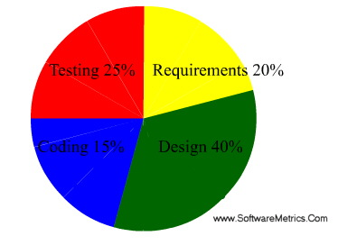
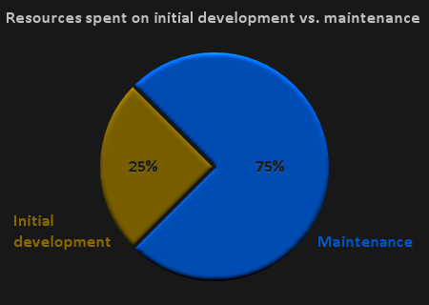
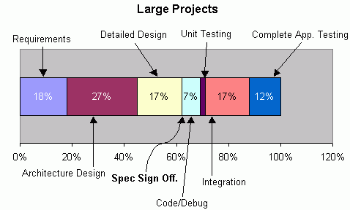
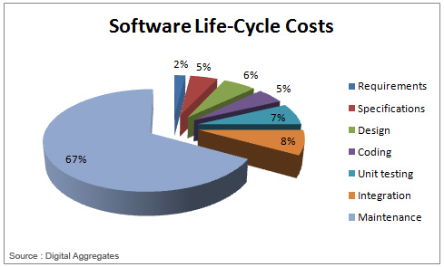
Per-phase “pie” charts: what do they have in common?
They total 100% … and they always will!
A great way to compare the costs of phases
A terrible way to assess costs in any absolute sense
http://www.softwaremetrics.com/Articles/estimating.htm
http://clarityincode.com/software-maintenance/
http://thibautvs.com/blog/?tag=maintenance
www.softmake.com.au/softwareDevelopmentMethodology/rapidDevelopmentSystem

Slide 18
Testing and evolution
Why might we care about what “too” means?
Is 50-75% too high for testing? What would be acceptable? Why? Is 0% a good goal? Are there benchmarks from other engineering disciplines and, if so, should we believe they may be analogous?
Is 90% for evolution and maintenance too high? What would be a good goal? 50%? 10%? 0%? Or is it too low, and 99% would be a better goal? Even the desired directionality for this is not entirely clear.

Slide 19
Cyber-physical systems
Dizzying increase in physical systems that have a significant software component: medical devices, spacecraft and airplanes, appliances, automobiles, bridges and buildings, telephones, and many more.
When these systems fail – consider the Denver airport, the Mars Polar Lander, the Arianne V, and many more – they are generally reported as software failures
In an important sense, this is accurate – specifically, in most cases, a variant on the software could have eliminated the failure.

Slide 20
Mars Polar Lander: $100M lost (plus opportunity costs)
“…the most likely cause of the failure of the mission was a software error that mistakenly identified the vibration caused by the deployment of the lander's legs as being caused by the vehicle touching down on the Martian surface, resulting in the vehicle's descent engines being cut off while it was still 40 meters above the surface, rather than on touchdown as planned.” [Wikipedia]

Slide 21
Co-design decisions
Allocation of function to physical vs. software components is critically important
In some domains these decisions come from those with more know-how on the physical side
Even more commonly, these decisions are made with a clear view that much complexity can and should be pushed into the software
Thus, it is tautological that software would cause more problems in cyber-physical systems simply because it is “assigned” greater complexity.
That is, Increasing the complexity of the software is (surely at times) a fine decision – but one should not then later be surprised at increased risks and costs

Slide 22
Lead time for physical manufacturing
Physical components generally require a long lead time for design and manufacture; for practical reasons, this is done concurrently with software production
The physical components and their means of production necessarily and practically become more stable and more costly to change over time
Changes made at later stages tend to be much more costly to fix
Just like software ☺ but even more costly!
If you really think software is too hard to change, try changing the physical components instead!

Slide 23
Changes to software requirements
So unexpected shortcomings on the physical side are often handled by changing the software requirements
This adds complexity and cost to the software because numerous design and implementation decisions have already been made during the concurrent development
To accommodate flaws in the engineering of the physical components, even more complexity is injected into the software
“Better” software can generally overcome these flaws, but the need to do so is induced by weaknesses on the physical side

Slide 24
Software is last
Testing software on the physical system instead of on simulators, mockups, etc. may be cheaper and easier
When software is changed to overcome physical flaws, the software is necessarily later
There is, quite reasonably, a perception that software is indeed “soft” compare and thus it seems to be able to withstand changes until (and often after) the last moment
But just because it is last doesn’t mean it is (entirely) at fault

Slide 25
Software: breaking [Moore’s] law” [Wikipedia]
“… exponentially improved hardware does not necessarily imply exponentially improved software performance to go with it. The productivity of software developers most assuredly does not increase exponentially with the improvement in hardware, but by most measures has increased only slowly and fitfully over the decades.”
The performance of software and software developers is compared to transistors on an integrated circuit
What human activity has matched the growth of Moore’s Law?
Do we (or should we) compare the performance of trains to their tracks? Of train designers to their trains?
What other technology has matched the growth of Moore’s Law? Batteries, displays, ??? IC circuits are a (wonderful and probably) singular technology
Would you rather take the bus to work or your lunch?
Would you rather be in love or in Tucson?

Slide 26
Blame isn’t the goal
Simply blaming software for the problems because it could fix the system and because it was (naturally) last to be stabilized cannot easily lead us to better solutions to costly fiascos
Of course we as software engineering researchers and engineers must work hard to do better – indeed, much better
We must not, however, let the playing ground be set in a way that is not helpful towards achieving critical goals

Slide 27
Value: missing from most discussions
Value is definitely hard to measure – but the world has surely agreed that software has value, or else companies that produce and sell it would not exist!
We need much more work in this area
Barry Boehm, Kevin Sullivan, Mary Shaw, and others have worked on software engineering economics – this is crucial but very difficult
But we have to remember that the reason software is important is because it provides value – real value to society, to the economy, to people – and if it didn’t, nobody would care about cost, dependability, etc.

Slide 28
Reprise: Standish ‘95: U.S. spends > US$250B annually on IT application development
Software industry (2008, worldwide) US$304B DataMonitor via Wikipedia
Advertising industry (2009, Worldwide) US$445B http://www.plunkettresearch.com/advertising%20branding%20market%20research/industry%20statistics
Travel industry (2008, Worldwide) US$944B Wikipedia
Porn industry (2004, Worldwide) US$57B http://www.toptenreviews.com/2-6-04.html
Size is an inherently limited way to assess how well an industry is doing…

Slide 29
Different kinds of questions…
…that could and should drive software engineering research
What should software systems cost to design, build, maintain? Can we find a useful lower bound?
If we had infinite cycles to help software engineers, what problems would still exist?
When changing software, we assume that new behavior can be arbitrarily far from old behavior. What if we instead focused on the common-case – a small Δ?
Under what conditions is it reasonable/unreasonable to characterize a class of software systems as similar/dissimilar?
How should we legitimately assess and achieve important properties that are – even if we dislike it – not binary, not efficiently computable, not even precisely defined, etc.?
…

Slide 30
Coarse course expectations…
Overall objective – allow you to focus on the subareas and dimensions of software engineering that you find most interesting and/or most beneficial to you
“History” assignments (#1 and #2)
Project #1: Tool use and evaluation (research) or software building (development)
Project #2: Primary research project or secondary research project
Some assigned work TBA
Course participation
No examinations

Slide 31
Just to show some awareness…
http://news.softpedia.com/news/SCADA-Software-Increasingly-Under-Scrutiny-by-Security-Researchers-191525.shtml
“Supervisory control and data acquisition (SCADA) software is responsible for monitoring and controlling equipment in industrial facilities, including oil and gas refineries, power and water processing plants, factories, etc. Attacks against SCADA software moved from theoretical to practical last year with the discovery of Stuxnet, a highly sophisticated industrial espionage malware whose purpose was to destroy uranium enrichment centrifuges at the Iran's Natanz nuclear plant. … [Researcher] Rubén Santamarta released an exploit for a remote code execution vulnerability affecting a Web-based SCADA product called BroadWin WebAccess. His decision to go public was the result of the vendor denying the existence of a problem. ‘I contacted ICS-CERT [Industrial Control Systems Cyber Emergency Response Team] to coordinate with Advantech but the vendor denied having a security flaw. So guys, the exploit I'm releasing does not exist. All is product of your mind,’ the researcher says ironically. …”

