Slide 1
Program Analysis for Software and Web Security
CSE 504
Ben Livshits
Microsoft Research and UW

Slide 2
Course Summary
Target audience:
Ph.D. and Master’s students
Advanced undergrads are welcome
If you are an undergrad considering this course, please consult the instructor prior to enrolment
Primarily a paper reading course
Will have external presentations by research and industry leaders
Students are expected to read, discuss, and present research papers
Designed to familiarize students with research in program analysis for security in the past 10 years

Slide 3
Course Topics
browsers
Security
Programming languages
Operating systems
compilers
runtime systems

Slide 4
Which Techniques Will I See?
Type systems and
static analysis
Runtime analysis
Symbolic execution

Slide 5
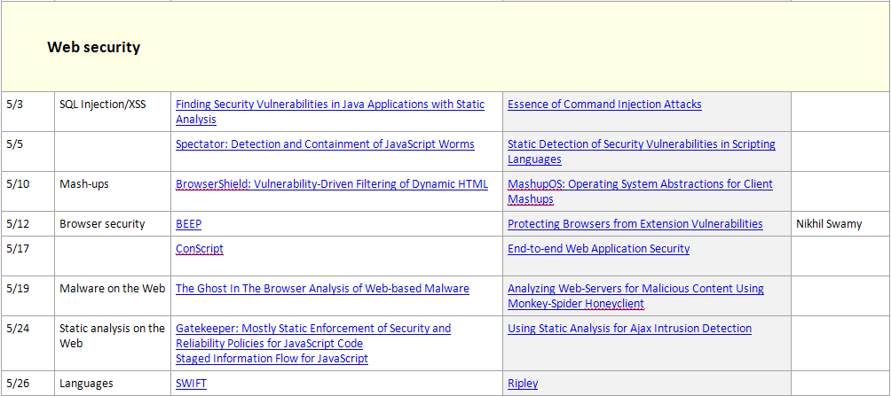
Which Techniques Will I See? (2)
Points-to analysis
Browser hacking
Aspect languages

Slide 6
Expected Workload
Students are responsible for
Reading one paper per class and writing a very short summary
Be actively involved in in-class discussions
Leading 2- 3 presentations done in pairs, if enough people register
These typically involve more preparation and discussions with the instructor
Paper response template: to be submitted individually before class
Contributions (3-5 points, no more than 1 line each)
Cons/weaknesses (3-5 points, no more than 1 line each)
Follow-up work /mini-projects (3-5 points, no more than 1 line each)
Do come to class prepared:
Carefully read the paper and get as much as you can out of it on your own
There will almost always be parts you don’t fully understand
This is to be expected, this is what class discussions are for

Slide 7
Presentations
One of the goals of the course is for you to develop strong presentations skills
Don’t expect to get it right the first time around
Expect to benefit from these skills for years to come
It’s okay to look at other people’s presentations of these papers, it’s not okay to copy them verbatim
Expect to iterate over your slides
Expectations:
A good presentation involves a lot of work
Presentations are to be done in teams
Expect to spend several hours preparing
Figure out how your want to subdivide the work
You will need to read more (optional papers) and address them in your presentation
Office hours
After class
Have your presentation ready for a dry run one class meeting before

Slide 8
Presenting Technical Papers in CS
Presentation Zen by Garr Reynolds
Presentation advice:
Giving a talk by Mike Ernst
Advice on giving talks by Tessa Lau
Tips for a Good Conference Talk by Jennifer Widom
Hints on making presentations by Jeff Offutt
Some Advice on giving a Talk, by Olivier Danvy. Issues in making an oral presentation
Presentation advice by Armando Fox
Conference talk advice from Mark Hill.
from http://people.engr.ncsu.edu/txie/advice.htm

Slide 9
Grading
Grading
Presentations
Paper reports
Class participation
Project (to be decided)
Exact breakdown is TBD

Slide 10
Industry Perspective
One of the features of the course will the a focus on how many of the techniques are used in the industry
Will have several external speakers from MSR and Microsoft

Slide 11
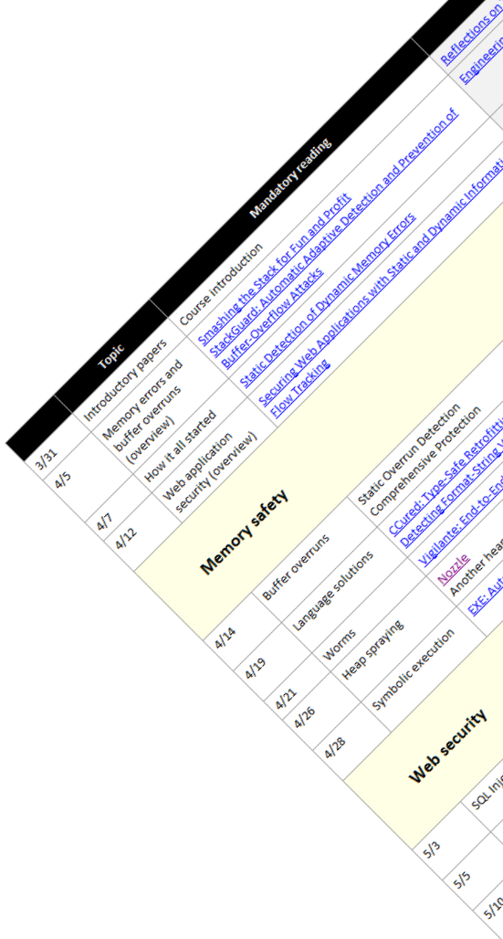
Questions?
Check out the course home page:
http://www.cs.washington.edu/education/courses/cse504/10sp/
Email the instructor
Ben Livshits
livshits@microsoft.com

