Slide 1
Securing Web Applications
Static and Dynamic Information Flow Tracking
Jason Ganzhorn
4/12/2010

Slide 2
The Issues
SQL Injection
Cross-site Scripting (XSS)
Other problems, such as HTTP response splitting…
Common Theme
Unchecked (or “tainted”) data from user reaches security-sensitive operations

Slide 3
Quick Vulnerability Review

Slide 4
What is Cross-Site Scripting?
Cross-site scripting, in a nutshell, refers to a malicious practice in which code from an evil server is injected into a legitimate page and then run by hapless victims who view the page.
There are complex variants on this theme, but we won’t be discussing that, since this isn’t a presentation on XSS.
Notes:
The motivation is usually to steal cookies or other user information.

Slide 5
HTTP Response Splitting
The basic idea behind HTTP response splitting is that the attacker attempts to divide an HTTP header such that the target interprets the response as two.
Involves an insertion of user-supplied data into the HTTP header.
If this insertion is successful, the attacker completely controls the content of the second header, which can be used to perform a cache poisoning attack (among other attacks).

Slide 6
SQL Injection
Basic idea: input from user is incorporated into query on database.
If the input is unchecked, a malicious attacker can perform nefarious acts such as examining the database structure, reading or writing to database tables, or completely discarding tables.

Slide 7
SQL Injection in the wild
From a recent (Jan. 14, 2010) security advisory for a product called Zenoss Core (http://www.zenoss.com): getJSONEventsInfo contains multiple SQL Injection vulnerabilities due to improperly sanitized user provided input. The following URL parameters are injectable: severity, state, filter, offset, and count. A proof of concept request might look like this: /zport/dmd/Events/getJSONEventsInfo?severity=1&state=1&filter=& offset=0&count=60 into outfile "/tmp/z“
Obtained from: http://www.ngenuity.org/wordpress/2010/01/14/ngenuity-2010-001-zenoss-getjsoneventsinfo-sql-injection/

Slide 8
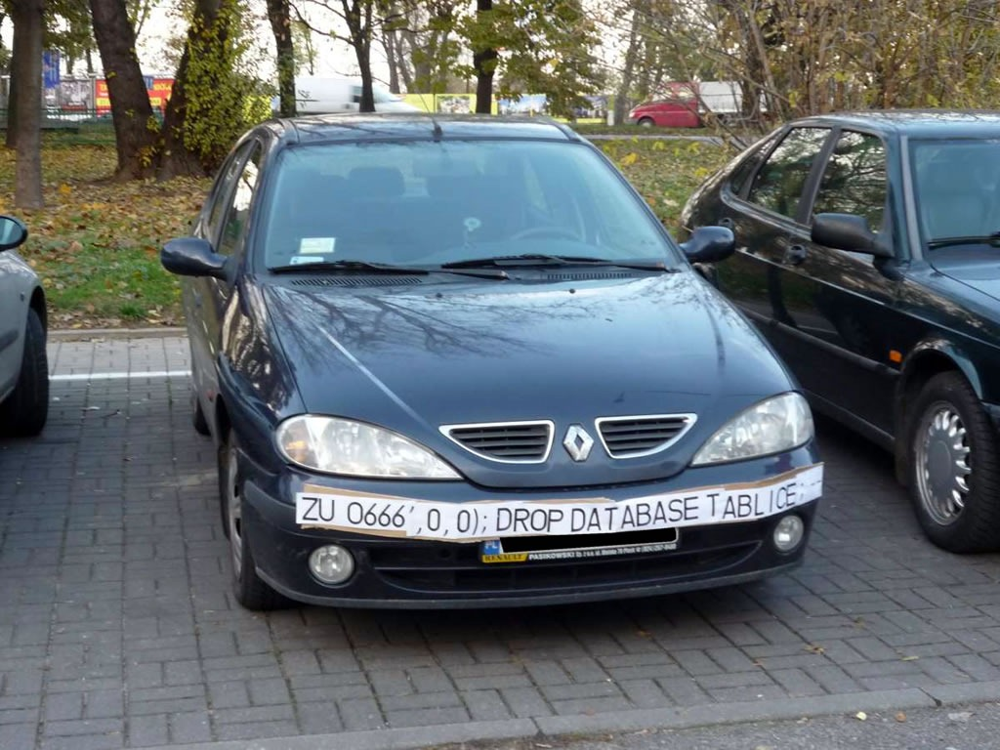
SQL Injection

Slide 9
Tainted Input
The root of many of these problems is that user-specified (or “tainted”) data is passed into critical code without being checked.
Why isn’t it being checked?
Sometimes the source of the data and the “sink” (e.g. a query construction) are widely separated and the connection is not obvious.

Slide 10
Tainted Input (cont’d)
Consider this example: You are programming a networked application, and you decide to use the AwesomeNetwork™ library to handle your database connections. However, you are short on time and the documentation for the library is lacking, so you assume that it provides SQL sanitization. Voila, you have introduced a SQL injection vulnerability.
Notes:
The take-away point for this slide is that it’s really not that hard to accidentally introduce paths from source to sink which do not include sanitization due to time constraints or code complexity.

Slide 11
How Serious Is It, Really?
According to the WhiteHat Website Security Statistics Report released in fall 2009, approximately 64% of the 1,364 scanned websites have at least one serious vulnerability.
There is an average of 6.5 severe unresolved vulnerabilities per website.
http://www.whitehatsec.com/home/resource/stats.html
Further interesting reading: http://www.symantec.com/business/theme.jsp?themeid=threatreport

Slide 12
Is There a Solution?
One solution is to adopt the mindset that user data cannot be trusted and should be sanitized whenever you are passing it to a sink.
You are still probably going to miss some subtle cases due to lengthy code paths.
Wouldn’t it be nice if there was an automated way to check for common vulnerability patterns?

Slide 13
Program Query Language
Securing Web Applications with Static and Dynamic Information Flow Tracking
Notes:
Well, there is! ;)

Slide 14
One Possible Solution
PQL – Program Query Language
Basic Idea
Represent a class of information flow as a pattern, or specification.
Use static and dynamic analysis to identify matches against a specification.
Allow program to recover from errors gracefully and defend against security breaches.
Make this as simple as possible for the programmer.

Slide 15
PQL System Architecture
Question
PQL Query
PQL Engine
Program
instrumenter
static analyzer
Instrumented
Program
Optimized
Instrumented
Program
Static
Results

Slide 16
Programs and PQL Queries
Question
PQL Query
PQL Engine
Program
instrumenter
static analyzer
Instrumented
Program
Optimized
Instrumented
Program
Static
Results

Slide 17
Execution Trace Example
Here is an extremely simple example of an SQL injection: HttpServletRequest req = /* ... */; java.sql.Connection conn = /* ... */; String q = req.getParameter(“QUERY”); conn.execute(q);
The corresponding abstract execution trace:
CALL o₁.getParameter(o₂)
RET o₂
CALL o₃.execute(o₂)
RET o₄
Notes:
Abstract objects are used to represent specifically defined variables in the code.

Slide 18
Another Execution Trace
Another simple SQL injection example: String read() { HttpServletRequest req = /* ... */; return req.getParameter(“QUERY”); } /* ... */ java.sql.Connection conn = /* ... */; conn.execute(read());
The corresponding abstract execution trace: CALL read() CALL o₁.getParameter(o₂) RET o₃ RET o₃ CALL o₄.execute(o₃) RET o₅

Slide 19
Trace Similarities
Note how the traces are similar:
1 CALL o₁.getParameter(o₂)
2 RET o₃
3 CALL o₄.execute(o₃)
4 RET o₅
1 CALL read()
2 CALL o₁.getParameter(o₂)
3 RET o₃
4 RET o₃
5 CALL o₄.execute(o₃)
6 RET o₅
PQL can be used to construct queries to look for patterns like these.
Notes:
This hints that there are patterns that can be exploited to track down other errors like these.

Slide 20
Constructing the Specification
The pattern, specified in PQL: query main() uses String x; matches { x = HttpServletRequest.getParameter(_); Connection.execute(x); }
The specification is simple, and works for non-adjacent lines of code
Not complete, however, as it does not match against code that executes a string derived from a parameter.

Slide 21
Things Get More Complicated
Need to handle derived strings as in this case: HttpServletRequest req = /* ... */; n = req.getParameter(“NAME”); p = req.getParameter(“PASSWORD”); conn.execute( “SELECT * FROM logins WHERE name=” + n + “ AND passwd=” + p
);
The PQL specification will have to be more complicated.

Slide 22
New PQL Query, Part 1
The sub-query to check whether one string is derived from another: query derived (Object x) uses Object temp; returns Object d; matches { { temp.append(x); d := derived(temp); } | { temp = x.toString(); d := derived(temp); } | { d := x; } }

Slide 23
New PQL Query, Part 2
The new main query: query main() uses String x, final; matches { x = HttpServletRequest.getParameter(_); | x = HttpServletRequest.getHeader(_); final := derived(x); Connection.execute(final); }
The new query is a bit more complex, but it does match quite a few more instances of an SQL injection.

Slide 24
Where Are We Right Now?
Question
PQL Query
PQL Engine
Program
instrumenter
static analyzer
Instrumented
Program
Optimized
Instrumented
Program
Static
Results
Notes:
The focus so far has been on the results of a static analysis of the code. Static analysis involves an approximate answer to the question “Can this program match this query?” Approximate, as the problem is in general undecidable.

Slide 25
Benefits So Far
Difficult for programmers to do analysis (either they don’t like it or they don’t know it).
However, they are familiar with the program code.
Analysis specialists are good with analysis, but they don’t know the specific program code.
Analysts can use PQL to generate generic specifications to catch security flaws.

Slide 26
Building More Robust Applications
So far we’ve seen PQL queries used to detect vulnerabilities in essentially a static fashion.
PQL can be used to integrate a specialized query matcher into the executable.
A match can trigger special code designed to sanitize possibly unsafe input.

Slide 27
Graceful Match Handling with PQL
Here is an example of how to trigger a function on a match in PQL: query main() uses String x, final; matches { x = HttpServletRequest.getParameter(_) | x = HttpServletRequest.getHeader(_); final := derived(x);
} replaces Connection.execute(final) with
SQLUtil.safeExecute(x, final);

Slide 28
Going Deeper
How does PQL do this dynamic analysis?
A naïve dynamic analysis would translate the queries into state machines that would digest a program’s full abstract execution trace:
Entire Abstract Execution Trace
Query-Derived
State Machine
Query
Recognizer
Matches

Slide 29
More Efficient Dynamic Analysis
Leverage results from static analysis
Reduce number of objects that need to be checked
Reduce number of points at which objects must be checked
PQL Engine
instrumenter
static analyzer
A much more complete
description of how PQL’s
dynamic analysis is done
can be found here.
Optimized
Instrumented
Program
Notes:
Program points that do not involve objects we are interested in for this query are irrelevant.

Slide 30
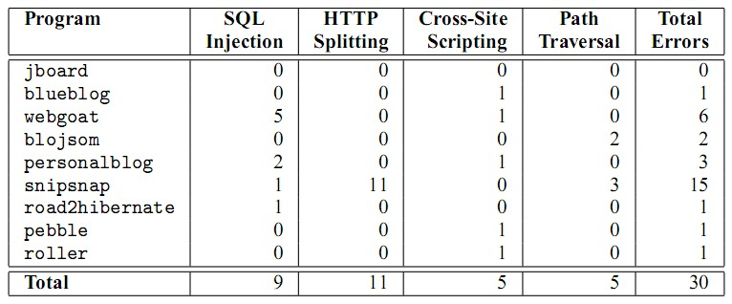
Experimental Results – Error Catching
PQL queries targeting different vulnerabilities were run on several open-source applications. The paper has a description of what each of these applications are for.

Slide 31
Experimental Results – False Positives
The false positive rate was very high at first.
Improvements to the underlying mechanics of the static analysis greatly decreased the number of false positives (from about 380 to 0 false positives in roller).
More details about the improvements can be found in the Usenix ‘05 presentation slides here.

Slide 32
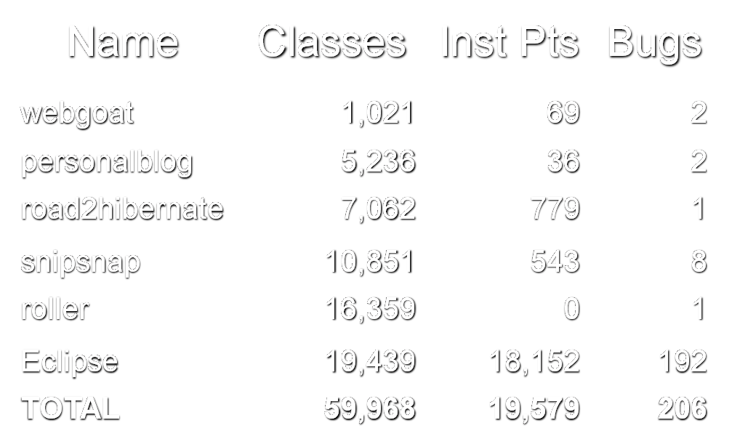
Experimental Results PQL Dynamic Analysis Overhead
Not a lot is mentioned about the overhead on a per-application basis.
In general, the number of program points that have to be checked appears to be indicative of overhead.
Notes:
This table is a bit confusing, but as far as I can tell, Inst Pts are basically the program points that have to be checked. Some of the numbers don’t match the table a couple of slides ago because apparently this was a different experiment?

Slide 33
Related Work
Static error-detection tools (SABER and WebSSARI are examples)
Event-based Analysis
Other Program Query Languages like ASTLOG and Jquery
Analysis Generators

Slide 34
Benefits of PQL
Division of labor between analysts and programmers.
Analysts can write PQL queries, programmers can run them and find bugs.
The results indicate that it does help track down security bugs.
The overhead of the dynamic analysis and protection is manageable enough that it can be run in real time.
However… Humans still have to come up with the specifications. Wouldn’t it be great if there were a way to infer specifications from program code?

Slide 35
MERLIN
Speciﬁcation Inference for
Explicit Information Flow Problems
Notes:
Turns out there is!

Slide 36
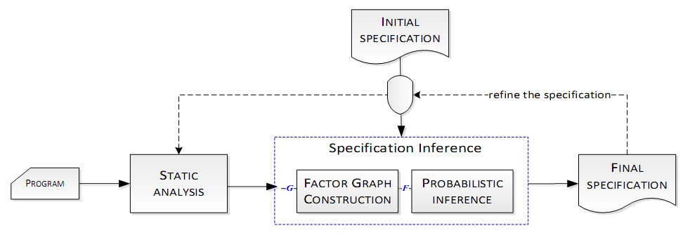
Overview of MERLIN
Schematic of the MERLIN internal architecture:
MERLIN can be integrated into the PQL architecture we have seen before.

Slide 37
MERLIN and the PQL Architecture
Initial PQL
Query
Question
MERLIN
PQL Query
PQL Engine
Program
instrumenter
static analyzer
Instrumented
Program
Optimized
Instrumented
Program
Static
Results

Slide 38
MERLIN Structure
Probabilistic inference is the core of MERLIN.
Used to solve a set of probabilistic constraints to generate a specification
Relies on assumptions about the nature of propagation graphs for most programs.
Errors are rare.
There are only a few sanitizers.
The assumptions can lead to contradictory constraints inferred from different paths.
Thus, constraints are parametrized with the probability of their satisfaction, based on a set of rules.
The MERLIN paper has much more information and can be found here.
Notes:
The paper seems to provide relatively little backup for why the propagation graph assumptions are valid – a couple of other specification inference techniques are referenced and a single standard specification is used as an example. Another approximation used to tame the exponential nature of the propagation graph is to treat paths as triples of <source, sanitizer, sink>.

Slide 39
MERLIN Structure
Control flow inside MERLIN starts with a propagation graph.
Informally, propagation graphs describe the flow of information between methods.
Generated by static analysis of the code.
Approximate.
Pointer analysis is involved.
Cycles in the propagation graph are removed for simplification.

Slide 40
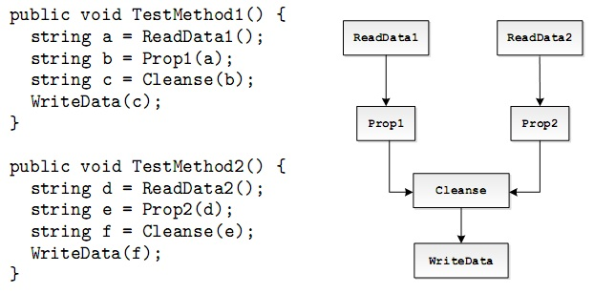
Propagation Graph Example
Notes:
Notice how the calls to common functions are reduced into a single path in the propagation graph.

Slide 41
MERLIN Structure
The construction of the factor graph and the probabilistic inference that follows is fairly involved.
Key points:
Probabilistic constraints are generated from the propagation graph.
The conjunction of the constraints can be used to construct a factor graph.
The factor graph is used in the probabilistic inference to measure the odds that propagation graph nodes are sources, sanitizers, or sinks.
Notes:
I’m going to have to wave my hands a bit about this factor graph. If you know what it is, that’s great. If you don’t, it’s a structure that’s used to expedite the probabilistic inference step, and that’s probably as deep as I’m going to go into it.

Slide 42
Experimental Results
MERLIN is built as an add-on on top of CAT.NET, a publicly available static analysis tool.
CAT.NET ships with an out-of-the-box specification, which MERLIN’s results are compared to.
10 different benchmark programs used in test.
MERLIN specifications: GOOD MAYBE BAD 167 127 87
This yields a false-positive rate of approximately 22%, which is quite decent.
Notes:
“Maybe” specifications were those where it wasn’t obvious whether the specification was good or bad (the determination is a matter of interpretation). The average state-of-the-art false positive rate is over 90% according to the MERLIN paper.

Slide 43
Experimental Results (cont’d)
When the good specifications generated by MERLIN were used to analyze the benchmark program code, fewer false positives were found.
CAT.NET’s false positive rate was 48% (43/89), MERLIN’s false positive rate was 1% (3/342).
MERLIN specifications also eliminated 13 former false positives.
Notes:
It would be interesting to see what happens if you use all the specifications, including the “maybe” and “bad” ones. This would simulate having more automation in the process.

Slide 44
Experimental Results (cont’d)
CAT.NET + MERLIN Running Time LoC # DLLs Time (s) 10,812 3 9.86 66,385 14 151.05 1,810,585 5 209.45
The analysis seems to scale quite well, and the running times are fairly reasonable.
Notes:
The running time was calculated for each of the benchmark programs – I have just selected a few to highlight here.
Reasonable, anyway, if you don’t want to run CAT.NET (with MERLIN) frequently on a large program with many DLLs.

Slide 45
Summary
PQL
Language to write abstract specifications in.
Allows for a division of labor between programmer and security analyst.
Includes the tools necessary to perform static and dynamic analyses using these specifications.
MERLIN
Program to infer specifications automatically from program code.
The combination of these two has a lot of potential.
Notes:
Programmers want to fix the holes quickly, analysts want to find security holes without having to do much.

