Slide 1
Static Analysis for Memory Safety
Salvatore Guarnieri
sammyg@cs.washington.edu

Slide 2
Papers
A First Step Towards Automated Detection of Buffer Overrun Vulnerabilities
Using static analysis and integer range analysis to find buffer overflows
A Practical Flow-Sensitive and Context Sensitive C and C++ Memory Leak Detector
Identifying memory ownership with static analysis
Detecting double frees
Notes:
attackers first abused buffer overflows to exploit programs, then when a program is buffer overrun free, they can use double free’s to exploit programs.

Slide 3
A First Step Towards Automated Detection of Buffer Overrun Vulnerabilities

Slide 4
Problem
char s[10];
strcpy(s, “Hello world!”);
“Hello world!” is 12 + 1 characters
s only holds 10 characters
How do we detect or prevent this buffer overflow?
Notes:
Motivating example, this is a buffer overflow, we all know this, but how do we go about detecting or preventing it?

Slide 5
“Modern” String Functions Don’t Fix the Problem
The strn*() calls behave dissimilarly
Inconsistency makes it harder for the programmer to remember how to use the “safe” primitives safely.
strncpy() may leave the target buffer unterminated.
strncat() and snprintf() always append a terminating ’\0’ byte
strncpy() has performance implications: it zero-fills the target buffer
strncpy() and strncat() encourage off-by- one bugs (Null character)
Notes:
Even if you ignore all other sources of buffer overruns and just focus on string functions, the modern str n functions don’t magically fix all the problems. The programmer still has to use them correctly and the various str n functions have slightly different semantics and calling conventions. So used correctly they can limit buffer overruns, but they still have to be used correctly.

Slide 6
Notes:
Talk about why this is important… Buffer overruns are common, we need to prevent them

Slide 7
Insight
We care about when we write past the end of an array
a[i] = ...
Should be
if (i < sizeof(a)) {
a[i] = ...
} else {error}

Slide 8
Basic Approach
Treat C strings as an abstract data type
Ignore everything but str* library functions
Model buffers as a pair integer ranges
len(a) is how far into the array the program accesses
alloc(a) is how large the array is
If len(a) > alloc(a), there is a buffer overrun

Slide 9
char *array = malloc(10);
array[1] = ‘h’;
array[9] = ‘\0’;
strcpy(array, “0123456789012”);
len(array) =
alloc(array) =

Slide 10
char *array = malloc(10);
array[1] = ‘h’;
array[9] = ‘\0’;
strcpy(array, “0123456789012”);
len(array) = 0
alloc(array) = 10

Slide 11
char *array = malloc(10);
array[1] = ‘h’;
array[9] = ‘\0’;
strcpy(array, “0123456789012”);
len(array) = 2
alloc(array) = 10

Slide 12
char *array = malloc(10);
array[1] = ‘h’;
array[9] = ‘\0’;
strcpy(array, “0123456789012”);
len(array) = 10
alloc(array) = 10

Slide 13
char *array = malloc(10);
array[1] = ‘h’;
len(dest) = len(src)
array[9] = ‘\0’;
strcpy(array, “0123456789012”);
len(array) = 14
alloc(array) = 10

Slide 14
char *array = malloc(10);
array[1] = ‘h’;
len(dest) = len(src)
array[9] = ‘\0’;
strcpy(array, “0123456789012”);
OVERRUN
len(array) = 14
alloc(array) = 10

Slide 15
It’s not that simple
char *array = malloc(10);
if (k == 7) {
strcpy(array, “hello”);
} else {
free(array); array = malloc(3);
strcpy(array, “world!”);
}
What is len(array)? What is alloc(array)?

Slide 16
Use Ranges
char *array = malloc(10);
if (k == 7) {
strcpy(array, “hello”);
} else {
free(array); array = malloc(3);
strcpy(array, “world!”);
}
len(array) = [5, 6], alloc(array) = [3,10]
5>3 so we have a possible overrun

Slide 17
len(a)
- | - | - | - | - | MIN | - | MAX | -
a
b
alloc(a)
- | - | - | MIN | - | - | - | - | MAX
c
d
If b <= c, no overrun
If a > d, definite overrun
Otherwise the ranges overlap and there may be an overrun
Notes:
Explain what ranges mean and how we check the ranges

Slide 18
Implementation Overview
Notes:
Talk about the dataflow here, outline of technique… takes c code, parses over it to generate these range constraints for statements, collects range constraints, combines them to have one range for a variable, produces warnings

Slide 19
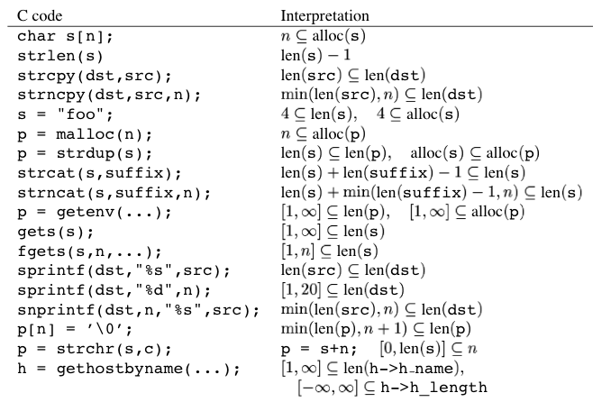
Constraint Generation
strlen(str) :: returns len(s) – 1
Length of the string without its null character
strncat(s,suffix,n) :: adds given constraint
len(s) – initial length of s
min(len(suffix)-1,n) – min of length of suffix
without null or max length of n
p[n] = NULL :: Sets the new effective length of p
The min doesn’t really make sense here
Notes:
Walk through the pop ups

Slide 20
Constraints
char *array = malloc(10);
if (k == 7) {
strcpy(array, “hello”);
} else {
free(array); array = malloc(3);
strcpy(array, “world!”);
}
len = [5,6]
alloc = [3,10]

Slide 21
Limitations
Double pointer
Doesn’t fit in with their method
Function pointers and union types
Ignored
Structs
All structs of same “type” are aliased
Struct members are treated as unique memory addresses
Flow Insensitive

Slide 22
Pointer Alias Limitations
char s[20], *p, t[10];
strcpy(s, “Hello”);
p = s + 5;
strcpy(p, “ world!”);
strcpy(t, s);
What is len(s)?
Notes:
Pointer aliasing
No alias analysis, so some writes/reads are missed

Slide 23
Evaluation
Run tool on programs from ~3kloc to ~35kloc
Does it find new bugs?
Does it find old bugs?
What is the false positive rate?
Are there any false negatives in practice?
How long does it take to execute on CPU?
How long does it take the user to use the tool?

Slide 24
Linux nettools
Total 3.5kloc with another 3.5kloc in a support library
Recently hand audited
Found several serious new buffer overruns
They don’t talk about the bugs that they find

Slide 25
Sendmail
~35 kloc
Found several minor bugs in latest revision
Found many already discovered buffer overruns in an old version
15 min to run for sendmail
A few minutes to parse
The rest for constraint generation
A few seconds to solve constraint system

Slide 26
Sendmail findings
An unchecked sprintf() from the results of a DNS lookup to a 200-byte stack-resident buffer; exploitable from remote hosts with long DNS records. (Fixed in sendmail 8.7.6.)
An unchecked strcpy() to a 64-byte buffer when parsing stdin; locally exploitable by “echo /canon aaaaa... | sendmail -bt”. (Fixed in 8.7.6)
An unchecked copy into a 512-byte buffer from stdin; try “echo /parse aaaaa... | sendmail -bt”. (Fixed in 8.8.6.)
An unchecked strcpy() to a (static) 514-byte buffer from a DNS lookup; possibly remotely exploitable with long DNS records, but the buffer doesn’t live on the stack, so the simplest attacks probably wouldn’t work.
Several places where the results of a NIS network query is blindly copied into a fixed-size buffer on the stack; probably remotely exploitable with long NIS records. (Fixed in 8.7.6 and 8.8.6.)

Slide 27
Human Experience
15 minutes to run…
44 warnings to investigate
4 real bugs
Without tool you would have to investigate 695 potentially unsafe call sites

Slide 29
Improvements
Improved Analysis | False alarms that would be removed
Flow-sensitive | 19/40 (47%)
Flow-sensitive with pointer analysis | 25/40 (62%)
Flow and context sensitive with linear invariants | 28/40 (70%)
Flow and context sensitive with linear invariants and pointer analysis | 38/40 (95%)
Notes:
A linear invariant is a simple, linear relationship between program variables—such as xyor alloc bufbuflen— that holds in all program executions.)

Slide 30
Identifying Memory Ownership -- Clouseau

Slide 31
From overruns to memory errors
Memory Leaks
Bloat
Slow performance
Crashes
Dangling pointers/Double free
Crashes
Unexpected behavior
Exploits

Slide 32
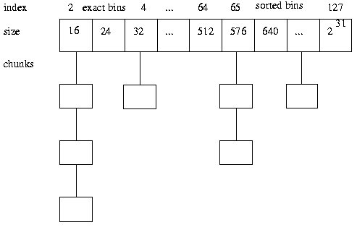
Double Free

Slide 33
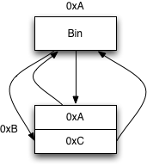
After Normal Free

Slide 34
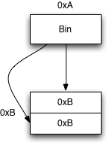
After Double Free

Slide 35
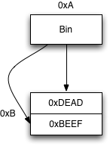
Alloc same size chunk again and get same memory. Write 8 bytes
Notes:
Now on our next alloc, the allocator will follow the pointers to get free memory for the program and we can write to the memory locations we previously wrote into the chunk

Slide 36
Motivating Example
Notes:
This is a simple container class that lets you set and get the object it contains

Slide 37
Motivating Example
Notes:
It holds holds the object with a pointer

Slide 38
Motivating Example
Notes:
You set the internal pointer with the construct, and delete it in the destructor. Already we are making assumptions about who should delete the object. The container didn’t alloc the memory, but it is deleting it

Slide 39
Motivating Example
Notes:
Then we get to the complex functions like set, that copies a new pointer into e and deletes the old one, get that gives out the pointer to e where other people might delete it, and replace that sets e to a new values but *doesn’t* delete the old value

Slide 40
Ownership
Introduce ownership to identify who is allowed and responsible to free memory
PROPERTY 1. There exists one and only one owning pointer to every object allocated but not deleted.
PROPERTY 2. A delete operation can only be applied to an owning pointer.

Slide 41
Key Design Choices
Ownership is connected with the pointer variable, not the object
Ownership is tracked as 0 (non-owning) or 1 (owning)
Partially to make solving the linear inequality constraints easier
Rank warnings with heuristics to minimize impact of false positives

Slide 42
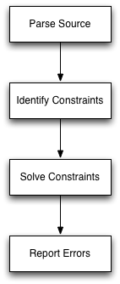
System Overview

Slide 43
Flow Sensitive Analysis
u = new int; //u is the owner
z = u;
delete z; //right before this line z is the owner
Order of instructions matters
Analysis identifies line 2 as a possible ownership transfer point

Slide 44
Constraint Solving Problem
u = new int; //u is the owner
z = u;
delete z; //right before this line z is the owner
Constructors indicate ownership
Deletion indicates desired/intended ownership
Generate all other constraints from assignments
Solve to identify owners

Slide 45
Evaluation

Slide 46
Evaluation -- C
85 bugs / 362 warnings = 23% true positives

Slide 47
Evaluation – C++

Slide 48
False Positives
For C
85 errors for 362 warnings – 23% accuracy
Many errors due to abnormal flow paths
breaks, error conditions, etc.
For C++
777 errors out of 1111 warnings – minor
49 errors out of 390 warnings – 12.5% accuracy
Double deletes, incorrect destructors

Slide 49
END.
Notes:
Our system does not yet model ownerships for the following C and C++ language features: aliases to the address of a pointer mem- ber field in a class, concurrent execution, exception handling, the use of unsafe typecasts, pointer arithmetic, and function pointers. The use of any of these features may prevent our system from iden- tifying all potential leaks.

Slide 50
Flow Insensitive
Instruction order doesn’t matter
char *a; a=malloc(10); strcpy(a, “hello”); a=malloc(3);
Is analyzed the same as
char *a; a=malloc(3); strcpy(a, “hello”); a=malloc(10);

Slide 51
Not Sound and Not Complete
Lack of pointer treatment makes this unsound
True positives can be missed
Already an imprecise algorithm, so it is incomplete
False positives could be generated
Evaluation will be very important

Slide 52
Sendmail findings
An unchecked sprintf() from the results of a DNS lookup to a 200-byte stack-resident buffer; exploitable from remote hosts with long DNS records. (Fixed in sendmail 8.7.6.)
An unchecked sprintf() to a 5-byte buffer from a command-line argument (indirectly, via several other variables); exploitable by local users with “sendmail -h65534 ...”. (Fixed in 8.7.6.)
An unchecked strcpy() to a 64-byte buffer when parsing stdin; locally exploitable by “echo /canon aaaaa... | sendmail -bt”. (Fixed in 8.7.6)
An unchecked copy into a 512-byte buffer from stdin; try “echo /parse aaaaa... | sendmail -bt”. (Fixed in 8.8.6.)
An unchecked sprintf() to a 257-byte buffer from a filename; probably not easily exploitable. (Fixed in 8.7.6.)
A call to bcopy() could create an unterminated string, because the programmer forgot to explicitly add a ’\0’; probably not exploitable. (Fixed by 8.8.6.)
An unchecked strcpy() in a very frequently used utility function. (Fixed in 8.7.6.)
An unchecked strcpy() to a (static) 514-byte buffer from a DNS lookup; possibly remotely exploitable with long DNS records, but the buffer doesn’t live on the stack, so the simplest attacks probably wouldn’t work.
Also, there is at least one other place where the result of a DNS lookup is blindly copied into a static fixed-size buffer. (Fixed in 8.7.6.)
Several places where the results of a NIS network query is blindly copied into a fixed-size buffer on the stack; probably remotely exploitable with long NIS records. (Fixed in 8.7.6 and 8.8.6.)

Slide 53
Double Free Exploit
Freeing a memory block twice corrupts allocation structures
First free puts block back in list
Second free mucks with forward and back pointers so they point to the same block (the current block)
Now future requests for blocks of that size will always return the same block
Write two memory addresses (8 bytes) to this chunk
Make another request of the same block size, same block will be used but since we just filled in data for forward and back pointers, we can write to any memory we want

Slide 54
cut
Enforce ownership with a type system
Infer types from code
No user provided annotations
Sound
Minimizes false positives by prioritizing constraints

Slide 55
Definition of Escape
Escaping violations refer to possible transfers of ownership to pointers stored in structures, arrays or indirectly accessed variables. While these warnings tell the users which data structures in the program may hold owning pointers, they leave the user with much of the burden of determining whether any of these pointers leak. Users are not expected to examine the escaping warnings, so we only examined the non-escaping warnings to find program errors.

Slide 56
Minor Errors in C++
First, many classes with owning member fields do not have their own copy constructors and copy operators; the default implementations are incorrect because copying owning fields will create multiple owners to the same object. Even if copy constructors and copy operators are not used in the current code, they should be properly defined in case they are used in the future.
Second, 578 of the 864 interprocedural warnings reported for SUIF2 are caused by leaks that occur just before the program finds an assertion violation and aborts. We have implemented a simple interprocedural analysis that can catch these cases and suppress the generation of such errors if desired.

