Slide 1
Memory Safety Through Runtime Analysis
Justin Samuel for CSE 504, Spring ‘10
Instructor: Ben Livshits

Slide 2
(A Few) Runtime Safety Approaches
Approach | Year | Summary
SFI | 1994 | Software Fault Isolation.
Bounds checking C | 1995 | Jones and Kelly, CRED.
StackGuard | 1998 | Canaries.
ASLR | 2001 | Address Space Layout Randomization (e.g. PAX).
Program Shepherding | 2002 | Run through an interpreter and verify branch instructions.
PointGuard | 2003 | Pointers encrypted in memory and decrypted at time of use.
CFI | 2005 | Control-Flow Integrity.
DieHard | 2005 | Multiple, large heaps with different allocation.
DFI | 2006 | Data-Flow Integrity.
WIT | 2008 | Write Integrity Testing.
NaCL | 2009 | Native Client. Uses SFI. Performs CFI.
2010-04-26
Runtime Memory Safety - CSE 504
2
Notes:
2

Slide 3
CFI: Control-Flow Integrity
Ensure execution follows the control-flow graph (CFG).
Statically analyze binary to identify valid destinations of all control transfers.
Instrument code with:
Unique IDs at destinations.
Checking destination IDs before all instructions that transfer control.
Not concerned with read or write destinations.
2010-04-26
Runtime Memory Safety - CSE 504
3

Slide 4
DFI: Data-Flow Integrity
Restrict reads based on instructions that wrote the data.
Statically analyze source to identify the instructions that are allowed to write values that are read.
Instrument code to:
Maintain a table of the last instructions to write memory locations.
Check the last-write table on reads against computed allowed write instructions.
Not directly concerned with control flow.
2010-04-26
Runtime Memory Safety - CSE 504
4

Slide 5
Preventing memory error exploits with WIT
Periklis Akritidis, Cristian Cada, Costin Raiciu, Manuel Costa, Miguel Castro
Microsoft Research, Cambridge UK

Slide 6
Example Vulnerable Code
1: char cgiCommand[1024];
2: char cgiDir[1024];
3:
4: void ProcessCGIRequest(char* msg, int sz) {
5: int i=0;
6: while (i < sz) {
7: cgiCommand[i] = msg[i];
8: i++;
9: }
10:
11: ExecuteRequest(cgiDir, cgiCommand);
12: }
2010-04-26
Runtime Memory Safety - CSE 504
6

Slide 7
Data-modifying Commands
1: char cgiCommand[1024];
2: char cgiDir[1024];
3:
4: void ProcessCGIRequest(char* msg, int sz) {
5: int i=0;
6: while (i < sz) {
7: cgiCommand[i] = msg[i];
8: i++;
9: }
10:
11: ExecuteRequest(cgiDir, cgiCommand);
12: }
2010-04-26
Runtime Memory Safety - CSE 504
7

Slide 8
Line 7’s Modified Objects
1: char cgiCommand[1024];
2: char cgiDir[1024];
3:
4: void ProcessCGIRequest(char* msg, int sz) {
5: int i=0;
6: while (i < sz) {
7: cgiCommand[i] = msg[i];
8: i++;
9: }
10:
11: ExecuteRequest(cgiDir, cgiCommand);
12: }
2010-04-26
Runtime Memory Safety - CSE 504
8

Slide 9
WIT: Write Integrity Testing
Approach:
Determine memory locations that individual instructions should legitimately be able to write to.
Only allow a given instruction to write to those locations.
Memory errors to protect against:
Buffer overflows and underflows
Dangling pointers
Double frees
2010-04-26
Runtime Memory Safety - CSE 504
9

Slide 10
Static Analysis
Two stages:
Points-to analysis
Write safety analysis
Goal: Create a color table.
Give each unsafe object a different color.
Give each write instruction the same color as the objects it can write.
2010-04-26
Runtime Memory Safety - CSE 504
10

Slide 11
Static Step 1: Points-to Analysis
Compute the set of objects that can be modified by each program instruction.
In the example:
Set {i} for the instructions at lines 5 and 8
Set {cgiCommand} for the instruction at line 7
1: char cgiCommand[1024];
2: char cgiDir[1024];
3:
4: void ProcessCGIRequest(char* msg, int sz) {
5: int i=0;
6: while (i < sz) {
7: cgiCommand[i] = msg[i];
8: i++;
9: }
10:
11: ExecuteRequest(cgiDir, cgiCommand);
12: }
2010-04-26
Runtime Memory Safety - CSE 504
11

Slide 12
Static Step 2: Write Safety Analysis
Purpose: runtime efficiency.
For all instructions and objects, determine whether safe or unsafe.
Safe instruction: cannot violate write integrity.
No destination operand
Operand is temporary, local, or global variable.
Safe object: all instructions that can modify it are safe.
2010-04-26
Runtime Memory Safety - CSE 504
12
Notes:
12

Slide 13
Safe
1: char cgiCommand[1024];
2: char cgiDir[1024];
3:
4: void ProcessCGIRequest(char* msg, int sz) {
5: int i=0;
6: while (i < sz) {
7: cgiCommand[i] = msg[i];
8: i++;
9: }
10:
11: ExecuteRequest(cgiDir, cgiCommand);
12: }
2010-04-26
Runtime Memory Safety - CSE 504
13

Slide 14
Not Safe
1: char cgiCommand[1024];
2: char cgiDir[1024];
3:
4: void ProcessCGIRequest(char* msg, int sz) {
5: int i=0;
6: while (i < sz) {
7: cgiCommand[i] = msg[i];
8: i++;
9: }
10:
11: ExecuteRequest(cgiDir, cgiCommand);
12: }
2010-04-26
Runtime Memory Safety - CSE 504
14
Notes:
14

Slide 15
Example Color Table
Record the color of each memory location.
Color 0 is used for safe objects.
Color | Instructions | Objects
0 | Lines 5, 8 | msg, sz, i
3 | Line 7 | cgiCommand
4 |  | cgiDir
2010-04-26
Runtime Memory Safety - CSE 504
15
Notes:
15

Slide 16
Function Colors
Compute possible indirect function calls.
Colors assigned to functions are disjoint from those assigned to objects.
Prevents:
Unsafe instructions from overwriting code.
Control transfers outside code regions.
2010-04-26
Runtime Memory Safety - CSE 504
16

Slide 17
Instrumentation
Insert guards.
Maintain color table.
Check writes.
Check indirect calls.
Use information from static analysis.
Add instrumentation during compilation.
2010-04-26
Runtime Memory Safety - CSE 504
17
Notes:
17

Slide 18
Instrumentation
Insert guards.
Maintain color table.
Check writes.
Check indirect calls.
Points-to analysis is imprecise.
False negatives possible
Insert guards between unsafe objects.
Guard objects have color 0 (safe objects).
2010-04-26
Runtime Memory Safety - CSE 504
18
Notes:
18

Slide 19
Instrumentation
GUARD (8 bytes)
Insert guards.
Maintain color table.
Check writes.
Check indirect calls.
cgiDir
[1024]
GUARD (8 bytes)
cgiCommand
[1024]
GUARD (8 bytes)
2010-04-26
Runtime Memory Safety - CSE 504
19
Notes:
19

Slide 20
Instrumentation
Insert guards.
Maintain color table.
Check writes.
Check indirect calls.
Different for the stack, heap, and global data.
Heap allocator’s header used as a guard by setting its color to 1.
2010-04-26
Runtime Memory Safety - CSE 504
20

Slide 21
Instrumentation
Insert guards.
Maintain color table.
Check writes.
Check indirect calls.
Tricky guard case:
Function arguments written by unsafe instruction.
Solution: Copy argument to local variable, guard that, and rewrite instructions to refer to the copy.
2010-04-26
Runtime Memory Safety - CSE 504
21

Slide 22
Instrumentation
Insert guards.
Maintain color table.
Check writes.
Check indirect calls.
8-bit color for each 8-byte memory slot
Space overhead is 12.5%
Pad generated code.
Instrument function prologues and epilogues to set and reset color table entries.
Wrappers for allocation functions (malloc, calloc, free).
2010-04-26
Runtime Memory Safety - CSE 504
22

Slide 23
Instrumentation
Insert guards.
Maintain color table.
Check writes.
Check indirect calls.
Only check writes by unsafe instructions.
Compare color of instruction to destination operand.
If they do not match, raise an exception.
2010-04-26
Runtime Memory Safety - CSE 504
23

Slide 24
Instrumentation
Insert guards.
Maintain color table.
Check writes.
Check indirect calls.
Lookup the color of the target function.
Compare with the color of the indirect call instruction.
If they do not match, raise an exception.
Zero last three bits of function pointer value to ensure 16-byte aligned, which should normally be the case.
2010-04-26
Runtime Memory Safety - CSE 504
24
Notes:
24

Slide 25
Prevented Attacks
WIT can prevent all attacks that violate write integrity.
Depends on precision of points-to analysis.
If two objects have the same color, WIT may fail to detect an attack.
Sequential overflow always prevented even if colors match.
What about reads?
2010-04-26
Runtime Memory Safety - CSE 504
25

Slide 26
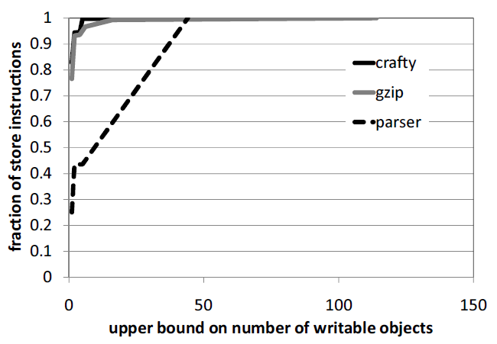
Number of Writable Objects
2010-04-26
Runtime Memory Safety - CSE 504
26

Slide 27
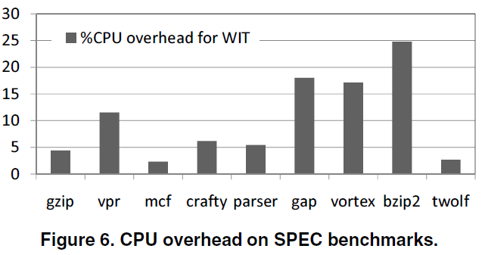
CPU Overhead
2010-04-26
Runtime Memory Safety - CSE 504
27

Slide 28
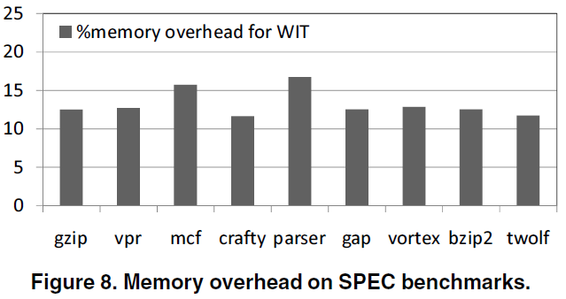
Memory Overhead
2010-04-26
Runtime Memory Safety - CSE 504
28

Slide 29
Testing with Vulnerabilities
Successful against benchmark of 18 control-data attacks that exploit buffer overflows.
All but one are detected when guard object overwritten. The other is detected when a corrupted pointer is used to overwrite a return address (color 0).
Tested with known vulnerabilities in real apps.
All detected when buffer overflow hit a guard object at the end of the buffer.
SQL Server sprintf overflow of stack buffer (Slammer).
Ghttpd vsprintf overflow of stack buffer.
Nullhttpd heap buffer overflow causes heap management data structures to be overwritten.
Stunnel vsprintf format string overflow of stack buffer.
Libpng stack buffer overflow.
2010-04-26
Runtime Memory Safety - CSE 504
29

Slide 30
Limitations
Libraries
WIT as just described doesn’t work for libraries.
WIT for libraries assigns the same well-known color to all unsafe objects allocated by libraries.
Will WIT work without recompiled libraries?
2010-04-26
Runtime Memory Safety - CSE 504
30

Slide 31
DieHard: Probabilistic Memory Safety for Unsafe Languages
Emery D. Berger and
Benjamin G. Zorn

Slide 32
Non-fatal Memory Errors
Existing approaches either:
Abort when memory errors detected.
Continue anyways (!)
How about detecting the memory error and allowing the program to continue correctly?
2010-04-26
Runtime Memory Safety - CSE 504
32

Slide 33
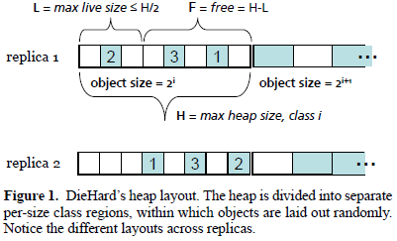
DieHard in a Nutshell
Randomize object locations in a large heap.
Can operate in a replicated mode.
Multiple replicas of the same application are run simultaneously. Require agreement on output.
2010-04-26
Runtime Memory Safety - CSE 504
33

Slide 34
Randomized Object Locations
Likely that buffer overflows end up overwriting only empty space.
Unlikely that a newly-freed object will soon be overwritten by a subsequent allocation.
2010-04-26
Runtime Memory Safety - CSE 504
34

Slide 35
Replication
Stand-alone DieHard cannot detect uninitialized reads.
Solution: execute several replicas simultaneously.
2010-04-26
Runtime Memory Safety - CSE 504
35

Slide 36
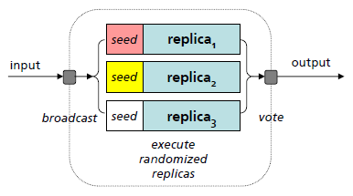
Detecting Uninitialized Reads
Fill allocated object with random values.
Execute same program in multiple replicas.
Compare outputs.
2010-04-26
Runtime Memory Safety - CSE 504
36

Slide 37
Replica Communication
DieHard uses pipes and shared memory to communicate with replicas.
Each replica receives stdin from and writes stdout to DieHard.
DieHard compares output from replicas.
Support not implemented for programs that modify filesystems or perform network I/O.
How would you support non-deterministic programs?
2010-04-26
Runtime Memory Safety - CSE 504
37

Slide 38
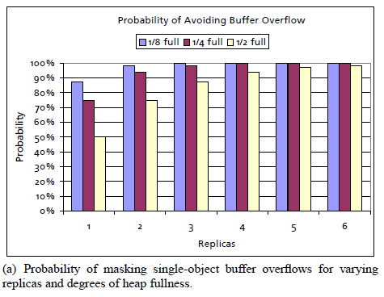
Avoiding Buffer Overflows
“…for our analysis, we model a buffer overflow as a write to any location in the heap.”
2010-04-26
Runtime Memory Safety - CSE 504
38

Slide 39
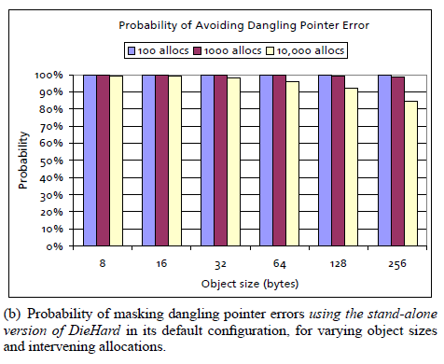
Avoiding Dangling Pointers
“…the likelihood that the object’s contents are not overwritten after A intervening allocations”
2010-04-26
Runtime Memory Safety - CSE 504
39

Slide 40
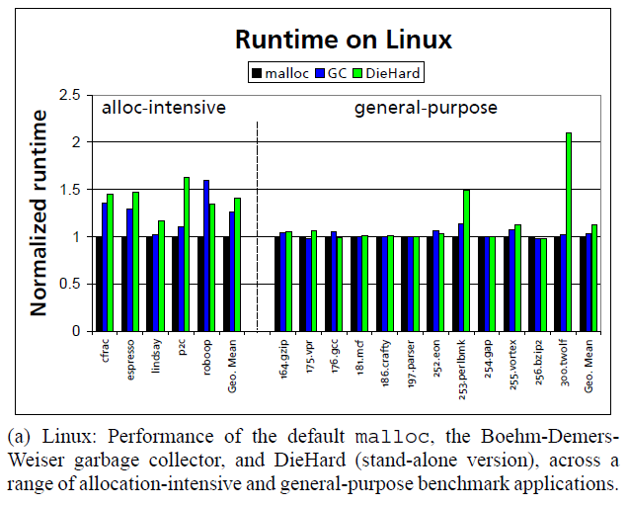
Runtime on Linux
2010-04-26
Runtime Memory Safety - CSE 504
40

Slide 41
Other Approaches
Rx: rollback to a checkpoint, re-execute in a modified environment.
2010-04-26
Runtime Memory Safety - CSE 504
41

Slide 42
Comparison
Approach | Protections | Limitations | CPU Overhead
Memory-safe C (CCured, Cyclone) | All memory errors. | Source and runtime changes (e.g. garbage collector). | High
Taint analysis | Many memory errors. | Accuracy vs. automation. | 2x WIT
Bounds checking C | All buffer overflows. | Doesn’t work with all programs. Protection granularity limited by compile-time information. | Up to 12x WIT
StackGuard, et al. | Specific targets (e.g. return address). | Only defend against specific attacks. | Low
CFI | Control-flow. | Data not protected. | 15-45%
DFI | Some out-of-bounds reads and writes | No guards against imprecise analysis. | 104% over WIT (so, 20-50%)
WIT | Incorrect writes. | Library incompatibility. | 10-25%
DieHard | Probabilistic memory safety. | Large heap, only supports simple programs. | 12-109%.
Dhurjati’s improvements on Jones and Kelly | Most out-of-bounds reads and writes. | No protection of buffer overflow inside structures or use of freed pointers, | 30-125%
Most numbers from WIT’s paper. Don’t take the numbers too seriously, they’ve been adjusted to have about the same frame of reference. Protections and limitations also require grains of salt.
2010-04-26
Runtime Memory Safety - CSE 504
42
Notes:
42

Slide 43
Summary: WIT and DieHard
WIT
Static analysis + instrumentation to protect writes.
Reasonably practical if everything compiled with WIT.
DieHard
Randomize heap object locations and run multiple copies of the program.
Replicas fairly impractical, just an interesting academic idea. (My uneducated opinion, of course.)
2010-04-26
Runtime Memory Safety - CSE 504
43

Slide 44
References
Akritidis, P. and Cadar, C. and Raiciu, C. and Costa, M. and Castro, M. Preventing memory error exploits with WIT. (Oakland 2008)
Abadi, M. and Budiu, M. and Erlingsson, U. and Ligatti, J. Control-flow integrity. (CCS 2005)
Berger, E.D. and Zorn, B.G. DieHard: probabilistic memory safety for unsafe languages. (SIGPLAN 2006)
Castro, M. and Costa, M. and Harris, T. Securing software by enforcing data-flow integrity. (OSDI 2006)
2010-04-26
Runtime Memory Safety - CSE 504
44

