Slide 1
Face Detection
CSE 576

Slide 2
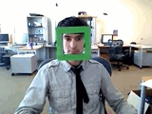
Face detection
State-of-the-art face detection demo
(Courtesy Boris Babenko)

Slide 3
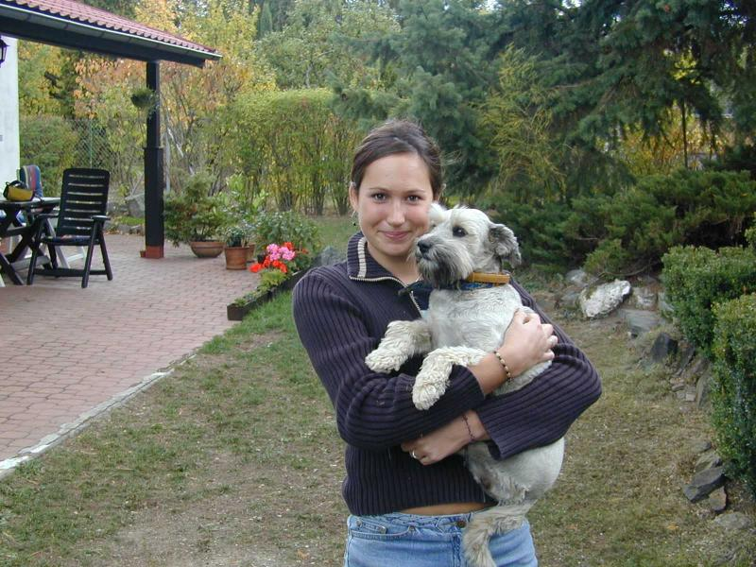
Face detection and recognition
Detection
Recognition
“Sally”

Slide 4
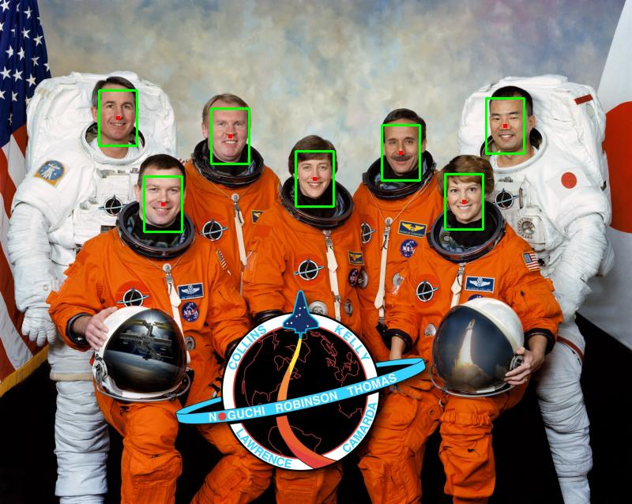
Face detection
Where are the faces?

Slide 5
Face Detection
What kind of features?
What kind of classifiers?

Slide 6
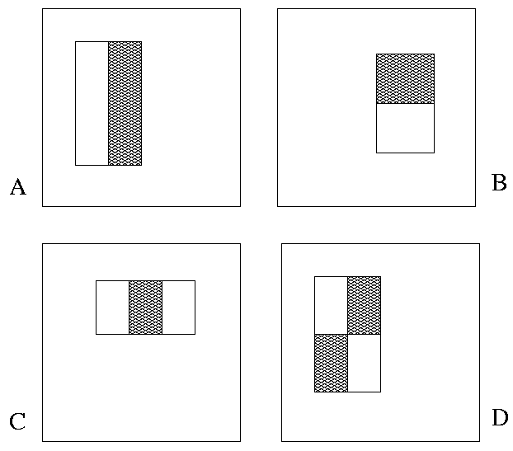
Image Features
“Rectangle filters”
+1
-1
Value =
∑ (pixels in white area) – ∑ (pixels in black area)

Slide 7
Feature extraction
“Rectangular” filters
Feature output is difference between adjacent regions
Efficiently computable with integral image: any sum can be computed in constant time
Avoid scaling images scale features directly for same cost
Viola & Jones, CVPR 2001
K. Grauman, B. Leibe
Notes:
7

Slide 8
Sums of rectangular regions
How do we compute the sum of the pixels in the red box?
243 | 239 | 240 | 225 | 206 | 185 | 188 | 218 | 211 | 206 | 216 | 225
242 | 239 | 218 | 110 | 67 | 31 | 34 | 152 | 213 | 206 | 208 | 221
243 | 242 | 123 | 58 | 94 | 82 | 132 | 77 | 108 | 208 | 208 | 215
235 | 217 | 115 | 212 | 243 | 236 | 247 | 139 | 91 | 209 | 208 | 211
233 | 208 | 131 | 222 | 219 | 226 | 196 | 114 | 74 | 208 | 213 | 214
232 | 217 | 131 | 116 | 77 | 150 | 69 | 56 | 52 | 201 | 228 | 223
232 | 232 | 182 | 186 | 184 | 179 | 159 | 123 | 93 | 232 | 235 | 235
232 | 236 | 201 | 154 | 216 | 133 | 129 | 81 | 175 | 252 | 241 | 240
235 | 238 | 230 | 128 | 172 | 138 | 65 | 63 | 234 | 249 | 241 | 245
237 | 236 | 247 | 143 | 59 | 78 | 10 | 94 | 255 | 248 | 247 | 251
234 | 237 | 245 | 193 | 55 | 33 | 115 | 144 | 213 | 255 | 253 | 251
248 | 245 | 161 | 128 | 149 | 109 | 138 | 65 | 47 | 156 | 239 | 255
190 | 107 | 39 | 102 | 94 | 73 | 114 | 58 | 17 | 7 | 51 | 137
23 | 32 | 33 | 148 | 168 | 203 | 179 | 43 | 27 | 17 | 12 | 8
17 | 26 | 12 | 160 | 255 | 255 | 109 | 22 | 26 | 19 | 35 | 24
After some pre-computation, this can be done in constant time for any box.
This “trick” is commonly used for computing Haar wavelets (a fundemental building block of many object recognition approaches.)

Slide 9
Sums of rectangular regions
The trick is to compute an “integral image.” Every pixel is the sum of its neighbors to the upper left.
Sequentially compute using:

Slide 10
Sums of rectangular regions
 |  | A |  |  |  |  |  |  | B
 |  | C |  |  |  |  |  |  | D
Solution is found using:
A + D – B - C
What if the position of the box lies between pixels?

Slide 11
Large library of filters
Considering all possible filter parameters: position, scale, and type:
180,000+ possible features associated with each 24 x 24 window
Use AdaBoost both to select the informative features and to form the classifier
Viola & Jones, CVPR 2001
Notes:
11

Slide 12
Feature selection
For a 24x24 detection region, the number of possible rectangle features is ~160,000!
At test time, it is impractical to evaluate the entire feature set
Can we create a good classifier using just a small subset of all possible features?
How to select such a subset?

Slide 13
AdaBoost for feature+classifier selection
Want to select the single rectangle feature and threshold that best separates positive (faces) and negative (non-faces) training examples, in terms of weighted error.
Resulting weak classifier:
For next round, reweight the examples according to errors, choose another filter/threshold combo.
…
Outputs of a possible rectangle feature on faces and non-faces.
Viola & Jones, CVPR 2001
Notes:
13

Slide 14
AdaBoost: Intuition
Consider a 2-d feature space with positive and negative examples.
Each weak classifier splits the training examples with at least 50% accuracy.
Examples misclassified by a previous weak learner are given more emphasis at future rounds.
K. Grauman, B. Leibe
Figure adapted from Freund and Schapire
Notes:
14

Slide 15
AdaBoost: Intuition
K. Grauman, B. Leibe
Notes:
15

Slide 16
AdaBoost: Intuition
Final classifier is combination of the weak classifiers
K. Grauman, B. Leibe
Notes:
16

Slide 17
Final classifier is combination of the weak ones, weighted according to error they had.

Slide 18
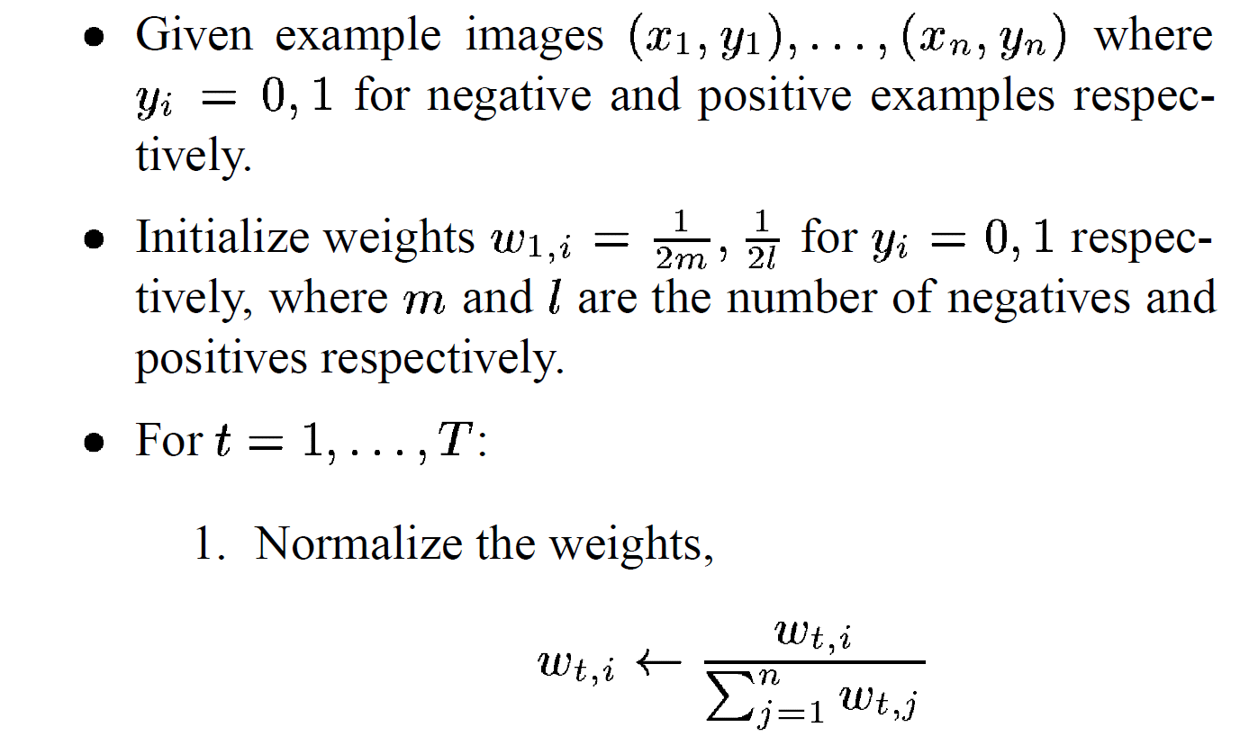
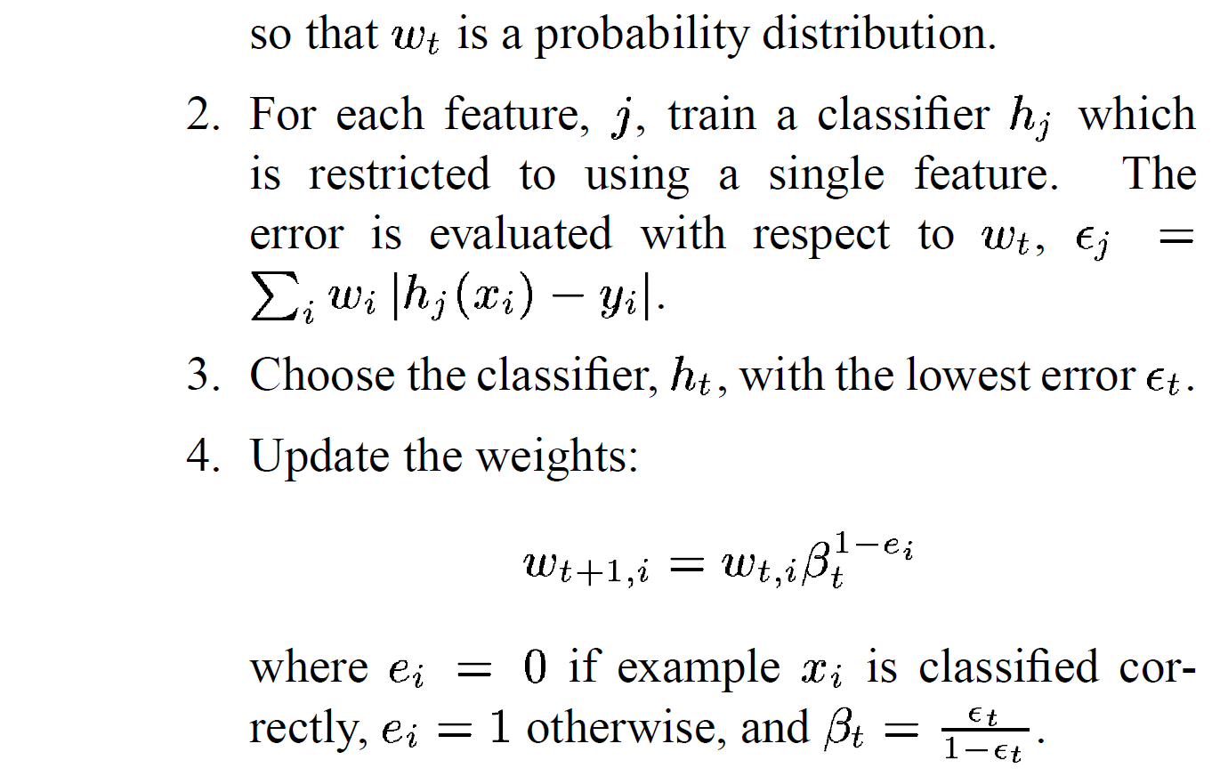
AdaBoost Algorithm
Start with uniform weights on training examples
{x₁,…x_{n}}
For T rounds
Find the best threshold and polarity for each feature, and return error.
Re-weight the examples:
Incorrectly classified -> more weight
Correctly classified -> less weight
Notes:
18

Slide 19
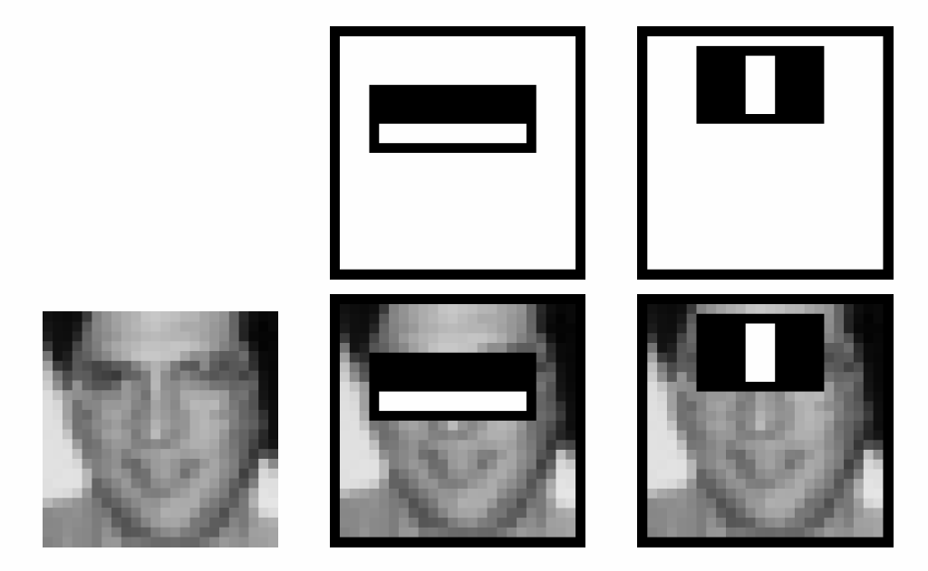
Recall
Classification
NN
Naïve Bayes
Logistic Regression
Boosting
Face Detection
Simple Features
Integral Images
Boosting
 |  | A |  |  |  |  |  |  | B
 |  | C |  |  |  |  |  |  | D

Slide 20
Picking the best classifier
Efficient single pass approach:
At each sample compute:
= min ( S + (T – S), S + (T – S) )
Find the minimum value of , and use the value of the corresponding sample as the threshold.
S = sum of samples below the current sample
T = total sum of all samples

Slide 21
Measuring classification performance
Confusion matrix
Accuracy
(TP+TN)/ (TP+TN+FP+FN)
True Positive Rate=Recall
TP/(TP+FN)
False Positive Rate
FP/(FP+TN)
Precision
TP/(TP+FP)
F1 Score
2*Recall*Precision/ (Recall+Precision)
 |  | Predicted class
 |  | Class1 | Class2 | Class3
Actual class | Class1 | 40 | 1 | 6
 | Class2 | 3 | 25 | 7
 | Class3 | 4 | 9 | 10
 |  | Predicted
 |  | Positive | Negative
Actual | Positive | True Positive | False Negative
 | Negative | False Positive | True Negative
Notes:
Compare to the output of classifier to the actual label
In the case of binary classification, postive and negative
Confusion matrix, each entry show the frequency of will show actual value, predicted value.
True positive, the number of positive examples that has been correctly classified as positive. False positive, negative, positive

Slide 22
Boosting for face detection
First two features selected by boosting: This feature combination can yield 100% detection rate and 50% false positive rate

Slide 23
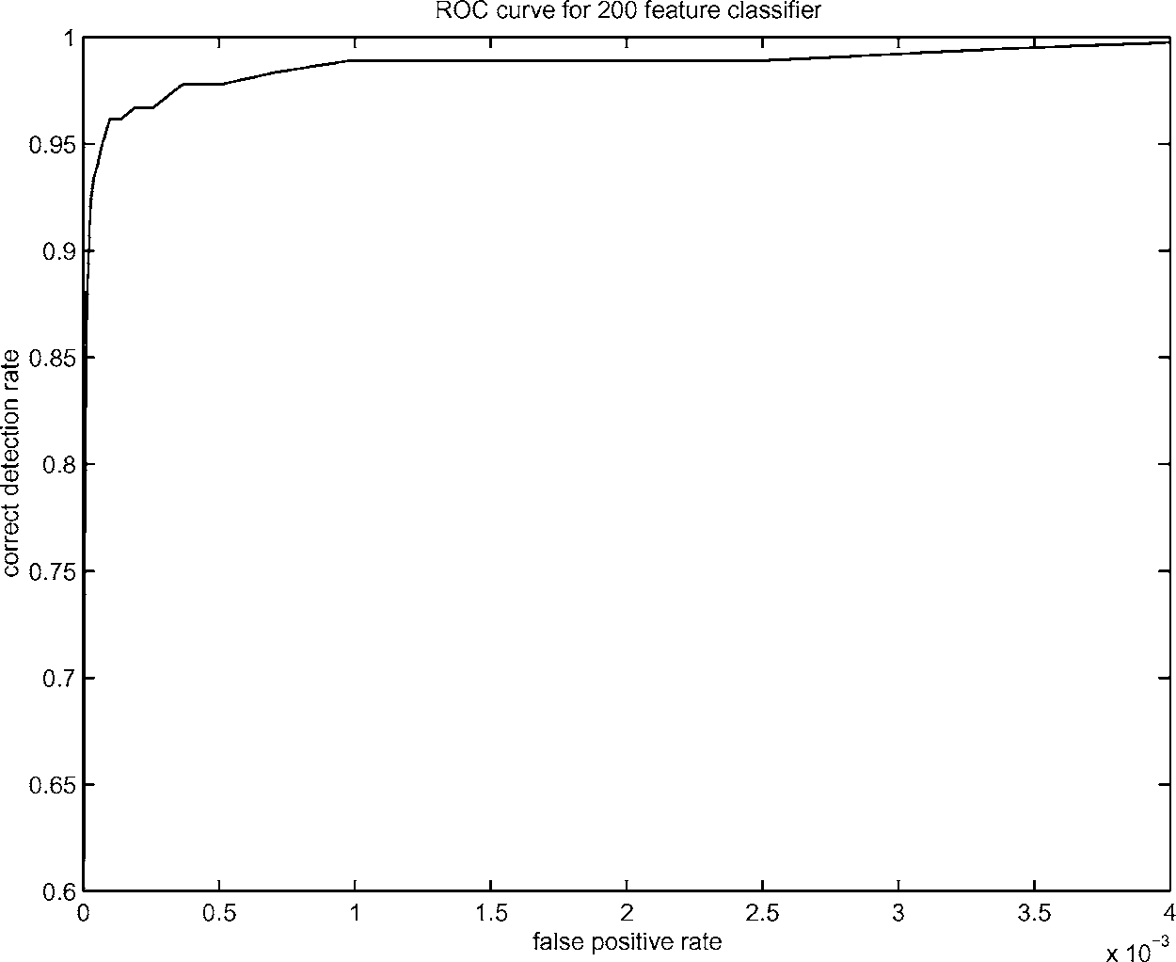
Boosting for face detection
A 200-feature classifier can yield 95% detection rate and a false positive rate of 1 in 14084
Is this good enough?
Receiver operating characteristic (ROC) curve

Slide 24
Attentional cascade
We start with simple classifiers which reject many of the negative sub-windows while detecting almost all positive sub-windows
Positive response from the first classifier triggers the evaluation of a second (more complex) classifier, and so on
A negative outcome at any point leads to the immediate rejection of the sub-window
T
T
T
IMAGE
SUB-WINDOW
T
FACE
Classifier 1
Classifier 2
Classifier 3
F
F
F
NON-FACE
NON-FACE
NON-FACE

Slide 25
Attentional cascade
Chain classifiers that are progressively more complex and have lower false positive rates:
Receiver operating characteristic
% False Pos
0
50
vs
false
neg
determined by
0 100
% Detection
T
T
T
IMAGE
SUB-WINDOW
T
FACE
Classifier 1
Classifier 2
Classifier 3
F
F
F
NON-FACE
NON-FACE
NON-FACE
Notes:
In general simple classifiers, while they are more efficient, they are also weaker.
We could define a computational risk hierarchy (in analogy with structural risk minimization)…
A nested set of classifier classes
The training process is reminiscent of boosting…
- previous classifiers reweight the examples used to train subsequent classifiers
The goal of the training process is different
- instead of minimizing errors minimize false positives

Slide 26
Attentional cascade
The detection rate and the false positive rate of the cascade are found by multiplying the respective rates of the individual stages
A detection rate of 0.9 and a false positive rate on the order of 10⁻⁶ can be achieved by a 10-stage cascade if each stage has a detection rate of 0.99 (0.99¹⁰ ≈ 0.9) and a false positive rate of about 0.30 (0.3¹⁰ ≈ 6×10⁻⁶)
T
T
T
IMAGE
SUB-WINDOW
T
FACE
Classifier 1
Classifier 2
Classifier 3
F
F
F
NON-FACE
NON-FACE
NON-FACE

Slide 27
Training the cascade
Set target detection and false positive rates for each stage
Keep adding features to the current stage until its target rates have been met
Need to lower AdaBoost threshold to maximize detection (as opposed to minimizing total classification error)
Test on a validation set
If the overall false positive rate is not low enough, then add another stage
Use false positives from current stage as the negative training examples for the next stage

Slide 28
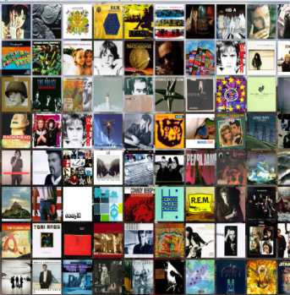
Viola-Jones Face Detector: Summary
Train cascade of classifiers with AdaBoost
Apply to each subwindow
Faces
New image
Selected features, thresholds, and weights
Non-faces
Train with 5K positives, 350M negatives
Real-time detector using 38 layer cascade
6061 features in final layer
[Implementation available in OpenCV: http://www.intel.com/technology/computing/opencv/]
Notes:
28

Slide 29
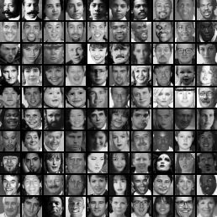
The implemented system
Training Data
5000 faces
All frontal, rescaled to 24x24 pixels
300 million non-faces
9500 non-face images
Faces are normalized
Scale, translation
Many variations
Across individuals
Illumination
Pose
Notes:
This situation with negative examples is actually quite common… where negative examples are free.

Slide 30
System performance
Training time: “weeks” on 466 MHz Sun workstation
38 layers, total of 6061 features
Average of 10 features evaluated per window on test set
“On a 700 Mhz Pentium III processor, the face detector can process a 384 by 288 pixel image in about .067 seconds”
15 Hz
15 times faster than previous detector of comparable accuracy (Rowley et al., 1998)

Slide 31
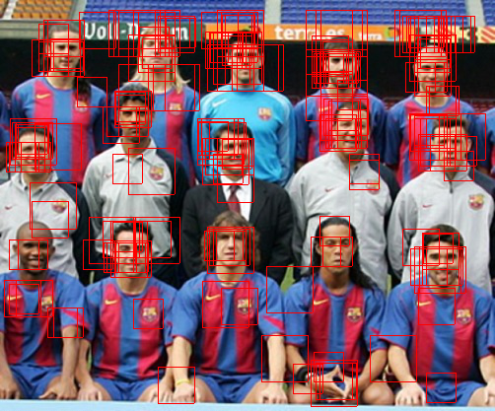
Non-maximal suppression (NMS)
Many detections above threshold.

Slide 32
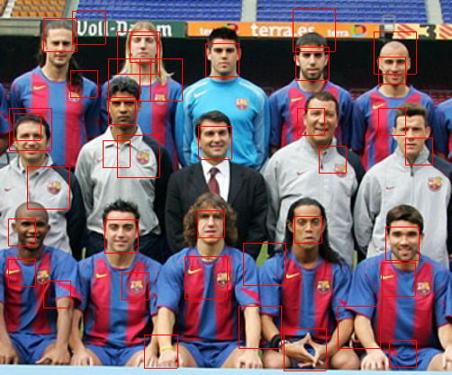
Non-maximal suppression (NMS)

Slide 33
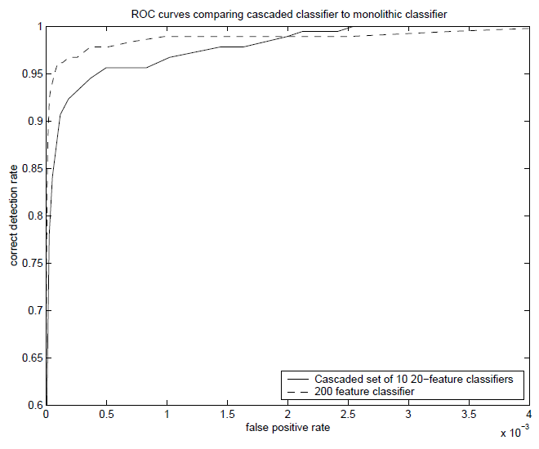
Is this good?
Similar accuracy, but 10x faster

Slide 34
Viola-Jones Face Detector: Results
Notes:
34

Slide 35
Viola-Jones Face Detector: Results
Notes:
35

Slide 36
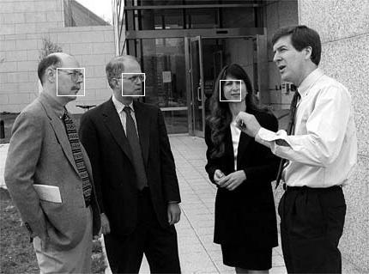
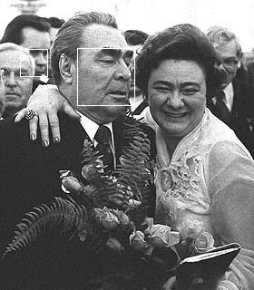
Viola-Jones Face Detector: Results

Slide 37
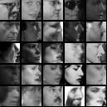
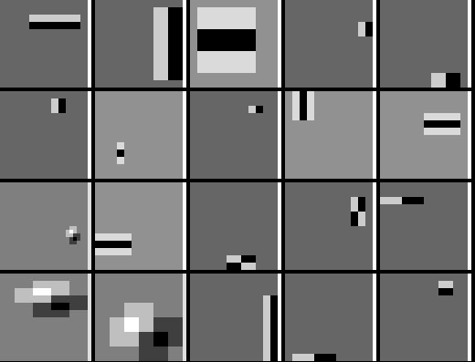
Detecting profile faces?
Detecting profile faces requires training separate detector with profile examples.

Slide 38
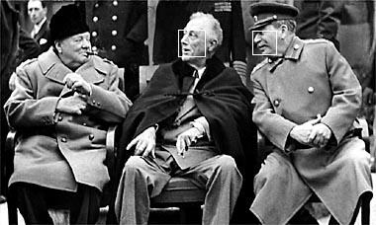
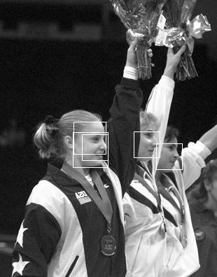
Viola-Jones Face Detector: Results
Paul Viola, ICCV tutorial

Slide 39
Summary: Viola/Jones detector
Rectangle features
Integral images for fast computation
Boosting for feature selection
Attentional cascade for fast rejection of negative windows

