Slide 1
Face Recognition
CSE 576

Slide 2


Face recognition: once you’ve detected and cropped a face, try to recognize it
Detection
Recognition
“Sally”

Slide 3
Face recognition: overview
Typical scenario: few examples per face, identify or verify test example
What’s hard: changes in expression, lighting, age, occlusion, viewpoint
Basic approaches (all nearest neighbor)
  Project into a new subspace
  Measure face features

Slide 4
Typical face recognition scenarios
Verification: a person is claiming a particular identity; verify whether that is true
  E.g., security
Closed-world identification: assign a face to one person from among a known set
General identification: assign a face to a known person or to “unknown”

Slide 5
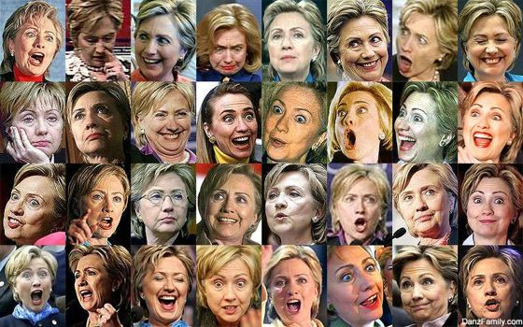
What makes face recognition hard?
Expression

Slide 6




What makes face recognition hard?
Lighting

Slide 7
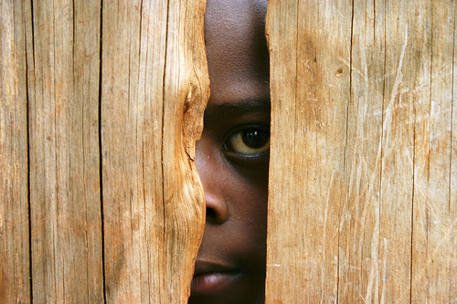
What makes face recognition hard?
Occlusion

Slide 8
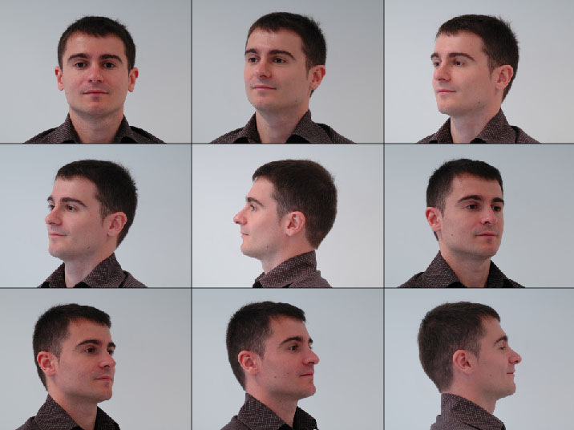
What makes face recognition hard?
Viewpoint

Slide 9

Simple idea for face recognition
Treat face image as a vector of intensities
Recognize face by nearest neighbor in database

Slide 10
The space of all face images
When viewed as vectors of pixel values, face images are extremely high-dimensional
  100x100 image = 10,000 dimensions
  Slow and lots of storage
But very few 10,000-dimensional vectors are valid face images
We want to effectively model the subspace of face images

Slide 11
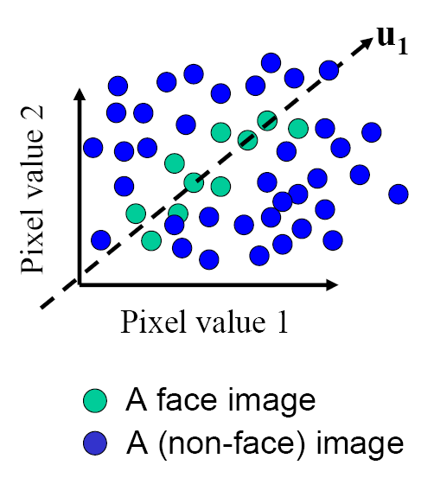
The space of all face images
Idea: construct a low-dimensional linear subspace that best explains the variation in the set of face images

Slide 12

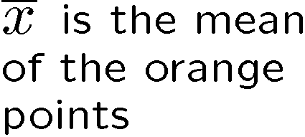
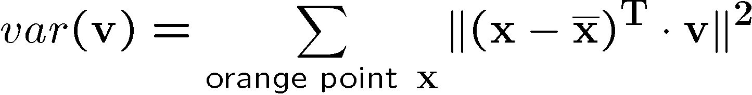







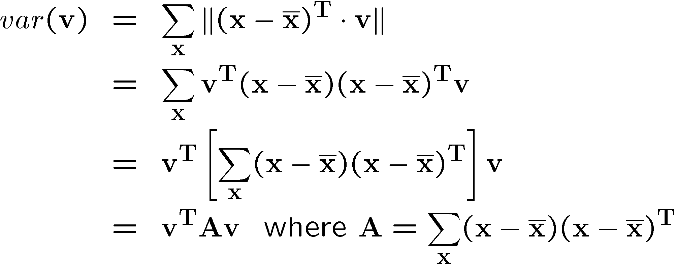
Linear subspaces
Consider the variation along direction v among all of the orange points:
What unit vector v minimizes var?
What unit vector v maximizes var?
Solution: v₁ is eigenvector of A with largest eigenvalue
v₂ is eigenvector of A with smallest eigenvalue

Slide 13
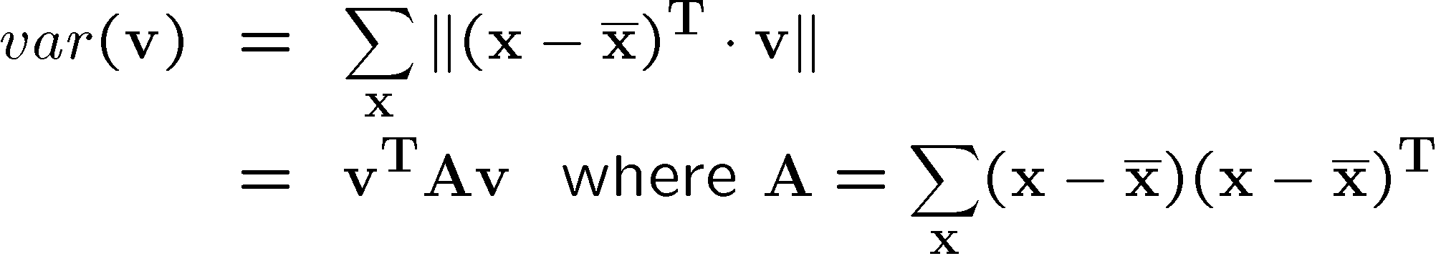
Principal component analysis (PCA)
Suppose each data point is N-dimensional
  Same procedure applies:
  The eigenvectors of A define a new coordinate system
    eigenvector with largest eigenvalue captures the most variation among training vectors x
    eigenvector with smallest eigenvalue has least variation
  We can compress the data by only using the top few eigenvectors
    corresponds to choosing a “linear subspace”
      represent points on a line, plane, or “hyper-plane”
    these eigenvectors are known as the principal components

Slide 14
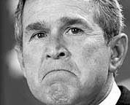
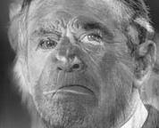
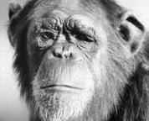
The space of faces
=
+
An image is a point in a high dimensional space
  An N x M image is a point in R^{NM}
  We can define vectors in this space as we did in the 2D case

Slide 15
Dimensionality reduction
The set of faces is a “subspace” of the set of images
  Suppose it is K dimensional
  We can find the best subspace using PCA
  This is like fitting a “hyper-plane” to the set of faces
    spanned by vectors v₁, v₂, ..., v_{K}
    any face

Slide 16
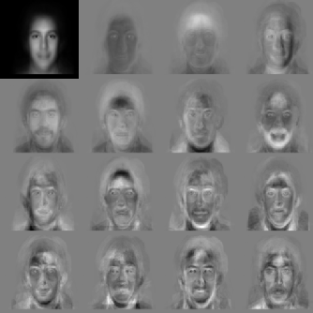


Eigenfaces
PCA extracts the eigenvectors of A
  Gives a set of vectors v₁, v₂, v₃, ...
  Each one of these vectors is a direction in face space
    what do these look like?

Slide 17

Visualization of eigenfaces
Principal component (eigenvector) u_{k}
μ + 3σ_{k}u_{k}
μ – 3σ_{k}u_{k}

Slide 18



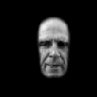
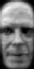










Projecting onto the eigenfaces
The eigenfaces v₁, ..., v_{K} span the space of faces
  A face is converted to eigenface coordinates by

Slide 19

Recognition with eigenfaces
Algorithm
  Process the image database (set of images with labels)
    Run PCA—compute eigenfaces
    Calculate the K coefficients for each image
  Given a new image (to be recognized) x, calculate K coefficients
  Detect if x is a face
  If it is a face, who is it?
Find closest labeled face in database
nearest-neighbor in K-dimensional space

Slide 20
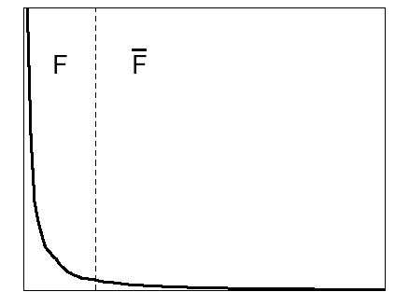

Choosing the dimension K
eigenvalues
i =
K
NM
How many eigenfaces to use?
Look at the decay of the eigenvalues
  the eigenvalue tells you the amount of variance “in the direction” of that eigenface
  ignore eigenfaces with low variance

Slide 21
PCA
General dimensionality reduction technique
Preserves most of variance with a much more compact representation
  Lower storage requirements (eigenvectors + a few numbers per face)
  Faster matching

Slide 22
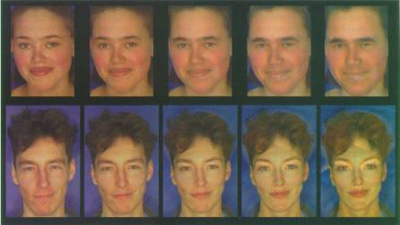
Enhancing gender
more same original androgynous more opposite
D. Rowland and D. Perrett, “Manipulating Facial Appearance through Shape and Color,” IEEE CG&A, September 1995
Slide credit: A. Efros

Slide 23
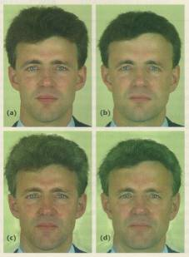
Changing age
Face becomes “rounder” and “more textured” and “grayer”
original shape
color both
D. Rowland and D. Perrett, “Manipulating Facial Appearance through Shape and Color,” IEEE CG&A, September 1995
Slide credit: A. Efros

Slide 24
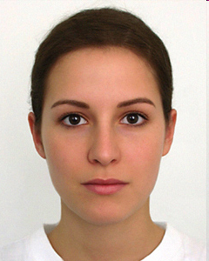
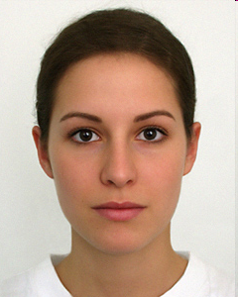
Which face is more attractive?
http://www.beautycheck.de

Slide 25
Which face is more attractive?
left
right

Slide 26
Which face is more attractive?
0.5(attractive + average)
attractive

Slide 27
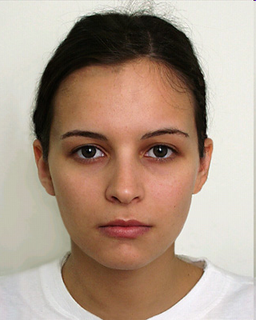
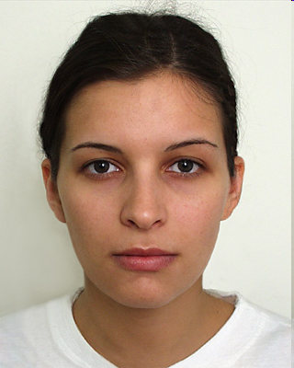
Which face is more attractive?
http://www.beautycheck.de

Slide 28
Which face is more attractive?
left
right

Slide 29
Which face is more attractive?
0.5(adult+child)
adult

Slide 30
Limitations
The direction of maximum variance is not always good for classification

Slide 31
A more discriminative subspace: FLD
Fisher Linear Discriminants → “Fisher Faces”
PCA preserves maximum variance
FLD preserves discrimination
  Find projection that maximizes scatter between classes and minimizes scatter within classes
Reference: Eigenfaces vs. Fisherfaces, Belheumer et al., PAMI 1997

Slide 32
Illustration of the Projection
Using two classes as example:
x2
x2
x1
x1
Poor Projection
Good

Slide 33
Comparing with PCA

Slide 34
Variables
N Sample images:
c classes:
Average of each class:
Average of all data:

Slide 35
Scatter Matrices
Scatter of class i:
Within class scatter:
Between class scatter:

Slide 36
Illustration
x2
Within class scatter
x1
Between class scatter

Slide 37
Mathematical Formulation
After projection
  Between class scatter
  Within class scatter
Objective
Solution: Generalized Eigenvectors
Rank of W_{opt} is limited
  Rank(S_{B}) <= |C|-1
  Rank(S_{W}) <= N-C

Slide 38
Illustration
x2
x1

Slide 39
Recognition with FLD
Use PCA to reduce dimensions to N-C
Compute within-class and between-class scatter matrices for PCA coefficients
Solve generalized eigenvector problem
Project to FLD subspace (c-1 dimensions)
Classify by nearest neighbor
Note: x in step 2 refers to PCA coef; x in step 4 refers to original data

Slide 40
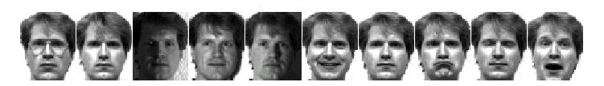
Results: Eigenface vs. Fisherface
Input: 160 images of 16 people
Train: 159 images
Test: 1 image
Variation in Facial Expression, Eyewear, and Lighting
With glasses
Without glasses
3 Lighting conditions
5 expressions
Reference: Eigenfaces vs. Fisherfaces, Belheumer et al., PAMI 1997

Slide 41
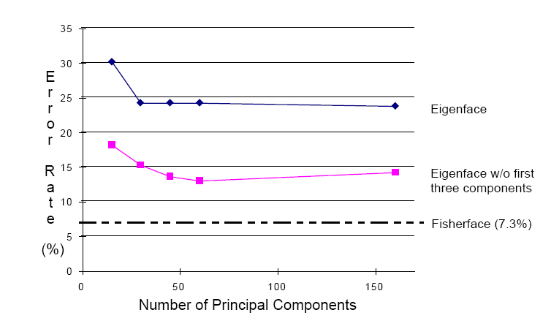
Eigenfaces vs. Fisherfaces
Reference: Eigenfaces vs. Fisherfaces, Belheumer et al., PAMI 1997

Slide 42
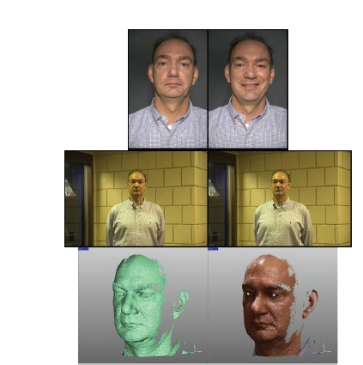
Large scale comparison of methods
FRVT 2006 Report

Slide 43
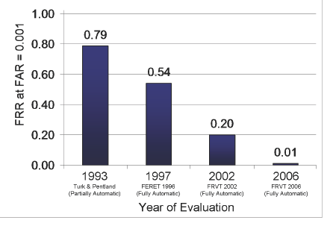
FVRT Challenge
Frontal faces
  FVRT2006 evaluation
False Rejection Rate at False Acceptance Rate = 0.001

Slide 44
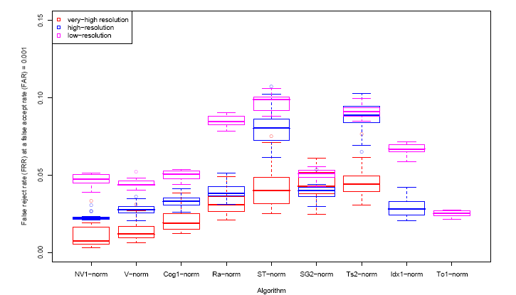
FVRT Challenge
Frontal faces
  FVRT2006 evaluation: controlled illumination

Slide 45
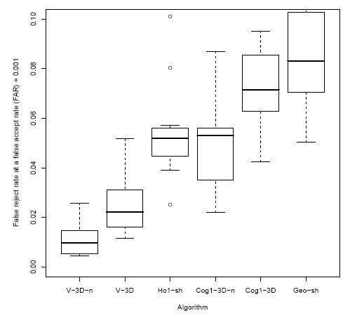
FVRT Challenge
Frontal faces
  FVRT2006 evaluation: uncontrolled illumination

Slide 46
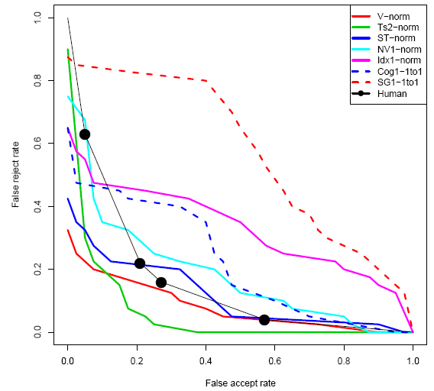
FVRT Challenge
Frontal faces
  FVRT2006 evaluation: computers win!

Slide 47
Face recognition by humans
Face recognition by humans: 20 results (2005)
Slides by Jianchao Yang

Slide 48
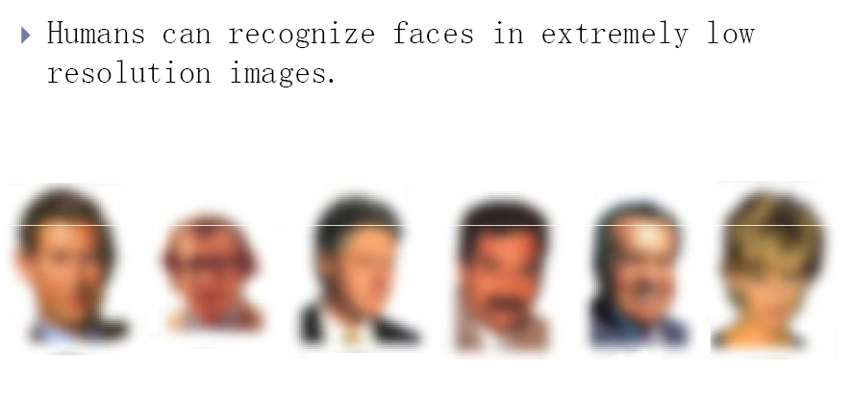

Slide 49
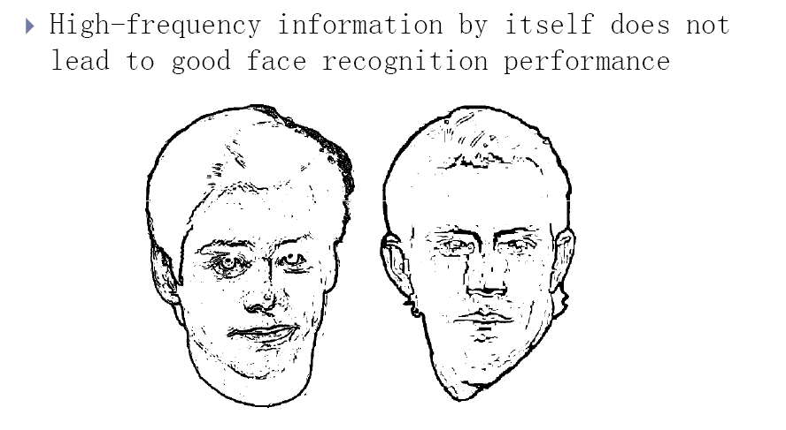

Slide 50
Result 4: Facial features are processed holistically

Slide 51
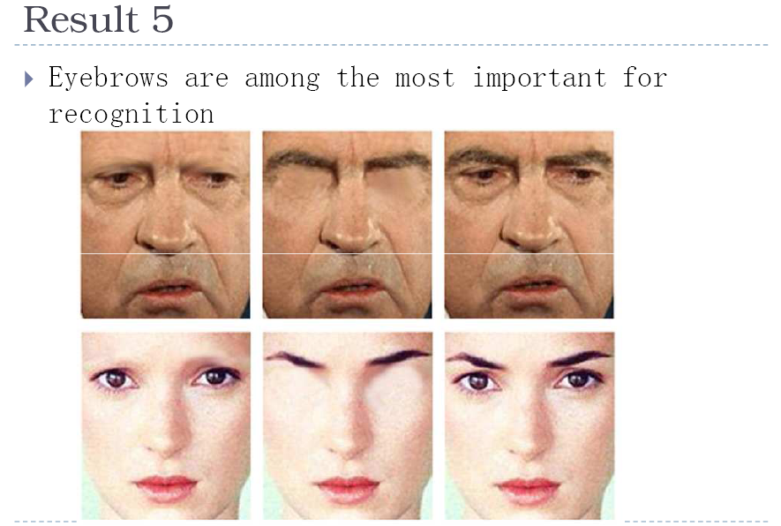

Slide 52
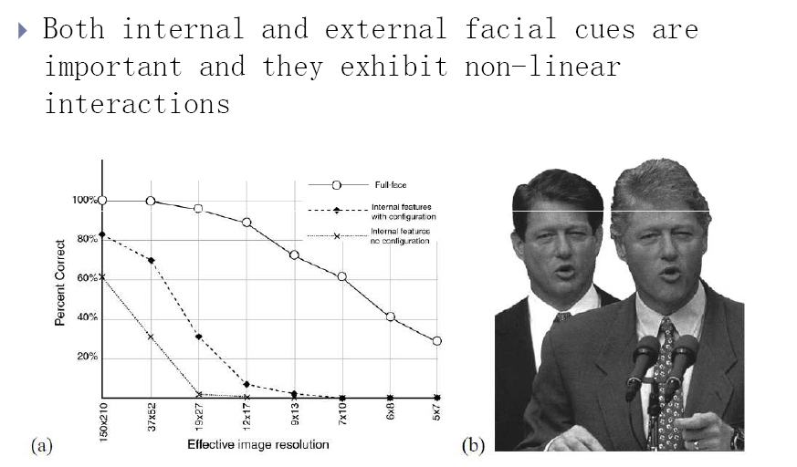

Slide 53
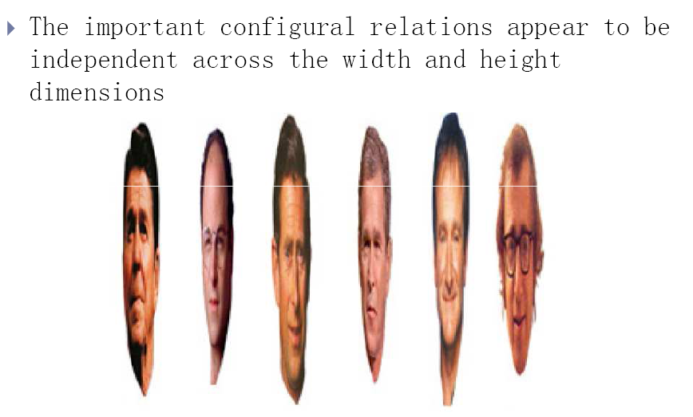

Slide 54
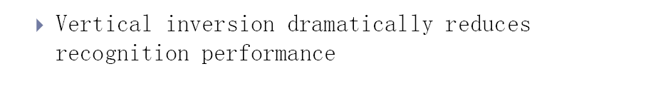
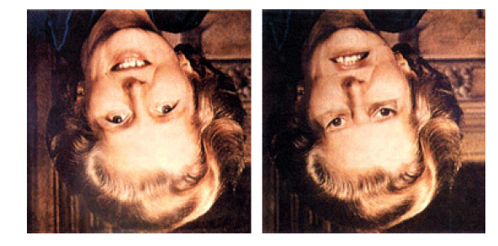
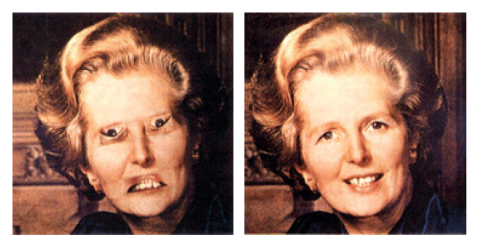

Slide 55
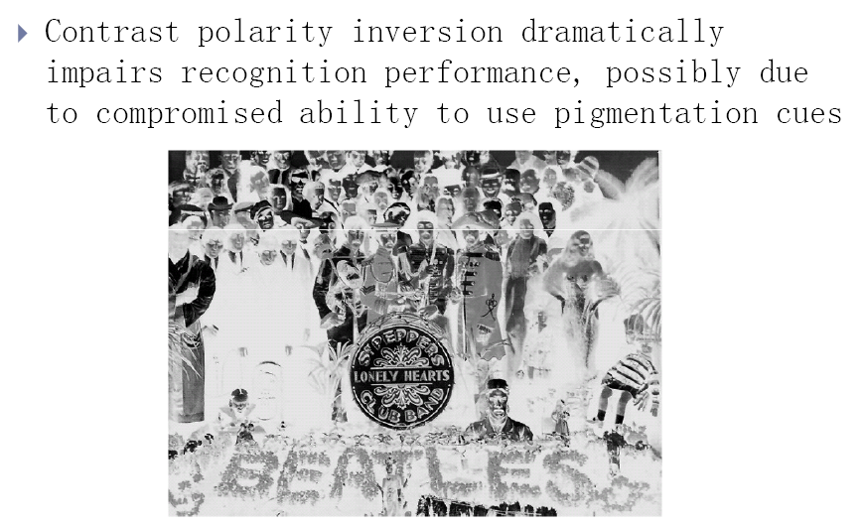
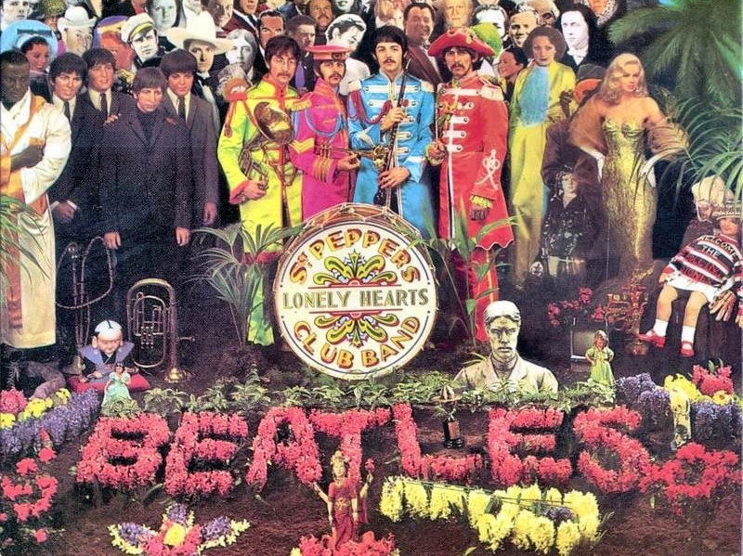

Slide 56
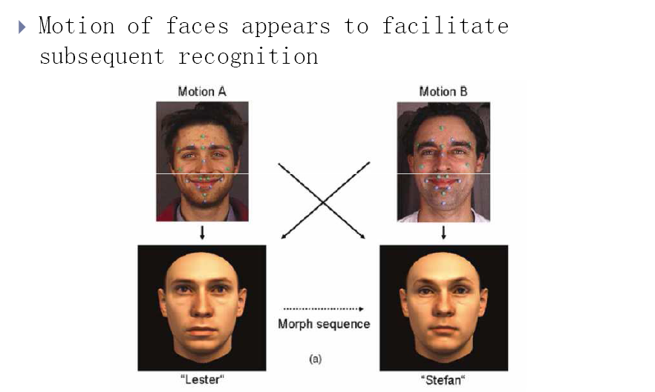

Slide 57
The visual system starts with a rudimentary preference for face- like patterns

Slide 58
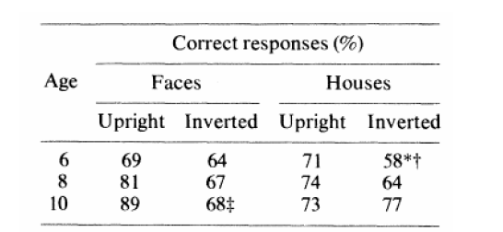
Result 17: Vision progresses from piecemeal to holistic

Slide 59
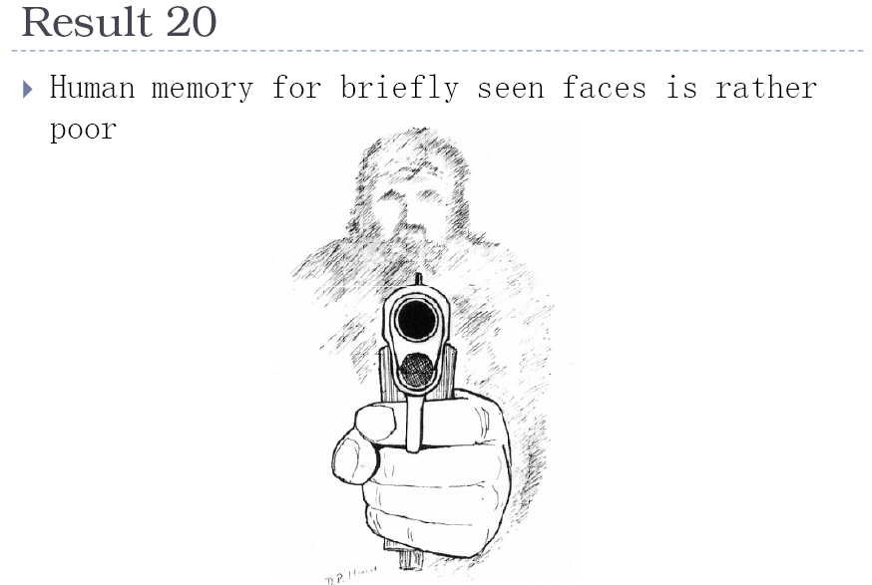

Slide 60
Things to remember
PCA is a generally useful dimensionality reduction technique
  But not ideal for discrimination
FLD better for discrimination, though only ideal under Gaussian data assumptions
Computer face recognition works very well under controlled environments – still room for improvement in general conditions

