Slide 1
Recognition III
Ali Farhadi
CSE 576

Slide 2
We have talked about
Nearest Neighbor
Naïve Bayes
Logistic Regression
Boosting

Slide 3
Support Vector Machines

Slide 4
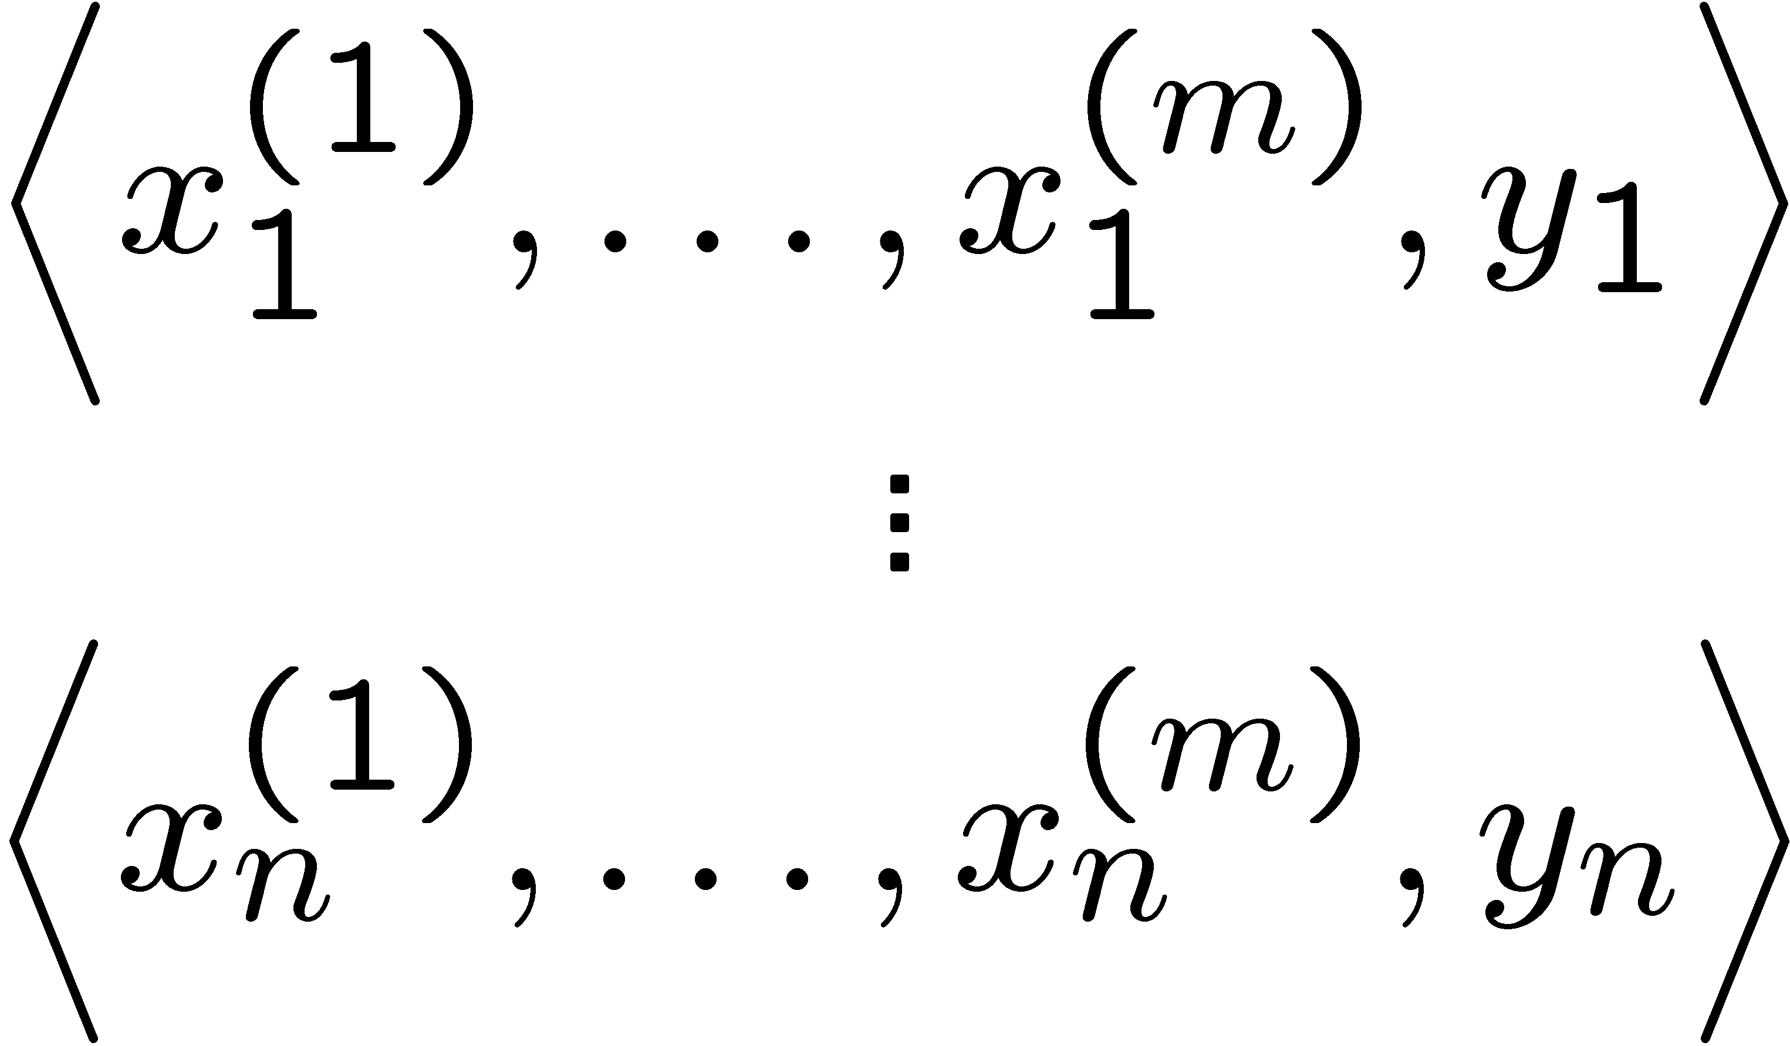
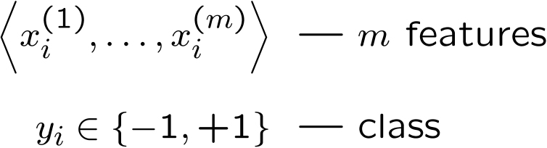
Linear classifiers – Which line is better?
w. = ∑_{j} w^{(j)} x^{(j)}
Data
Example i
Notes:
(1) perceptron, (2) minize weights, (3) max margin

Slide 5
Pick the one with the largest margin!
Margin: measures height of w.x+b plane at each point, increases with distance
w.x + b >> 0
w.x + b > 0
w.x + b = 0
w.x + b < 0
w.x + b << 0
γ
γ
γ
Max Margin: two equivalent forms
γ
(1)
(2)
w.x = ∑_{j} w^{(j)} x^{(j)}

Slide 6
How many possible solutions?
w.x + b = 0
Any other ways of writing the same dividing line?
w.x + b = 0
2w.x + 2b = 0
1000w.x + 1000b = 0
….
Any constant scaling has the same intersection with z=0 plane, so same dividing line!
Do we really want to max _{γ,w,b}?

Slide 7
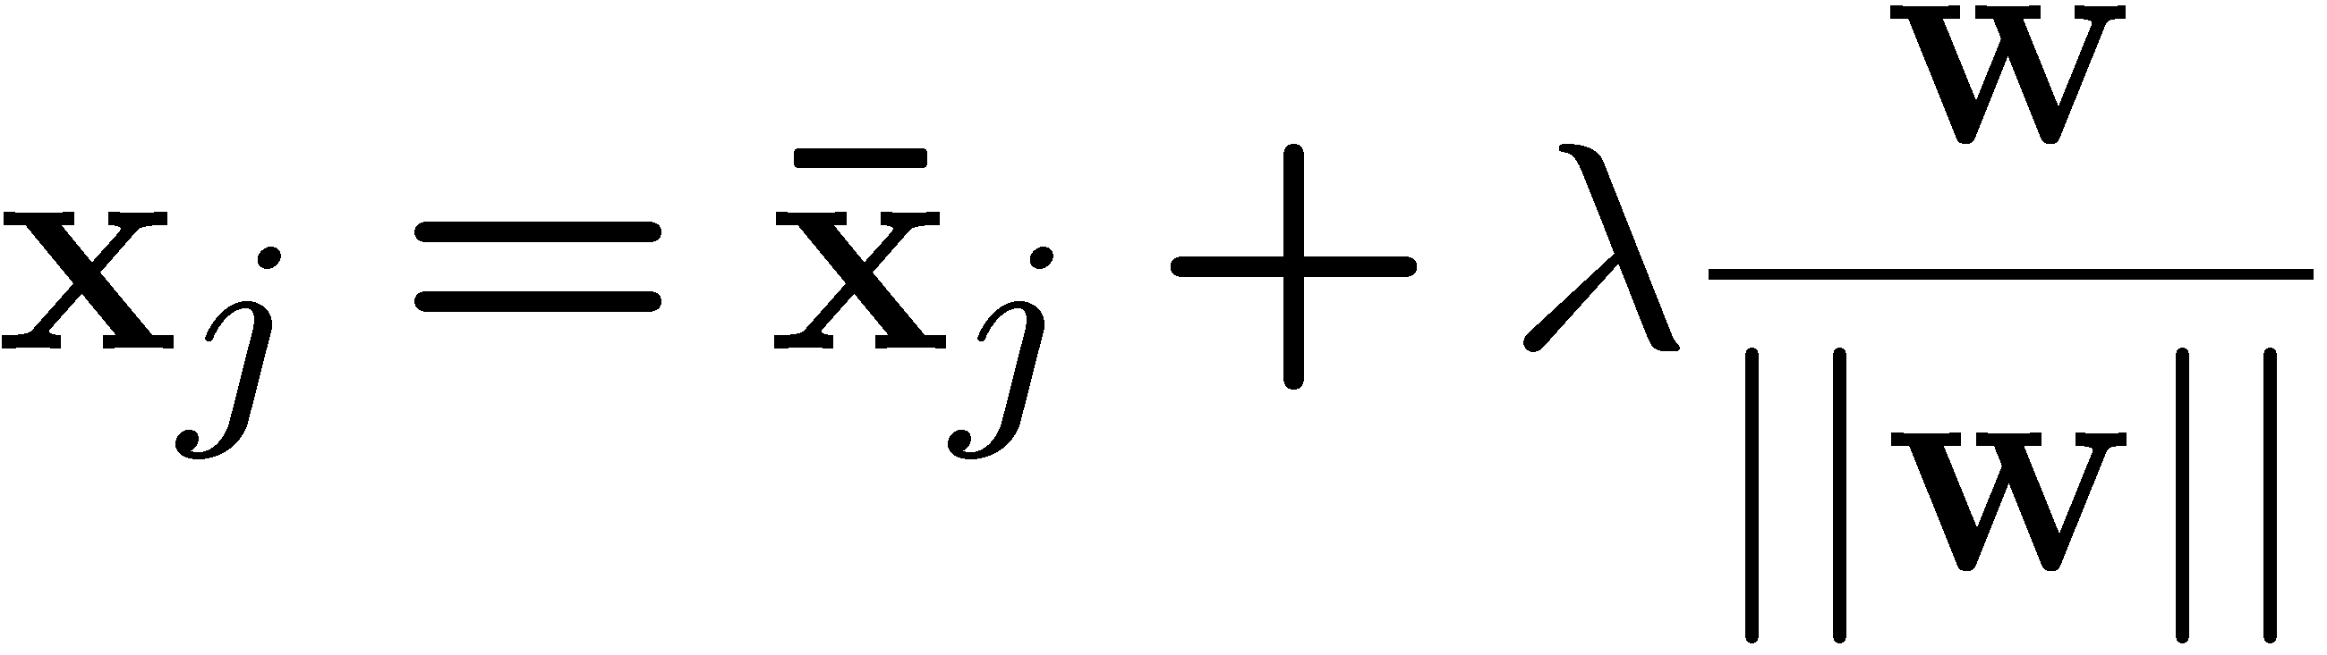
Review: Normal to a plane
w.x + b = 0
Key Terms
-- projection of x_{j} onto w
-- unit vector normal to w

Slide 8
Idea: constrained margin
Generally:
w.x + b = +1
w.x + b = 0
w.x + b = -1
Assume: x⁺ on positive line, x⁻ on negative
γ
x⁺
x⁻
Final result: can maximize constrained margin by minimizing ||w||₂!!!

Slide 9
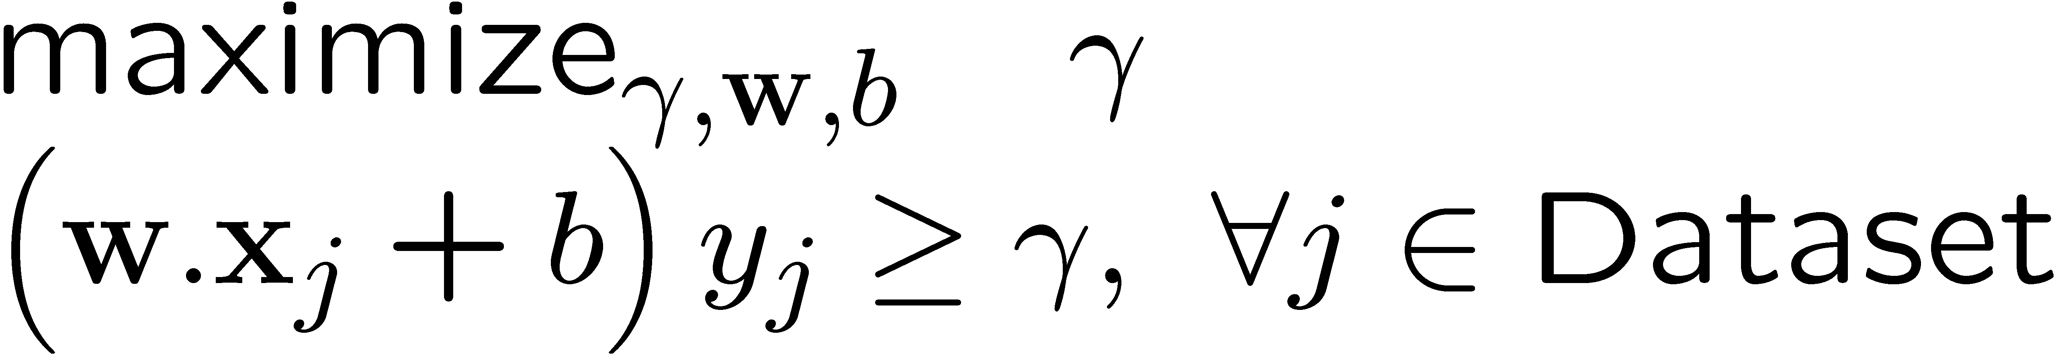
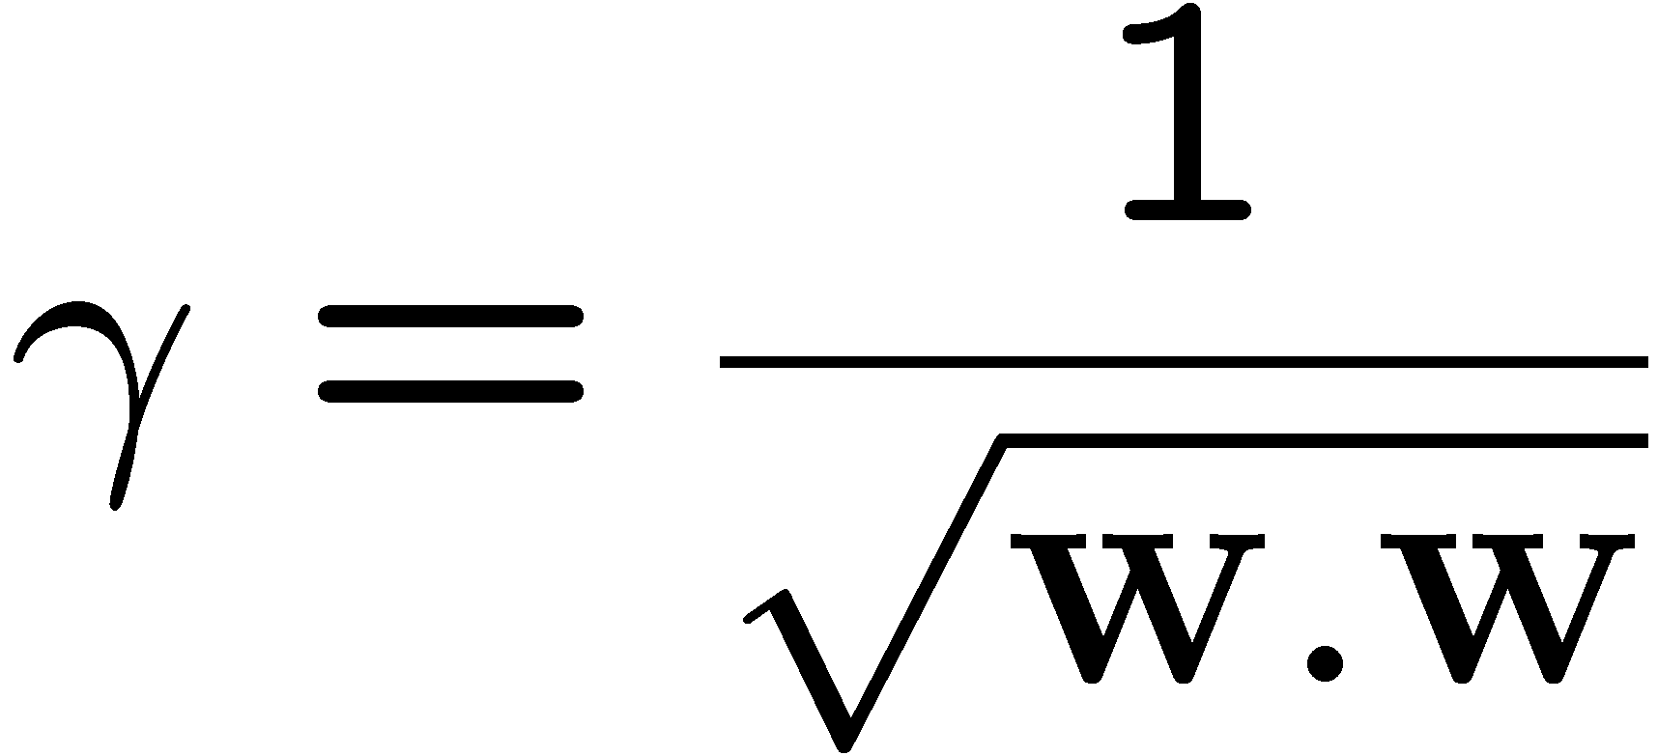
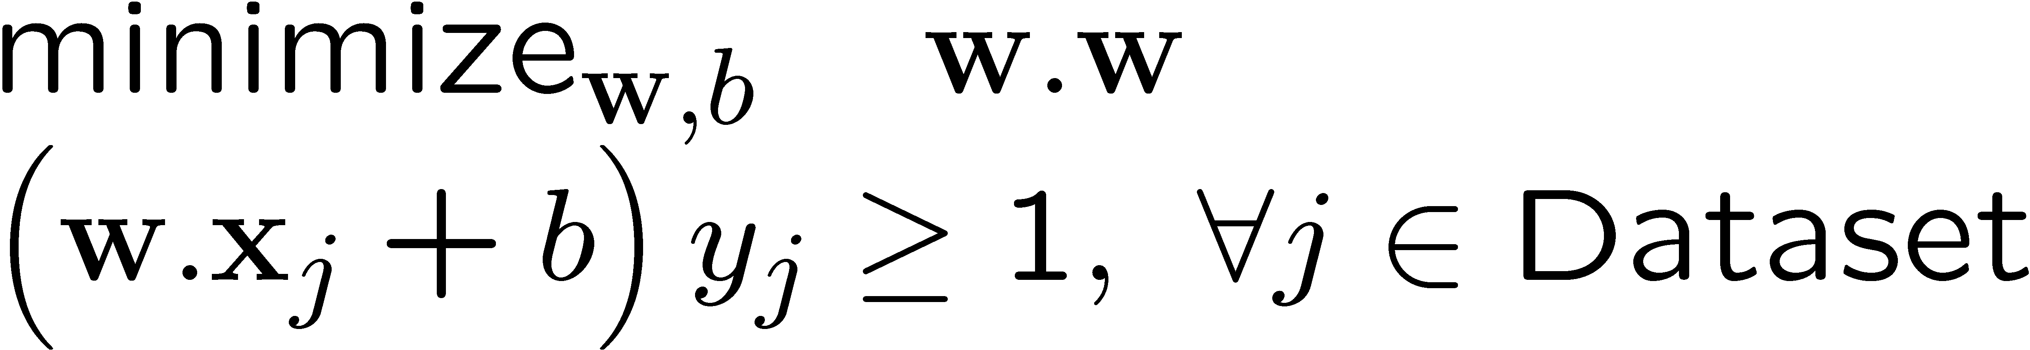
Max margin using canonical hyperplanes
w.x + b = +1
w.x + b = 0
w.x + b = -1
γ
x⁺
x⁻
The assumption of canonical hyperplanes (at +1 and -1) changes the objective and the constraints!

Slide 10
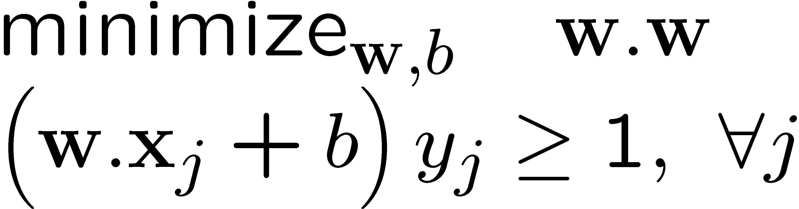
Support vector machines (SVMs)
w.x + b = +1
w.x + b = 0
w.x + b = -1
Solve efficiently by quadratic programming (QP)
  Well-studied solution algorithms
  Not simple gradient ascent, but close
Hyperplane defined by support vectors
  Could use them as a lower-dimension basis to write down line, although we haven’t seen how yet
  More on this later
margin 2γ
Non-support Vectors:
everything else
moving them will not change w
Support Vectors:
data points on the canonical lines

Slide 11
What if the data is not linearly separable?
Add More Features!!!
What about overfitting?

Slide 12
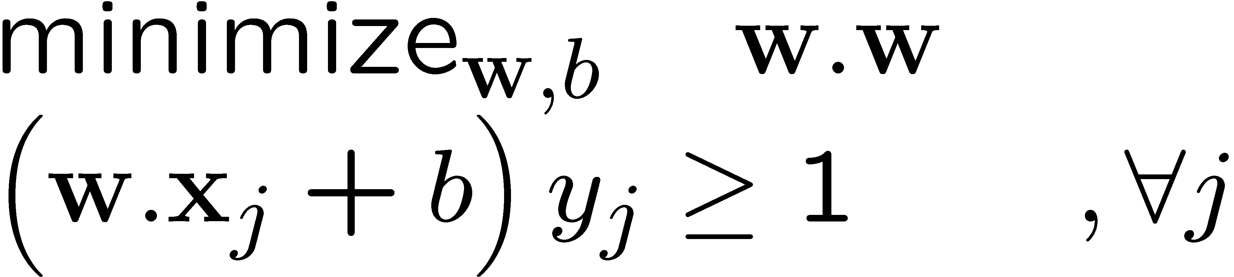
What if the data is still not linearly separable?
+ C #(mistakes)
First Idea: Jointly minimize w.w and number of training mistakes
  How to tradeoff two criteria?
  Pick C on development / cross validation
Tradeoff #(mistakes) and w.w
  0/1 loss
  Not QP anymore
  Also doesn’t distinguish near misses and really bad mistakes
  NP hard to find optimal solution!!!

Slide 13
Slack variables – Hinge loss
+ C Σ_{j} ξ_{j}
w.x + b = +1
w.x + b = 0
w.x + b = -1
- ξ_{j}
ξ_{j}≥0
ξ
ξ
Slack Penalty C > 0:
C=∞ → have to separate the data!
C=0 → ignore data entirely!
Select on dev. set, etc.
ξ
ξ
For each data point:
If margin ≥ 1, don’t care
If margin < 1, pay linear penalty

Slide 14
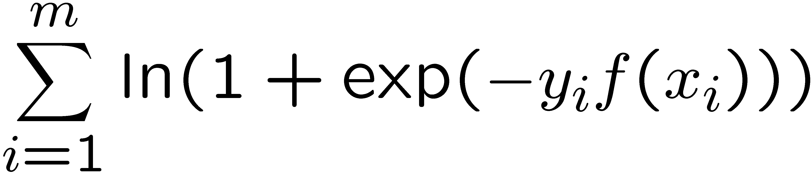
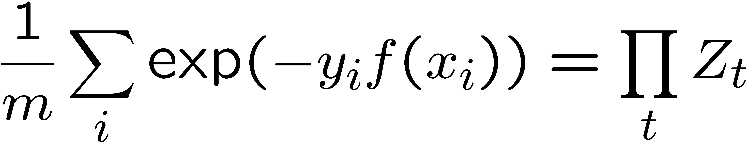
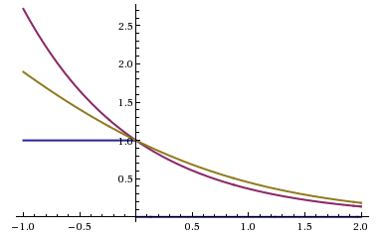
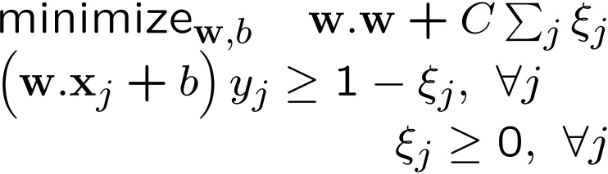
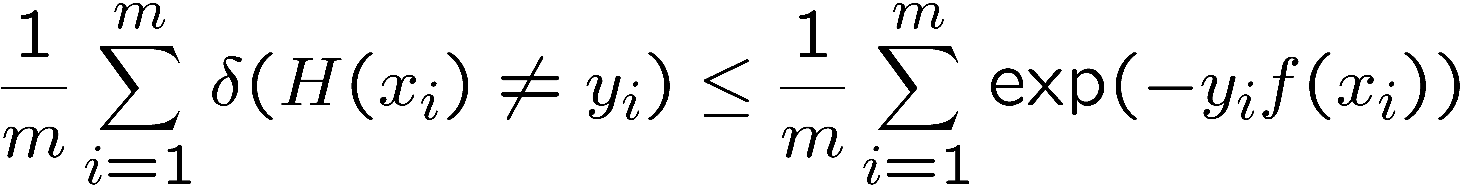
Side Note: Different Losses
Logistic regression:
Boosting :
SVM:
Hinge loss:
0-1 Loss:
All our new losses approximate 0/1 loss!
Notes:
Hinge loss can lead to sparse solutions!!!!

Slide 15
What about multiple classes?

Slide 16
One against All
w₊
Learn 3 classifiers:
+ vs {0,-}, weights w₊
- vs {0,+}, weights w₋
0 vs {+,-}, weights w₀
Output for x:
y = argmax_{i} w_{i}.x
w₋
w₀
Any other way?
Any problems?
Notes:
Could we learn lines above? Yes, but would require slack vairables?

Slide 17
Learn 1 classifier: Multiclass SVM
w₊
Simultaneously learn 3 sets of weights:
How do we guarantee the correct labels?
Need new constraints!
w₋
w₀
For j possible classes:
Notes:
Could we learn lines above? Currently, no slack variables…

Slide 18
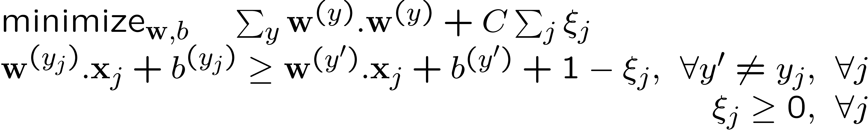
Learn 1 classifier: Multiclass SVM
Also, can introduce slack variables, as before:

Slide 19
What if the data is not linearly separable?
Add More Features!!!

Slide 20


Slide 21
Comparison
assuming x in {0 1}
Learning Objective
Training
Inference
Naïve Bayes
Logistic Regression
Gradient ascent
Linear SVM
Quadratic programming or subgradient opt.
Kernelized SVM
complicated to write
Quadratic programming
Nearest Neighbor
most similar features → same label
Record data

Slide 22

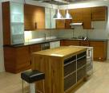



Image Categorization
Training
Training Labels
Training Images
Image Features
Classifier Training
Trained Classifier
Testing
Image Features
Trained Classifier
Prediction
Outdoor
Test Image

Slide 23
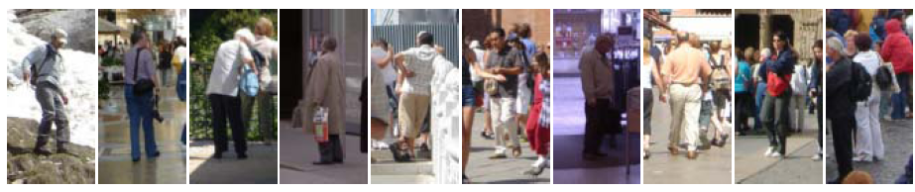
Example: Dalal-Triggs pedestrian detector
Extract fixed-sized (64x128 pixel) window at each position and scale
Compute HOG (histogram of gradient) features within each window
Score the window with a linear SVM classifier
Perform non-maxima suppression to remove overlapping detections with lower scores
Navneet Dalal and Bill Triggs, Histograms of Oriented Gradients for Human Detection, CVPR05

Slide 24

Slides by Pete Barnum
Navneet Dalal and Bill Triggs, Histograms of Oriented Gradients for Human Detection, CVPR05

Slide 25
Tested with
  RGB
  LAB
  Grayscale
Slightly better performance vs. grayscale

Slide 26


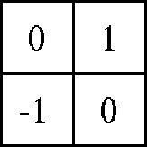

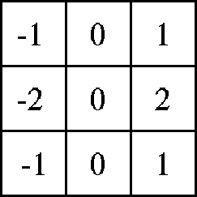

Outperforms
centered
diagonal
uncentered
cubic-corrected
Sobel
Slides by Pete Barnum
Navneet Dalal and Bill Triggs, Histograms of Oriented Gradients for Human Detection, CVPR05

Slide 27

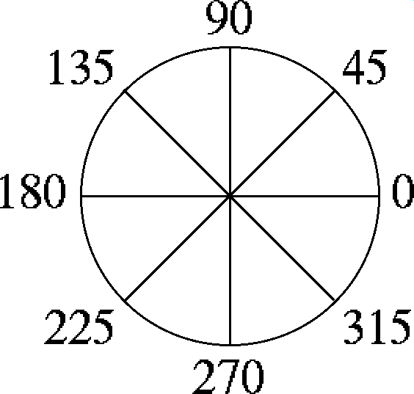
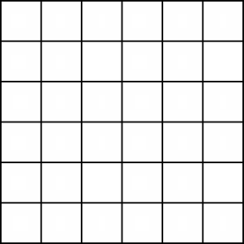
Histogram of gradient orientations
  Votes weighted by magnitude
  Bilinear interpolation between cells
Orientation: 9 bins (for unsigned angles)
Histograms in 8x8 pixel cells
Slides by Pete Barnum
Navneet Dalal and Bill Triggs, Histograms of Oriented Gradients for Human Detection, CVPR05

Slide 28
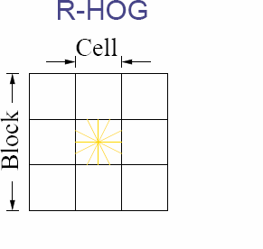
Normalize with respect to surrounding cells
Slides by Pete Barnum
Navneet Dalal and Bill Triggs, Histograms of Oriented Gradients for Human Detection, CVPR05

Slide 29
# orientations
# features = 15 x 7 x 9 x 4 = 3780
X=
# cells
# normalizations by neighboring cells
Slides by Pete Barnum
Navneet Dalal and Bill Triggs, Histograms of Oriented Gradients for Human Detection, CVPR05

Slide 30
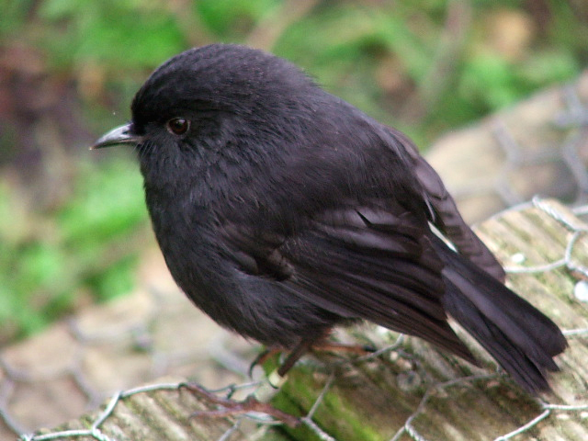
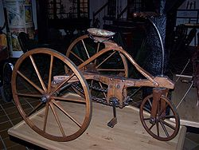
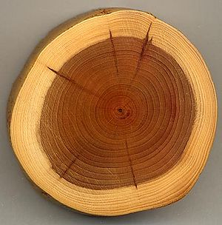
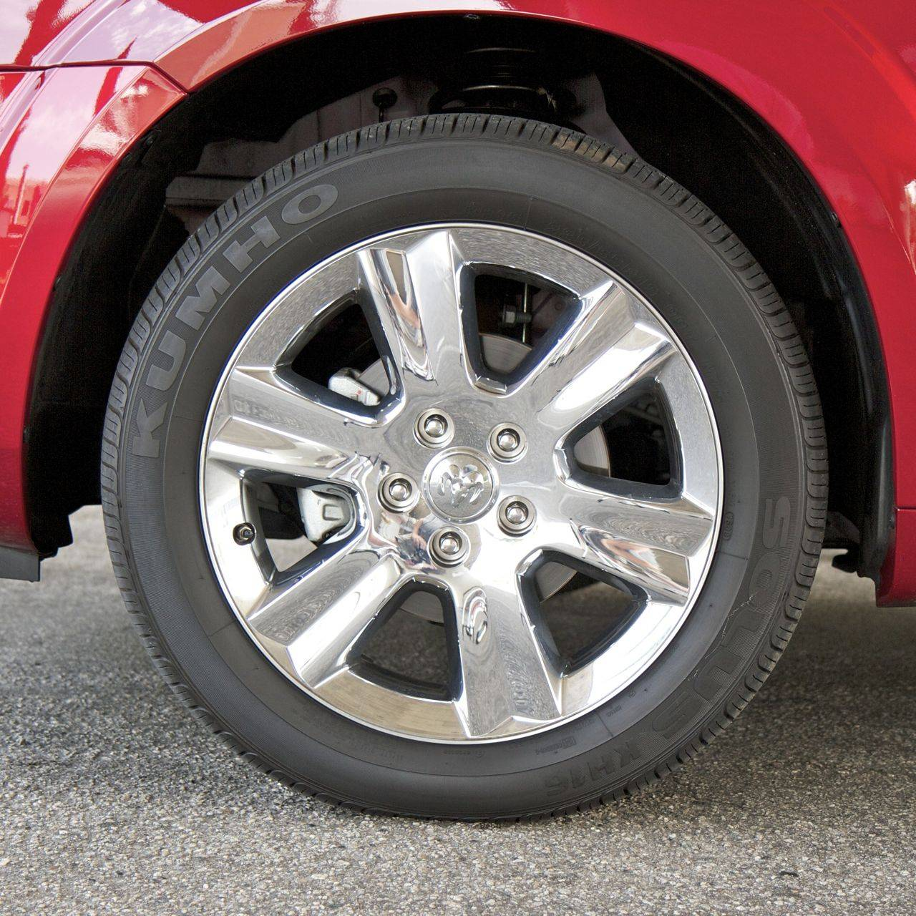
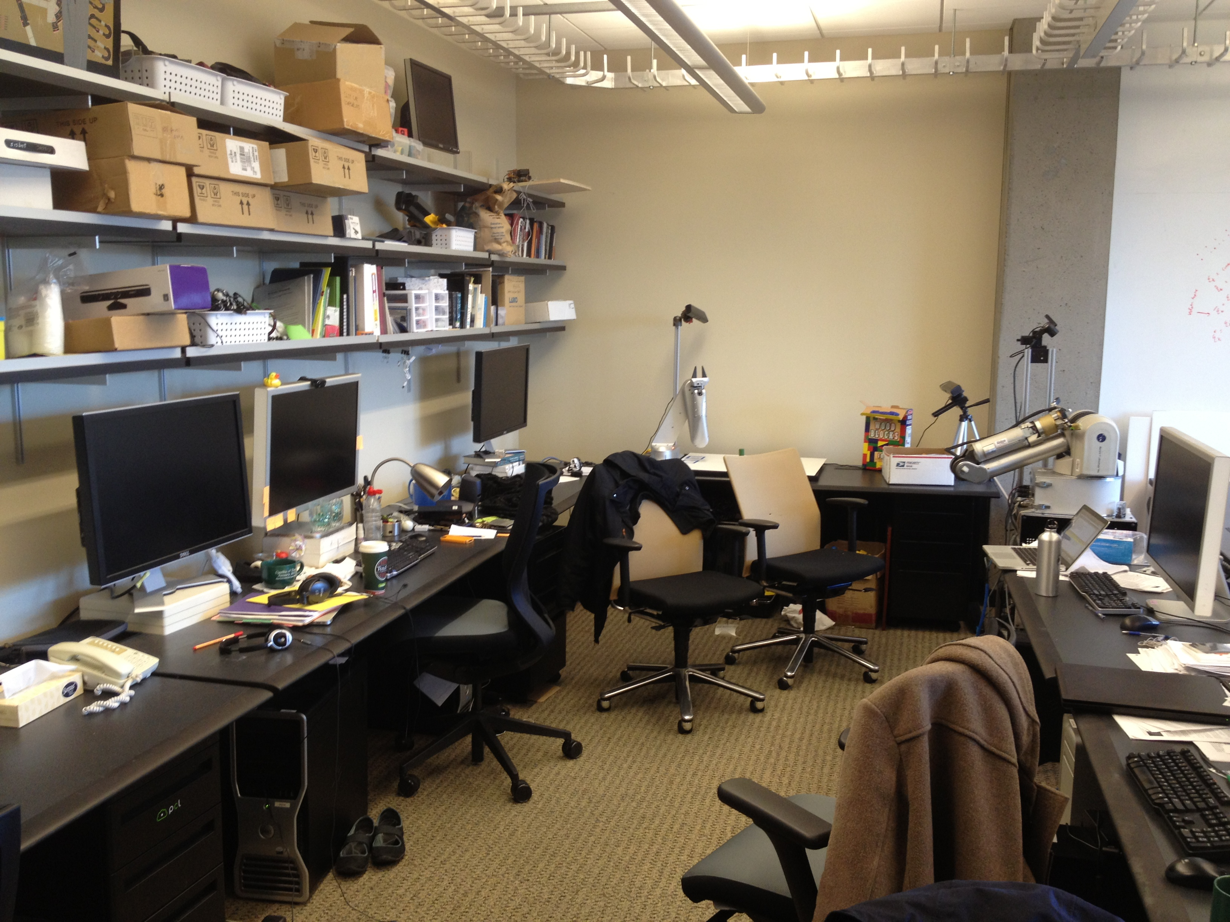
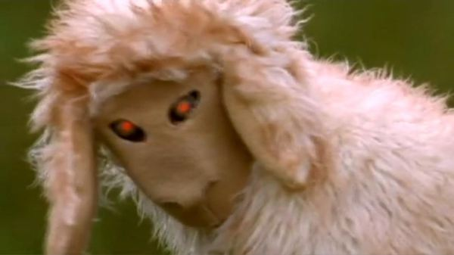
Training set

Slide 31
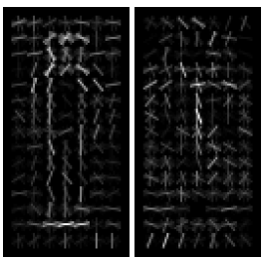
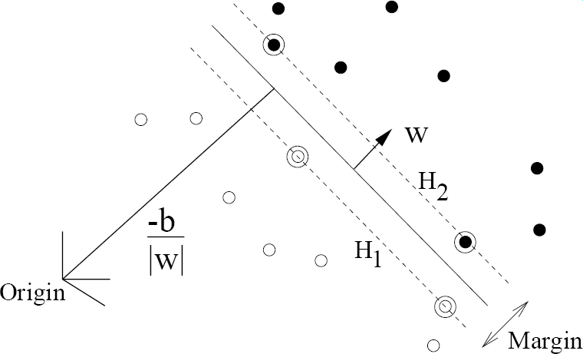
pos w
neg w
Slides by Pete Barnum
Navneet Dalal and Bill Triggs, Histograms of Oriented Gradients for Human Detection, CVPR05

Slide 32
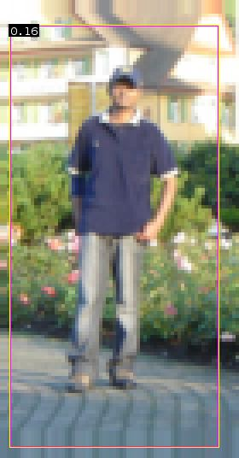


pedestrian
Slides by Pete Barnum
Navneet Dalal and Bill Triggs, Histograms of Oriented Gradients for Human Detection, CVPR05

Slide 33
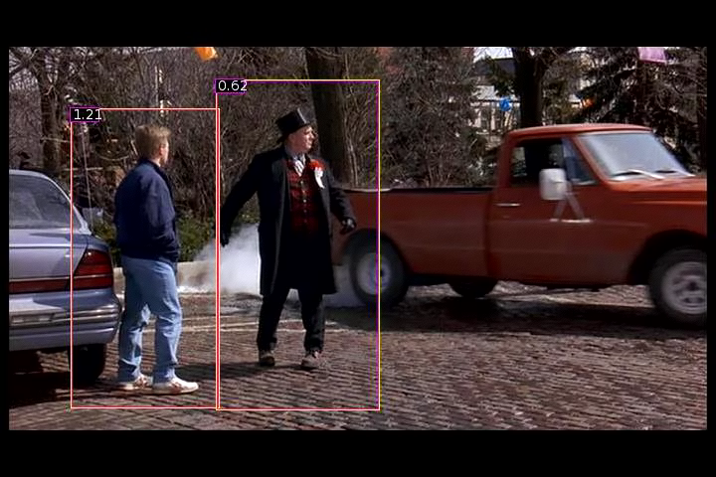
Detection examples

Slide 34


Slide 35

Each window is separately classified

Slide 37

What about this one?
Can the model we trained for pedestrians detect the person in this image?

Slide 38
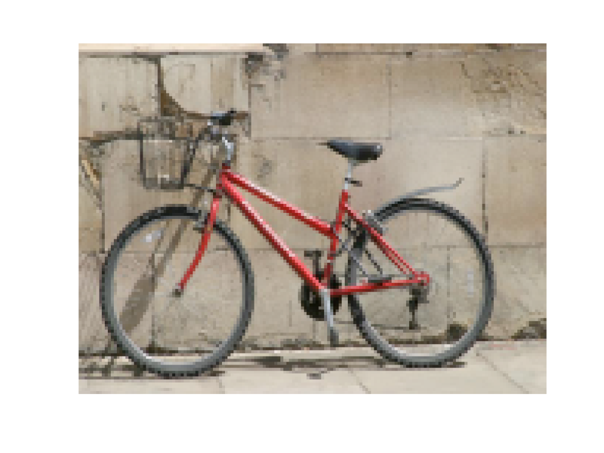
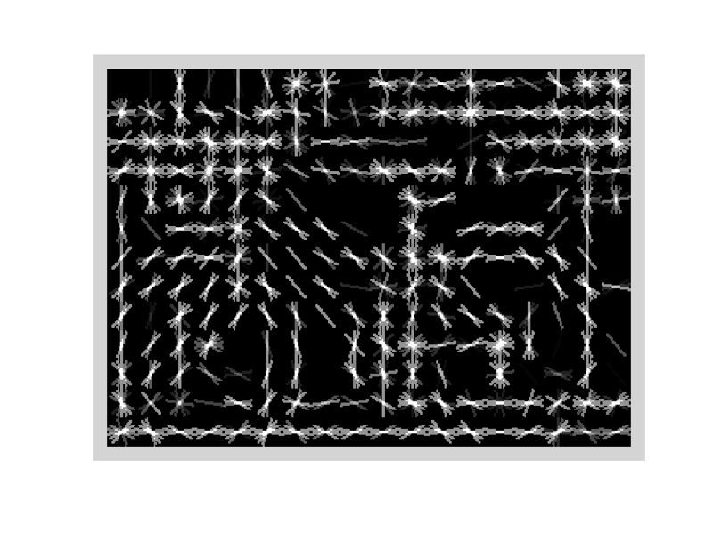
Specifying an object model
Statistical Template in Bounding Box
  Object is some (x,y,w,h) in image
  Features defined wrt bounding box coordinates
Image
Template Visualization
Images from Felzenszwalb

Slide 39
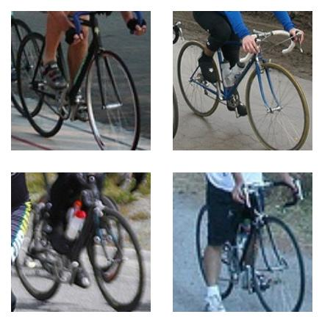
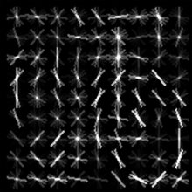
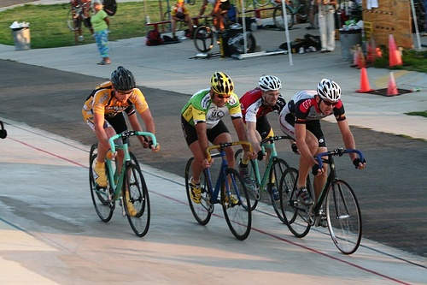

Slide 40
Notes:
Recall that in the latent reclustering process, we initially cluster the training samples into different subcategories. Then we learn the models for each of the subcategories. We then apply these subcategory models on the ground-truth instances and reassign the instances to the max-scoring model.

Slide 41
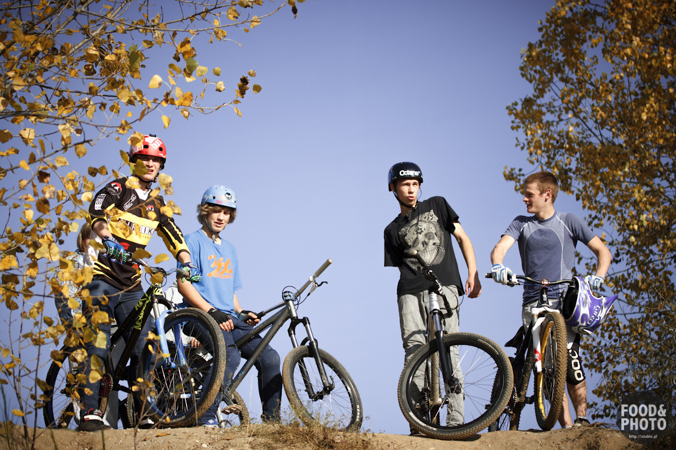

Slide 42
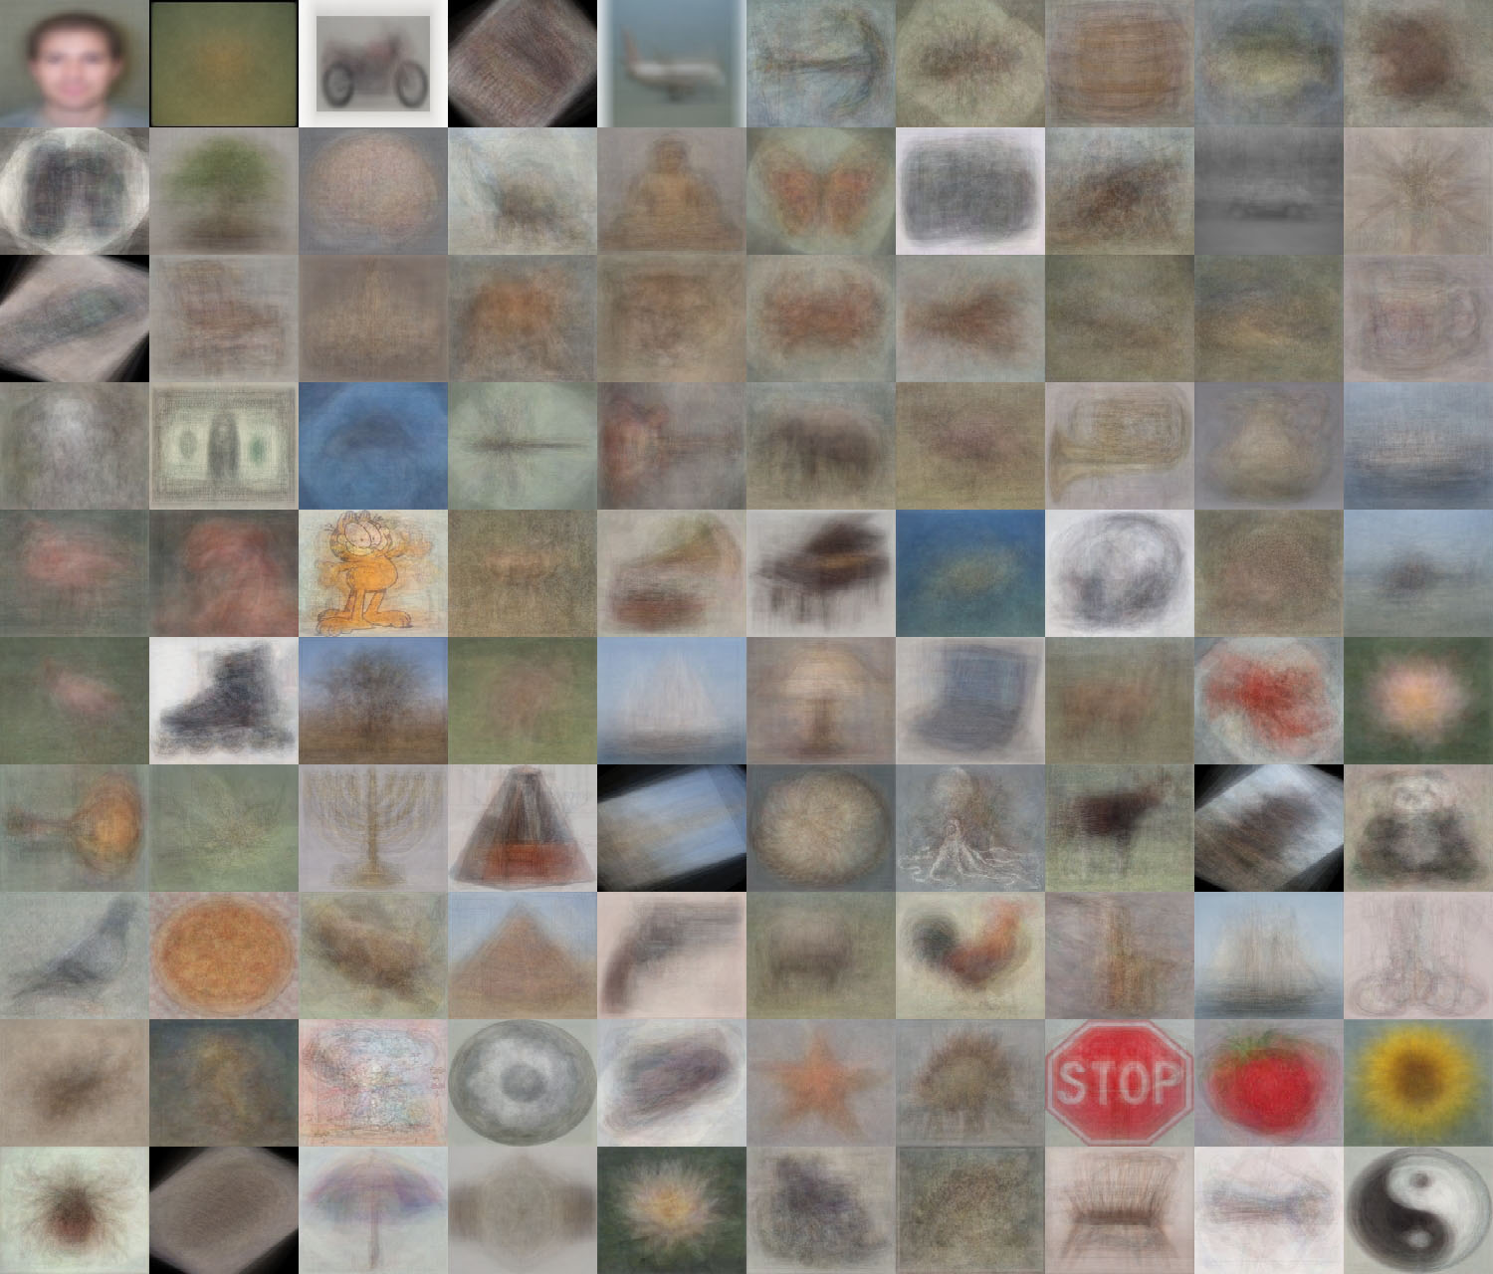
When do statistical templates make sense?
Caltech 101 Average Object Images

Slide 43
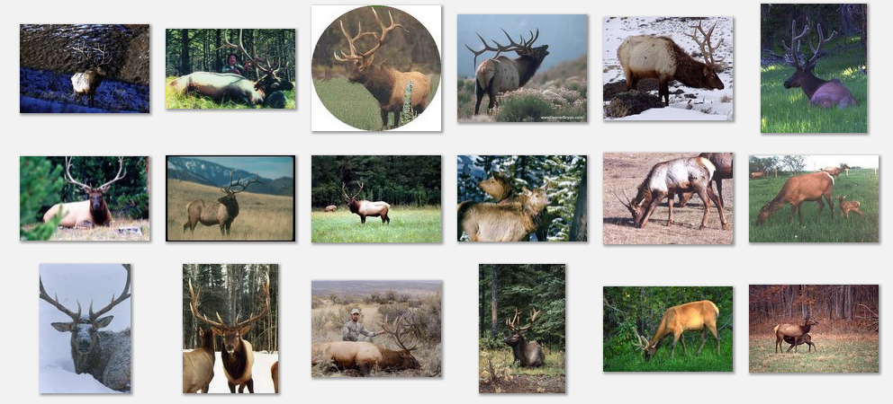
Deformable objects
Images from Caltech-256
Slide Credit: Duan Tran

Slide 44
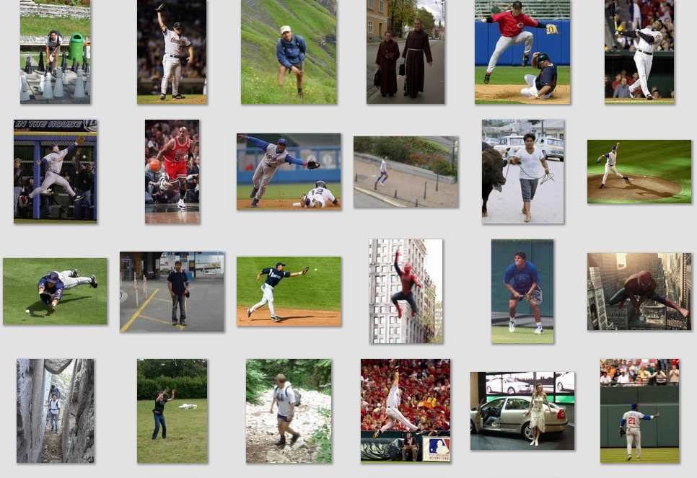
Deformable objects
Images from D. Ramanan’s dataset
Slide Credit: Duan Tran

Slide 45
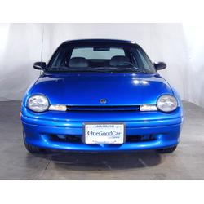
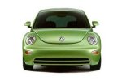
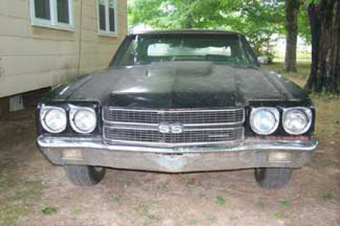
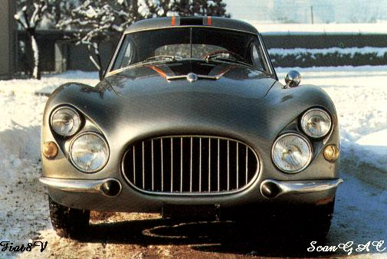
Parts-based Models
Define objects by collection of parts modeled by
  Appearance
  Spatial configuration
Slide credit: Rob Fergus

Slide 46
How to model spatial relations?
One extreme: fixed template

Slide 47
Statistical Template
Object model = sum of scores of features at fixed positions
?
+3
+2
-2
-1
-2.5
= -0.5
> 7.5
Non-object
?
+4
+1
+0.5
+3
+0.5
= 10.5
> 7.5
Object

Slide 48
How to model spatial relations?
Another extreme: bag of words
=

Slide 49
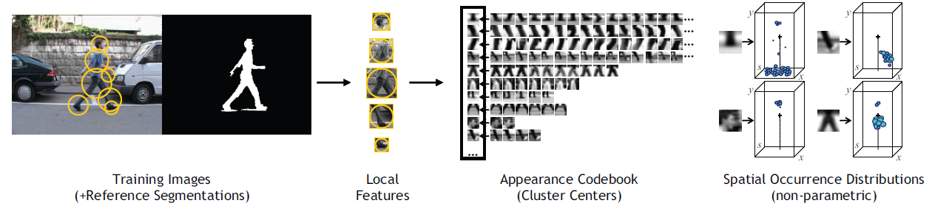
ISM: Implicit Shape Model
Training overview
Start with bounding boxes and (ideally) segmentations of objects
Extract local features (e.g., patches or SIFT) at interest points on objects
Cluster features to create codebook
Record relative bounding box and segmentation for each codeword

Slide 50
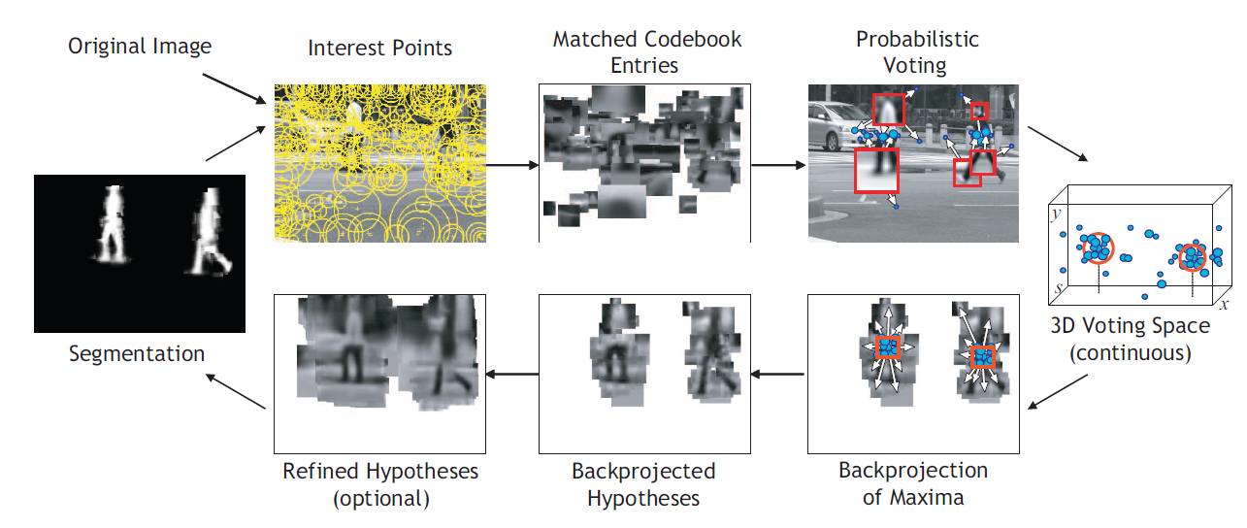
ISM: Implicit Shape Model
Testing overview
Extract interest points in test image
Softly match to codebook entries
Each matched codeword votes for object bounding box
Compute modes of votes using mean-shift
Check which codewords voted for modes
Refine

Slide 51
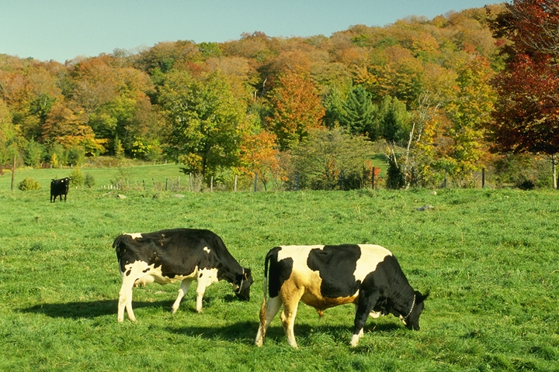
Example: Results on Cows
Original image

Slide 52
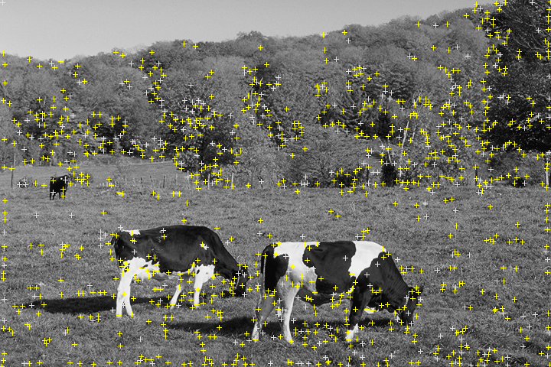
Example: Results on Cows
Original image
Interest points

Slide 53
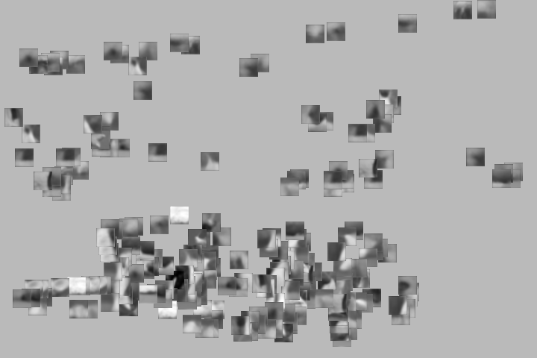
Example: Results on Cows
Original image
Interest points
Matched patches

Slide 54

Example: Results on Cows
Original image
Interest points
Prob. Votes
Matched patches

Slide 55
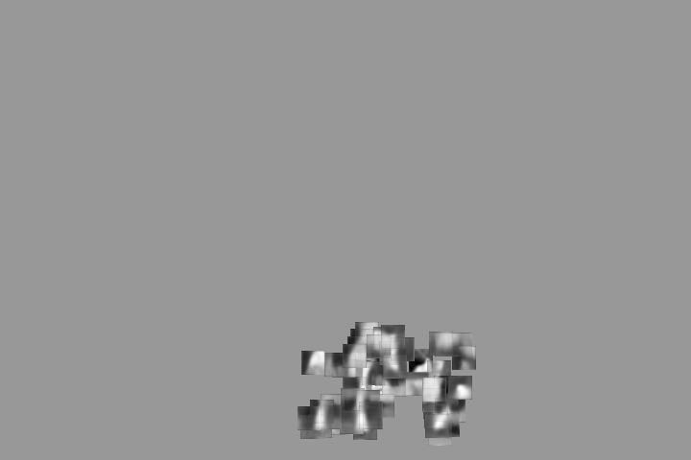
Example: Results on Cows
1st hypothesis

Slide 56

Example: Results on Cows
2nd hypothesis

Slide 57

Example: Results on Cows
3rd hypothesis

Slide 58
ISM: Detection Results
Qualitative Performance
  Robust to clutter, occlusion, noise, low contrast

Slide 59


Explicit Models
Hybrid template/parts model
Detections
Template Visualization
Felzenszwalb et al. 2008

Slide 60
How to model spatial relations?
Explicit Models
Too expensive
Part
Part
Part
Part
Part

Slide 61
How to model spatial relations?
Star-shaped model
Part
Part
Part
Root
Part
Part

Slide 62
How to model spatial relations?
Star-shaped model
=
X
X
≈
Part
Part
Part
X
Root
Part
Part

Slide 63
How to model spatial relations?
Tree-shaped model

Slide 64
How to model spatial relations?
Many others...
O(N⁶)
O(N²)
O(N³)
O(N²)
Fergus et al. ’03
Fei-Fei et al. ‘03
Leibe et al. ’04, ‘08
Crandall et al. ‘05
Fergus et al. ’05
Crandall et al. ‘05
Felzenszwalb & Huttenlocher ‘05
Csurka ’04
Vasconcelos ‘00
Bouchard & Triggs ‘05
Carneiro & Lowe ‘06
from [Carneiro & Lowe, ECCV’06]

Slide 65
Tree-shaped model

Slide 66



Pictorial Structures Model
Part = oriented rectangle
Spatial model = relative size/orientation
Felzenszwalb and Huttenlocher 2005
Notes:
What is the root of the tree?

Slide 67

Pictorial Structures Model
Appearance likelihood
Geometry likelihood

Slide 68
Modeling the Appearance
Any appearance model could be used
  HOG Templates, etc.
  Here: rectangles fit to background subtracted binary map
Can train appearance models independently (easy, not as good) or jointly (more complicated but better)
Appearance likelihood
Geometry likelihood

Slide 69



Part representation
Background subtraction

Slide 70



Pictorial structures model
Optimization is tricky but can be efficient
For each l₁, find best l₂:
Remove v₂, and repeat with smaller tree, until only a single part
For k parts, n locations per part, this has complexity of O(kn²), but can be solved in ~O(nk) using generalized distance transform

Slide 71


Pictorial Structures

Slide 72


Slide 73



Complexity O(h^{n})
h: number of possible part placements
n: number of parts

Slide 75

Complexity O(nh²)

Slide 77


Slide 78


Slide 79


Slide 80


Slide 81
Pictorial Structures: Summary

Slide 82

Results for person matching

Slide 83

Results for person matching

Slide 84

Enhanced pictorial structures
BMVC 2009

Slide 85
Deformable Latent Parts Model
Useful parts discovered during training
Detections
Template Visualization
Felzenszwalb et al. 2008

Slide 86

Score = F₀.Φ(p₀,H) + Σ F_{i}.Φ(p_{i},H) - Σ d_{i}.Φ_{d}(x,y)

Slide 87


Slide 88


Slide 89


Slide 94



State-of-the-art Detector:
Deformable Parts Model (DPM)
Lifetime
Achievement
Strong low-level features based on HOG
Efficient matching algorithms for deformable part-based models (pictorial structures)
Discriminative learning with latent variables (latent SVM)
Felzenszwalb et al., 2008, 2010, 2011, 2012
Notes:
For the local window detector implementation, we used the publicly available implementation of the DPM detector. This is the best performing sliding window implementation and has consistently performed well in the VOC challenge receiving the lifetime achievement award.

Slide 95


Slide 96


Slide 97

Car

Slide 98


Slide 99

Cat

Slide 100


Slide 101

Person riding horse

Slide 102

Person riding bicycle

Slide 103


Slide 104

Structure
Recognition using Visual Phrases , CVPR 2011

Slide 105


Structured Prediction
Prediction of complex outputs
  Structured outputs: multivariate, correlated, constrained
Novel, general way to solve many learning problems

Slide 106
Handwriting Recognition
x
y
brace
Sequential structure

Slide 107
Object Segmentation
x
y
Spatial structure

Slide 108

Scene Parsing
Recursive structure

Slide 109
Bipartite Matching
En
vertu
de
les
nouvelles
propositions
,
quel
est
le
coût
prévu
de
perception
de
les
droits
?
x
y
What
is
the
anticipated
cost
of
collecting
fees
under
the
new
proposal
?
What is the anticipated cost of collecting fees under the new proposal?
En vertu des nouvelles propositions, quel est le coût prévu de perception des droits?
Combinatorial structure

Slide 110


Local Prediction
b
r
a
c
e
Classify using local information
⇒ Ignores correlations & constraints!

Slide 111


Local Prediction
building
tree
shrub
ground

Slide 112
Structured Prediction
b
r
a
c
e
Use local information
Exploit correlations

Slide 113


Structured Prediction
building
tree
shrub
ground

Slide 114


Structured Models
scoring function
space of feasible outputs
Mild assumptions:
linear combination
sum of part scores

Slide 115




Supervised Structured Prediction
Model:
Data
Learning
Prediction
Estimate w
Example:
Weighted matching
Generally:
Combinatorial
optimization
Local
(ignores structure)
Margin
Likelihood
(can be intractable)

Slide 116

Local Estimation
Model:
Treat edges as independent decisions
Estimate w locally, use globally
  E.g., naïve Bayes, SVM, logistic regression
  Cf. [Matusov+al, 03] for matchings
  Simple and cheap
  Not well-calibrated for matching model
  Ignores correlations & constraints
Data

Slide 117




Conditional Likelihood Estimation
Model:
Estimate w jointly:
Denominator is #P-complete
  [Valiant 79, Jerrum & Sinclair 93]
Tractable model, intractable learning
Need tractable learning method
⇒ margin-based estimation
Data

Slide 118
Structured large margin estimation
We want:
Equivalently:
“brace”
“brace”
“aaaaa”
“brace”
“aaaab”
a lot!
…
“brace”
“zzzzz”

Slide 119
Structured Loss
b c a r e
2
b r o r e
2
b r o c e
1
b r a c e
0

Slide 120





Large margin estimation
Given training examples , we want:
Maximize margin
Mistake weighted margin:
# of mistakes in y
*Collins 02, Altun et al 03, Taskar 03

Slide 121




Large margin estimation
Eliminate
Add slacks for inseparable case (hinge loss)

Slide 122



Large margin estimation
Brute force enumeration
Min-max formulation
  ‘Plug-in’ linear program for inference

Slide 123





Min-max formulation
Structured loss (Hamming):
Inference
LP Inference
Key step:
discrete optim.
continuous optim.

Slide 124










Matching Inference LP
Need Hamming-like loss
En
vertu
de
les
nouvelles
propositions
,
quel
est
le
coût
prévu
de
perception
de
le
droits
?
What
is
the
anticipated
cost
of
collecting
fees
under
the
new
proposal
?
k
degree
j

Slide 125


LP Duality
Linear programming duality
  Variables ⇒ constraints
  Constraints ⇒ variables
Optimal values are the same
  When both feasible regions are bounded

Slide 126





Min-max Formulation
LP duality

Slide 127

Min-max formulation summary
*Taskar et al 04

Slide 128


3D Mapping
Data provided by: Michael Montemerlo & Sebastian Thrun
Laser Range Finder
GPS
IMU
Label: ground, building, tree, shrub
Training: 30 thousand points Testing: 3 million points

Slide 130


Slide 133
Before and After
Before Decoding
After Decoding
Recognition using Visual Phrases , CVPR 2011

Slide 134
Before and After
Before Decoding
After Decoding
Recognition using Visual Phrases , CVPR 2011

