Slide 1
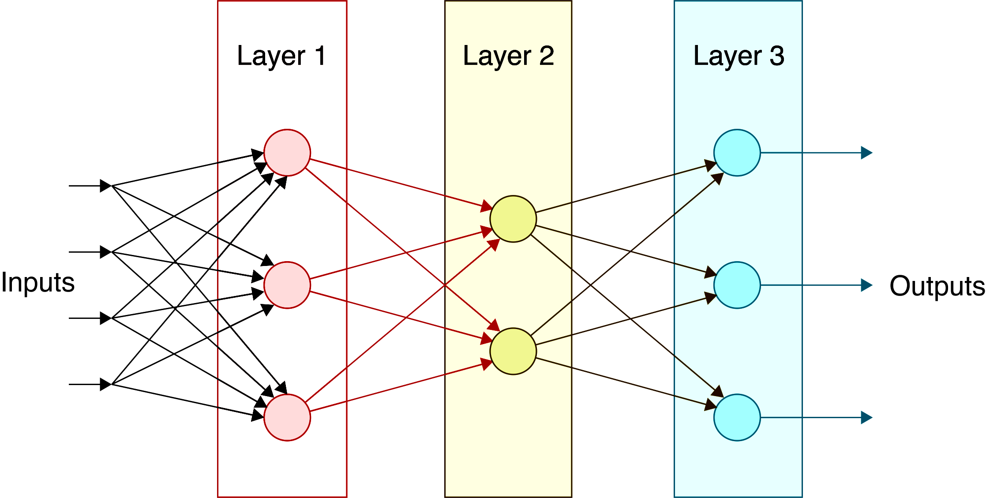
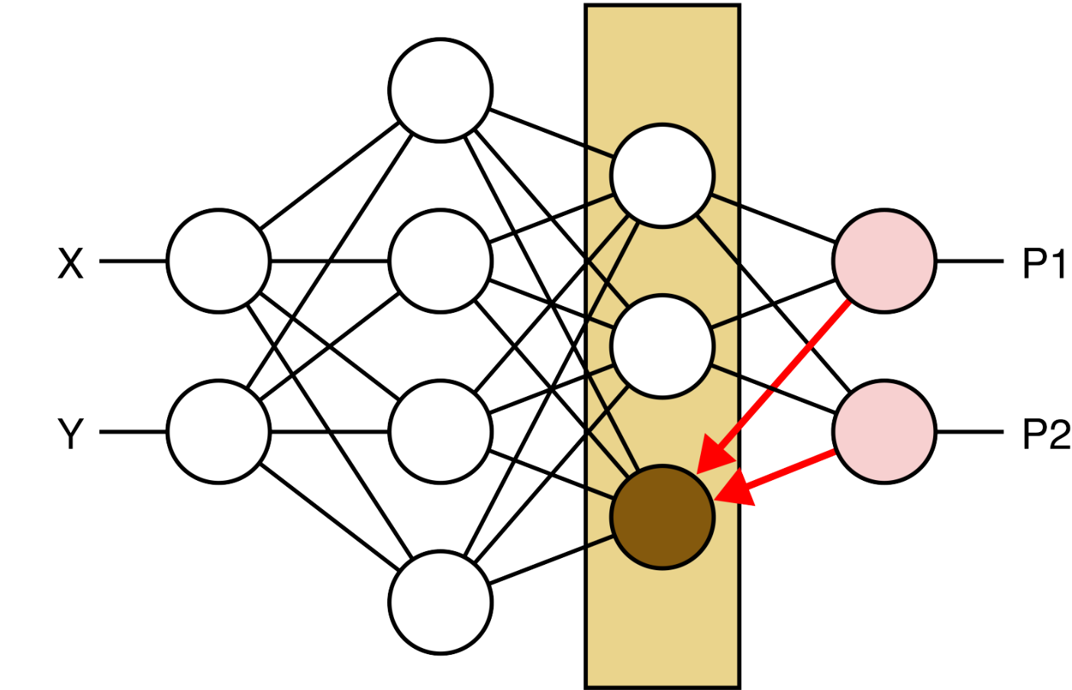
Deep Neural Networks
Computer Vision (UW EE/CSE 576)
Richard Szeliski
Facebook & UW
Lecture 7 – Apr 21, 2020

Slide 2
Class calendar
Date | Topic | Slides | Reading | Homework
April 9 | Filters and convolutions | Google Slides | Szeliski, Chapter 3 | HW1 due, HW2 assigned
April 14 | Interpolation and Optimization | pdf, pptx | Szeliski, Chapter 4
April 16 | Machine Learning | pdf, pptx | Szeliski, Chapter 5.1-5.2
April 21 | Deep Neural Networks |  | Szeliski, Chapter 5.3
April 23 | Convolutional Neural Networks |  | Szeliski, Chapter 5.4 | HW2 due, HW3 assigned
April 28 | Network Architectures |  | Szeliski, Chapter 5.4-5.5
April 30 | Object Detection |  | Szeliski, Chapter 6.3
May 5 | Detection and Instance Segmentation |  | Szeliski, Chapter 6.4
May 7 | Edges, features, matching, RANSAC |  | Szeliski, Chapter 7.1-7.2, 8.1-8.2 | HW3 due, HW4 assigned

Slide 3
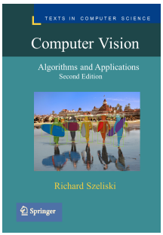
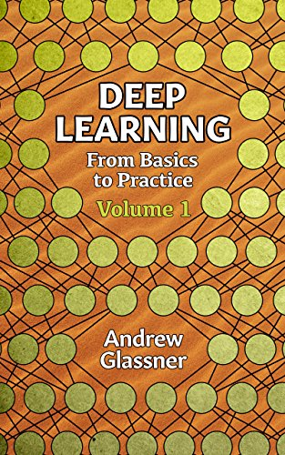
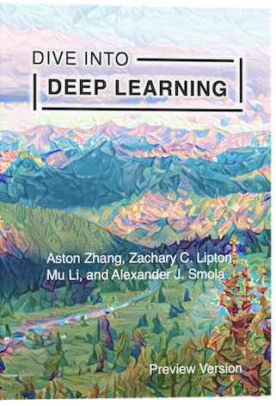
References
(Thanks, Matt Dietke, for the very helpful comments.)
https://d2l.ai/

Slide 4
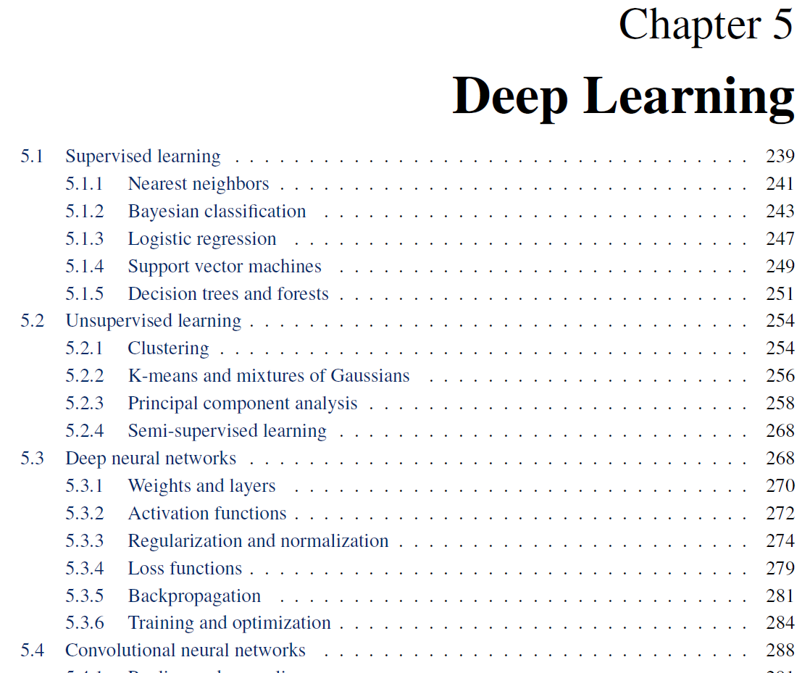
Readings

Slide 5
Deep neural networks (today’s lecture)
Loss functions
Regularization
Weights and layers
Activation functions
Backpropagation
Training and optimization (?)
Notes:
The order in the lecture is a little different from the book, because Justin Johnson’s lectures follow a different order

Slide 6
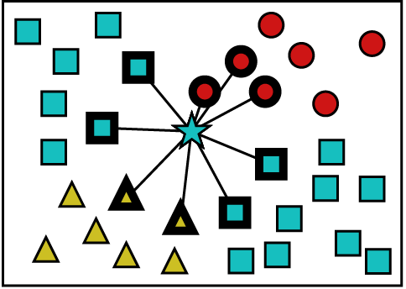
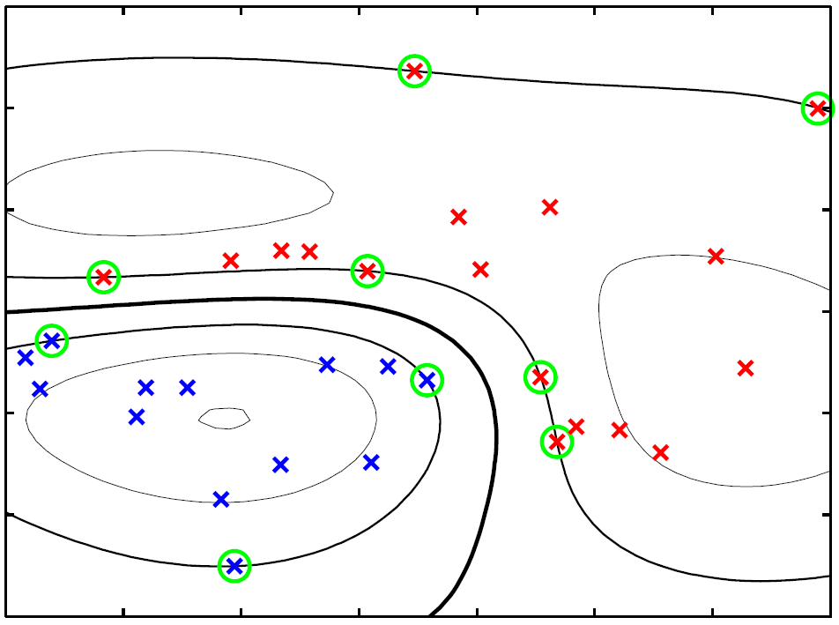
Machine learning (previous lecture)
Why learning?
Nearest neighbors
Bayesian classification
Logistic regression
Support vector machines
Clustering
Principal component analysis
Notes:
This is the actual content of Lecture 5 for CSE 576

Slide 7
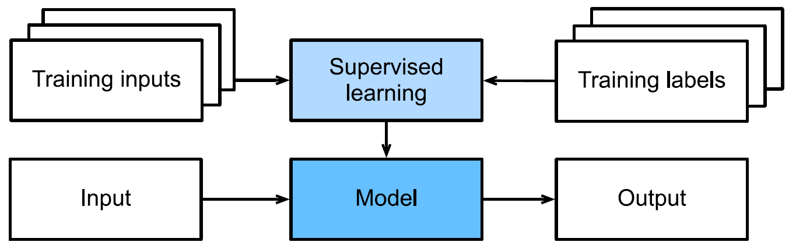
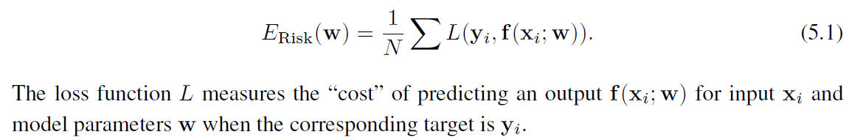
Supervised learning
Goal: provide best output predictions for novel inputs
How can we predict future performance?
Placeholder answer: minimize empirical risk
What are potential models and loss functions?

Slide 8
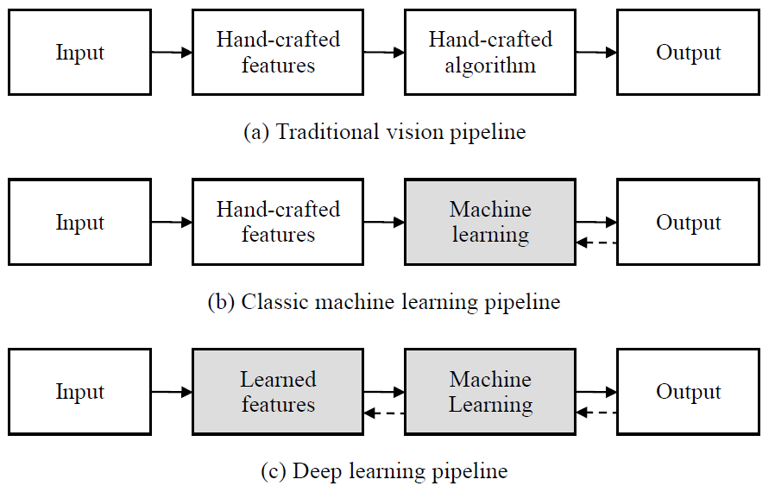
Traditional and deep learning

Slide 9
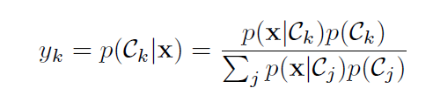
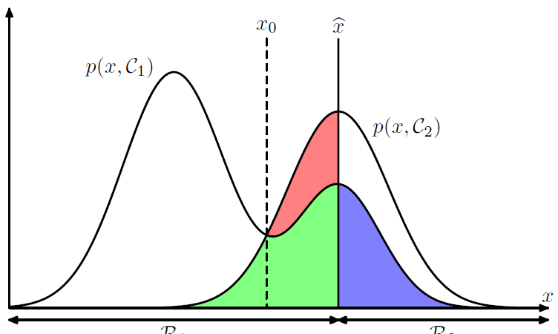
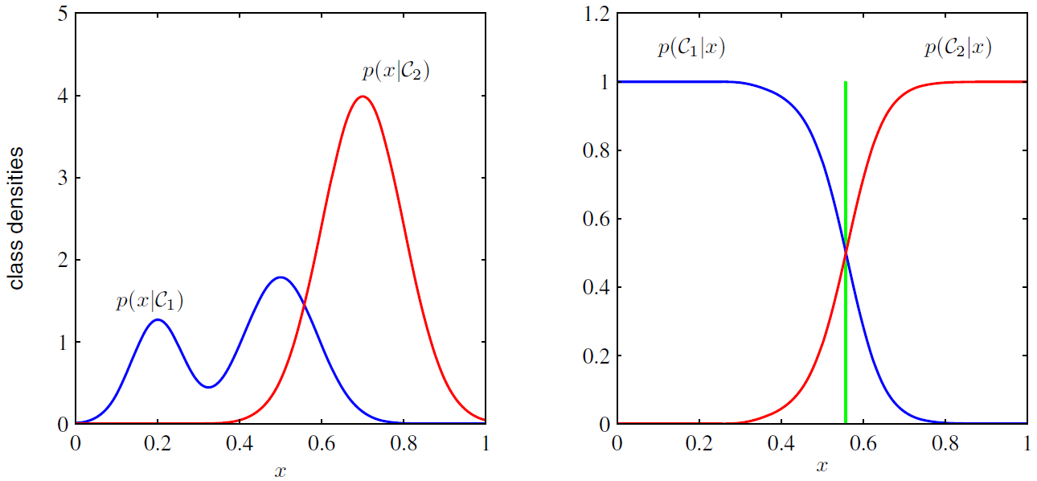
Bayesian classification
Bayes’ Rule
current decision threshold
Notes:
What are the red, green, and blue regions?
To obtain the *posterior* of a class given an input (feature), you have to multiply by the class priors and normalize (divide) by the sum of all likelihoods

Slide 10
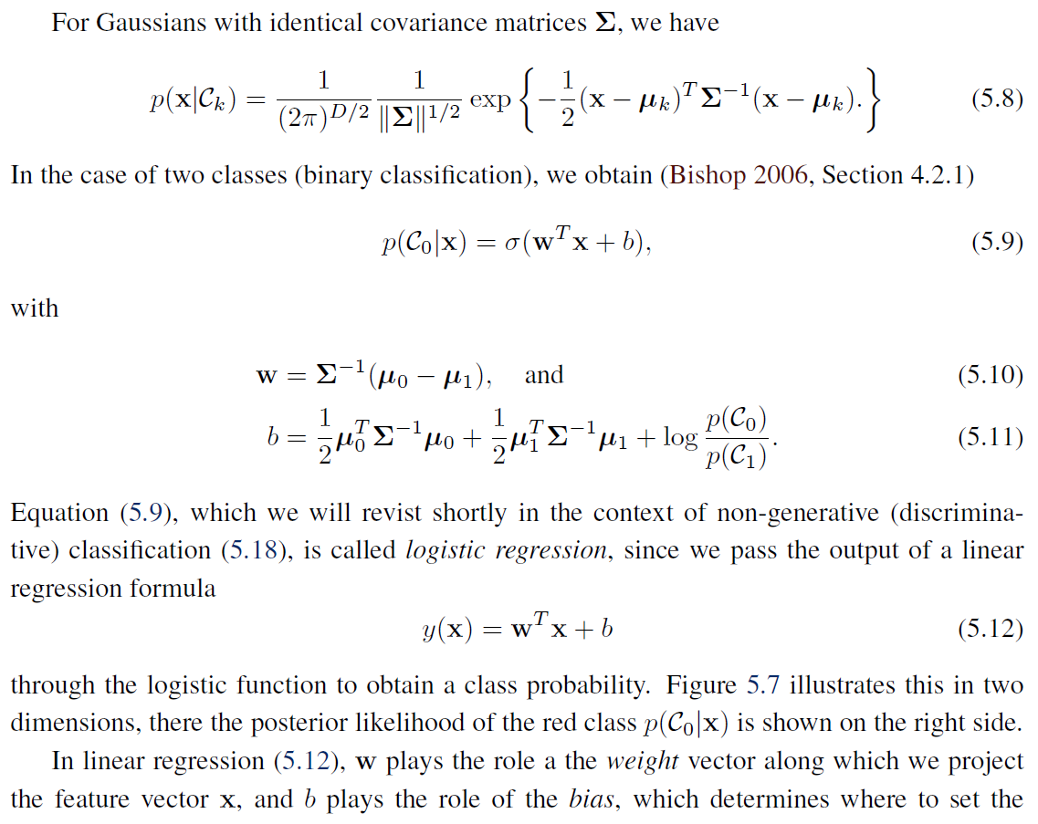
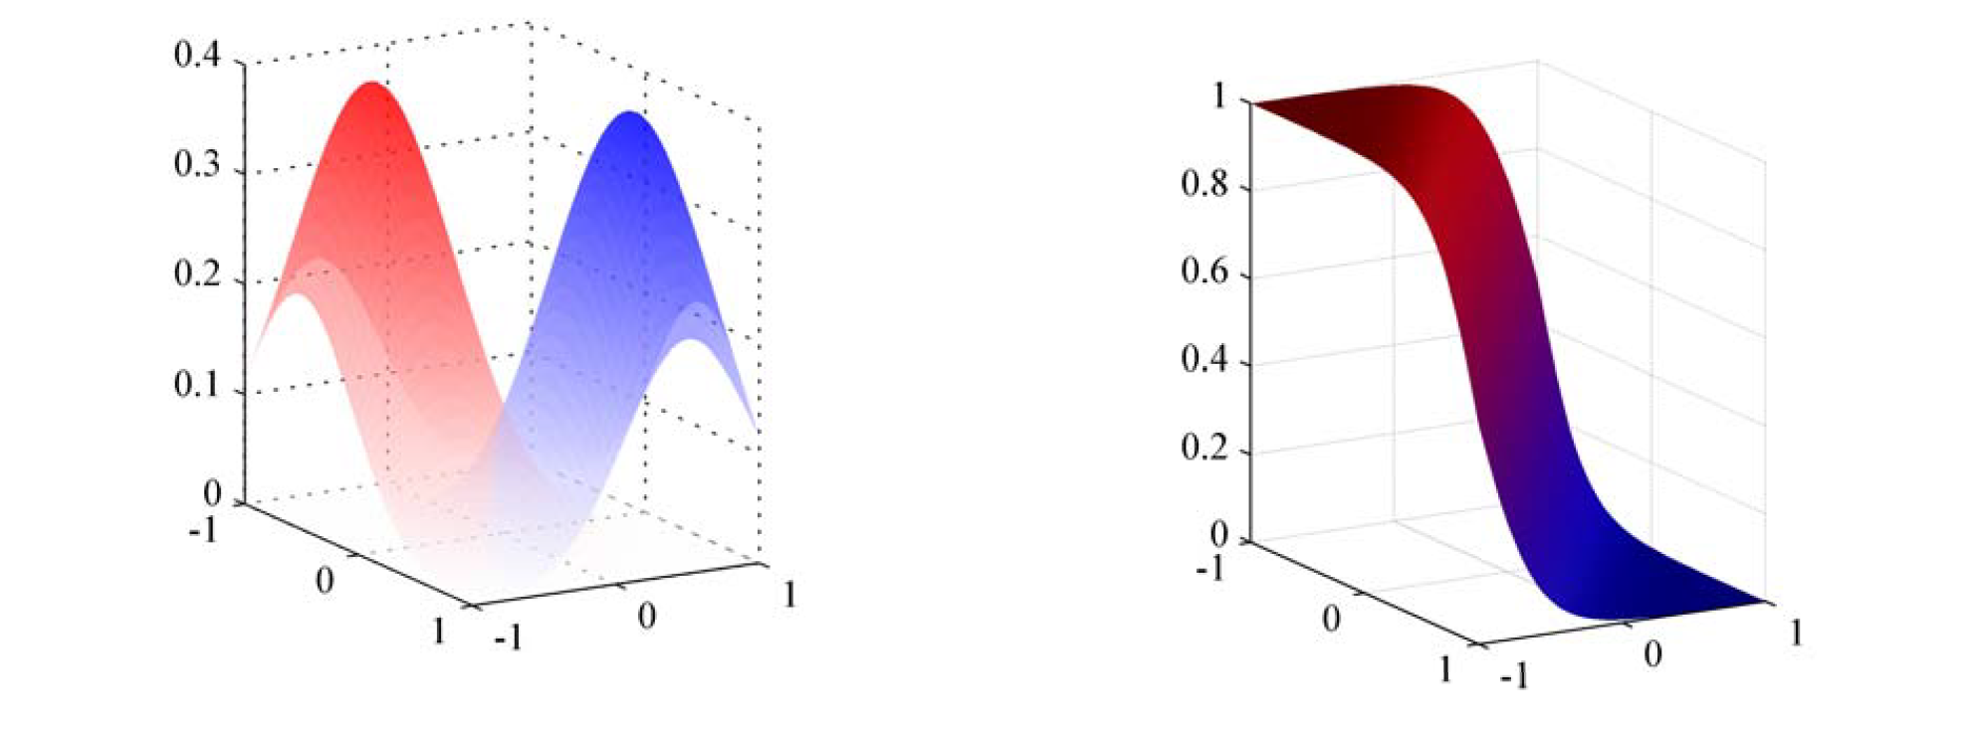
Logistic regression

Slide 11
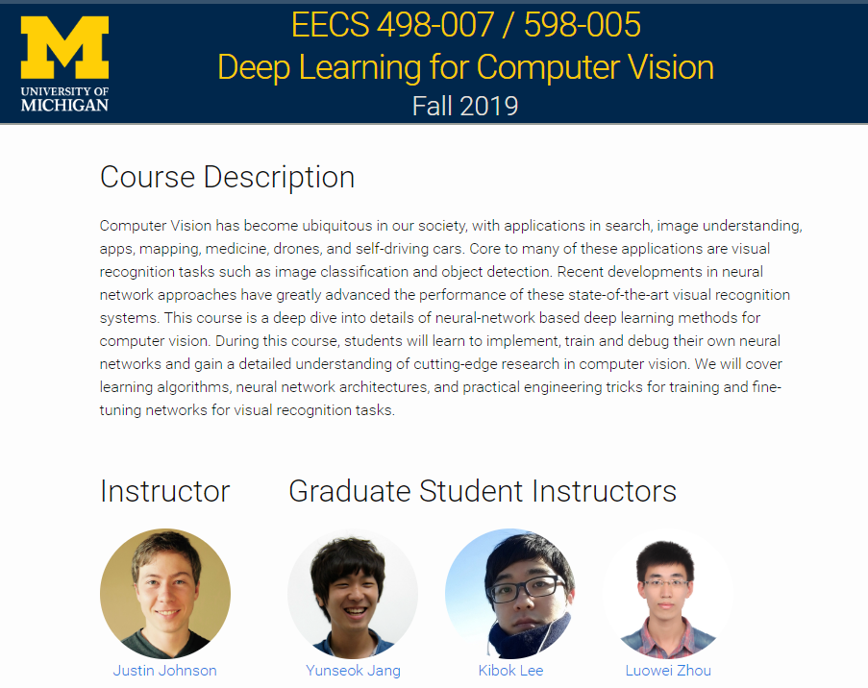
As before, I’m borrowing slides from

Slide 12
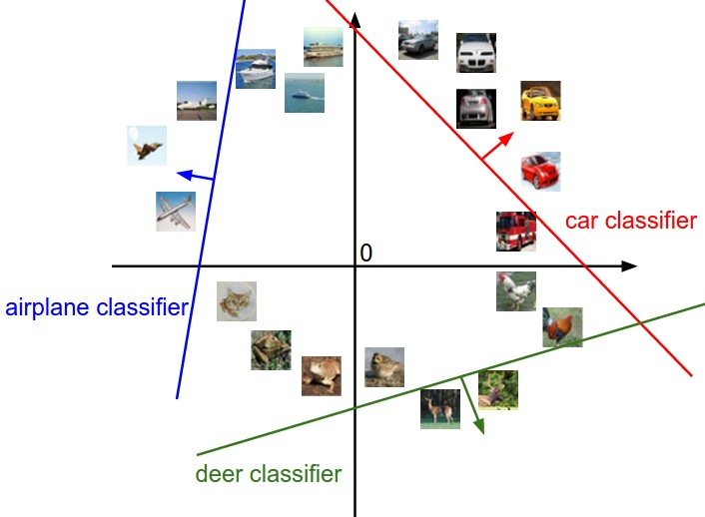
Lecture 3:
Linear Classifiers

Slide 13

Neural Network
Linear classifiers
This image is CC0 1.0 public domain

Slide 14
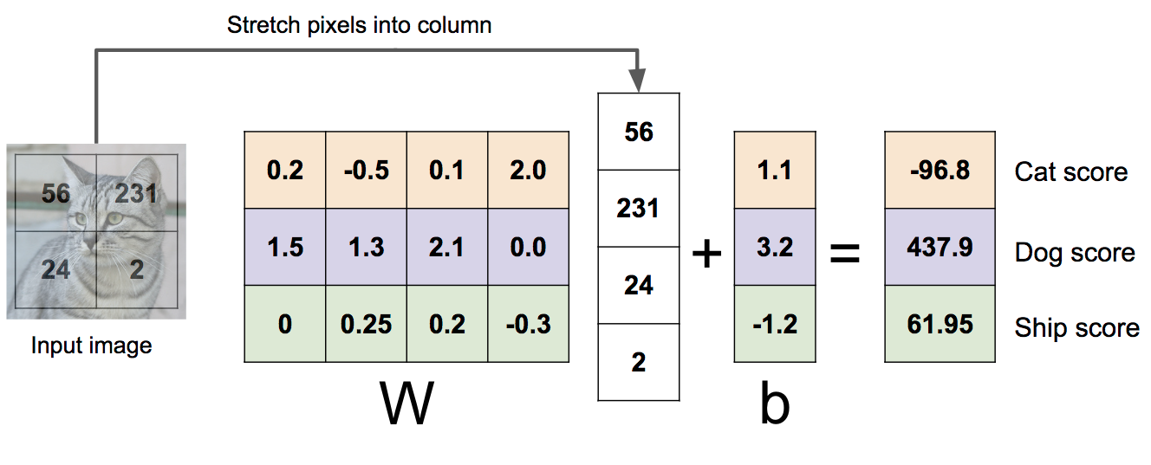

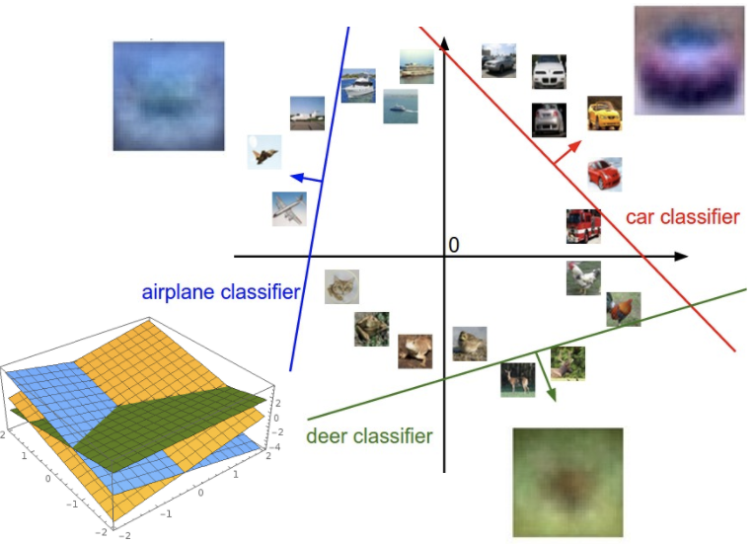
Linear Classifier: Three Viewpoints
Algebraic Viewpoint
Visual Viewpoint
Geometric Viewpoint
f(x,W) = Wx
One template per class
Hyperplanes cutting up space

Slide 15
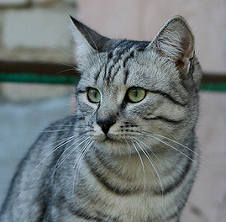
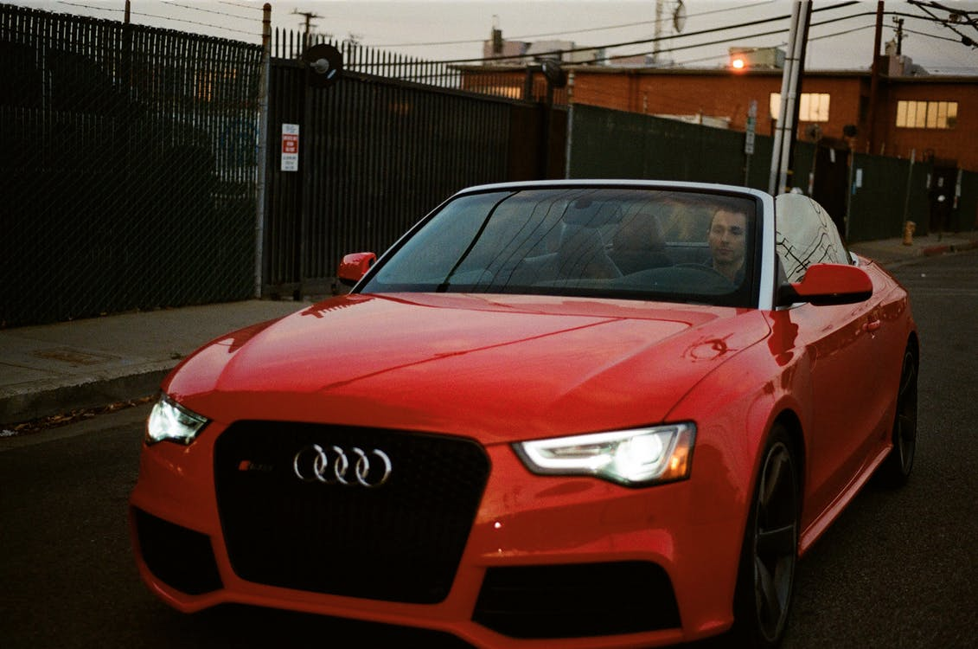
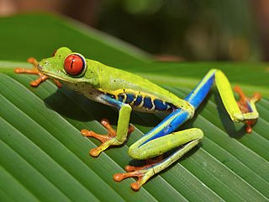
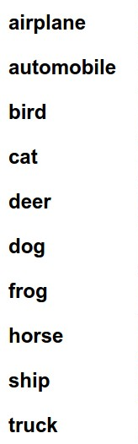
So Far: Defined a linear score function
f(x,W) = Wx + b
Given a W, we can compute class scores for an image x.
But how can we actually choose a good W?
-3.45
-8.87
0.09
2.9
4.48
8.02
3.78
1.06
-0.36
-0.72
-0.51
6.04
5.31
-4.22
-4.19
3.58
4.49
-4.37
-2.09
-2.93
3.42
4.64
2.65
5.1
2.64
5.55
-4.34
-1.5
-4.79
6.14
Cat image by Nikita is licensed under CC-BY 2.0; Car image is CC0 1.0 public domain; Frog image is in the public domain

Slide 16
Choosing a good W
f(x,W) = Wx + b
TODO:
Use a loss function to quantify how good a value of W is
Find a W that minimizes the loss function (optimization)
-3.45
-8.87
0.09
2.9
4.48
8.02
3.78
1.06
-0.36
-0.72
-0.51
6.04
5.31
-4.22
-4.19
3.58
4.49
-4.37
-2.09
-2.93
3.42
4.64
2.65
5.1
2.64
5.55
-4.34
-1.5
-4.79
6.14

Slide 17
Loss Function
A loss function tells how good our current classifier is
Low loss = good classifier
High loss = bad classifier
(Also called: objective function; cost function)

Slide 18
Loss Function
A loss function tells how good our current classifier is
Low loss = good classifier
High loss = bad classifier
(Also called: objective function; cost function)
Negative loss function sometimes called reward function, profit function, utility function, fitness function, etc

Slide 19
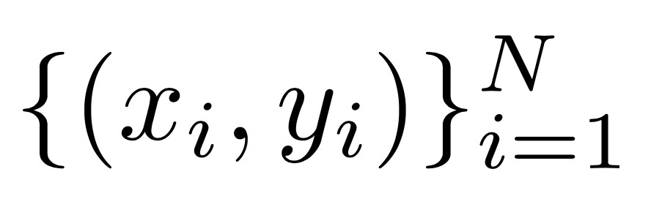

Loss Function
Given a dataset of examples
Where is image and
is (integer) label
A loss function tells how good our current classifier is
Low loss = good classifier
High loss = bad classifier
(Also called: objective function; cost function)
Negative loss function sometimes called reward function, profit function, utility function, fitness function, etc

Slide 20
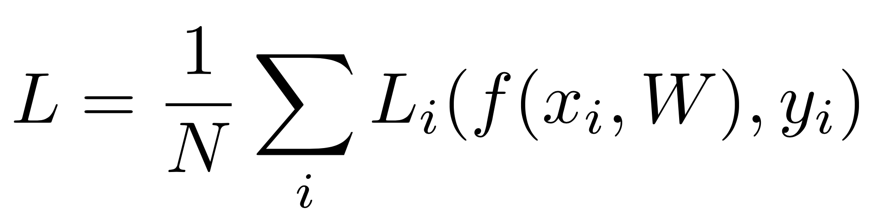
Loss Function
Given a dataset of examples
Where is image and
is (integer) label
Loss for a single example is
A loss function tells how good our current classifier is
Low loss = good classifier
High loss = bad classifier
(Also called: objective function; cost function)
Negative loss function sometimes called reward function, profit function, utility function, fitness function, etc

Slide 21
Loss Function
Given a dataset of examples
Where is image and
is (integer) label
Loss for a single example is
Loss for the dataset is average of per-example losses:
A loss function tells how good our current classifier is
Low loss = good classifier
High loss = bad classifier
(Also called: objective function; cost function)
Negative loss function sometimes called reward function, profit function, utility function, fitness function, etc

Slide 22
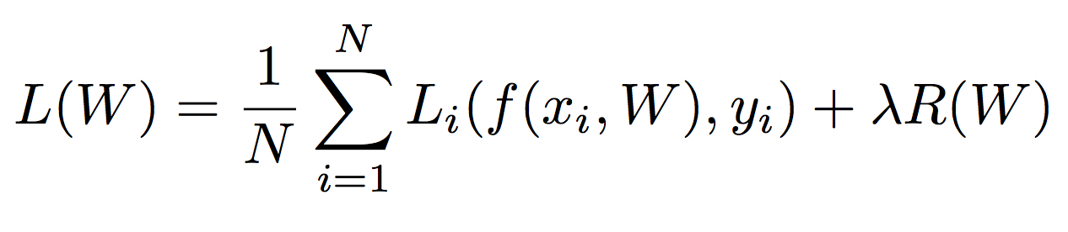
Regularization: Beyond Training Error
Data loss: Model predictions should match training data

Slide 23




Regularization: Beyond Training Error
= regularization strength
(hyperparameter)
Data loss: Model predictions should match training data
Regularization: Prevent the model from doing too well on training data
Simple examples
L2 regularization:
L1 regularization:
Elastic net (L1 + L2):
More complex:
Dropout
Batch normalization
Cutout, Mixup, Stochastic depth, etc…

Slide 24
Regularization: Beyond Training Error
= regularization strength
(hyperparameter)
Data loss: Model predictions should match training data
Regularization: Prevent the model from doing too well on training data
Purpose of Regularization:
Express preferences in among models beyond ”minimize training error”
Avoid overfitting: Prefer simple models that generalize better
Improve optimization by adding curvature

Slide 25



Cross-Entropy Loss (Multinomial Logistic Regression)
Want to interpret raw classifier scores as probabilities
Softmax function
Probabilities must be >= 0
Probabilities must sum to 1
cat
3.2
24.5
0.13
L_{i} = -log(0.13)
= 2.04
exp
car
5.1
164.0
normalize
0.87
Maximum Likelihood Estimation
Choose weights to maximize the likelihood of the observed data
(next lecture)
frog
-1.7
0.18
0.00
Unnormalized log-probabilities / logits
unnormalized probabilities
probabilities

Slide 26
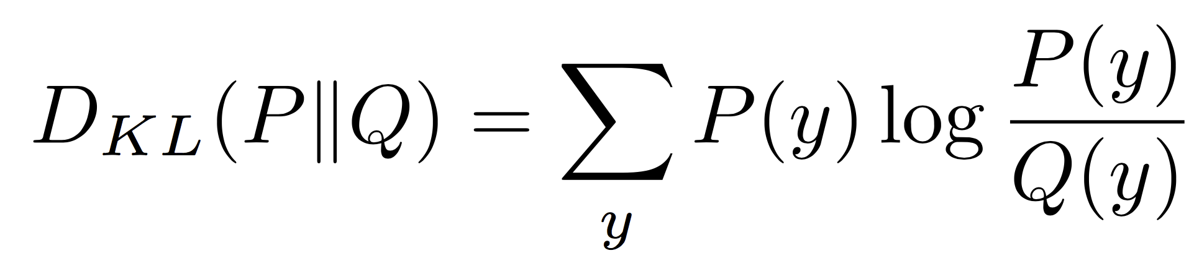
Cross-Entropy Loss (Multinomial Logistic Regression)
Want to interpret raw classifier scores as probabilities
Softmax function
Probabilities must be >= 0
Probabilities must sum to 1
cat
3.2
24.5
0.13
Compare
1.00
exp
Kullback–Leibler divergence
car
5.1
164.0
normalize
0.87
0.00
frog
-1.7
0.18
0.00
0.00
Unnormalized log-probabilities / logits
unnormalized probabilities
Correct
probs
probabilities

Slide 27
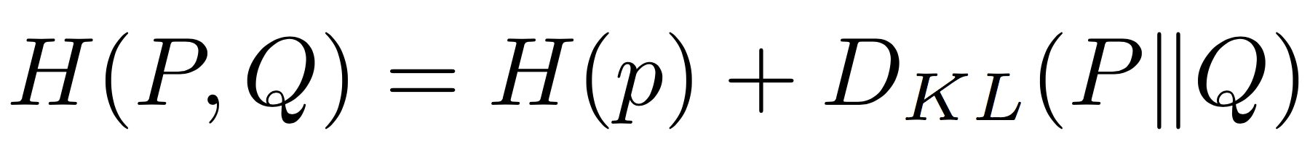
Cross-Entropy Loss (Multinomial Logistic Regression)
Want to interpret raw classifier scores as probabilities
Softmax function
Probabilities must be >= 0
Probabilities must sum to 1
cat
3.2
24.5
0.13
Compare
1.00
exp
car
5.1
164.0
normalize
0.87
0.00
Cross Entropy
frog
-1.7
0.18
0.00
0.00
Unnormalized log-probabilities / logits
unnormalized probabilities
Correct
probs
probabilities

Slide 28

Cross-Entropy Loss (Multinomial Logistic Regression)
Want to interpret raw classifier scores as probabilities
Softmax function
Maximize probability of correct class
Putting it all together:
cat
3.2
car
5.1
Q: What is the min / max possible loss L_{i}?
frog
-1.7
A: Min 0, max +infinity

Slide 29
Cross-Entropy Loss (Multinomial Logistic Regression)
Want to interpret raw classifier scores as probabilities
Softmax function
Maximize probability of correct class
Putting it all together:
cat
3.2
car
5.1
Q: If all scores are small random values, what is the loss?
frog
-1.7
A: -log(1/C)
log(10) ≈ 2.3

Slide 30
Recap: Three ways to think about linear classifiers
Algebraic Viewpoint
Visual Viewpoint
Geometric Viewpoint
f(x,W) = Wx
One template per class
Hyperplanes cutting up space

Slide 31

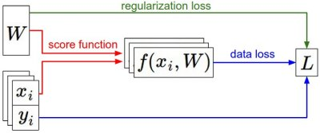


Recap: Loss Functions quantify preferences
We have some dataset of (x, y)
We have a score function:
We have a loss function:
Linear classifier
Softmax
SVM
Full loss

Slide 32
Recap: Loss Functions quantify preferences
Q: How do we find the best W?
We have some dataset of (x, y)
We have a score function:
We have a loss function:
Linear classifier
A: Later in this lecture
Softmax
SVM
Full loss

Slide 33
Machine learning
Why learning?
Nearest neighbors
Bayesian classification
Logistic regression
Support vector machines
Clustering
Principal component analysis
Notes:
This is the actual content of Lecture 5 for CSE 576

Slide 34
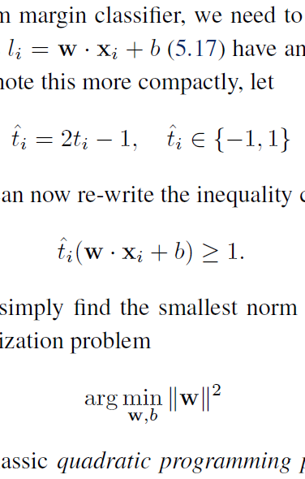
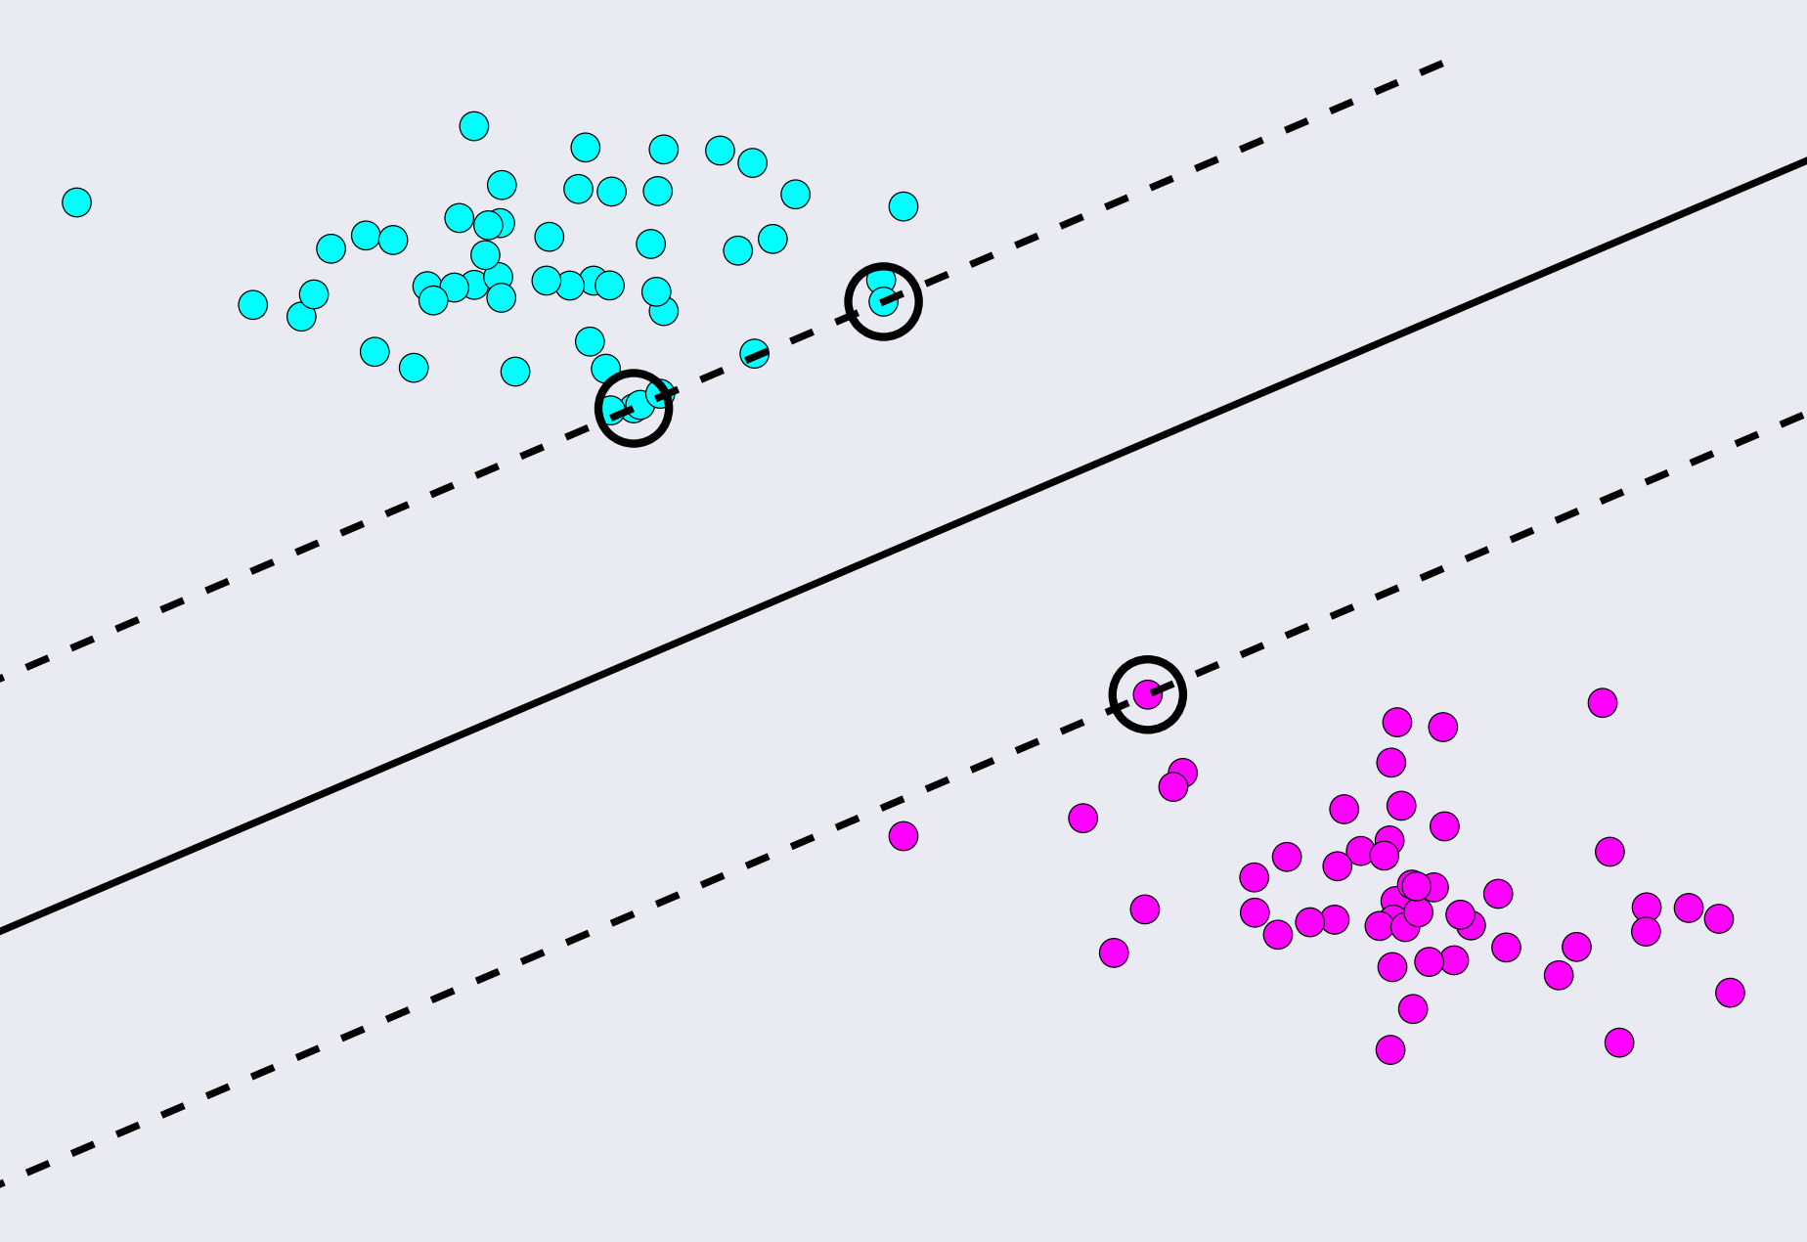
Support vector machines (SVMs)
Maximize the margin between the decision surfaces
The only points that matter are the circled support vectors

Slide 35
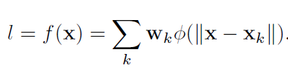
Kernelized support vector machines
Replace linear function with a sum of kernel functions
(e.g., Gaussian bumps)
Circled points are
support vectors,
lie on f = ± 1 surfaces
(f = 0 is the dark curve)

Slide 36
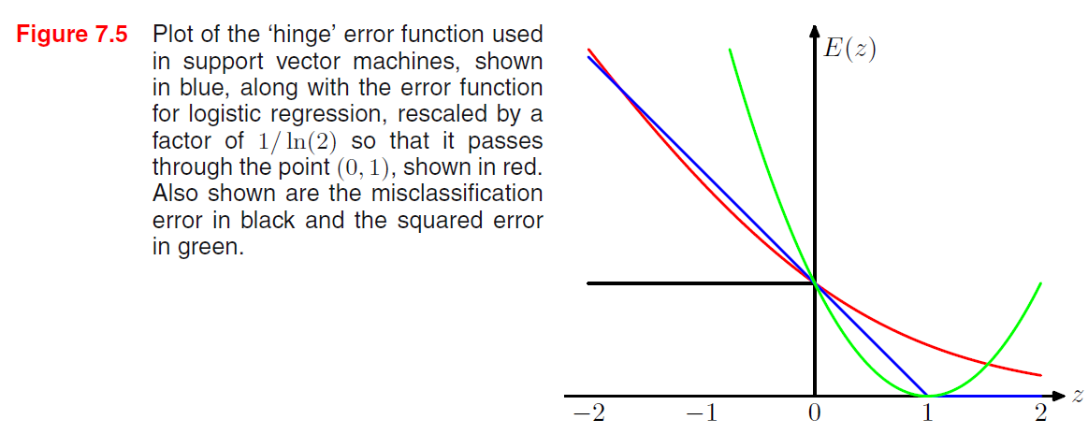
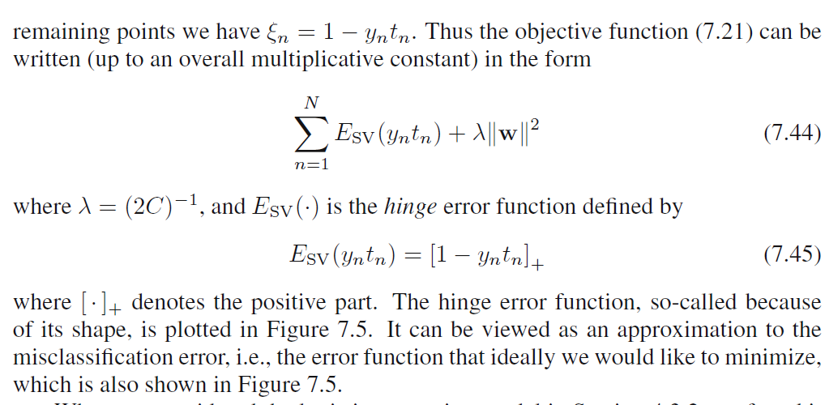
Hinge loss vs. logistic regression

Slide 37
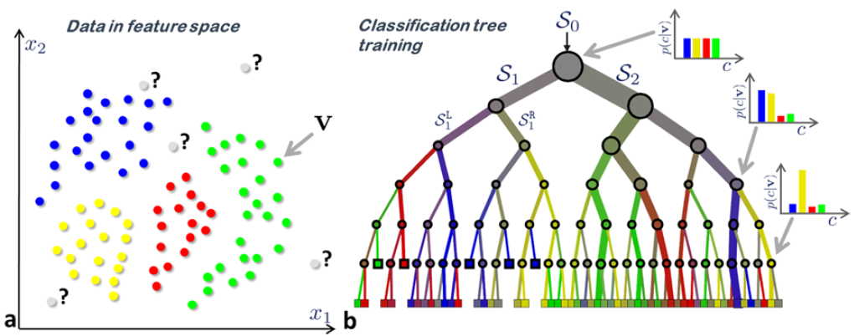
Decision trees (lighting speed)
D = tree depth

Slide 38
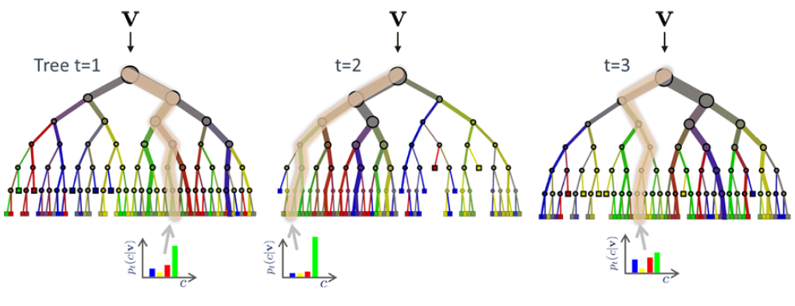
Random forest
T = # trees

Slide 39
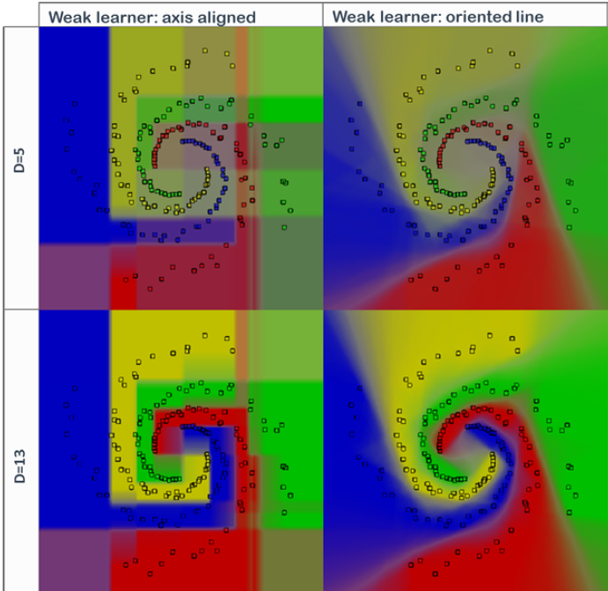
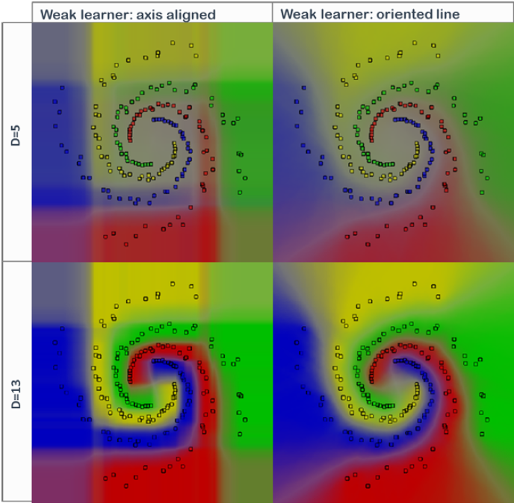
Random forest
ρ = 500 ρ = 5
ρ = # samples at each node at construction time

Slide 40
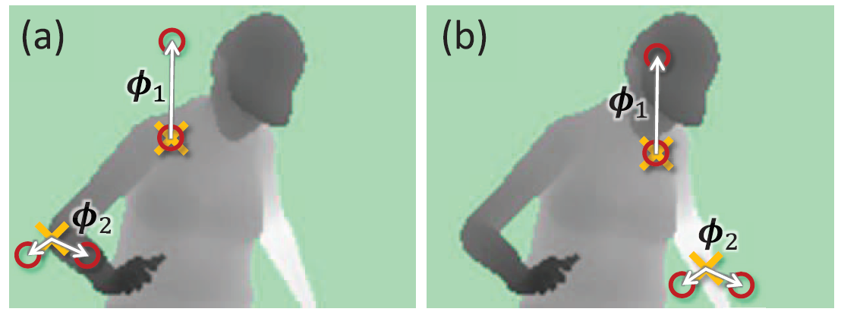
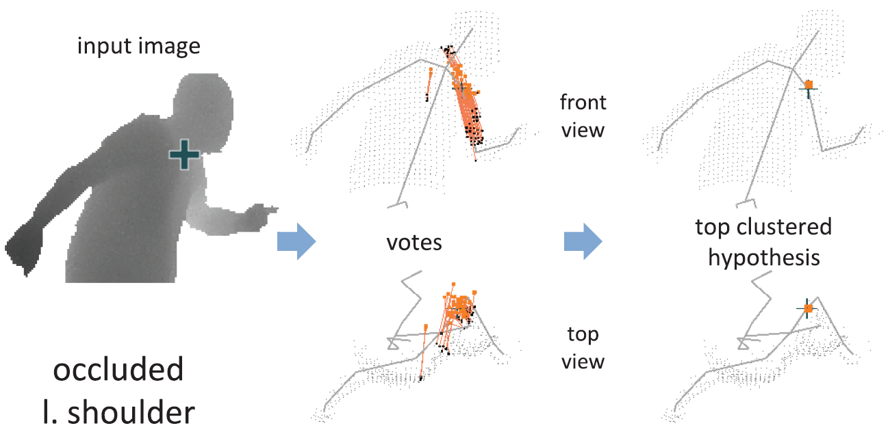
Application: Kinect body pose estimation

Slide 41
Deep neural networks (today’s lecture)
Loss functions
Regularization
Weights and layers
Activation functions
Backpropagation
Training and optimization
Notes:
The order in the lecture is a little different from the book, because Justin Johnson’s lectures follow a different order

Slide 42
Lecture 5:
Neural Networks

Slide 43
Problem: Linear Classifiers aren’t that powerful
Geometric Viewpoint
Visual Viewpoint
y
One template per class:
Can’t recognize different modes of a class
x

Slide 44
One solution: Feature Transforms
Original space
y
r = (x² + y²)^{1/2}
θ = tan⁻¹(y/x)
x
Feature transform

Slide 45
One solution: Feature Transforms
Original space
Feature space
y
θ
r = (x² + y²)^{1/2}
θ = tan⁻¹(y/x)
x
Feature transform
r

Slide 46
One solution: Feature Transforms
Original space
Feature space
y
θ
r = (x² + y²)^{1/2}
θ = tan⁻¹(y/x)
x
Feature transform
r
Linear classifier in feature space

Slide 47
One solution: Feature Transforms
Original space
Feature space
y
θ
r = (x² + y²)^{1/2}
θ = tan⁻¹(y/x)
x
Feature transform
r
Nonlinear classifier in original space!
Linear classifier in feature space

Slide 48

Image Features: Color Histogram
Ignores texture, spatial positions
+1
Frog image is in the public domain

Slide 49

Image Features: Histogram of Oriented Gradients (HoG)
Compute edge direction / strength at each pixel
Divide image into 8x8 regions
Within each region compute a histogram of edge directions weighted by edge strength
Lowe, “Object recognition from local scale-invariant features”, ICCV 1999
Dalal and Triggs, "Histograms of oriented gradients for human detection," CVPR 2005

Slide 50
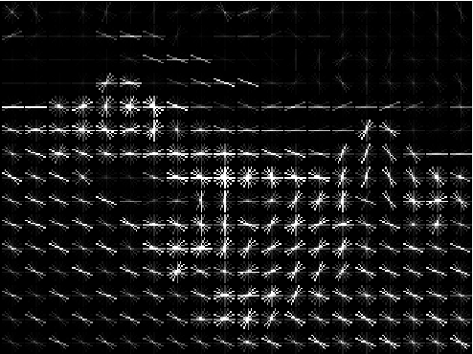
Image Features: Histogram of Oriented Gradients (HoG)
Compute edge direction / strength at each pixel
Divide image into 8x8 regions
Within each region compute a histogram of edge directions weighted by edge strength
Example: 320x240 image gets divided into 40x30 bins; 8 directions per bin; feature vector has 30*40*9 = 10,800 numbers
Lowe, “Object recognition from local scale-invariant features”, ICCV 1999
Dalal and Triggs, "Histograms of oriented gradients for human detection," CVPR 2005

Slide 51
Image Features: Histogram of Oriented Gradients (HoG)
Weak edges
Strong diagonal edges
Edges in all directions
Captures texture and position, robust to small image changes
Compute edge direction / strength at each pixel
Divide image into 8x8 regions
Within each region compute a histogram of edge directions weighted by edge strength
Example: 320x240 image gets divided into 40x30 bins; 8 directions per bin; feature vector has 30*40*9 = 10,800 numbers
Lowe, “Object recognition from local scale-invariant features”, ICCV 1999
Dalal and Triggs, "Histograms of oriented gradients for human detection," CVPR 2005

Slide 52

Image Features: Bag of Words (Data-Driven!)
Step 1: Build codebook
Cluster patches to form “codebook” of “visual words”
Extract random patches
Fei-Fei and Perona, “A bayesian hierarchical model for learning natural scene categories”, CVPR 2005
Car image is CC0 1.0 public domain

Slide 53
Image Features: Bag of Words (Data-Driven!)
Step 1: Build codebook
Cluster patches to form “codebook” of “visual words”
Extract random patches
Step 2: Encode images
Fei-Fei and Perona, “A bayesian hierarchical model for learning natural scene categories”, CVPR 2005

Slide 54
Image Features

Slide 55
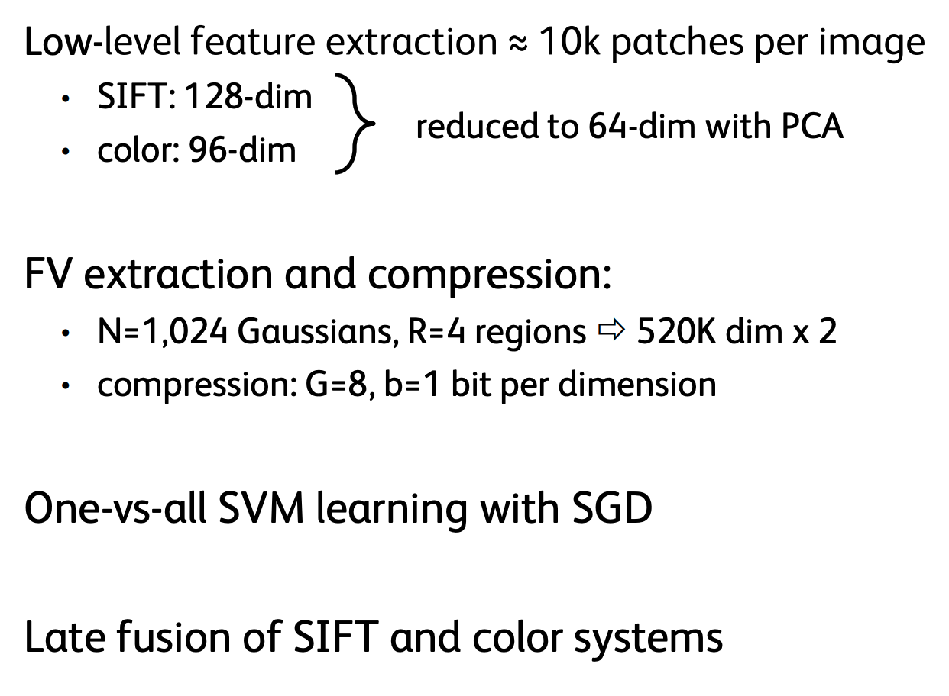
Example: Winner of 2011 ImageNet challenge
F. Perronnin, J. Sánchez, “Compressed Fisher vectors for LSVRC”, PASCAL VOC / ImageNet workshop, ICCV, 2011.

Slide 56
Image Features
f
Feature Extraction
10 numbers giving scores for classes
training

Slide 57
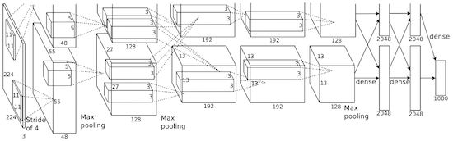
Image Features vs Neural Networks
f
Feature Extraction
10 numbers giving scores for classes
training
Krizhevsky, Sutskever, and Hinton, “Imagenet classification with deep convolutional neural networks”, NIPS 2012.
Figure copyright Krizhevsky, Sutskever, and Hinton, 2012. Reproduced with permission.
10 numbers giving scores for classes
training

Slide 58


Neural Networks
(Before) Linear score function:

Slide 59


Neural Networks
(Before) Linear score function:
(Now) 2-layer Neural Network
(In practice we will usually add a learnable bias at each layer as well)

Slide 60
Neural Networks
(Before) Linear score function:
(Now) 2-layer Neural Network
or 3-layer Neural Network
(In practice we will usually add a learnable bias at each layer as well)

Slide 61
Neural Networks
(Before) Linear score function:
(Now) 2-layer Neural Network
x
h
Input:
3072
W₁
W₂
s
Output: 10
Hidden layer:
100

Slide 62
Neural Networks
(Before) Linear score function:
(Now) 2-layer Neural Network
x
Element (i, j) of W₁ gives the effect on h_{i} from x_{j}
Element (i, j) of W₂ gives the effect on s_{i} from h_{j}
h
Input:
3072
W₁
W₂
s
Output: 10
Hidden layer:
100

Slide 63
Neural Networks
(Before) Linear score function:
(Now) 2-layer Neural Network
Element (i, j) of W₁ gives the effect on h_{i} from x_{j}
x
Element (i, j) of W₂ gives the effect on s_{i} from h_{j}
h
Input:
3072
W₁
W₂
s
All elements of x affect all elements of h
Output: 10
All elements of h affect all elements of s
Hidden layer:
100
Fully-connected neural network
Also “Multi-Layer Perceptron” (MLP)

Slide 64
Neural Networks
(Before) Linear score function:
(Now) 2-layer Neural Network
Linear classifier: One template per class
x
h
Input:
3072
W₁
W₂
s
Output: 10
Hidden layer:
100

Slide 65
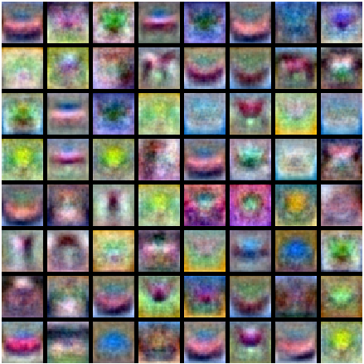
Neural Networks
Neural net: first layer is bank of templates;
Second layer recombines templates
(Before) Linear score function:
(Now) 2-layer Neural Network
x
h
Input:
3072
W₁
W₂
s
Output: 10
Hidden layer:
100

Slide 66
Neural Networks
Can use different templates to cover multiple modes of a class!
(Before) Linear score function:
(Now) 2-layer Neural Network
x
h
Input:
3072
W₁
W₂
s
Output: 10
Hidden layer:
100

Slide 67
Neural Networks
“Distributed representation”: Most templates not interpretable!
(Before) Linear score function:
(Now) 2-layer Neural Network
x
h
Input:
3072
W₁
W₂
s
Output: 10
Hidden layer:
100

Slide 68
Deep Neural Networks
Depth = number of layers
x
h₁
h₂
h₃
h₄
h₅
Width:
Size of each layer
W₁
W₂
W₃
W₄
W₅
W₆
s
Output: 10
Input:
3072

Slide 69

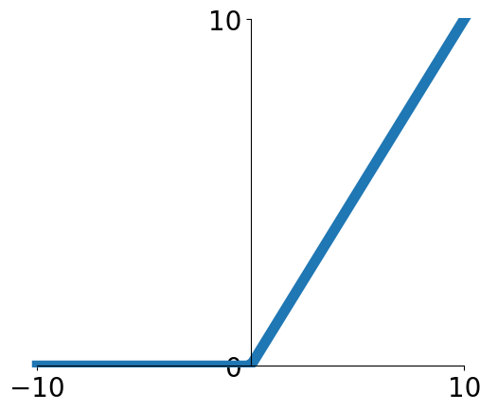
Activation Functions
2-layer Neural Network
The function is called “Rectified Linear Unit”
This is called the activation function of the neural network

Slide 70

Activation Functions
2-layer Neural Network
The function is called “Rectified Linear Unit”
This is called the activation function of the neural network
Q: What happens if we build a neural network with no activation function?

Slide 71
Activation Functions
2-layer Neural Network
The function is called “Rectified Linear Unit”
This is called the activation function of the neural network
Q: What happens if we build a neural network with no activation function?
A: We end up with a linear classifier!

Slide 72
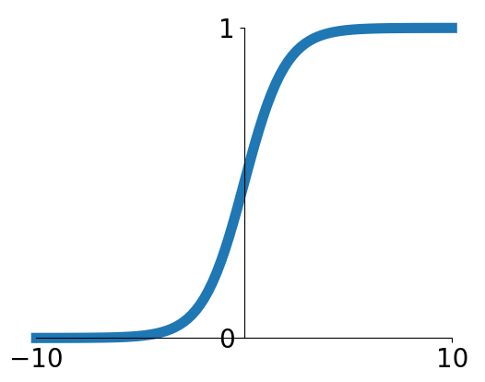
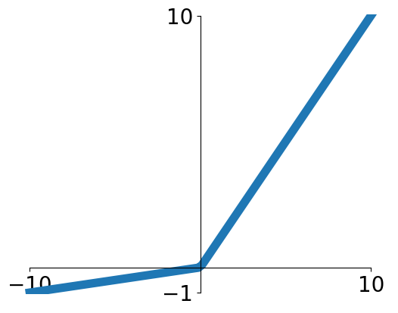


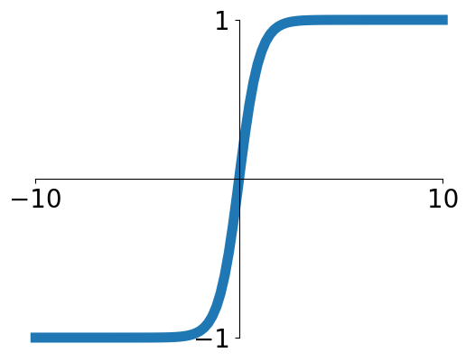


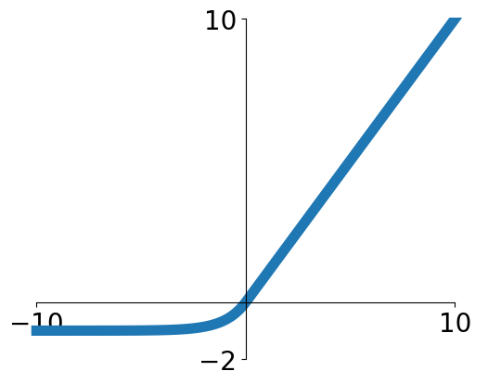


Activation Functions
Sigmoid
Leaky ReLU
tanh
Maxout
ReLU
ELU

Slide 73
Activation Functions
ReLU is a good default choice for most problems
Sigmoid
Leaky ReLU
tanh
Maxout
ReLU
ELU

Slide 74


Neural Net in <20 lines!
Initialize weights and data
Compute loss (sigmoid activation, L2 loss)
Compute gradients
Stochastic Gradient Descent (SGD) step

Slide 75


Our brains are made of Neurons
Presynaptic terminal
Axon
Synapse
Impulses carried away from cell body
Cell body
Impulses carried toward cell body
Firing rate is a nonlinear function of inputs
Dendrite

Slide 76


Biological Neuron
presynaptic
terminal
dendrite
Artificial Neuron
axon
cell body
Neuron image by Felipe Perucho
is licensed under CC-BY 3.0

Slide 77

Setting the number of layers and their sizes
3 hidden units
6 hidden units
20 hidden units
More hidden units = more capacity

Slide 78

Don’t regularize with size; instead use stronger L2
(Web demo with ConvNetJS: http://cs.stanford.edu/people/karpathy/convnetjs/demo/classify2d.html)

Slide 79
Summary
Feature transform + Linear classifier allows nonlinear decision boundaries
Neural Networks as learnable feature transforms

Slide 80
Summary
Linear classifier: One template per class
From linear classifiers to fully-connected networks
Neural networks: Many reusable templates

Slide 81
Deep neural networks
Loss functions
Regularization
Weights and layers
Activation functions
Backpropagation
Training and optimization
Notes:
The order in the lecture is a little different from the book, because Justin Johnson’s lectures follow a different order

Slide 82
Lecture 6:
Backpropagation

Slide 83


Problem: How to compute gradients?
Nonlinear score function
SVM Loss on predictions
Regularization
Total loss: data loss + regularization
If we can compute then we can learn W₁ and W₂

Slide 84


(Bad) Idea: Derive on paper
Problem: Very tedious: Lots of matrix calculus, need lots of paper
Problem: What if we want to change loss? E.g. use softmax instead of SVM? Need to re-derive from scratch. Not modular!
Problem: Not feasible for very complex models!

Slide 85


Better Idea: Computational Graphs
x
s (scores)
hinge loss
*
+
L
W
R

Slide 86


Backpropagation:
Simple Example

Slide 87
Backpropagation:
Simple Example
e.g. x = -2, y = 5, z = -4

Slide 88


Backpropagation:
Simple Example
e.g. x = -2, y = 5, z = -4
1. Forward pass: Compute outputs

Slide 89

Backpropagation:
Simple Example
e.g. x = -2, y = 5, z = -4
1. Forward pass: Compute outputs
2. Backward pass: Compute derivatives
Want:

Slide 90

Backpropagation:
Simple Example
e.g. x = -2, y = 5, z = -4
1. Forward pass: Compute outputs
2. Backward pass: Compute derivatives
Want:

Slide 91
Backpropagation:
Simple Example
e.g. x = -2, y = 5, z = -4
1. Forward pass: Compute outputs
2. Backward pass: Compute derivatives
Want:

Slide 92

Backpropagation:
Simple Example
e.g. x = -2, y = 5, z = -4
1. Forward pass: Compute outputs
2. Backward pass: Compute derivatives
Want:

Slide 93
Backpropagation:
Simple Example
e.g. x = -2, y = 5, z = -4
1. Forward pass: Compute outputs
2. Backward pass: Compute derivatives
Want:

Slide 94

Backpropagation:
Simple Example
e.g. x = -2, y = 5, z = -4
1. Forward pass: Compute outputs
2. Backward pass: Compute derivatives
Want:

Slide 95
Backpropagation:
Simple Example
e.g. x = -2, y = 5, z = -4
1. Forward pass: Compute outputs
2. Backward pass: Compute derivatives
Want:

Slide 96

Backpropagation:
Simple Example
e.g. x = -2, y = 5, z = -4
1. Forward pass: Compute outputs
2. Backward pass: Compute derivatives
Want:

Slide 97
Backpropagation:
Simple Example
e.g. x = -2, y = 5, z = -4
1. Forward pass: Compute outputs
Chain Rule
2. Backward pass: Compute derivatives
Want:

Slide 98

Backpropagation:
Simple Example
e.g. x = -2, y = 5, z = -4
1. Forward pass: Compute outputs
Chain Rule
2. Backward pass: Compute derivatives
Want:
Downstream
Gradient
Local
Gradient
Upstream
Gradient

Slide 99
Backpropagation:
Simple Example
e.g. x = -2, y = 5, z = -4
1. Forward pass: Compute outputs
Chain Rule
2. Backward pass: Compute derivatives
Want:
Downstream
Gradient
Local
Gradient
Upstream
Gradient

Slide 100


Backpropagation:
Simple Example
e.g. x = -2, y = 5, z = -4
1. Forward pass: Compute outputs
Chain Rule
2. Backward pass: Compute derivatives
Want:
Downstream
Gradient
Local
Gradient
Upstream
Gradient

Slide 101
Backpropagation:
Simple Example
e.g. x = -2, y = 5, z = -4
1. Forward pass: Compute outputs
Chain Rule
2. Backward pass: Compute derivatives
Want:
Downstream
Gradient
Local
Gradient
Upstream
Gradient

Slide 102

f

Slide 103

f
Upstream gradient

Slide 104


f
Local gradients
Upstream gradient

Slide 105


f
Downstream
gradients
Local gradients
Upstream gradient

Slide 106
f
Downstream
gradients
Local gradients
Upstream gradient

Slide 107


Another Example

Slide 108
Another Example
Forward pass: Compute outputs

Slide 109
Another Example
Backward pass: Compute gradients
Base Case

Slide 110

Another Example
Backward pass: Compute gradients
Local Gradient
Downstream
Gradient
Upstream Gradient

Slide 111

Another Example
Backward pass: Compute gradients
Local Gradient
Downstream
Gradient
Upstream Gradient

Slide 112

Another Example
Backward pass: Compute gradients
Local Gradient
Downstream
Gradient
Upstream Gradient

Slide 113

Another Example
Backward pass: Compute gradients
Local Gradient
Downstream
Gradient
Upstream Gradient

Slide 114

Another Example
Backward pass: Compute gradients
Local Gradient
Upstream Gradient
Downstream
Gradient

Slide 115
Another Example
Backward pass: Compute gradients
Local Gradient
Downstream
Gradient
Upstream Gradient

Slide 116

Another Example
Downstream Gradient
Upstream Gradient
Backward pass: Compute gradients
Local Gradient

Slide 117
Another Example
Downstream Gradient
Upstream Gradient
Backward pass: Compute gradients
Local Gradient

Slide 118


Another Example
Backward pass: Compute gradients
Computational graph is not unique: we can use primitives that have simple local gradients
Sigmoid

Slide 119
Another Example
Backward pass: Compute gradients
Computational graph is not unique: we can use primitives that have simple local gradients
Sigmoid
Sigmoid local gradient:

Slide 120
Another Example
Backward pass: Compute gradients
Computational graph is not unique: we can use primitives that have simple local gradients
Sigmoid
[Downstream] = [Local] * [Upstream]
= (1 – 0.73) * 0.73 * 1.0 = 0.2
Sigmoid local gradient:

Slide 121
Gradients of other Activation Functions?
Sigmoid
Leaky ReLU
tanh
Maxout
ReLU
ELU

Slide 122

Gradients of activation functions?
Sigmoid local gradient:
https://towardsdatascience.com/activation-functions-neural-networks-1cbd9f8d91d6
Notes:
The order in the lecture is a little different from the book, because Justin Johnson’s lectures follow a different order

Slide 123
Cross-Entropy Loss (Multinomial Logistic Regression)
Want to interpret raw classifier scores as probabilities
Softmax function
Probabilities must be >= 0
Probabilities must sum to 1
cat
3.2
24.5
0.13
L_{i} = -log(0.13)
= 2.04
exp
car
5.1
164.0
normalize
0.87
Maximum Likelihood Estimation
Choose weights to maximize the likelihood of the observed data
(next lecture)
frog
-1.7
0.18
0.00
Unnormalized log-probabilities / logits
unnormalized probabilities
probabilities

Slide 124


Gradients of softmax?
https://eli.thegreenplace.net/2016/the-softmax-function-and-its-derivative/
Notes:
The order in the lecture is a little different from the book, because Justin Johnson’s lectures follow a different order

Slide 125
Patterns in Gradient Flow
add gate: gradient distributor
3
2
+
7
4
2
2

Slide 126
Patterns in Gradient Flow
add gate: gradient distributor
3
2
+
7
4
2
2
copy gate: gradient adder
7
7
4
4+2=6
7
2

Slide 127
Patterns in Gradient Flow
add gate: gradient distributor
mul gate: “swap multiplier”
3
2
2
5*3=15
+
7
×
6
4
2
3
5
2
2*5=10
copy gate: gradient adder
7
7
4
4+2=6
7
2

Slide 128
Patterns in Gradient Flow
add gate: gradient distributor
mul gate: “swap multiplier”
3
2
2
5*3=15
+
7
×
6
4
2
3
5
2
2*5=10
copy gate: gradient adder
max gate: gradient router
7
4
4
0
7
5
max
4+2=6
7
5
9
2
9

Slide 129


Backprop Implementation:
”Flat” gradient code:
Forward pass:
Compute output

Slide 130
Backprop Implementation:
”Flat” gradient code:
Forward pass:
Compute output
Backward pass:
Compute grads

Slide 131
Backprop Implementation:
”Flat” gradient code:
Forward pass:
Compute output
Base case

Slide 132
Backprop Implementation:
”Flat” gradient code:
Forward pass:
Compute output
Sigmoid

Slide 133
Backprop Implementation:
”Flat” gradient code:
Forward pass:
Compute output
Add

Slide 134
Backprop Implementation:
”Flat” gradient code:
Forward pass:
Compute output
Add

Slide 135
Backprop Implementation:
”Flat” gradient code:
Forward pass:
Compute output
Multiply

Slide 136
Backprop Implementation:
”Flat” gradient code:
Forward pass:
Compute output
Multiply

Slide 137


“Flat” Backprop: Do this for Assignment 2!
Your gradient code should look like a “reversed version” of your forward pass!
E.g. for the SVM:

Slide 138

“Flat” Backprop: Do this for Assignment 2!
Your gradient code should look like a “reversed version” of your forward pass!
E.g. for two-layer neural net:

Slide 139


Backprop Implementation: Modular API
Graph (or Net) object (rough pseudo code)

Slide 140

Example: PyTorch Autograd Functions
Write something similar in HW3
x
z
Need to stash some values for use in backward
*
y
(x,y,z are scalars)
Upstream gradient
Multiply upstream and local gradients

Slide 141


Example: PyTorch operators

Slide 142

PyTorch sigmoid layer
Source

Slide 143
PyTorch sigmoid layer
Forward
Source

Slide 144

PyTorch sigmoid layer
Forward
Forward actually defined elsewhere...
Source

Slide 145
PyTorch sigmoid layer
Forward
Backward
Source

Slide 146
So far: backprop with scalars
What about vector-valued functions?

Slide 147


Recap: Vector Derivatives
Regular derivative:
If x changes by a small amount, how much will y change?

Slide 148



Recap: Vector Derivatives
Regular derivative:
Derivative is Gradient:
If x changes by a small amount, how much will y change?
For each element of x, if it changes by a small amount then how much will y change?

Slide 149



Recap: Vector Derivatives
Regular derivative:
Derivative is Gradient:
Derivative is Jacobian:
If x changes by a small amount, how much will y change?
For each element of x, if it changes by a small amount then how much will y change?
For each element of x, if it changes by a small amount then how much will each element of y change?

Slide 150


Backprop with Vectors
D_{x}
f
D_{z}
D_{y}

Slide 151

Backprop with Vectors
Loss L still a scalar!
D_{x}
f
D_{z}
D_{z}
D_{y}
Upstream Gradient
For each element of z, how much does it influence L?

Slide 152


Backprop with Vectors
Loss L still a scalar!
D_{x}
f
Local
Jacobian matrices
[D_{x} x D_{z}]
D_{z}
[D_{y} x D_{z}]
D_{z}
D_{y}
Upstream Gradient
For each element of z, how much does it influence L?

Slide 153


Backprop with Vectors
Loss L still a scalar!
D_{x}
f
Local
Jacobian matrices
D_{x}
[D_{x} x D_{z}]
D_{z}
Downstream Gradients
Matrix-vector
multiply
[D_{y} x D_{z}]
D_{z}
D_{y}
Upstream Gradient
D_{y}
For each element of z, how much does it influence L?

Slide 154
Backprop with Vectors
4D input x:
[ 1 ]
[ -2 ]
[ 3 ]
[ -1 ]
4D output y:
[ 1 ]
[ 0 ]
[ 3 ]
[ 0 ]
f(x) = max(0,x)
(elementwise)

Slide 155
Backprop with Vectors
4D input x:
[ 1 ]
[ -2 ]
[ 3 ]
[ -1 ]
4D output y:
[ 1 ]
[ 0 ]
[ 3 ]
[ 0 ]
f(x) = max(0,x)
(elementwise)
4D dL/dy:
[ 4 ]
[ -1 ]
[ 5 ]
[ 9 ]
Upstream
gradient

Slide 156
Backprop with Vectors
4D input x:
[ 1 ]
[ -2 ]
[ 3 ]
[ -1 ]
4D output y:
[ 1 ]
[ 0 ]
[ 3 ]
[ 0 ]
f(x) = max(0,x)
(elementwise)
Jacobian dy/dx
[ 1 0 0 0 ]
[ 0 0 0 0 ]
[ 0 0 1 0 ]
[ 0 0 0 0 ]
4D dL/dy:
[ 4 ]
[ -1 ]
[ 5 ]
[ 9 ]
Upstream
gradient

Slide 157
Backprop with Vectors
4D input x:
[ 1 ]
[ -2 ]
[ 3 ]
[ -1 ]
4D output y:
[ 1 ]
[ 0 ]
[ 3 ]
[ 0 ]
f(x) = max(0,x)
(elementwise)
[dy/dx] [dL/dy]
[ 1 0 0 0 ] [ 4 ]
[ 0 0 0 0 ] [ -1 ]
[ 0 0 1 0 ] [ 5 ]
[ 0 0 0 0 ] [ 9 ]
4D dL/dy:
[ 4 ]
[ -1 ]
[ 5 ]
[ 9 ]
Upstream
gradient

Slide 158
Backprop with Vectors
4D input x:
[ 1 ]
[ -2 ]
[ 3 ]
[ -1 ]
4D output y:
[ 1 ]
[ 0 ]
[ 3 ]
[ 0 ]
f(x) = max(0,x)
(elementwise)
4D dL/dx:
[ 4 ]
[ 0 ]
[ 5 ]
[ 0 ]
[dy/dx] [dL/dy]
[ 1 0 0 0 ] [ 4 ]
[ 0 0 0 0 ] [ -1 ]
[ 0 0 1 0 ] [ 5 ]
[ 0 0 0 0 ] [ 9 ]
4D dL/dy:
[ 4 ]
[ -1 ]
[ 5 ]
[ 9 ]
Upstream
gradient

Slide 159
Backprop with Vectors
Jacobian is sparse: off-diagonal entries all zero! Never explicitly form Jacobian; instead use implicit multiplication
4D input x:
[ 1 ]
[ -2 ]
[ 3 ]
[ -1 ]
4D output y:
[ 1 ]
[ 0 ]
[ 3 ]
[ 0 ]
f(x) = max(0,x)
(elementwise)
4D dL/dx:
[ 4 ]
[ 0 ]
[ 5 ]
[ 0 ]
[dy/dx] [dL/dy]
[ 1 0 0 0 ] [ 4 ]
[ 0 0 0 0 ] [ -1 ]
[ 0 0 1 0 ] [ 5 ]
[ 0 0 0 0 ] [ 9 ]
4D dL/dy:
[ 4 ]
[ -1 ]
[ 5 ]
[ 9 ]
Upstream
gradient

Slide 160

Backprop with Vectors
Jacobian is sparse: off-diagonal entries all zero! Never explicitly form Jacobian; instead use implicit multiplication
4D input x:
[ 1 ]
[ -2 ]
[ 3 ]
[ -1 ]
4D output y:
[ 1 ]
[ 0 ]
[ 3 ]
[ 0 ]
f(x) = max(0,x)
(elementwise)
4D dL/dx:
[ 4 ]
[ 0 ]
[ 5 ]
[ 0 ]
[dy/dx] [dL/dy]
4D dL/dy:
[ 4 ]
[ -1 ]
[ 5 ]
[ 9 ]
Upstream
gradient

Slide 161
Backprop with Matrices (or Tensors):
[D_{x}×M_{x}]
[D_{z}×M_{z}]
[D_{y}×M_{y}]

Slide 162
Backprop with Matrices (or Tensors):
Loss L still a scalar!
[D_{x}×M_{x}]
dL/dx always has the same shape as x!
[D_{z}×M_{z}]
[D_{y}×M_{y}]

Slide 163
Backprop with Matrices (or Tensors):
Loss L still a scalar!
[D_{x}×M_{x}]
dL/dx always has the same shape as x!
[D_{z}×M_{z}]
[D_{y}×M_{y}]
[D_{z}×M_{z}]
Upstream gradient
For each element of z, how much does it influence L?

Slide 164
Backprop with Matrices (or Tensors):
Loss L still a scalar!
[D_{x}×M_{x}]
dL/dx always has the same shape as x!
Local
Jacobian matrices
[(D_{x}×M_{x})×(D_{z}×M_{z})]
[D_{z}×M_{z}]
[(D_{y}×M_{y})×(D_{z}×M_{z})]
[D_{y}×M_{y}]
[D_{z}×M_{z}]
Upstream gradient
For each element of y, how much does it influence each element of z?
For each element of z, how much does it influence L?

Slide 165

Backprop with Matrices (or Tensors):
Loss L still a scalar!
[D_{x}×M_{x}]
dL/dx always has the same shape as x!
Local
Jacobian matrices
[D_{x}×M_{x}]
[(D_{x}×M_{x})×(D_{z}×M_{z})]
[D_{z}×M_{z}]
Matrix-vector
multiply
[(D_{y}×M_{y})×(D_{z}×M_{z})]
[D_{y}×M_{y}]
[D_{z}×M_{z}]
Upstream gradient
[D_{y}×M_{y}]
For each element of y, how much does it influence each element of z?
For each element of z, how much does it influence L?

Slide 166

Example: Matrix Multiplication
y: [N×M]
[-1 -1 2 6 ]
[ 5 2 11 7 ]
x: [N×D]
[ 2 1 -3 ]
[ -3 4 2 ]
w: [D×M]
[ 3 2 1 -1]
[ 2 1 3 2]
[ 3 2 1 -2]
Matrix Multiply y = xw

Slide 167
Example: Matrix Multiplication
y: [N×M]
[-1 -1 2 6 ]
[ 5 2 11 7 ]
x: [N×D]
[ 2 1 -3 ]
[ -3 4 2 ]
w: [D×M]
[ 3 2 1 -1]
[ 2 1 3 2]
[ 3 2 1 -2]
Matrix Multiply y = xw
dL/dy: [N×M]
[ 2 3 -3 9 ]
[ -8 1 4 6 ]
dL/dx: [N×D]
[ 0 16 -9 ]
[-24 9 -30 ]
? ? ? ? ? ?

Slide 168
Example: Matrix Multiplication
y: [N×M]
[-1 -1 2 6 ]
[ 5 2 11 7 ]
x: [N×D]
[ 2 1 -3 ]
[ -3 4 2 ]
w: [D×M]
[ 3 2 1 -1]
[ 2 1 3 2]
[ 3 2 1 -2]
Matrix Multiply y = xw
dL/dy: [N×M]
[ 2 3 -3 9 ]
[ -8 1 4 6 ]
dL/dx: [N×D]
[ 0 16 -9 ]
[-24 9 -30 ]
Jacobians:
dy/dx: [(N×D)×(N×M)]
dy/dw: [(D×M)×(N×M)]
For a neural net we may have
N=64, D=M=4096
Each Jacobian takes 256 GB of memory! Must work with them implicitly!
? ? ? ? ? ?

Slide 169
Example: Matrix Multiplication
y: [N×M]
[-1 -1 2 6 ]
[ 5 2 11 7 ]
x: [N×D]
[ 2 1 -3 ]
[ -3 4 2 ]
w: [D×M]
[ 3 2 1 -1]
[ 2 1 3 2]
[ 3 2 1 -2]
Matrix Multiply y = xw
dL/dy: [N×M]
[ 2 3 -3 9 ]
[ -8 1 4 6 ]
dL/dx: [N×D]
[ 0 16 -9 ]
[-24 9 -30 ]
? ? ? ? ? ?
Local Gradient Slice:
dy/dx_{1,1}
[ ? ? ? ? ]
[ ? ? ? ? ]
dL/dx_{1,1}
= (dy/dx_{1,1}) · (dL/dy)

Slide 170
Example: Matrix Multiplication
y: [N×M]
[-1 -1 2 6 ]
[ 5 2 11 7 ]
x: [N×D]
[ 2 1 -3 ]
[ -3 4 2 ]
w: [D×M]
[ 3 2 1 -1]
[ 2 1 3 2]
[ 3 2 1 -2]
Matrix Multiply y = xw
dL/dy: [N×M]
[ 2 3 -3 9 ]
[ -8 1 4 6 ]
dL/dx: [N×D]
[ 0 16 -9 ]
[-24 9 -30 ]
? ? ? ? ? ?
Local Gradient Slice:
dy/dx_{1,1}
[ ? ? ? ? ]
[ ? ? ? ? ]
dy_{1,1}/dx_{1,1}
dL/dx_{1,1}
= (dy/dx_{1,1}) · (dL/dy)

Slide 171
Example: Matrix Multiplication
y: [N×M]
[-1 -1 2 6 ]
[ 5 2 11 7 ]
x: [N×D]
[ 2 1 -3 ]
[ -3 4 2 ]
w: [D×M]
[ 3 2 1 -1]
[ 2 1 3 2]
[ 3 2 1 -2]
Matrix Multiply y = xw
dL/dy: [N×M]
[ 2 3 -3 9 ]
[ -8 1 4 6 ]
dL/dx: [N×D]
[ 0 16 -9 ]
[-24 9 -30 ]
? ? ? ? ? ?
Local Gradient Slice:
dy/dx_{1,1}
[ ? ? ? ? ]
[ ? ? ? ? ]
dy_{1,1}/dx_{1,1}
dL/dx_{1,1}
= (dy/dx_{1,1}) · (dL/dy)
y_{1,1} = x_{1,1}w_{1,1} + x_{1,2}w_{2,1} + x_{1,3}w_{3,1}

Slide 172
Example: Matrix Multiplication
y: [N×M]
[-1 -1 2 6 ]
[ 5 2 11 7 ]
x: [N×D]
[ 2 1 -3 ]
[ -3 4 2 ]
w: [D×M]
[ 3 2 1 -1]
[ 2 1 3 2]
[ 3 2 1 -2]
Matrix Multiply y = xw
dL/dy: [N×M]
[ 2 3 -3 9 ]
[ -8 1 4 6 ]
dL/dx: [N×D]
[ 0 16 -9 ]
[-24 9 -30 ]
? ? ? ? ? ?
Local Gradient Slice:
dy/dx_{1,1}
[ 3 ? ? ? ]
[ ? ? ? ? ]
dy_{1,1}/dx_{1,1}
dL/dx_{1,1}
= (dy/dx_{1,1}) · (dL/dy)
y_{1,1} = x_{1,1}w_{1,1} + x_{1,2}w_{2,1} + x_{1,3}w_{3,1}
=> dy_{1,1}/dx_{1,1} = w_{1,1}

Slide 173
Example: Matrix Multiplication
y: [N×M]
[-1 -1 2 6 ]
[ 5 2 11 7 ]
x: [N×D]
[ 2 1 -3 ]
[ -3 4 2 ]
w: [D×M]
[ 3 2 1 -1]
[ 2 1 3 2]
[ 3 2 1 -2]
Matrix Multiply y = xw
dL/dy: [N×M]
[ 2 3 -3 9 ]
[ -8 1 4 6 ]
dL/dx: [N×D]
[ 0 16 -9 ]
[-24 9 -30 ]
? ? ? ? ? ?
Local Gradient Slice:
dy/dx_{1,1}
[ 3 ? ? ? ]
[ ? ? ? ? ]
dy_{1,2}/dx_{1,1}
dL/dx_{1,1}
= (dy/dx_{1,1}) · (dL/dy)

Slide 174
Example: Matrix Multiplication
y: [N×M]
[-1 -1 2 6 ]
[ 5 2 11 7 ]
x: [N×D]
[ 2 1 -3 ]
[ -3 4 2 ]
w: [D×M]
[ 3 2 1 -1]
[ 2 1 3 2]
[ 3 2 1 -2]
Matrix Multiply y = xw
dL/dy: [N×M]
[ 2 3 -3 9 ]
[ -8 1 4 6 ]
dL/dx: [N×D]
[ 0 16 -9 ]
[-24 9 -30 ]
? ? ? ? ? ?
Local Gradient Slice:
dy/dx_{1,1}
[ 3 ? ? ? ]
[ ? ? ? ? ]
dy_{1,2}/dx_{1,1}
dL/dx_{1,1}
= (dy/dx_{1,1}) · (dL/dy)
y_{1,2} = x_{1,1}w_{1,2} + x_{1,2}w_{2,2} + x_{1,3}w_{3,2}

Slide 175
Example: Matrix Multiplication
y: [N×M]
[-1 -1 2 6 ]
[ 5 2 11 7 ]
x: [N×D]
[ 2 1 -3 ]
[ -3 4 2 ]
w: [D×M]
[ 3 2 1 -1]
[ 2 1 3 2]
[ 3 2 1 -2]
Matrix Multiply y = xw
dL/dy: [N×M]
[ 2 3 -3 9 ]
[ -8 1 4 6 ]
dL/dx: [N×D]
[ 0 16 -9 ]
[-24 9 -30 ]
? ? ? ? ? ?
Local Gradient Slice:
dy/dx_{1,1}
[ 3 2 ? ? ]
[ ? ? ? ? ]
dy_{1,2}/dx_{1,1}
dL/dx_{1,1}
= (dy/dx_{1,1}) · (dL/dy)
y_{1,2} = x_{1,1}w_{1,2} + x_{1,2}w_{2,2} + x_{1,3}w_{3,2}
=> dy_{1,2}/dx_{1,1} = w_{1,2}

Slide 176
Example: Matrix Multiplication
y: [N×M]
[-1 -1 2 6 ]
[ 5 2 11 7 ]
x: [N×D]
[ 2 1 -3 ]
[ -3 4 2 ]
w: [D×M]
[ 3 2 1 -1]
[ 2 1 3 2]
[ 3 2 1 -2]
Matrix Multiply y = xw
dL/dy: [N×M]
[ 2 3 -3 9 ]
[ -8 1 4 6 ]
dL/dx: [N×D]
[ 0 16 -9 ]
[-24 9 -30 ]
? ? ? ? ? ?
Local Gradient Slice:
dy/dx_{1,1}
[ 3 2 1 -1 ]
[ ? ? ? ? ]
dy_{1,2}/dx_{1,1}
dL/dx_{1,1}
= (dy/dx_{1,1}) · (dL/dy)

Slide 177
Example: Matrix Multiplication
y: [N×M]
[-1 -1 2 6 ]
[ 5 2 11 7 ]
x: [N×D]
[ 2 1 -3 ]
[ -3 4 2 ]
w: [D×M]
[ 3 2 1 -1]
[ 2 1 3 2]
[ 3 2 1 -2]
Matrix Multiply y = xw
dL/dy: [N×M]
[ 2 3 -3 9 ]
[ -8 1 4 6 ]
dL/dx: [N×D]
[ 0 16 -9 ]
[-24 9 -30 ]
? ? ? ? ? ?
Local Gradient Slice:
dy/dx_{1,1}
[ 3 2 1 -1 ]
[ ? ? ? ? ]
dy_{1,2}/dx_{1,1}
dL/dx_{1,1}
= (dy/dx_{1,1}) · (dL/dy)
y_{2,1} = x_{2,1}w_{1,1} + x_{2,2}w_{2,1} + x_{2,3}w_{3,1}

Slide 178
Example: Matrix Multiplication
y: [N×M]
[-1 -1 2 6 ]
[ 5 2 11 7 ]
x: [N×D]
[ 2 1 -3 ]
[ -3 4 2 ]
w: [D×M]
[ 3 2 1 -1]
[ 2 1 3 2]
[ 3 2 1 -2]
Matrix Multiply y = xw
dL/dy: [N×M]
[ 2 3 -3 9 ]
[ -8 1 4 6 ]
dL/dx: [N×D]
[ 0 16 -9 ]
[-24 9 -30 ]
? ? ? ? ? ?
Local Gradient Slice:
dy/dx_{1,1}
[ 3 2 1 -1 ]
[ 0 ? ? ? ]
dy_{1,2}/dx_{1,1}
dL/dx_{1,1}
= (dy/dx_{1,1}) · (dL/dy)
y_{2,1} = x_{2,1}w_{1,1} + x_{2,2}w_{2,1} + x_{2,3}w_{3,1}
=> dy_{2,1}/dx_{1,1} = 0

Slide 179
Example: Matrix Multiplication
y: [N×M]
[-1 -1 2 6 ]
[ 5 2 11 7 ]
x: [N×D]
[ 2 1 -3 ]
[ -3 4 2 ]
w: [D×M]
[ 3 2 1 -1]
[ 2 1 3 2]
[ 3 2 1 -2]
Matrix Multiply y = xw
dL/dy: [N×M]
[ 2 3 -3 9 ]
[ -8 1 4 6 ]
dL/dx: [N×D]
[ 0 16 -9 ]
[-24 9 -30 ]
? ? ? ? ? ?
Local Gradient Slice:
dy/dx_{1,1}
[ 3 2 1 -1 ]
[ 0 0 0 0 ]
dy_{1,2}/dx_{1,1}
dL/dx_{1,1}
= (dy/dx_{1,1}) · (dL/dy)

Slide 180
Example: Matrix Multiplication
y: [N×M]
[-1 -1 2 6 ]
[ 5 2 11 7 ]
x: [N×D]
[ 2 1 -3 ]
[ -3 4 2 ]
w: [D×M]
[ 3 2 1 -1]
[ 2 1 3 2]
[ 3 2 1 -2]
Matrix Multiply y = xw
dL/dy: [N×M]
[ 2 3 -3 9 ]
[ -8 1 4 6 ]
dL/dx: [N×D]
[ 0 16 -9 ]
[-24 9 -30 ]
? ? ? ? ? ?
Local Gradient Slice:
dy/dx_{1,1}
[ 3 2 1 -1 ]
[ 0 0 0 0 ]
dL/dx_{1,1}
= (dy/dx_{1,1}) · (dL/dy)

Slide 181
Example: Matrix Multiplication
y: [N×M]
[-1 -1 2 6 ]
[ 5 2 11 7 ]
x: [N×D]
[ 2 1 -3 ]
[ -3 4 2 ]
w: [D×M]
[ 3 2 1 -1]
[ 2 1 3 2]
[ 3 2 1 -2]
Matrix Multiply y = xw
dL/dy: [N×M]
[ 2 3 -3 9 ]
[ -8 1 4 6 ]
dL/dx: [N×D]
[ 0 16 -9 ]
[-24 9 -30 ]
0 ? ? ? ? ?
Local Gradient Slice:
dy/dx_{1,1}
[ 3 2 1 -1 ]
[ 0 0 0 0 ]
dL/dx_{1,1}
= (dy/dx_{1,1}) · (dL/dy)
= (w_{1,:}) · (dL/dy_{1,:})
= 3*2 + 2*3 + 1*(-3) + (-1)*9 = 0

Slide 182
Example: Matrix Multiplication
y: [N×M]
[-1 -1 2 6 ]
[ 5 2 11 7 ]
x: [N×D]
[ 2 1 -3 ]
[ -3 4 2 ]
w: [D×M]
[ 3 2 1 -1]
[ 2 1 3 2]
[ 3 2 1 -2]
Matrix Multiply y = xw
dL/dy: [N×M]
[ 2 3 -3 9 ]
[ -8 1 4 6 ]
dL/dx: [N×D]
[ 0 16 -9 ]
[-24 9 -30 ]
0 ? ? ? ? -30
Local Gradient Slice:
dy/dx_{2,3}
[ 0 0 0 0 ]
[ 3 2 1 -2 ]
dL/dx_{2,3}
= (dy/dx_{2,3}) · (dL/dy)

Slide 183
Example: Matrix Multiplication
y: [N×M]
[-1 -1 2 6 ]
[ 5 2 11 7 ]
x: [N×D]
[ 2 1 -3 ]
[ -3 4 2 ]
w: [D×M]
[ 3 2 1 -1]
[ 2 1 3 2]
[ 3 2 1 -2]
Matrix Multiply y = xw
dL/dy: [N×M]
[ 2 3 -3 9 ]
[ -8 1 4 6 ]
dL/dx: [N×D]
[ 0 16 -9 ]
[-24 9 -30 ]
0 ? ? ? ? -30
Local Gradient Slice:
dy/dx_{2,3}
[ 0 0 0 0 ]
[ 3 2 1 -2 ]
dL/dx_{2,3}
= (dy/dx_{2,3}) · (dL/dy)
= (w_{3,:}) · (dL/dy_{2,:})
= 3*(-8) + 2*1 + 1*4 + (-2)*6 = -30

Slide 184
Example: Matrix Multiplication
y: [N×M]
[-1 -1 2 6 ]
[ 5 2 11 7 ]
x: [N×D]
[ 2 1 -3 ]
[ -3 4 2 ]
w: [D×M]
[ 3 2 1 -1]
[ 2 1 3 2]
[ 3 2 1 -2]
Matrix Multiply y = xw
dL/dy: [N×M]
[ 2 3 -3 9 ]
[ -8 1 4 6 ]
dL/dx: [N×D]
[ 0 16 -9 ]
[-24 9 -30 ]
dL/dx_{i,j}
= (dy/dx_{i,j}) · (dL/dy)
= (w_{j,:}) · (dL/dy_{i,:})

Slide 185
Example: Matrix Multiplication
y: [N×M]
[-1 -1 2 6 ]
[ 5 2 11 7 ]
x: [N×D]
[ 2 1 -3 ]
[ -3 4 2 ]
w: [D×M]
[ 3 2 1 -1]
[ 2 1 3 2]
[ 3 2 1 -2]
Matrix Multiply y = xw
dL/dy: [N×M]
[ 2 3 -3 9 ]
[ -8 1 4 6 ]
dL/dx: [N×D]
[ 0 16 -9 ]
[-24 9 -30 ]
dL/dx = (dL/dy) w^{T}
[N x D] [N x M] [M x D]
Easy way to remember:
It’s the only way the shapes work out!
dL/dx_{i,j}
= (dy/dx_{i,j}) · (dL/dy)
= (w_{j,:}) · (dL/dy_{i,:})

Slide 186
Example: Matrix Multiplication
y: [N×M]
[-1 -1 2 6 ]
[ 5 2 11 7 ]
x: [N×D]
[ 2 1 -3 ]
[ -3 4 2 ]
w: [D×M]
[ 3 2 1 -1]
[ 2 1 3 2]
[ 3 2 1 -2]
Matrix Multiply y = xw
dL/dy: [N×M]
[ 2 3 -3 9 ]
[ -8 1 4 6 ]
dL/dx: [N×D]
[ 0 16 -9 ]
[-24 9 -30 ]
dL/dx = (dL/dy) w^{T}
[N x D] [N x M] [M x D]
Easy way to remember:
It’s the only way the shapes work out!
dL/dw = x^{T} (dL/dy)
[D x M] [D x N] [N x M]

Slide 187

Backpropagation: Another View
x₀
D₀
f₁
x₁
D₁
f₂
x₂
D₂
f₃
x₃
D₃
f₄
L
scalar
Chain rule

Slide 188
Backpropagation: Another View
x₀
D₀
f₁
x₁
D₁
f₂
x₂
D₂
f₃
x₃
D₃
f₄
L
scalar
Matrix multiplication is associative: we can compute products in any order
Chain rule
D₀ x D₁
D₁ x D₂
D₂ x D₃
D₃

Slide 189
Reverse-Mode Automatic Differentiation
x₀
D₀
f₁
x₁
D₁
f₂
x₂
D₂
f₃
x₃
D₃
f₄
L
scalar
Matrix multiplication is associative: we can compute products in any order
Computing products right-to-left avoids matrix-matrix products; only needs matrix-vector
Chain rule
D₀ x D₁
D₁ x D₂
D₂ x D₃
D₃

Slide 190
Reverse-Mode Automatic Differentiation
x₀
D₀
f₁
x₁
D₁
f₂
x₂
D₂
f₃
x₃
D₃
f₄
L
scalar
Matrix multiplication is associative: we can compute products in any order
Computing products right-to-left avoids matrix-matrix products; only needs matrix-vector
Chain rule
Compute grad of scalar output w/respect to all vector inputs
D₀ x D₁
D₁ x D₂
D₂ x D₃
D₃

Slide 191

Backprop: Higher-Order Derivatives
x₀
D₀
f₁
x₁
D₁
f₂
L
scalar
Hessian matrix H of second derivatives.
D₀ x D₀

Slide 192
Backprop: Higher-Order Derivatives
x₀
D₀
f₁
x₁
D₁
f₂
L
scalar
Hessian / vector multiply
Hessian matrix H of second derivatives.
D₀ x D₀
D₀ x D₀
D₀

Slide 193
Backprop: Higher-Order Derivatives
x₀
D₀
f₁
x₁
D₁
f₂
L
scalar
Hessian / vector multiply
Hessian matrix H of second derivatives.
(if v doesn’t depend on x₀)
D₀ x D₀
D₀ x D₀
D₀

Slide 194
Backprop: Higher-Order Derivatives
x₀
D₀
f₁
x₁
D₁
f₂
L
scalar
f'₂
dL/dx₁
D₁
f'₁
dL/dx₀
D₀
(dL/dx₀) · v
scalar
· v
Hessian / vector multiply
Hessian matrix H of second derivatives.
(if v doesn’t depend on x₀)
D₀ x D₀
D₀ x D₀
D₀

Slide 195
Backprop: Higher-Order Derivatives
x₀
D₀
f₁
x₁
D₁
f₂
L
scalar
f'₂
dL/dx₁
D₁
f'₁
dL/dx₀
D₀
(dL/dx₀) · v
scalar
· v
Backprop!
Hessian / vector multiply
Hessian matrix H of second derivatives.
(if v doesn’t depend on x₀)
D₀ x D₀
D₀ x D₀
D₀

Slide 196
Backprop: Higher-Order Derivatives
x₀
D₀
f₁
x₁
D₁
f₂
L
scalar
f'₂
dL/dx₁
D₁
f'₁
dL/dx₀
D₀
(dL/dx₀) · v
scalar
· v
Backprop!
This is implemented in PyTorch / Tensorflow!
Hessian / vector multiply
Hessian matrix H of second derivatives.
(if v doesn’t depend on x₀)
D₀ x D₀
D₀ x D₀
D₀

Slide 197


Backprop: Higher-Order Derivatives
x₀
D₀
f₁
x₁
D₁
f₂
L
scalar
f'₂
dL/dx₁
D₁
f'₁
dL/dx₀
D₀
|dL/dx₀|²
scalar
norm
Backprop!
This is implemented in PyTorch / Tensorflow!
Example: Regularization to penalize the norm of the gradient
Gulrajani et al, “Improved Training of Wasserstein GANs”, NeurIPS 2017

Slide 198
Summary
During the backward pass, each node in the graph receives upstream gradients and multiplies them by local gradients to compute downstream gradients
Represent complex expressions as computational graphs
Forward pass computes outputs
Backward pass computes gradients

Slide 199
Summary
Backprop can be implemented with “flat” code where the backward pass looks like forward pass reversed (Use this for A2!)
Backprop can be implemented with a modular API, as a set of paired forward/backward functions
(We will do this on A3!)

Slide 200
Deep neural networks
Loss functions
Regularization
Weights and layers
Activation functions
Backpropagation
Training and optimization
Notes:
The order in the lecture is a little different from the book, because Justin Johnson’s lectures follow a different order

Slide 201
Lecture 4:
Optimization

Slide 202
Loss Functions quantify preferences
Q: How do we find the best W?
We have some dataset of (x, y)
We have a score function:
We have a loss function:
Linear classifier
Softmax
SVM
Full loss

Slide 203

Follow the slope
In 1-dimension, the derivative of a function gives the slope:
In multiple dimensions, the gradient is the vector of (partial derivatives) along each dimension
The slope in any direction is the dot product of the direction with the gradient
The direction of steepest descent is the negative gradient

Slide 204




Loss is a function of W: Analytic Gradient
want
Use calculus to compute an analytic gradient
This image is in the public domain
This image is in the public domain

Slide 205
Computing Gradients
Numeric gradient: approximate, slow, easy to write
Analytic gradient: exact, fast, error-prone
In practice: Always use analytic gradient, but check implementation with numerical gradient. This is called a gradient check.

Slide 206

Computing Gradients
Numeric gradient: approximate, slow, easy to write
Analytic gradient: exact, fast, error-prone
In practice: Always use analytic gradient, but check implementation with numerical gradient. This is called a gradient check.

Slide 207

Computing Gradients
Numeric gradient: approximate, slow, easy to write
Analytic gradient: exact, fast, error-prone
In practice: Always use analytic gradient, but check implementation with numerical gradient. This is called a gradient check.

Slide 208

Computing Gradients
Numeric gradient: approximate, slow, easy to write
Analytic gradient: exact, fast, error-prone
In practice: Always use analytic gradient, but check implementation with numerical gradient. This is called a gradient check.

Slide 209

Gradient Descent
Iteratively step in the direction of the negative gradient
(direction of local steepest descent)
Hyperparameters:
Weight initialization method
Number of steps
Learning rate

Slide 210

Gradient Descent
negative gradient direction
original W
Iteratively step in the direction of the negative gradient
(direction of local steepest descent)
W_2
Hyperparameters:
Weight initialization method
Number of steps
Learning rate
W_1

Slide 211

Gradient Descent
Iteratively step in the direction of the negative gradient
(direction of local steepest descent)
Hyperparameters:
Weight initialization method
Number of steps
Learning rate

Slide 212

Batch Gradient Descent
Full sum expensive when N is large!

Slide 213

Stochastic Gradient Descent (SGD)
Full sum expensive when N is large!
Approximate sum using a minibatch of examples
32 / 64 / 128 common
Hyperparameters:
Weight initialization
Number of steps
Learning rate
Batch size
Data sampling

Slide 214
Stochastic Gradient Descent (SGD)
Think of loss as an expectation over the full data distribution p_{data}
Approximate expectation via sampling

Slide 215
Stochastic Gradient Descent (SGD)
Think of loss as an expectation over the full data distribution p_{data}
Approximate expectation via sampling

Slide 216
Recall: Reverse-Mode Automatic Differentiation
x₀
D₀
f₁
x₁
D₁
f₂
x₂
D₂
f₃
x₃
D₃
f₄
L
scalar
Matrix multiplication is associative: we can compute products in any order
Computing products right-to-left avoids matrix-matrix products; only needs matrix-vector
Chain rule
Compute grad of scalar output w/respect to all vector inputs
D₀ x D₁
D₁ x D₂
D₂ x D₃
D₃

Slide 217
Mini-batch evaluation with matrices (HW3)
DNNs are described as passing vectors
between layers
Why not pass all samples in a mini-batch
as a matrix?
What used to be column vectors are now rows
Need to adjust weight-vector multiplies
s = W x
becomes
S = X W^{T}
Need to adjust gradients (Jacobians) as well
Fix this description after doing homework…
Notes:
The order in the lecture is a little different from the book, because Justin Johnson’s lectures follow a different order

Slide 218

Interactive Web Demo
http://vision.stanford.edu/teaching/cs231n-demos/linear-classify/

Slide 219
Problems with SGD
What if loss changes quickly in one direction and slowly in another?
What does gradient descent do?
Loss function has high condition number: ratio of largest to smallest singular value of the Hessian matrix is large

Slide 220
Problems with SGD
What if loss changes quickly in one direction and slowly in another?
What does gradient descent do?
Very slow progress along shallow dimension, jitter along steep direction
Loss function has high condition number: ratio of largest to smallest singular value of the Hessian matrix is large

Slide 221

Problems with SGD
Local Minimum
What if the loss function has a local minimum or saddle point?
Saddle point

Slide 222
Problems with SGD
Local Minimum
What if the loss function has a local minimum or saddle point?
Zero gradient, gradient descent gets stuck
Saddle point

Slide 223

Problems with SGD
Our gradients come from minibatches so they can be noisy!

Slide 224


SGD
SGD

Slide 225


SGD + Momentum
SGD
SGD+Momentum
Build up “velocity” as a running mean of gradients
Rho gives “friction”; typically rho=0.9 or 0.99
Sutskever et al, “On the importance of initialization and momentum in deep learning”, ICML 2013

Slide 226


SGD + Momentum
SGD+Momentum
SGD+Momentum
You may see SGD+Momentum formulated different ways, but they are equivalent - give same sequence of x
Sutskever et al, “On the importance of initialization and momentum in deep learning”, ICML 2013

Slide 227

SGD + Momentum
Gradient Noise
Local Minima
Saddle points
Poor Conditioning
SGD
SGD+Momentum
Sutskever et al, “On the importance of initialization and momentum in deep learning”, ICML 2013

Slide 228
SGD + Momentum
Momentum update:
Velocity
actual step
Gradient
Combine gradient at current point with velocity to get step used to update weights
Nesterov, “A method of solving a convex programming problem with convergence rate O(1/k^2)”, 1983
Nesterov, “Introductory lectures on convex optimization: a basic course”, 2004
Sutskever et al, “On the importance of initialization and momentum in deep learning”, ICML 2013

Slide 229
Nesterov Momentum
Momentum update:
Nesterov Momentum
Gradient
Velocity
Velocity
actual step
actual step
Gradient
Combine gradient at current point with velocity to get step used to update weights
“Look ahead” to the point where updating using velocity would take us; compute gradient there and mix it with velocity to get actual update direction
Nesterov, “A method of solving a convex programming problem with convergence rate O(1/k^2)”, 1983
Nesterov, “Introductory lectures on convex optimization: a basic course”, 2004
Sutskever et al, “On the importance of initialization and momentum in deep learning”, ICML 2013

Slide 230

Nesterov Momentum
Gradient
Velocity
actual step
“Look ahead” to the point where updating using velocity would take us; compute gradient there and mix it with velocity to get actual update direction

Slide 231

Nesterov Momentum
Annoying, usually we want
update in terms of
Gradient
Velocity
actual step
“Look ahead” to the point where updating using velocity would take us; compute gradient there and mix it with velocity to get actual update direction

Slide 232



Nesterov Momentum
Annoying, usually we want
update in terms of
Change of variables and rearrange:

Slide 233

Nesterov Momentum
SGD
SGD+Momentum
Nesterov

Slide 234

AdaGrad
Added element-wise scaling of the gradient based on the historical sum of squares in each dimension
“Per-parameter learning rates”
or “adaptive learning rates”
Duchi et al, “Adaptive subgradient methods for online learning and stochastic optimization”, JMLR 2011

Slide 235
AdaGrad
Duchi et al, “Adaptive subgradient methods for online learning and stochastic optimization”, JMLR 2011

Slide 236
AdaGrad
Q: What happens with AdaGrad?

Slide 237
AdaGrad
Q: What happens with AdaGrad?
Progress along “steep” directions is damped; progress along “flat” directions is accelerated

Slide 238

RMSProp: “Leaky Adagrad”
AdaGrad
RMSProp
Tieleman and Hinton, 2012

Slide 239

RMSProp
SGD
SGD+Momentum
RMSProp

Slide 240

Adam (almost): RMSProp + Momentum
Kingma and Ba, “Adam: A method for stochastic optimization”, ICLR 2015

Slide 241

Adam (almost): RMSProp + Momentum
Adam
Momentum
SGD+Momentum
Kingma and Ba, “Adam: A method for stochastic optimization”, ICLR 2015

Slide 242
Adam (almost): RMSProp + Momentum
Adam
Momentum
AdaGrad / RMSProp
RMSProp
Kingma and Ba, “Adam: A method for stochastic optimization”, ICLR 2015

Slide 243
Adam (almost): RMSProp + Momentum
Adam
Momentum
AdaGrad / RMSProp
Bias correction
Q: What happens at t=0?
(Assume beta2 = 0.999)
Kingma and Ba, “Adam: A method for stochastic optimization”, ICLR 2015

Slide 244

Adam (almost): RMSProp + Momentum
Momentum
AdaGrad / RMSProp
Bias correction
Bias correction for the fact that first and second moment estimates start at zero
Kingma and Ba, “Adam: A method for stochastic optimization”, ICLR 2015

Slide 245
Adam (almost): RMSProp + Momentum
Bias correction for the fact that first and second moment estimates start at zero
Adam with beta1 = 0.9,
beta2 = 0.999, and learning_rate = 1e-3, 5e-4, 1e-4
is a great starting point for many models!
Kingma and Ba, “Adam: A method for stochastic optimization”, ICLR 2015

Slide 246




Adam: Very Common in Practice!
Bakhtin, van der Maaten, Johnson, Gustafson, and Girshick, NeurIPS 2019
Johnson, Gupta, and Fei-Fei, CVPR 2018
Gkioxari, Malik, and Johnson, ICCV 2019
Zhu, Kaplan, Johnson, and Fei-Fei, ECCV 2018
Adam with beta1 = 0.9,
beta2 = 0.999, and learning_rate = 1e-3, 5e-4, 1e-4
is a great starting point for many models!
Gupta, Johnson, et al, CVPR 2018

Slide 247

Adam
SGD
SGD+Momentum
RMSProp
Adam

Slide 248
Optimization Algorithm Comparison
Algorithm | Tracks first moments (Momentum) | Tracks second moments (Adaptive learning rates) | Leaky second moments | Bias correction for moment estimates
SGD | 𝙭 | 𝙭 | 𝙭 | 𝙭
SGD+Momentum | ✓ | 𝙭 | 𝙭 | 𝙭
Nesterov | ✓ | 𝙭 | 𝙭 | 𝙭
AdaGrad | 𝙭 | ✓ | 𝙭 | 𝙭
RMSProp | 𝙭 | ✓ | ✓ | 𝙭
Adam | ✓ | ✓ | ✓ | ✓

Slide 249
In practice:
Adam is a good default choice in many cases SGD+Momentum can outperform Adam but may require more tuning
If you can afford to do full batch updates then try out L-BFGS (and don’t forget to disable all sources of noise)

Slide 250
Deep neural networks
Loss functions
Regularization
Weights and layers
Activation functions
Backpropagation
Training and optimization
Notes:
The order in the lecture is a little different from the book, because Justin Johnson’s lectures follow a different order

