Slide 1
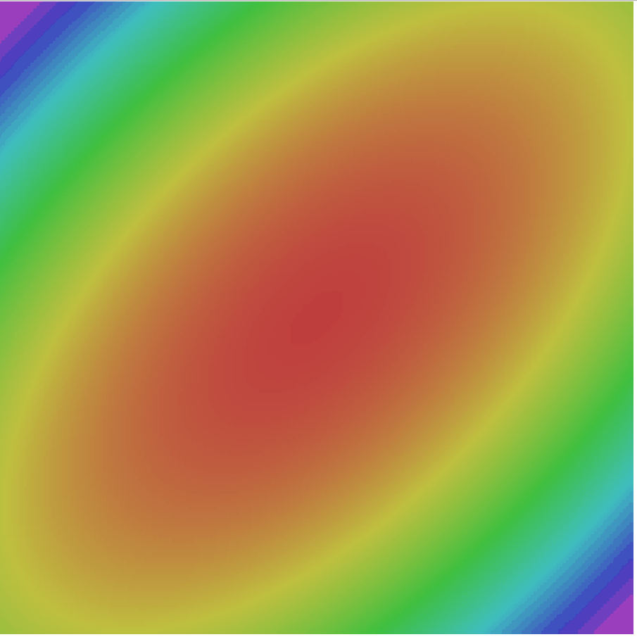
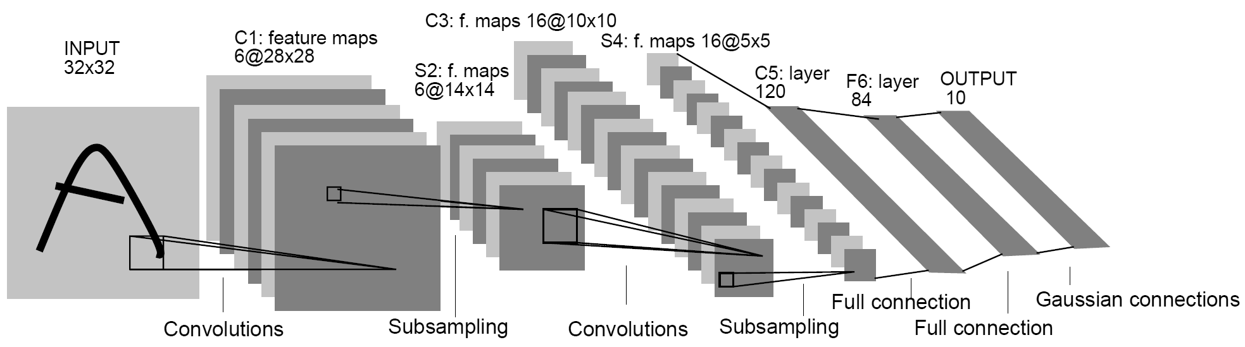
Convolutional Neural Networks
Computer Vision (UW EE/CSE 576)
Richard Szeliski
Facebook & UW
Lecture 8 – Apr 23, 2020

Slide 2
Class calendar
Date | Topic | Slides | Reading | Homework
April 9 | Filters and convolutions | Google Slides | Szeliski, Chapter 3 | HW1 due, HW2 assigned
April 14 | Interpolation and Optimization | pdf, pptx | Szeliski, Chapter 4
April 16 | Machine Learning | pdf, pptx | Szeliski, Chapter 5.1-5.2
April 21 | Deep Neural Networks |  | Szeliski, Chapter 5.3
April 23 | Convolutional Neural Networks |  | Szeliski, Chapter 5.4 | HW2 due, HW3 assigned
April 28 | Network Architectures |  | Szeliski, Chapter 5.4-5.5
April 30 | Object Detection |  | Szeliski, Chapter 6.3
May 5 | Detection and Instance Segmentation |  | Szeliski, Chapter 6.4
May 7 | Edges, features, matching, RANSAC |  | Szeliski, Chapter 7.1-7.2, 8.1-8.2 | HW3 due, HW4 assigned

Slide 3
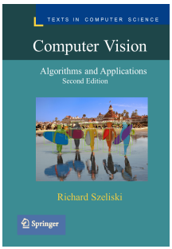

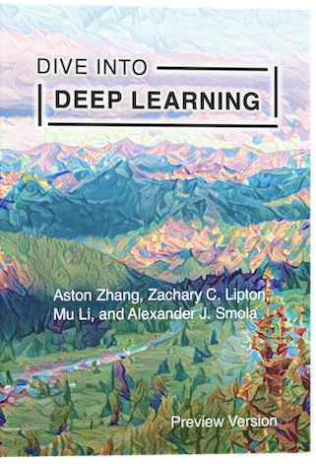
References
https://d2l.ai/

Slide 4
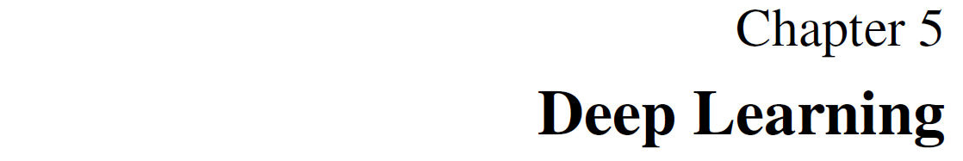
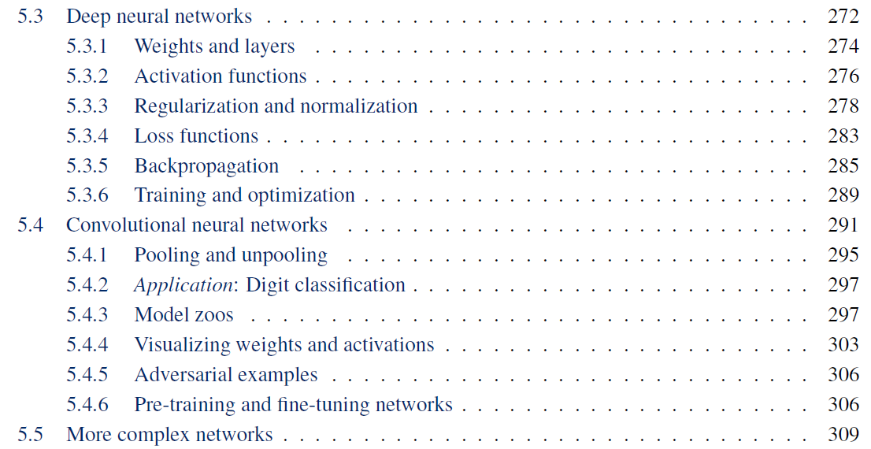
Readings

Slide 5
Convolutional neural networks++
Training and optimization
More regularization (dropout, …)
Convolutional neural networks
Pooling
Batch normalization
Notes:
The order in the lecture is a little different from the book, because Justin Johnson’s lectures follow a different order

Slide 6

As before, I’m borrowing slides from

Slide 7



Slide 8
Lecture 4:
Optimization

Slide 9


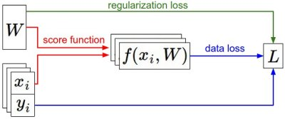


Loss Functions quantify preferences
Q: How do we find the best W?
We have some dataset of (x, y)
We have a score function:
We have a loss function:
Linear classifier
Softmax
SVM
Full loss

Slide 10

Follow the slope
In 1-dimension, the derivative of a function gives the slope:
In multiple dimensions, the gradient is the vector of (partial derivatives) along each dimension
The slope in any direction is the dot product of the direction with the gradient
The direction of steepest descent is the negative gradient

Slide 11

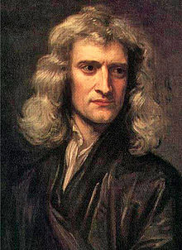
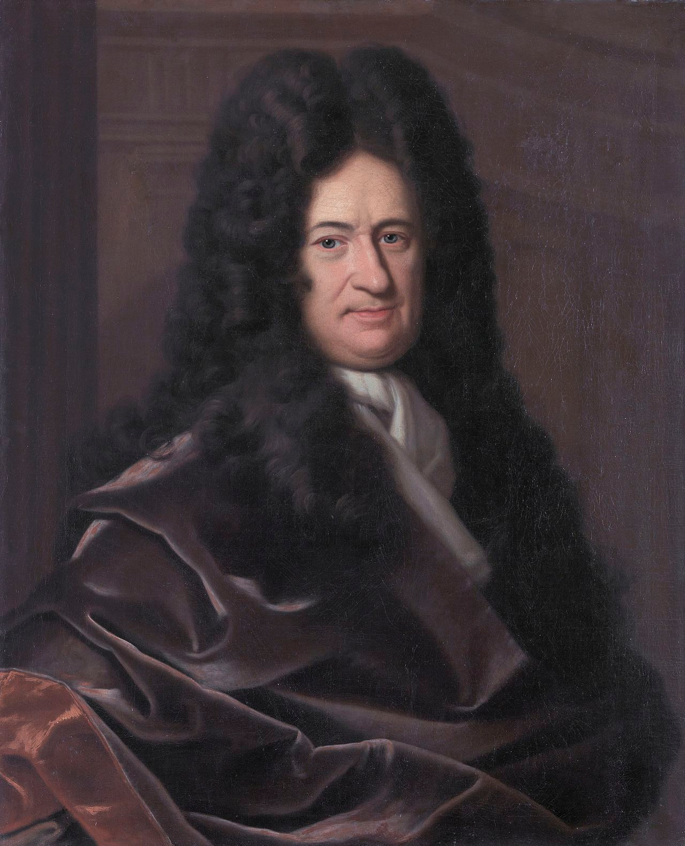

Loss is a function of W: Analytic Gradient
want
Use calculus to compute an analytic gradient
This image is in the public domain
This image is in the public domain

Slide 12
Computing Gradients
Numeric gradient: approximate, slow, easy to write
Analytic gradient: exact, fast, error-prone
What’s the difference?
Which one is better?

Slide 13
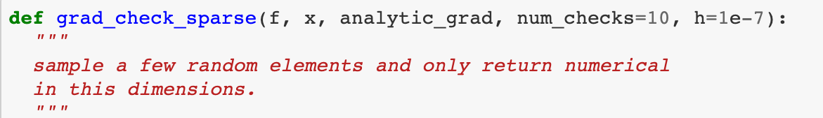
Computing Gradients
Numeric gradient: approximate, slow, easy to write
Analytic gradient: exact, fast, error-prone
In practice: Always use analytic gradient, but check implementation with numerical gradient. This is called a gradient check.

Slide 14
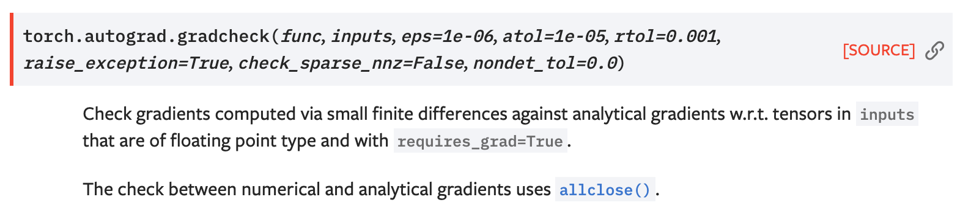
Computing Gradients
Numeric gradient: approximate, slow, easy to write
Analytic gradient: exact, fast, error-prone
In practice: Always use analytic gradient, but check implementation with numerical gradient. This is called a gradient check.

Slide 15
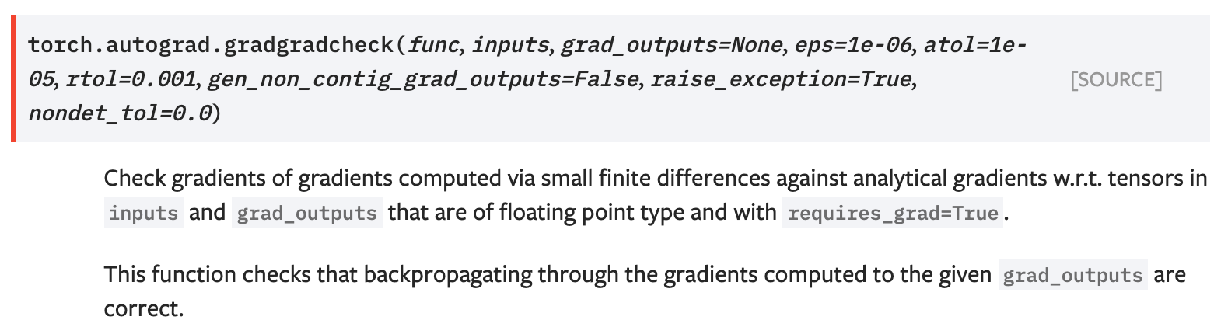
Computing Gradients
Numeric gradient: approximate, slow, easy to write
Analytic gradient: exact, fast, error-prone
In practice: Always use analytic gradient, but check implementation with numerical gradient. This is called a gradient check.

Slide 16
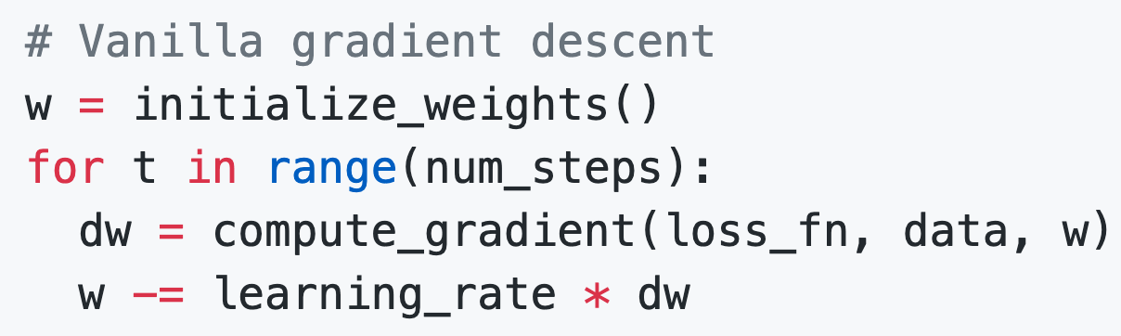
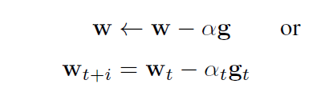
Gradient Descent
Iteratively step in the direction of the negative gradient
(direction of local steepest descent)
Hyperparameters:
Weight initialization method
Number of steps
Learning rate

Slide 17

Gradient Descent
negative gradient direction
original W
Iteratively step in the direction of the negative gradient
(direction of local steepest descent)
W_2
Hyperparameters:
Weight initialization method
Number of steps
Learning rate
W_1

Slide 18
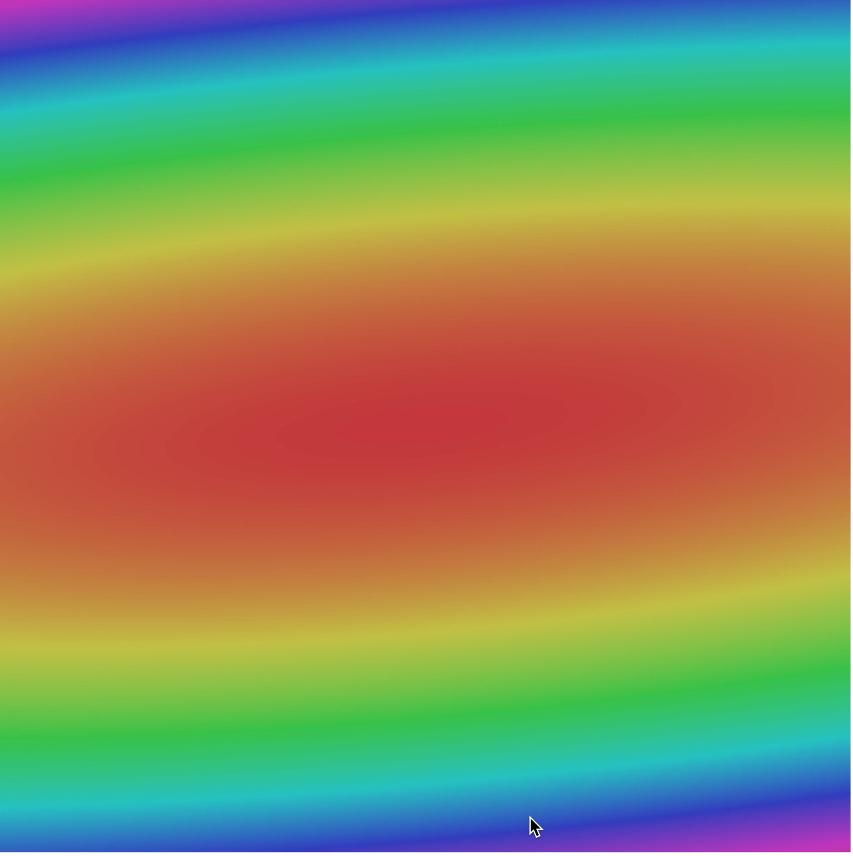
Gradient Descent
Iteratively step in the direction of the negative gradient
(direction of local steepest descent)
Hyperparameters:
Weight initialization method
Number of steps
Learning rate

Slide 19
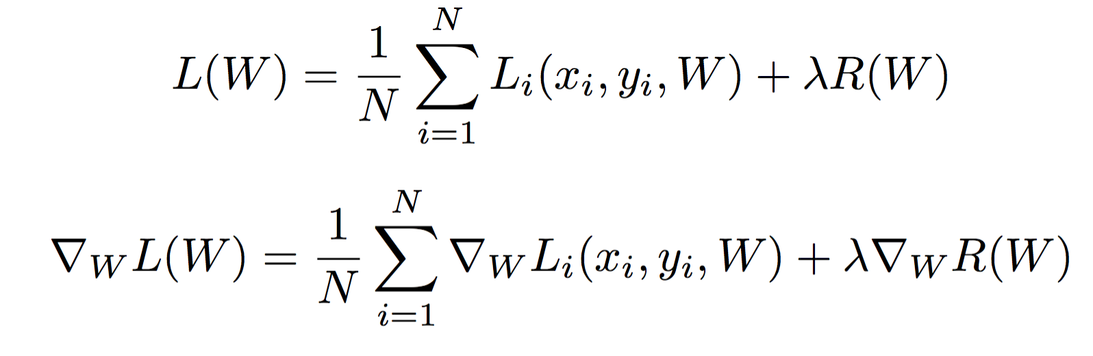
Batch Gradient Descent
Full sum expensive when N is large!

Slide 20
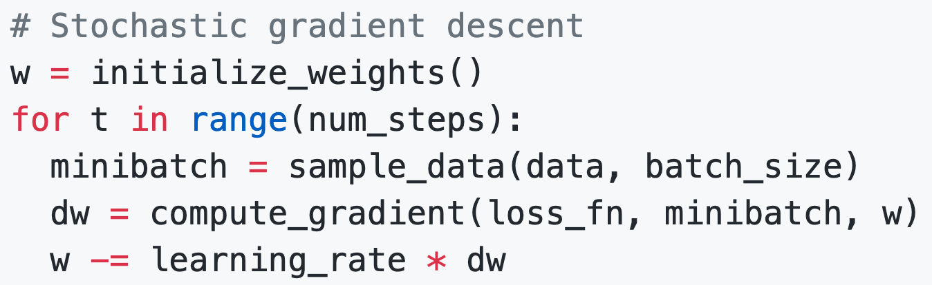
[Minibatch] Stochastic Gradient Descent (SGD)
Full sum expensive when N is large!
Approximate sum using a minibatch of examples
32 / 64 / 128 common
Hyperparameters:
Weight initialization
Number of steps
Learning rate
Batch size
Data sampling

Slide 21
Stochastic Gradient Descent (SGD)
Think of loss as an expectation over the full data distribution p_{data}
Approximate expectation via sampling

Slide 22
Stochastic Gradient Descent (SGD)
Think of loss as an expectation over the full data distribution p_{data}
Approximate expectation via sampling

Slide 23
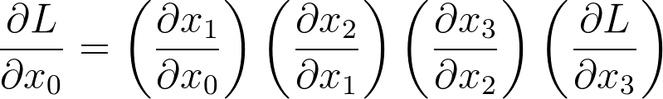
Recall: Reverse-Mode Automatic Differentiation
x₀
D₀
f₁
x₁
D₁
f₂
x₂
D₂
f₃
x₃
D₃
f₄
L
scalar
Matrix multiplication is associative: we can compute products in any order
Computing products right-to-left avoids matrix-matrix products; only needs matrix-vector
Chain rule
D₀ x D₁
D₁ x D₂
D₂ x D₃
D₃

Slide 24
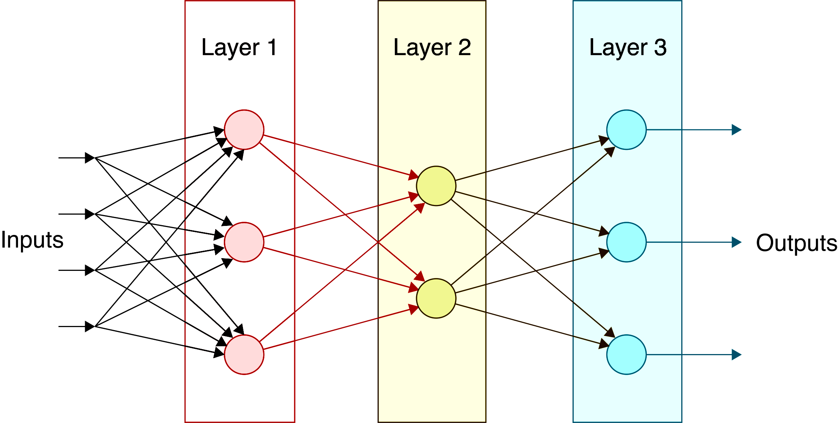
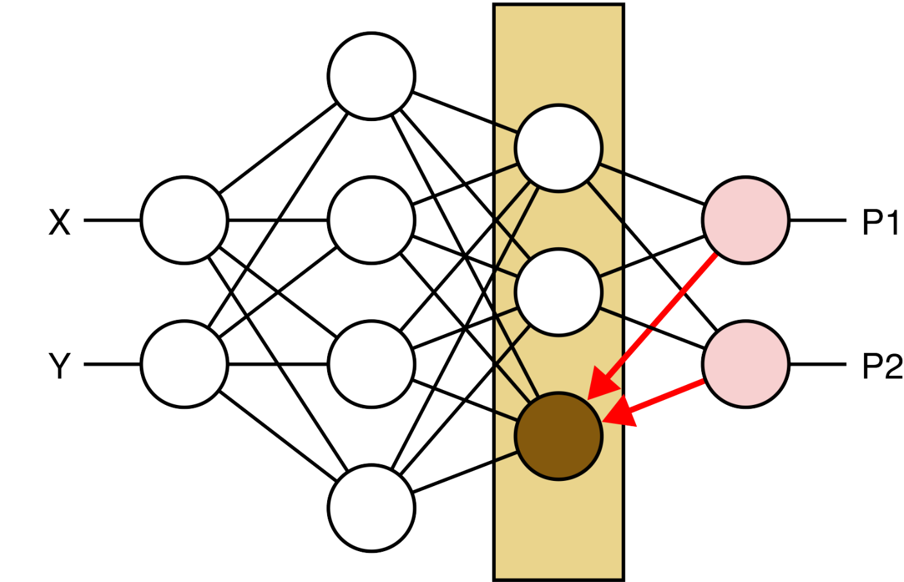
Mini-batch evaluation with matrices (HW3)
DNNs are described as passing vectors
between layers
Why not pass all samples in a mini-batch
as a matrix?
What used to be column vectors are now rows
Need to adjust weight-vector multiplies
s = W x
becomes
S = X W^{T}
Need to adjust gradients (Jacobians) as well
Notes:
The order in the lecture is a little different from the book, because Justin Johnson’s lectures follow a different order

Slide 25
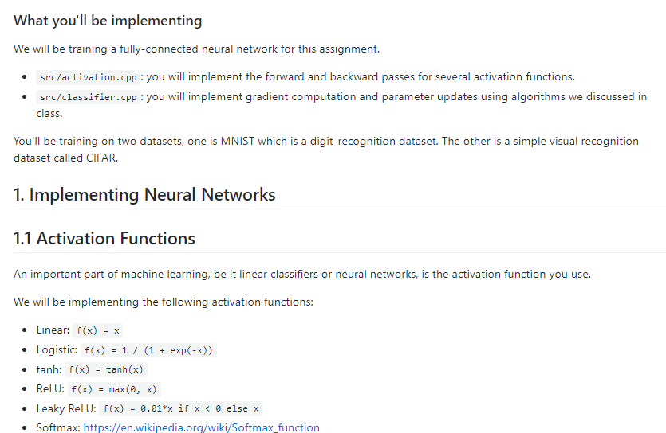

Homework 3: Neural Networks in C++
Quick overview by
Keunhong Park

Slide 26
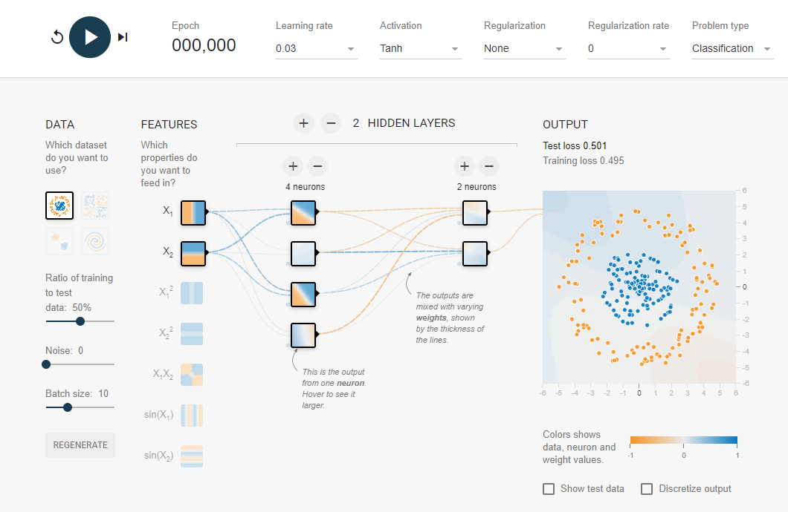
Interactive Web demo
https://playground.tensorflow.org/
(Thanks, Doruk)

Slide 27
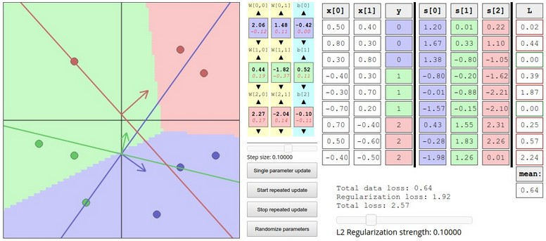
Interactive Web Demo
http://vision.stanford.edu/teaching/cs231n-demos/linear-classify/

Slide 28
Problems with SGD
What if loss changes quickly in one direction and slowly in another?
What does gradient descent do?
Loss function has high condition number: ratio of largest to smallest singular value of the Hessian matrix is large

Slide 29
Problems with SGD
What if loss changes quickly in one direction and slowly in another?
What does gradient descent do?
Very slow progress along shallow dimension, jitter along steep direction
Loss function has high condition number: ratio of largest to smallest singular value of the Hessian matrix is large

Slide 30
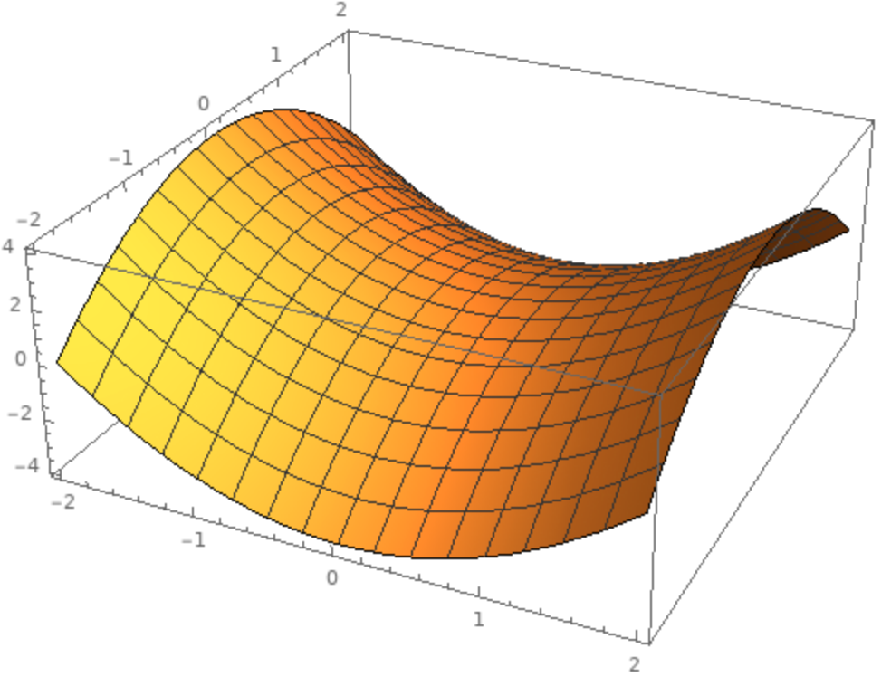
Problems with SGD
Local Minimum
What if the loss function has a local minimum or saddle point?
Saddle point

Slide 31
Problems with SGD
Local Minimum
What if the loss function has a local minimum or saddle point?
Zero gradient, gradient descent gets stuck
Saddle point

Slide 32
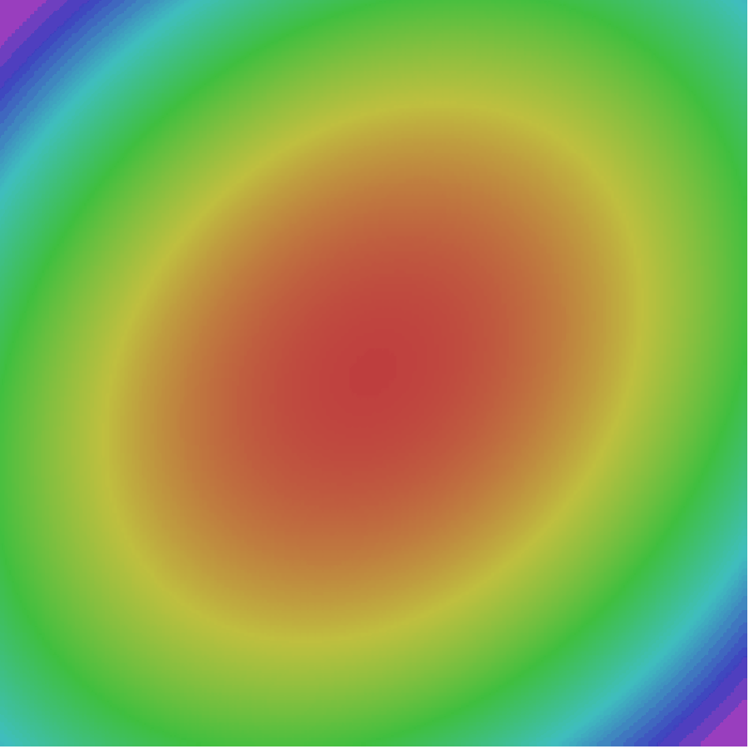
Problems with SGD
Our gradients come from minibatches so they can be noisy!

Slide 33

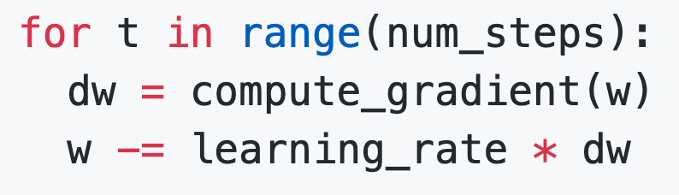
SGD
SGD

Slide 34
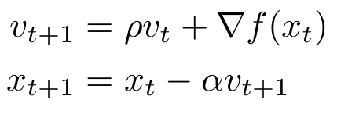
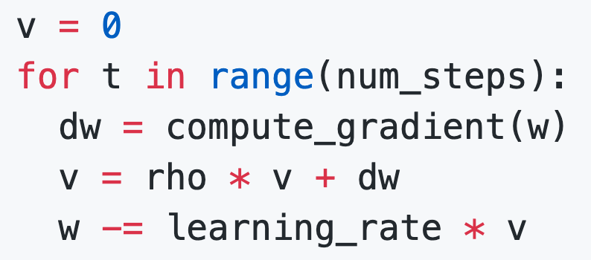
SGD + Momentum
SGD
SGD+Momentum
Build up “velocity” as a running mean of gradients
Rho gives “friction”; typically rho=0.9 or 0.99
Sutskever et al, “On the importance of initialization and momentum in deep learning”, ICML 2013

Slide 35
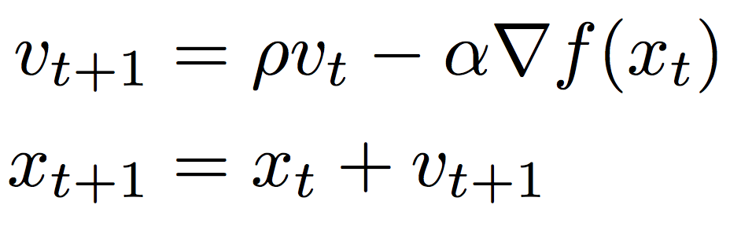
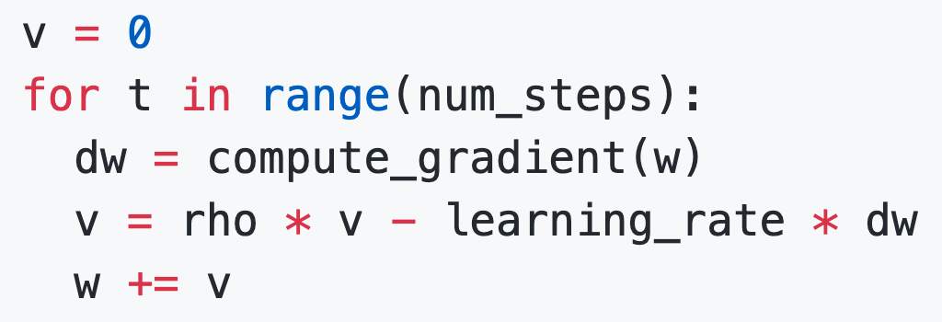
SGD + Momentum
SGD+Momentum
SGD+Momentum
You may see SGD+Momentum formulated different ways, but they are equivalent - give same sequence of x
Sutskever et al, “On the importance of initialization and momentum in deep learning”, ICML 2013

Slide 36
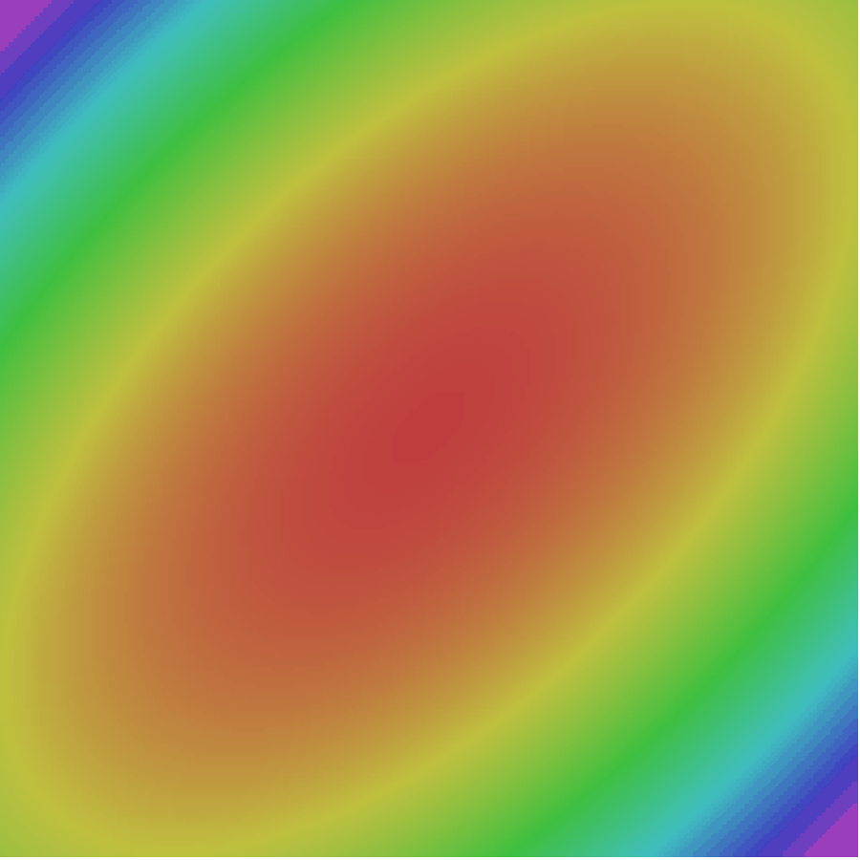
SGD + Momentum
Gradient Noise
Local Minima
Saddle points
Poor Conditioning
SGD
SGD+Momentum
Sutskever et al, “On the importance of initialization and momentum in deep learning”, ICML 2013

Slide 37
SGD + Momentum
Momentum update:
Velocity
actual step
Gradient
Combine gradient at current point with velocity to get step used to update weights
Nesterov, “A method of solving a convex programming problem with convergence rate O(1/k^2)”, 1983
Nesterov, “Introductory lectures on convex optimization: a basic course”, 2004
Sutskever et al, “On the importance of initialization and momentum in deep learning”, ICML 2013

Slide 38
Nesterov Momentum
Momentum update:
Nesterov Momentum
Gradient
Velocity
Velocity
actual step
actual step
Gradient
Combine gradient at current point with velocity to get step used to update weights
“Look ahead” to the point where updating using velocity would take us; compute gradient there and mix it with velocity to get actual update direction
Nesterov, “A method of solving a convex programming problem with convergence rate O(1/k^2)”, 1983
Nesterov, “Introductory lectures on convex optimization: a basic course”, 2004
Sutskever et al, “On the importance of initialization and momentum in deep learning”, ICML 2013

Slide 39
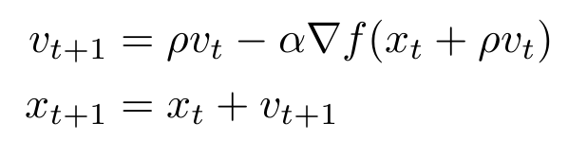
Nesterov Momentum
Gradient
Velocity
actual step
“Look ahead” to the point where updating using velocity would take us; compute gradient there and mix it with velocity to get actual update direction

Slide 40

Nesterov Momentum
Annoying, usually we want
update in terms of
Gradient
Velocity
actual step
“Look ahead” to the point where updating using velocity would take us; compute gradient there and mix it with velocity to get actual update direction

Slide 41

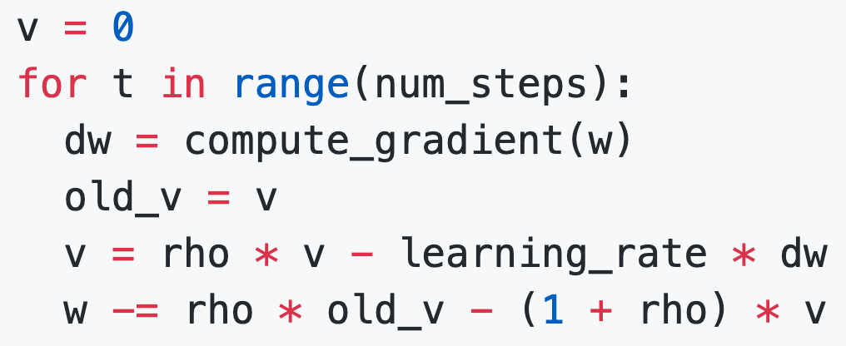
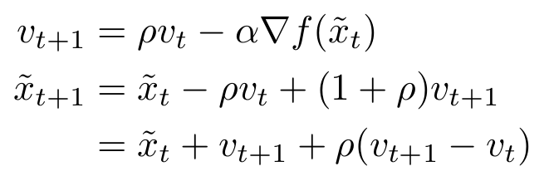
Nesterov Momentum
Annoying, usually we want
update in terms of
Change of variables and rearrange:

Slide 42
Nesterov Momentum
SGD
SGD+Momentum
Nesterov

Slide 43
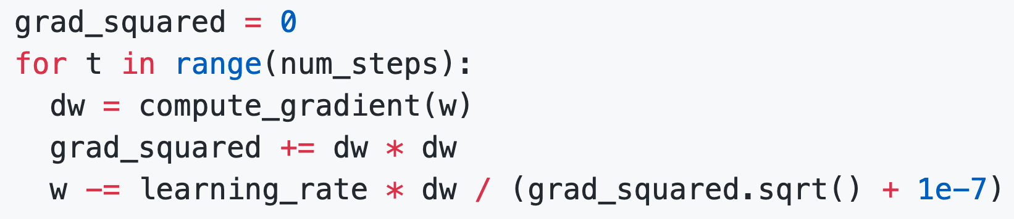
AdaGrad
Added element-wise scaling of the gradient based on the historical sum of squares in each dimension
“Per-parameter learning rates”
or “adaptive learning rates”
Duchi et al, “Adaptive subgradient methods for online learning and stochastic optimization”, JMLR 2011

Slide 44
AdaGrad
Duchi et al, “Adaptive subgradient methods for online learning and stochastic optimization”, JMLR 2011

Slide 45
AdaGrad
Q: What happens with AdaGrad?

Slide 46
AdaGrad
Q: What happens with AdaGrad?
Progress along “steep” directions is damped; progress along “flat” directions is accelerated

Slide 47
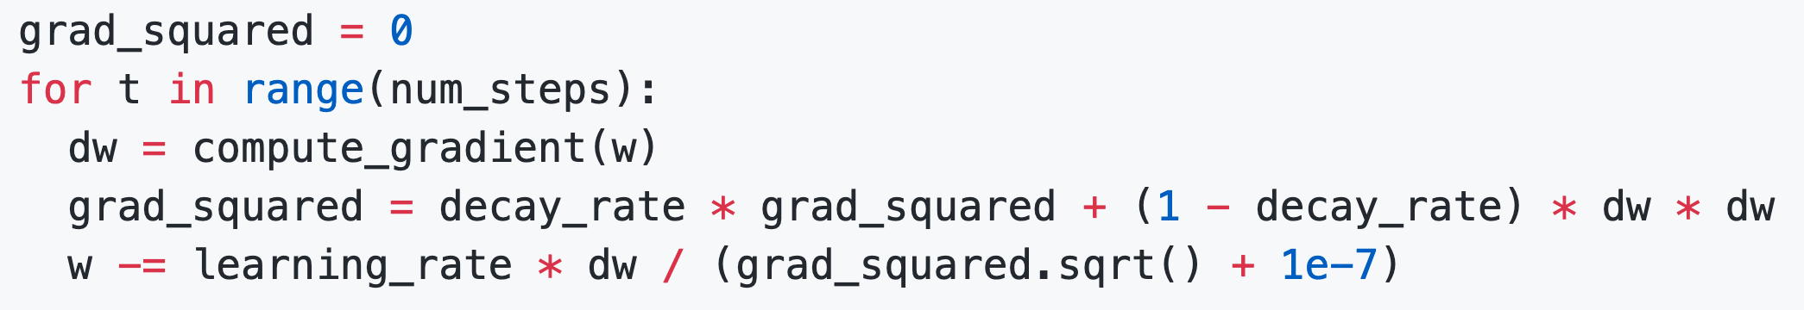
RMSProp: “Leaky Adagrad”
AdaGrad
RMSProp
Tieleman and Hinton, 2012

Slide 48
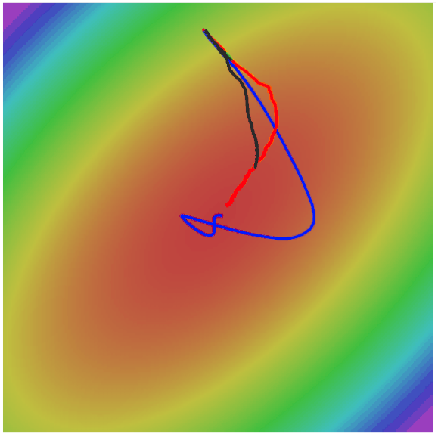
RMSProp
SGD
SGD+Momentum
RMSProp

Slide 49
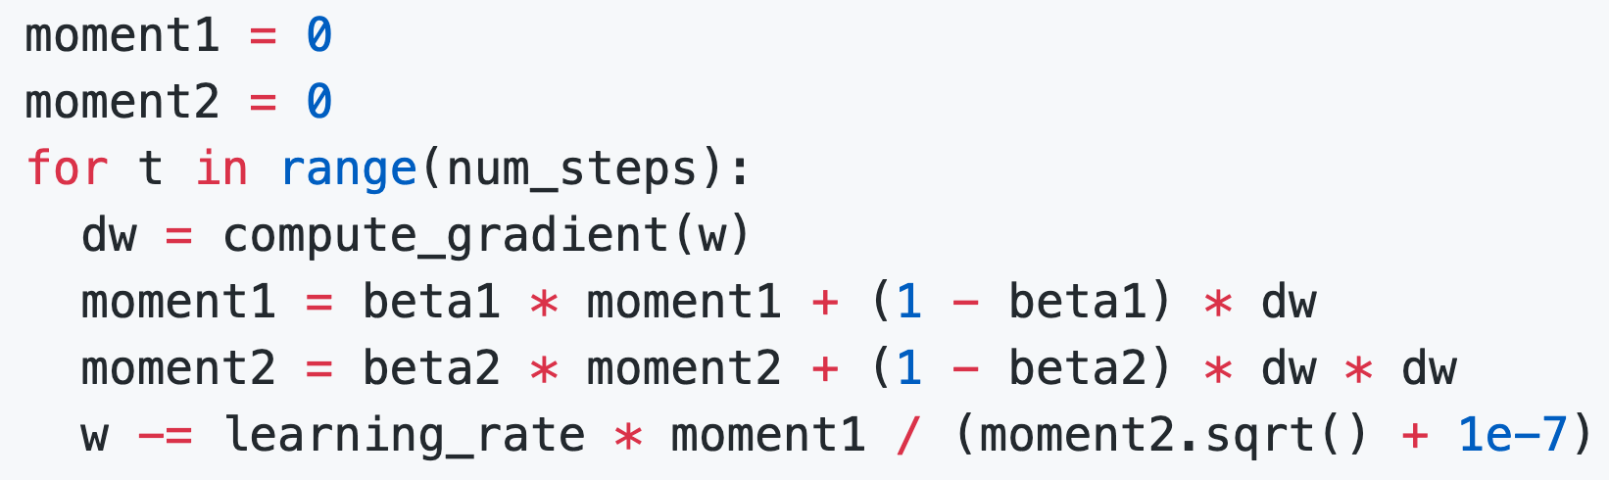
Adam (almost): RMSProp + Momentum
Kingma and Ba, “Adam: A method for stochastic optimization”, ICLR 2015

Slide 50
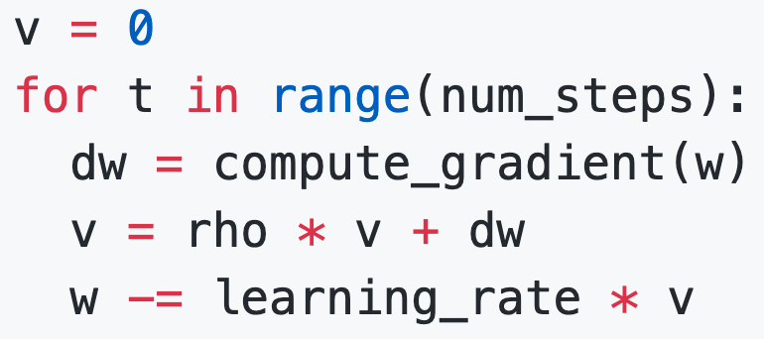
Adam (almost): RMSProp + Momentum
Adam
Momentum
SGD+Momentum
Kingma and Ba, “Adam: A method for stochastic optimization”, ICLR 2015

Slide 51
Adam (almost): RMSProp + Momentum
Adam
Momentum
AdaGrad / RMSProp
RMSProp
Kingma and Ba, “Adam: A method for stochastic optimization”, ICLR 2015

Slide 52
Adam (almost): RMSProp + Momentum
Adam
Momentum
AdaGrad / RMSProp
Bias correction
Q: What happens at t=0?
(Assume beta2 = 0.999)
Kingma and Ba, “Adam: A method for stochastic optimization”, ICLR 2015

Slide 53
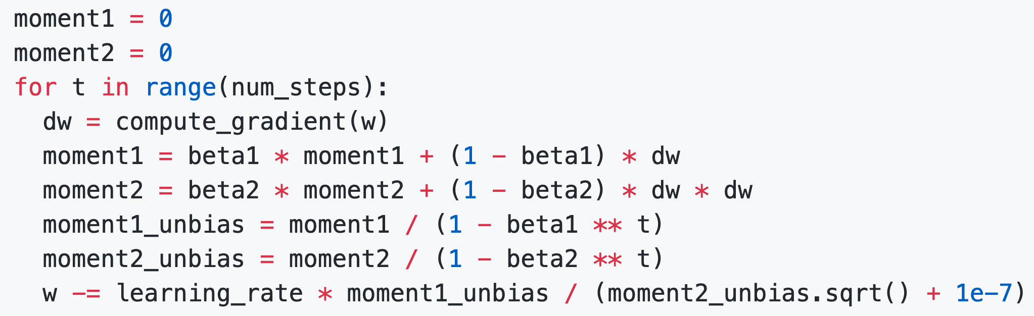
Adam (almost): RMSProp + Momentum
Momentum
AdaGrad / RMSProp
Bias correction
Bias correction for the fact that first and second moment estimates start at zero
Kingma and Ba, “Adam: A method for stochastic optimization”, ICLR 2015

Slide 54
Adam (almost): RMSProp + Momentum
Bias correction for the fact that first and second moment estimates start at zero
Adam with beta1 = 0.9,
beta2 = 0.999, and learning_rate = 1e-3, 5e-4, 1e-4
is a great starting point for many models!
Kingma and Ba, “Adam: A method for stochastic optimization”, ICLR 2015

Slide 55
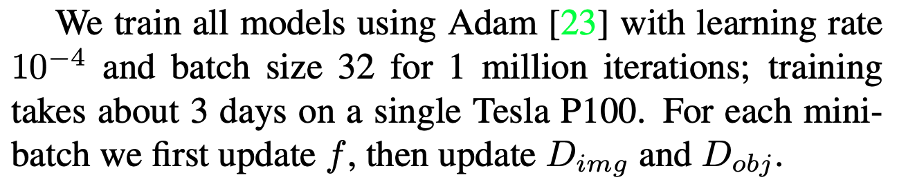
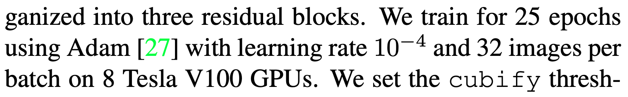
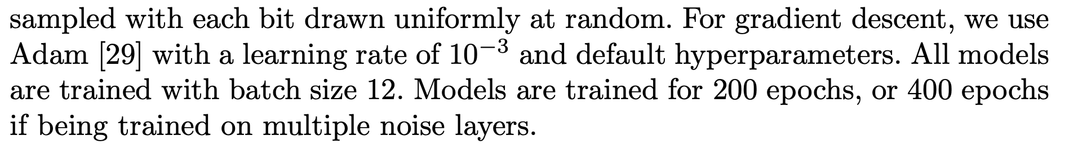
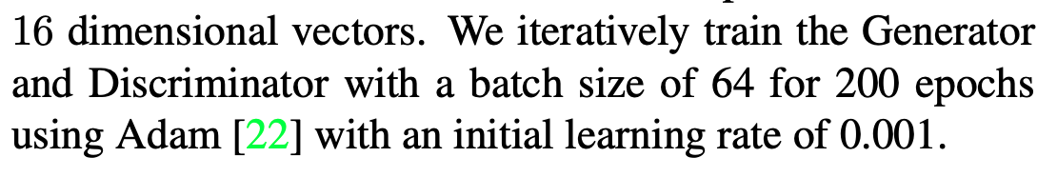
Adam: Very Common in Practice!
Bakhtin, van der Maaten, Johnson, Gustafson, and Girshick, NeurIPS 2019
Johnson, Gupta, and Fei-Fei, CVPR 2018
Gkioxari, Malik, and Johnson, ICCV 2019
Zhu, Kaplan, Johnson, and Fei-Fei, ECCV 2018
Adam with beta1 = 0.9,
beta2 = 0.999, and learning_rate = 1e-3, 5e-4, 1e-4
is a great starting point for many models!
Gupta, Johnson, et al, CVPR 2018

Slide 56
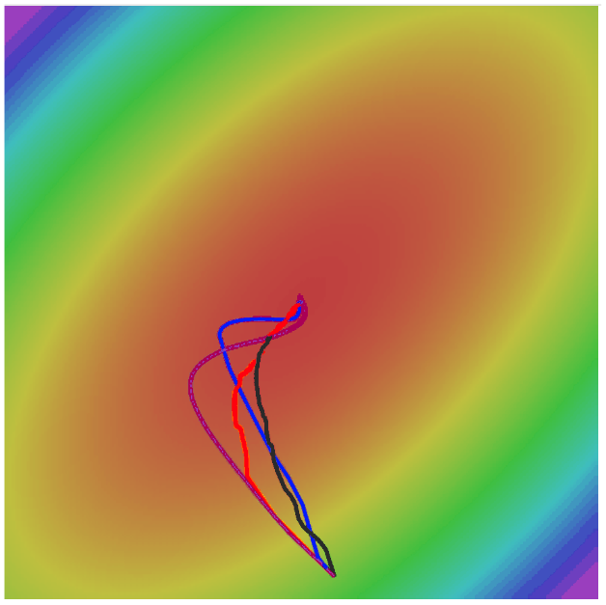
Adam
SGD
SGD+Momentum
RMSProp
Adam

Slide 57
Optimization Algorithm Comparison
Algorithm | Tracks first moments (Momentum) | Tracks second moments (Adaptive learning rates) | Leaky second moments | Bias correction for moment estimates
SGD | 𝙭 | 𝙭 | 𝙭 | 𝙭
SGD+Momentum | ✓ | 𝙭 | 𝙭 | 𝙭
Nesterov | ✓ | 𝙭 | 𝙭 | 𝙭
AdaGrad | 𝙭 | ✓ | 𝙭 | 𝙭
RMSProp | 𝙭 | ✓ | ✓ | 𝙭
Adam | ✓ | ✓ | ✓ | ✓

Slide 58
In practice:
Adam is a good default choice in many cases SGD+Momentum can outperform Adam but may require more tuning
If you can afford to do full batch updates then try out L-BFGS (and don’t forget to disable all sources of noise)

Slide 59
Lecture 10:
Training Neural Networks
(Part 1)

Slide 60
Overview
One time setup
Activation functions, data preprocessing, weight initialization, regularization
Training dynamics
Learning rate schedules; large-batch training; hyperparameter optimization
After training
Model ensembles, transfer learning

Slide 61
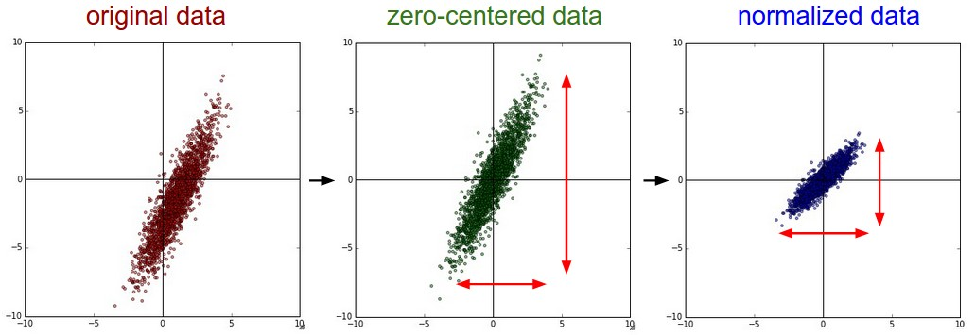
Snapshot: Data Preprocessing

Slide 62
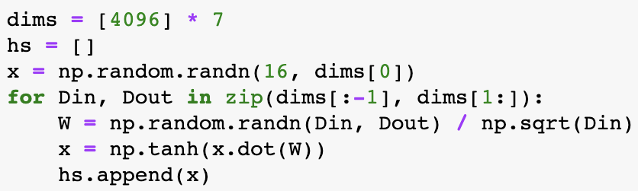
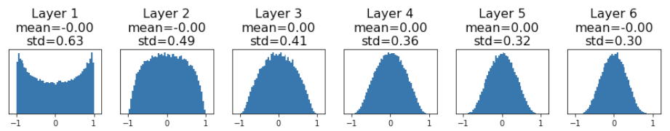
Snapshot: Weight Initialization
“Xavier” initialization:
std = 1/sqrt(Din)
“Just right”: Activations are nicely scaled for all layers!
Glorot and Bengio, “Understanding the difficulty of training deep feedforward neural networks”, AISTAT 2010

Slide 63
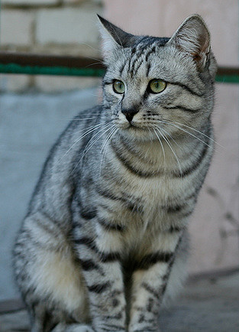
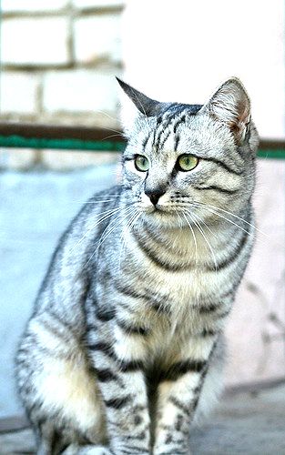
Snapshot: Data Augmentation
Load image and label
“cat”
Compute
loss
CNN
Transform image

Slide 64
Data Augmentation: Random Crops and Scales
Training: sample random crops / scales
ResNet:
Pick random L in range [256, 480]
Resize training image, short side = L
Sample random 224 x 224 patch

Slide 65


Regularization
Stochastic Depth
Cutout
Training: Add randomness
Testing: Marginalize out randomness
Examples:
Batch Normalization
Data Augmentation
Dropout
DropConnect
Fractional pooling
Mixup

Slide 66



(Old style) regularization: Add term to the loss
In common use:
L2 regularization
L1 regularization
Elastic net (L1 + L2)
(Weight decay)

Slide 67
Regularization: Dropout
In each forward pass, randomly set some neurons to zero
Probability of dropping is a hyperparameter; 0.5 is common
Srivastava et al, “Dropout: A simple way to prevent neural networks from overfitting”, JMLR 2014

Slide 68
Regularization: Dropout
Another interpretation:
Dropout is training a large ensemble of models (that share parameters).
Each binary mask is one model
An FC layer with 4096 units has
2⁴⁰⁹⁶ ~ 10¹²³³ possible masks!
Only ~ 10⁸² atoms in the universe...

Slide 69

Dropout: Test Time
At test time all neurons are active always
=> We must scale the activations so that for each neuron:
output at test time = expected output at training time

Slide 70

More common: “Inverted dropout”
Drop and scale during training
test time is unchanged!

Slide 71
Learning Rate Schedules

Slide 72

SGD, SGD+Momentum, Adagrad, RMSProp, Adam all have learning rate as a hyperparameter.
Q: Which one of these learning rates is best to use?
A: All of them! Start with large learning rate and decay over time

Slide 73
How long to train? Early Stopping
Train
Val
Loss
Accuracy
Stop training here
Iteration
Iteration
Stop training the model when accuracy on the validation set decreases
Or train for a long time, but always keep track of the model snapshot that worked best on val. Always a good idea to do this!

Slide 74
Model Ensembles
Train multiple independent models
At test time average their results
(Take average of predicted probability distributions, then choose argmax)
Enjoy 2% extra performance

Slide 75


Model Ensembles: Tips and Tricks
Instead of training independent models, use multiple snapshots of a single model during training!
Cyclic learning rate schedules can make this work even better!
Loshchilov and Hutter, “SGDR: Stochastic gradient descent with restarts”, arXiv 2016
Huang et al, “Snapshot ensembles: train 1, get M for free”, ICLR 2017
Figures copyright Yixuan Li and Geoff Pleiss, 2017. Reproduced with permission.

Slide 76
Convolutional neural networks++
Training and optimization
More regularization (dropout, …)
Convolutional neural networks
Pooling
Batch normalization
Notes:
The order in the lecture is a little different from the book, because Justin Johnson’s lectures follow a different order

Slide 77
Lecture 7:
Convolutional Networks

Slide 78


f(x,W) = Wx
Problem: So far our classifiers don’t respect the spatial structure of images!

Slide 79
f(x,W) = Wx
Problem: So far our classifiers don’t respect the spatial structure of images!
Solution: Define new computational nodes that operate on images!

Slide 80

Components of a Fully-Connected Network
Fully-Connected Layers
Activation Function

Slide 81


Components of a Convolutional Network
Fully-Connected Layers
Activation Function
Convolution Layers
Pooling Layers
Normalization

Slide 82
Components of a Convolutional Network
Fully-Connected Layers
Activation Function
Convolution Layers
Pooling Layers
Normalization

Slide 83
Fully-Connected Layer
32x32x3 image -> stretch to 3072 x 1
Input
Output
1
1
10 x 3072
weights
3072
10

Slide 84
Fully-Connected Layer
32x32x3 image -> stretch to 3072 x 1
Input
Output
1
1
10 x 3072
weights
3072
10
1 number:
the result of taking a dot product between a row of W and the input (a 3072-dimensional dot product)

Slide 85
Convolution Layer
3x32x32 image: preserve spatial structure
32
height
32
width
3
depth / channels

Slide 86
Convolution Layer
3x32x32 image
3x5x5 filter
Convolve the filter with the image
i.e. “slide over the image spatially, computing dot products”
32
height
32
width
3
depth / channels

Slide 87
Convolution Layer
Filters (almost) always extend the full depth of the input volume
3x32x32 image
3x5x5 filter
Convolve the filter with the image
i.e. “slide over the image spatially, computing dot products”
32
height
32
width
3
depth / channels

Slide 88

Convolution Layer
3x32x32 image
3x5x5 filter
1 number:
the result of taking a dot product between the filter and a small 3x5x5 chunk of the image
(i.e. 3*5*5 = 75-dimensional dot product + bias)
32
32
3

Slide 89
Convolution Layer
1x28x28 activation map
3x32x32 image
3x5x5 filter
28
convolve (slide) over all spatial locations
32
28
32
1
3

Slide 90
Convolution Layer
two 1x28x28 activation map
3x32x32 image
Consider repeating with a second (green) filter:
3x5x5 filter
28
28
convolve (slide) over all spatial locations
32
28
32
1
1
3

Slide 91
Convolution Layer
6 activation maps,
each 1x28x28
3x32x32 image
Consider 6 filters, each 3x5x5
Convolution Layer
32
32
6x3x5x5 filters
Stack activations to get a 6x28x28 output image!
3

Slide 92
Convolution Layer
6 activation maps,
each 1x28x28
3x32x32 image
Also 6-dim bias vector:
Convolution Layer
32
32
6x3x5x5 filters
Stack activations to get a 6x28x28 output image!
3

Slide 93
Convolution Layer
28x28 grid, at each point a 6-dim vector
3x32x32 image
Also 6-dim bias vector:
Convolution Layer
32
32
6x3x5x5 filters
Stack activations to get a 6x28x28 output image!
3

Slide 94
Convolution Layer
2x6x28x28
Batch of outputs
2x3x32x32
Batch of images
Also 6-dim bias vector:
Convolution Layer
32
32
6x3x5x5 filters
3

Slide 95
Convolution Layer
N x C_{out} x H’ x W’
Batch of outputs
N x C_{in} x H x W
Batch of images
Also C_{out}-dim bias vector:
Convolution Layer
H
W
C_{out} x C_{in}x K_{w} x K_{h} filters
C_{out}
C_{in}

Slide 96
Stacking Convolutions
32
28
26
….
Conv
Conv
Conv
W₁: 6x3x5x5
b₁: 5
W₂: 10x6x3x3
b₂: 10
W₃: 12x10x3x3
b₃: 12
32
28
26
3
6
10
Input:
N x 3 x 32 x 32
First hidden layer:
N x 6 x 28 x 28
Second hidden layer:
N x 10 x 26 x 26

Slide 97
Stacking Convolutions
Q: What happens if we stack two convolution layers?
A: We get another convolution!
Q: How to fix this?
(Recall y=W₂W₁x is a linear classifier)
32
28
26
….
Conv
Conv
Conv
W₁: 6x3x5x5
b₁: 5
W₂: 10x6x3x3
b₂: 10
W₃: 12x10x3x3
b₃: 12
32
28
26
3
6
10
Input:
N x 3 x 32 x 32
First hidden layer:
N x 6 x 28 x 28
Second hidden layer:
N x 10 x 26 x 26

Slide 98
Stacking Convolutions
Q: What happens if we stack two convolution layers?
A: We get another convolution!
Q: How to fix this?
A: Non-linearity
(Recall y=W₂W₁x is a linear classifier)
32
28
26
….
Conv
ReLU
Conv
ReLU
Conv
ReLU
W₁: 6x3x5x5
b₁: 6
W₂: 10x6x3x3
b₂: 10
W₃: 12x10x3x3
b₃: 12
32
28
26
3
6
10
Input:
N x 3 x 32 x 32
First hidden layer:
N x 6 x 28 x 28
Second hidden layer:
N x 10 x 26 x 26

Slide 99
What do convolutional filters learn?
32
28
26
….
Conv
ReLU
Conv
ReLU
Conv
ReLU
W₁: 6x3x5x5
b₁: 6
W₂: 10x6x3x3
b₂: 10
W₃: 12x10x3x3
b₃: 12
32
28
26
3
6
10
Input:
N x 3 x 32 x 32
First hidden layer:
N x 6 x 28 x 28
Second hidden layer:
N x 10 x 26 x 26

Slide 100

What do convolutional filters learn?
32
28
Linear classifier: One template per class
Conv
ReLU
W₁: 6x3x5x5
b₁: 6
32
28
3
6
Input:
N x 3 x 32 x 32
First hidden layer:
N x 6 x 28 x 28

Slide 101

What do convolutional filters learn?
MLP: Bank of whole-image templates
32
28
Conv
ReLU
W₁: 6x3x5x5
b₁: 6
32
28
3
6
Input:
N x 3 x 32 x 32
First hidden layer:
N x 6 x 28 x 28

Slide 102

What do convolutional filters learn?
First-layer conv filters: local image templates
(Often learns oriented edges, opposing colors)
32
28
Conv
ReLU
W₁: 6x3x5x5
b₁: 6
32
28
3
6
Input:
N x 3 x 32 x 32
First hidden layer:
N x 6 x 28 x 28
AlexNet: 64 filters, each 3x11x11

Slide 103
A closer look at spatial dimensions
32
28
Conv
ReLU
W₁: 6x3x5x5
b₁: 6
32
28
3
6
Input:
N x 3 x 32 x 32
First hidden layer:
N x 6 x 28 x 28

Slide 104
A closer look at spatial dimensions
Input: 7x7
Filter: 3x3
7
7

Slide 105
A closer look at spatial dimensions
Input: 7x7
Filter: 3x3
7
7

Slide 106
A closer look at spatial dimensions
Input: 7x7
Filter: 3x3
7
7

Slide 107
A closer look at spatial dimensions
Input: 7x7
Filter: 3x3
7
7

Slide 108
A closer look at spatial dimensions
Input: 7x7
Filter: 3x3
Output: 5x5
7
7

Slide 109
A closer look at spatial dimensions
Input: 7x7
Filter: 3x3
Output: 5x5
Problem: Feature maps “shrink” with each layer!
In general:
Input: W
Filter: K
Output: W – K + 1
7
7

Slide 110
A closer look at spatial dimensions
0 | 0 | 0 | 0 | 0 | 0 | 0 | 0 | 0
0 |  |  |  |  |  |  |  | 0
0 |  |  |  |  |  |  |  | 0
0 |  |  |  |  |  |  |  | 0
0 |  |  |  |  |  |  |  | 0
0 |  |  |  |  |  |  |  | 0
0 |  |  |  |  |  |  |  | 0
0 |  |  |  |  |  |  |  | 0
0 | 0 | 0 | 0 | 0 | 0 | 0 | 0 | 0
Input: 7x7
Filter: 3x3
Output: 5x5
Problem: Feature maps “shrink” with each layer!
In general:
Input: W
Filter: K
Output: W – K + 1
Solution: padding
Add zeros around the input

Slide 111
A closer look at spatial dimensions
0 | 0 | 0 | 0 | 0 | 0 | 0 | 0 | 0
0 |  |  |  |  |  |  |  | 0
0 |  |  |  |  |  |  |  | 0
0 |  |  |  |  |  |  |  | 0
0 |  |  |  |  |  |  |  | 0
0 |  |  |  |  |  |  |  | 0
0 |  |  |  |  |  |  |  | 0
0 |  |  |  |  |  |  |  | 0
0 | 0 | 0 | 0 | 0 | 0 | 0 | 0 | 0
Input: 7x7
Filter: 3x3
Output: 5x5
In general:
Input: W
Filter: K
Padding: P
Output: W – K + 1 + 2P
Very common:
Set P = (K – 1) / 2 to make output have same size as input!

Slide 112
Receptive Fields
For convolution with kernel size K, each element in the output depends on a K x K receptive field in the input
Input
Output

Slide 113
Receptive Fields
Each successive convolution adds K – 1 to the receptive field size
With L layers the receptive field size is 1 + L * (K – 1)
Input
Output
Be careful – ”receptive field in the input” vs “receptive field in the previous layer”
Hopefully clear from context!

Slide 114
Receptive Fields
Each successive convolution adds K – 1 to the receptive field size
With L layers the receptive field size is 1 + L * (K – 1)
Input
Problem: For large images we need many layers for each output to “see” the whole image image
Output

Slide 115
Receptive Fields
Each successive convolution adds K – 1 to the receptive field size
With L layers the receptive field size is 1 + L * (K – 1)
Input
Problem: For large images we need many layers for each output to “see” the whole image image
Output
Solution: Downsample inside the network

Slide 116
Strided Convolution
Input: 7x7
Filter: 3x3
Stride: 2

Slide 117
Strided Convolution
Input: 7x7
Filter: 3x3
Stride: 2

Slide 118
Strided Convolution
Input: 7x7
Filter: 3x3
Stride: 2
Output: 3x3

Slide 119
Strided Convolution
Input: 7x7
Filter: 3x3
Stride: 2
Output: 3x3
In general:
Input: W
Filter: K
Padding: P
Stride: S
Output: (W – K + 2P) / S + 1

Slide 120
Convolution Example
Input volume: 3 x 32 x 32
10 5x5 filters with stride 1, pad 2
Output volume size: ?

Slide 121
Convolution Example
Input volume: 3 x 32 x 32
10 5x5 filters with stride 1, pad 2
Output volume size:
(32+2*2-5)/1+1 = 32 spatially, so
10 x 32 x 32

Slide 122
Convolution Example
Input volume: 3 x 32 x 32
10 5x5 filters with stride 1, pad 2
Output volume size: 10 x 32 x 32
Number of learnable parameters: ?

Slide 123
Convolution Example
Input volume: 3 x 32 x 32
10 5x5 filters with stride 1, pad 2
Output volume size: 10 x 32 x 32
Number of learnable parameters: 760
Parameters per filter: 3*5*5 + 1 (for bias) = 76
10 filters, so total is 10 * 76 = 760

Slide 124
Convolution Example
Input volume: 3 x 32 x 32
10 5x5 filters with stride 1, pad 2
Output volume size: 10 x 32 x 32
Number of learnable parameters: 760
Number of multiply-add operations: ?

Slide 125
Convolution Example
Input volume: 3 x 32 x 32
10 5x5 filters with stride 1, pad 2
Output volume size: 10 x 32 x 32
Number of learnable parameters: 760
Number of multiply-add operations: 768,000
10*32*32 = 10,240 outputs; each output is the inner product of two 3x5x5 tensors (75 elems); total = 75*10240 = 768K

Slide 126
Example: 1x1 Convolution
1x1 CONV
with 32 filters
56
56
(each filter has size 1x1x64, and performs a 64-dimensional dot product)
56
56
64
32

Slide 127
Example: 1x1 Convolution
1x1 CONV
with 32 filters
56
56
(each filter has size 1x1x64, and performs a 64-dimensional dot product)
56
56
Stacking 1x1 conv layers gives MLP operating on each input position
64
32
Lin et al, “Network in Network”, ICLR 2014

Slide 128
Convolution Summary
Input: C_{in} x H x W
Hyperparameters:
Kernel size: K_{H} x K_{W}
Number filters: C_{out}
Padding: P
Stride: S
Weight matrix: C_{out} x C_{in} x K_{H} x K_{W} giving C_{out} filters of size C_{in} x K_{H} x K_{W}
Bias vector: C_{out}
Output size: C_{out} x H’ x W’ where:
H’ = (H – K + 2P) / S + 1
W’ = (W – K + 2P) / S + 1

Slide 129
Convolution Summary
Input: C_{in} x H x W
Hyperparameters:
Kernel size: K_{H} x K_{W}
Number filters: C_{out}
Padding: P
Stride: S
Weight matrix: C_{out} x C_{in} x K_{H} x K_{W} giving C_{out} filters of size C_{in} x K_{H} x K_{W}
Bias vector: C_{out}
Output size: C_{out} x H’ x W’ where:
H’ = (H – K + 2P) / S + 1
W’ = (W – K + 2P) / S + 1
Common settings:
K_{H} = K_{W} (Small square filters)
P = (K – 1) / 2 (”Same” padding)
C_{in}, C_{out} = 32, 64, 128, 256 (powers of 2)
K = 3, P = 1, S = 1 (3x3 conv)
K = 5, P = 2, S = 1 (5x5 conv)
K = 1, P = 0, S = 1 (1x1 conv)
K = 3, P = 1, S = 2 (Downsample by 2)

Slide 130
Other types of convolution
So far: 2D Convolution
Input: C_{in} x H x W
Weights: C_{out} x C_{in} x K x K
H
W
C_{in}

Slide 131
Other types of convolution
So far: 2D Convolution
1D Convolution
Input: C_{in} x H x W
Weights: C_{out} x C_{in} x K x K
Input: C_{in} x W
Weights: C_{out} x C_{in} x K
H
C_{in}
W
C_{in}
W

Slide 132
Other types of convolution
So far: 2D Convolution
3D Convolution
Input: C_{in} x H x W
Weights: C_{out} x C_{in} x K x K
Input: C_{in} x H x W x D
Weights: C_{out} x C_{in} x K x K x K
H
C_{in}-dim vector at each point in the volume
H
D
W
C_{in}
W

Slide 133

PyTorch Convolution Layer

Slide 134


PyTorch Convolution Layers

Slide 135
Components of a Convolutional Network
Fully-Connected Layers
Activation Function
Convolution Layers
Pooling Layers
Normalization

Slide 136
Pooling Layers: Another way to downsample
Hyperparameters:
Kernel Size
Stride
Pooling function

Slide 137
Max Pooling
Single depth slice
1 | 1 | 2 | 4
5 | 6 | 7 | 8
3 | 2 | 1 | 0
1 | 2 | 3 | 4
x
Max pooling with 2x2 kernel size and stride 2
6 | 8
3 | 4
Introduces invariance to small spatial shifts
No learnable parameters!
y

Slide 138
Pooling Summary
Input: C x H x W
Hyperparameters:
Kernel size: K
Stride: S
Pooling function (max, avg)
Output: C x H’ x W’ where
H’ = (H – K) / S + 1
W’ = (W – K) / S + 1
Learnable parameters: None!
Common settings:
max, K = 2, S = 2
max, K = 3, S = 2 (AlexNet)

Slide 139






What about shift invariance?
https://richzhang.github.io/antialiased-cnns/
Notes:
The order in the lecture is a little different from the book, because Justin Johnson’s lectures follow a different order

Slide 140
Components of a Convolutional Network
Fully-Connected Layers
Activation Function
Convolution Layers
Pooling Layers
Normalization

Slide 141

Convolutional Networks
Classic architecture: [Conv, ReLU, Pool] x N, flatten, [FC, ReLU] x N, FC
Example: LeNet-5
Lecun et al, “Gradient-based learning applied to document recognition”, 1998

Slide 142
Example: LeNet-5
Layer | Output Size | Weight Size
Input | 1 x 28 x 28
Conv (C_{out}=20, K=5, P=2, S=1) | 20 x 28 x 28 | 20 x 1 x 5 x 5
ReLU | 20 x 28 x 28
MaxPool(K=2, S=2) | 20 x 14 x 14
Conv (C_{out}=50, K=5, P=2, S=1) | 50 x 14 x 14 | 50 x 20 x 5 x 5
ReLU | 50 x 14 x 14
MaxPool(K=2, S=2) | 50 x 7 x 7
Flatten | 2450
Linear (2450 -> 500) | 500 | 2450 x 500
ReLU | 500
Linear (500 -> 10) | 10 | 500 x 10
Lecun et al, “Gradient-based learning applied to document recognition”, 1998

Slide 143
Example: LeNet-5*
Layer | Output Size | Weight Size
Input | 1 x 28 x 28
Conv (C_{out}=20*,K=5,P=2, S=1) | 20 x 28 x 28 | 20 x 1 x 5 x 5
ReLU** | 20 x 28 x 28
MaxPool(K=2, S=2) | 20 x 14 x 14
Conv (C_{out}=50, K=5, P=2, S=1) | 50 x 14 x 14 | 50 x 20 x 5 x 5
ReLU | 50 x 14 x 14
MaxPool(K=2, S=2) | 50 x 7 x 7
Flatten | 2450
Linear (2450 -> 500) | 500 | 2450 x 500
ReLU | 500
Linear (500 -> 10) | 10 | 500 x 10
* Original paper: C_{out} = 6
** Original paper: sigmoid
Lecun et al, “Gradient-based learning applied to document recognition”, 1998

Slide 144
Example: LeNet-5
Layer | Output Size | Weight Size
Input | 1 x 28 x 28
Conv (C_{out}=20, K=5, P=2, S=1) | 20 x 28 x 28 | 20 x 1 x 5 x 5
ReLU | 20 x 28 x 28
MaxPool(K=2, S=2)* | 20 x 14 x 14
Conv (C_{out}=50, K=5, P=2, S=1) | 50 x 14 x 14 | 50 x 20 x 5 x 5
ReLU | 50 x 14 x 14
MaxPool(K=2, S=2) | 50 x 7 x 7
Flatten | 2450
Linear (2450 -> 500) | 500 | 2450 x 500
ReLU | 500
Linear (500 -> 10) | 10 | 500 x 10
* 2x2 strided convolution
Lecun et al, “Gradient-based learning applied to document recognition”, 1998

Slide 145
Example: LeNet-5
Layer | Output Size | Weight Size
Input | 1 x 28 x 28
Conv (C_{out}=20, K=5, P=2, S=1) | 20 x 28 x 28 | 20 x 1 x 5 x 5
ReLU | 20 x 28 x 28
MaxPool(K=2, S=2) | 20 x 14 x 14
Conv (C_{out}=50*,K=5,P=2, S=1) | 50 x 14 x 14 | 50 x 20 x 5 x 5
ReLU** | 50 x 14 x 14
MaxPool(K=2, S=2) | 50 x 7 x 7
Flatten | 2450
Linear (2450 -> 500) | 500 | 2450 x 500
ReLU | 500
Linear (500 -> 10) | 10 | 500 x 10
* Original paper: C_{out} = 16, grouped convolutions
** Original paper: sigmoid
Lecun et al, “Gradient-based learning applied to document recognition”, 1998

Slide 146
Example: LeNet-5
Layer | Output Size | Weight Size
Input | 1 x 28 x 28
Conv (C_{out}=20, K=5, P=2, S=1) | 20 x 28 x 28 | 20 x 1 x 5 x 5
ReLU | 20 x 28 x 28
MaxPool(K=2, S=2) | 20 x 14 x 14
Conv (C_{out}=50, K=5, P=2, S=1) | 50 x 14 x 14 | 50 x 20 x 5 x 5
ReLU | 50 x 14 x 14
MaxPool(K=2, S=2)* | 50 x 7 x 7
Flatten | 2450
Linear (2450 -> 500) | 500 | 2450 x 500
ReLU | 500
Linear (500 -> 10) | 10 | 500 x 10
* 2x2 strided convolution
Lecun et al, “Gradient-based learning applied to document recognition”, 1998

Slide 147
Example: LeNet-5
Layer | Output Size | Weight Size
Input | 1 x 28 x 28
Conv (C_{out}=20, K=5, P=2, S=1) | 20 x 28 x 28 | 20 x 1 x 5 x 5
ReLU | 20 x 28 x 28
MaxPool(K=2, S=2) | 20 x 14 x 14
Conv (C_{out}=50, K=5, P=2, S=1) | 50 x 14 x 14 | 50 x 20 x 5 x 5
ReLU | 50 x 14 x 14
MaxPool(K=2, S=2) | 50 x 7 x 7
Flatten | 2450
Linear (2450 -> 500) | 500 | 2450 x 500
ReLU | 500
Linear (500 -> 10) | 10 | 500 x 10
Lecun et al, “Gradient-based learning applied to document recognition”, 1998

Slide 148
Example: LeNet-5
Layer | Output Size | Weight Size
Input | 1 x 28 x 28
Conv (C_{out}=20, K=5, P=2, S=1) | 20 x 28 x 28 | 20 x 1 x 5 x 5
ReLU | 20 x 28 x 28
MaxPool(K=2, S=2) | 20 x 14 x 14
Conv (C_{out}=50, K=5, P=2, S=1) | 50 x 14 x 14 | 50 x 20 x 5 x 5
ReLU | 50 x 14 x 14
MaxPool(K=2, S=2) | 50 x 7 x 7
Flatten | 2450
Linear (2450 -> 500) | 500 | 2450 x 500
ReLU* | 500
Linear (500 -> 10) | 10 | 500 x 10
* Original paper has different 1x1 convolutions,
sigmoid non-linearities
Lecun et al, “Gradient-based learning applied to document recognition”, 1998

Slide 149
Example: LeNet-5*
Layer | Output Size | Weight Size
Input | 1 x 28 x 28
Conv (C_{out}=20, K=5, P=2, S=1) | 20 x 28 x 28 | 20 x 1 x 5 x 5
ReLU | 20 x 28 x 28
MaxPool(K=2, S=2) | 20 x 14 x 14
Conv (C_{out}=50, K=5, P=2, S=1) | 50 x 14 x 14 | 50 x 20 x 5 x 5
ReLU | 50 x 14 x 14
MaxPool(K=2, S=2) | 50 x 7 x 7
Flatten | 2450
Linear (2450 -> 500) | 500 | 2450 x 500
ReLU | 500
Linear (500 -> 10)* | 10 | 500 x 10
* Original paper uses RBF (radial basis function) kernels instead of a softmax
Lecun et al, “Gradient-based learning applied to document recognition”, 1998

Slide 150
Example: LeNet-5
Layer | Output Size | Weight Size
Input | 1 x 28 x 28
Conv (C_{out}=20, K=5, P=2, S=1) | 20 x 28 x 28 | 20 x 1 x 5 x 5
ReLU | 20 x 28 x 28
MaxPool(K=2, S=2) | 20 x 14 x 14
Conv (C_{out}=50, K=5, P=2, S=1) | 50 x 14 x 14 | 50 x 20 x 5 x 5
ReLU | 50 x 14 x 14
MaxPool(K=2, S=2) | 50 x 7 x 7
Flatten | 2450
Linear (2450 -> 500) | 500 | 2450 x 500
ReLU | 500
Linear (500 -> 10) | 10 | 500 x 10
As we go through the network:
Spatial size decreases
(using pooling or strided conv)
Number of channels increases
(total “volume” is preserved!)
Lecun et al, “Gradient-based learning applied to document recognition”, 1998

Slide 151
Problem: Deep Networks very hard to train!

Slide 152
Components of a Convolutional Network
Fully-Connected Layers
Activation Function
Convolution Layers
Pooling Layers
Normalization

Slide 153

Batch Normalization
Idea: “Normalize” the outputs of a layer so they have zero mean and unit variance. Why?
Why? Helps reduce “internal covariate shift”, improves optimization
We can normalize a batch of activations like this:
This is a differentiable function, so we can use it as an operator in our networks and backprop through it!
Ioffe and Szegedy, “Batch normalization: Accelerating deep network training by reducing internal covariate shift”, ICML 2015

Slide 154



Activation and weight scaling

Slide 155

Activation and weight scaling

Slide 156

Activation and weight scaling

Slide 157

Batch Normalization
Input:
Per-channel mean, shape is D
X
Per-channel std, shape is D
N
Normalized x,
Shape is N x D
D
Ioffe and Szegedy, “Batch normalization: Accelerating deep network training by reducing internal covariate shift”, ICML 2015

Slide 158
Batch Normalization
Input:
Per-channel mean, shape is D
X
Per-channel std, shape is D
N
Normalized x,
Shape is N x D
D
Problem: What if zero-mean, unit variance is too hard of a constraint?
Ioffe and Szegedy, “Batch normalization: Accelerating deep network training by reducing internal covariate shift”, ICML 2015

Slide 159

Batch Normalization
Input:
Per-channel mean, shape is D
Learnable scale and shift parameters:
Per-channel std, shape is D
Normalized x,
Shape is N x D
Learning = ,
= will recover the identity function!
Output,
Shape is N x D

Slide 160
Batch Normalization: Test-Time
Problem: Estimates depend on minibatch; can’t do this at test-time!
Input:
Per-channel mean, shape is D
Learnable scale and shift parameters:
Per-channel std, shape is D
Normalized x,
Shape is N x D
Learning = ,
= will recover the identity function!
Output,
Shape is N x D

Slide 161
Batch Normalization: Test-Time
Input:
(Running) average of
values seen during training
Per-channel mean, shape is D
Learnable scale and shift parameters:
(Running) average of
values seen during training
Per-channel std, shape is D
Normalized x,
Shape is N x D
Learning = ,
= will recover the identity function!
Output,
Shape is N x D

Slide 162
Batch Normalization: Test-Time
Input:
(Running) average of
values seen during training
Per-channel mean, shape is D
Learnable scale and shift parameters:
(Running) average of
values seen during training
Per-channel std, shape is D
Normalized x,
Shape is N x D
During testing batchnorm becomes a linear operator!
Can be fused with the previous fully-connected or conv layer
Output,
Shape is N x D

Slide 163
Batch Normalization for ConvNets
Batch Normalization for
convolutional networks
(Spatial Batchnorm, BatchNorm2D)
Batch Normalization for fully-connected networks
x: N × D
𝞵,𝝈: 1 × D
ɣ,β: 1 × D
y = ɣ(x-𝞵)/𝝈+β
x: N×C×H×W
𝞵,𝝈: 1×C×1×1
ɣ,β: 1×C×1×1
y = ɣ(x-𝞵)/𝝈+β
Normalize
Normalize

Slide 164
Batch Normalization
FC
Usually inserted after Fully Connected or Convolutional layers, and before nonlinearity.
BN
tanh
FC
BN
tanh
Ioffe and Szegedy, “Batch normalization: Accelerating deep network training by reducing internal covariate shift”, ICML 2015

Slide 165

Batch Normalization
Makes deep networks much easier to train!
Allows higher learning rates, faster convergence
Networks become more robust to initialization
Acts as regularization during training
Zero overhead at test-time: can be fused with conv!
FC
BN
tanh
FC
BN
ImageNet accuracy
tanh
Ioffe and Szegedy, “Batch normalization: Accelerating deep network training by reducing internal covariate shift”, ICML 2015
Training iterations

Slide 166
Batch Normalization
Makes deep networks much easier to train!
Allows higher learning rates, faster convergence
Networks become more robust to initialization
Acts as regularization during training
Zero overhead at test-time: can be fused with conv!
Not well-understood theoretically (yet)
Behaves differently during training and testing: this is a very common source of bugs!
FC
BN
tanh
FC
BN
tanh
Ioffe and Szegedy, “Batch normalization: Accelerating deep network training by reducing internal covariate shift”, ICML 2015

Slide 167
Layer Normalization
Layer Normalization for fully-connected networks
Same behavior at train and test!
Used in RNNs, Transformers
Batch Normalization for fully-connected networks
x: N × D
𝞵,𝝈: 1 × D
ɣ,β: 1 × D
y = ɣ(x-𝞵)/𝝈+β
x: N × D
𝞵,𝝈: N × 1
ɣ,β: 1 × D
y = ɣ(x-𝞵)/𝝈+β
Normalize
Normalize
Ba, Kiros, and Hinton, “Layer Normalization”, arXiv 2016

Slide 168
Instance Normalization
Instance Normalization for convolutional networks
Same behavior at train / test!
Batch Normalization for convolutional networks
x: N×C×H×W
𝞵,𝝈: 1×C×1×1
ɣ,β: 1×C×1×1
y = ɣ(x-𝞵)/𝝈+β
x: N×C×H×W
𝞵,𝝈: N×C×1×1
ɣ,β: 1×C×1×1
y = ɣ(x-𝞵)/𝝈+β
Normalize
Normalize
Ulyanov et al, Improved Texture Networks: Maximizing Quality and Diversity in Feed-forward Stylization and Texture Synthesis, CVPR 2017

Slide 169

Comparison of Normalization Layers
Wu and He, “Group Normalization”, ECCV 2018

Slide 170
Group Normalization
Wu and He, “Group Normalization”, ECCV 2018

Slide 171
Components of a Convolutional Network
Convolution Layers
Pooling Layers
Fully-Connected Layers
Activation Function
Normalization

Slide 172
Components of a Convolutional Network
Convolution Layers
Pooling Layers
Fully-Connected Layers
Most computationally expensive!
Activation Function
Normalization

Slide 173
Summary: Components of a Convolutional Network
Convolution Layers
Pooling Layers
Fully-Connected Layers
Activation Function
Normalization

Slide 174
Summary: Components of a Convolutional Network
Problem: What is the right way to combine all these components?

Slide 175
Convolutional neural networks++
Training and optimization
More regularization (dropout, …)
Convolutional neural networks
Pooling
Batch normalization
CNN architectures
Notes:
The order in the lecture is a little different from the book, because Justin Johnson’s lectures follow a different order

