Slide 1
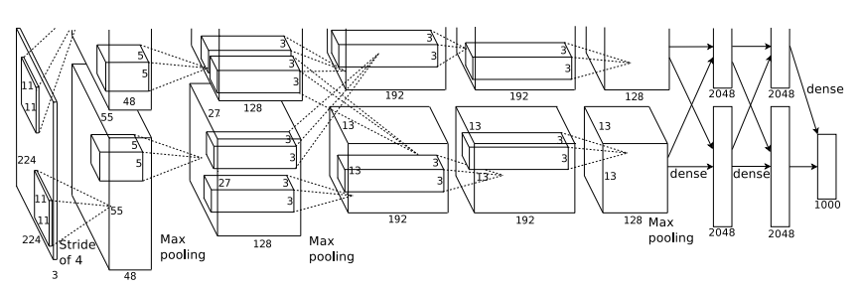
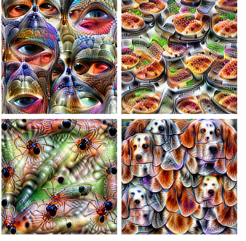
Network Architectures
Computer Vision (UW EE/CSE 576)
Richard Szeliski
Facebook & UW
Lecture 9 – Apr 28, 2020

Slide 2
Class calendar
Date | Topic | Slides | Reading | Homework
April 9 | Filters and convolutions | Google Slides | Szeliski, Chapter 3 | HW1 due, HW2 assigned
April 14 | Interpolation and Optimization | pdf, pptx | Szeliski, Chapter 4
April 16 | Machine Learning | pdf, pptx | Szeliski, Chapter 5.1-5.2
April 21 | Deep Neural Networks | pdf, pptx | Szeliski, Chapter 5.3
April 23 | Convolutional Neural Networks |  | Szeliski, Chapter 5.4 | HW2 due, HW3 assigned
April 28 | Network Architectures |  | Szeliski, Chapter 5.4
April 30 | Object Detection |  | Szeliski, Chapter 6.3
May 5 | Detection and Instance Segmentation |  | Szeliski, Chapter 6.4
May 7 | Edges, features, matching, RANSAC |  | Szeliski, Chapter 7.1-7.2, 8.1-8.2 | HW3 due, HW4 assigned

Slide 3
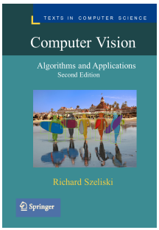

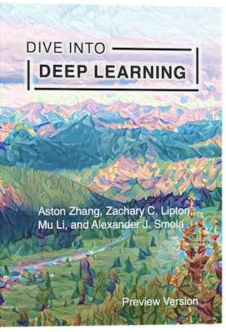
References
https://d2l.ai/

Slide 4
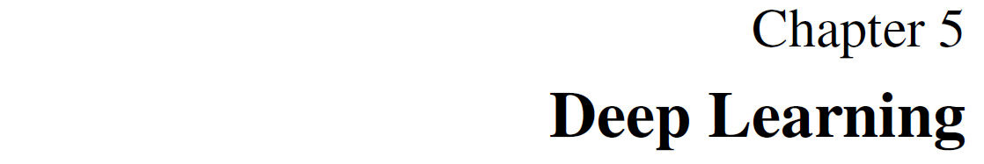
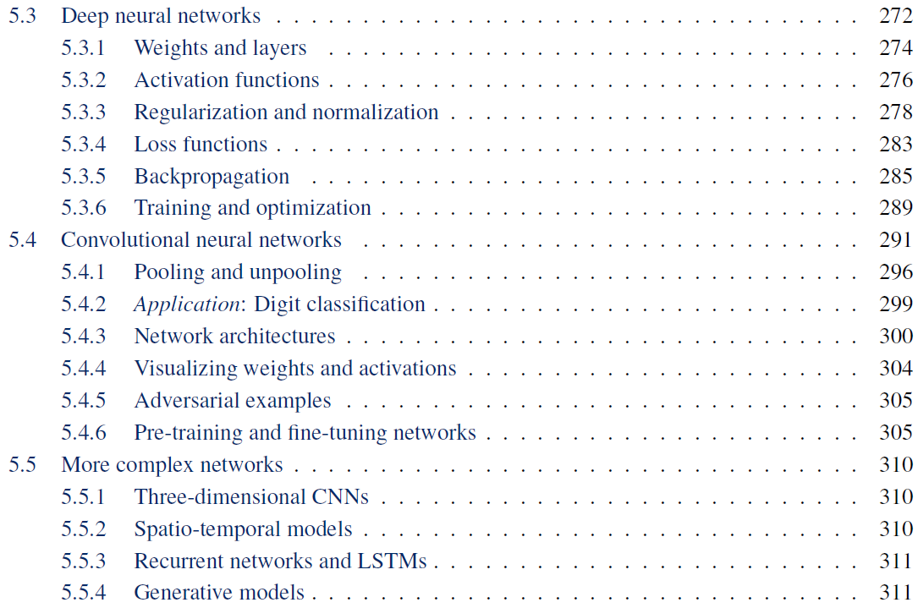
Readings

Slide 5
Network architectures
Batch normalization
CNN architectures
Visualization
Adversarial examples
Deconvolution and U-Nets
Deep learning software
Sky
Cow
Grass
Notes:
The order in the lecture is a little different from the book, because Justin Johnson’s lectures follow a different order

Slide 6
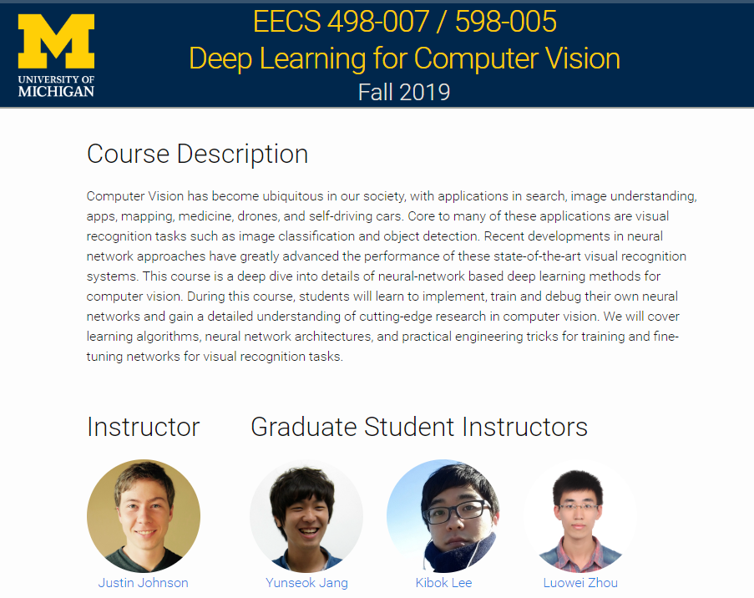
As before, I’m borrowing slides from

Slide 7
Lecture 7:
Convolutional Networks

Slide 8
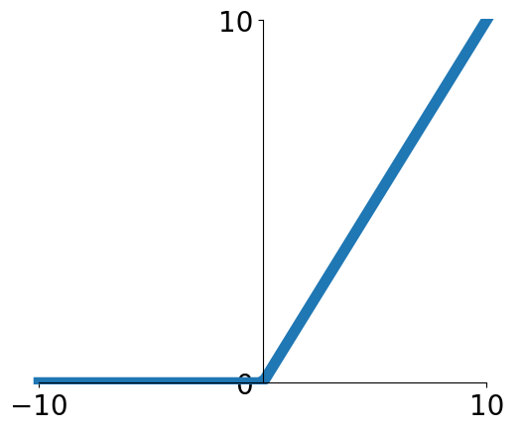
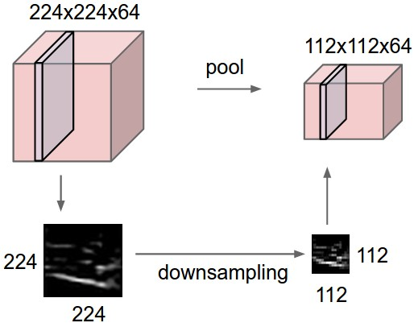
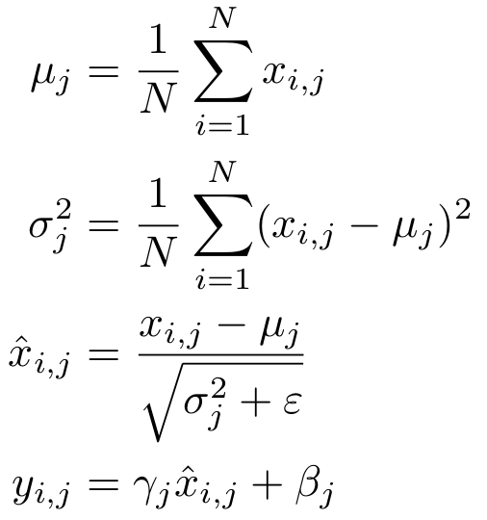
Components of a Convolutional Network
Fully-Connected Layers
Activation Function
Convolution Layers
Pooling Layers
Normalization

Slide 9

Batch Normalization
Idea: “Normalize” the outputs of a layer so they have zero mean and unit variance. Why?
Why? Helps reduce “internal covariate shift”, improves optimization
We can normalize a batch of activations like this:
This is a differentiable function, so we can use it as an operator in our networks and backprop through it!
Ioffe and Szegedy, “Batch normalization: Accelerating deep network training by reducing internal covariate shift”, ICML 2015

Slide 10
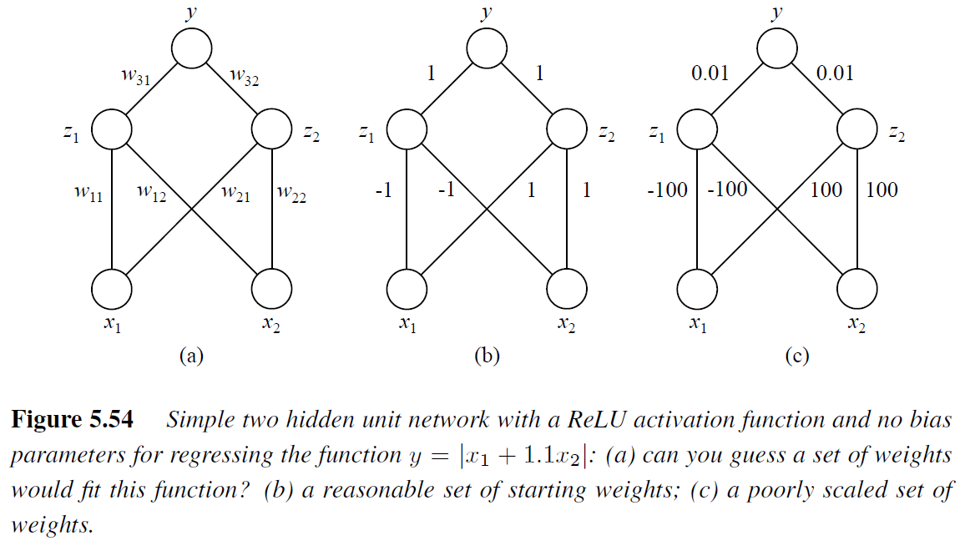
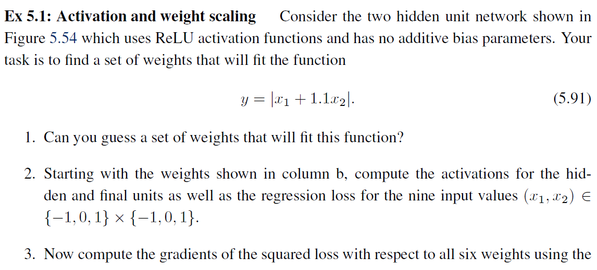
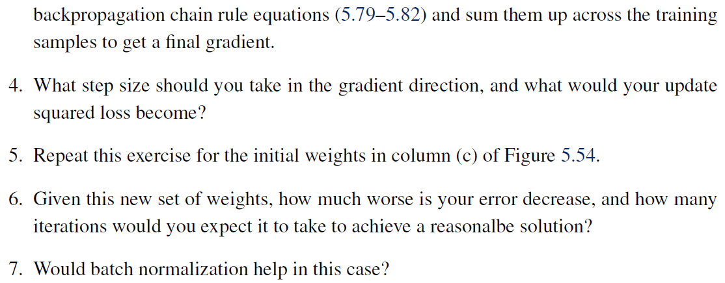
Activation and weight scaling

Slide 11
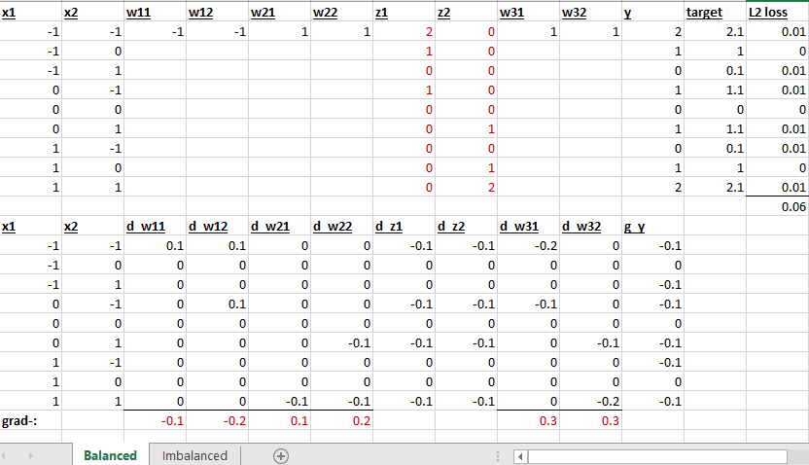
Activation and weight scaling

Slide 12
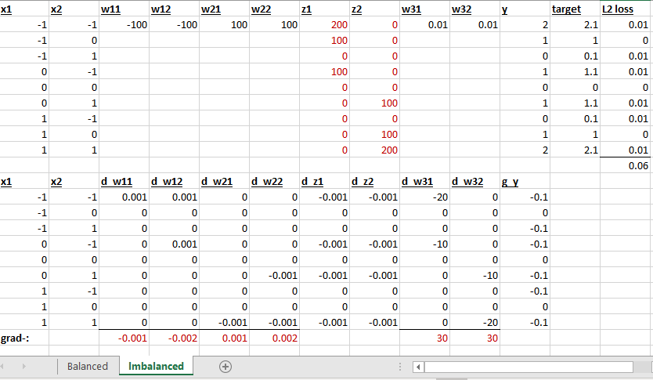
Activation and weight scaling

Slide 13

Batch Normalization
Input:
Per-channel mean, shape is D
X
Per-channel std, shape is D
N
Normalized x,
Shape is N x D
D
Ioffe and Szegedy, “Batch normalization: Accelerating deep network training by reducing internal covariate shift”, ICML 2015

Slide 14
Batch Normalization
Input:
Per-channel mean, shape is D
X
Per-channel std, shape is D
N
Normalized x,
Shape is N x D
D
Problem: What if zero-mean, unit variance is too hard of a constraint?
Ioffe and Szegedy, “Batch normalization: Accelerating deep network training by reducing internal covariate shift”, ICML 2015

Slide 15

Batch Normalization
Input:
Per-channel mean, shape is D
Learnable scale and shift parameters:
Per-channel std, shape is D
Normalized x,
Shape is N x D
Learning = ,
= will recover the identity function!
Output,
Shape is N x D

Slide 16
Batch Normalization: Test-Time
Problem: Estimates depend on minibatch; can’t do this at test-time
Input:
Per-channel mean, shape is D
Learnable scale and shift parameters:
Per-channel std, shape is D
Normalized x,
Shape is N x D
Learning = ,
= will recover the identity function!
Output,
Shape is N x D

Slide 17
Batch Normalization: Test-Time
Input:
(Running) average of
values seen during training
Per-channel mean, shape is D
Learnable scale and shift parameters:
(Running) average of
values seen during training
Per-channel std, shape is D
Normalized x,
Shape is N x D
Learning = ,
= will recover the identity function!
Output,
Shape is N x D

Slide 18
Batch Normalization: Test-Time
Input:
(Running) average of
values seen during training
Per-channel mean, shape is D
Learnable scale and shift parameters:
(Running) average of
values seen during training
Per-channel std, shape is D
Normalized x,
Shape is N x D
During testing batchnorm becomes a linear operator.
Can be fused with the previous fully-connected or conv layer
Output,
Shape is N x D

Slide 19
Batch Normalization for ConvNets
Batch Normalization for
convolutional networks
(Spatial Batchnorm, BatchNorm2D)
Batch Normalization for fully-connected networks
x: N × D
𝞵,𝝈: 1 × D
ɣ,β: 1 × D
y = ɣ(x-𝞵)/𝝈+β
x: N×C×H×W
𝞵,𝝈: 1×C×1×1
ɣ,β: 1×C×1×1
y = ɣ(x-𝞵)/𝝈+β
Normalize
Normalize

Slide 20
Batch Normalization
FC
Usually inserted after Fully Connected or Convolutional layers, and before nonlinearity.
BN
tanh
FC
BN
tanh
Ioffe and Szegedy, “Batch normalization: Accelerating deep network training by reducing internal covariate shift”, ICML 2015

Slide 21
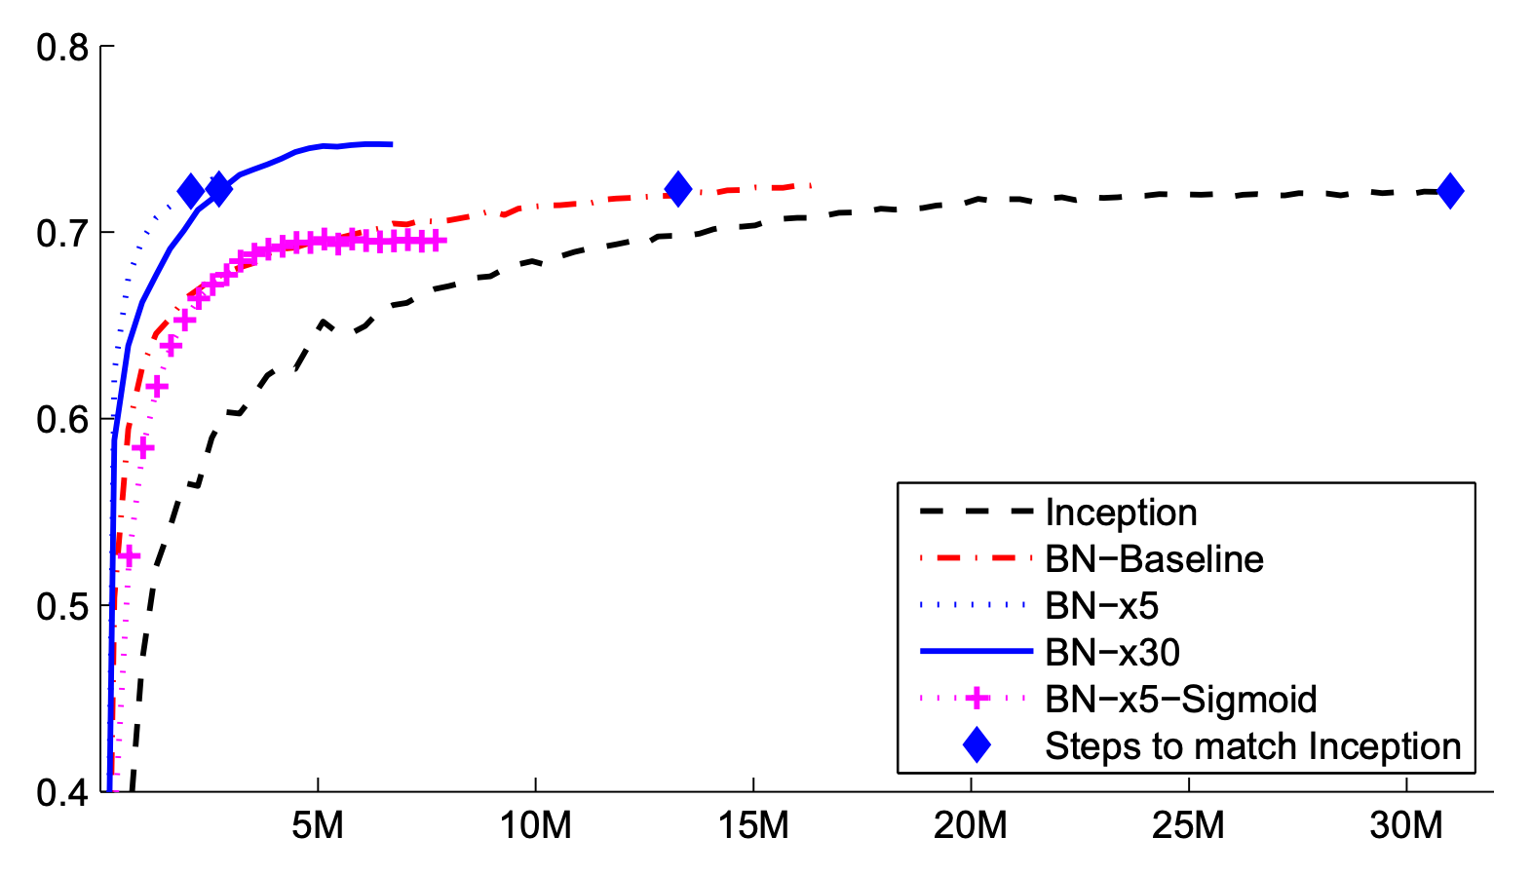
Batch Normalization
Makes deep networks much easier to train!
Allows higher learning rates, faster convergence
Networks become more robust to initialization
Acts as regularization during training
Zero overhead at test-time: can be fused with conv!
FC
BN
tanh
FC
BN
ImageNet accuracy
tanh
Ioffe and Szegedy, “Batch normalization: Accelerating deep network training by reducing internal covariate shift”, ICML 2015
Training iterations

Slide 22
Batch Normalization
Makes deep networks much easier to train!
Allows higher learning rates, faster convergence
Networks become more robust to initialization
Acts as regularization during training
Zero overhead at test-time: can be fused with conv!
Not well-understood theoretically (yet)
Behaves differently during training and testing: this is a very common source of bugs!
FC
BN
tanh
FC
BN
tanh
Ioffe and Szegedy, “Batch normalization: Accelerating deep network training by reducing internal covariate shift”, ICML 2015

Slide 23
Layer Normalization
Layer Normalization for fully-connected networks
Same behavior at train and test!
Used in RNNs, Transformers
Batch Normalization for fully-connected networks
x: N × D
𝞵,𝝈: 1 × D
ɣ,β: 1 × D
y = ɣ(x-𝞵)/𝝈+β
x: N × D
𝞵,𝝈: N × 1
ɣ,β: 1 × D
y = ɣ(x-𝞵)/𝝈+β
Normalize
Normalize
Ba, Kiros, and Hinton, “Layer Normalization”, arXiv 2016

Slide 24
Instance Normalization
Instance Normalization for convolutional networks
Same behavior at train / test!
Batch Normalization for convolutional networks
x: N×C×H×W
𝞵,𝝈: 1×C×1×1
ɣ,β: 1×C×1×1
y = ɣ(x-𝞵)/𝝈+β
x: N×C×H×W
𝞵,𝝈: N×C×1×1
ɣ,β: 1×C×1×1
y = ɣ(x-𝞵)/𝝈+β
Normalize
Normalize
Ulyanov et al, Improved Texture Networks: Maximizing Quality and Diversity in Feed-forward Stylization and Texture Synthesis, CVPR 2017

Slide 25
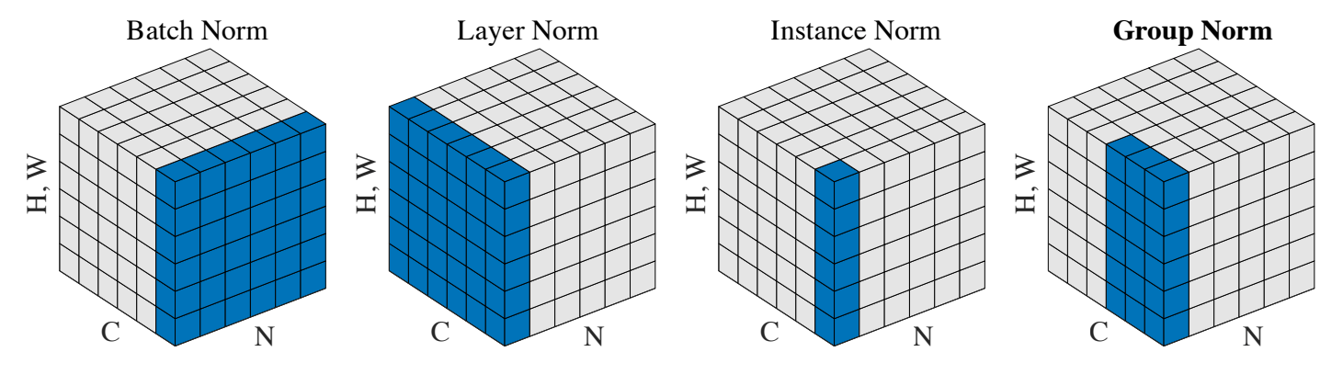
Comparison of Normalization Layers
Wu and He, “Group Normalization”, ECCV 2018

Slide 26
Group Normalization
Wu and He, “Group Normalization”, ECCV 2018

Slide 27
Components of a Convolutional Network
Convolution Layers
Pooling Layers
Fully-Connected Layers
Activation Function
Normalization

Slide 28
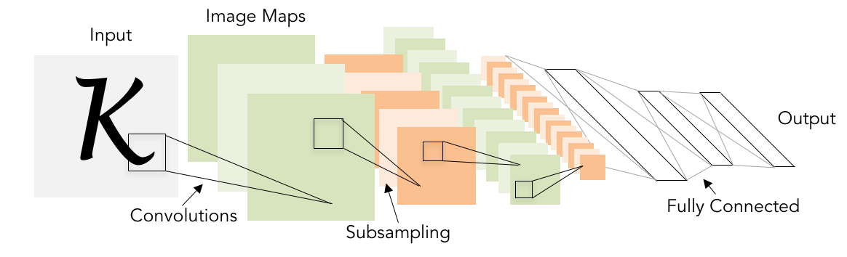
Components of a Convolutional Network
Problem: What is the right way to combine all these components?

Slide 29
Network architectures
Batch normalization
CNN architectures
Visualization
Adversarial examples
Deconvolution and U-Nets
Deep learning software
Sky
Cow
Grass
Notes:
The order in the lecture is a little different from the book, because Justin Johnson’s lectures follow a different order

Slide 30
Lecture 8:
CNN Architectures

Slide 31
ImageNet Classification Challenge
Lin et al
Sanchez & Perronnin
Krizhevsky et al (AlexNet)
Zeiler & Fergus
Simonyan & Zisserman (VGG)
Szegedy et al (GoogLeNet)
He et al (ResNet)
Shao et al
Hu et al
(SENet)
Russakovsky et al

Slide 32
ImageNet Classification Challenge
Lin et al
Sanchez & Perronnin
Krizhevsky et al (AlexNet)
Zeiler & Fergus
Simonyan & Zisserman (VGG)
Szegedy et al (GoogLeNet)
He et al (ResNet)
Shao et al
Hu et al
(SENet)
Russakovsky et al

Slide 33
AlexNet
227 x 227 inputs
5 Convolutional layers
Max pooling
3 fully-connected layers
ReLU nonlinearities
Figure copyright Alex Krizhevsky, Ilya Sutskever, and Geoffrey Hinton, 2012. Reproduced with permission.

Slide 34
AlexNet
Used “Local response normalization”;
Not used anymore
Trained on two GTX 580 GPUs – only 3GB of memory each! Model split over two GPUs
227 x 227 inputs
5 Convolutional layers
Max pooling
3 fully-connected layers
ReLU nonlinearities
Figure copyright Alex Krizhevsky, Ilya Sutskever, and Geoffrey Hinton, 2012. Reproduced with permission.

Slide 35
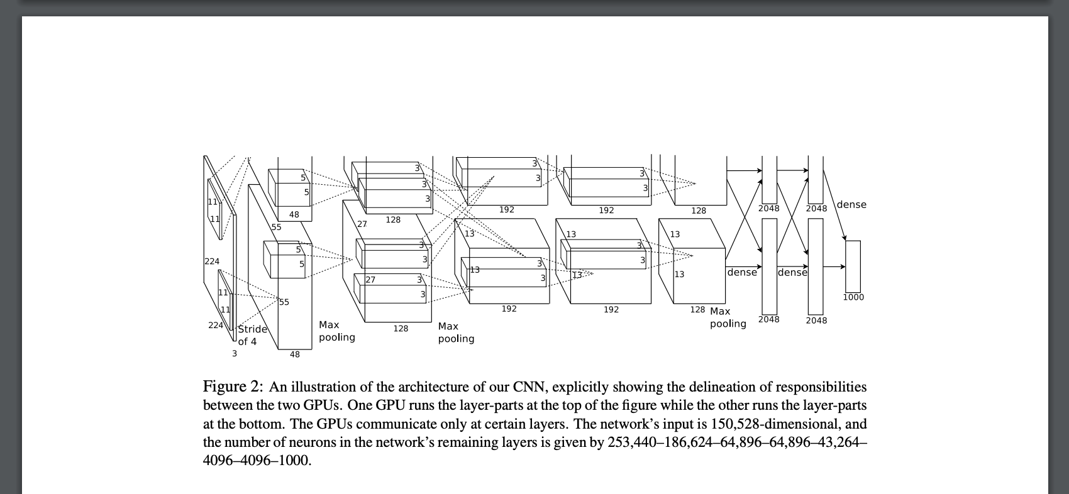
AlexNet
Figure copyright Alex Krizhevsky, Ilya Sutskever, and Geoffrey Hinton, 2012. Reproduced with permission.

Slide 36
AlexNet
Total Citations: 46,510
Figure copyright Alex Krizhevsky, Ilya Sutskever, and Geoffrey Hinton, 2012. Reproduced with permission.

Slide 37
AlexNet
Citation Counts
Darwin, “On the origin of species”, 1859: 50,007
Shannon, “A mathematical theory of communication”, 1948: 69,351
Watson and Crick, “Molecular Structure of Nucleic Acids”, 1953: 13,111
ATLAS Collaboration, “Observation of a new particle in the search for the Standard Model Higgs boson with the ATLAS detector at the LHC”, 2012: 14,424
Total Citations: 46,510
Figure copyright Alex Krizhevsky, Ilya Sutskever, and Geoffrey Hinton, 2012. Reproduced with permission.

Slide 38
AlexNet
Interesting trends here!
 | Input size |  | Layer |  |  |  | Output size
Layer | C | H / W | filters | kernel | stride | pad | C | H / W | memory (KB) | params (k) | flop (M)
conv1 | 3 | 227 | 64 | 11 | 4 | 2 | 64 | 56 | 784 | 23 | 73
pool1 | 64 | 56 |  | 3 | 2 | 0 | 64 | 27 | 182 | 0 | 0
conv2 | 64 | 27 | 192 | 5 | 1 | 2 | 192 | 27 | 547 | 307 | 224
pool2 | 192 | 27 |  | 3 | 2 | 0 | 192 | 13 | 127 | 0 | 0
conv3 | 192 | 13 | 384 | 3 | 1 | 1 | 384 | 13 | 254 | 664 | 112
conv4 | 384 | 13 | 256 | 3 | 1 | 1 | 256 | 13 | 169 | 885 | 145
conv5 | 256 | 13 | 256 | 3 | 1 | 1 | 256 | 13 | 169 | 590 | 100
pool5 | 256 | 13 |  | 3 | 2 | 0 | 256 | 6 | 36 | 0 | 0
flatten | 256 | 6 |  |  |  |  | 9216 |  | 36 | 0 | 0
fc6 | 9216 |  | 4096 |  |  |  | 4096 |  | 16 | 37,749 | 38
fc7 | 4096 |  | 4096 |  |  |  | 4096 |  | 16 | 16,777 | 17
fc8 | 4096 |  | 1000 |  |  |  | 1000 |  | 4 | 4,096 | 4

Slide 39
AlexNet
Most of the memory usage is in the early convolution layers
Most floating-point ops occur in the convolution layers
Nearly all parameters are in the fully-connected layers

Slide 40
ImageNet Classification Challenge
Lin et al
Sanchez & Perronnin
Krizhevsky et al (AlexNet)
Zeiler & Fergus
Simonyan & Zisserman (VGG)
Szegedy et al (GoogLeNet)
He et al (ResNet)
Shao et al
Hu et al
(SENet)
Russakovsky et al

Slide 41
ImageNet Classification Challenge
Lin et al
Sanchez & Perronnin
Krizhevsky et al (AlexNet)
Zeiler & Fergus
Simonyan & Zisserman (VGG)
Szegedy et al (GoogLeNet)
He et al (ResNet)
Shao et al
Hu et al
(SENet)
Russakovsky et al

Slide 42
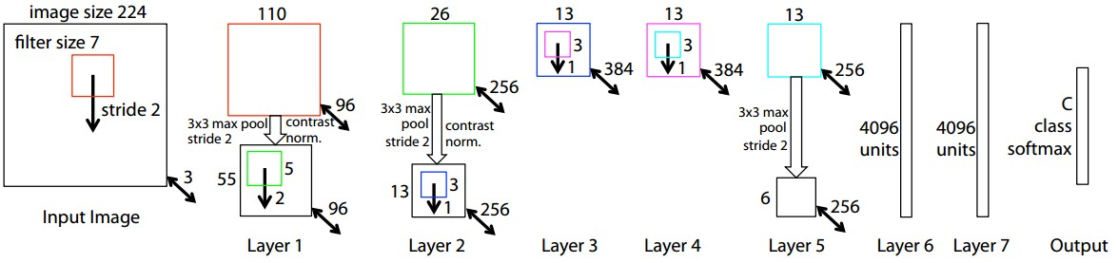
ZFNet: A Bigger AlexNet
ImageNet top 5 error: 16.4% -> 11.7%
AlexNet but:
CONV1: change from (11x11 stride 4) to (7x7 stride 2)
CONV3,4,5: instead of 384, 384, 256 filters use 512, 1024, 512
More trial and error =(
Zeiler and Fergus, “Visualizing and Understanding Convolutional Networks”, ECCV 2014

Slide 43
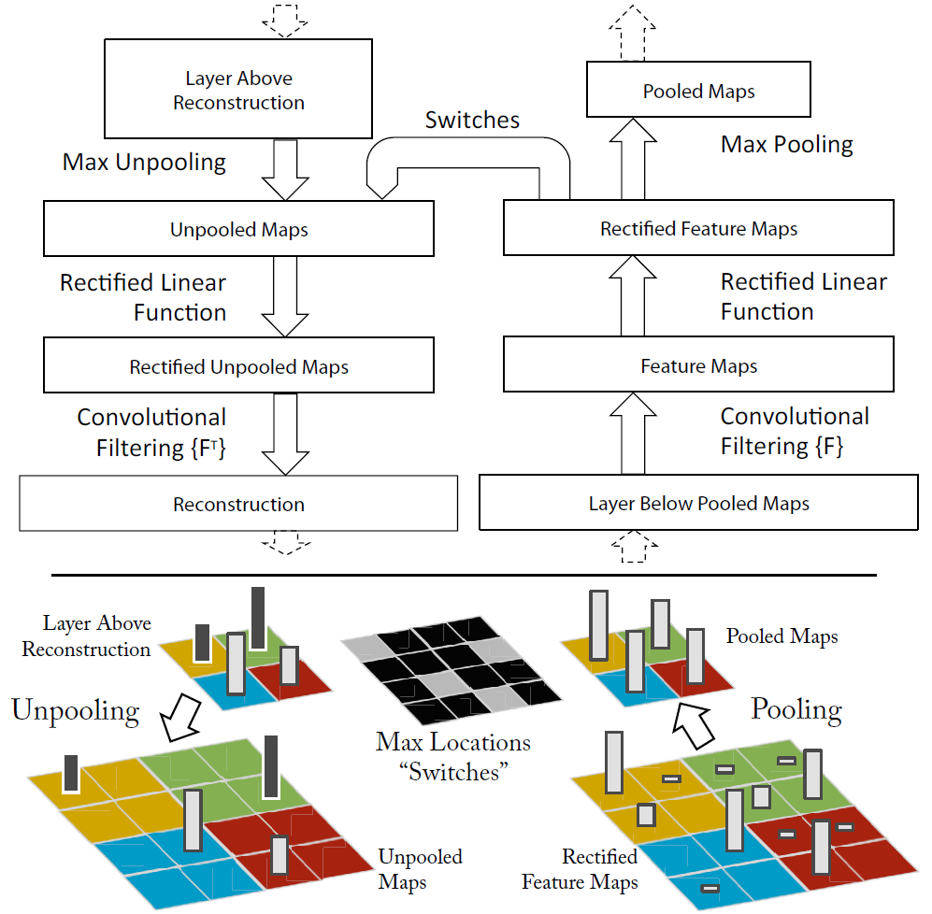
The really cool part
Visualizing features with
backprojection
(``deconvnet’’)
How could you do this?
What about max pooling?

Slide 44
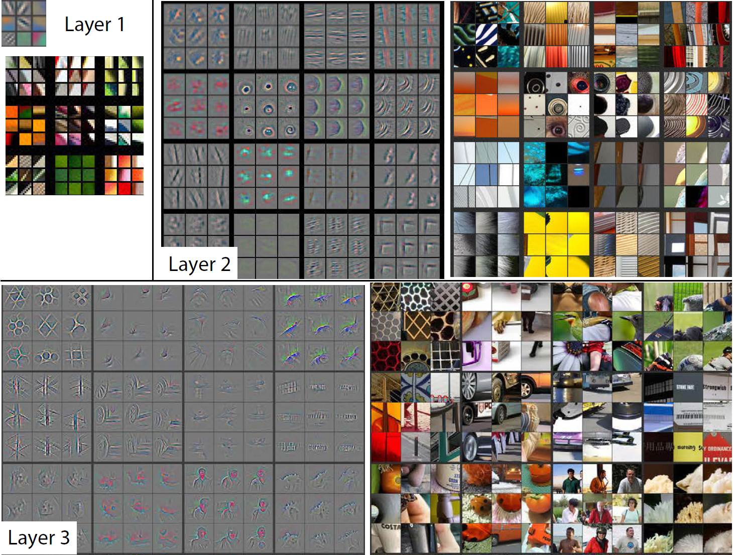
Visualizing features through backprojection
Zeiler and Fergus, “Visualizing and Understanding Convolutional Networks”, ECCV 2014
gray: max stimulus, color: patch
Notes:
The order in the lecture is a little different from the book, because Justin Johnson’s lectures follow a different order

Slide 45
Visualizing features through backprojection
Zeiler and Fergus, “Visualizing and Understanding Convolutional Networks”, ECCV 2014
gray: max stimulus, color: patch
Notes:
The order in the lecture is a little different from the book, because Justin Johnson’s lectures follow a different order

Slide 46
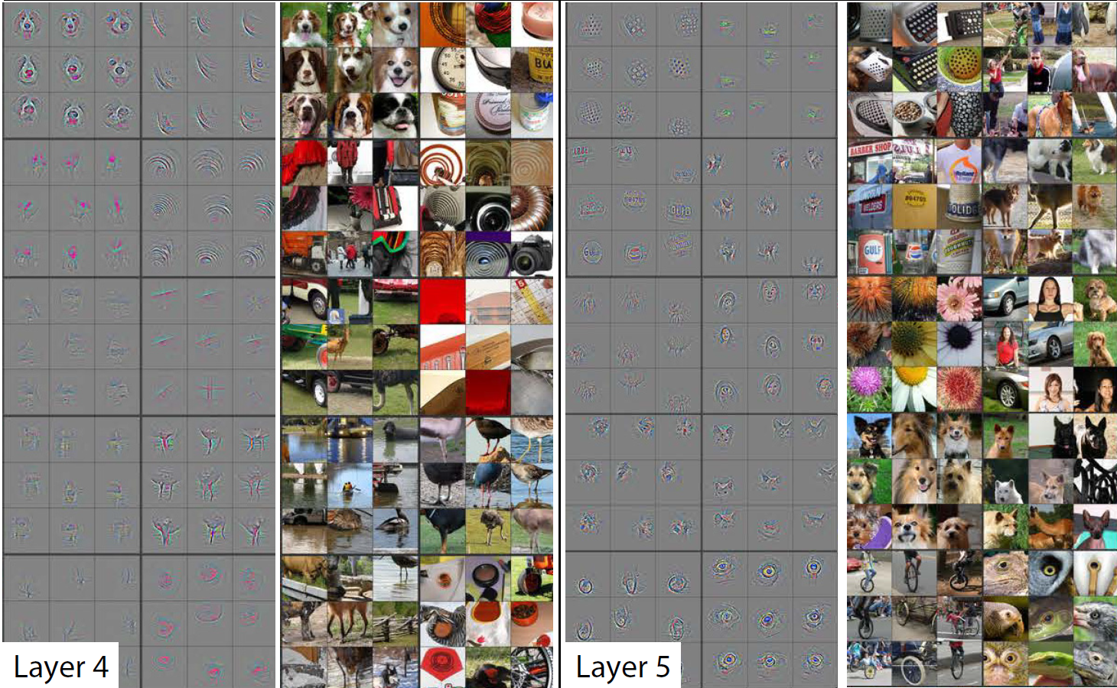
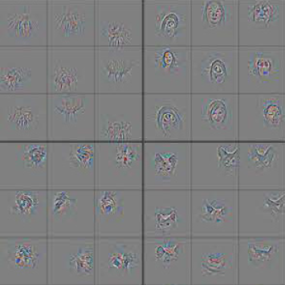
Visualizing features through backprojection
gray: max stimulus, color: patch
Notes:
The order in the lecture is a little different from the book, because Justin Johnson’s lectures follow a different order

Slide 47
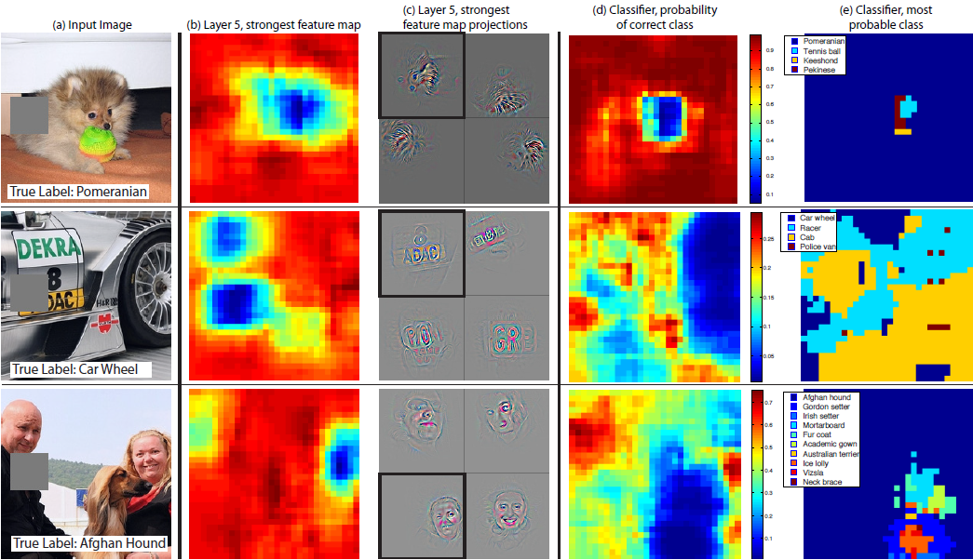
Attribution: saliency via occlusions
Notes:
The order in the lecture is a little different from the book, because Justin Johnson’s lectures follow a different order

Slide 48
ImageNet Classification Challenge
Lin et al
Sanchez & Perronnin
Krizhevsky et al (AlexNet)
Zeiler & Fergus
Simonyan & Zisserman (VGG)
Szegedy et al (GoogLeNet)
He et al (ResNet)
Shao et al
Hu et al
(SENet)
Russakovsky et al

Slide 49
ImageNet Classification Challenge
Lin et al
Sanchez & Perronnin
Krizhevsky et al (AlexNet)
Zeiler & Fergus
Simonyan & Zisserman (VGG)
Szegedy et al (GoogLeNet)
He et al (ResNet)
Shao et al
Hu et al
(SENet)
Russakovsky et al

Slide 50
VGG: Deeper Networks, Regular Design
Softmax
FC 1000
Softmax
FC 4096
VGG Design rules:
All conv are 3x3 stride 1 pad 1
All max pool are 2x2 stride 2
After pool, double #channels
FC 1000
FC 4096
FC 4096
Pool
FC 4096
3x3 conv, 512
Pool
3x3 conv, 512
3x3 conv, 512
3x3 conv, 512
3x3 conv, 512
3x3 conv, 512
3x3 conv, 512
Pool
Pool
3x3 conv, 512
Softmax
3x3 conv, 512
3x3 conv, 512
Network has 5 convolutional stages:
Stage 1: conv-conv-pool
Stage 2: conv-conv-pool
Stage 3: conv-conv-pool
Stage 4: conv-conv-conv-[conv]-pool
Stage 5: conv-conv-conv-[conv]-pool
(VGG-19 has 4 conv in stages 4 and 5)
FC 1000
3x3 conv, 512
3x3 conv, 512
FC 4096
3x3 conv, 512
3x3 conv, 512
FC 4096
Pool
Pool
Pool
3x3 conv, 256
3x3 conv, 256
3x3 conv, 256
3x3 conv, 256
3x3 conv, 256
3x3 conv, 384
Pool
Pool
Pool
3x3 conv, 128
3x3 conv, 128
3x3 conv, 384
3x3 conv, 128
3x3 conv, 128
Pool
Pool
Pool
5x5 conv, 256
3x3 conv, 64
3x3 conv, 64
11x11 conv, 96
3x3 conv, 64
3x3 conv, 64
Input
Input
Input
AlexNet
VGG16
VGG19
Simonyan and Zissermann, “Very Deep Convolutional Networks for Large-Scale Image Recognition”, ICLR 2015

Slide 51
VGG: Deeper Networks, Regular Design
Softmax
FC 1000
Softmax
FC 4096
VGG Design rules:
All conv are 3x3 stride 1 pad 1
All max pool are 2x2 stride 2
After pool, double #channels
FC 1000
FC 4096
Two 3x3 conv has same receptive field as a single 5x5 conv, but has fewer parameters and takes less computation
FC 4096
Pool
FC 4096
3x3 conv, 512
Pool
3x3 conv, 512
3x3 conv, 512
3x3 conv, 512
3x3 conv, 512
3x3 conv, 512
3x3 conv, 512
Pool
Pool
3x3 conv, 512
Softmax
3x3 conv, 512
3x3 conv, 512
FC 1000
3x3 conv, 512
3x3 conv, 512
Option 1:
Conv(5x5, C -> C)
Params: 25C²
FLOPs: 25C²HW
Option 2:
Conv(3x3, C -> C)
Conv(3x3, C -> C)
Params: 18C²
FLOPs: 18C²HW
FC 4096
3x3 conv, 512
3x3 conv, 512
FC 4096
Pool
Pool
Pool
3x3 conv, 256
3x3 conv, 256
3x3 conv, 256
3x3 conv, 256
3x3 conv, 256
3x3 conv, 384
Pool
Pool
Pool
3x3 conv, 128
3x3 conv, 128
3x3 conv, 384
3x3 conv, 128
3x3 conv, 128
Pool
Pool
Pool
5x5 conv, 256
3x3 conv, 64
3x3 conv, 64
11x11 conv, 96
3x3 conv, 64
3x3 conv, 64
Input
Input
Input
AlexNet
VGG16
VGG19
Simonyan and Zissermann, “Very Deep Convolutional Networks for Large-Scale Image Recognition”, ICLR 2015

Slide 52
AlexNet vs VGG-16: Much bigger network!
AlexNet total: 1.9 MB
VGG-16 total: 48.6 MB (25x)
AlexNet total: 61M
VGG-16 total: 138M (2.3x)
AlexNet total: 0.7 GFLOP
VGG-16 total: 13.6 GFLOP (19.4x)

Slide 53
ImageNet Classification Challenge
Lin et al
Sanchez & Perronnin
Krizhevsky et al (AlexNet)
Zeiler & Fergus
Simonyan & Zisserman (VGG)
Szegedy et al (GoogLeNet)
He et al (ResNet)
Shao et al
Hu et al
(SENet)
Russakovsky et al

Slide 54
ImageNet Classification Challenge
Lin et al
Sanchez & Perronnin
Krizhevsky et al (AlexNet)
Zeiler & Fergus
Simonyan & Zisserman (VGG)
Szegedy et al (GoogLeNet)
He et al (ResNet)
Shao et al
Hu et al
(SENet)
Russakovsky et al

Slide 55
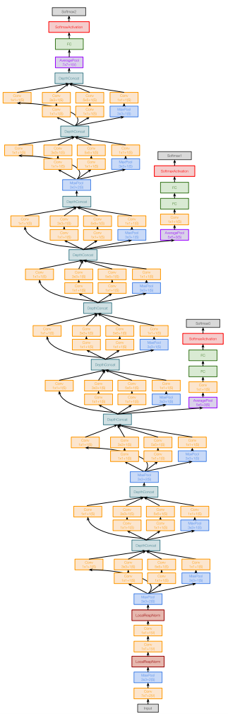
GoogLeNet: Focus on Efficiency
Many innovations for efficiency: reduce parameter count, memory usage, and computation
Szegedy et al, “Going deeper with convolutions”, CVPR 2015

Slide 56
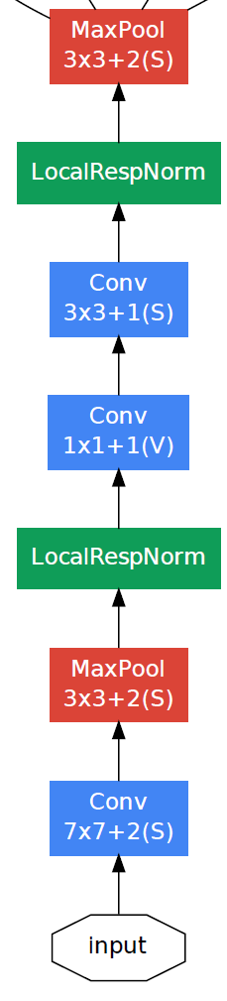
GoogLeNet: Aggressive Stem
Stem network at the start aggressively downsamples input
(Recall in VGG-16: Most of the compute was at the start)
Szegedy et al, “Going deeper with convolutions”, CVPR 2015

Slide 57
GoogLeNet: Aggressive Stem
Stem network at the start aggressively downsamples input
(Recall in VGG-16: Most of the compute was at the start)
 | Input size |  | Layer |  |  |  | Output size
Layer | C | H / W | filters | kernel | stride | pad | C | H/W | memory (KB) | params (K) | flop (M)
conv | 3 | 224 | 64 | 7 | 2 | 3 | 64 | 112 | 3136 | 9 | 118
max-pool | 64 | 112 |  | 3 | 2 | 1 | 64 | 56 | 784 | 0 | 2
conv | 64 | 56 | 64 | 1 | 1 | 0 | 64 | 56 | 784 | 4 | 13
conv | 64 | 56 | 192 | 3 | 1 | 1 | 192 | 56 | 2352 | 111 | 347
max-pool | 192 | 56 |  | 3 | 2 | 1 | 192 | 28 | 588 | 0 | 1
Total from 224 to 28 spatial resolution:
Memory: 7.5 MB
Params: 124K
MFLOP: 418
Szegedy et al, “Going deeper with convolutions”, CVPR 2015

Slide 58
GoogLeNet: Aggressive Stem
Stem network at the start aggressively downsamples input
(Recall in VGG-16: Most of the compute was at the start)
 | Input size |  | Layer |  |  |  | Output size
Layer | C | H / W | filters | kernel | stride | pad | C | H/W | memory (KB) | params (K) | flop (M)
conv | 3 | 224 | 64 | 7 | 2 | 3 | 64 | 112 | 3136 | 9 | 118
max-pool | 64 | 112 |  | 3 | 2 | 1 | 64 | 56 | 784 | 0 | 2
conv | 64 | 56 | 64 | 1 | 1 | 0 | 64 | 56 | 784 | 4 | 13
conv | 64 | 56 | 192 | 3 | 1 | 1 | 192 | 56 | 2352 | 111 | 347
max-pool | 192 | 56 |  | 3 | 2 | 1 | 192 | 28 | 588 | 0 | 1
Total from 224 to 28 spatial resolution:
Memory: 7.5 MB
Params: 124K
MFLOP: 418
Compare VGG-16:
Memory: 42.9 MB (5.7x)
Params: 1.1M (8.9x)
MFLOP: 7485 (17.8x)
Szegedy et al, “Going deeper with convolutions”, CVPR 2015

Slide 59
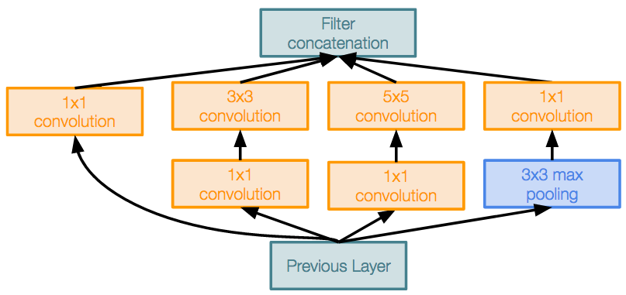
GoogLeNet: Inception Module
Inception module
Local unit with
parallel branches
Local structure repeated
many times throughout the network
Szegedy et al, “Going deeper with convolutions”, CVPR 2015

Slide 60
GoogLeNet: Inception Module
Inception module
Local unit with
parallel branches
Local structure repeated
many times throughout the network
Uses 1x1 “Bottleneck” layers to reduce channel dimension before expensive conv (we will revisit this with ResNet!)
Related to (sum of) separable filters
Perona, “Deformable kernels for early vision”. PAMI 1995
Szegedy et al, “Going deeper with convolutions”, CVPR 2015

Slide 61
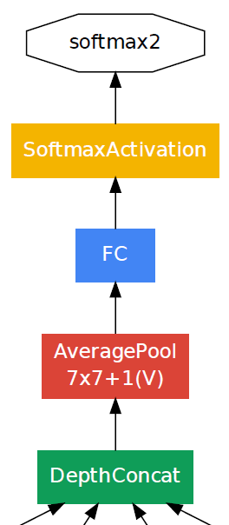
GoogLeNet: Global Average Pooling
No large FC layers at the end! Instead uses global average pooling to collapse spatial dimensions, and one linear layer to produce class scores
(Recall VGG-16: Most parameters were in the FC layers!)
 | Input size |  | Layer |  |  |  | Output size
Layer | C | H/W | filters | kernel | stride | pad | C | H/W | memory (KB) | params (k) | flop (M)
avg-pool | 1024 | 7 |  | 7 | 1 | 0 | 1024 | 1 | 4 | 0 | 0
fc | 1024 |  | 1000 |  |  |  | 1000 |  | 0 | 1025 | 1
Layer | C | H/W | filters | kernel | stride | pad | C | H/W | memory (KB) | params (K) | flop (M)
flatten | 512 | 7 |  |  |  |  | 25088 |  | 98
fc6 | 25088 |  |  | 4096 |  |  | 4096 |  | 16 | 102760 | 103
fc7 | 4096 |  |  | 4096 |  |  | 4096 |  | 16 | 16777 | 17
fc8 | 4096 |  |  | 1000 |  |  | 1000 |  | 4 | 4096 | 4
Compare with VGG-16:

Slide 62
GoogLeNet: Global Average Pooling
No large FC layers at the end! Instead uses “global average pooling” to collapse spatial dimensions, and one linear layer to produce class scores
(Recall VGG-16: Most parameters were in the FC layers!)
 | Input size |  | Layer |  |  |  | Output size
Layer | C | H/W | filters | kernel | stride | pad | C | H/W | memory (KB) | params (k) | flop (M)
avg-pool | 1024 | 7 |  | 7 | 1 | 0 | 1024 | 1 | 4 | 0 | 0
fc | 1024 |  | 1000 |  |  |  | 1000 |  | 0 | 1025 | 1
Layer | C | H/W | filters | kernel | stride | pad | C | H/W | memory (KB) | params (K) | flop (M)
flatten | 512 | 7 |  |  |  |  | 25088 |  | 98
fc6 | 25088 |  |  | 4096 |  |  | 4096 |  | 16 | 102760 | 103
fc7 | 4096 |  |  | 4096 |  |  | 4096 |  | 16 | 16777 | 17
fc8 | 4096 |  |  | 1000 |  |  | 1000 |  | 4 | 4096 | 4
Compare with VGG-16:

Slide 63
GoogLeNet: Auxiliary Classifiers
Training using loss at the end of the network didn’t work well:
Network is too deep, gradients don’t propagate cleanly
As a hack, attach “auxiliary classifiers” at several intermediate points in the network that also try to classify the image and receive loss
GoogLeNet was before batch normalization! With BatchNorm no longer need to use this trick

Slide 64
ImageNet Classification Challenge
Lin et al
Sanchez & Perronnin
Krizhevsky et al (AlexNet)
Zeiler & Fergus
Simonyan & Zisserman (VGG)
Szegedy et al (GoogLeNet)
He et al (ResNet)
Shao et al
Hu et al
(SENet)
Russakovsky et al

Slide 65
ImageNet Classification Challenge
Lin et al
Sanchez & Perronnin
Krizhevsky et al (AlexNet)
Zeiler & Fergus
Simonyan & Zisserman (VGG)
Szegedy et al (GoogLeNet)
He et al (ResNet)
Shao et al
Hu et al
(SENet)
Russakovsky et al

Slide 66
Residual Networks
Once we have Batch Normalization, we can train networks with 10+ layers. What happens as we go deeper?
He et al, “Deep Residual Learning for Image Recognition”, CVPR 2016

Slide 67
Residual Networks
Once we have Batch Normalization, we can train networks with 10+ layers. What happens as we go deeper?
Test error
Deeper model does worse than shallow model!
Initial guess: Deep model is overfitting since it is much bigger than the other model
56-layer
20-layer
Iterations
He et al, “Deep Residual Learning for Image Recognition”, CVPR 2016

Slide 68
Residual Networks
Once we have Batch Normalization, we can train networks with 10+ layers. What happens as we go deeper?
Training error
Test error
56-layer
56-layer
20-layer
20-layer
Iterations
Iterations
In fact the deep model seems to be underfitting since it also performs worse than the shallow model on the training set! It is actually underfitting
He et al, “Deep Residual Learning for Image Recognition”, CVPR 2016

Slide 69
Residual Networks
A deeper model can emulate a shallower model: copy layers from shallower model, set extra layers to identity
Thus deeper models should do at least as good as shallow models
Hypothesis: This is an optimization problem. Deeper models are harder to optimize, and in particular don’t learn identity functions to emulate shallow models
He et al, “Deep Residual Learning for Image Recognition”, CVPR 2016

Slide 70
Residual Networks
A deeper model can emulate a shallower model: copy layers from shallower model, set extra layers to identity
Thus deeper models should do at least as good as shallow models
Hypothesis: This is an optimization problem. Deeper models are harder to optimize, and in particular don’t learn identity functions to emulate shallow models
Solution: Change the network so learning identity functions with extra layers is easy!
He et al, “Deep Residual Learning for Image Recognition”, CVPR 2016

Slide 71
Residual Networks
Solution: Change the network so learning identity functions with extra layers is easy!
H(x)
relu
F(x) + x
conv
conv
F(x)
Additive “shortcut”
relu
relu
conv
conv
X
X
“Plain” block
Residual Block
He et al, “Deep Residual Learning for Image Recognition”, CVPR 2016

Slide 72
Residual Networks
Solution: Change the network so learning identity functions with extra layers is easy!
H(x)
relu
F(x) + x
conv
If you set these to 0, the whole block will compute the identity function!
conv
F(x)
Additive “shortcut”
relu
relu
conv
conv
X
X
“Plain” block
Residual Block
He et al, “Deep Residual Learning for Image Recognition”, CVPR 2016

Slide 73
Residual Networks
Softmax
FC 1000
Pool
3x3 conv, 512
3x3 conv, 512
A residual network is a stack of many residual blocks
Regular design, like VGG: each residual block has two 3x3 conv
Network is divided into stages: the first block of each stage halves the resolution (with stride-2 conv) and doubles the number of channels
3x3 conv, 512
relu
3x3 conv, 512
F(x) + x
3x3 conv, 512
3x3 conv, 512, /2
...
3x3 conv
3x3 conv, 128
3x3 conv, 128
F(x)
relu
3x3 conv, 128
3x3 conv, 128
3x3 conv
3x3 conv, 128
3x3 conv, 128, / 2
3x3 conv, 64
3x3 conv, 64
X
3x3 conv, 64
Residual block
3x3 conv, 64
3x3 conv, 64
3x3 conv, 64
Pool
7x7 conv, 64, / 2
Input
He et al, “Deep Residual Learning for Image Recognition”, CVPR 2016

Slide 74
Residual Networks
Softmax
FC 1000
Pool
3x3 conv, 512
3x3 conv, 512
3x3 conv, 512
Uses the same aggressive stem as GoogleNet to downsample the input 4x before applying residual blocks:
3x3 conv, 512
3x3 conv, 512
3x3 conv, 512, /2
...
3x3 conv, 128
 | Input size |  | Layer |  |  |  | Output size
Layer | C | H/W | filters | kernel | stride | pad | C | H/W | memory (KB) | params (k) | flop (M)
conv | 3 | 224 | 64 | 7 | 2 | 3 | 64 | 112 | 3136 | 9 | 118
max-pool | 64 | 112 |  | 3 | 2 | 1 | 64 | 56 | 784 | 0 | 2
3x3 conv, 128
3x3 conv, 128
3x3 conv, 128
3x3 conv, 128
3x3 conv, 128, / 2
3x3 conv, 64
3x3 conv, 64
3x3 conv, 64
3x3 conv, 64
3x3 conv, 64
3x3 conv, 64
Pool
7x7 conv, 64, / 2
Input
He et al, “Deep Residual Learning for Image Recognition”, CVPR 2016

Slide 75
Residual Networks
Softmax
FC 1000
Pool
3x3 conv, 512
3x3 conv, 512
3x3 conv, 512
3x3 conv, 512
3x3 conv, 512
3x3 conv, 512, /2
Like GoogLeNet, no big fully-connected-layers: instead use global average pooling and a single linear layer at the end
...
3x3 conv, 128
3x3 conv, 128
3x3 conv, 128
3x3 conv, 128
3x3 conv, 128
3x3 conv, 128, / 2
3x3 conv, 64
3x3 conv, 64
3x3 conv, 64
3x3 conv, 64
3x3 conv, 64
3x3 conv, 64
Pool
7x7 conv, 64, / 2
Input
He et al, “Deep Residual Learning for Image Recognition”, CVPR 2016

Slide 76
Residual Networks
Softmax
FC 1000
Pool
3x3 conv, 512
ResNet-18:
Stem: 1 conv layer
Stage 1 (C=64): 2 res. block = 4 conv
Stage 2 (C=128): 2 res. block = 4 conv
Stage 3 (C=256): 2 res. block = 4 conv
Stage 4 (C=512): 2 res. block = 4 conv
Linear
ImageNet top-5 error: 10.92
GFLOP: 1.8
3x3 conv, 512
3x3 conv, 512
3x3 conv, 512
3x3 conv, 512
3x3 conv, 512, /2
...
3x3 conv, 128
3x3 conv, 128
3x3 conv, 128
3x3 conv, 128
3x3 conv, 128
3x3 conv, 128, / 2
3x3 conv, 64
3x3 conv, 64
3x3 conv, 64
3x3 conv, 64
3x3 conv, 64
3x3 conv, 64
Pool
He et al, “Deep Residual Learning for Image Recognition”, CVPR 2016
Error rates are 224x224 single-crop testing, reported by torchvision
7x7 conv, 64, / 2
Input

Slide 77
Residual Networks
Softmax
FC 1000
Pool
3x3 conv, 512
ResNet-18:
Stem: 1 conv layer
Stage 1 (C=64): 2 res. block = 4 conv
Stage 2 (C=128): 2 res. block = 4 conv
Stage 3 (C=256): 2 res. block = 4 conv
Stage 4 (C=512): 2 res. block = 4 conv
Linear
ImageNet top-5 error: 10.92
GFLOP: 1.8
ResNet-34:
Stem: 1 conv layer
Stage 1: 3 res. block = 6 conv
Stage 2: 4 res. block = 8 conv
Stage 3: 6 res. block = 12 conv
Stage 4: 3 res. block = 6 conv
Linear
ImageNet top-5 error: 8.58
GFLOP: 3.6
3x3 conv, 512
3x3 conv, 512
3x3 conv, 512
3x3 conv, 512
3x3 conv, 512, /2
...
3x3 conv, 128
3x3 conv, 128
3x3 conv, 128
3x3 conv, 128
3x3 conv, 128
3x3 conv, 128, / 2
3x3 conv, 64
3x3 conv, 64
3x3 conv, 64
3x3 conv, 64
3x3 conv, 64
3x3 conv, 64
Pool
He et al, “Deep Residual Learning for Image Recognition”, CVPR 2016
Error rates are 224x224 single-crop testing, reported by torchvision
7x7 conv, 64, / 2
Input

Slide 78
Residual Networks
Softmax
FC 1000
Pool
3x3 conv, 512
ResNet-18:
Stem: 1 conv layer
Stage 1 (C=64): 2 res. block = 4 conv
Stage 2 (C=128): 2 res. block = 4 conv
Stage 3 (C=256): 2 res. block = 4 conv
Stage 4 (C=512): 2 res. block = 4 conv
Linear
ImageNet top-5 error: 10.92
GFLOP: 1.8
ResNet-34:
Stem: 1 conv layer
Stage 1: 3 res. block = 6 conv
Stage 2: 4 res. block = 8 conv
Stage 3: 6 res. block = 12 conv
Stage 4: 3 res. block = 6 conv
Linear
ImageNet top-5 error: 8.58
GFLOP: 3.6
3x3 conv, 512
3x3 conv, 512
3x3 conv, 512
3x3 conv, 512
3x3 conv, 512, /2
...
3x3 conv, 128
3x3 conv, 128
3x3 conv, 128
3x3 conv, 128
3x3 conv, 128
3x3 conv, 128, / 2
3x3 conv, 64
3x3 conv, 64
3x3 conv, 64
3x3 conv, 64
VGG-16:
ImageNet top-5 error: 9.62
GFLOP: 13.6
3x3 conv, 64
3x3 conv, 64
Pool
He et al, “Deep Residual Learning for Image Recognition”, CVPR 2016
Error rates are 224x224 single-crop testing, reported by torchvision
7x7 conv, 64, / 2
Input

Slide 79
Residual Networks: Basic Block
Conv(3x3, C->C)
Conv(3x3, C->C)
“Basic”
Residual block
He et al, “Deep Residual Learning for Image Recognition”, CVPR 2016

Slide 80
Residual Networks: Basic Block
Conv(3x3, C->C)
FLOPs: 9HWC²
Conv(3x3, C->C)
FLOPs: 9HWC²
“Basic”
Residual block
Total FLOPs:
18HWC²
He et al, “Deep Residual Learning for Image Recognition”, CVPR 2016

Slide 81
Residual Networks: Bottleneck Block
Conv(1x1, C->4C)
Conv(3x3, C->C)
FLOPs: 9HWC²
Conv(3x3, C->C)
Conv(3x3, C->C)
FLOPs: 9HWC²
Conv(1x1, 4C->C)
“Basic”
Residual block
Total FLOPs:
18HWC²
“Bottleneck”
Residual block
He et al, “Deep Residual Learning for Image Recognition”, CVPR 2016

Slide 82
Residual Networks: Bottleneck Block
More layers, less computational cost!
FLOPs: 4HWC²
Conv(1x1, C->4C)
Conv(3x3, C->C)
FLOPs: 9HWC²
FLOPs: 9HWC²
Conv(3x3, C->C)
Conv(3x3, C->C)
FLOPs: 9HWC²
FLOPs: 4HWC²
Conv(1x1, 4C->C)
“Basic”
Residual block
Total FLOPs:
18HWC²
Total FLOPs:
17HWC²
“Bottleneck”
Residual block
He et al, “Deep Residual Learning for Image Recognition”, CVPR 2016

Slide 83
Residual Networks
Softmax
FC 1000
Pool
3x3 conv, 512
3x3 conv, 512
3x3 conv, 512
3x3 conv, 512
3x3 conv, 512
3x3 conv, 512, /2
 |  |  | Stage 1 |  | Stage 2 |  | Stage 3 |  | Stage 4
 | Block type | Stem layers | Blocks | Layers | Blocks | Layers | Blocks | Layers | Blocks | Layers | FC layers | GFLOP | ImageNet top-5 error
ResNet-18 | Basic | 1 | 2 | 4 | 2 | 4 | 2 | 4 | 2 | 4 | 1 | 1.8 | 10.92
ResNet-34 | Basic | 1 | 3 | 6 | 4 | 8 | 6 | 12 | 3 | 6 | 1 | 3.6 | 8.58
ResNet-50 | Bottle | 1 | 3 | 9 | 4 | 12 | 6 | 18 | 3 | 9 | 1 | 3.8 | 7.13
ResNet-101 | Bottle | 1 | 3 | 9 | 4 | 12 | 23 | 69 | 3 | 9 | 1 | 7.6 | 6.44
ResNet-152 | Bottle | 1 | 3 | 9 | 8 | 24 | 36 | 108 | 3 | 9 | 1 | 11.3 | 5.94
...
3x3 conv, 128
3x3 conv, 128
3x3 conv, 128
3x3 conv, 128
3x3 conv, 128
3x3 conv, 128, / 2
3x3 conv, 64
3x3 conv, 64
3x3 conv, 64
3x3 conv, 64
3x3 conv, 64
3x3 conv, 64
Pool
He et al, “Deep Residual Learning for Image Recognition”, CVPR 2016
Error rates are 224x224 single-crop testing, reported by torchvision
7x7 conv, 64, / 2
Input

Slide 84
Residual Networks
Softmax
FC 1000
Pool
3x3 conv, 512
3x3 conv, 512
ResNet-50 is the same as ResNet-34, but replaces Basic blocks with Bottleneck Blocks.
This is a great baseline architecture for many tasks even today!
3x3 conv, 512
3x3 conv, 512
3x3 conv, 512
3x3 conv, 512, /2
 |  |  | Stage 1 |  | Stage 2 |  | Stage 3 |  | Stage 4
 | Block type | Stem layers | Blocks | Layers | Blocks | Layers | Blocks | Layers | Blocks | Layers | FC layers | GFLOP | ImageNet top-5 error
ResNet-18 | Basic | 1 | 2 | 4 | 2 | 4 | 2 | 4 | 2 | 4 | 1 | 1.8 | 10.92
ResNet-34 | Basic | 1 | 3 | 6 | 4 | 8 | 6 | 12 | 3 | 6 | 1 | 3.6 | 8.58
ResNet-50 | Bottle | 1 | 3 | 9 | 4 | 12 | 6 | 18 | 3 | 9 | 1 | 3.8 | 7.13
ResNet-101 | Bottle | 1 | 3 | 9 | 4 | 12 | 23 | 69 | 3 | 9 | 1 | 7.6 | 6.44
ResNet-152 | Bottle | 1 | 3 | 9 | 8 | 24 | 36 | 108 | 3 | 9 | 1 | 11.3 | 5.94
...
3x3 conv, 128
3x3 conv, 128
3x3 conv, 128
3x3 conv, 128
3x3 conv, 128
3x3 conv, 128, / 2
3x3 conv, 64
3x3 conv, 64
3x3 conv, 64
3x3 conv, 64
3x3 conv, 64
3x3 conv, 64
Pool
He et al, “Deep Residual Learning for Image Recognition”, CVPR 2016
Error rates are 224x224 single-crop testing, reported by torchvision
7x7 conv, 64, / 2
Input

Slide 85
Residual Networks
Softmax
FC 1000
Pool
3x3 conv, 512
3x3 conv, 512
Deeper ResNet-101 and ResNet-152 models are more accurate, but also more computationally heavy
3x3 conv, 512
3x3 conv, 512
3x3 conv, 512
3x3 conv, 512, /2
 |  |  | Stage 1 |  | Stage 2 |  | Stage 3 |  | Stage 4
 | Block type | Stem layers | Blocks | Layers | Blocks | Layers | Blocks | Layers | Blocks | Layers | FC layers | GFLOP | ImageNet top-5 error
ResNet-18 | Basic | 1 | 2 | 4 | 2 | 4 | 2 | 4 | 2 | 4 | 1 | 1.8 | 10.92
ResNet-34 | Basic | 1 | 3 | 6 | 4 | 8 | 6 | 12 | 3 | 6 | 1 | 3.6 | 8.58
ResNet-50 | Bottle | 1 | 3 | 9 | 4 | 12 | 6 | 18 | 3 | 9 | 1 | 3.8 | 7.13
ResNet-101 | Bottle | 1 | 3 | 9 | 4 | 12 | 23 | 69 | 3 | 9 | 1 | 7.6 | 6.44
ResNet-152 | Bottle | 1 | 3 | 9 | 8 | 24 | 36 | 108 | 3 | 9 | 1 | 11.3 | 5.94
...
3x3 conv, 128
3x3 conv, 128
3x3 conv, 128
3x3 conv, 128
3x3 conv, 128
3x3 conv, 128, / 2
3x3 conv, 64
3x3 conv, 64
3x3 conv, 64
3x3 conv, 64
3x3 conv, 64
3x3 conv, 64
Pool
He et al, “Deep Residual Learning for Image Recognition”, CVPR 2016
Error rates are 224x224 single-crop testing, reported by torchvision
7x7 conv, 64, / 2
Input

Slide 86
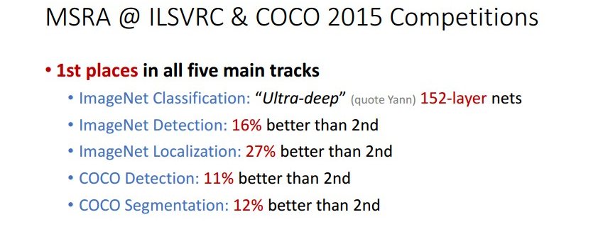
Residual Networks
Able to train very deep networks
Deeper networks do better than shallow networks (as expected)
Swept 1st place in all ILSVRC and COCO 2015 competitions
Still widely used today!
He et al, “Deep Residual Learning for Image Recognition”, CVPR 2016

Slide 87
Improving Residual Networks: Block Design
Original ResNet block
“Pre-Activation” ResNet Block
ReLU
Note ReLU after residual:
Cannot actually learn identity function since outputs are nonnegative!
Conv
Batch Norm
ReLU
Conv
Batch Norm
Note ReLU inside residual:
Can learn true identity function by setting Conv weights to zero!
ReLU
Conv
Batch Norm
ReLU
Conv
Batch Norm
He et al, ”Identity mappings in deep residual networks”, ECCV 2016

Slide 88
Improving Residual Networks: Block Design
Original ResNet block
“Pre-Activation” ResNet Block
ReLU
Slight improvement in accuracy
(ImageNet top-1 error)
ResNet-152: 21.3 vs 21.1
ResNet-200: 21.8 vs 20.7
Not actually used that much in practice
Conv
Batch Norm
ReLU
Conv
Batch Norm
ReLU
Conv
Batch Norm
ReLU
Conv
Batch Norm
He et al, ”Identity mappings in deep residual networks”, ECCV 2016

Slide 89
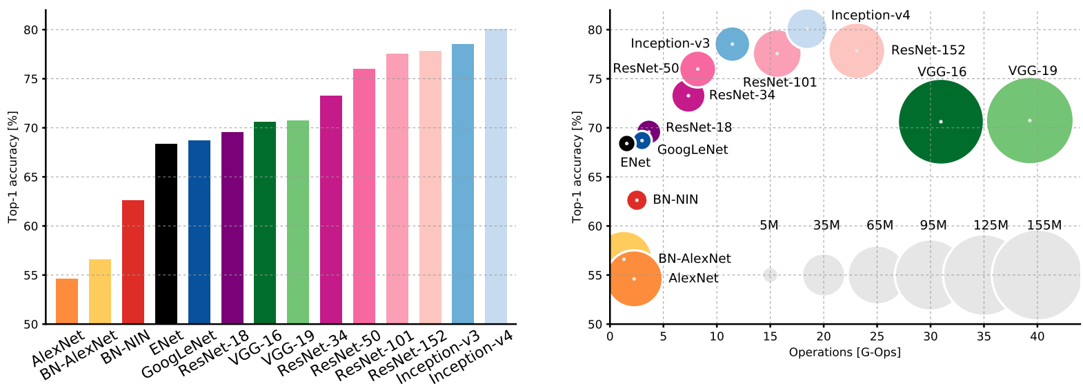
Comparing Complexity
BN: batch normalized version
Canziani et al, “An analysis of deep neural network models for practical applications”, 2017

Slide 90
Comparing Complexity
Inception-v4: Resnet + Inception!
BN: batch normalized version
Canziani et al, “An analysis of deep neural network models for practical applications”, 2017

Slide 91
Comparing Complexity
VGG: Highest memory, most operations
BN: batch normalized version
Canziani et al, “An analysis of deep neural network models for practical applications”, 2017

Slide 92
Comparing Complexity
GoogLeNet: Very efficient!
BN: batch normalized version
Canziani et al, “An analysis of deep neural network models for practical applications”, 2017

Slide 93
Comparing Complexity
AlexNet: Low compute, lots of parameters
BN: batch normalized version
Canziani et al, “An analysis of deep neural network models for practical applications”, 2017

Slide 94
Comparing Complexity
ResNet: Simple design, moderate efficiency, high accuracy
BN: batch normalized version
Canziani et al, “An analysis of deep neural network models for practical applications”, 2017

Slide 95
ImageNet Classification Challenge
Lin et al
Sanchez & Perronnin
Krizhevsky et al (AlexNet)
Zeiler & Fergus
Simonyan & Zisserman (VGG)
Szegedy et al (GoogLeNet)
He et al (ResNet)
Shao et al
Hu et al
(SENet)
Russakovsky et al

Slide 96
ImageNet Classification Challenge
Lin et al
Sanchez & Perronnin
Krizhevsky et al (AlexNet)
Zeiler & Fergus
Simonyan & Zisserman (VGG)
Szegedy et al (GoogLeNet)
He et al (ResNet)
Shao et al
Hu et al
(SENet)
Russakovsky et al

Slide 97
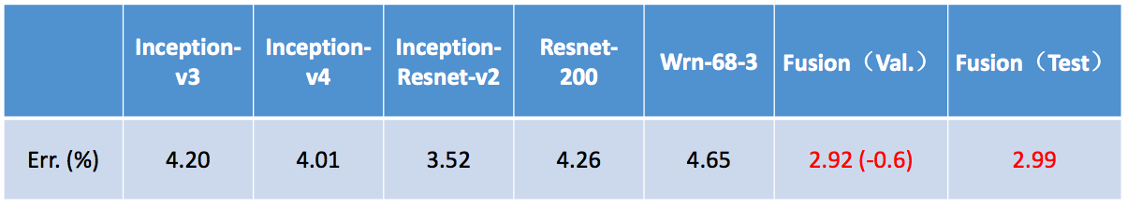
ImageNet 2016 winner: Model Ensembles
Multi-scale ensemble of Inception, Inception-Resnet, Resnet, Wide Resnet models
Shao et al, 2016

Slide 98
Improving ResNets
Conv(1x1, C->4C)
FLOPs:
4HWC²
Conv(3x3, C->C)
FLOPs:
9HWC²
Conv(1x1, 4C->C)
FLOPs:
4HWC²
“Bottleneck”
Residual block
Total FLOPs:
17HWC²

Slide 99
Improving ResNets: ResNeXt
G parallel pathways
Conv(1x1, C->4C)
FLOPs:
4HWC²
Conv(1x1, c->4C)
Conv(1x1, c->4C)
…
Conv(3x3, C->C)
FLOPs:
9HWC²
Conv(3x3, c->c)
Conv(3x3, c->c)
Conv(1x1, 4C->C)
FLOPs:
4HWC²
Conv(1x1, 4C->c)
Conv(1x1, 4C->c)
“Bottleneck”
Residual block
Total FLOPs:
17HWC²
Xie et al, “Aggregated residual transformations for deep neural networks”, CVPR 2017

Slide 100
Improving ResNets: ResNeXt
G parallel pathways
Conv(1x1, C->4C)
FLOPs:
4HWC²
Conv(1x1, c->4C)
Conv(1x1, c->4C)
4HWCc
…
Conv(3x3, C->C)
FLOPs:
9HWC²
9HWc²
Conv(3x3, c->c)
Conv(3x3, c->c)
Conv(1x1, 4C->C)
FLOPs:
4HWC²
Conv(1x1, 4C->c)
Conv(1x1, 4C->c)
4HWCc
Total FLOPs:
(8Cc + 9c²)*HWG
“Bottleneck”
Residual block
Total FLOPs:
17HWC²
Xie et al, “Aggregated residual transformations for deep neural networks”, CVPR 2017

Slide 101
Improving ResNets: ResNeXt
G parallel pathways
Conv(1x1, C->4C)
FLOPs:
4HWC²
Conv(1x1, c->4C)
Conv(1x1, c->4C)
4HWCc
…
Conv(3x3, C->C)
FLOPs:
9HWC²
9HWc²
Conv(3x3, c->c)
Conv(3x3, c->c)
Conv(1x1, 4C->C)
FLOPs:
4HWC²
Conv(1x1, 4C->c)
Conv(1x1, 4C->c)
4HWCc
Total FLOPs:
(8Cc + 9c²)*HWG
“Bottleneck”
Residual block
Total FLOPs:
17HWC²
Equal cost when
9Gc² + 8GCc – 17C² = 0
Example: C=64, G=4, c=24; C=64, G=32, c=4
Xie et al, “Aggregated residual transformations for deep neural networks”, CVPR 2017

Slide 102
Grouped Convolution
Convolution with groups=1:
Normal convolution
Input: C_{in} x H x W
Weight: C_{out} x C_{in} x K x K
Output: C_{out} x H’ x W’
FLOPs: C_{out}C_{in}K²HW
All convolutional kernels touch all C_{in} channels of the input

Slide 103
Grouped Convolution
Convolution with groups=2:
Two parallel convolution layers that work on half the channels
Convolution with groups=1:
Normal convolution
Input: C_{in} x H x W
Weight: C_{out} x C_{in} x K x K
Output: C_{out} x H’ x W’
FLOPs: C_{out}C_{in}K²HW
All convolutional kernels touch all C_{in} channels of the input
Input: C_{in} x H x W
Split
Group 1:
(C_{in} / 2) x H x W
Group 2:
(C_{in} / 2) x H x W
Conv(K x K, C_{in}/2 -> C_{out}/2)
Conv(K x K, C_{in}/2 -> C_{out}/2)
Out 1:
(C_{out} / 2) x H’ x W’
Out 2:
(C_{out} / 2) x H’ x W’
Concat
Output: C_{out} x H’ x W’

Slide 104
Grouped Convolution
Convolution with groups=1:
Normal convolution
Input: C_{in} x H x W
Weight: C_{out} x C_{in} x K x K
Output: C_{out} x H’ x W’
FLOPs: C_{out}C_{in}K²HW
All convolutional kernels touch all C_{in} channels of the input
Convolution with groups=G:
G parallel conv layers; each “sees” C_{in}/G input channels and produces C_{out}/G output channels
Input: C_{in} x H x W
Split to G x [(C_{in} / G) x H x W]
Weight: G x (C_{out} / G) x (C_{in} x G) x K x K
G parallel convolutions
Output: G x [(C_{out} / G) x H’ x W’]
Concat to C_{out} x H’ x W’
FLOPs: C_{out}C_{in}K²HW/G

Slide 105
Grouped Convolution
Convolution with groups=1:
Normal convolution
Input: C_{in} x H x W
Weight: C_{out} x C_{in} x K x K
Output: C_{out} x H’ x W’
FLOPs: C_{out}C_{in}K²HW
All convolutional kernels touch all C_{in} channels of the input
Convolution with groups=G:
G parallel conv layers; each “sees” C_{in}/G input channels and produces C_{out}/G output channels
Input: C_{in} x H x W
Split to G x [(C_{in} / G) x H x W]
Weight: G x (C_{out} / G) x (C_{in} x G) x K x K
G parallel convolutions
Output: G x [(C_{out} / G) x H’ x W’]
Concat to C_{out} x H’ x W’
FLOPs: C_{out}C_{in}K²HW/G
Depthwise Convolution
Special case: G=C_{in}, C_{out} = nC_{in}
Each input channel is convolved with n different K x K filters to produce n output channels

Slide 106
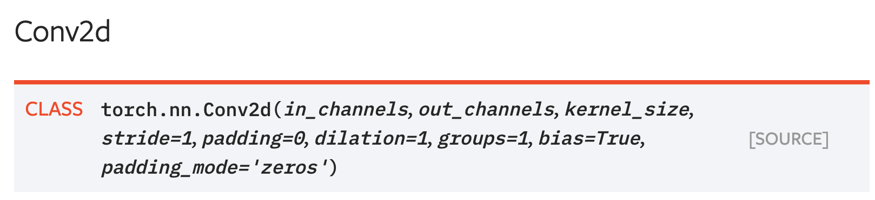
Grouped Convolution in PyTorch
PyTorch convolution gives an option for groups!

Slide 107
Improving ResNets: ResNeXt
G parallel pathways
Equivalent formulation with grouped convolution
Conv(1x1, Gc->4C)
Conv(1x1, c->4C)
Conv(1x1, c->4C)
4HWCc
Conv(3x3, Gc->Gc, groups=G)
…
9HWc²
Conv(3x3, c->c)
Conv(3x3, c->c)
Conv(1x1, 4C->Gc)
4HWCc
Conv(1x1, 4C->c)
Conv(1x1, 4C->c)
Total FLOPs:
(8Cc + 9c²)*HWG
ResNeXt block: Grouped convolution
Equal cost when
9Gc² + 8GCc – 17C² = 0
Example: C=64, G=4, c=24; C=64, G=32, c=4
Xie et al, “Aggregated residual transformations for deep neural networks”, CVPR 2017

Slide 108
ResNeXt: Maintain computation by adding groups!
Model | Groups | Group width | Top-1 Error
ResNet-50 | 1 | 64 | 23.9
ResNeXt-50 | 2 | 40 | 23
ResNeXt-50 | 4 | 24 | 22.6
ResNeXt-50 | 8 | 14 | 22.3
ResNeXt-50 | 32 | 4 | 22.2
Model | Groups | Group width | Top-1 Error
ResNet-101 | 1 | 64 | 22.0
ResNeXt-101 | 2 | 40 | 21.7
ResNeXt-101 | 4 | 24 | 21.4
ResNeXt-101 | 8 | 14 | 21.3
ResNeXt-101 | 32 | 4 | 21.2
Adding groups improves performance with same computational complexity!
Xie et al, “Aggregated residual transformations for deep neural networks”, CVPR 2017

Slide 109
ImageNet Classification Challenge
Lin et al
Sanchez & Perronnin
Krizhevsky et al (AlexNet)
Zeiler & Fergus
Simonyan & Zisserman (VGG)
Szegedy et al (GoogLeNet)
He et al (ResNet)
Shao et al
Hu et al
(SENet)
Russakovsky et al

Slide 110
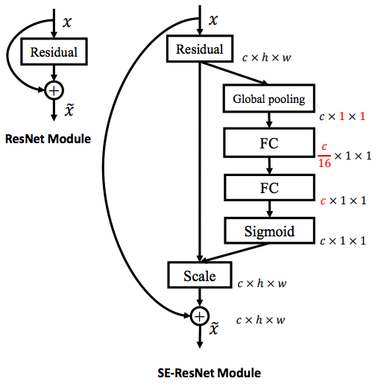
Squeeze-and-Excitation Networks
Adds a ”Squeeze-and-excite” branch to each residual block that performs global pooling, full-connected layers, and multiplies back onto feature map
Adds global context to each residual block!
Won ILSVRC 2017 with ResNeXt-152-SE
Hu et al, “Squeeze-and-Excitation networks”, CVPR 2018

Slide 111
ImageNet Classification Challenge
Completion of the challenge:
Annual ImageNet competition no longer held after 2017 -> now moved to Kaggle.
Lin et al
Sanchez & Perronnin
Krizhevsky et al (AlexNet)
Zeiler & Fergus
Simonyan & Zisserman (VGG)
Szegedy et al (GoogLeNet)
He et al (ResNet)
Shao et al
Hu et al
(SENet)
Russakovsky et al

Slide 112
Densely Connected Neural Networks
Softmax
FC
1x1 conv, 64
Pool
Dense blocks where each layer is connected to every other layer in feedforward fashion
Alleviates vanishing gradient, strengthens feature propagation, encourages feature reuse
Concat
Dense Block 3
Conv
1x1 conv, 64
Pool
Conv
Concat
Dense Block 2
Conv
Conv
Pool
Concat
Conv
Conv
Dense Block 1
Conv
Input
Input
Dense Block
Huang et al, “Densely connected neural networks”, CVPR 2017

Slide 113
MobileNets: Tiny Networks (For Mobile Devices)
Standard Convolution Block
Total cost: 9C²HW
Depthwise Separable Convolution
Total cost: (9C + C²)HW
ReLU
ReLU
Batch Norm
Batch Norm
C²HW
Conv(1x1, C->C)
“Pointwise Convolution”
Conv(3x3, C->C)
9C²HW
ReLU
Batch Norm
Speedup = 9C²/(9C+C²)
= 9C/(9+C)
=> 9 (as C->inf)
9CHW
Conv(3x3, C->C,
groups=C)
“Depthwise Convolution”
Howard et al, “MobileNets: Efficient Convolutional Neural Networks for Mobile Vision Applications”, 2017

Slide 114
MobileNets: Tiny Networks (For Mobile Devices)
Depthwise Separable Convolution
Total cost: (9C + C²)HW
Also related:
ShuffleNet: Zhang et al, CVPR 2018
MobileNetV2: Sandler et al, CVPR 2018
ShuffleNetV2: Ma et al, ECCV 2018
ReLU
Batch Norm
C²HW
Conv(1x1, C->C)
“Pointwise Convolution”
ReLU
Batch Norm
9CHW
Conv(3x3, C->C,
groups=C)
“Depthwise Convolution”
Howard et al, “MobileNets: Efficient Convolutional Neural Networks for Mobile Vision Applications”, 2017

Slide 115
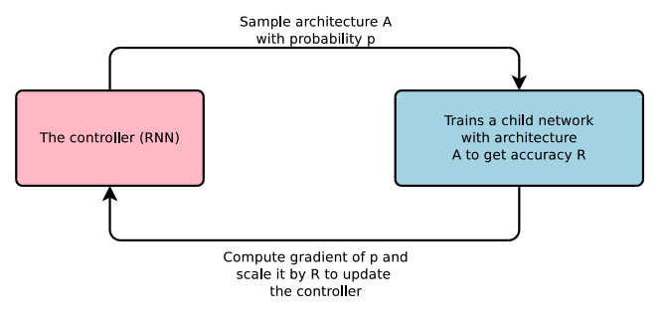
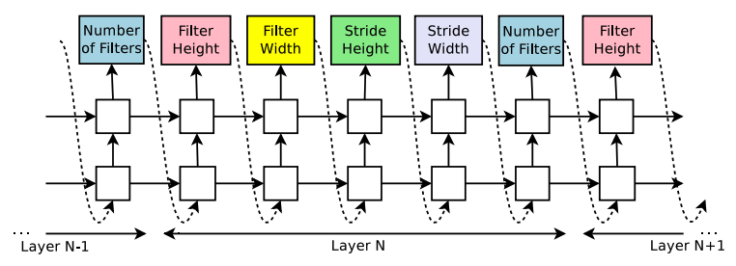
Neural Architecture Search
Designing neural network architectures is hard – let’s automate it!
One network (controller) outputs network architectures
Sample child networks from controller and train them
After training a batch of child networks, make a gradient step on controller network (Using policy gradient)
Over time, controller learns to output good architectures!
Zoph and Le, “Neural Architecture Search with Reinforcement Learning”, ICLR 2017

Slide 116
Neural Architecture Search
Designing neural network architectures is hard – let’s automate it!
One network (controller) outputs network architectures
Sample child networks from controller and train them
After training a batch of child networks, make a gradient step on controller network (Using policy gradient)
Over time, controller learns to output good architectures!
VERY EXPENSIVE!! Each gradient step on controller requires training a batch of child models!
Original paper trained on 800 GPUs for 28 days!
Followup work has focused on efficient search
Zoph and Le, “Neural Architecture Search with Reinforcement Learning”, ICLR 2017

Slide 117
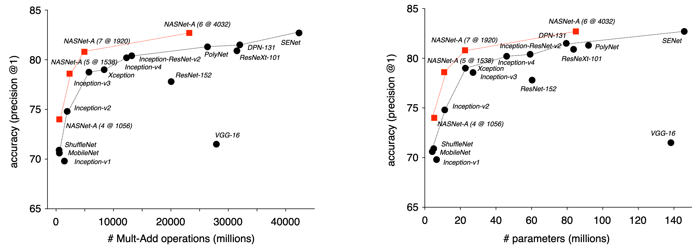
Neural Architecture Search
Neural architecture search can be used to find efficient CNN architectures!
Zoph et al, “Learning Transferable Architectures for Scalable Image Recognition”, CVPR 2018

Slide 118
CNN Architectures Summary
Early work (AlexNet -> ZFNet -> VGG) shows that bigger networks work better
GoogLeNet one of the first to focus on efficiency (aggressive stem, 1x1 bottleneck convolutions, global avg pool instead of FC layers)
ResNet showed us how to train extremely deep networks – limited only by GPU memory! Started to show diminishing returns as networks got bigger
After ResNet: Efficient networks became central: how can we improve the accuracy without increasing the complexity?
Lots of tiny networks aimed at mobile devices: MobileNet, ShuffleNet, etc
Neural Architecture Search promises to automate architecture design

Slide 119
Which Architecture should I use?
Don’t be a hero. For most problems you should use an off-the-shelf architecture; don’t try to design your own!
If you just care about accuracy, ResNet-50 or ResNet-101 are great choices
If you want an efficient network (real-time, run on mobile, etc) try MobileNets and ShuffleNets

Slide 120
Network architectures
Batch normalization
CNN architectures
Visualization
Adversarial examples
Deconvolution and U-Nets
Deep learning software
Sky
Cow
Grass
Notes:
The order in the lecture is a little different from the book, because Justin Johnson’s lectures follow a different order

Slide 121
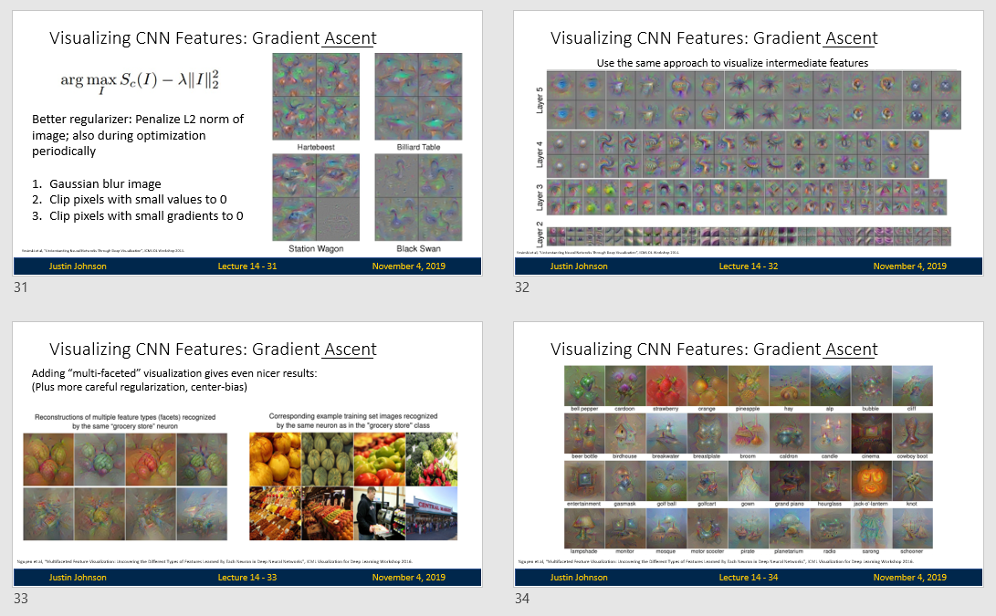
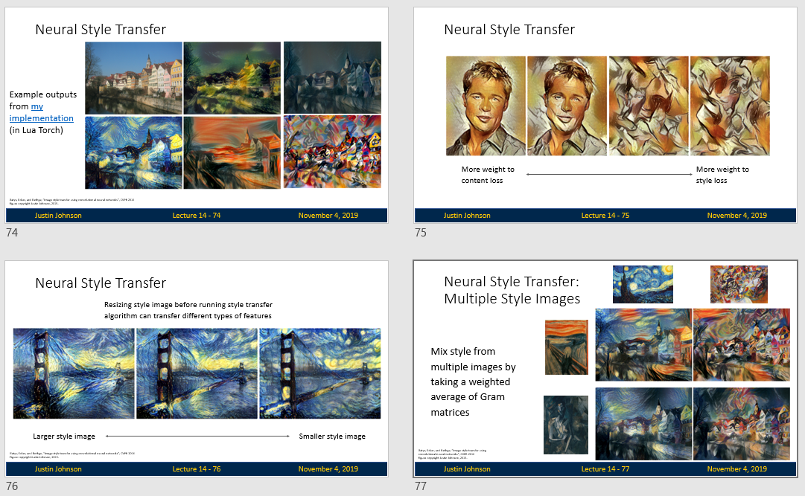
Lecture 14:
Visualizing
CNNs
(see slides on Web site)

Slide 122
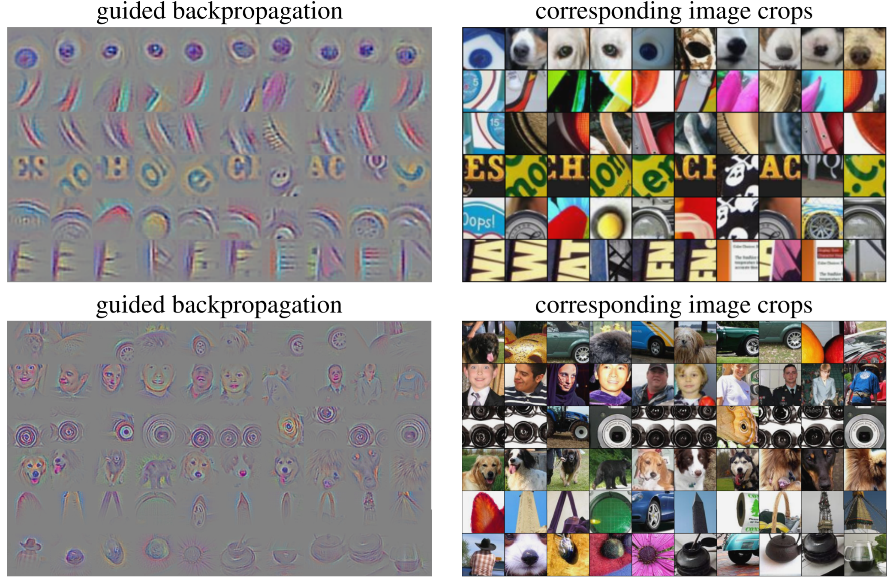
Intermediate Features via (guided) backprop
Maximally activating patches
(Each row is a different neuron)
Guided Backprop
Zeiler and Fergus, “Visualizing and Understanding Convolutional Networks”, ECCV 2014
Springenberg et al, “Striving for Simplicity: The All Convolutional Net”, ICLR Workshop 2015
Figure copyright Jost Tobias Springenberg, Alexey Dosovitskiy, Thomas Brox, Martin Riedmiller, 2015; reproduced with permission.

Slide 123
Visualizing CNN Features: Gradient Ascent
(Guided) backprop:
Find the part of an image that a neuron responds to
Gradient ascent:
Generate a synthetic image that maximally activates a neuron
I* = arg max_{I} f(I) + R(I)
Neuron value
Natural image regularizer

Slide 124

Visualizing CNN Features: Gradient Ascent
Initialize image to zeros
score for class c (before Softmax)
zero image
Repeat:
2. Forward image to compute current scores
3. Backprop to get gradient of neuron value with respect to image pixels
4. Make a small update to the image

Slide 125
Visualizing CNN Features: Gradient Ascent
Simple regularizer: Penalize L2 norm of generated image
Simonyan, Vedaldi, and Zisserman, “Deep Inside Convolutional Networks: Visualising Image Classification Models and Saliency Maps”, ICLR Workshop 2014.
Figures copyright Karen Simonyan, Andrea Vedaldi, and Andrew Zisserman, 2014; reproduced with permission.

Slide 126
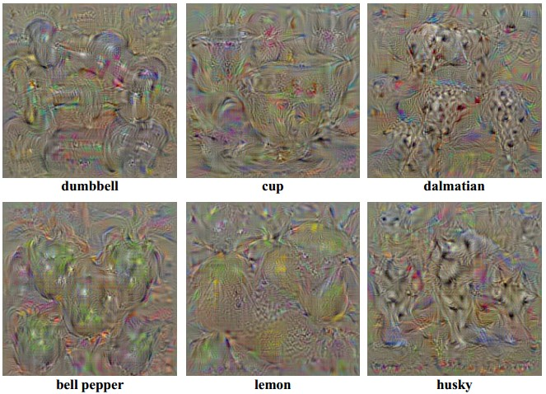
Visualizing CNN Features: Gradient Ascent
Simple regularizer: Penalize L2 norm of generated image
Simonyan, Vedaldi, and Zisserman, “Deep Inside Convolutional Networks: Visualising Image Classification Models and Saliency Maps”, ICLR Workshop 2014.
Figures copyright Karen Simonyan, Andrea Vedaldi, and Andrew Zisserman, 2014; reproduced with permission.

Slide 127
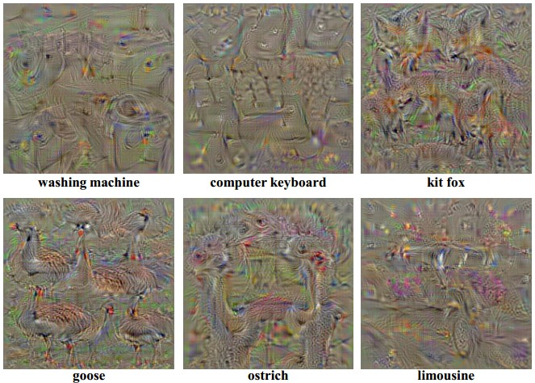
Visualizing CNN Features: Gradient Ascent
Simple regularizer: Penalize L2 norm of generated image
Simonyan, Vedaldi, and Zisserman, “Deep Inside Convolutional Networks: Visualising Image Classification Models and Saliency Maps”, ICLR Workshop 2014.
Figures copyright Karen Simonyan, Andrea Vedaldi, and Andrew Zisserman, 2014; reproduced with permission.

Slide 128
Visualizing CNN Features: Gradient Ascent
Better regularizer: Penalize L2 norm of image; also during optimization periodically
Gaussian blur image
Clip pixels with small values to 0
Clip pixels with small gradients to 0
Yosinski et al, “Understanding Neural Networks Through Deep Visualization”, ICML DL Workshop 2014.

Slide 129
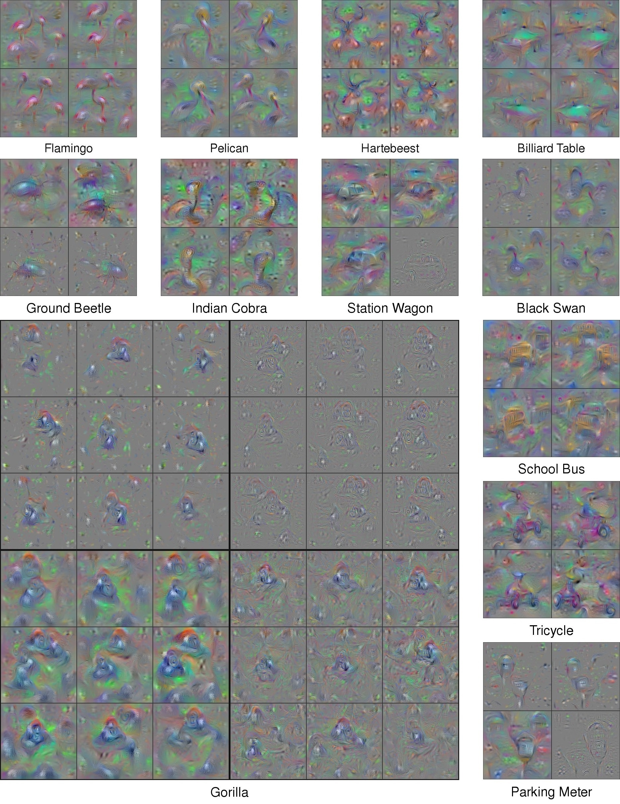
Visualizing CNN Features: Gradient Ascent
Better regularizer: Penalize L2 norm of image; also during optimization periodically
Gaussian blur image
Clip pixels with small values to 0
Clip pixels with small gradients to 0
Yosinski et al, “Understanding Neural Networks Through Deep Visualization”, ICML DL Workshop 2014.

Slide 130
Visualizing CNN Features: Gradient Ascent
Better regularizer: Penalize L2 norm of image; also during optimization periodically
Gaussian blur image
Clip pixels with small values to 0
Clip pixels with small gradients to 0
Yosinski et al, “Understanding Neural Networks Through Deep Visualization”, ICML DL Workshop 2014.

Slide 131
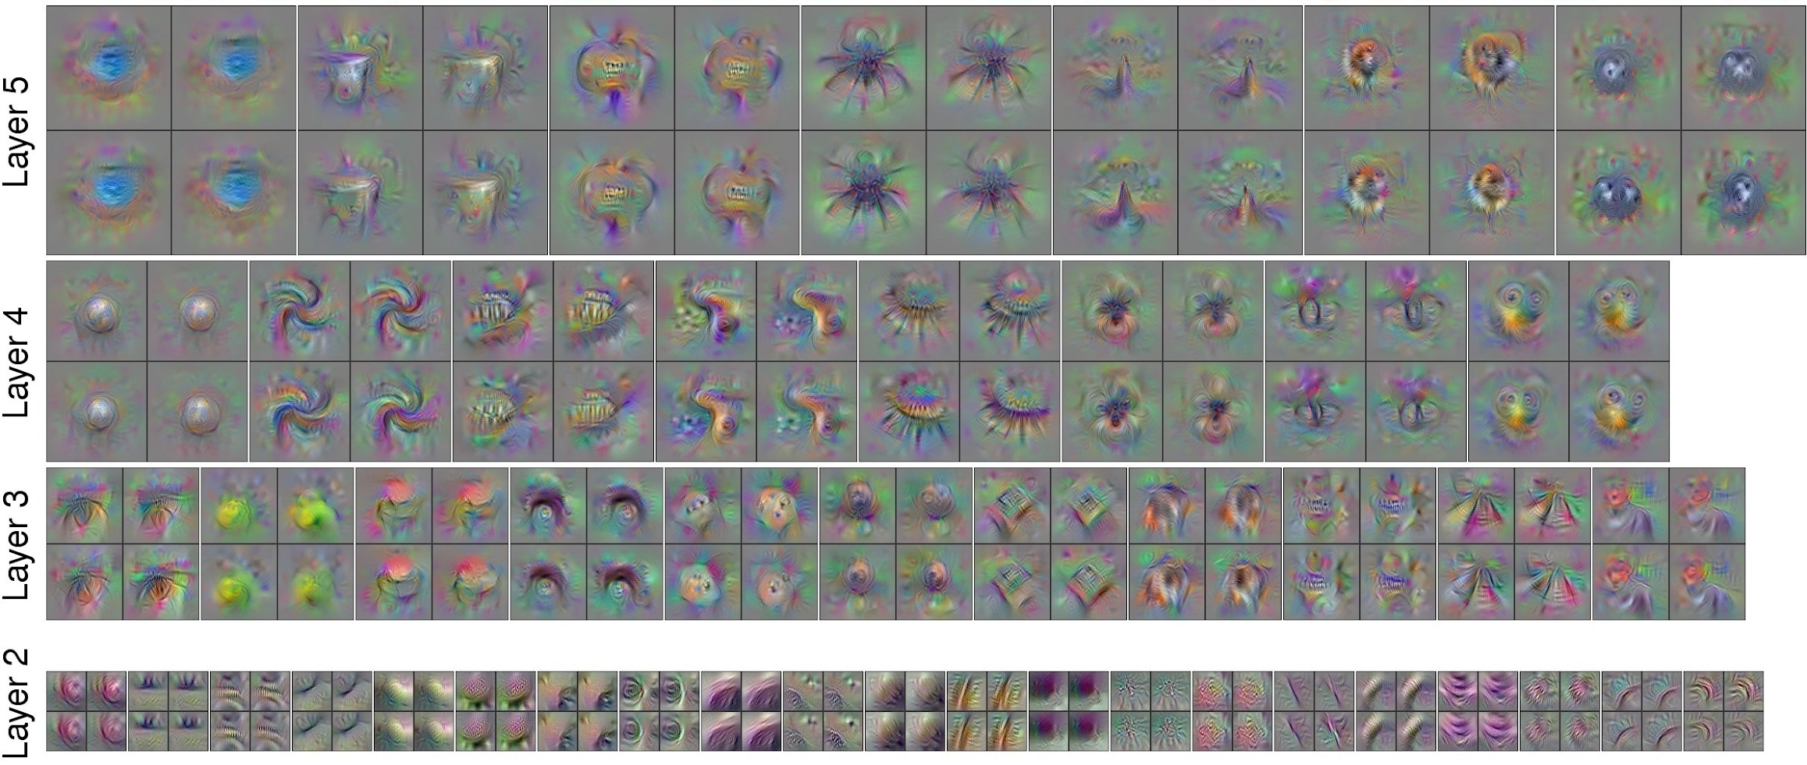
Visualizing CNN Features: Gradient Ascent
Use the same approach to visualize intermediate features
Yosinski et al, “Understanding Neural Networks Through Deep Visualization”, ICML DL Workshop 2014.

Slide 132
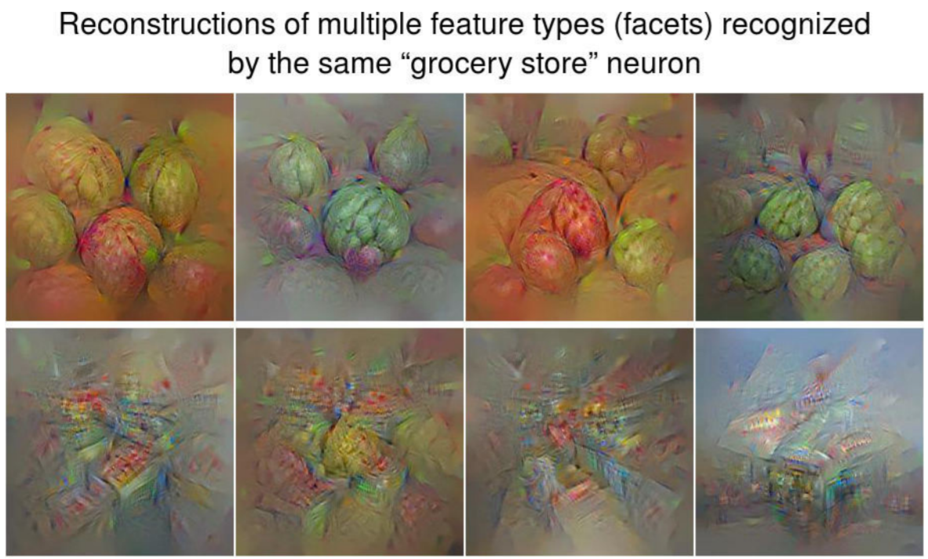
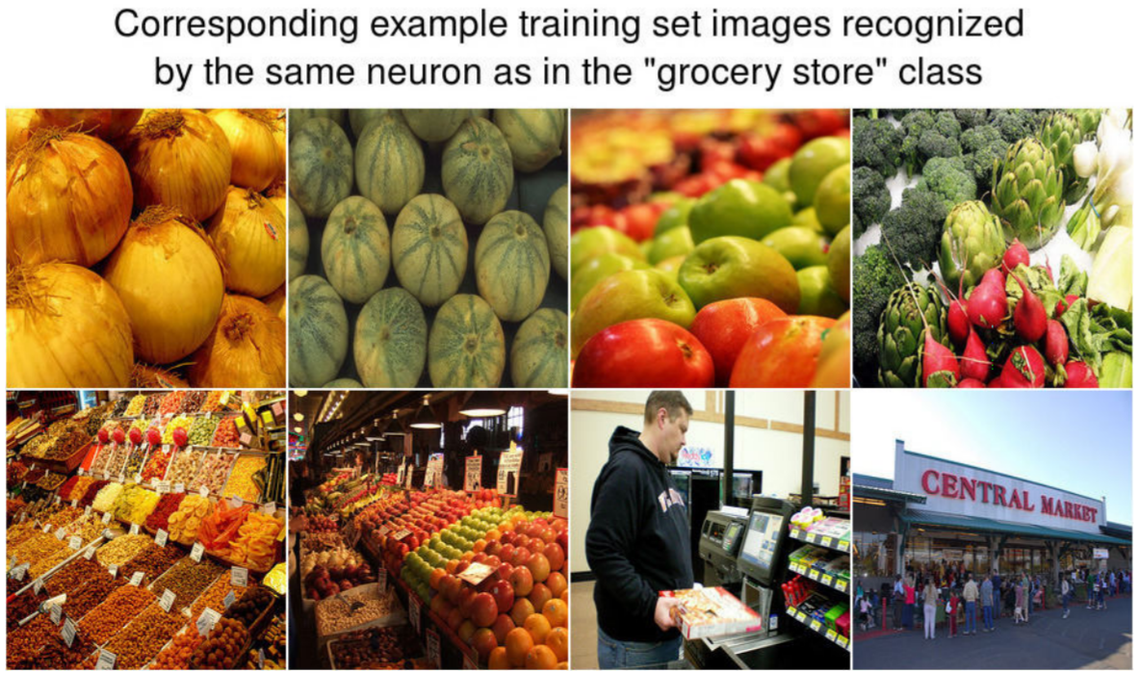
Visualizing CNN Features: Gradient Ascent
Adding “multi-faceted” visualization gives even nicer results:
(Plus more careful regularization, center-bias)
Nguyen et al, “Multifaceted Feature Visualization: Uncovering the Different Types of Features Learned By Each Neuron in Deep Neural Networks”, ICML Visualization for Deep Learning Workshop 2016.

Slide 133
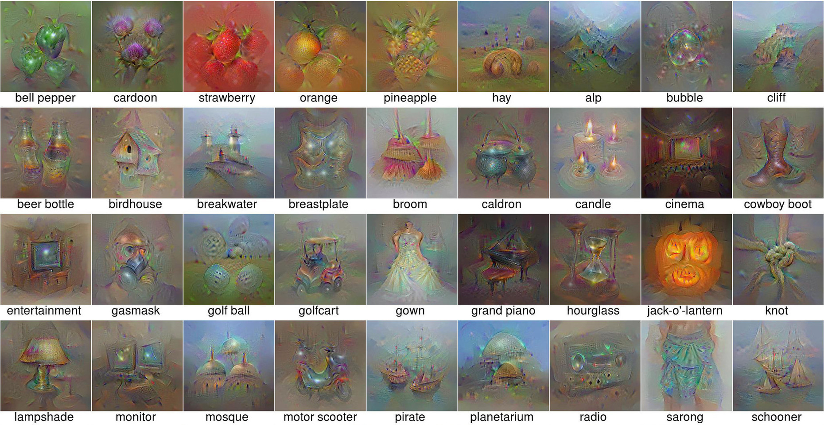
Visualizing CNN Features: Gradient Ascent
Nguyen et al, “Multifaceted Feature Visualization: Uncovering the Different Types of Features Learned By Each Neuron in Deep Neural Networks”, ICML Visualization for Deep Learning Workshop 2016.

Slide 134
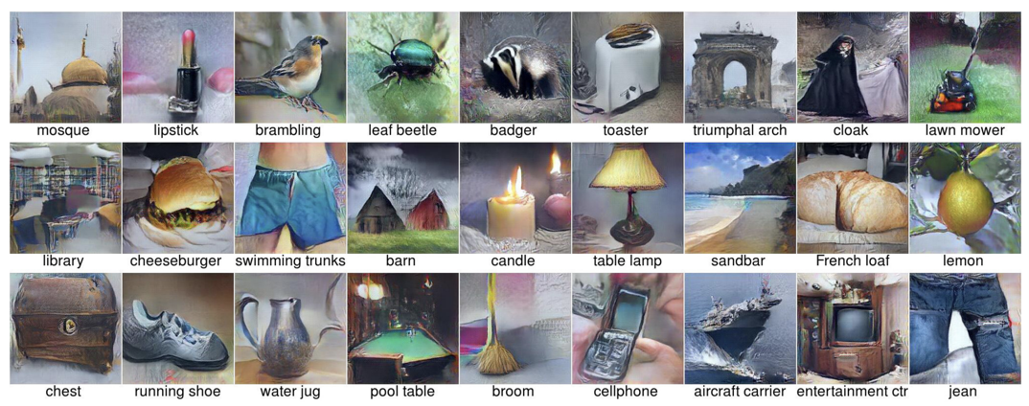
Visualizing CNN Features: Gradient Ascent
Nguyen et al, “Synthesizing the preferred inputs for neurons in neural networks via deep generator networks,” NIPS 2016

Slide 135
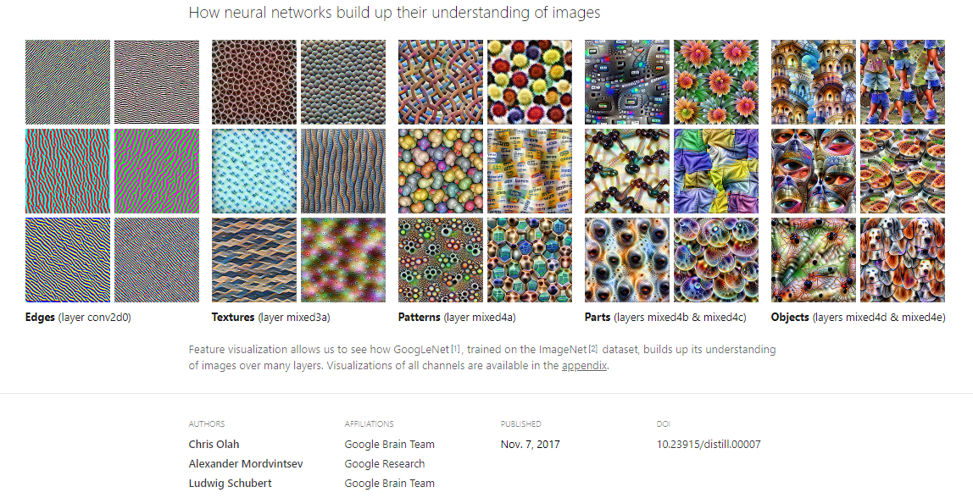
Feature visualization by optimization
https://distill.pub/2017/feature-visualization/
Notes:
The order in the lecture is a little different from the book, because Justin Johnson’s lectures follow a different order

Slide 136
Adversarial Examples
Start from an arbitrary image
Pick an arbitrary category
Modify the image (via gradient ascent)
to maximize the class score
Stop when the network is fooled
Szegedy et al, “Intriguing properties of neural networks”, 2013

Slide 137
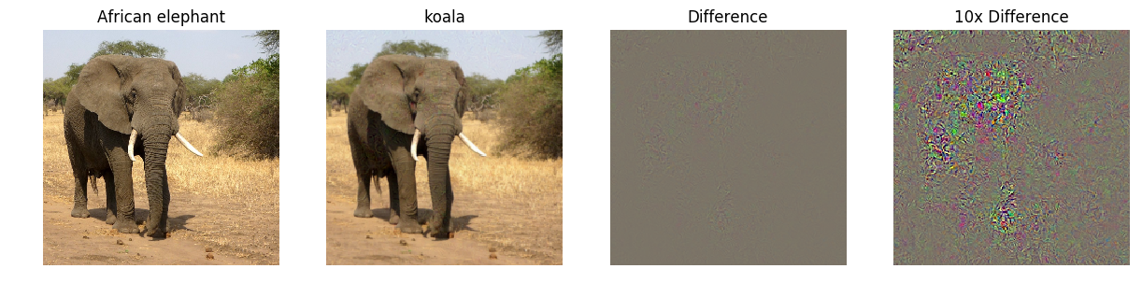

Adversarial Examples
Boat image is CC0 public domain
Elephant image is CC0 public domain

Slide 138
Network architectures
Batch normalization
CNN architectures
Visualization
Adversarial examples
Deconvolution and U-Nets
Deep learning software
Sky
Cow
Grass
Notes:
The order in the lecture is a little different from the book, because Justin Johnson’s lectures follow a different order

Slide 139
Lecture 16:
Semantic Segmentation

Slide 140



Computer Vision Tasks: Semantic Segmentation
Classification
Semantic
Segmentation
Object
Detection
Instance Segmentation
CAT
GRASS, CAT, TREE, SKY
DOG, DOG, CAT
DOG, DOG, CAT
No spatial extent
No objects, just pixels
Multiple Objects

Slide 141

Semantic Segmentation
This image is CC0 public domain
Label each pixel in the image with a category label
Don’t differentiate instances, only care about pixels
Sky
Trees
Sky
Trees
Cat
Cow
Grass
Grass

Slide 142
Semantic Segmentation Idea: Sliding Window
Extract patch
Classify center pixel with CNN
Full image
Cow
Cow
Grass
Farabet et al, “Learning Hierarchical Features for Scene Labeling,” TPAMI 2013
Pinheiro and Collobert, “Recurrent Convolutional Neural Networks for Scene Labeling”, ICML 2014

Slide 143
Semantic Segmentation Idea: Sliding Window
Extract patch
Classify center pixel with CNN
Full image
Cow
Cow
Grass
Problem: Very inefficient! Not reusing shared features between overlapping patches
Farabet et al, “Learning Hierarchical Features for Scene Labeling,” TPAMI 2013
Pinheiro and Collobert, “Recurrent Convolutional Neural Networks for Scene Labeling”, ICML 2014

Slide 144
Semantic Segmentation: Fully Convolutional Network
Design a network as a bunch of convolutional layers to make predictions for pixels all at once!
Conv
Conv
Conv
Conv
argmax
Input:
3 x H x W
Scores:
C x H x W
Predictions:
H x W
Convolutions:
D x H x W
Loss function: Per-Pixel cross-entropy
Long et al, “Fully convolutional networks for semantic segmentation”, CVPR 2015

Slide 145
Semantic Segmentation: Fully Convolutional Network
Design a network as a bunch of convolutional layers to make predictions for pixels all at once!
Conv
Conv
Conv
Conv
argmax
Input:
3 x H x W
Problem #1: Effective receptive field size is linear in number of conv layers: With L 3x3 conv layers, receptive field is 1+2L
Long et al, “Fully convolutional networks for semantic segmentation”, CVPR 2015

Slide 146
Semantic Segmentation: Fully Convolutional Network
Design a network as a bunch of convolutional layers to make predictions for pixels all at once!
Conv
Conv
Conv
Conv
argmax
Input:
3 x H x W
Problem #1: Effective receptive field size is linear in number of conv layers: With L 3x3 conv layers, receptive field is 1+2L
Problem #2: Convolution on high res images is expensive! Recall ResNet stem aggressively downsamples
Long et al, “Fully convolutional networks for semantic segmentation”, CVPR 2015

Slide 147
Semantic Segmentation: Fully Convolutional Network
Design network as a bunch of convolutional layers, with downsampling and upsampling inside the network!
Med-res:
D₂ x H/4 x W/4
Med-res:
D₂ x H/4 x W/4
Low-res:
D₃ x H/4 x W/4
Input:
3 x H x W
High-res:
D₁ x H/2 x W/2
High-res:
D₁ x H/2 x W/2
Predictions:
H x W
Long, Shelhamer, and Darrell, “Fully Convolutional Networks for Semantic Segmentation”, CVPR 2015
Noh et al, “Learning Deconvolution Network for Semantic Segmentation”, ICCV 2015

Slide 148
Semantic Segmentation: Fully Convolutional Network
Downsampling:
Pooling, strided convolution
Design network as a bunch of convolutional layers, with downsampling and upsampling inside the network!
Upsampling:
???
Med-res:
D₂ x H/4 x W/4
Med-res:
D₂ x H/4 x W/4
Low-res:
D₃ x H/4 x W/4
Input:
3 x H x W
High-res:
D₁ x H/2 x W/2
High-res:
D₁ x H/2 x W/2
Predictions:
H x W
Long, Shelhamer, and Darrell, “Fully Convolutional Networks for Semantic Segmentation”, CVPR 2015
Noh et al, “Learning Deconvolution Network for Semantic Segmentation”, ICCV 2015

Slide 149
In-Network Upsampling: “Unpooling”
Bed of Nails
1
0
2
0
1
2
0
0
0
0
3
4
3
0
4
0
0
0
0
0
Input
C x 2 x 2
Output
C x 4 x 4

Slide 150
In-Network Upsampling: “Unpooling”
Bed of Nails
Nearest Neighbor
1
0
2
0
1
1
2
2
1
2
0
0
0
0
1
2
1
1
2
2
3
4
3
0
4
0
3
4
3
3
4
4
0
0
0
0
3
3
4
4
Input
C x 2 x 2
Output
C x 4 x 4
Input
C x 2 x 2
Output
C x 4 x 4

Slide 151

In-Network Upsampling: Bilinear Interpolation
1.00
1.25
1.75
2.00
1
2
1.50
1.75
2.25
2.50
3
4
2.50
2.75
3.25
3.50
3.00
3.25
3.75
4.00
Input: C x 2 x 2
Output: C x 4 x 4
Use two closest neighbors in x and y to construct linear approximations

Slide 152
In-Network Upsampling: Bicubic Interpolation
0.68
1.02
1.56
1.89
1
2
1.35
1.68
2.23
2.56
3
4
2.44
2.77
3.32
3.65
3.11
3.44
3.98
4.32
Input: C x 2 x 2
Output: C x 4 x 4
Use three closest neighbors in x and y to construct cubic approximations
(This is how we normally resize images!)

Slide 153
In-Network Upsampling: “Max Unpooling”
Max Pooling: Remember which position had the max
Max Unpooling: Place into remembered positions
1
2
6
3
0
0
2
0
3
5
2
1
5
6
Rest of net
1
2
0
1
0
0
1
2
2
1
7
8
3
4
0
0
0
0
7
3
4
8
3
0
0
4
Pair each downsampling layer with an upsampling layer
Noh et al, “Learning Deconvolution Network for Semantic Segmentation”, ICCV 2015

Slide 154
Learnable Upsampling: Transposed Convolution
Recall: Normal 3 x 3 convolution, stride 1, pad 1
Input: 4 x 4
Output: 4 x 4

Slide 155
Learnable Upsampling: Transposed Convolution
Recall: Normal 3 x 3 convolution, stride 1, pad 1
Dot product between input and filter
Input: 4 x 4
Output: 4 x 4

Slide 156
Learnable Upsampling: Transposed Convolution
Recall: Normal 3 x 3 convolution, stride 1, pad 1
Dot product between input and filter
Input: 4 x 4
Output: 4 x 4

Slide 157
Learnable Upsampling: Transposed Convolution
Recall: Normal 3 x 3 convolution, stride 2, pad 1
Input: 4 x 4
Output: 2 x 2

Slide 158
Learnable Upsampling: Transposed Convolution
Recall: Normal 3 x 3 convolution, stride 2, pad 1
Dot product between input and filter
Input: 4 x 4
Output: 2 x 2

Slide 159
Learnable Upsampling: Transposed Convolution
Recall: Normal 3 x 3 convolution, stride 2, pad 1
Dot product between input and filter
Input: 4 x 4
Output: 2 x 2

Slide 160
Learnable Upsampling: Transposed Convolution
Recall: Normal 3 x 3 convolution, stride 2, pad 1
Convolution with stride > 1 is “Learnable Downsampling”
Can we use stride < 1 for “Learnable Upsampling”?
Dot product between input and filter
Input: 4 x 4
Output: 2 x 2

Slide 161
Learnable Upsampling: Transposed Convolution
3 x 3 convolution transpose, stride 2
Input: 2 x 2
Output: 4 x 4

Slide 162
Learnable Upsampling: Transposed Convolution
3 x 3 convolution transpose, stride 2
Weight filter by input value and copy to output
Input: 2 x 2
Output: 4 x 4

Slide 163
Learnable Upsampling: Transposed Convolution
3 x 3 convolution transpose, stride 2
Filter moves 2 pixels in output for every 1 pixel in input
Weight filter by input value and copy to output
Input: 2 x 2
Output: 4 x 4

Slide 164
Learnable Upsampling: Transposed Convolution
Sum where output overlaps
3 x 3 convolution transpose, stride 2
Filter moves 2 pixels in output for every 1 pixel in input
Weight filter by input value and copy to output
Input: 2 x 2
Output: 4 x 4

Slide 165
Learnable Upsampling: Transposed Convolution
Sum where output overlaps
3 x 3 convolution transpose, stride 2
This gives 5x5 output – need to trim one pixel from top and left to give 4x4 output
Weight filter by input value and copy to output
Input: 2 x 2
Output: 4 x 4

Slide 166
Transposed Convolution: 1D example
Input
Filter
Output
ax
Output has copies of filter weighted by input
Stride 2: Move 2 pixels output for each pixel in input
Sum at overlaps
x
ay
a
y
az+bx
b
z
by
bz

Slide 167
Transposed Convolution: 1D example
Input
Filter
Output
This has many names:
- Deconvolution (bad)!
- Upconvolution
- Fractionally strided convolution
- Backward strided convolution
- Transposed Convolution
(best name)
ax
x
ay
a
y
az+bx
b
z
by
bz

Slide 168


Convolution as Matrix Multiplication (1D Example)
We can express convolution in terms of a matrix multiplication
Example: 1D conv, kernel size=3, stride=1, padding=1

Slide 169


Convolution as Matrix Multiplication (1D Example)
We can express convolution in terms of a matrix multiplication
Transposed convolution multiplies by the transpose of the same matrix:
Example: 1D conv, kernel size=3, stride=1, padding=1
When stride=1, transposed conv is just a regular conv (with different padding rules)

Slide 170

Convolution as Matrix Multiplication (1D Example)
We can express convolution in terms of a matrix multiplication
Transposed convolution multiplies by the transpose of the same matrix:
Example: 1D conv, kernel size=3, stride=2, padding=1

Slide 171

Convolution as Matrix Multiplication (1D Example)
We can express convolution in terms of a matrix multiplication
Transposed convolution multiplies by the transpose of the same matrix:
Example: 1D conv, kernel size=3, stride=2, padding=1
When stride>1, transposed convolution cannot be expressed as normal conv

Slide 172
Semantic Segmentation: Fully Convolutional Network
Design network as a bunch of convolutional layers, with downsampling and upsampling inside the network!
Upsampling:
Iinterpolation, transposed conv
Downsampling:
Pooling, strided convolution
Med-res:
D₂ x H/4 x W/4
Med-res:
D₂ x H/4 x W/4
Low-res:
D₃ x H/4 x W/4
Input:
3 x H x W
High-res:
D₁ x H/2 x W/2
High-res:
D₁ x H/2 x W/2
Predictions:
H x W
Loss function: Per-Pixel cross-entropy
Long, Shelhamer, and Darrell, “Fully Convolutional Networks for Semantic Segmentation”, CVPR 2015
Noh et al, “Learning Deconvolution Network for Semantic Segmentation”, ICCV 2015

Slide 173

U-Nets
Skip connections between
encoding and decoding stages
Widely used in image denoising,
inpainting, flow, stereo, …
Notes:
The order in the lecture is a little different from the book, because Justin Johnson’s lectures follow a different order

Slide 174

Deep Learning Software
Will cover this May 5 (CSE 576 Lecture 11)
JIT for HW4

Slide 175
Summary: Network architectures
Batch normalization
CNN architectures
Visualization
Adversarial examples
Deconvolution and U-Nets
Deep learning software
Sky
Cow
Grass
Notes:
The order in the lecture is a little different from the book, because Justin Johnson’s lectures follow a different order

