Slide 1
Visual Motion Estimation
Harpreet S Sawhney
Microsoft / Vision & Mixed Reality
May 14th , 2020

Slide 2
Information Content in Dynamic Imagery ...extract information behind pixel data...
Foreground
Background
Temporal
Persistence
Scene
Geometry
Segment,Track,Fingerprint
Moving Objects
Layers with 2D/3D
Scene Models
Layers & Mosaics
Motion Analysis provides
Compact Representation for Manipulation & Recognition of Scene Content

Slide 3
Motion is a powerful perceptual cue
via Svetlana
Sometimes, it is the only cue

Slide 4
Motion is a powerful perceptual cue
via Svetlana
Even “impoverished” motion data can evoke a strong percept
G. Johansson, “Visual Perception of Biological Motion and a Model For Its Analysis", Perception and Psychophysics 14, 201-211, 1973.

Slide 5
Motion is a powerful perceptual cue
via Svetlana
Even “impoverished” motion data can evoke a strong percept
G. Johansson, “Visual Perception of Biological Motion and a Model For Its Analysis", Perception and Psychophysics 14, 201-211, 1973.

Slide 6
Motion Field & Optical Flow
Y
w
Motion Field : 2D projections of 3D
y
displacement vectors due to camera
Ty
and/or object motion
w
x
X
^{p’}
P
’
p
Tx
P
w
z
Optical Flow :
I
m
age displacement field
that measures the apparent motion of
Tz
brightness patterns

Slide 7
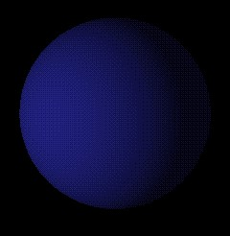
Motion Field vs. Optical Flow
Lambertian ball rotating in 3D
Motion Field ?
Optical Flow ?
Courtesy : Michael Black @ Brown.edu
Image : http://www.evl.uic.edu/aej/488/

Slide 8
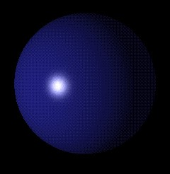
Motion Field vs. Optical Flow
Stationary Lambertian ball with a moving point light source
Motion Field ?
Optical Flow ?
Courtesy : Michael Black @ Brown.edu
Image : http://www.evl.uic.edu/aej/488/

Slide 9
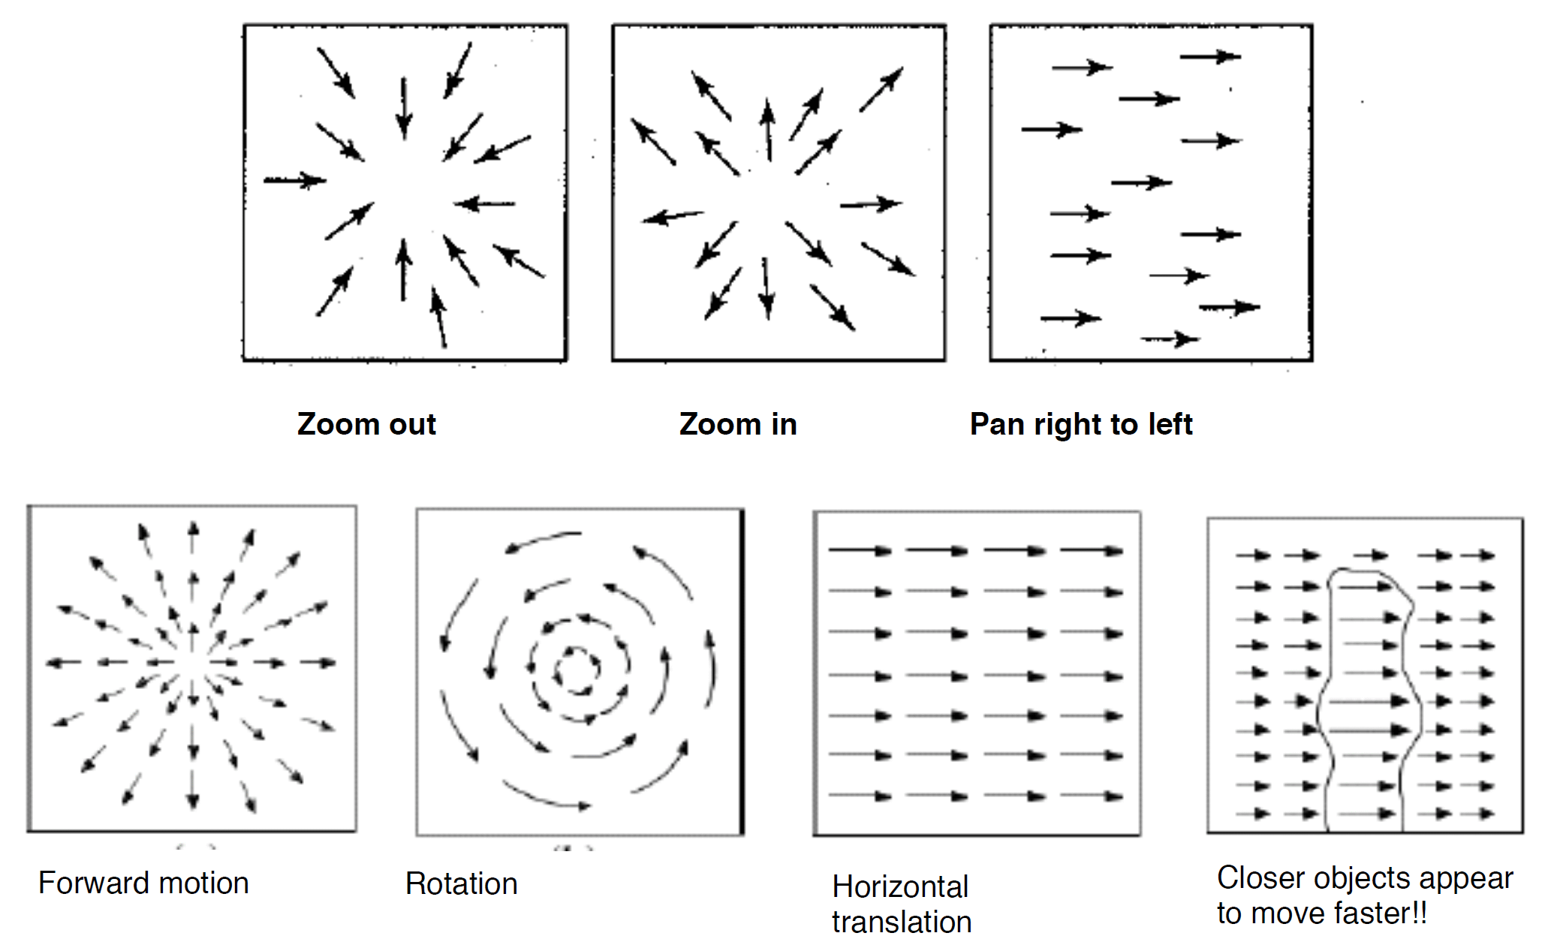
Typical Motion Fields
via Jason Corso

Slide 10
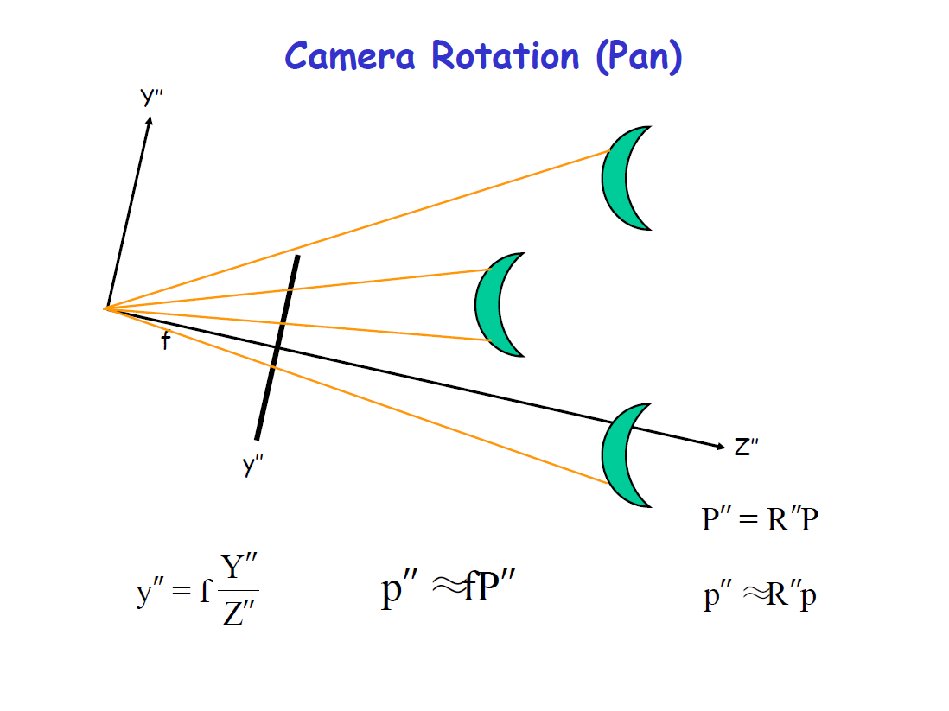
Motion Field : Induced by Camera Motion
3D Rotations : Pan / Tilt

Slide 11
3D Translations

Slide 12
3D Translations
$$y^{′}−y=f\frac{T_{y}}{Z}$$
$$y^{′}−y=−y^{′}\frac{T_{z}}{Z}$$

Slide 13
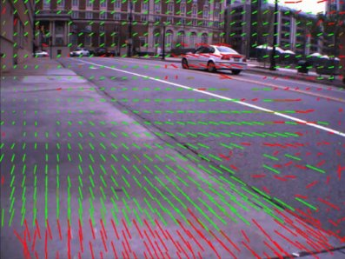
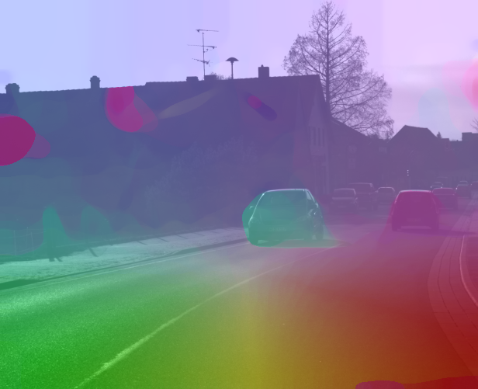
Sparse Correspondences versus Dense Optical Flow
2D Flow Vectors
Hue (Angle) – Saturation (Length) Visualization

Slide 14
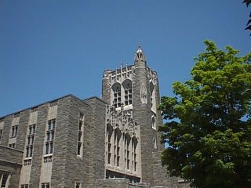
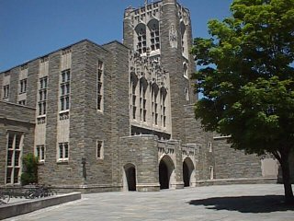
Computing Optical Flow
$$I_{1}(p^{′})$$
$$I_{2}(p)$$
$$p$$
$$p−u(p)$$
Brightness Constancy: Appearance of a point / patch remains constant under small motions
$$I_{2}(p)=I_{1}(p−u(p;Θ))=I_{1}(p^{′})$$
Images separated
by
time, space,
sensor types

Slide 15
Computing Optical Flow
$$I_{1}(p^{′})$$
$$I_{2}(p)$$
$$p$$
$$p−u(p)$$
Brightness Constancy: Appearance of a point / patch remains constant under small motions
$$I_{2}(p)=I_{1}(p−u(p;Θ))=I_{1}(p^{′})$$
Images separated
by
time, space,
sensor types
Reference
Coordinate
System

Slide 16
Computing Optical Flow
$$I_{1}(p^{′})$$
$$I_{2}(p)$$
$$p$$
$$p−u(p)$$
Brightness Constancy: Appearance of a point / patch remains constant under small motions
$$I_{2}(p)=I_{1}(p−u(p;Θ))=I_{1}(p^{′})$$
Images separated
by
time, space,
sensor types
Reference
Coordinate
System
Optical
Flow

Slide 17
Computing Optical Flow
$$I_{1}(p^{′})$$
$$I_{2}(p)$$
$$p$$
$$p−u(p)$$
Brightness Constancy: Appearance of a point / patch remains constant under small motions
$$I_{2}(p)=I_{1}(p−u(p;Θ))=I_{1}(p^{′})$$
Images separated
by
time, space,
sensor types
Reference
Coordinate
System
Optical
Flow
Flow
Parameters

Slide 18
Computing Optical Flow: Basic Constraint
$$I_{1}(p^{′})$$
$$I_{2}(p)$$
$$p$$
$$p−u(p)$$
Brightness Constancy: Appearance of a point / patch remains constant under small motions
$$I_{2}(p;t)=I_{1}(p−u\left(p;Θ\right);t−1)=I_{1}(p^{′};t−1)$$
Using Taylor series expansion and rearranging terms (dropping t for simplicity)
$\left(I_{2}\left(p\right)−I_{1}\left(p\right)\right)+∇I_{1} {(p)}^{T}$ $u\left(p;Θ\right)$ = 0
$δI(p)+∇I_{1} {(p)}^{T}$ $u\left(p;Θ\right)$ = 0

Slide 19
Computing Optical Flow: Basic Constraint
Using Taylor series expansion and rearranging terms (dropping t for simplicity)
$\left(I_{2}\left(p\right)−I_{1}\left(p\right)\right)+∇I_{1} {(p)}^{T}$ $u\left(p;Θ\right)$ = 0
$δI(p)+∇I_{1} {(p)}^{T}$ $u\left(p;Θ\right)$ = 0
The component of the flow perpendicular to the gradient (i.e., parallel to the edge) is unknown!
gradient
(u,v)
If (u, v) satisfies the equation, so does (u+u’, v+v’) if
$$∇I⋅(u′,v′)=0$$
(u’,v’)
(u+u’,v+v’)
edge

Slide 20
The Aperture Problem in Motion
An example of the barberpole illusion. The grating is actually drifting downwards and to the right at 45 degrees, but its motion is captured by the elongated axis of the aperture.
https://en.wikipedia.org/wiki/Barberpole_illusion

Slide 21
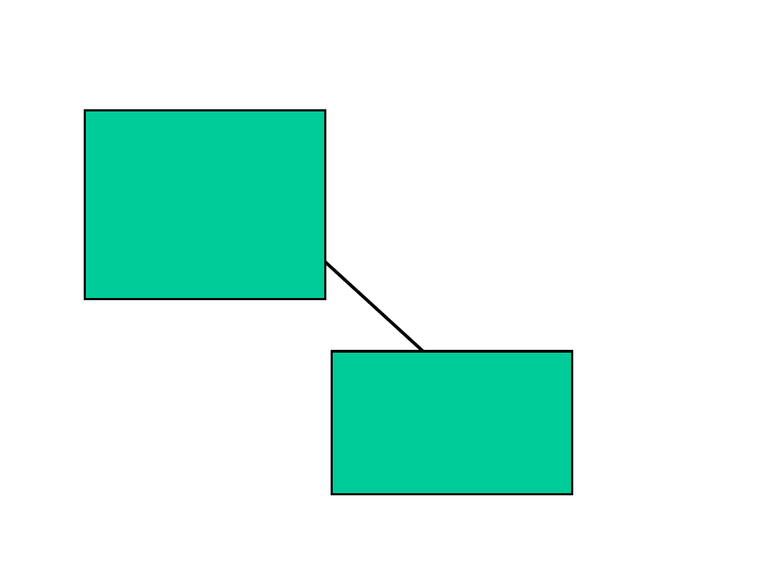

Slide 22
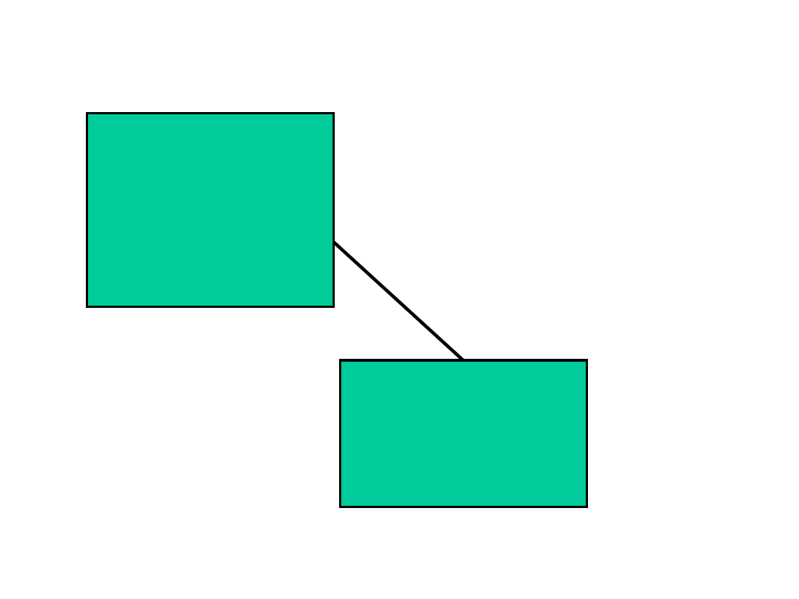

Slide 24
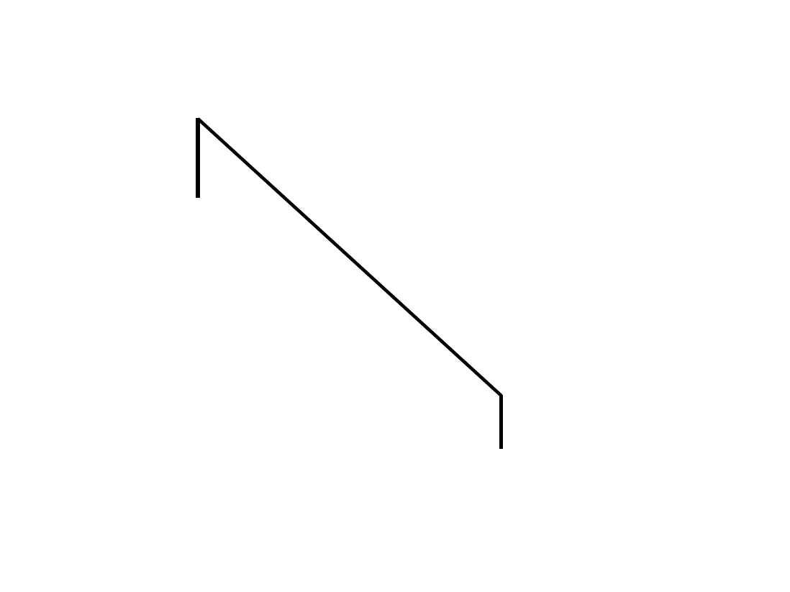

Slide 25
Solving the aperture problem
via Svetlana
How to get more equations for a pixel?
Spatial coherence constraint: assume the pixel’s neighbors have the same (u,v)
E.g., if we use a 5x5 window, that gives us 25 equations per pixel
$$∇I(x_{i})⋅[u,v]+I_{t}(x_{i})=0$$
$$\left[\begin{matrix}I_{x}(x_{1}) & I_{y}(x_{1}) \\ I_{x}(x_{2}) & I_{y}(x_{2}) \\ ⋮ & ⋮ \\ I_{x}(x_{n}) & I_{y}(x_{n})\end{matrix}\right] \left[\begin{matrix}u \\ v\end{matrix}\right]=−\left[\begin{matrix}I_{t}(x_{1}) \\ I_{t}(x_{2}) \\ ⋮ \\ I_{t}(x_{n})\end{matrix}\right]$$
B. Lucas and T. Kanade. An iterative image registration technique with an application to
stereo vision. In Proceedings of the International Joint Conference on Artificial Intelligence, pp. 674–679, 1981.

Slide 26
Lucas-Kanade flow
via Svetlana
Linear least squares problem:
$$\left[\begin{matrix}I_{x}(x_{1}) & I_{y}(x_{1}) \\ I_{x}(x_{2}) & I_{y}(x_{2}) \\ ⋮ & ⋮ \\ I_{x}(x_{n}) & I_{y}(x_{n})\end{matrix}\right] \left[\begin{matrix}u \\ v\end{matrix}\right]=−\left[\begin{matrix}I_{t}(x_{1}) \\ I_{t}(x_{2}) \\ ⋮ \\ I_{t}(x_{n})\end{matrix}\right]$$
$$\underset{n×2}{A}\underset{2×1}{d}=\underset{n×1}{b}$$
$$(A^{T}A)d=A^{T}b$$
Solution given by
$$\left[\begin{matrix}\sum{I_{x}I_{x}} & \sum{I_{x}I_{y}} \\ \sum{I_{x}I_{y}} & \sum{I_{y}I_{y}}\end{matrix}\right]\left[\begin{matrix}u \\ v\end{matrix}\right]=−\left[\begin{matrix}\sum{I_{x}I_{t}} \\ \sum{I_{y}I_{t}}\end{matrix}\right]$$
M = A^{T}A is the second moment matrix!
(summations are over all pixels in the window)

Slide 27
Recall: Structure / Second Moment Matrix
via Svetlana
Estimation of optical flow is well-conditioned precisely for regions with multiple orientations:
λ₂
“Edge” λ₂ >> λ₁
“Corner” /
Texture / Multiple Edges λ₁ and λ₂ are large, λ₁ ~ λ₂
λ₁ and λ₂ are small
“Flat” region
“Edge” λ₁ >> λ₂
λ₁

Slide 28
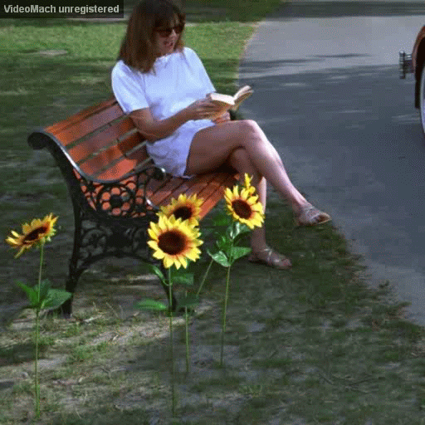
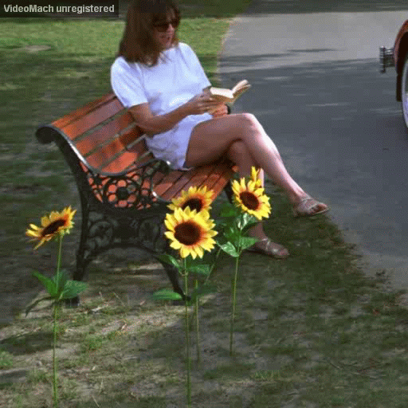
Aligned Images with Flow Warping
Original Pair
Flow Aligned Pair

Slide 29
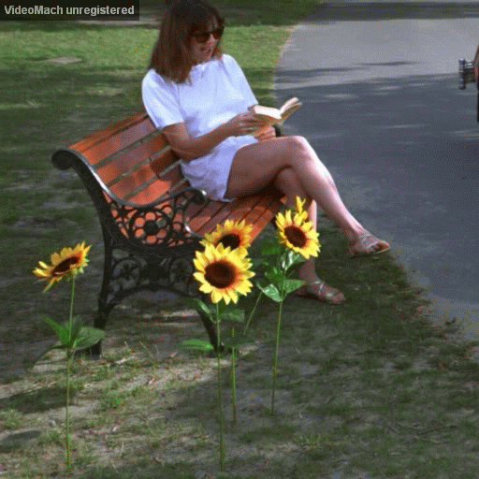
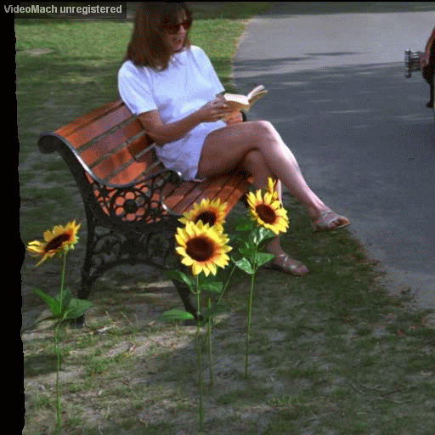
Aligned Images with Flow Warping
Original Pair
Flow Aligned Pair

Slide 30
Limitation of Optical Flow: Small Motion Assumption
$$I_{1}(p^{′})$$
$$I_{2}(p)$$
$$p$$
$$p−u(p)$$
Using Taylor series expansion and rearranging terms (dropping t for simplicity)
$\left(I_{2}\left(p\right)−I_{1}\left(p\right)\right)+∇I_{1} {(p)}^{T}$ $u\left(p;Θ\right)$ = 0
$δI(p)+∇I_{1} {(p)}^{T}$ $u\left(p;Θ\right)$ = 0
Valid only for small motions < 1 pixel or so
So how do we handle larger motions?

Slide 31
A Hierarchy of Models Taxonomy by Bergen,Anandan et al.’92
Parametric motion models
2D translation, affine, projective, 3D pose
Piecewise parametric motion models
2D parametric motion/structure layers
Quasi-parametric
3D R, T & depth per pixel
Plane + parallax
Piecewise quasi-parametric motion models
2D parametric layers + parallax per layer
Non-parametric
Optic flow: 2D vector per pixel

Slide 32
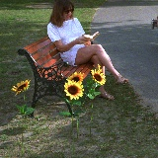
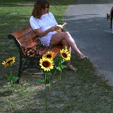
Large Motions: Iterative Coarse-to-fine Pyramid based Motion Estimation Primer
dx(p) dy(p)
-
u=1.25 pixels
Warper
2X
u=2.5 pixels
2X
u=5 pixels
{ R, T, d(p) }
{ H, e, k(p) }
{ dx(p), dy(p) }
$$\min_{θ} \sum_{p}{{(I}_{2}\left(p\right)−I_{1}(p−u(p;Θ))}{2}$$

Slide 33
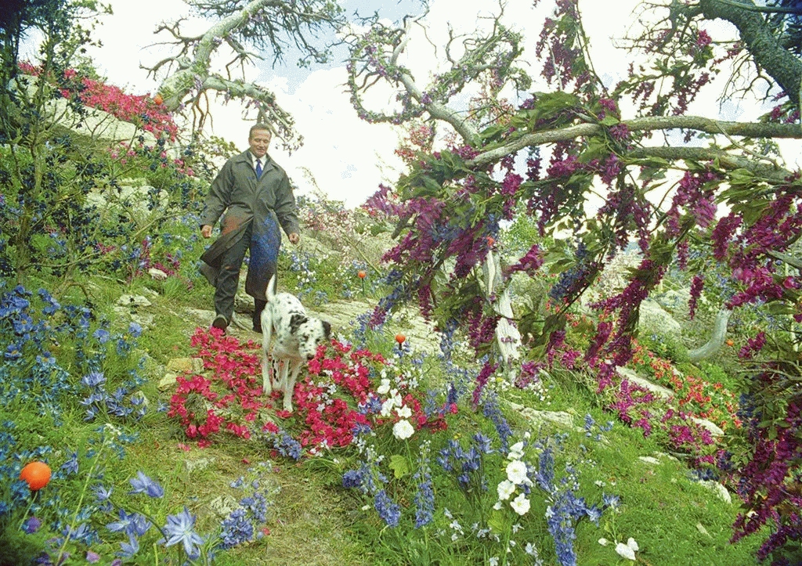
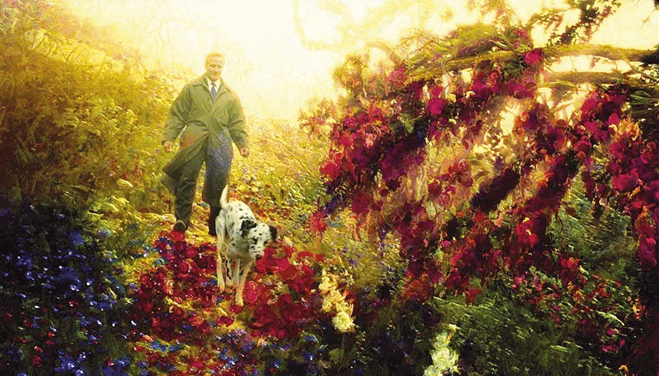
Optical Flow VFX: PAINTING THE AFTERLIFE IN WHAT DREAMS MAY COME
The final shot was enabled with extensive development of tracking techniques, optical flow and a specialized particles tool to produce the painterly effects.

Slide 34
Separation of Moving Pixels into Layers ...motion and scene structure analysis...
Unknown pixel assignments to objects
&
Unknown object motion/structure
Separate coherent & significant motion & structure components
Coherence : Align images using 2D/3D models of motion and structure
Separate backgrounds and moving objects with layers
Significance : Regions of support for various motion & structure components

Slide 35
Layered Motion Algorithm
INITIALIZATION
EM-step
Scale and motion
parameters initial
estimates
E-step:
computation of
ownership
probabilitities
M-step:
computation of
motion and scale
parameters
MAP-step:
motion labeling
using a MAP
criterion
MDL-step:
selection of the
number of models
and outlier detection
MAP segmentation
MDL-step

Slide 36
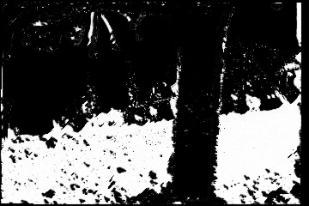
Automatic Extraction of 2D Layers
Layers
Input Sequence

Slide 37
Deep Learning Approaches

Slide 38
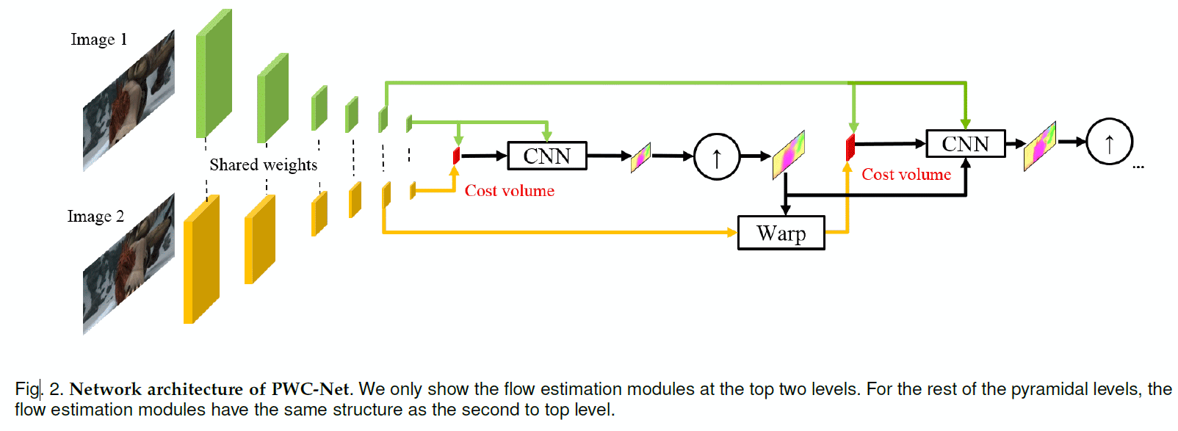
PWC-Net : Inspired by Pyramid Processing for Flow Estimation
Replace the fixed image pyramid with learnable feature pyramids
Warping, as in traditional estimation, is a layer to estimate large motion
Cost volume is computed using features of the first image and the warped features of the second image
The cost volume, features of the first image, and the upsampeld flow are fed to a CNN to estimate flow at the current level, which is then upsampled to the next (third) level.
The process repeats until the desired level

Slide 39
Traditional Coarse-to-Fine vs. PWC-Net
Feature Pyramid Extractor: L layers of Conv filters with 16, 32, 64, 96, 128 and 192 feature channels
Warping Layer: Upsample to the next finest level and warp with rescaled flow:
Cost Volume Layer: Correlation with motion range of d pixels ➔
Optical Flow Estimator: Multi-layer CNN with Cost Volume, Image 1 Features and Upsampled flow as inputs.

Slide 40
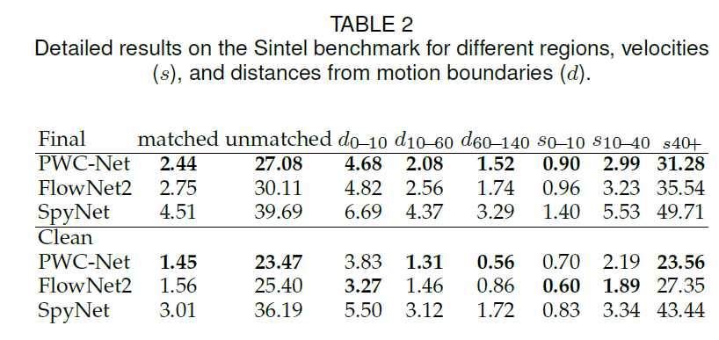
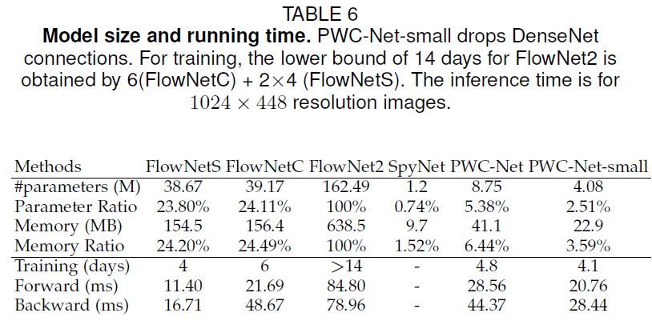
Sample Results

Slide 41
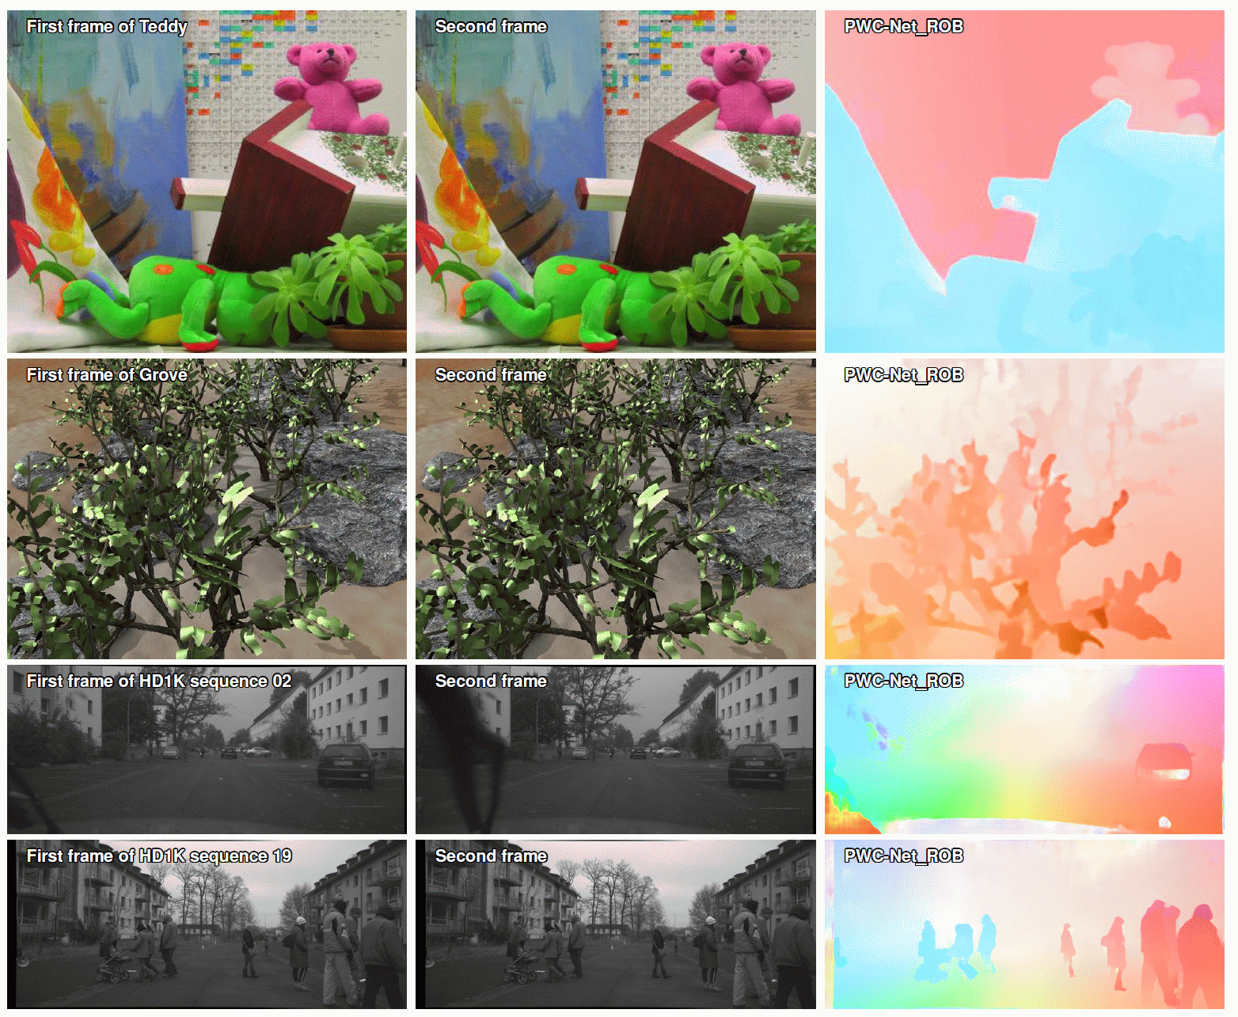
Sample Results

Slide 42
DGC-Net: Dense Geometric Correspondence Network
Reference Target
Flow based warping
DGC-Net based warping
Closely related to optical flow estimation where ConvNets (CNNs)
Optical flow methods do not deal well with the strong geometric transformations
Coarse-to-fine CNN-based framework leverages the advantages of optical flow approaches and extends them to the case of large transformations providing dense and subpixel accurate estimates.
Trained on synthetic transformations and demonstrates very good performance to unseen, realistic, data.
Apply to the problem of relative camera pose estimation: Outperforms existing dense approaches.

Slide 43
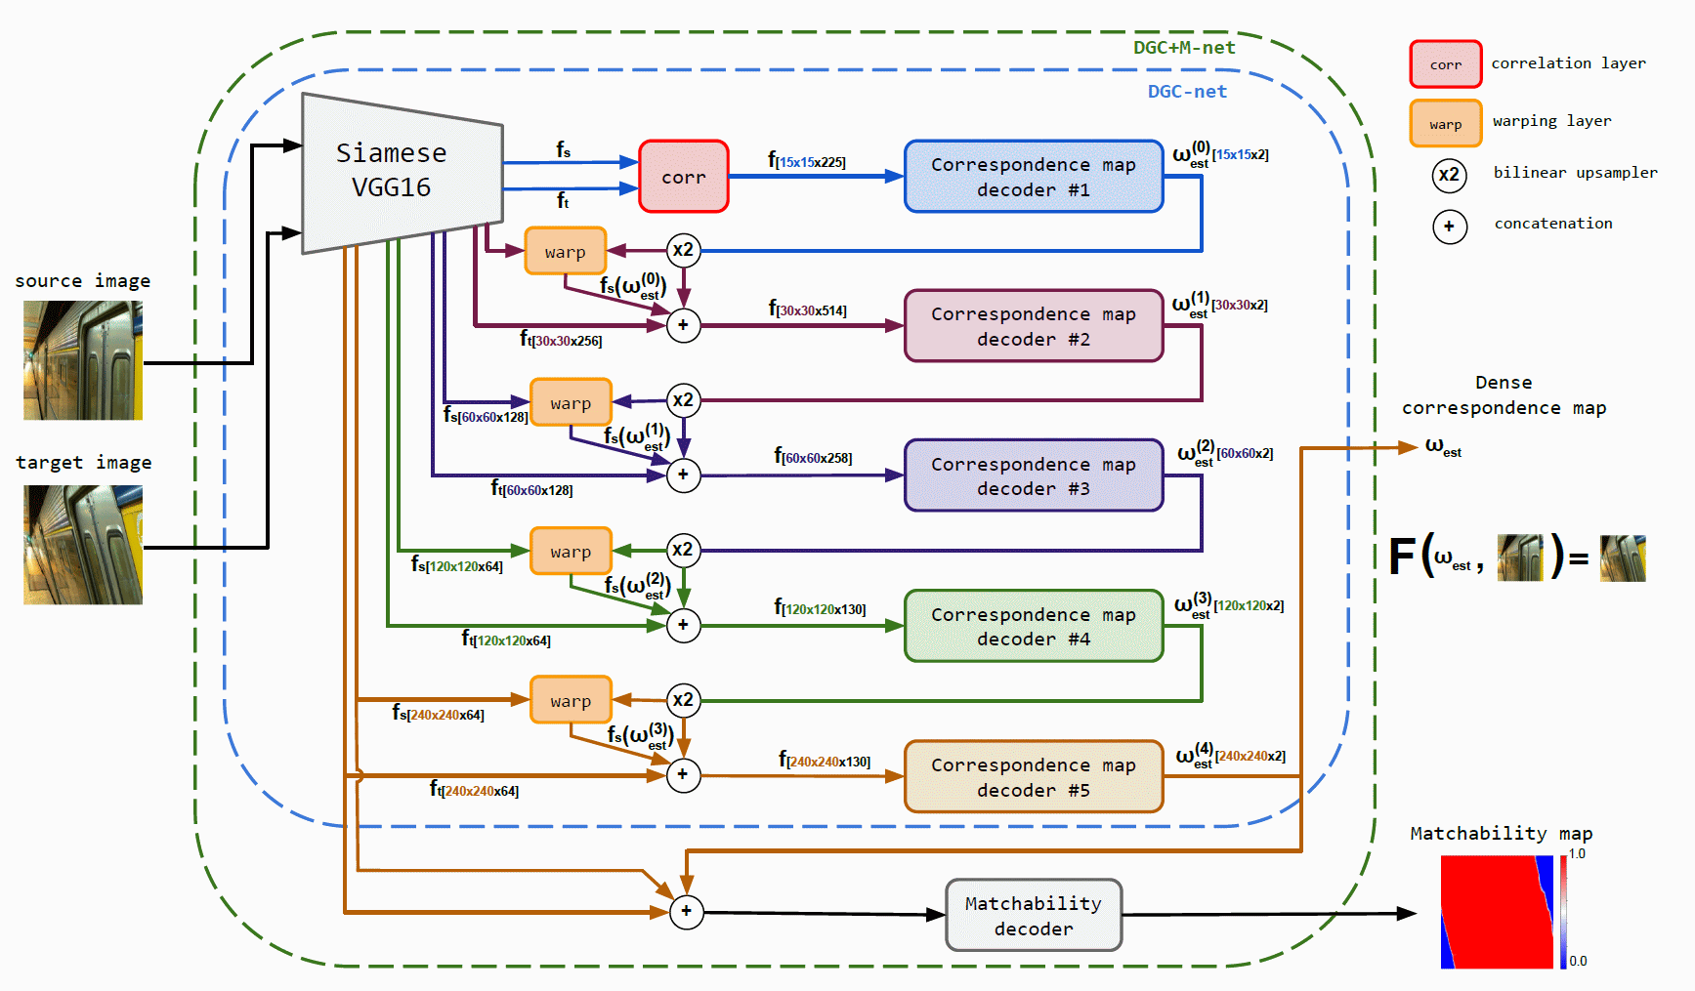
Feature pyramid creator.
Correlation layer estimates the pairwise similarity score of the source and target feature descriptors.
Fully convolutional correspondence map decoders predict the dense correspondence map between input image pair at each level of the feature pyramid.
Warping layer warps features of the source image using the upsampled transforming grid from a correspondence map decoder.
The matchability decoder is a tiny CNN that predicts a confidence map with higher scores for those pixels in the source image that have correspondences in the target.

Slide 44
3D Motion Estimation with Dense Correspondences

