Slide 1
Computer Vision
CSE/EE 576
Face/Flesh Detection and Face Recognition
Linda Shapiro
Professor of Computer Science & Engineering
Professor of Electrical & Computer Engineering

Slide 2
What’s Coming
Review of Bakic flesh detector
Fleck and Forsyth flesh detector
Review of Rowley face detector
The Viola Jones face detector with Adaboost
Face recognition with PCA

Slide 3
Person Detection
Example: Face Detection
Example: Skin Detection
(Rowley, Baluja & Kanade, 1998)
(Jones & Rehg, 1999)

Slide 4
Review: Bakic Flesh Finder
Convert pixels to normalized (r,g) space
Train a binary classifier to recognize pixels in this space as skin or not skin by giving it lots of examples of both classes.
On test images, have the classifier label the skin pixels.
Find large connected components.

Slide 5
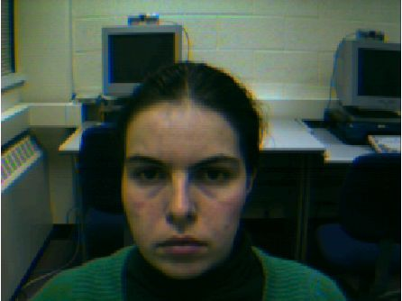
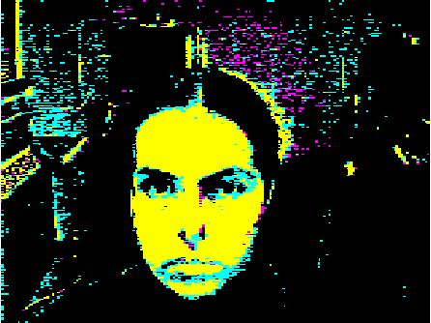
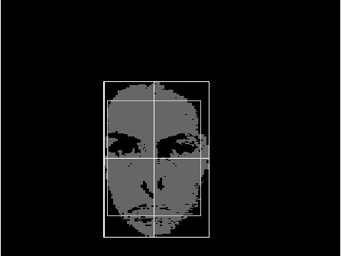
Finding a face in a video frame
input video frame pixels classified in largest connected
normalized r-g space component with aspect
similar to a face
(all work contributed by Vera Bakic)

Slide 6
Fleck and Forsyth’s
Flesh Detector
Convert RGB to HSI
Use the intensity component to compute a texture map
texture = med2 ( | I - med1(I) | )
If a pixel falls into either of the following ranges,
it’s a potential skin pixel
texture < 5, 110 < hue < 150, 20 < saturation < 60
texture < 5, 130 < hue < 170, 30 < saturation < 130
median filters of
radii 4 and 6
* Margaret Fleck, David Forsyth, and Chris Bregler (1996)
“Finding Naked People,” 1996 European Conference on
Computer Vision , Volume II, pp. 592-602.

Slide 7
Algorithm
Skin Filter: The algorithm first locates images containing large areas
whose color and texture is appropriate for skin.
2. Grouper: Within these areas, the algorithm finds elongated regions
and groups them into possible human limbs and connected groups
of limbs, using specialized groupers which incorporate substantial
amounts of information about object structure.
3. Images containing sufficiently large skin-colored groups of
possible limbs are reported as potentially containing naked people.
This algorithm was tested on a database of 4854 images: 565 images
of naked people and 4289 control images from a variety of sources.
The skin filter identified 448 test images and 485 control images as
containing substantial areas of skin. Of these, the grouper identified
241 test images and 182 control images as containing people-like shapes.

Slide 8

Grouping

Slide 9

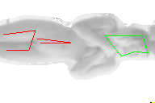
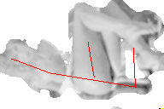
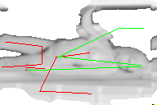

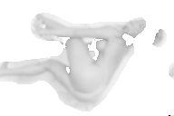

Results
Some True Positives
False Negatives True Negative

Slide 10
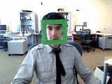
Face detection
State-of-the-art face detection demo
(Courtesy Boris Babenko)

Slide 11
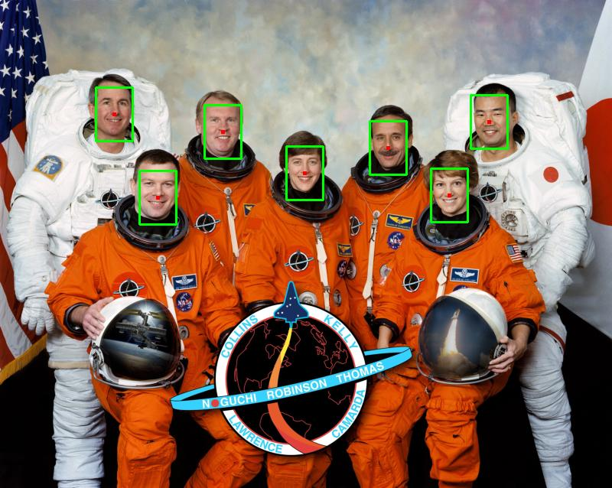
Face detection
Where are the faces?

Slide 12
Face Detection
What kind of features?
Rowley: 32 x 32 subimages at different levels of a pyramid
Viola/Jones: rectangular features
What kind of classifiers?
Rowley: neural nets
Viola/Jones: Adaboost over simple one-node decision trees (stumps)

Slide 13
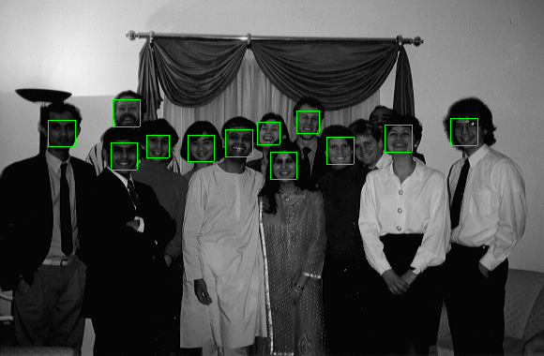
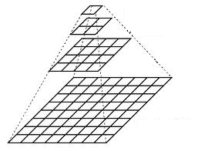
Object Detection:
Rowley’s Face Finder
1. convert to gray scale
2. normalize for lighting
3. histogram equalization
4. apply neural net(s)
trained on 16K images
What data is fed to
the classifier?
20 x 20 windows in
a pyramid structure

Slide 14
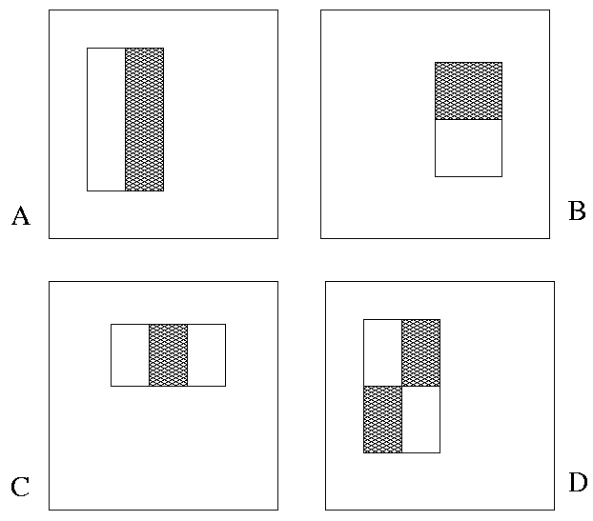
Viola/Jones: Image Features
“Rectangle filters”
+1
-1
People call them Haar-like features,
since similar to 2D Haar wavelets.
Value =
∑ (pixels in white area) –
∑ (pixels in black area)

Slide 15


Feature extraction
“Rectangular” filters
  Filters can be different sizes.
  Filters can be anywhere in the
  box being analyzed.
  Feature output is very simple
  convolution.
  Requires sums of large boxes.
  Efficiently computable with integral image: any sum can be computed in constant time
  Avoid scaling images scale features directly for same cost
Viola & Jones, CVPR 2001
K. Grauman, B. Leibe
Notes:
15

Slide 16

Large library of filters
  Considering all possible filter parameters: position, scale, and type:
160,000+ possible features associated with each 24 x 24 window
Use AdaBoost both to select the informative features and to form the classifier
Viola & Jones, CVPR 2001
Notes:
16

Slide 17
Feature selection
For a 24x24 detection region, the number of possible rectangle features is ~160,000!
At test time, it is impractical to evaluate the entire feature set
Can we create a good classifier using just a small subset of all possible features?
How to select such a subset?

Slide 18
Basic AdaBoost Review
Input is a set of training examples (X_{i}, y_{i}) i = 1 to m.
We train a sequence of weak classifiers, such as decision trees, neural nets or SVMs. Weak because not as strong as the final classifier.
The training examples will have weights, initially all equal.
At each step, we use the current weights, train a new classifier, and use its performance on the training data to produce new weights for the next step (normalized).
But we keep ALL the weak classifiers.
When it’s time for testing on a new feature vector, we will combine the results from all of the weak classifiers.

Slide 19
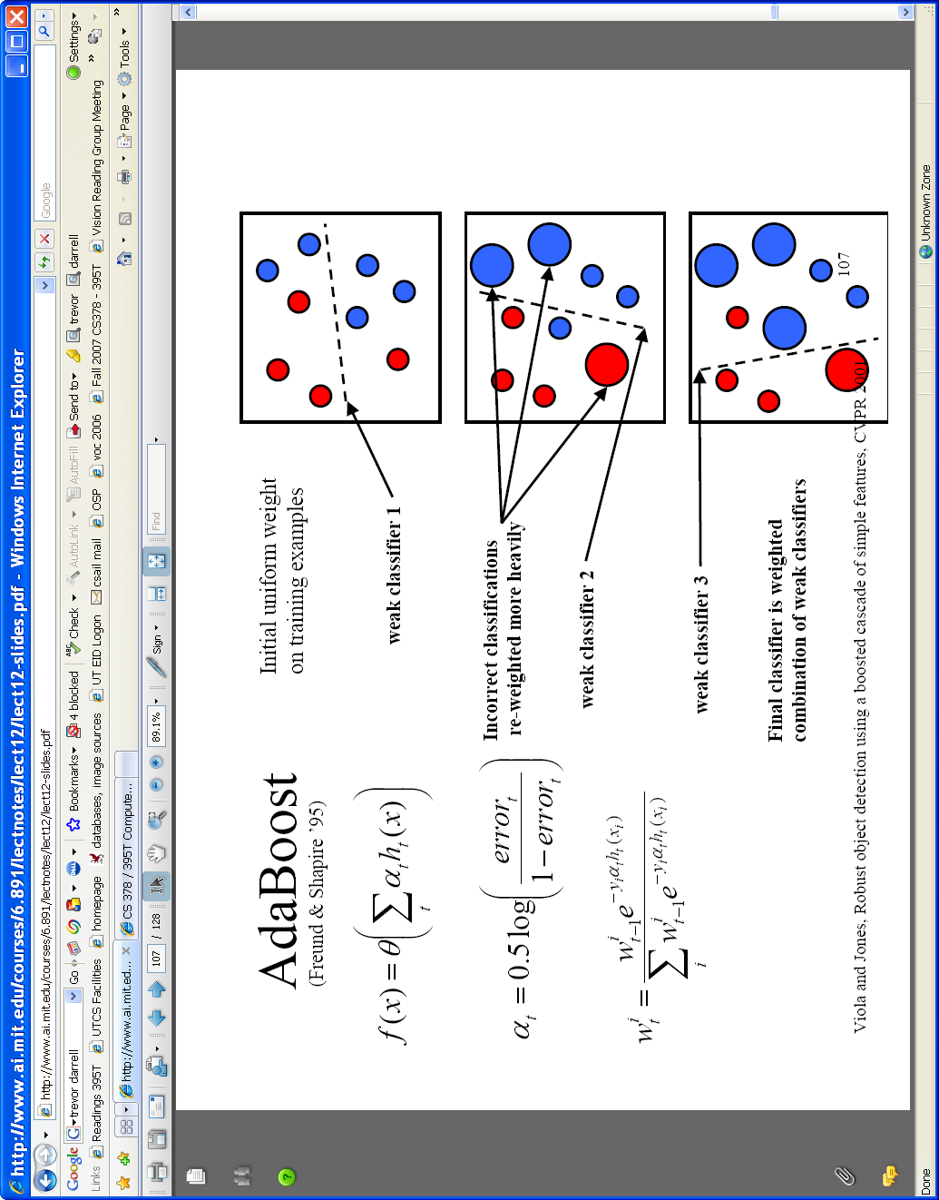

AdaBoost for feature+classifier selection
Want to select the single rectangle feature and threshold that best separates positive (faces) and negative (non-faces) training examples, in terms of weighted error.
θ_{t} is a threshold for classifier h_{t}
Resulting weak classifier:
0
For next round, reweight the examples according to errors, choose another filter/threshold combo.
…
Outputs of a possible rectangle feature on training examples x (faces and non faces)
Viola & Jones, CVPR 2001
Notes:
19

Slide 20
Weak Classifiers
Each weak classifier works on exactly one rectangle feature.
Each weak classifier has 3 associated variables
  its threshold θ
  its polarity p
  its weight α
The polarity can be 0 or 1 (in our code)
The weak classifier computes its one feature f
  When the polarity is 1, we want f > θ for face
  When the polarity is 0, we want f < θ for face
The weight will be used in the final classification by AdaBoost.

Slide 21
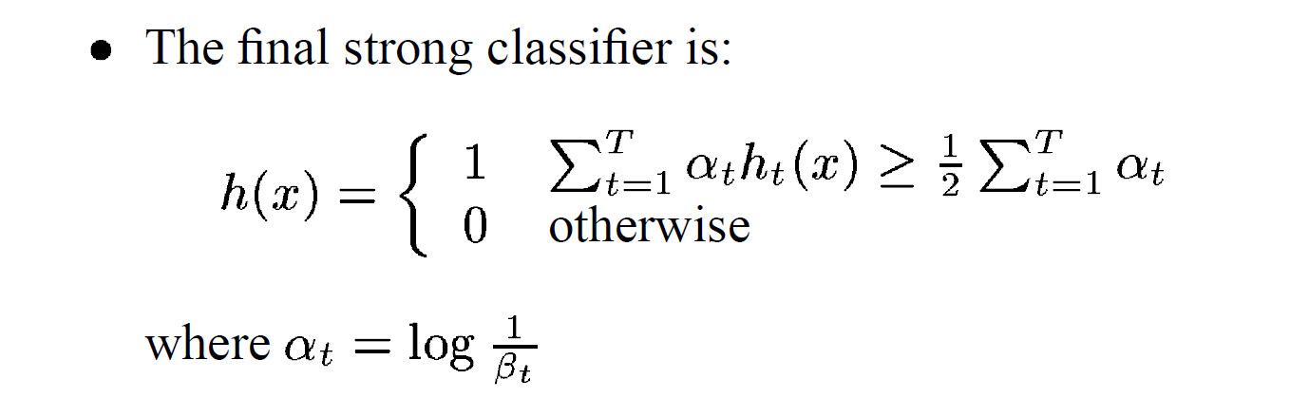

β_{t} = ε_{t} / (1- ε_{t}): the training error of the classifier h_{t}
Final classifier is combination of the weak ones, weighted according to error they had.
E.g. β_{t} = .25/.75 = .3333. 1/.3333 = 3; log₂3 = 1.58,
β_{t} = .1/.9; log₂9 = 3.16
If the error were 0, β_{t} = 0/1 = 0, and 1/0 is infinite, so code has to handle that but the weight should be large!

Slide 22
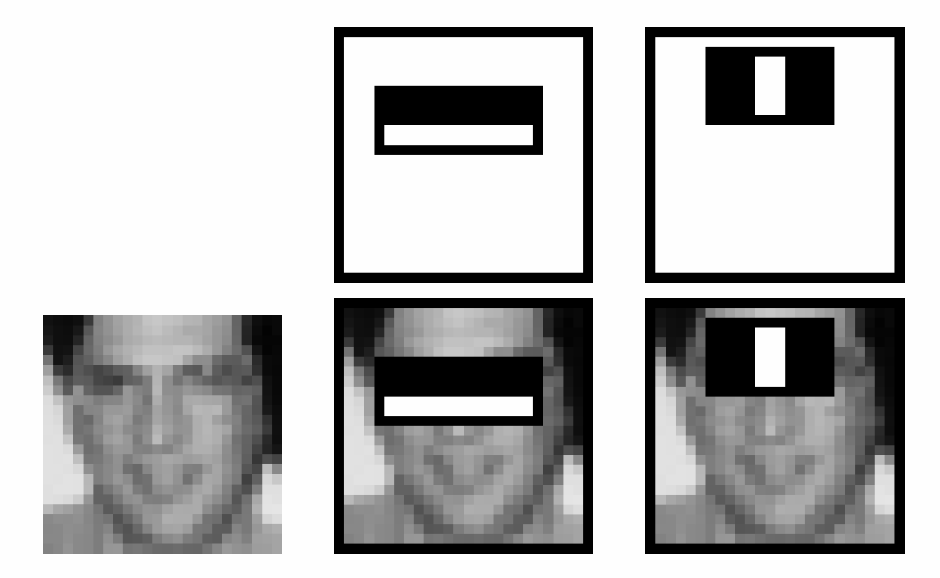
Boosting for face detection
First two features selected by boosting:
This feature combination can yield 100% detection rate and 50% false positive rate

Slide 23
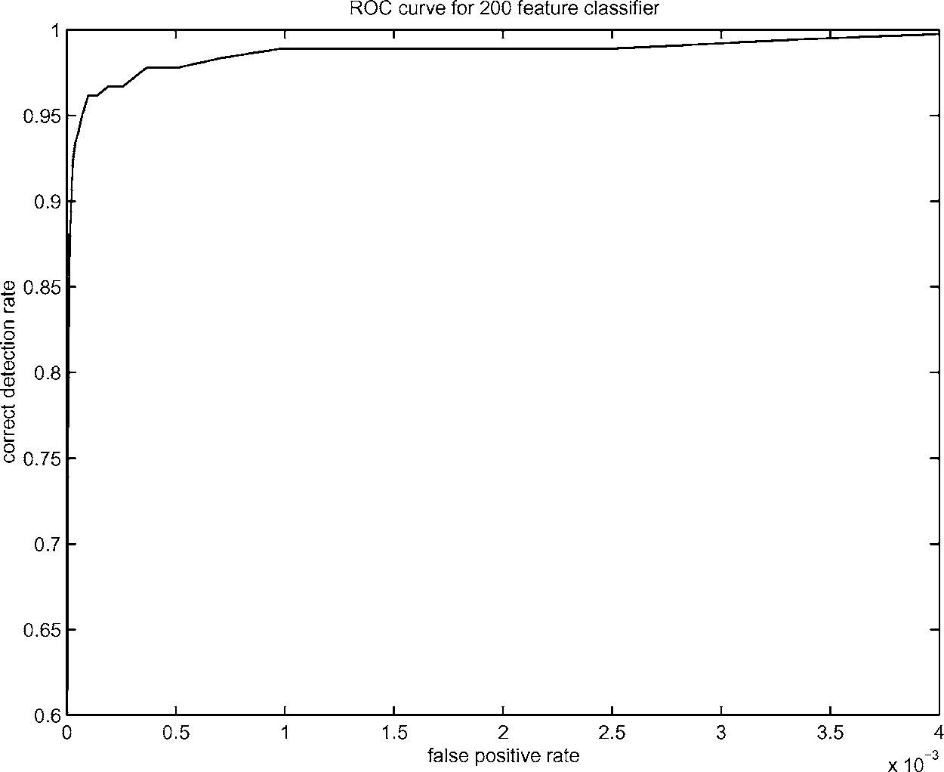
Boosting for face detection
A 200-feature classifier can yield 95% detection rate and a false positive rate of 1 in 14084
Is this good enough?
Receiver operating characteristic (ROC) curve

Slide 24
Attentional cascade (from Viola-Jones)
We start with simple classifiers which reject many of the negative sub-windows while detecting almost all positive sub-windows
Positive response from the first classifier triggers the evaluation of a second (more complex) classifier, and so on
A negative outcome at any point leads to the immediate rejection of the sub-window
T
T
T
IMAGE
SUB-WINDOW
T
FACE
Classifier 1
Classifier 2
Classifier 3
F
F
F
NON-FACE
NON-FACE
NON-FACE

Slide 25
Attentional cascade
Chain of classifiers that are progressively more complex and have lower false positive rates:
Receiver operating characteristic
% False Pos
0
50
vs
false
neg
determined by
0 100
% Detection
T
T
T
IMAGE
SUB-WINDOW
T
FACE
Classifier 1
Classifier 2
Classifier 3
F
F
F
NON-FACE
NON-FACE
NON-FACE
Notes:
In general simple classifiers, while they are more efficient, they are also weaker.
We could define a computational risk hierarchy (in analogy with structural risk minimization)…
A nested set of classifier classes
The training process is reminiscent of boosting…
- previous classifiers reweight the examples used to train subsequent classifiers
The goal of the training process is different
- instead of minimizing errors minimize false positives

Slide 26
Attentional cascade
The detection rate and the false positive rate of the cascade are found by multiplying the respective rates of the individual stages
A detection rate of 0.9 and a false positive rate on the order of 10⁻⁶ can be achieved by a
10-stage cascade if each stage has a detection rate of 0.99 (0.99¹⁰ ≈ 0.9) and a false positive rate of about 0.30 (0.3¹⁰ ≈ 6×10⁻⁶)
T
T
T
IMAGE
SUB-WINDOW
T
FACE
Classifier 1
Classifier 2
Classifier 3
F
F
F
NON-FACE
NON-FACE
NON-FACE

Slide 27
Training the cascade
Set target detection and false positive rates for each stage
Keep adding features to the current stage until its target rates have been met
  Need to lower AdaBoost threshold to maximize detection
  (as opposed to minimizing total classification error)
  Test on a validation set
If the overall false positive rate is not low enough, then add another stage
Use false positives from current stage as the negative training examples for the next stage

Slide 28
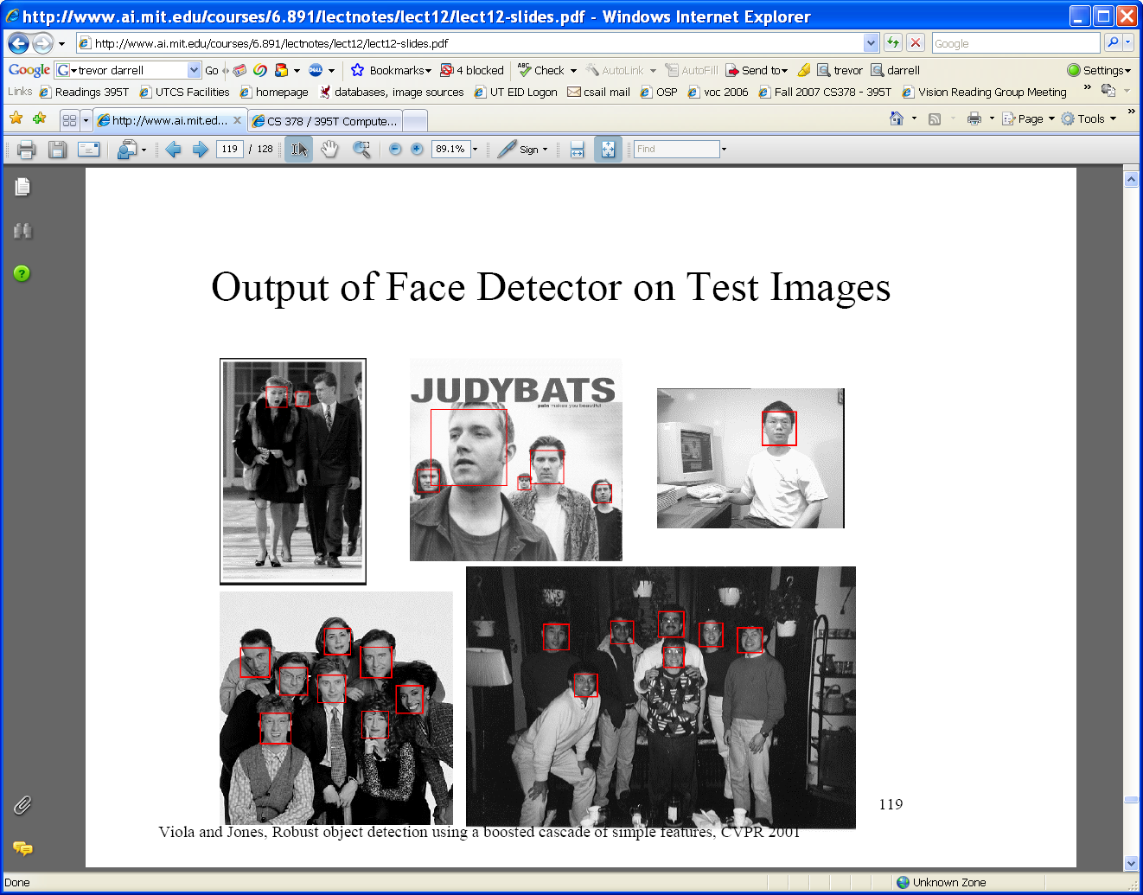






Viola-Jones Face Detector: Summary
Train cascade of classifiers with AdaBoost
Apply to each subwindow
Faces
New image
Selected features, thresholds, and weights
Non-faces
Train with 5K positives, 350M negatives
Real-time detector using 38 layer cascade
6061 features in final layer
[Implementation available in OpenCV: http://www.intel.com/technology/computing/opencv/]
Notes:
28

Slide 29

The implemented system
Training Data
  5000 faces
    All frontal, rescaled to
    24x24 pixels
  300 million non-faces
    9500 non-face images
  Faces are normalized
    Scale, translation
Many variations
  Across individuals
  Illumination
  Pose
Notes:
This situation with negative examples is actually quite common… where negative examples are free.

Slide 30
System performance
Training time: “weeks” on 466 MHz Sun workstation
38 layers, total of 6061 features
Average of 10 features evaluated per window on test set
“On a 700 Mhz Pentium III processor, the face detector can process a 384 by 288 pixel image in about .067 seconds”
  15 Hz
  15 times faster than previous detector of comparable accuracy (Rowley et al., 1998)

Slide 31
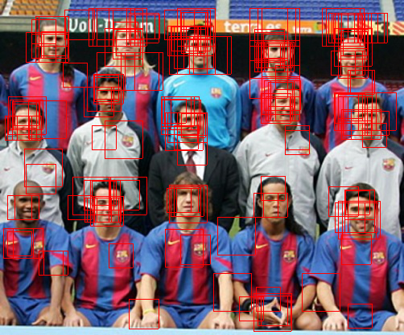
Non-maximal suppression (NMS)
Many detections above threshold.

Slide 32
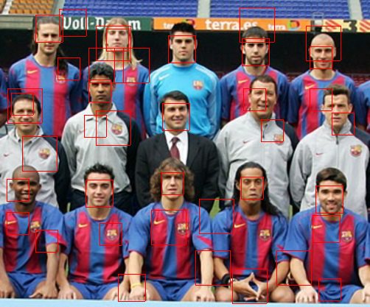
Non-maximal suppression (NMS)

Slide 33
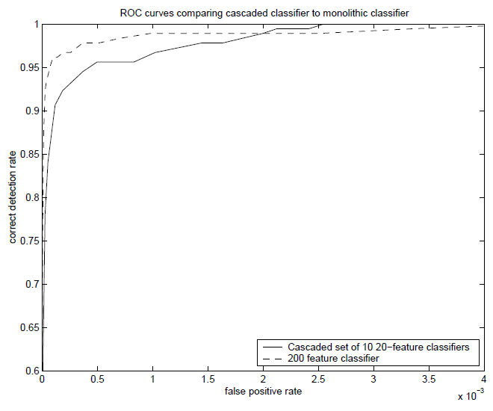
Is this good?
Similar accuracy, but 10x faster

Slide 34
Viola-Jones Face Detector: Results
Notes:
34

Slide 35
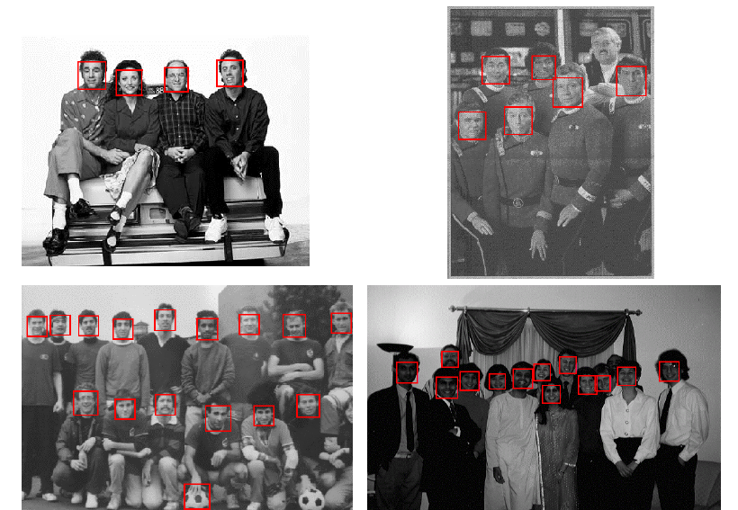
Viola-Jones Face Detector: Results
Notes:
35

Slide 36
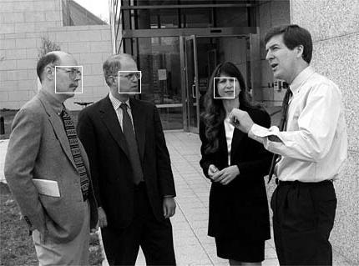
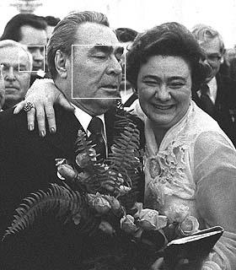
Viola-Jones Face Detector: Results

Slide 37
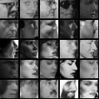
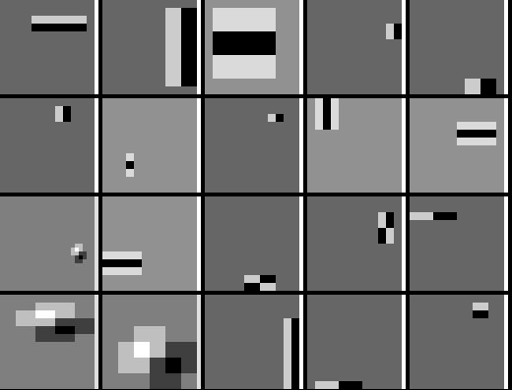
Detecting profile faces?
Detecting profile faces requires training separate detector with profile examples.

Slide 38
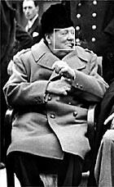

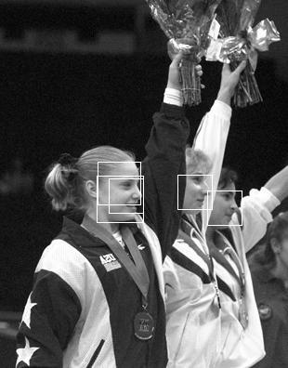
Viola-Jones Face Detector: Results
Paul Viola, ICCV tutorial

Slide 39
Summary: Viola/Jones detector
Rectangle features
Integral images for fast computation
Boosting for feature selection
Attentional cascade for fast rejection of negative windows

Slide 40


Face recognition: once you’ve detected and cropped a face, try to recognize it
Detection
Recognition
“Sally”

Slide 41
Face recognition: overview
Typical scenario: few examples per face, identify or verify test example
What’s hard: changes in expression, lighting, age, occlusion, viewpoint
Basic approaches (all nearest neighbor)
  Project into a new subspace (or kernel space) (e.g., “Eigenfaces”=PCA)
  Measure face features

Slide 42
Typical face recognition scenarios
Verification: a person is claiming a particular identity; verify whether that is true
  E.g., security
Closed-world identification: assign a face to one person from among a known set
General identification: assign a face to a known person or to “unknown”

Slide 43
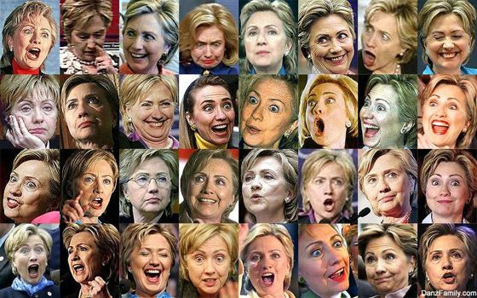
What makes face recognition hard?
Expression

Slide 44






Slide 45




What makes face recognition hard?
Lighting

Slide 46
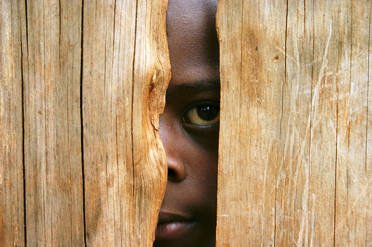
What makes face recognition hard?
Occlusion

Slide 47
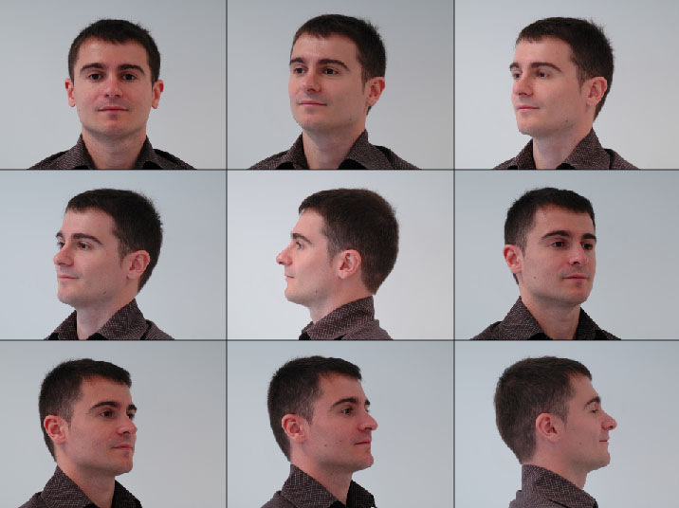
What makes face recognition hard?
Viewpoint

Slide 48
Simple idea for face recognition
Treat face image as a vector of intensities
Recognize face by nearest neighbor in database

Slide 49
The space of all face images
When viewed as vectors of pixel values, face images are extremely high-dimensional
  100x100 image = 10,000 dimensions
  Slow and lots of storage
But very few 10,000-dimensional vectors are valid face images
We want to effectively model the subspace of face images

Slide 50
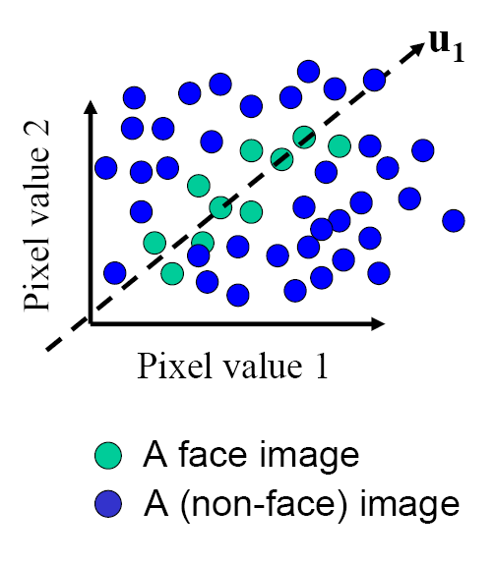
The space of all face images
Eigenface idea: construct a low-dimensional linear subspace that best explains the variation in the set of face images

Slide 51
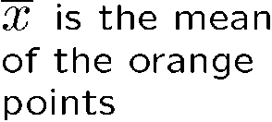




Linear subspaces
Pixel 2
v₁ is the major direction of the orange
points and v₂ is perpendicular to v_{1.}
Convert x into v₁, v₂ coordinates
What does the v₂ coordinate measure?
  distance to line
  use it for classification—near 0 for orange pts
What does the v₁ coordinate measure?
  position along line
  use it to specify which orange point it is
Pixel 1
Classification (to what class does x belong) can be expensive
  Big search problem
Suppose the data points are arranged as above
  Idea—fit a line, classifier measures distance to line
Selected slides adapted from Steve Seitz, Linda Shapiro, Raj Rao

Slide 52
Dimensionality reduction
Pixel 2
Pixel 1
Dimensionality reduction
  We can represent the orange points with only their v₁ coordinates
    since v₂ coordinates are all essentially 0
  This makes it much cheaper to store and compare points
  A bigger deal for higher dimensional problems (like images!)

Slide 53
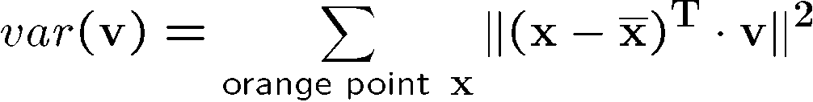


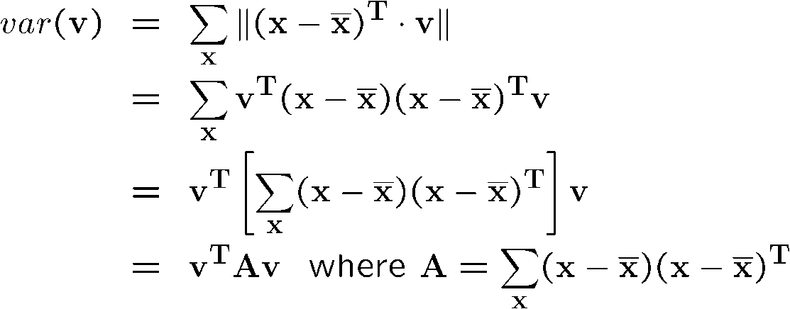
Eigenvectors and Eigenvalues
Pixel 2
Consider the variation along a direction v among all of the orange points:
What unit vector v minimizes var?
What unit vector v maximizes var?
Pixel 1
2
A = covariance matrix of data points (if divided by no. of points)
Solution: v₁ is eigenvector of A with largest eigenvalue
v₂ is eigenvector of A with smallest eigenvalue

Slide 54
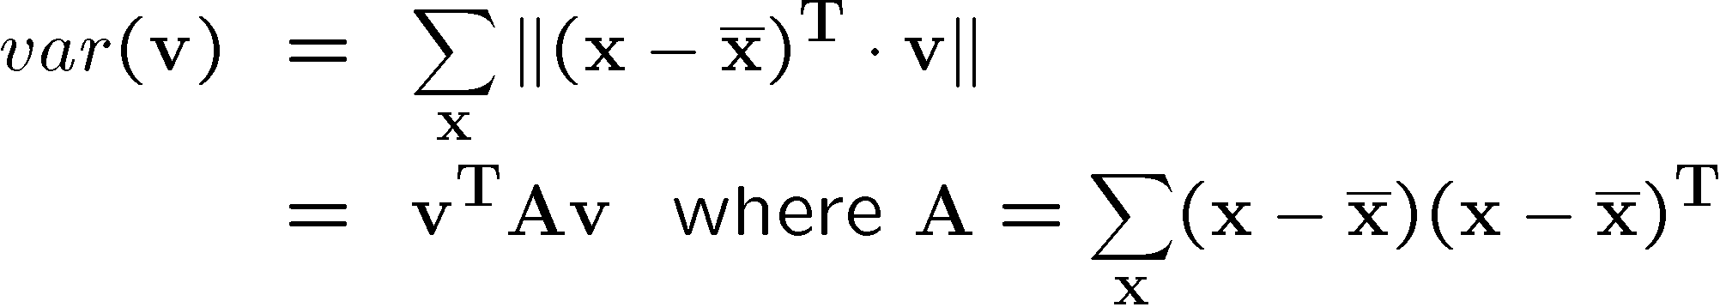

Principal component analysis (PCA)
Suppose each data point is N-dimensional
  Same procedure applies:
  The eigenvectors of A define a new coordinate system
    eigenvector with largest eigenvalue captures the most variation among training vectors x
    eigenvector with smallest eigenvalue has least variation
  We can compress the data by only using the top few eigenvectors
    corresponds to choosing a “linear subspace”
      represent points on a line, plane, or “hyper-plane”
    these eigenvectors are known as the principal components

Slide 55
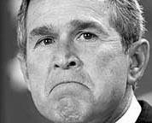
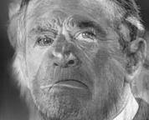
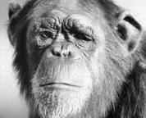
The space of faces
An image is a point in a high dimensional space
  An N x M image is a point in R^{NM}
  We can define vectors in this space as we did in the 2D case

Slide 56
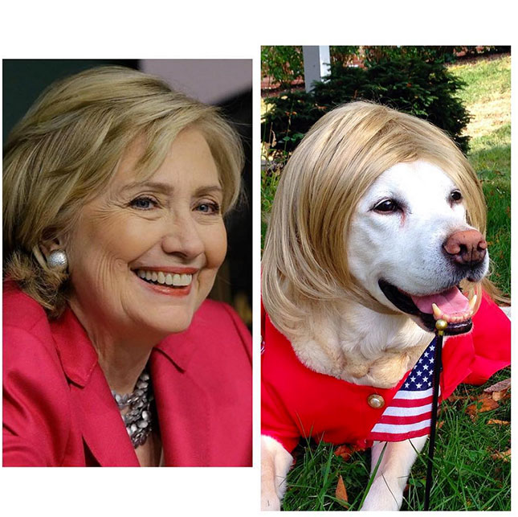

Dimensionality reduction
The set of faces is a “subspace” of the set of images
  Suppose it is K dimensional
  We can find the best subspace using PCA
  This is like fitting a “hyper-plane” to the set of faces
    spanned by vectors v₁, v₂, ..., v_{K}
    any face

Slide 57
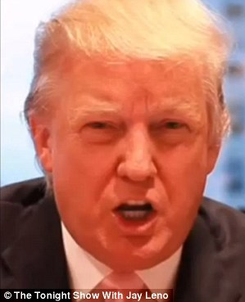
Dimensionality reduction
The set of faces is a “subspace” of the set of images
  Suppose it is K dimensional
  We can find the best subspace using PCA
  This is like fitting a “hyper-plane” to the set of faces
    spanned by vectors v₁, v₂, ..., v_{K}
    any face

Slide 58
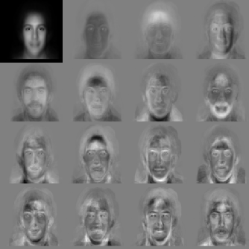


Eigenfaces
PCA extracts the eigenvectors of A
  Gives a set of vectors v₁, v₂, v₃, ...
  Each one of these vectors is a direction in face space
    what do these look like?

Slide 59

Visualization of eigenfaces
Principal component (eigenvector) u_{k}
μ + 3σ_{k}u_{k}
μ – 3σ_{k}u_{k}

Slide 60



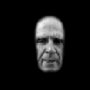
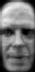











Projecting onto the eigenfaces
The eigenfaces v₁, ..., v_{K} span the space of faces
  A face is converted to eigenface coordinates by

Slide 61


Recognition with eigenfaces
Algorithm
  Process the image database (set of images with labels)
    Run PCA—compute eigenfaces
    Calculate the K coefficients for each image
  Given a new image (to be recognized) x, calculate K coefficients
  Detect if x is a face
  If it is a face, who is it?
Find closest labeled face in database
Nearest-neighbor in K-dimensional space

Slide 62
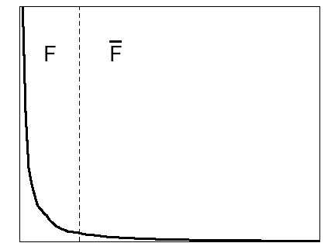

Choosing the dimension K
eigenvalues
i =
K
NM
How many eigenfaces to use?
Look at the decay of the eigenvalues
  the eigenvalue tells you the amount of variance “in the direction” of that eigenface
  ignore eigenfaces with low variance

Slide 63

Representation and reconstruction
Face x in “face space” coordinates:
=

Slide 64


Representation and reconstruction
Face x in “face space” coordinates:
Reconstruction:
=
=
+
^
x
=
µ + w₁u₁+w₂u₂+w₃u₃+w₄u₄+ …

Slide 65
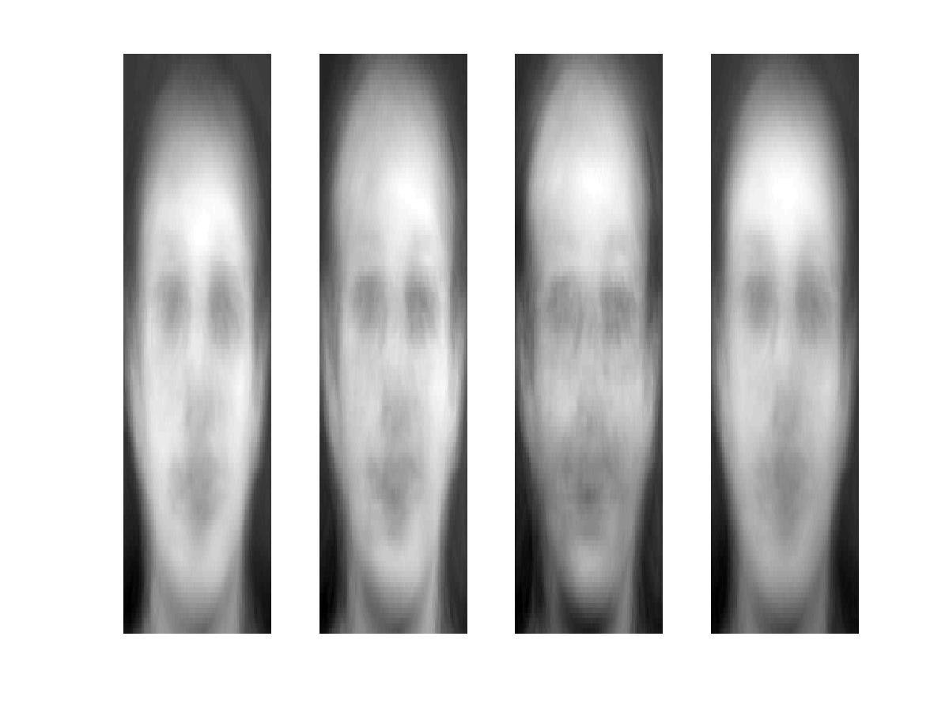
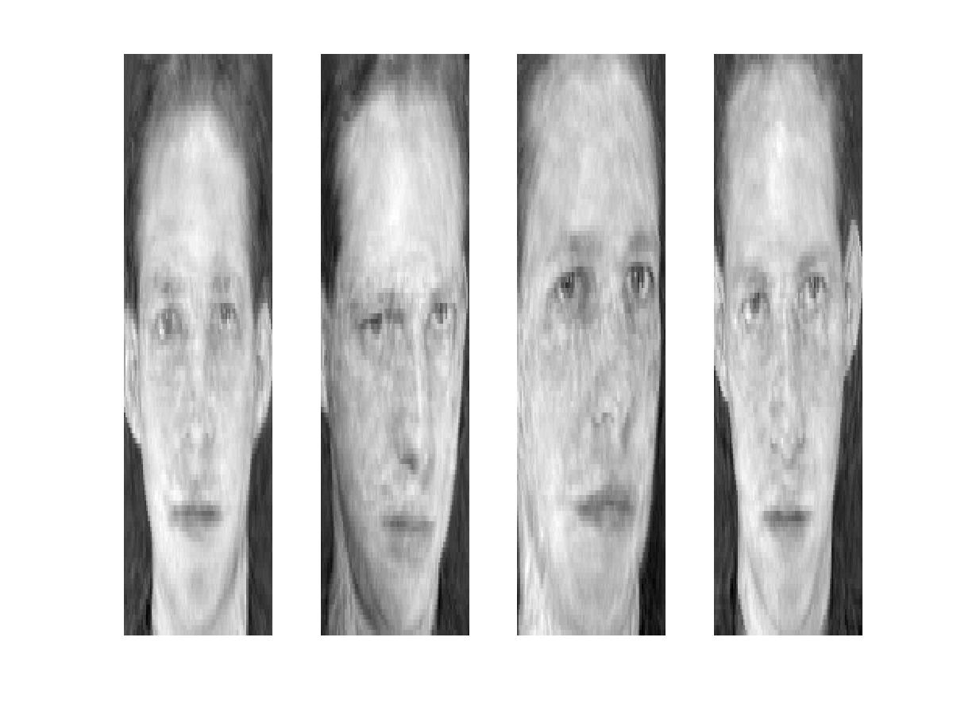
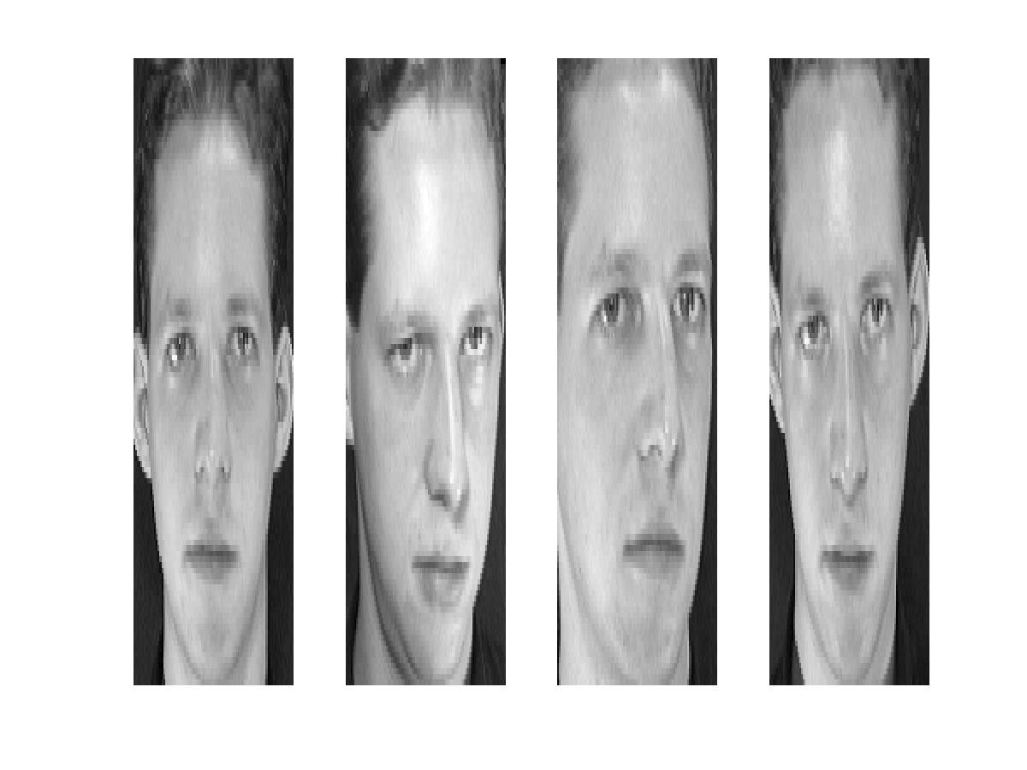
Reconstruction
P = 4
P = 200
P = 400
After computing eigenfaces using 400 face images from ORL face database

Slide 66
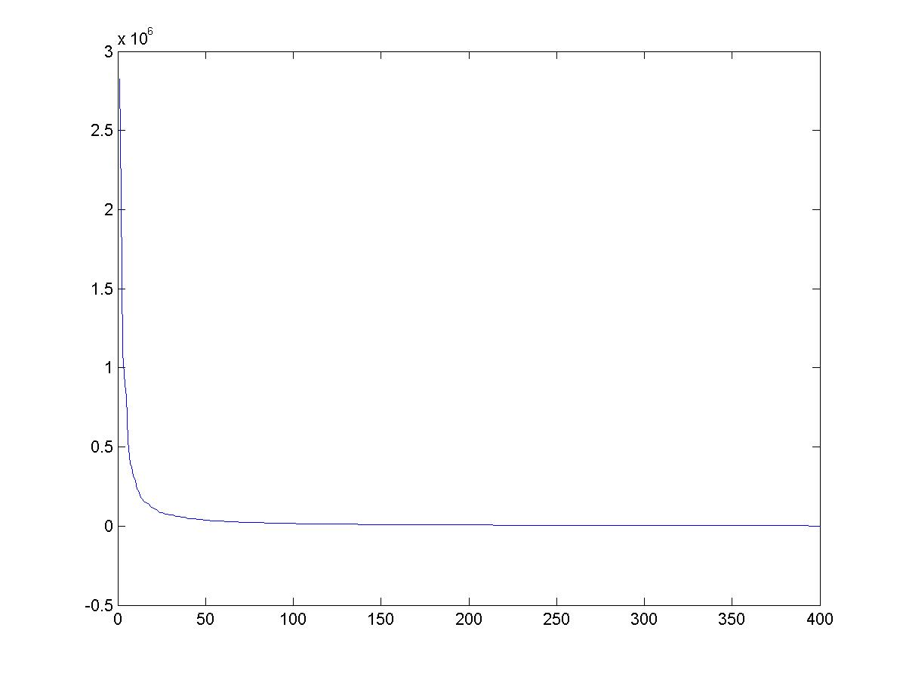
Eigenvalues (variance along eigenvectors)

Slide 67
Note
Preserving variance (minimizing MSE) does not necessarily lead to qualitatively good reconstruction.
P = 200

Slide 68
Recognition with eigenfaces
Process labeled training images
Find mean µ and covariance matrix Σ
Find k principal components (eigenvectors of Σ) u₁,…u_{k}
Project each training image x_{i} onto subspace spanned by principal components:
(w_{i1},…,w_{ik}) = (u₁^{T}(x_{i} – µ), … , u_{k}^{T}(x_{i} – µ))
Given novel image x
Project onto subspace:
(w₁,…,w_{k}) = (u₁^{T}(x – µ), … , u_{k}^{T}(x – µ))
Optional: check reconstruction error x – x to determine whether image is really a face
Classify as closest training face in k-dimensional subspace
^
M. Turk and A. Pentland, Face Recognition using Eigenfaces, CVPR 1991

Slide 69
PCA
General dimensionality reduction technique
Preserves most of variance with a much more compact representation
  Lower storage requirements (eigenvectors + a few numbers per face)
  Faster matching
What other applications?

Slide 70
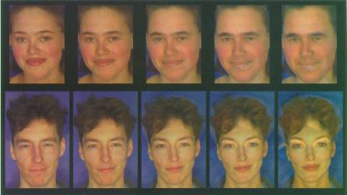
Enhancing gender
more same original androgynous more opposite
D. Rowland and D. Perrett, “Manipulating Facial Appearance through Shape and Color,” IEEE CG&A, September 1995
Slide credit: A. Efros

Slide 71
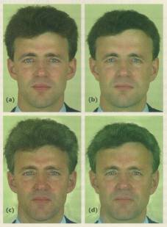
Changing age
Face becomes “rounder” and “more textured” and “grayer”
original shape
color both
D. Rowland and D. Perrett, “Manipulating Facial Appearance through Shape and Color,” IEEE CG&A, September 1995
Slide credit: A. Efros

Slide 72


Which face is more attractive?
http://www.beautycheck.de

Slide 73
Use in Cleft Severity Analysis
We have a large database of normal 3D faces.
We construct their principal components.
We can reconstruct any normal face accurately using these components.
But when we reconstruct a cleft face from the normal components, there is a lot of error.
This error can be used to measure the severity of the cleft.

Slide 74
Use of PCA Reconstruction Error to Judge Cleft Severity

Slide 75
Question
Would PCA on image pixels work well as a general compression technique?
P = 200

Slide 76
Extension to 3D Objects
Murase and Nayar (1994, 1995) extended this idea to 3D
objects.
The training set had multiple views of each object, on a
dark background.
The views included multiple (discrete) rotations of the object on
a turntable and also multiple (discrete) illuminations.
The system could be used first to identify the object and then to
determine its (approximate) pose and illumination.

Slide 77

Sample Objects
Columbia Object Recognition Database

Slide 78
Significance of this work
The extension to 3D objects was an important contribution.
Instead of using brute force search, the authors observed that
All the views of a single object, when transformed into the
eigenvector space became points on a manifold in that space.
Using this, they developed fast algorithms to find the closest
object manifold to an unknown input image.
Recognition with pose finding took less than a second.

Slide 79
Appearance-Based Recognition
Training images must be representative of the instances
of objects to be recognized.
The object must be well-framed.
Positions and sizes must be controlled.
Dimensionality reduction is needed.
It is not powerful enough to handle general scenes
without prior segmentation into relevant objects.
* The newer systems that use “parts” from interest operators
are an answer to these restrictions.

