Slide 1
Computer Vision CSE/EE 576 Content-Based Image Retrieval and the EM Algorithm Linda Shapiro Professor of Computer Science & Engineering Professor of Electrical & Computer Engineering

Slide 2
Joe’s Defense Audience
Kelp

Slide 3
Content-Based Image Retrieval
Queries
Commercial Systems
Retrieval Features
Indexing in the FIDS System
Lead-in to Object Recognition

Slide 4
Content-based Image Retrieval (CBIR)
Searching a large database for images that match a query:
What kinds of databases?
What kinds of queries?
What constitutes a match?
How do we make such searches efficient?

Slide 5
Applications
Art Collections
e.g. Fine Arts Museum of San Francisco
Medical Image Databases
CT, MRI, Ultrasound, The Visible Human
Scientific Databases
e.g. Earth Sciences
General Image Collections for Licensing
Corbis, Getty Images
The World Wide Web
Google, Microsoft, etc

Slide 6
What is a query?
an image you already have
a rough sketch you draw
a symbolic description of what you want
e.g. an image of a man and a woman on
a beach

Slide 7
Some Systems You Can Try
Corbis sells sold high-quality images for use in advertising,
marketing, illustrating, etc. Corbis was sold to a Chinese
company, but
Getty images now provides the image sales.
http://www.gettyimages.com/search/2/image?excludenudity=true&sort=best

Slide 8
Google Image
Google Images
http://www.google.com/imghp
Try the camera icon.

Slide 9
Microsoft Bing
http://www.bing.com/

Slide 10
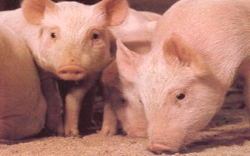
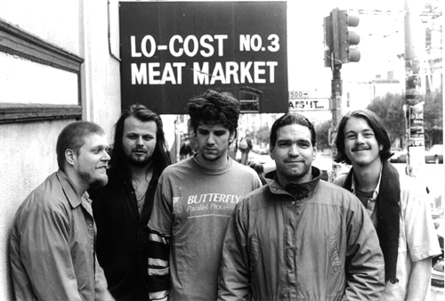
Problem with Text-Based Search
Retrieval for pigs for the color chapter of my book
Small company (was called Ditto)
Allows you to search for pictures from web pages

Slide 11
Features
Color (histograms, gridded layout, wavelets)
Texture (Laws, Gabor filters, local binary pattern)
Shape (first segment the image, then use statistical
or structural shape similarity measures)
Objects and their Relationships
This is the most powerful, but you have to be able to
recognize the objects!

Slide 12
Color Histograms

Slide 13
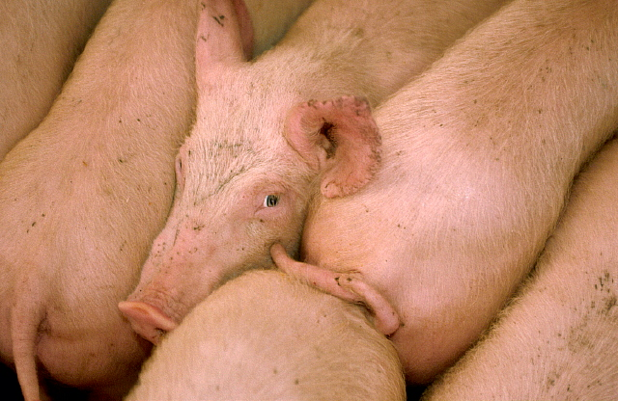
Gridded Color
Gridded color distance is the sum of the color distances
in each of the corresponding grid squares.
1
2
1
2
3
4
3
4
What color distance would you use for a pair of grid squares?

Slide 14
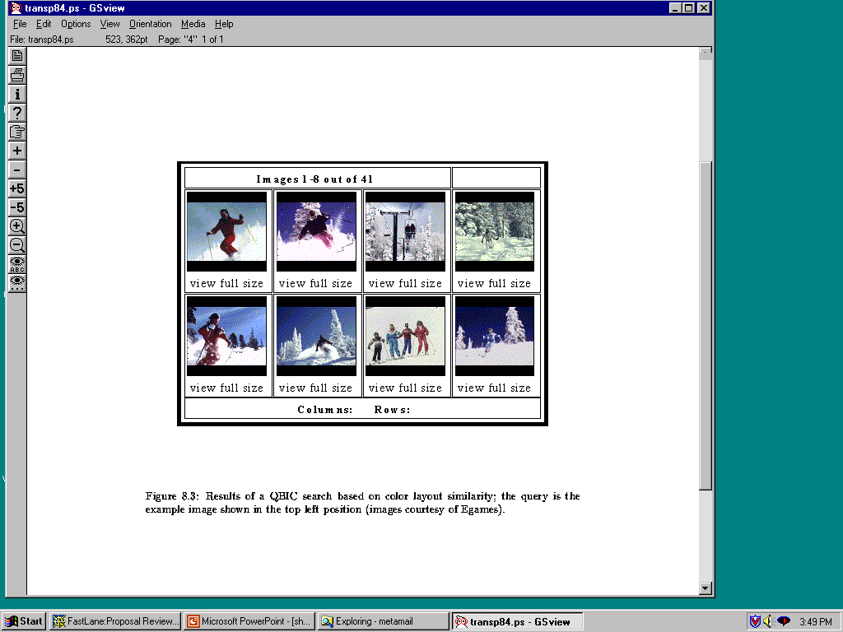
Color Layout (IBM’s Gridded Color)

Slide 15
Texture Distances
Pick and Click (user clicks on a pixel and system
retrieves images that have in them a region with
similar texture to the region surrounding it.
Gridded (just like gridded color, but use texture).
Histogram-based (e.g. compare the LBP histograms).

Slide 16
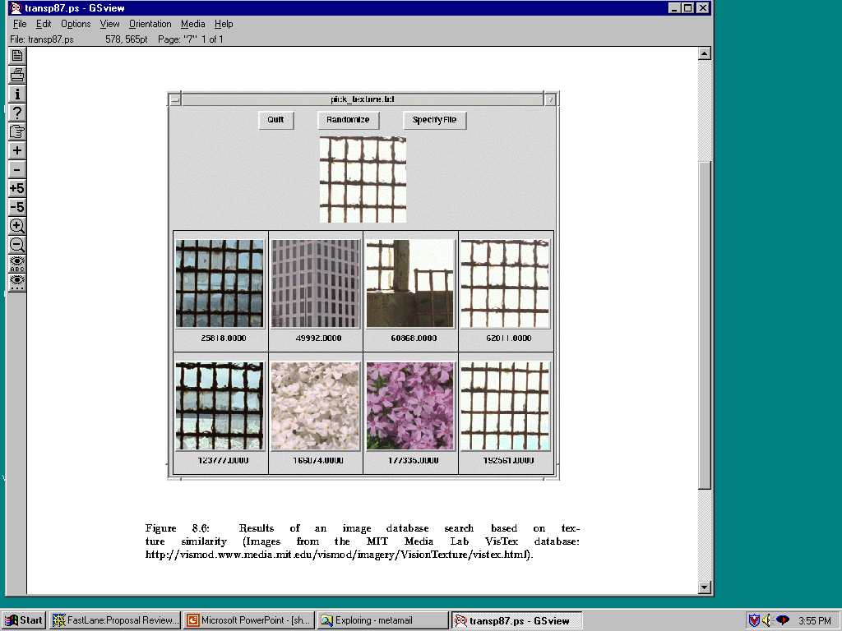
Laws Texture

Slide 17
Shape Distances
Shape goes one step further than color and texture.
It requires identification of regions to compare.
There have been many shape similarity measures
suggested for pattern recognition that can be used
to construct shape distance measures.

Slide 18
Global Shape Properties: Projection Matching
0
4
1
3
2
0
Feature Vector
(0,4,1,3,2,0,0,4,3,2,1,0)
0 4 3 2 1 0
In projection matching, the horizontal and vertical
projections form a histogram.
What are the weaknesses of this method? strengths?

Slide 19
Global Shape Properties: Tangent-Angle Histograms
135
0 30 45 135
Is this feature invariant to starting point?
Is it invariant to size, translation, rotation?

Slide 20
Boundary Matching
Fourier Descriptors
Sides and Angles
Elastic Matching
The distance between query shape and image shape
has two components:
1. energy required to deform the query shape into
one that best matches the image shape
2. a measure of how well the deformed query matches
the image

Slide 21
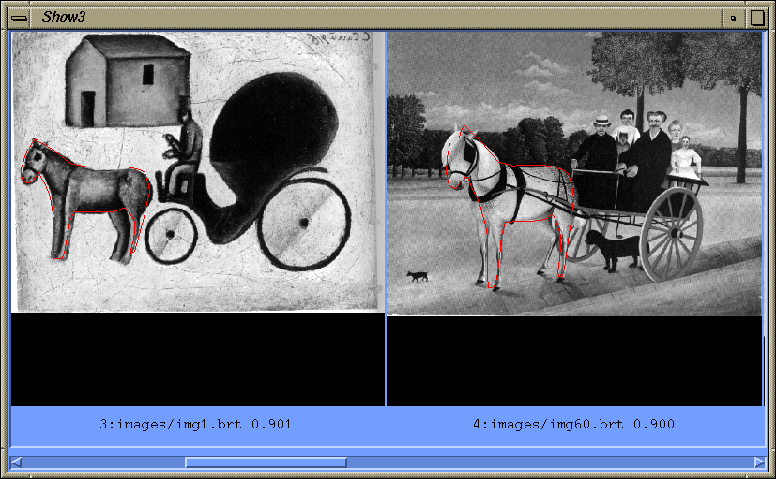
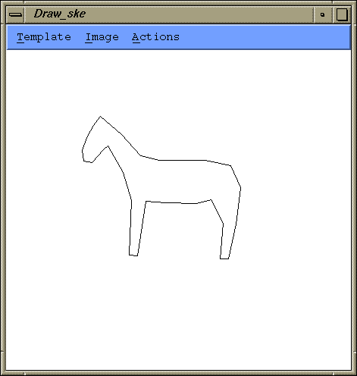
Del Bimbo Elastic Shape Matching
query
retrieved images

Slide 22
Regions and Relationships
Segment the image into regions
Find their properties and interrelationships
Construct a graph representation with
nodes for regions and edges for
spatial relationships
Use graph matching to compare images
Like
what?

Slide 23
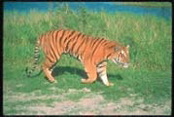
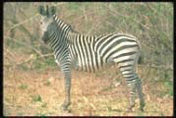
Blobworld (Carson et al, 1999)
Segmented the query (and all database images) using EM on color+texture
Allowed users to select the most important region and what characteristics of it (color, texture, location)
Asked users if the background was also important

Slide 24
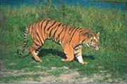
Tiger Image as a Graph (motivated by Blobworld)
sky
image
above
above
adjacent
inside
tiger
grass
above
above
adjacent
sand
abstract regions

Slide 25
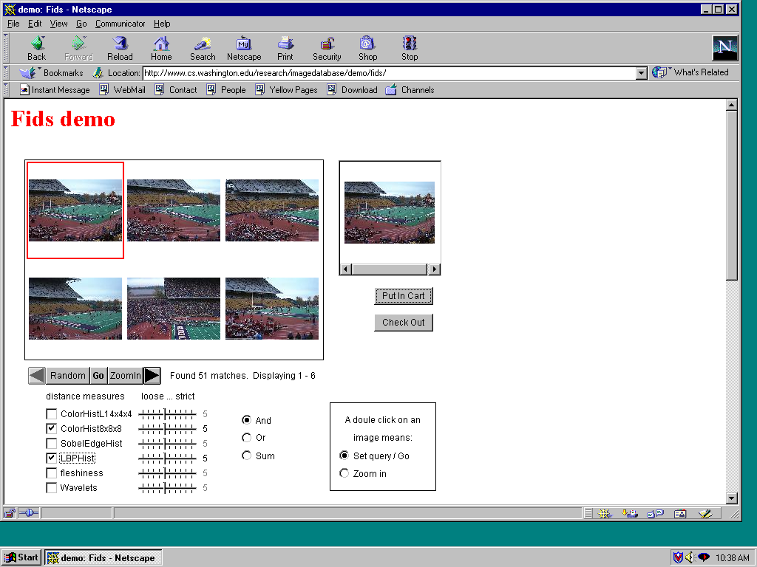
Andy Berman’s FIDS System
multiple distance measures
Boolean and linear combinations
efficient indexing using images as keys

Slide 26
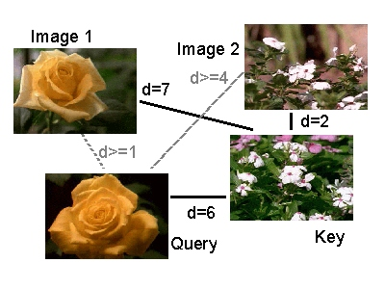
Andy Berman’s FIDS System:
Use of key images and the triangle inequality
for efficient retrieval. d(I,Q) >= |d((I,K) – d(Q,K)|

Slide 27
Andy Berman’s FIDS System:
Bare-Bones Triangle Inequality Algorithm
Offline
1. Choose a small set of key images
2. Store distances from database images to keys
Online (given query Q)
1. Compute the distance from Q to each key
2. Obtain lower bounds on distances to database images
3. Threshold or return all images in order of lower bounds

Slide 28
Andy Berman’s FIDS System:

Slide 29
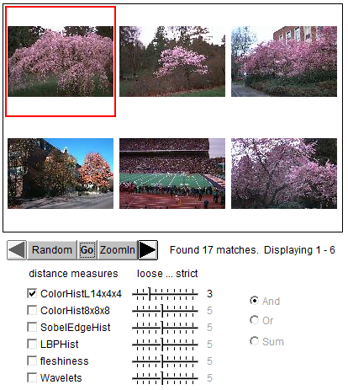
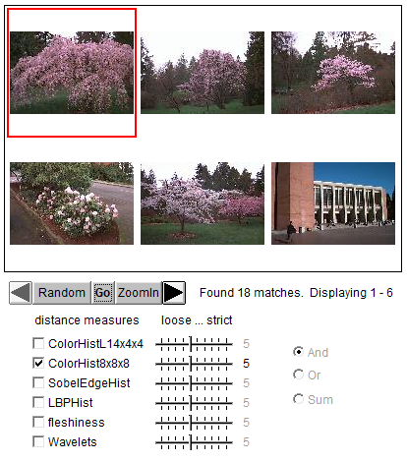
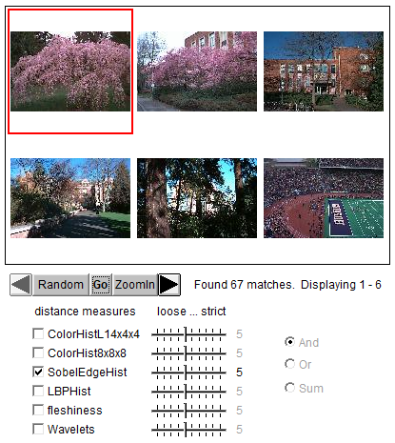
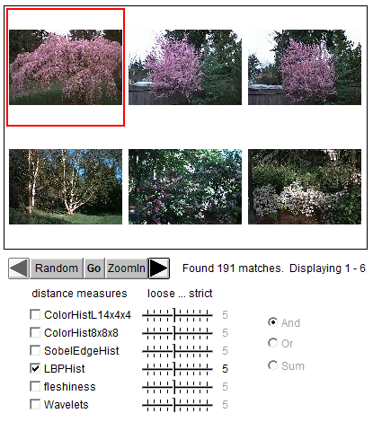
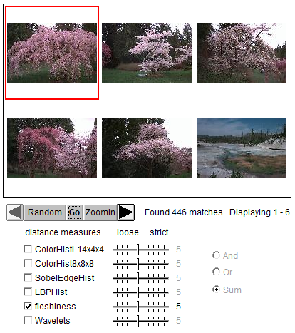
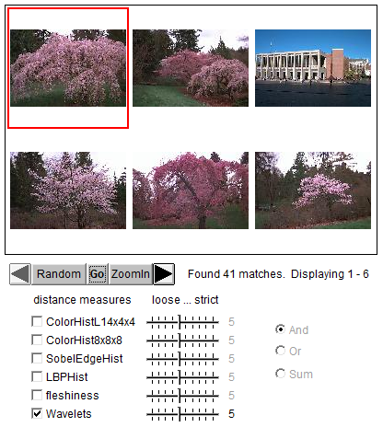
Different Features

Slide 30
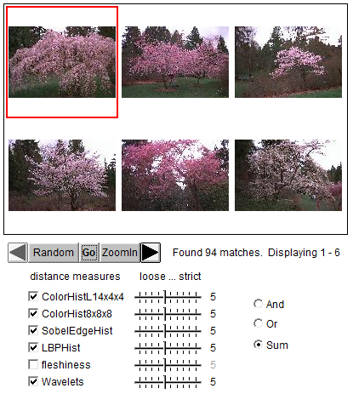
Combined Features

Slide 31
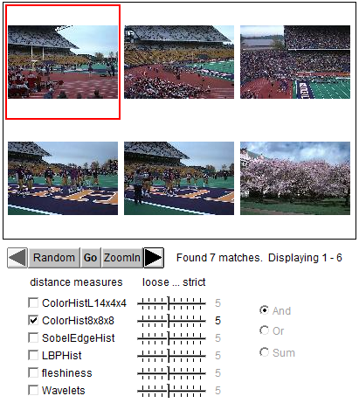
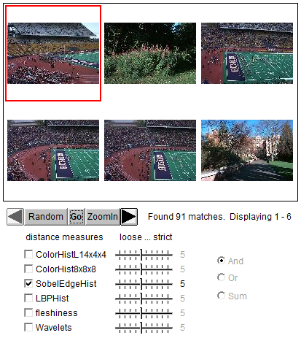
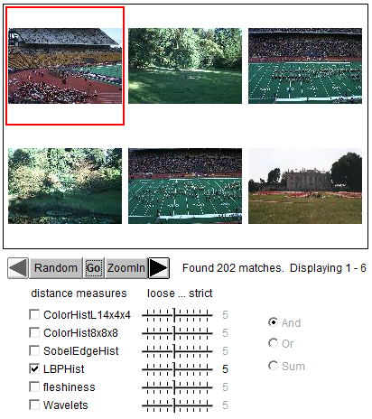
Another example: different features

Slide 32
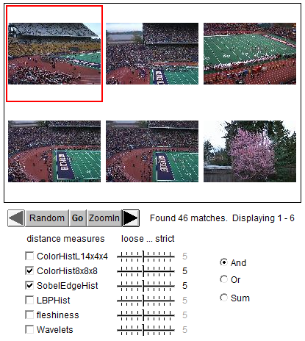
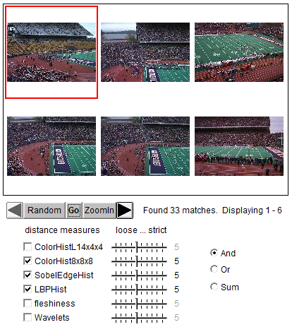
Combined Features

Slide 33
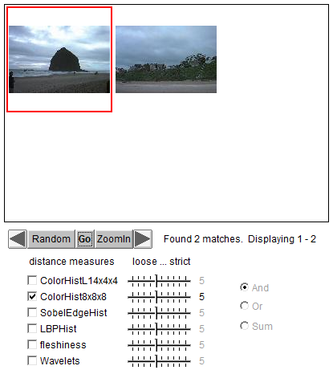
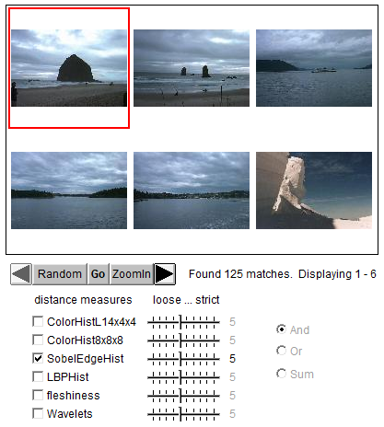
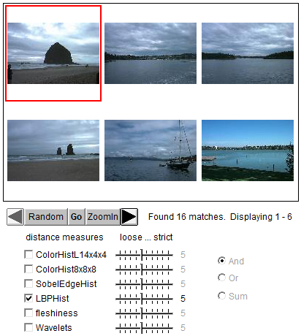
Another example: different features

Slide 34
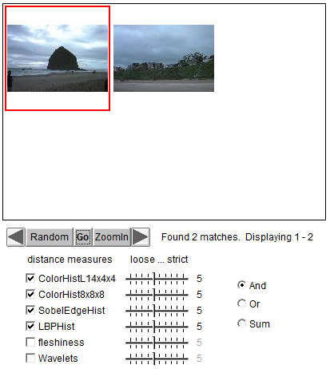
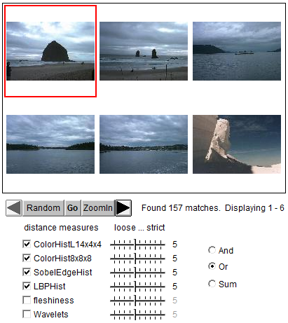
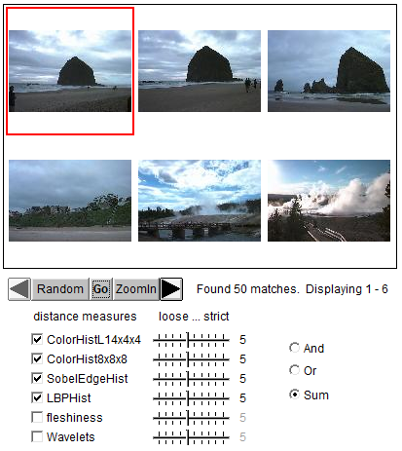
Different ways for combination

Slide 35
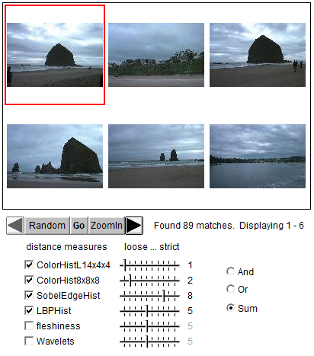
Different weights on features

Slide 36
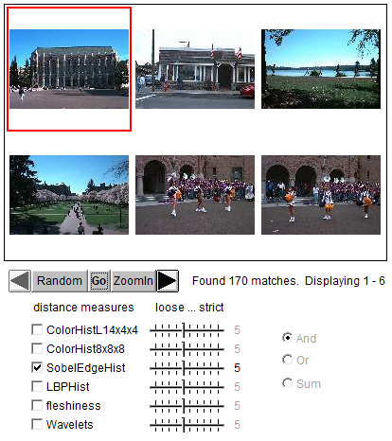
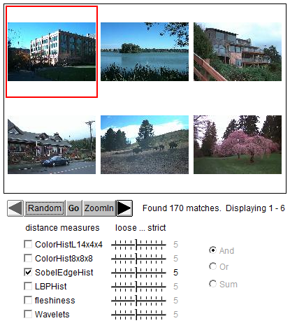

Slide 37
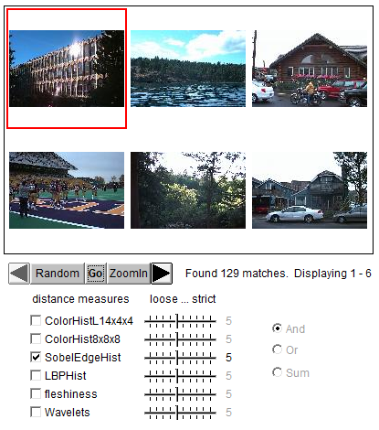
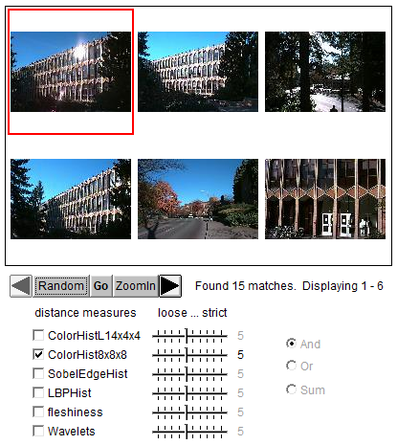

Slide 38
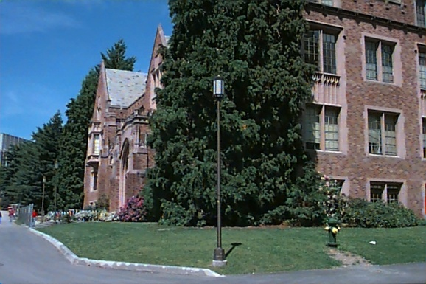
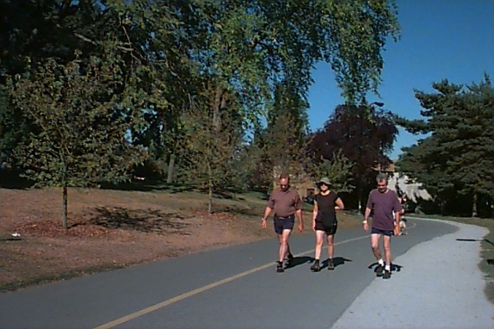
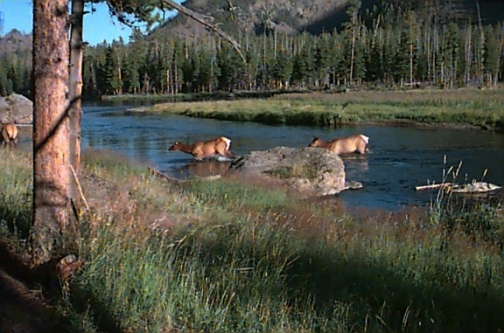
Weakness of Low-level Features
Can’t capture the high-level concepts

Slide 39
Yi Li’s Overall Approach
Develop object recognizers for common objects
Use these recognizers to design a new set of both
low- and mid-level features
Design a learning system that can use these
features to recognize classes of objects

Slide 40
Building Features: Consistent Line Clusters (CLC)
A Consistent Line Cluster is a set of lines that are homogeneous in terms of some line features.
Color-CLC: The lines have the same color feature.
Orientation-CLC: The lines are parallel to each other or converge to a common vanishing point.
Spatially-CLC: The lines are in close proximity to each other.

Slide 41
Experimental Evaluation
Object Recognition
97 well-patterned buildings (bp): 97/97
44 not well-patterned buildings (bnp): 42/44
16 not patterned non-buildings (nbnp): 15/16 (one false positive)
25 patterned non-buildings (nbp): 0/25
CBIR
Notes:
19, 20 , 21, 22

Slide 42
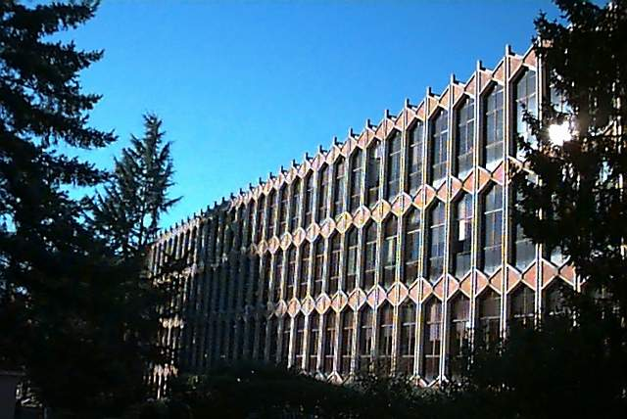
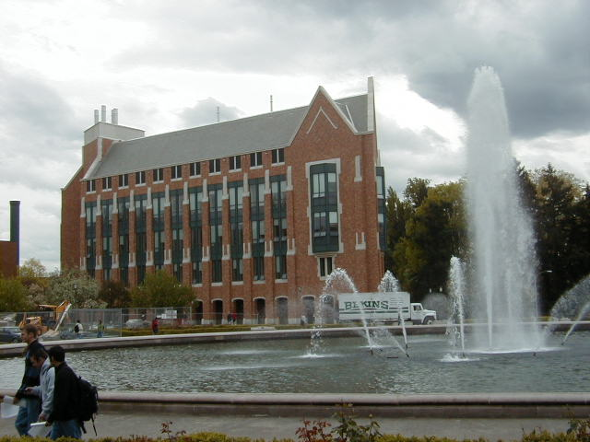
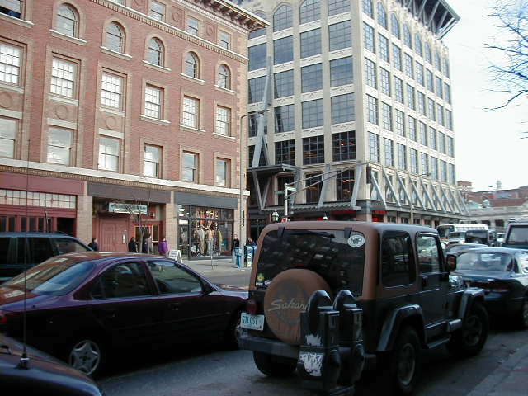
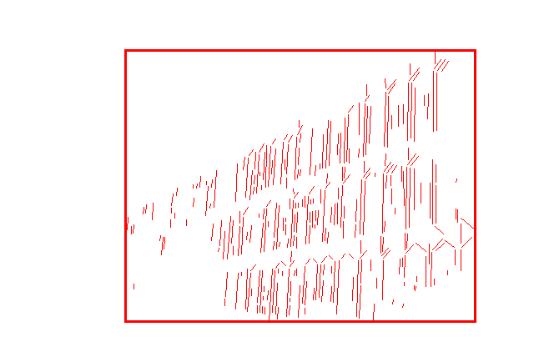
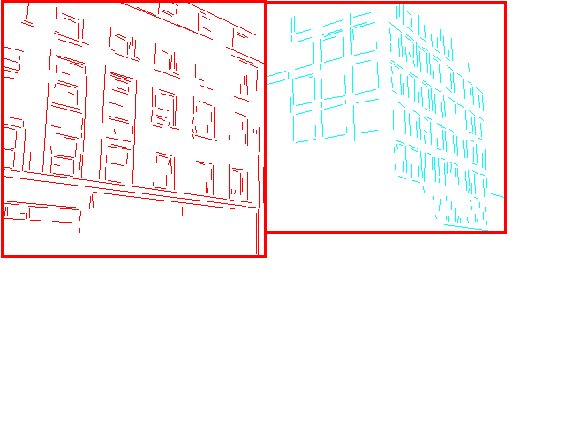
Experimental Evaluation Well-Patterned Buildings
Notes:
19, 20 , 21, 22

Slide 43
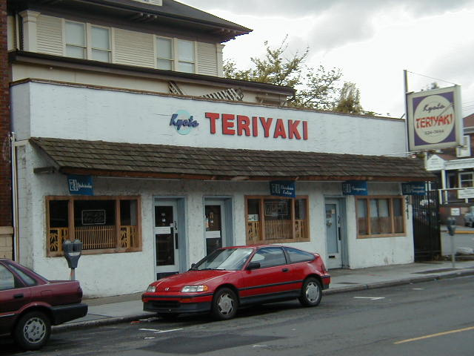
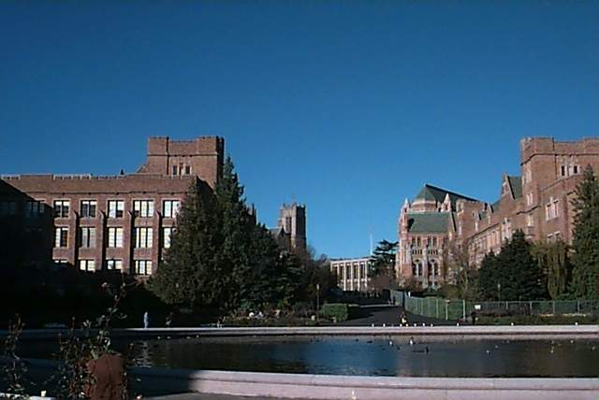
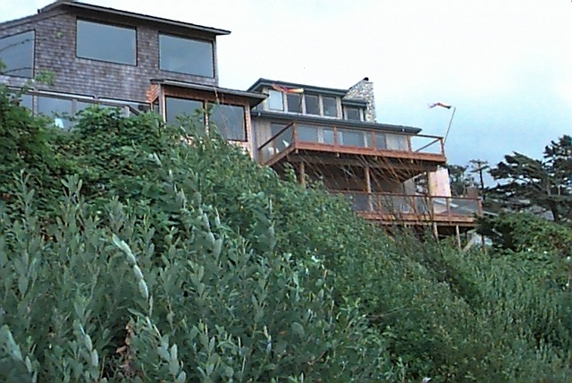
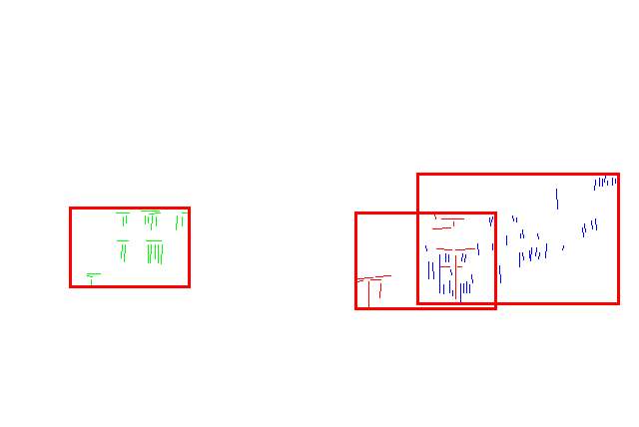
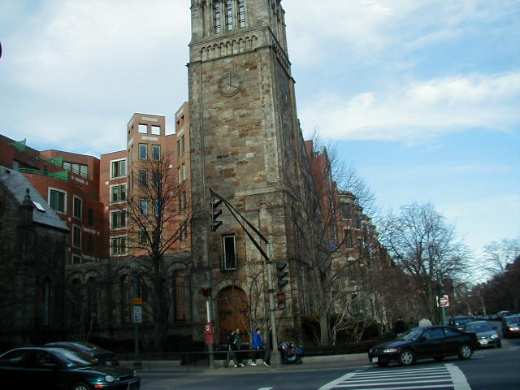
Experimental Evaluation Non-Well-Patterned Buildings
False negative
False negative
Notes:
19, 20 , 21, 22

Slide 44
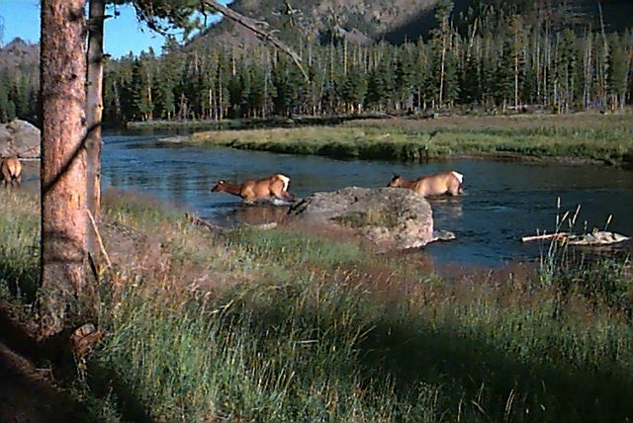
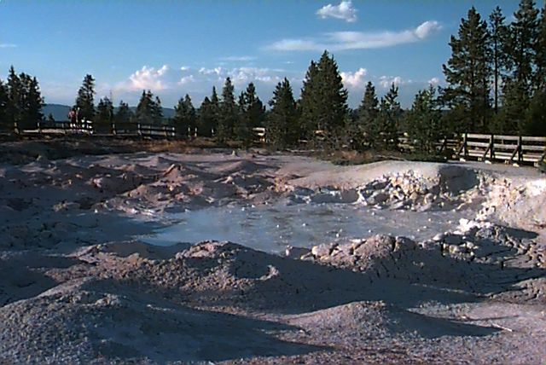
Experimental Evaluation Non-Well-Patterned Non-Buildings
False positive
Notes:
19, 20 , 21, 22

Slide 45
Experimental Evaluation Well-Patterned Non-Buildings (false positives)
Notes:
19, 20 , 21, 22

Slide 46
Experimental Evaluation (CBIR)
 | Total Positive Classification (#) | Total Negative Classification (#) | False positive (#) | False negative (#) | Accuracy (%)
Arborgreens | 0 | 47 | 0 | 0 | 100
Campusinfall | 27 | 21 | 0 | 5 | 89.6
Cannonbeach | 30 | 18 | 0 | 6 | 87.5
Yellowstone | 4 | 44 | 4 | 0 | 91.7
Notes:
Figure l-4 (false examples)
Figure 23 (false yellowstone)

Slide 47
Experimental Evaluation (CBIR) False positives from Yellowstone
Notes:
Figure l-4 (false examples)
Figure 23 (false yellowstone)

Slide 48
Machine Learning!
Unsupervised (given the data, no class labels)
Supervised (given data with class labels)
We will look at two unsupervised methods today
K-means
EM
We saw that EM was used in Rob Fergus’s work.

Slide 49
Clustering
There are K clusters C₁,…, C_{K} with means m₁,…, m_{K}.
The least-squares error is defined as
Out of all possible partitions into K clusters,
choose the one that minimizes D.
K
2
D = ∑ ∑ || x_{i} - m_{k} || .
k=1 x_{i} ∈ C_{k}
Why don’t we just do this?
If we could, would we get meaningful objects?

Slide 50
K-Means Clustering
Form K-means clusters from a set of n-dimensional vectors
1. Set ic (iteration count) to 1
2. Choose randomly a set of K means m₁(1), …, m_{K}(1).
3. For each vector x_{i} compute D(x_{i} , m_{k}(ic)), k=1,…K
and assign x_{i} to the cluster C_{j} with nearest mean.
4. Increment ic by 1, update the means to get m₁(ic),…,m_{K}(ic).
5. Repeat steps 3 and 4 until C_{k}(ic) = C_{k}(ic+1) for all k.

Slide 51
K-Means Example 1

Slide 52
K-Means Example 2

Slide 53
K-Means Example 3

Slide 54
K-means Variants
Different ways to initialize the means
Different stopping criteria
Dynamic methods for determining the right number of clusters (K) for a given image
The EM Algorithm: a probabilistic formulation

Slide 55
K-Means
Boot Step:
Initialize K clusters: C₁, …, C_{K}
Each cluster is represented by its mean m_{j}
Iteration Step:
Estimate the cluster for each data point
Re-estimate the cluster parameters
x_{i}
C(x_{i})

Slide 56
K-Means Example

Slide 57
K-Means Example
Where do the red points belong?

Slide 58
K-Means → EM
Boot Step:
Initialize K clusters: C₁, …, C_{K}
Iteration Step:
Estimate the cluster of each data point
Re-estimate the cluster parameters
(μ_{j,} Σ_{j}) and P(C_{j}) for each cluster j.
Expectation
Maximization
For each cluster j

Slide 59
What is a covariance matrix
For a multidimensional distribution of n dimensions (X₁, X₂, … X_{n}):
Its mean µ is a vector µ = (x₁, x₂, …x_{n})
Example: µ = (r, g, b)
Its covariance matrix gives the variances and covariances for pairs of variables:
Σ = a matrix in which Σ_{ii} = σ_{i}² (variance)
and Σ_{ij} = Cov(X_{i},X_{j}) (covariance of two)

Slide 60
1-D EM with Gaussian Distributions
Each cluster C_{j} is represented by a Gaussian distribution N(μ_{j} , σ_{j}).
Initialization: For each cluster C_{j} initialize its mean μ_{j} , variance σ_{j}, and weight α_{j}.
N(μ₁ , σ₁)
α₁ = P(C₁)
N(μ₂ , σ₂)
α₂ = P(C₂)
N(μ₃ , σ₃)
α₃ = P(C₃)

Slide 61
Expectation
For each point x_{i} and each cluster C_{j} compute P(C_{j} | x_{i}).
P(C_{j} | x_{i}) = P(x_{i} | C_{j}) P(C_{j} ) / P(x_{i})
P(x_{i}) = Σ P(x_{i} | C_{j}) P(C_{j})
Where do we get P(x_{i} | C_{j}) and P(C_{j})?
j

Slide 62
Use the pdf for a normal distribution:
Use α_{j} = P(C_{j}) from the current
parameters of cluster C_{j}.

Slide 63
Maximization
Having computed P(C_{j} | x_{i}) for each point x_{i} and each cluster C_{j}, use them to compute new mean, variance, and weight for each cluster.
∑_{j}

Slide 64
Multi-Dimensional Expectation Step for Color Image Segmentation
Input (Known)
Input (Estimation)
Output
x₁={r₁, g₁, b₁}
x₂={r₂, g₂, b₂}
…
x_{i}={r_{i}, g_{i}, b_{i}}
…
Cluster Parameters
(μ₁,Σ₁), p(C₁) for C₁
(μ₂,Σ₂), p(C₂) for C₂
…
(μ_{k},Σ_{k}), p(C_{k}) for C_{k}
Classification Results
p(C₁|x₁)
p(C_{j}|x₂)
…
p(C_{j}|x_{i})
…
+

Slide 65
Multi-dimensional Maximization Step for Color Image Segmentation
Input (Known)
Input (Estimation)
Output
x₁={r₁, g₁, b₁}
x₂={r₂, g₂, b₂}
…
x_{i}={r_{i}, g_{i}, b_{i}}
…
Classification Results
p(C₁|x₁)
p(C_{j}|x₂)
…
p(C_{j}|x_{i})
…
Cluster Parameters
(μ₁,Σ₁), p(C₁) for C₁
(μ₂,Σ₂), p(C₂) for C₂
…
(μ_{k},Σ_{k}), p(C_{k}) for C_{k}
+

Slide 66
Full EM Algorithm Multi-Dimensional
Boot Step:
Initialize K clusters: C₁, …, C_{K}
Iteration Step:
Expectation Step
Maximization Step
(μ_{j,} Σ_{j}) and P(C_{j}) for each cluster j.

Slide 67
EM Applications
Blobworld: Image segmentation using Expectation-Maximization and its application to image querying
Used both color and texture features with the EM algorithm.

Slide 68
Blobworld: Sample Results

Slide 69
EM Classifier Approach Object Class Recognition using Images of Abstract Regions
Yi Li, Jeff A. Bilmes, and Linda G. Shapiro
Department of Computer Science and Engineering
Department of Electrical Engineering
University of Washington
Notes:
Our research in the field of CBIR.
Maybe a better title: “Object Class Recognition in CBIR”

Slide 70
Problem Statement
Given: Some images and their corresponding descriptions
•••
{trees, grass, cherry trees}
{cheetah, trunk}
{mountains, sky}
{beach, sky, trees, water}
To solve: What object classes are present in new images
•••
?
?
?
?
Notes:
Remove arrow
Dot!
Our
Give title/description of each system

Slide 71
Image Features for Object Recognition
Color
Texture
Structure
Context

Slide 72
Abstract Regions
Original Images
Color Regions
Texture Regions
Line Clusters
Notes:
Caption!

Slide 73
Abstract Regions
Multiple segmentations whose regions are not labeled;
a list of labels is provided for each training image.
image
various different
segmentations
region
attributes
from several
different
types of
regions
labels
{sky, building}

Slide 74
Model Initial Estimation
Estimate the initial model of an object using all the region features from all images that contain the object
Tree
Sky

Slide 75
EM Classifier: the Idea
Initial Model for “trees”
Final Model for “trees”
EM
Initial Model for “sky”
Final Model for “sky”

Slide 76
EM Algorithm
Start with K clusters, each represented by a probability distribution
Assuming a Gaussian or Normal distribution, each cluster is represented by its mean and variance (or covariance matrix) and has a weight.
Go through the training data and soft-assign it to each cluster. Do this by computing the probability that each training vector belongs to each cluster.
Using the results of the soft assignment, recompute the parameters of each cluster.
Perform the last 2 steps iteratively.

Slide 77
1-D EM with Gaussian Distributions
Each cluster C_{j} is represented by a Gaussian distribution N(μ_{j} , σ_{j}).
Initialization: For each cluster C_{j} initialize its mean μ_{j} , variance σ_{j}, and weight α_{j}.
With no other knowledge, use random means and variances and equal weights.
N(μ₁ , σ₁)
α₁ = P(C₁)
N(μ₂ , σ₂)
α₂ = P(C₂)
N(μ₃ , σ₃)
α₃ = P(C₃)

Slide 78
Standard EM to EM Classifier
That’s the standard EM algorithm.
For n-dimensional data, the variance becomes a co-variance matrix, which changes the formulas slightly.
But we used an EM variant to produce a classifier.
The next slide indicates the differences between what we used and the standard.

Slide 79
EM Classifier
Fixed Gaussian components (one Gaussian per object class) and fixed weights corresponding to the frequencies of the corresponding objects in the training data.
2. Customized initialization uses only the training images that contain a particular object class to initialize its Gaussian.
3. Controlled expectation step ensures that a feature vector only contributes to the Gaussian components representing objects present in its training image.
4. Extra background component absorbs noise.
Gaussian for Gaussian for Gaussian for Gaussian for
trees buildings sky background

Slide 80
1. Initialization Step (Example)
Image & description
I₁
O₁
O₂
I₂
O₁
O₃
I₃
O₂
O₃
W=0.5
W=0.5
W=0.5
W=0.5
W=0.5
W=0.5
W=0.5
W=0.5
W=0.5
W=0.5
W=0.5
W=0.5
Notes:
I use real images with regions. The last histograms mark red, green, blue

Slide 81
2. Iteration Step (Example)
I₁
O₁
O₂
I₂
O₁
O₃
I₃
O₂
O₃
E-Step
W=0.8
W=0.2
W=0.2
W=0.8
W=0.2
W=0.8
W=0.8
W=0.2
W=0.8
W=0.2
W=0.2
W=0.8
M-Step

Slide 82
Recognition
Object Model
Database
Test Image
Color Regions
compare
Tree
Sky
How do you decide if a particular object is in an image?
To calculate p(tree | image)
p( tree| )
f is a function that combines
probabilities from all the color
regions in the image.
e.g. max or mean
p(tree | image) = f
p( tree| )
p( tree| )
p( tree| )

Slide 83
Combining different types of abstract regions: First Try
Treat the different types of regions independently and combine at the time of classification.
1. P(object| a₁, a₂,..,a_{n}) = P(object|a₁)*..*P(object|a_{n})
2. Form intersections of the different types of regions, creating smaller regions that have both color and texture properties for classification.

Slide 84
Experiments (on 860 images)
18 keywords: mountains (30), orangutan (37), track (40), tree trunk (43), football field (43), beach (45), prairie grass (53), cherry tree (53), snow (54), zebra (56), polar bear (56), lion (71), water (76), chimpanzee (79), cheetah (112), sky (259), grass (272), tree (361).
A set of cross-validation experiments (80% as training set and the other 20% as test set)
The poorest results are on object classes “tree,” “grass,” and “water,” each of which has a high variance; a single Gaussian model is insufficient.

Slide 85
ROC Charts: True Positive vs. False Positive
Independent Treatment of
Color and Texture
Using Intersections of
Color and Texture Regions
Notes:
Add captions
What’s ROC chart?

Slide 86
Sample Retrieval Results
cheetah

Slide 87
Sample Results (Cont.)
grass

Slide 88
Sample Results (Cont.)
cherry tree

Slide 89
Sample Results (Cont.)
lion

Slide 90
Summary
Designed a set of abstract region features: color,
texture, structure, . . .
Developed a new semi-supervised EM-like algorithm to recognize object classes in color photographic images of outdoor scenes; tested on 860 images.
Compared two different methods of combining different types of abstract regions. The intersection method had a higher performance

Slide 91
Weakness of the EM Classifier Approach
It did not generalize well to multiple features
It assumed that object classes could be modeled as Gaussians

