Slide 1
Fast and Compact Retrieval Methods in Computer Vision
Rahul Garg
Xiao Ling

Slide 2
Objective
phrase
Given a Query image, find all instances of that object in an image database
On the web

Slide 3
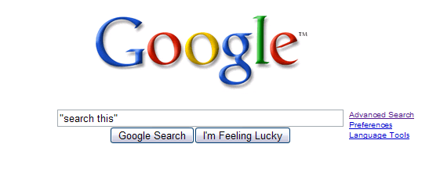
Objective
phrase
Given a Query image, find all instances of that object in an image database
On the web
World Wide Web
“search this”

Slide 4
Text Search Overview

Slide 5
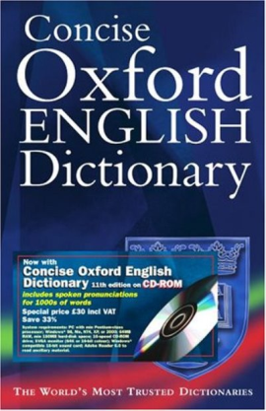
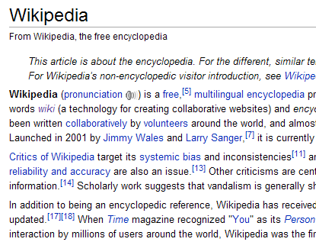
Document Representation
Parse into words
vocabulary
Vector of frequencies of words
(0,3,4,0,0,5,6,0,……….,1)

Slide 6
Document Representation
(0,3,4,0,0,5,6,0,……….,1)
K dimensional vector
K : number of words in vocabulary

Slide 7
Document Representation: Example
Quick
Brown
Fox
Jump
Over
Dog
Cat
The quick brown fox jumps over
the brown dog
Vocabulary
1 | 2 | 1 | 1 | 1 | 1 | 0
Quick | Brown | Fox | Jump | Over | Dog | Cat

Slide 8
Document Representation: Weighted Frequencies
Uncommon words are given more weight
Weight( word_{i}) α log(1/number of occurrences of word_{i} in the whole database)
1 | 2 | 1 | 1 | 1 | 1 | 0
Quick | Brown | Fox | Jump | Over | Dog | Cat
Term frequency – inverse document frequency (tf-idf)
Notes:
Mention tf-idf

Slide 9
Querying
Reduce query to vector form
Find “nearest” document vectors
quick brown fox
(1,1,1,0,0,0,0)

Slide 10
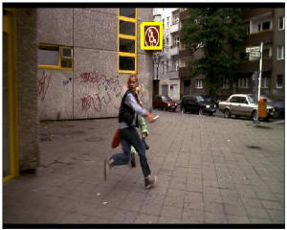
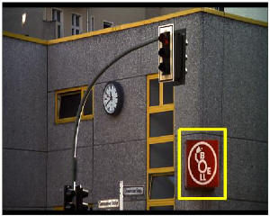
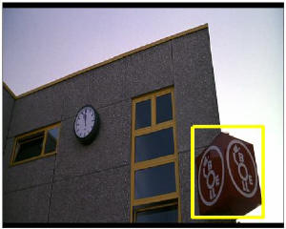
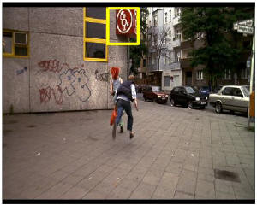
Text Retrieval Applied to Object Retrieval in Images
Video Google, Sivic et. al. ICCV 2003

Slide 11
Text Retrieval vs Object Retrieval
Text Retrieval
Object Retrieval
Documents
Images
Words

Slide 12
“Visual Words”
Idea: Regions of image which are easy to detect and match
Build descriptor
(representation)
of the region

Slide 13
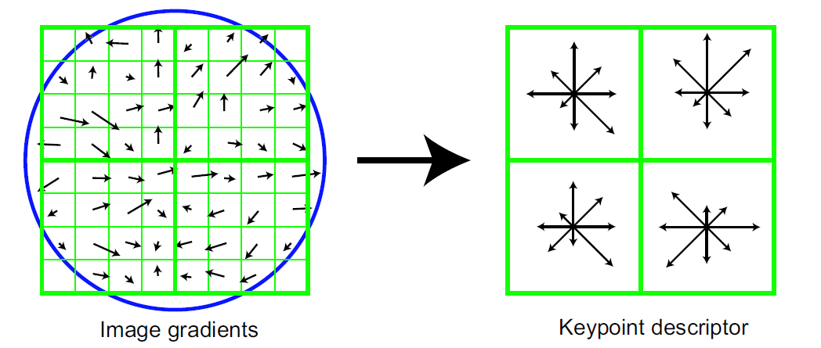
Feature Descriptors
( 130,129,….,101)
Issues
Illumination changes
Pose changes
Scale….
Video Google uses SIFT
Notes:
More description?

Slide 14
Problem: Visual Words are noisy
Descriptors may turn out to be slightly different
Solution: Quantize!

Slide 15
Building Vocabulary of Visual Words
Throw in all descriptors
from the database
Cluster Into K
Visual words using
K means
Vocabulary of K visual words

Slide 16
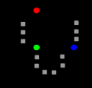
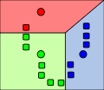
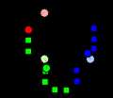
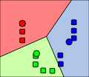
Vocabulary Construction K-means [Sivic and Zisserman, ICCV’03]
Objective
Alternating Minimization Optimization
(courtesy of wikipedia)
Notes:
Use k-means clustering to build the vocabulary
Clustering problem is to automatically cluster data into groups
U_i is the i-th group center, nacentroid
X_j is the data point
Use em-style optimization with two iterative steps
Assign each point into one group
Recalculate the centroid

Slide 17
Image Representation
Analogous to Document Representation
Find
Descriptors
Map
Descriptors
To nearest visual words
Frequency
Vector
(0,3,4,0,0,5,6,0,……….,1)

Slide 18
Querying
(0,3,4,0,0,5,6,0,……….,1)
Find similar vectors (images) in the database

Slide 19
Finding Similar Vectors
Problem: Number of Vectors is large
Vectors are sparse: index using words
Word 1 | List of images containing word1
Word 2 | …..
Inverted Index Files

Slide 20
Stop Lists
Text Retrieval: Remove common words from vocabulary
Analogy: Remove common visual words from vocabulary
is, are, the, that,…

Slide 21
Spatial Consistency Ranking
Text Retrieval: Increase ranking of results where search words appear close
Search: quick brown fox
>
The quick brown fox jumps
over the lazy dog
Fox news: How to make brown
brownies quickly

Slide 22
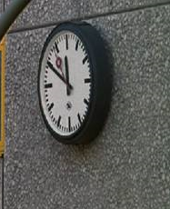
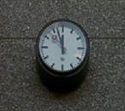
Spatial Consistency Ranking
More relevant in case of images: visual words need to be in same configuration
T

Slide 23
Spatial Consistency Ranking in Video Google

Slide 24
Other ideas borrowed from text retrieval
Stop List : Remove common visual words from vocabulary
Inverted Index Files: Frequency vectors are sparse, index using words
Rank results using spatial consistency
Word 1 | List of images containing word1
Word 2 | …..

Slide 25
Performance Evaluation Metrics
K results returned by query
c: correct results
N: total number of correct results in the database
Precision: c/K
Recall: c/N
Increase K gradually to generate (Precision, Recall) pairs till K = N (Recall = 1.0)

Slide 26
Performance Evaluation Metrics
Recall
Area Under Curve:
Average Precision (AP)

Slide 27
Video Google: Summary
Find Descriptors
Learn Vocabulary
Assign descriptors to words
Find Similar vectors
Rank Results
SIFT
K Means
O(Nk)
Linear Search
O(k)
Inverted Files
Loose Spatial Consistency
We need MORE words!
Vocab
Building
K = ~6K – 10K
Query
Stage
Notes:
Usually… ~6K – 10K clusters
From the iteration the time complexity is mainly on the assignment
The problem comes as
Hierarchical K-Means [Nieter et al, CVPR’06]
Approximate K-Means [Philbin et al, CVPR’07]
Hierarchical Dirichlet Process [?]

Slide 28
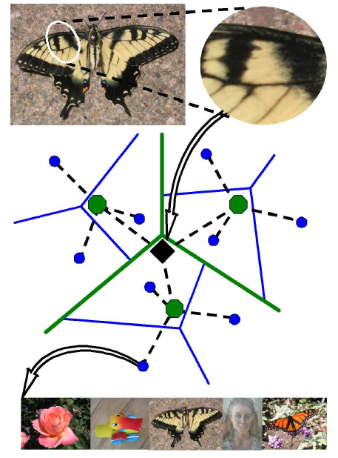
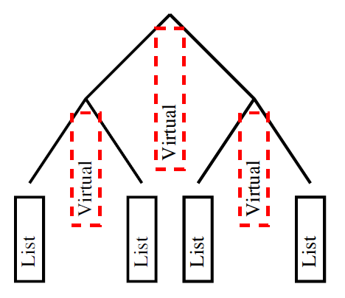
Tree Structure
Tree structure for
searching
indexing
Incorporate inner nodes for scoring
Inverted Document Frequency
Term Frequency
Notes:
O(# of leaves) search
Though large size of words may bring distictiveness, but was haunted by noise. It would be better to consider inner nodes which may be regarded large quantization cells for scoring.
Inner nodes with appending list of children
Tf is based on the path down the leaf
Utilize Inverted file list to compute the ???

Slide 29
Hierarchical K-Means [Nistér et al, CVPR’06]
K – branching factor
Time complexity:
O(N log (# of leaves)) for construction
O(log (# of leaves)) for searching
Cons:
Wrong nearest neighbors assignment
Suffer from bad initial clusters
Notes:
Cons: as a result, descriptors arising from the same object/scene region in different images can be assigned to different cluster

Slide 30
Hierarchical K-Means: Summary
Find Descriptors
Learn Vocabulary
Assign descriptors to words
Find Similar vectors
Rank Results
SIFT
K Means
O(Nk)
Linear Search
O(k)
Inverted Files
Loose Spatial Consistency
MSER. SIFT
Hierarchical K Means
O(N log(# of leaves))
Search along the path
O(k log(# of leaves))
Each node has a Inverted File list
No Spatial Consistency
# of leaves = 1M
Vocab
Building
Query
Stage
Notes:
They claim that spatial information doesn’t matter with a large vocabulary. Though they admitted that it would be a problem with small vocabulary

Slide 31
Approximate k-means [Philbin et al, CVPR’07]
HKM: 1. not the best NN 2. error propagation
Go back to flat vocabulary, but much faster
Nearest neighbor search is the bottleneck
Use kd-tree to speed up
Notes:
Let’s go back to flat structure
K-dim data choose one certain dim and do binary split, again and again
Random version: choose one of the highest variance dimensions, choose randomly some point around median

Slide 32
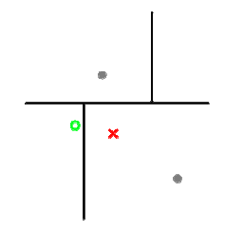
Kd tree
k-d tree hierarchically decomposes the descriptor space
Notes:
Conjunction of trees creates an overlapping partition of the feature space
TO avoid the point which is near the boundary to be wrongly assigned.
Use the best-bin first strategy to determine which branch of the tree to examine next
share this priority queue between multiple trees – searching multiple trees only slightly more expensive than searching one

Slide 33
Approximate k-means cont.
Best bin first Search: O(log k)
Priority queue by dist
dist
dist

Slide 34
AKM cont.
Share one priority queue!
Use multiple (L) randomized kd trees for Approximate NN search, in both construction and assignment phase
Searching complexity: O(L*log K + C)
Approximate K-means complexity: O(N log K)

Slide 35
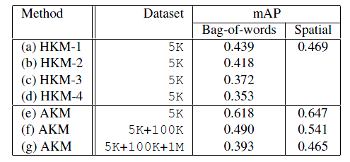
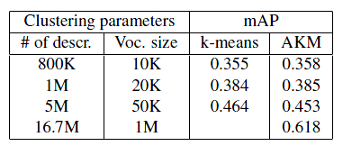
Approximate k-means cont.
Close to exact k-means, though much faster
Superior to HKM empirically
Mean AP
Notes:
One possible way is sampling.

Slide 36
Approximate K-Means: Summary
Find Descriptors
Learn Vocabulary
Assign descriptors to words
Find Similar vectors
Rank Results
SIFT
Approximate K Means
O(N log(# of leaves))
Search
O(log(# of leaves))
Inverted File list
Transformation based Spatial Verification
# of leaves = 1M
Vocab
Building
Query
Stage
Notes:
They claim that spatial information doesn’t matter with a large vocabulary. Though they admitted that it would be a problem with small vocabulary

Slide 37
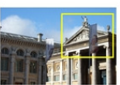
Low Recall
Feature detection and quantization
Even for the same object,
different visual words!
Query region may not
contain enough features
Two possible solutions
Query expansion [Chum et al, ICCV’07]
Soft Assignment [Philbin et al, CVPR’08]
NOISY!
Notes:
Unfortunately, feature detection and quantization are noisy processes and this can result in variation in particular visual words that appear in different images of the same object, then missed results

Slide 38
Query Expansion
Text retrieval
Dimension is too high!
results
Results about fiddle
……
……
Query: violin
Search engine
Search engine
Expanded query

Slide 39
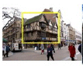
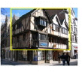
Query expansion [Chum et al, ICCV’07]
What if the initial results are poor?
Filter by spatial constraints
Basic idea: augment the query with visual words from initial matching region
Query → initial result list
…
expanded query by → new results
averaging the results
Notes:
Allow to use those relevant words not present in the query image
Naïve: average N results to form a new query
They did some transformation for the query image to find the inliers.

Slide 40
Query expansion cont.
Results
Query
Initial results
Results by expansion

Slide 41
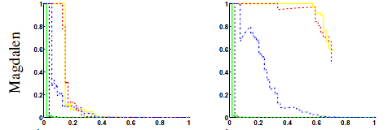
Query expansion cont.
Increasing recall without loss of precision
Precision-recall curves
before
after
Each line: each query image for a certain landmark

Slide 42
Query Expansion: Summary
Find Descriptors
Learn Vocabulary
Assign descriptors to words
Find Similar vectors
Rank Results
SIFT
Approximate K Means
Search
Inverted File list
Spatial Verification to find inliers for expansion
Vocab
Building
Query
Stage

Slide 43
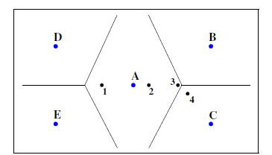
Soft Assignment [Philbin et al, CVPR’08]
Try to capture the information for the near-boundary features by associating one feature to several words
Intuition: includes “semantically” similar variants in the context of text retrieval
with denser image representation (thus more storage)
Can be applied to existing methods
tradeoff!

Slide 44
Soft Assignment
Associate a single descriptor with r nearby cluster centers instead of its single nearest-neighbor cluster
weight
Modified tfidf scheme
tf: use real values for frequency
idf: counting occurrence as one, empirically best
Modified spatial verification
weighted score instead of occurrence to rank hypothesis
Notes:
Increase recall,
Try to mitigate the effect of points closer to boundary, same aim as approx nn, while ann still adopts the hard assignment

Slide 45
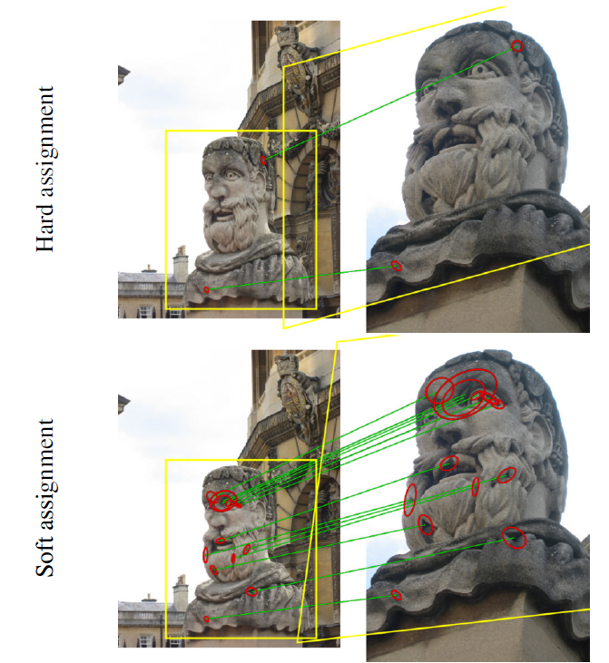
Matching
Results

Slide 46
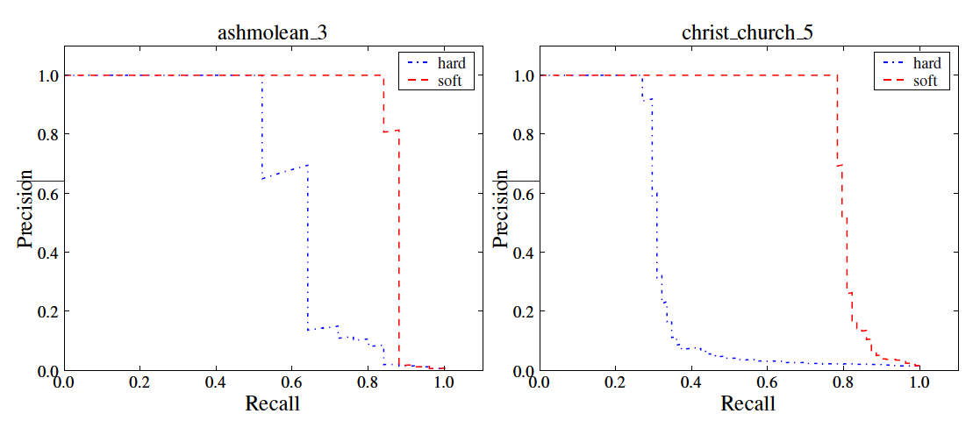
Soft assignment cont.
Improvements

Slide 47
Soft Assignments: Summary
Find Descriptors
Learn Vocabulary
Assign descriptors to words
Find Similar vectors
Rank Results
SIFT
Approximate K Means
Soft Assignment
Inverted File list
Spatial Verification reranking + query expansion
Vocab
Building
3 times storage when using 3-NN soft assignment
10% mAP gain
Query
Stage
Tradeoff!

Slide 48
Spatial Information Lost
Quantization is information loss process
From 2d (pixel) structure to (feature)vector
How to model the geometry?

Slide 49
Spatial Consistency Constraints [Chum et al, ICCV’07]
T’ (6 dof)
T (3 dof)
scale₁
scale₂
Notes:
Consider the set of matches. Let us consider a single match from this set of matches. The descriptors also have a scale attached with them. Using this scale, we can compute a 3 dof transformation from one image to the other ( 2 dof for translation and one for isotropic scaling). We count how many matches are “explained” by this transformation. If there are enough, we use all these inliers to compute a full 6 dof affine transformation and again count the number of inliers. RANSAC is used to select the match that generates the most number of inliers. If there are enough inliers for the 6 dof transformation, the image can be used for query expansion.

Slide 50
Conclusion
Find Descriptors
Learn Vocabulary
Assign descriptors to words
Find Similar vectors
Rank Results
Borrow text retrieval methods to conduct fast image retrieval, e.g. tf-idf weight, query expansion
Quantization, searching and indexing are the core problems

Slide 51
Future Work
Goal: Web-scale retrieval system
Vocabulary to span the space of all images?
Spatial information in Indexing instead of Ranking

Slide 52
QA and comments?

