Slide 1
Silhouettes in Multiview Stereo
Ian Simon

Slide 2
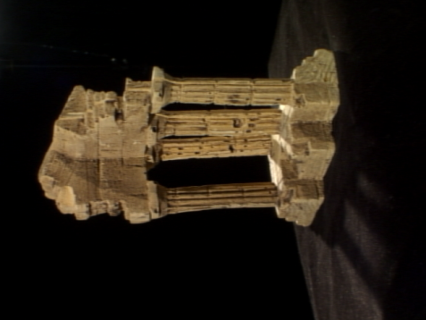
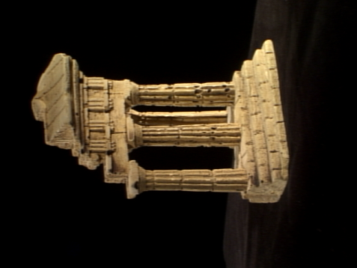
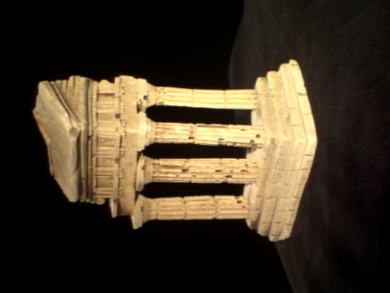
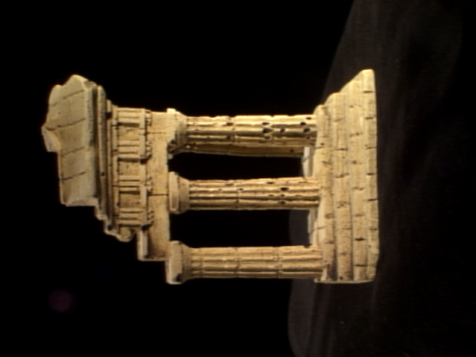
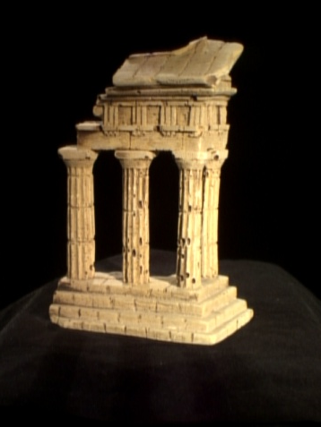
Multiview Stereo Problem
Input:
a collection of images of a rigid object (or scene)
camera parameters for each image

Slide 3
Multiview Stereo Problem
Output:
a 3D model of the object

Slide 4
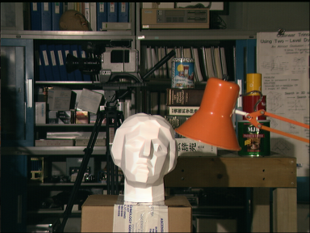
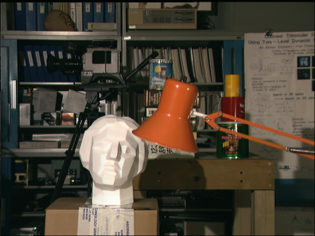
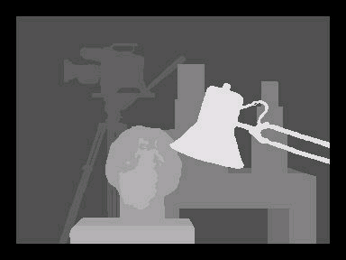
2-View Stereo Comparison
+
=
2-View Stereo
output depth map
most points visible in both images
smoothness critical
Multiview Stereo
output complete object model (e.g. 3D mesh)
visibility varies greatly across images
more data, smoothness less useful

Slide 5
Outline
Multiview Stereo Cues
Local Photoconsistency
Weighted Minimal Surfaces
Silhouette Constraints
Relaxation & Thresholding
Results
Solving the Relaxed Problem

Slide 6
Multiview Stereo Cues
What information can help us compute the object’s shape?

Slide 7
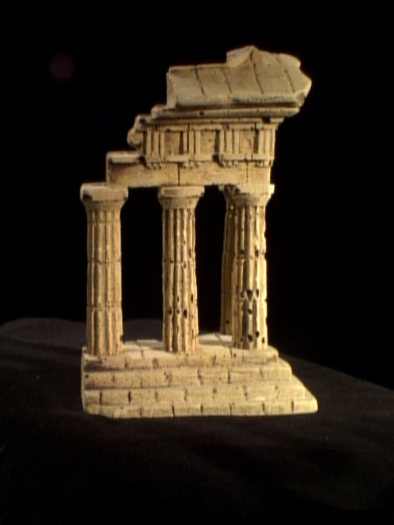
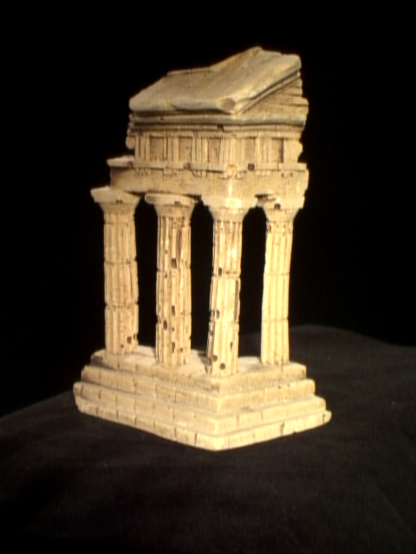
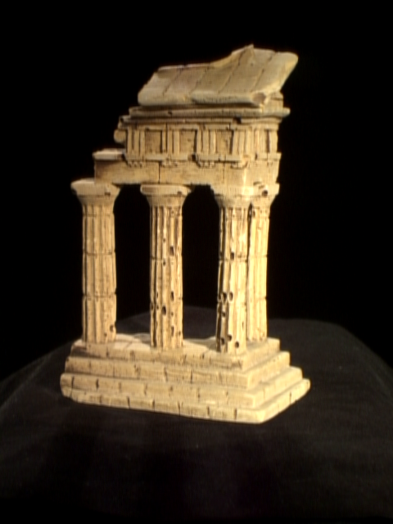
Cues: Photoconsistency
3D point on the object must have consistent appearance in all images in which it is visible.

Slide 8
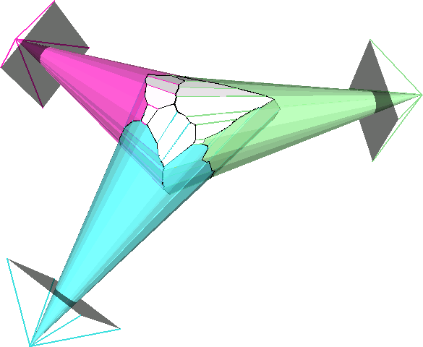
Cues: Silhouettes
Projection of 3D shape into image must agree with object contours in the image.

Slide 9
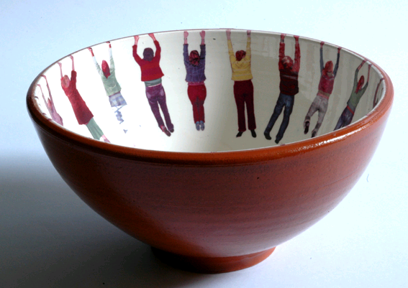
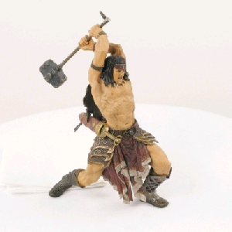
Photoconsistency + Silhouettes
Concavities do not show up in silhouettes.
Photoconsistency is ambiguous for textureless regions.
Photoconsistency often fails for thin regions with high curvature.

Slide 10
Photoconsistency + Silhouettes

Slide 11
Using Photoconsistency
Goal:
Solve for shape with minimum photoconsistency-weighted surface area.
inverse photoconsistency

Slide 12
Visibility Issue
The photoconsistency of a point depends on the global 3D shape.
Is there a good local approximation?

Slide 13
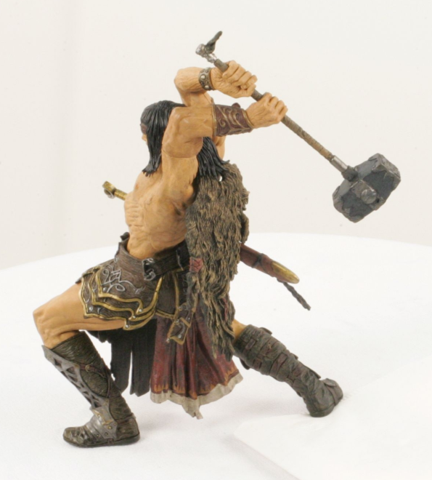
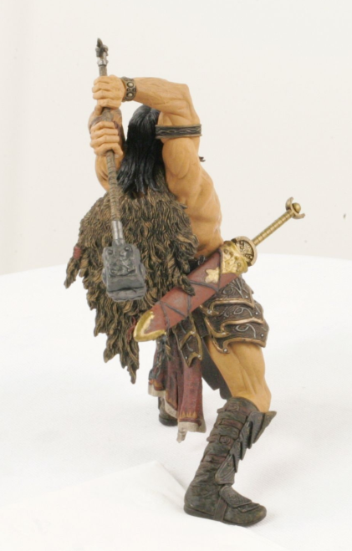
Local Photoconsistency
Hernández & Schmitt, “Silhouette and Stereo Fusion for 3D Object Modeling”, CVIU 2004.
Idea: treat occlusions as outliers

Slide 14
Computing Photoconsistency
For each image I:
For each pixel p in I:
Sample equally spaced points q_{d} along R(p).
For each neighboring image N_{j}:
Compute projection π(q_{d}) of all q_{d} into N_{j}.
Compute the NCC between W(p) and W(π(q_{d})).
Choose depth d with high NCC scores, if one exists.
Add one vote for voxel v containing q_{d}.
The number of votes received by each voxel is a measure of its photoconsistency.

Slide 15
Photoconsistency Map
We now have a photoconsistency map ρ.
Next: compute photoconsistency-weighted minimal surface

Slide 16
Ballooning Term
Vogiatzis et al., “Multi-view Stereo via Volumetric Graph-cuts”, CVPR 2005.
Problem: the empty set minimizes
Hack: add term
volume enclosed by S

Slide 17
Volumetric Graph Cut
1 vertex per voxel
edge between adjacent voxels
(photoconsistency sampled between voxels)
graph cut yields optimal surface

Slide 18
Outline
Multiview Stereo Cues
Local Photoconsistency
Weighted Minimal Surfaces
Silhouette Constraints
Relaxation & Thresholding
Results
Solving the Relaxed Problem

Slide 19
Enforcing Silhouette Constraints
Previous Approaches:
Pin the surface to points on the visual hull. (Tran & Davis, Sinha et al.)
Add silhouette-aligning steps to the optimization. (Hernández & Schmitt, Furukawa & Ponce)

Slide 20
Pinning the Surface
Tran & Davis, “3D Surface Reconstruction Using Graph Cuts with Surface Constraints”, ECCV 2006.
A viewing ray through a silhouette boundary must touch the surface at one point (or more).
But which one?

Slide 21
Where to Pin
For each silhouette ray, pin the most photoconsistent point.

Slide 22
How to Pin
Problem: no way to force graph cuts to cut an edge.
Hack:
Choose surface S_{in} that is guaranteed to be contained by the actual surface.
Connect S_{in} to each pinned point p by a chain of edges with large weight.

Slide 23
Where are we?
So far we’ve seen:
how to compute a photoconsistency map
the minimal photoconsistency-weighted surface
(represented as voxel occupancy grid)
an attempt at enforcing silhouettes
Next:
a cleaner way to enforce silhouettes

Slide 24
Silhouettes: Another Try
Kolev & Cremers, “Integration of Multiview Stereo and Silhouettes Via Convex Functionals on Convex Domains”, ECCV 2008.
enforces silhouette constraints exactly
no ballooning terms or pinned surface points
finds globally optimal solution (of relaxed problem)

Slide 25
Silhouette Constraint
p not in silhouette
u(v) = occupancy of voxel v
u(v) є {0,1}
p in silhouette

Slide 26
Convex Relaxation
Problem:
Silhouette constraint on voxel occupancy is non-binary, non-submodular.
no graph cuts
Not (Really) a Hack:
Relax u to take values in [0,1].
Now we can solve for the (photoconsistency-weighted) minimal surface.

Slide 27
Convex Relaxation
minimize
s.t.
photoconsistency-weighted surface area
voxels on ray through pixel outside silhouette are empty
total amount of “stuff” on ray through pixel inside silhouette exceeds a fixed threshold

Slide 28
Convex Relaxation
Is this convex?
constraints are affine
ρ(x) is constant
norm of gradient is convex:
Okay, it’s convex.
min.
s.t.

Slide 29
Algorithm
Compute photoconsistency map ρ.
Solve relaxed optimization problem (globally).
Threshold continuous voxel occupancies to {0,1}.

Slide 30
Thresholding
Choose as the threshold.
(or choose 0.5 if it’s smaller)
Find the voxel with smallest occupancy value that is the largest for some silhouette ray.
This guarantees that all silhouette constraints are satisfied.

Slide 31
Outline
Multiview Stereo Cues
Local Photoconsistency
Weighted Minimal Surfaces
Silhouette Constraints
Relaxation & Thresholding
Results
Solving the Relaxed Problem

Slide 32
Results
Vogiatzis et al.
(ballooning)
Kolev & Cremers (convex relaxation)

Slide 33
Results
Sinha et al.
(not discussed)
Kolev & Cremers

Slide 34
Results

Slide 35
Solving the Relaxed Problem
min.
s.t.
is minimized at
For fixed , this is linear.
Solve by SOR, update , and repeat.
Periodically project u onto feasible (silhouette-consistent) region.

