Slide 1
Poselets
Michael Krainin
CSE 590V
Oct 18, 2011

Slide 2
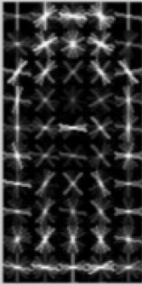
Person Detection
Dalal and Triggs ‘05
Learn to classify pedestrians vs. background
HOG + linear SVM
Doesn’t account for variations in body pose and viewpoint

Slide 3
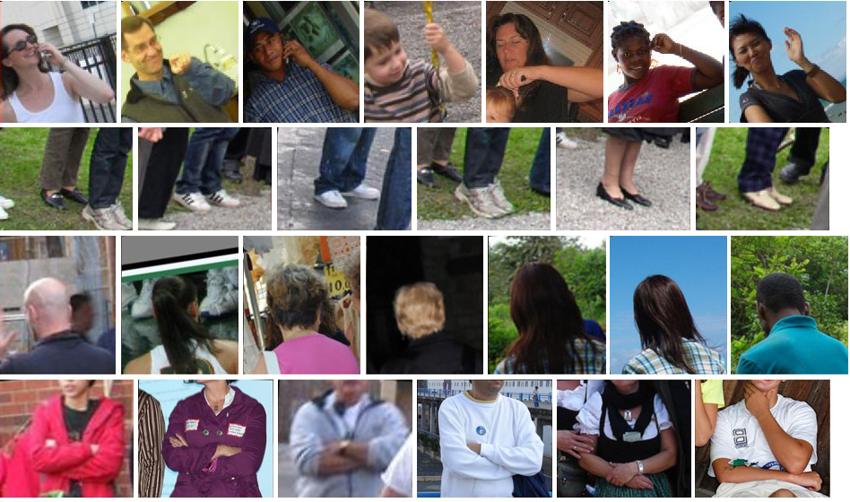
Poselets
Poselets capture part of the pose from a given viewpoint
[Bourdev & Malik, ICCV09]

Slide 4
Poselets
But how are we going to create training examples of poselets?
[Bourdev & Malik, ICCV09]

Slide 5
How do we train a poselet for a given pose configuration?
[Bourdev & Malik, ICCV09]

Slide 6
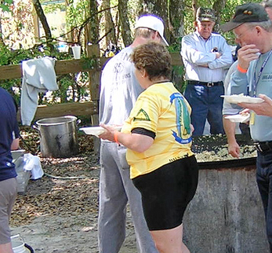
Finding correspondences at training time
Given part of a human pose
How do we find a similar pose configuration in the training set?
[Bourdev & Malik, ICCV09]

Slide 7
Finding correspondences at training time
Left Shoulder
Left Hip
We use keypoints to annotate the joints, eyes, nose, etc. of people
[Bourdev & Malik, ICCV09]

Slide 8
Finding correspondences at training time
Residual Error
[Bourdev & Malik, ICCV09]

Slide 9
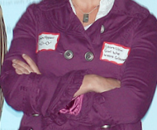
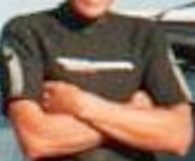
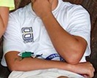
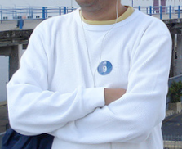
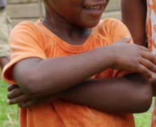
Training poselet classifiers
Residual Error:
0.15
0.20
0.10
0.85
0.15
0.35
Given a seed patch
Find the closest patch for every other person
Sort them by residual error
Threshold them
[Bourdev & Malik, ICCV09]

Slide 10
Training poselet classifiers
Given a seed patch
Find the closest patch for every other person
Sort them by residual error
Threshold them
Use them as positive training examples to train a linear SVM with HOG features
[Bourdev & Malik, ICCV09]

Slide 11
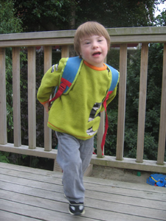
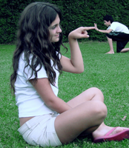
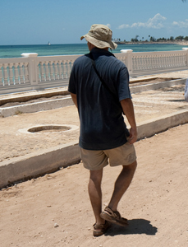
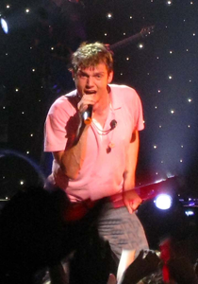
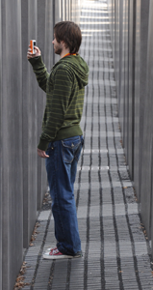
Which poselets should we train?
Choose thousands of random windows, generate poselet candidates, train linear SVMs
Select a small set of poselets that are:
Individually effective
Complementary
[Bourdev & Malik, ICCV09]

Slide 12
Person Detection Using Poselets
[12] Felzenszwalb et al. Object Detection with Discriminatively Trained Part Based Models. PAMI 2010.

Slide 13
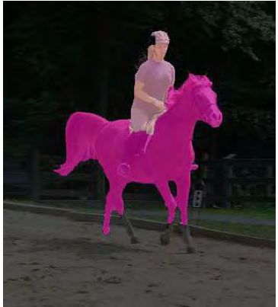
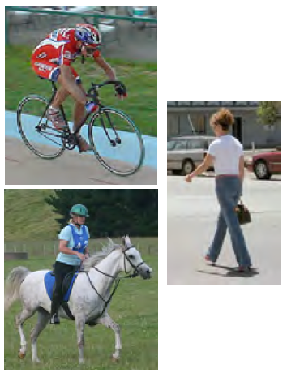
Other Uses of Poselets
Object Segmentation (CVPR 2011)
Predict area using “soft masks”
Deformation to match image edges
Extends poselets to other objects
Activity Recognition (CVPR 2011)
Recognition from a single image
Use which poselets fired and to what extent to predict the activity

Slide 14
Describing People: A Poselet-Based Approach to Attribute Classification
L. Bourdev, S. Maji, and J. Malik
ICCV 2011

Slide 15
Random 1¼% of the test set
[Bourdev et al., ICCV11]

Slide 16
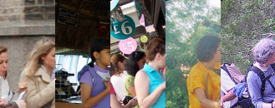
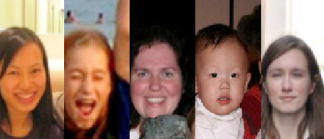
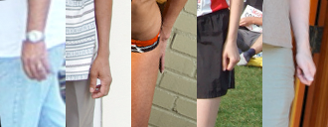
How poselets help in high-level vision
The image is a complex function of the viewpoint, pose, appearance, etc.
Poselets decouple pose and camera view from appearance
[Bourdev et al., ICCV11]

Slide 17
Gender recognition with poselets
[Bourdev et al., ICCV11]

Slide 18
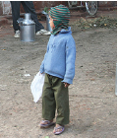
Attribute Classification Overview
Given a test image
Poselet
Activations
[Bourdev et al., ICCV11]

Slide 19
Features
Pyramid HOG
LAB histogram
Skin features
Hands-skin
Legs-skin
Poselet
patch
Skin
mask
Arms
mask
B .* C
Features
Features
Poselet
Activations
[Bourdev et al., ICCV11]

Slide 20
Poselet Level Classification
Linear SVM + Sigmoid
Some attributes are associated with a particular body part
Poselet-level Classifiers
Features
Poselet
Activations
[Bourdev et al., ICCV11]

Slide 21
Person-level Classification
Another Linear SVM + Sigmoid
Person-level Classifiers
Poselet-level
Classifiers
Features
Poselet
Activations
[Bourdev et al., ICCV11]

Slide 22
Context-Level Classification
Context-level Classifiers
Person-level Classifiers
Poselet-level Classifiers
Features
Poselet
Activations
[Bourdev et al., ICCV11]

Slide 23
Results

Slide 24
Random 1¼% of the test set
[Bourdev et al., ICCV11]

Slide 25
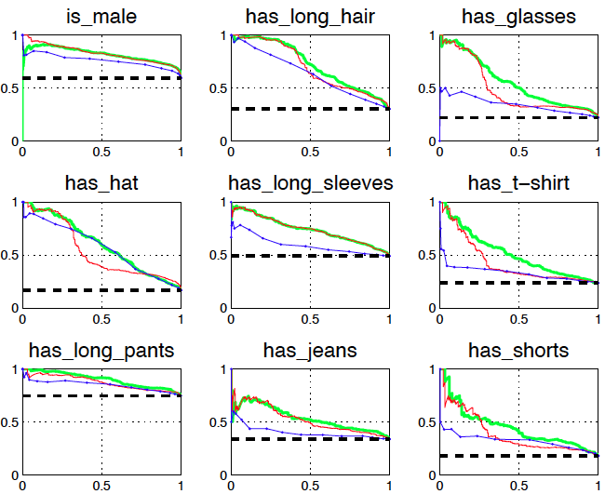
Precision/recall on our test set
Label Frequency SPM Poselets-No-context Poselets-Full
[Bourdev et al., ICCV11]

Slide 26
Gender Recognition vs. Cognitec
Cognitec is one of the leading face recognition companies (according to latest NIST test)
 | Cognitec | Poselets
Scope | Frontal faces only | Any view
Features | Proprietary biometric | Standard HOG
Min resolution | 60pixel face width | Any resolution
Performance | 75.0% AP | 82.4% AP
Upper bound for any gender recognizer based on frontal faces: Max AP=80.5% vs. 82.4%
[Bourdev et al., ICCV11]

Slide 27
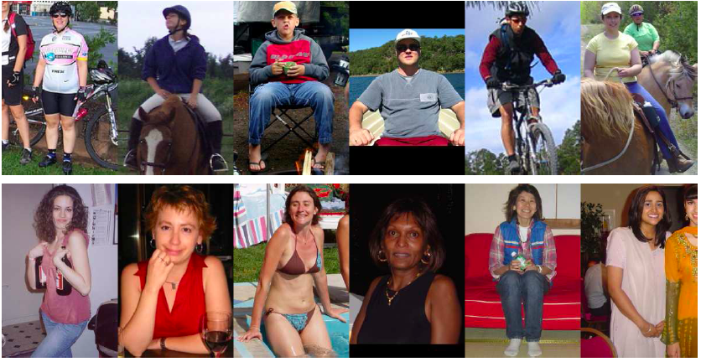
Highest-scoring “is male”
Lowest-scoring “is male”
[Bourdev et al., ICCV11]

Slide 28
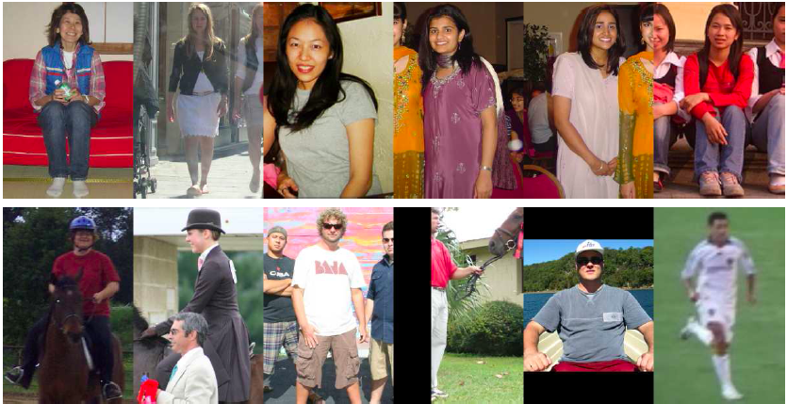
Highest-scoring “has long hair”
Lowest-scoring “has long hair”
[Bourdev et al., ICCV11]

Slide 29
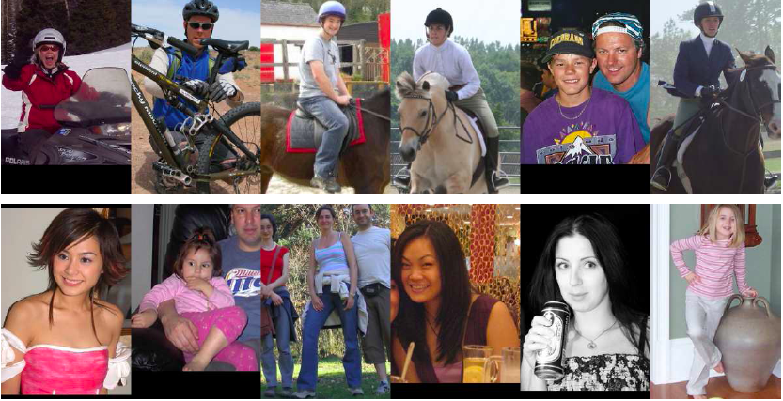
Highest-scoring “wears a hat”
Lowest-scoring “wears a hat”
[Bourdev et al., ICCV11]

Slide 30
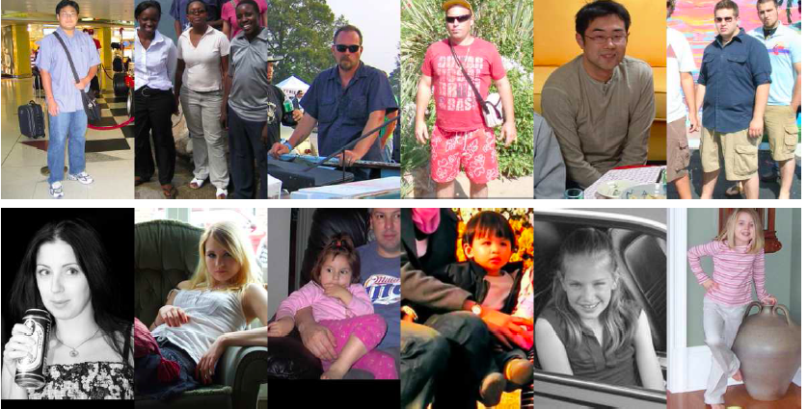
Highest-scoring “wears glasses”
Lowest-scoring “wears glasses”
[Bourdev et al., ICCV11]

Slide 31
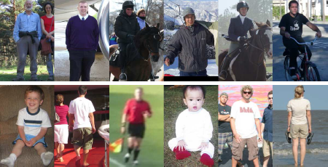
Highest-scoring “long sleeves”
Lowest-scoring “long sleeves”
[Bourdev et al., ICCV11]

Slide 32
[Bourdev et al., ICCV11]

Slide 33
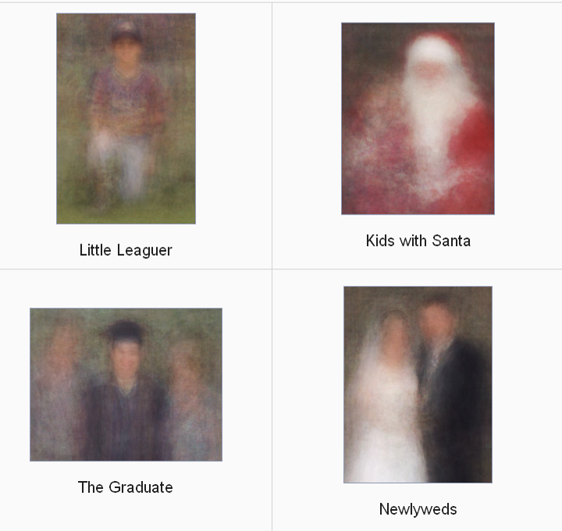
“100 Special Moments” by Jason Salavon

Slide 34
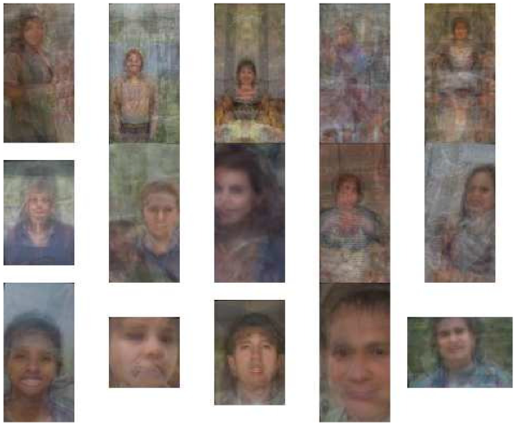
Highly-Weighted Poselets
is-male
has-long-hair
has-glasses

Slide 35
Which poselets are discriminative for gender?
Preferred by human subjects
best
worst
Preferred by our system
best
worst
[Bourdev et al., ICCV11]

Slide 36
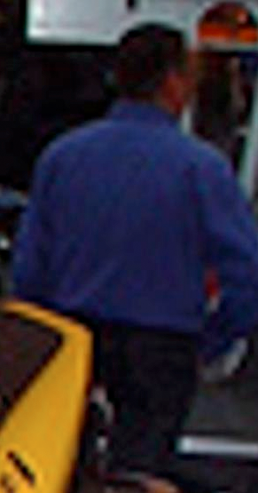
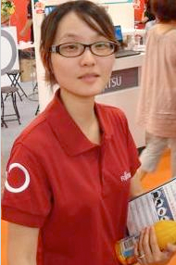
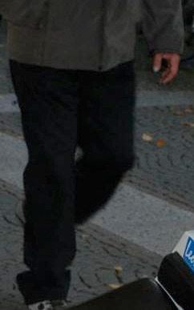
Describing people
“A man with short
hair and long sleeves”
“A woman with long hair,
glasses and long pants”(??)
“A person with
long pants”
[Bourdev et al., ICCV11]

Slide 37
Poselets website
http://eecs.berkeley.edu/~lbourdev/poselets
The set of published poselet papers
H3D data set + Matlab tools
Java3D annotation tool + video tutorial
Matlab code to detect people using poselets
Latest trained poselets
[Bourdev et al., ICCV11]

