Slide 1
Pictorial Structures for Articulated Pose Estimation
Ankit Gupta
CSE 590V: Vision Seminar

Slide 2
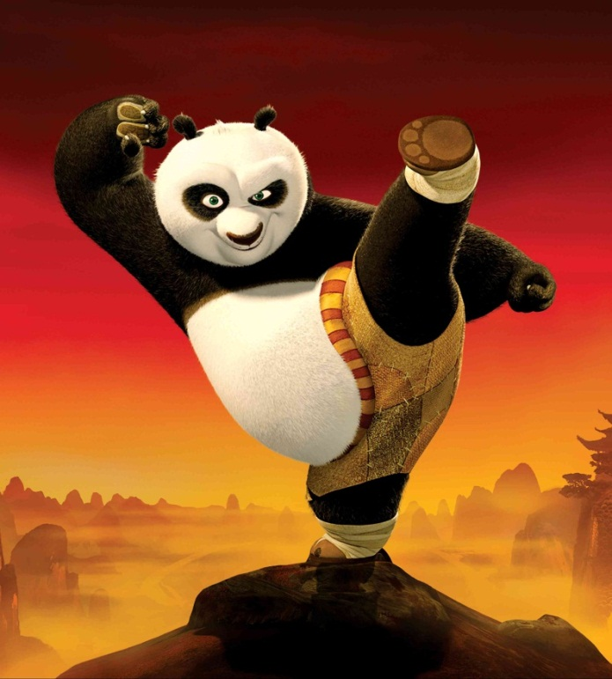
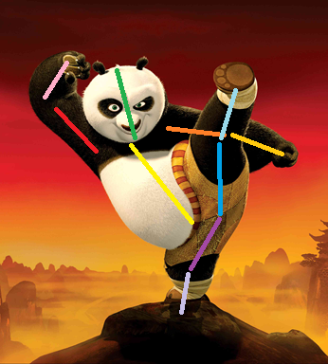
Goal
Articulated pose estimation ( )
recovers the pose of an articulated object which consists of joints and rigid parts
Slide taken from authors, Yang et al.

Slide 3
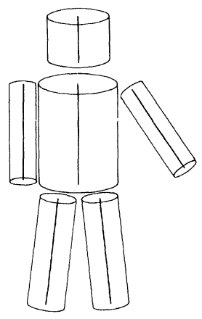
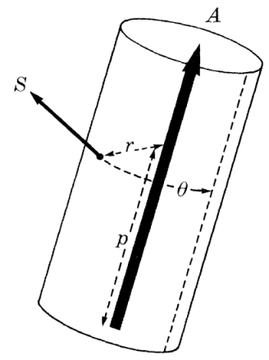
Classic Approach
Part Representation
Head, Torso, Arm, Leg
Location, Rotation, Scale
Marr & Nishihara 1978
Slide taken from authors, Yang et al.

Slide 4
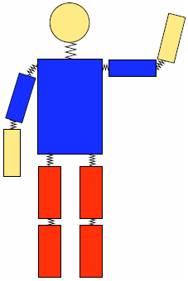
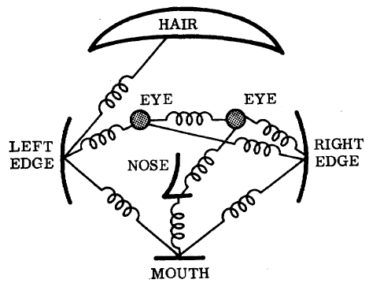
Classic Approach
Part Representation
Head, Torso, Arm, Leg
Location, Rotation, Scale
Marr & Nishihara 1978
Pictorial Structure
Unary Templates
Pairwise Springs
Fischler & Elschlager 1973
Felzenszwalb & Huttenlocher 2005
Slide taken from authors, Yang et al.

Slide 5
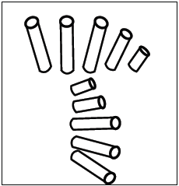
Classic Approach
Part Representation
Head, Torso, Arm, Leg
Location, Rotation, Scale
Marr & Nishihara 1978
Pictorial Structure
Unary Templates
Pairwise Springs
Fischler & Elschlager 1973
Felzenszwalb & Huttenlocher 2005
Lan & Huttenlocher 2005
Andriluka etc. 2009
Sigal & Black 2006
Eichner etc. 2009
Ramanan 2007
Singh etc. 2010
Epshteian & Ullman 2007
Johnson & Everingham 2010
Wang & Mori 2008
Sapp etc. 2010
Ferrari etc. 2008
Tran & Forsyth 2010
Slide taken from authors, Yang et al.

Slide 6
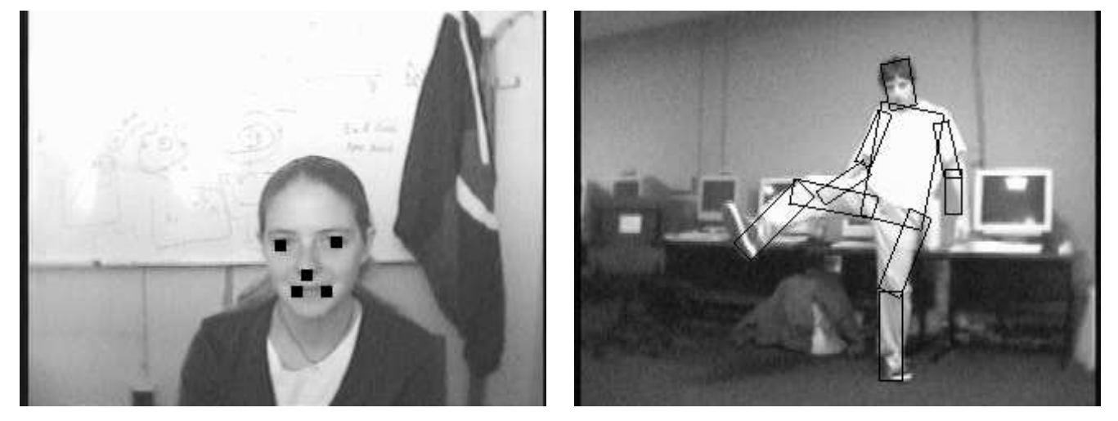
Pictorial Structures for Object Recognition Pedro F. Felzenszwalb, Daniel P. Huttenlocher IJCV, 2005

Slide 7
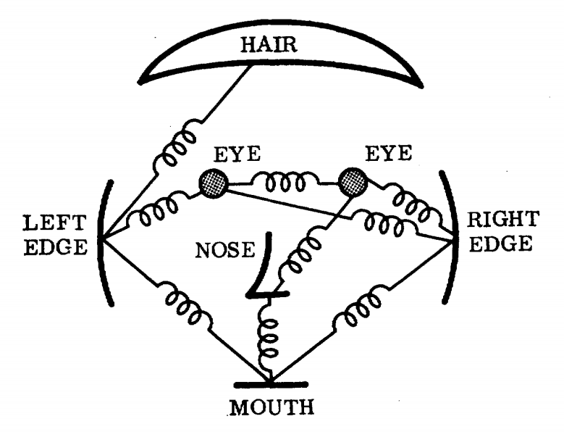
Pictorial structure for Face

Slide 8
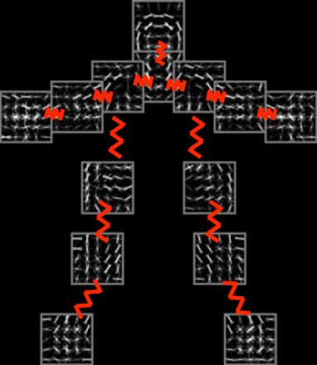
Pictorial Structure Model
$I$: Image
$l_{i}$: Location of part $i$
Slide taken from authors, Yang et al.

Slide 9
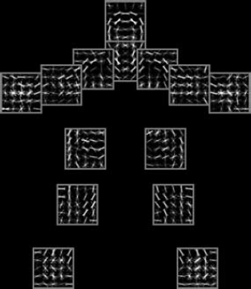
Pictorial Structure Model
$α_{i}$: Unary template for part $i$
$φ(I,l_{i})$: Local image features at location $l_{i}$
Slide taken from authors, Yang et al.

Slide 10
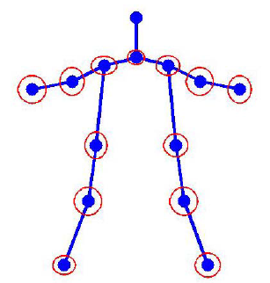
Pictorial Structure Model
$ψ(l_{i},l_{j})$: Spatial features between $l_{i}$ and $l_{j}$
$β_{ij}$: Pairwise springs between part $i$ and part $j$
Slide taken from authors, Yang et al.

Slide 11
Using this Model

Slide 12
Test phase
Train phase

Slide 13
Test phase
Train phase
Given:
- Images (I)
- Known locations of the parts (L)
Need to learn
- Unary templates
- Spatial features

Slide 14
Test phase
Train phase
Given:
- Images (I)
- Known locations of the parts (L)
Need to learn
- Unary templates
- Spatial features
Standard Structural SVM formulation
- Standard solvers available
(SVMStruct)

Slide 15
Test phase
Train phase
Given:
- Images (I)
- Known locations of the parts (L)
Need to learn
- Unary templates
- Spatial features
Given:
- Image (I)
Need to compute
- Part locations (L)
Algorithm
- L* = arg max (S(I,L))
Standard Structural SVM formulation
- Standard solvers available
(SVMStruct)

Slide 16
Test phase
Train phase
Given:
- Images (I)
- Known locations of the parts (L)
Need to learn
- Unary templates
- Spatial features
Given:
- Image (I)
Need to compute
- Part locations (L)
Algorithm
- L* = arg max (S(I,L))
Standard inference problem
- For tree graphs, can be exactly computed using belief propagation
Standard Structural SVM formulation
- Standard solvers available
(SVMStruct)

Slide 17
Articulated Pose Estimation with Flexible Mixtures of Parts
Yi Yang & Deva Ramanan
University of California, Irvine

Slide 18
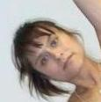
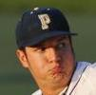
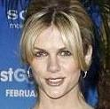
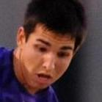
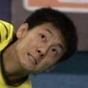
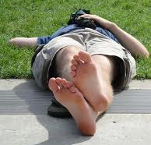
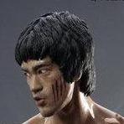
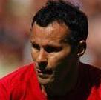
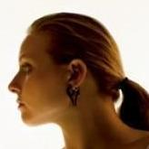
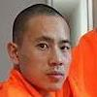
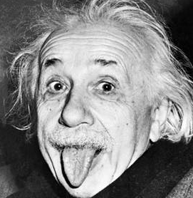
Problems with previous methods: Wide Variations
In-plane rotation | Foreshortening
Scaling | Out-of-plane rotation
Intra-category variation | Aspect ratio
Slide taken from authors, Yang et al.

Slide 19
Problems with previous methods: Wide Variations
In-plane rotation | Foreshortening
Scaling | Out-of-plane rotation
Intra-category variation | Aspect ratio
Naïve brute-force evaluation is expensive
Slide taken from authors, Yang et al.

Slide 20
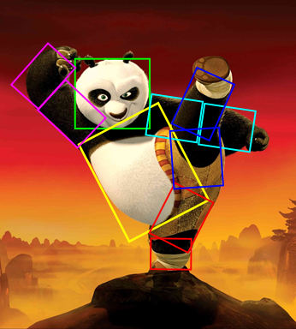
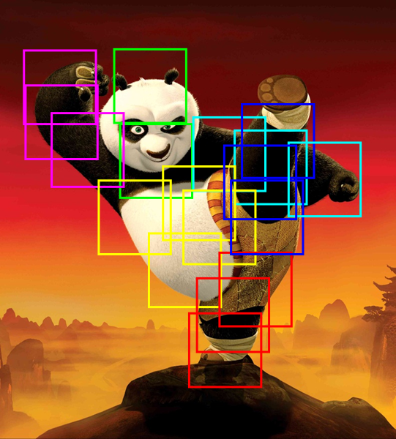
Our Method – “Mini-Parts”
Key idea:
“mini part” model can approximate deformations
Slide taken from authors, Yang et al.

Slide 21
Example: Arm Approximation
Slide taken from authors, Yang et al.

Slide 22
Pictorial Structure Model
$ψ(l_{i},l_{j})$: Spatial features between $l_{i}$ and $l_{j}$
$β_{ij}$: Pairwise springs between part $i$ and part $j$
Slide taken from authors, Yang et al.

Slide 23
The Flexible Mixture Model
$m_{i}$: Mixture of part $i$
Slide taken from authors, Yang et al.

Slide 24
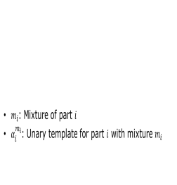
Our Flexible Mixture Model
$m_{i}$: Mixture of part $i$
$α_{i}^{m_{i}}$: Unary template for part $i$ with mixture $m_{i}$
Slide taken from authors, Yang et al.

Slide 25
Our Flexible Mixture Model
$m_{i}$: Mixture of part $i$
$α_{i}^{m_{i}}$: Unary template for part $i$ with mixture $m_{i}$
$β_{ij}^{m_{i}m_{j}}$: Pairwise springs between part $i$ with mixture $m_{i}$ and part $j$ with mixture $m_{j}$
Slide taken from authors, Yang et al.

Slide 26
Our Flexible Mixture Model
$m_{i}$: Mixture of part $i$
$α_{i}^{m_{i}}$: Unary template for part $i$ with mixture $m_{i}$
$β_{ij}^{m_{i}m_{j}}$: Pairwise springs between part $i$ with mixture $m_{i}$ and part $j$ with mixture $m_{j}$
Slide taken from authors, Yang et al.

Slide 27
Co-occurrence “Bias”
$b_{ij}^{m_{i}m_{j}}$: Pairwise co-occurrence prior between part $i$ with mixture $m_{i}$ and part $j$ with mixture $m_{j}$
Can also add unary terms $b_{i}^{m_{i}}$ to have priors over mixtures of a part
Slide taken from authors, Yang et al.

Slide 28
Co-occurrence “Bias”: Example
Let
part i : eyes, mixture m_{i} = {open, closed}
part j : mouth, mixture m_{j} = {smile, frown}
Notes:
We visualize the co-occurrence model for each pair as a 4 by 4 matrix. For example, if two parts are on the same rigid limb, they should have consistent orientations. Then this matrix will be diagonal .

Slide 29
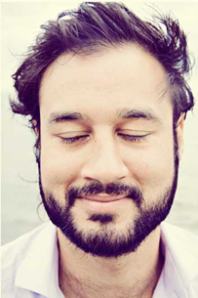
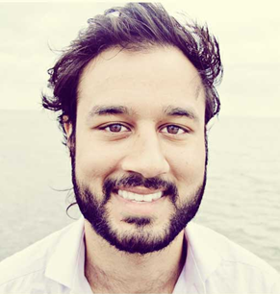
Co-occurrence “Bias”: Example
Let
part i : eyes, mixture m_{i} = {open, closed}
part j : mouth, mixture m_{j} = {smile, frown}
vs
b (closed eyes, smiling mouth) b (open eyes, smiling mouth)

Slide 30
Co-occurrence “Bias”: Example
Let
part i : eyes, mixture m_{i} = {open, closed}
part j : mouth, mixture m_{j} = {smile, frown}
<
learnt
b (closed eyes, smiling mouth) b (open eyes, smiling mouth)

Slide 31
Using this Model

Slide 32
Test phase
Train phase

Slide 33
Test phase
Train phase
Given:
- Images (I)
- Known locations of the parts (L)
Need to learn
- Unary templates
- Spatial features
- Co-occurrence
Standard Structural SVM formulation
- Standard solvers available
(SVMStruct)

Slide 34
Test phase
Train phase
Given:
- Images (I)
- Known locations of the parts (L)
Need to learn
- Unary templates
- Spatial features
- Co-occurrence
Given:
- Image (I)
Need to compute
- Part locations (L)
- Part mixtures (M)
Algorithm
- (L*,M*) = arg max (S(I,L,M))
Standard inference problem
- For tree graphs, can be exactly computed using belief propagation
Standard Structural SVM formulation
- Standard solvers available
(SVMStruct)

Slide 35
Results

Slide 36
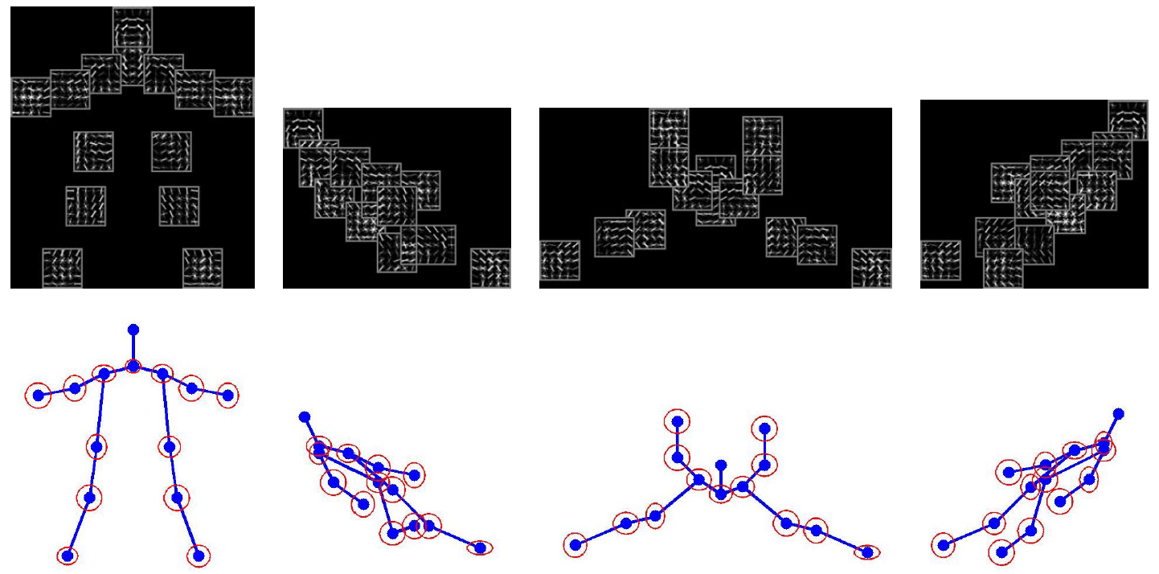
Achieving articulation
Slide taken from authors, Yang et al.

Slide 37
Achieving articulation
$K$ parts, $M$ mixtures $⇒$ $K^{M}$ unique pictorial structures
Not all are equally likely --- “prior” given by $S(M)$
Slide taken from authors, Yang et al.

Slide 38
Qualitative Results

Slide 39
Qualitative Results

Slide 40
Qualitative Results

Slide 41
Failure cases
To be put

Slide 42
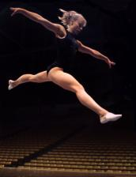
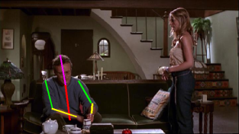
Benchmark Datasets
PARSE Full-body http://www.ics.uci.edu/~dramanan/papers/parse/index.html | BUFFY Upper-body http://www.robots.ox.ac.uk/~vgg/data/stickmen/index.html
Slide taken from authors, Yang et al.

Slide 43
Quantitative Results on PARSE
% of correctly localized limbs
1 second per image
Image Parse Testset
Method | Head | Torso | U. Legs | L. Legs | U. Arms | L. Arms | Total
Ramanan 2007 | 52.1 | 37.5 | 31.0 | 29.0 | 17.5 | 13.6 | 27.2
Andrikluka 2009 | 81.4 | 75.6 | 63.2 | 55.1 | 47.6 | 31.7 | 55.2
Johnson 2009 | 77.6 | 68.8 | 61.5 | 54.9 | 53.2 | 39.3 | 56.4
Singh 2010 | 91.2 | 76.6 | 71.5 | 64.9 | 50.0 | 34.2 | 60.9
Johnson 2010 | 85.4 | 76.1 | 73.4 | 65.4 | 64.7 | 46.9 | 66.2
Our Model | 97.6 | 93.2 | 83.9 | 75.1 | 72.0 | 48.3 | 74.9
Slide taken from authors, Yang et al.

Slide 44
Quantitative Results on BUFFY
% of correctly localized limbs
All previous work use explicitly articulated models
Subset of Buffy Testset
Method | Head | Torso | U. Arms | L. Arms | Total
Tran 2010 | --- | --- | --- | --- | 62.3
Andrikluka 2009 | 90.7 | 95.5 | 79.3 | 41.2 | 73.5
Eichner 2009 | 98.7 | 97.9 | 82.8 | 59.8 | 80.1
Sapp 2010a | 100 | 100 | 91.1 | 65.7 | 85.9
Sapp 2010b | 100 | 96.2 | 95.3 | 63.0 | 85.5
Our Model | 100 | 99.6 | 96.6 | 70.9 | 89.1
Slide taken from authors, Yang et al.

Slide 45
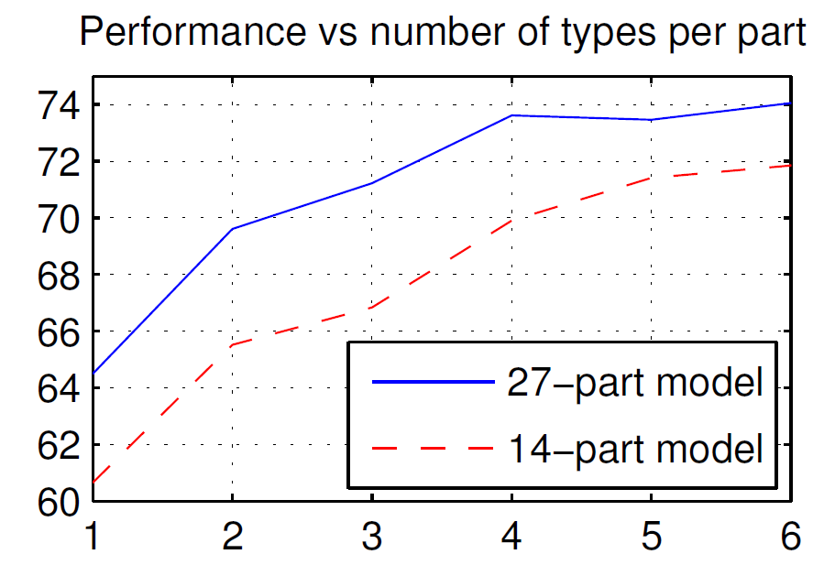
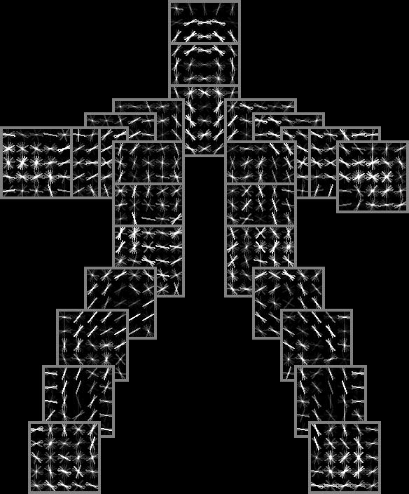
More Parts and Mixtures Help
14 parts (joints)
27 parts (joints + midpoints)
Slide taken from authors, Yang et al.

Slide 46
Discussion
Possible limitations?
Something other than human pose estimation?
Can do more useful things with the Kinect?
Can this encode occlusions well?

Slide 47
References
http://phoenix.ics.uci.edu/software/pose/
Code and benchmark datasets available

