Slide 1
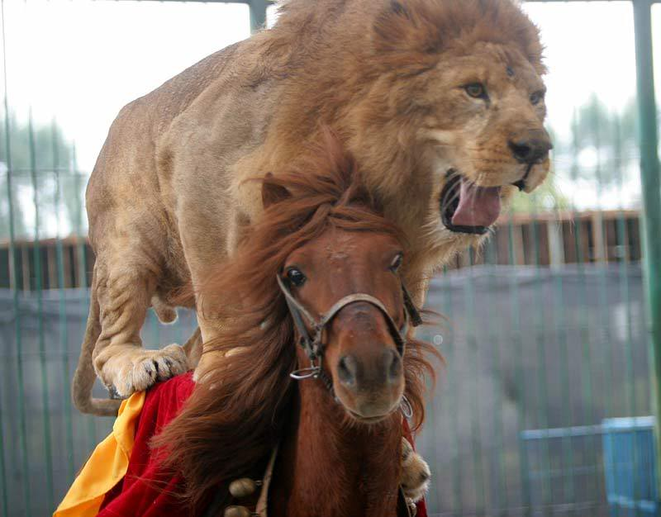
Visual Phrases
Don’t eat me!
CSE 590V
Supasorn Suwajanakorn

Slide 2
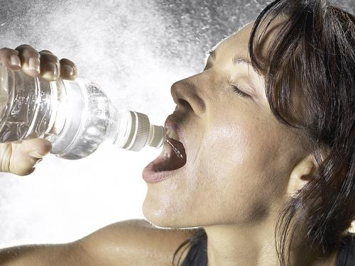
Visual Phrases
A person riding a horse
Objects
+
Interactions
A woman drinks from a water bottle

Slide 3
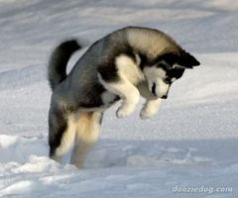
Visual Phrases
Dog Jumping
Object
+
Activity

Slide 4
Why do we care?
So that we understand the scene better
Help detect individual objects!
(... if we have an accurate visual phrase detector)

Slide 5
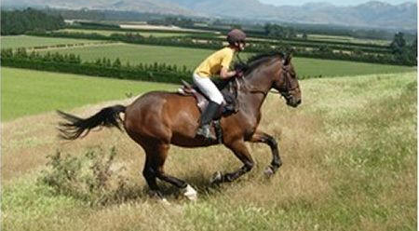
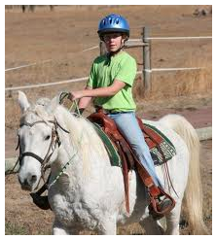
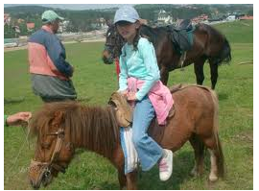
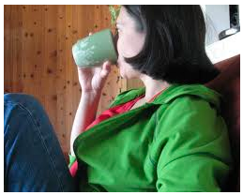
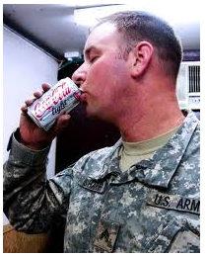
Design a Visual Phrase Detector
Say, we want to detect people as well as describe activity in these pictures

Slide 6
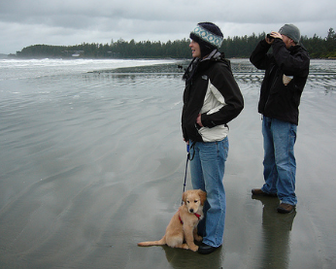
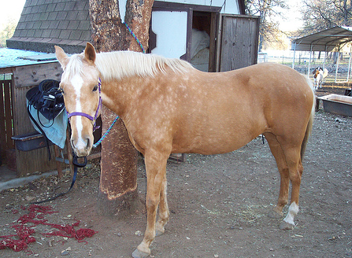
Design a Visual Phrase Detector
Let’s look at what our detectors are good at
Find a person like this
Find a horse like this
So, we can combine these two detectors then
try to model the relationship

Slide 7
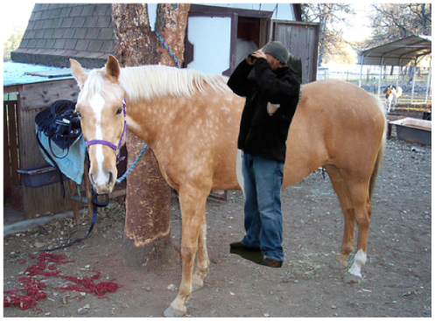
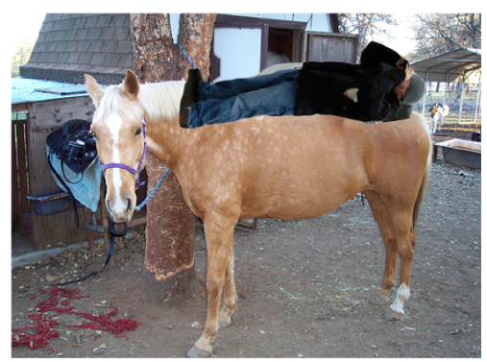
Design a Visual Phrase Detector
Using that method, we can excel at finding person
in pictures like these
Can we find a person in this picture with good precision?
Maybe

Slide 8
Design a Visual Phrase Detector
VS
Person riding a horse usually has:
Change in Appearance
A few postures
How do we take advantage of this?
One leg not visible
…

Slide 9
Design a Visual Phrase Detector
A simple solution
Add one more class “person riding horse”, in addition to “person” and “horse”
Train a classifier to detect “person riding horse” using some training examples
Done?

Slide 10
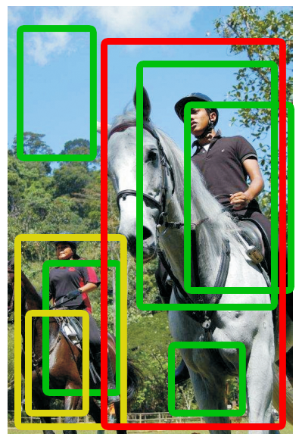
Design a Visual Phrase Detector

Slide 11
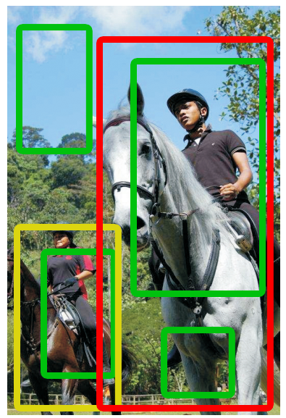
Design a Visual Phrase Detector
Person
Horse
P rides H
NMS
Non-maximum suppression

Slide 12
What’s wrong with NMS
We could have done better
if visual phrase plays a role
Maybe remove this because some person is riding a horse and there shouldn’t be another person under the horse

Slide 13
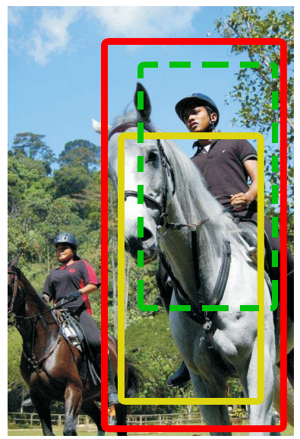
What’s wrong with NMS
We could have done better
if visual phrase plays a role
If person detector gives a low confidence, but we are pretty sure there are horse and person riding it, confidence for this person should go up
Need a better method that take into
account the relationship between
objects

Slide 14
NMS to Decoder
Our current pipeline
NMS
Novel decoding procedure
“Recognition Using Visual Phrases”
Mohammad Sadeghi, Ali Farhadi

Slide 15
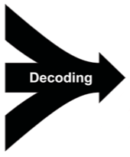
NMS to Decoder
Our current pipeline
Novel decoding procedure
“Recognition Using Visual Phrases”
Mohammad Sadeghi, Ali Farhadi

Slide 16
Redefine Feature
Decoding needs more info from features
Goal: a new representation of feature that is aware of the surrounding features

Slide 17
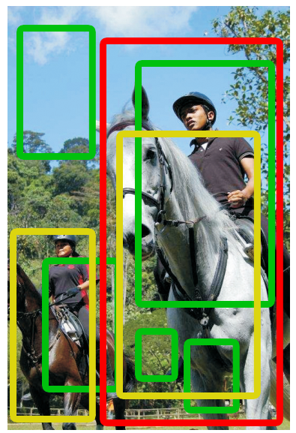
Representation of Feature x₁
Consider this “person”-bounding box
Suppose this is feature x₁
Now let’s consider x₁ in relation with other surrounding “person”
Confidence
Overlap
Size ratio
0
0
0
Above
Conf 0.2
0.4
0
0.2
Conf 0.4
Below
0
0
0
Overlap

Slide 18
Representation of Feature x₁
Consider this “person”-bounding box
Suppose this is feature x₁
Now let’s consider x₁ in relation with other surrounding “horse”
Confidence
Overlap
Size ratio
0
0
0
Above
0
0
0
Below
0.8
0.7
1.2
Overlap

Slide 19
Representation of Feature x₁
Consider this “person”-bounding box
Suppose this is feature x₁
Now let’s consider x₁ in relation with other surrounding “P rides H”
Confidence
Overlap
Size ratio
0
0
0
Above
0
0
0
Below
0.9
0.6
1.8
Overlap

Slide 20
Representation of Feature x₁
feature vector x₁ (class “person”)
0 | 0 | 0
0.4 | 0 | 0.2
0 | 0 | 0
Interaction of x₁with
“person”
0 | 0 | 0
0 | 0 | 0
0.8 | 0.7 | 1.2
Interaction of x₁with
“horse”
0 | 0 | 0
0 | 0 | 0
0.9 | 0.6 | 1.8
Interaction of x₁with
“P rides H”

Slide 21
Representation of Feature x₁
feature vector x₁
0 | 0 | 0
0.4 | 0 | 0.2
0 | 0 | 0
“person”
0 | 0 | 0
0 | 0 | 0
0.8 | 0.7 | 1.2
3 x 9
…
“horse”
0 | 0 | 0
0 | 0 | 0
0.9 | 0.6 | 1.8
+1
“P rides H”
Confidence of this bounding box
More generally (K x 9) + 1, K=# of classes

Slide 22
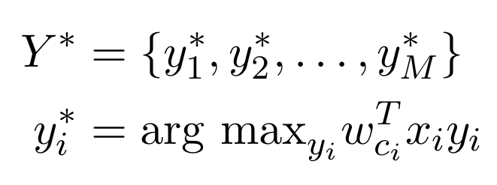
Inference (Decoder)
Goal: Decides whether x_{i} should be in final response
Max margin structure learning

Slide 23
Comparing Methods
This paper
Sadeghi & Farhadi
Related Method Discriminative models for multi-class
object layout (C. F. C. Desai, D. Ramanan)
Pairwise term
No info about
surrounding
Problem?
Inference is hard. Need to guess labels (greedily search)
Fix (Sadeghi & Farhadi)
No need to guess labels. Labels directly from detectors
Infer y_{i} only (0 or 1)
Get exact inference

Slide 24
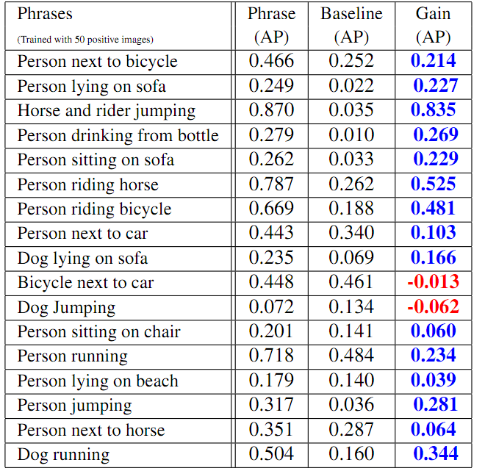
Results
Baseline:
Optimistic upper-bound on how well one can detect visual phrases by individually detecting participating objects then
Modeling the relation.

Slide 25
Significant gain in detecting visual phrases compared to detecting objects and describing their relations.

Slide 26
Results

Slide 27
Results

Slide 28
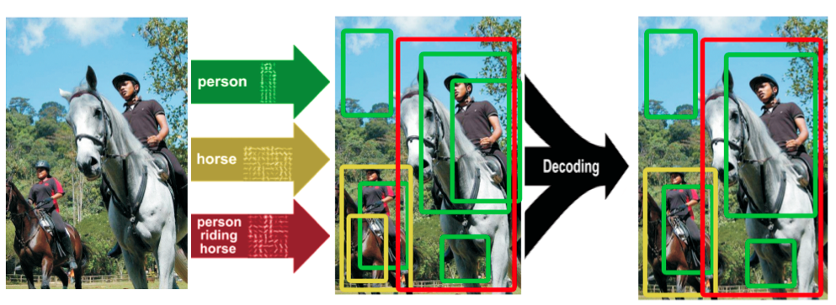
Results
This method outperforms state-of-the-art object detector+NMS and
state-of-the-art multiclass recognition method of C. F. C. Desai, D. Ramana.

Slide 29
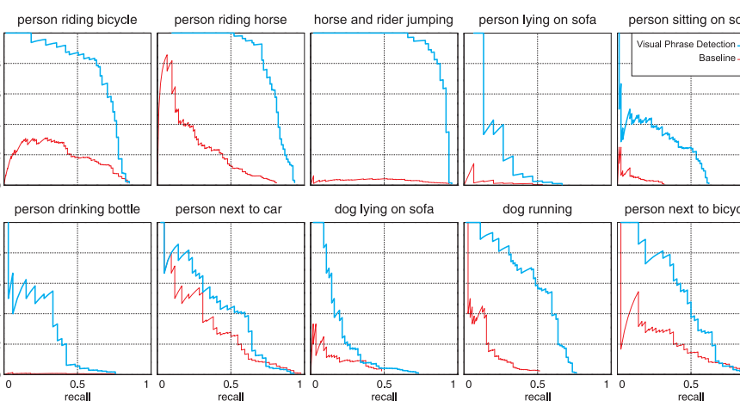
Discussion
Negative examples do not contain participating objects. If we detect person riding horse with a picture of person next to horse, false positive might rise, precision might fall
Visual phrases in practice, limitations

